Slide 1
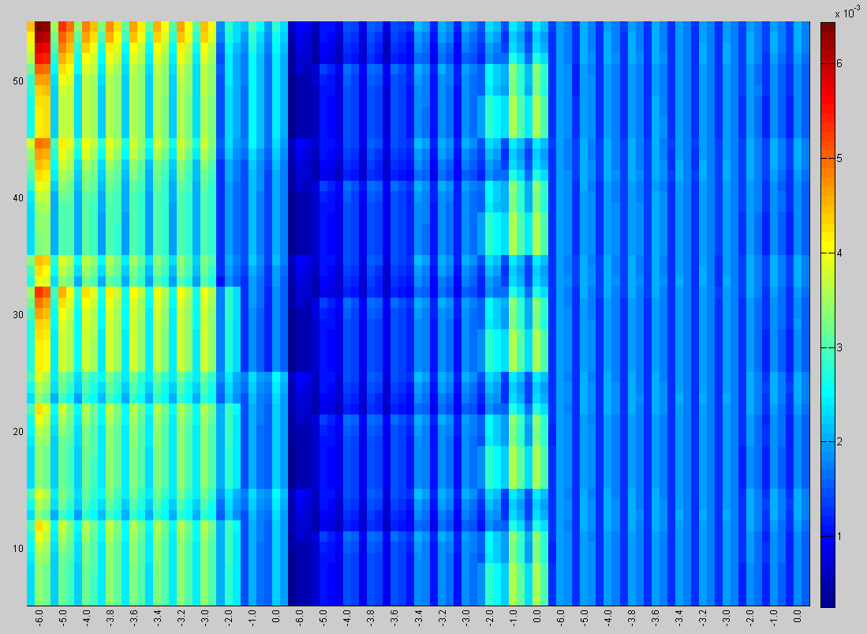
SC PCT
1.0
0.0
1.0
0.0
1.0
0.0
1.0
0.0
1.0
0.0
RTC
E
C
O

