Slide 1
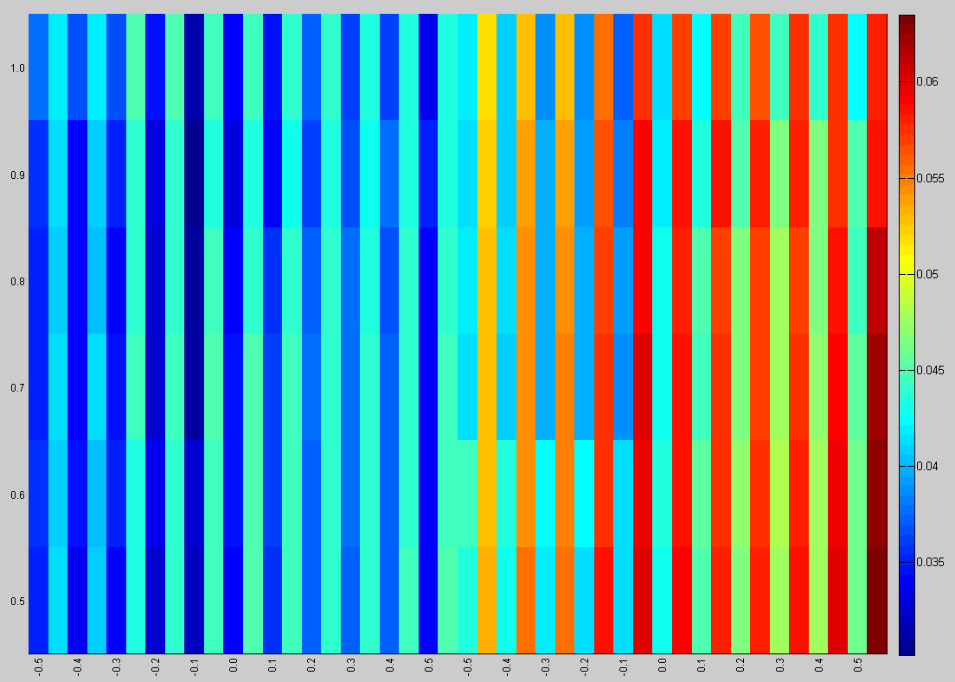
SC
RTC
Switchers
NonSwitchers

