Slide 1
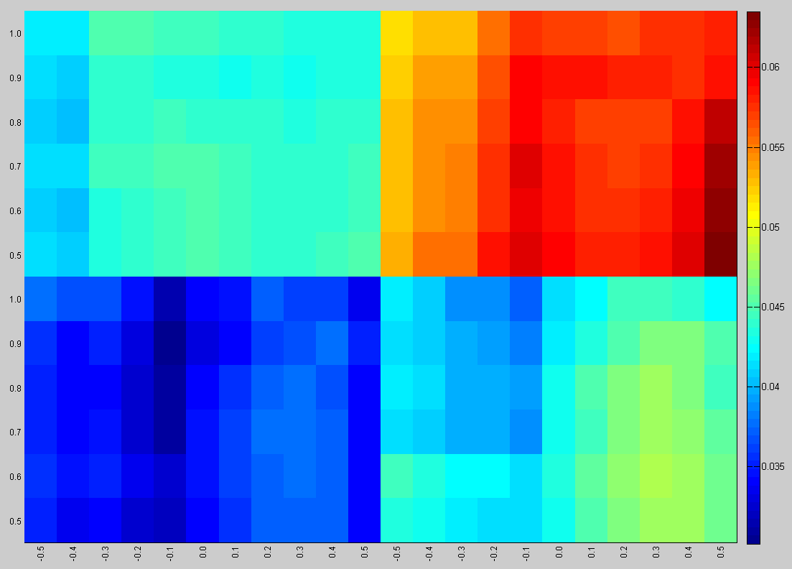
SC
NonSwitchers
Switchers
RTC
Switchers
NonSwitchers

