Slide 1
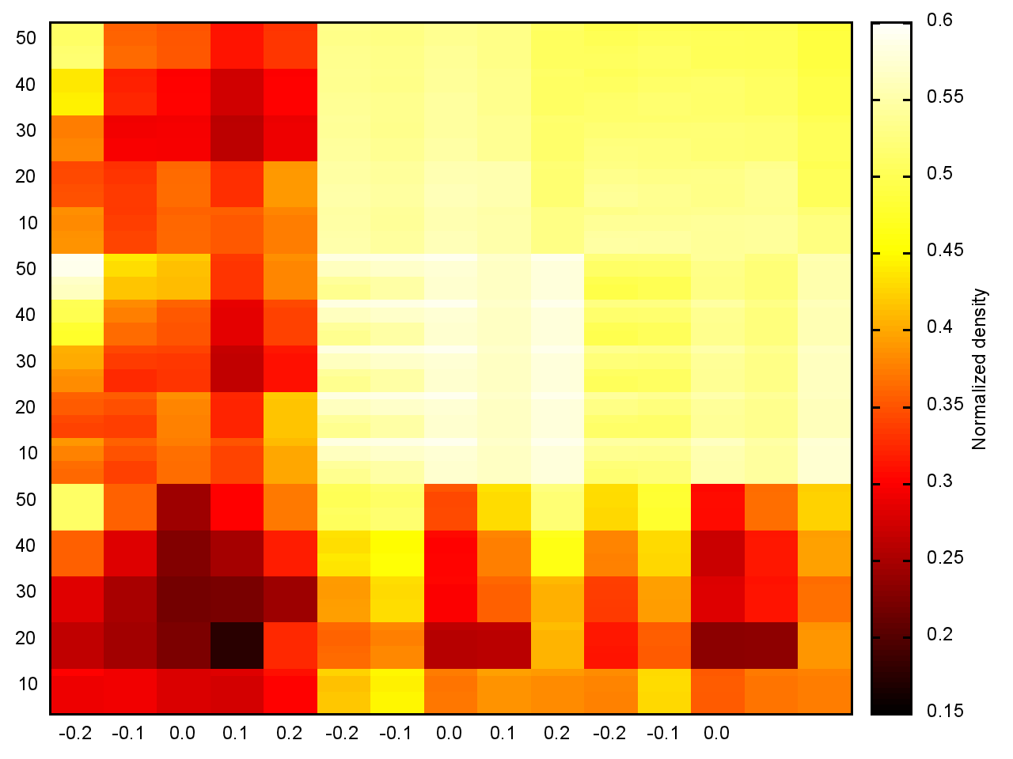
PCT
O
C
E
0.1
0.2
RTC
E
C
O

