Slide 1

Function-oriented edge probability assignment for signaling networks
Haitham Gabr
CIS 6930 – Recent Advances in Bioinformatics

Slide 2
Motivation
Probabilistic networks provide an elaborate framework for studying biological interactions.
Computational methods utilize edge probabilities for a plethora of problems.
Pathway extraction, alignment, reachability, …etc.
Recurring question: how do you get the probability values of the edges?
Most methods available are ad hoc.

Slide 3
Idea
Research shows that gene coexpression is tightly related to signaling.
Therefore, signal reachability should be proportional to gene coexpression.
For a signaling network to perform its function in best manner, edge probabilities should bring reachability as close as possible to gene coexpression.

Slide 4
Problem statement
Given
A directed network G = (V, E).
Set of source and target nodes S, T ⊂ V.
Function C(s, t) returns a normalized correlation value of expression between s ∈ S, t ∈ T.
Find
Function P(e ∈ E), such that ∥C – R∥ is minimum, where:
C is a vector of C(s, t) values ∀ s ∈ S & t ∈ T,
R is a vector of reachability probability ∀ s ∈ S & t ∈ T

Slide 5
Method
Two phases:
Genetic algorithm to obtain a starting point that is better than random.
Hill climbing for local optimization

Slide 6
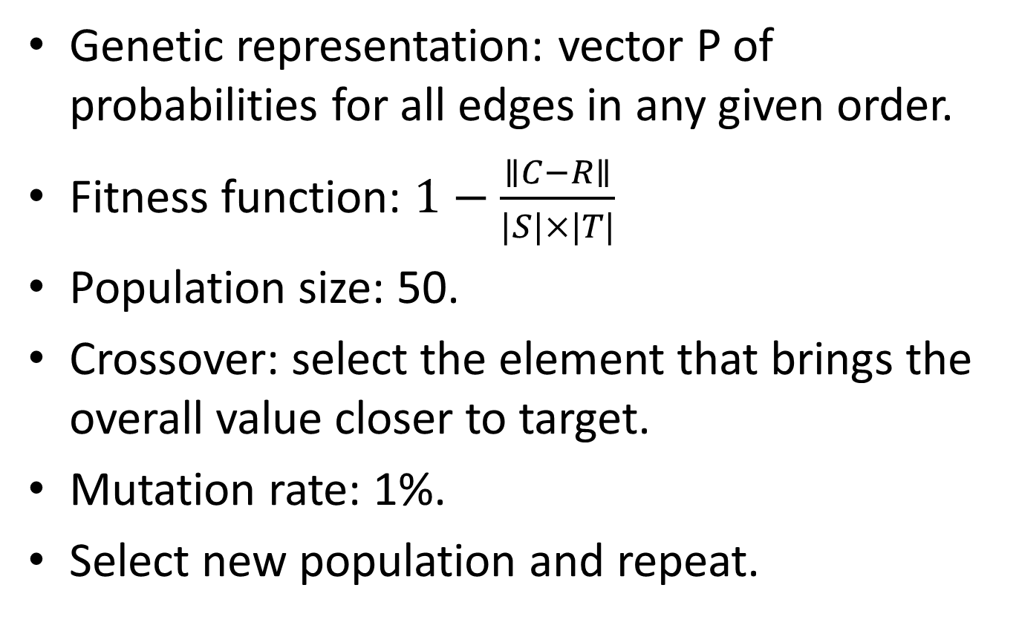
Genetic algorithm
Genetic representation: vector P of probabilities for all edges in any given order.
Fitness function: $1−\frac{∥C−R∥}{|S|×|T|}$
Population size: 50.
Crossover: select the element that brings the overall value closer to target.
Mutation rate: 1%.
Select new population and repeat.

Slide 7
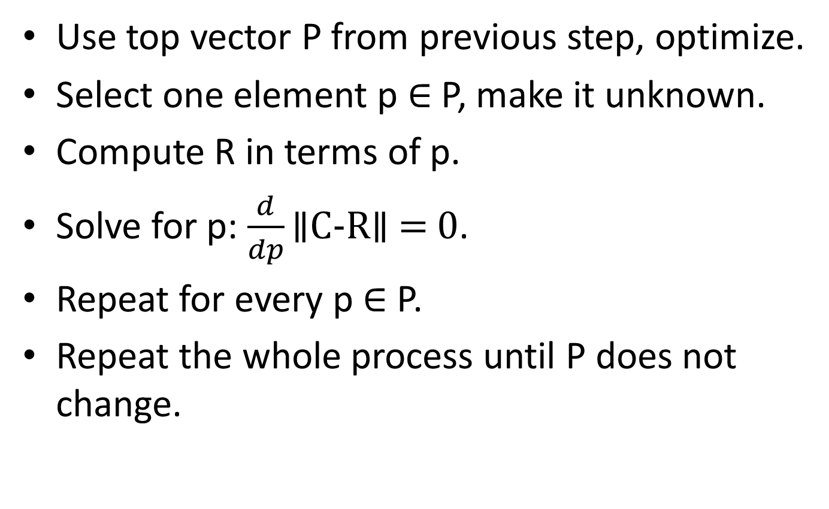
Hill climbing
Use top vector P from previous step, optimize.
Select one element p ∈ P, make it unknown.
Compute R in terms of p.
Solve for p: $\frac{d}{dp}\text{∥}\text{C}\text{−}\text{R}\text{∥}\text{ = 0}\text{.}$
Repeat for every p ∈ P.
Repeat the whole process until P does not change.

Slide 8
Datasets
Networks: H. sapiens signaling networks from KEGG
Gene expression data: random synthetic vlaues.
Projected to use with real gene expression data for different Leukemia subtypes.

Slide 9
Results
Running times (100 genetic rounds + hill climbing):
ErbB: 82 seconds
Wnt: 95 seconds
MAPK:
After 10 minutes, first genetic round didn’t finish.
Removing genetic phase, also first hill climbing round does not finish.

Slide 10
Results
Observations about results from synthetic expressions on ErbB:
Multiple solutions, same quality.
Quality value is rather high (>96%).
Removal of genetic phase has no effect.
Many zero values in the output.

Slide 11
Thank you
Questions?

