Slide 1
Sales Tracking System
Google Form → Google Sheet → Looker Studio Live Dashboard
A complete step-by-step guide with links
Business Analytics Course | Instructor Guide

Slide 2
Project Overview
● Goal: build a live sales-tracking system for a sales team, from data entry to dashboard.
● Sales reps record every sale using a Google Form.
● Form answers are saved automatically into a Google Sheet (the Response Sheet).
● A formula in the sheet auto-calculates Total Sales for each row.
● A Looker Studio dashboard is connected to that same sheet and refreshes automatically.
● Result: a rep submits a sale, and it appears on the live dashboard within about 15 minutes.
Flow: Google Form → Google Sheet (auto formula) → Looker Studio Dashboard

Slide 3
Step 1 — Build the Google Form
1) Go to forms.google.com and click the "+" (Blank form).
2) Add these fields matching the sales data you need: Sales Rep Name, Customer Name, Products, Quantity, Unit Price, Place, Notes.
3) Set the field type for Quantity and Unit Price to "Short answer", then click the 3-dot menu → Response validation.
4) Choose Number → Greater than → type 0. This blocks zero or negative numbers.
5) In the "Custom error text" box, write a clear message, e.g. "Please enter a number greater than 0."
Link: forms.google.com | Live example form: forms.gle/hyqEd73EtJ8g1LZC8

Slide 4
Step 2 — Use Dropdowns for Consistency
● Why: if reps type names freely, you get typos like "sameh" vs "Sameh" vs "Sammeh" — this breaks charts and totals.
● Fix: change the question type for Sales Rep Name to "Dropdown" and list every rep's exact name once.
● Do the same for Products, make it a Dropdown with the fixed product list (Laptop, TV, Printer, Monitor...).
● Toggle "Required" (bottom-right switch on each question) so the form cannot be submitted empty.
● This keeps names spelled exactly the same every time, so Looker Studio can group and sum data correctly.
Dropdown + Required = clean, consistent data with zero typos.

Slide 5
Step 3 — Configure Form Settings
● Open Form Settings (third tab the top of the form editor).
● Under "Responses": turn ON "Collect email addresses" (choose "Verified").
● Turn ON "Allow response editing" so a rep can fix a mistake without creating a duplicate row.
● Turn ON "Send responders a copy of their response" so each rep gets an email confirmation.
● Make sure "Limit to 1 response" is OFF reps need to submit the form unlimited times (once per sale).
These settings live under the gear icon → Responses tab in Google Forms.

Slide 6
Step 4 — Create the Response Sheet & Auto-Calculate
● In the form editor, go to the "Responses" tab and click the green Sheets icon → "Create a new spreadsheet".
● This creates a live Google Sheet that fills in automatically every time someone submits the form.
● Add a new column header "Total Sales" (column H if Quantity=F and Unit Price=G).
● In the first data row of that column, paste this formula — it calculates ALL rows automatically, no dragging down needed:
=ARRAYFORMULA(IF(G2:G="","",F2:F*G2:G))
● This formula multiplies Quantity × Unit Price for every new row instantly, the moment a form is submitted.
Response Sheet link: docs.google.com/spreadsheets/d/15X9-YDlK1z7xCOSTMDqAQ6S22j4wsbmehtGlKpqZhCk

Slide 7
Step 5 — Connect Looker Studio to the Sheet
● Go to lookerstudio.google.com and click "Blank Report".
● Choose the "Google Sheets" connector, select your Response Sheet, then pick the correct tab (Form Responses 1).
● Click "Add" — Looker Studio pulls in every column (Sales Rep, Product, Quantity, Total Sales, Place, etc.) as fields.
● Build charts: a column chart for Total Sales by Sales Rep, a pie chart for Total Sales by Product, a bar chart by rep, and a Treemap by Place.
● These are exactly the four visuals shown in the sample dashboard: sales by rep, product share pie, top reps bar, and location breakdown.
Looker Studio link: lookerstudio.google.com

Slide 8
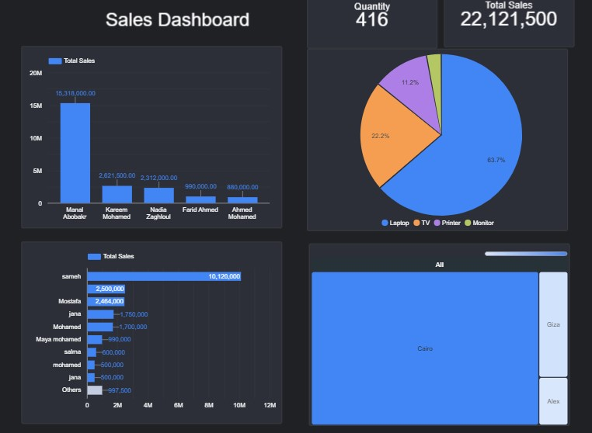
Sales Dashboard Screenshot
Looker Studio link: lookerstudio.google.com

Slide 9
Step 6 — Make the Dashboard Auto-Refresh
● By default, Google Sheets data in Looker Studio refreshes automatically — no manual action needed.
● To control the refresh speed: click Resource (top menu) → "Manage added data sources".
● Find your Google Sheets source and click "Edit", then click on "Data freshness" at the top.
● Choose the fastest option: "Every 15 minutes" (this is the minimum refresh time Google allows for Sheets).
● Result: a rep submits a new sale on the form, and within about 15 minutes it appears automatically on the live dashboard — no manual refresh needed.
Data freshness setting: Resource → Manage added data sources → Edit → Data freshness

Slide 10
Step 7 — Style, Theme & Company Logo
● Change theme/colors: click "Theme and Layout" on the right panel while editing the report.
● Pick a ready-made theme (e.g. the dark theme used in the sample dashboard) or click "Customize" to set your own colors.
● Add your logo: click Insert → Image, then upload the company logo file from your computer.
● Resize and place the logo in a header area at the top of the report, next to the dashboard title.
● Once ready, click "Share" → "Publish" (or "Get report link") to get a shareable public/view link.
Menu paths: Theme and Layout (right panel) | Insert → Image (top menu)

Slide 11
Project Links & Quick Checklist
1. Google Form (data entry): forms.gle/hyqEd73EtJ8g1LZC8
2. Google Sheet (live responses): docs.google.com/spreadsheets/d/15X9-YDlK1z7xCOSTMDqAQ6S22j4wsbmehtGlKpqZhCk
3. Looker Studio Dashboard: datastudio.google.com/s/m7cZLCI1Sgo
4. Key formula: =ARRAYFORMULA(IF(G2:G="","",F2:F*G2:G))
5. Auto-refresh: every 15 minutes (Google Sheets connector minimum)
6. Settings checklist: Collect email ✓ | Edit response ✓ | Email copy ✓ | Unlimited responses ✓

