Slide 1


Client Name: Orange Coding Academy.

Slide 2
Mockups

Slide 3
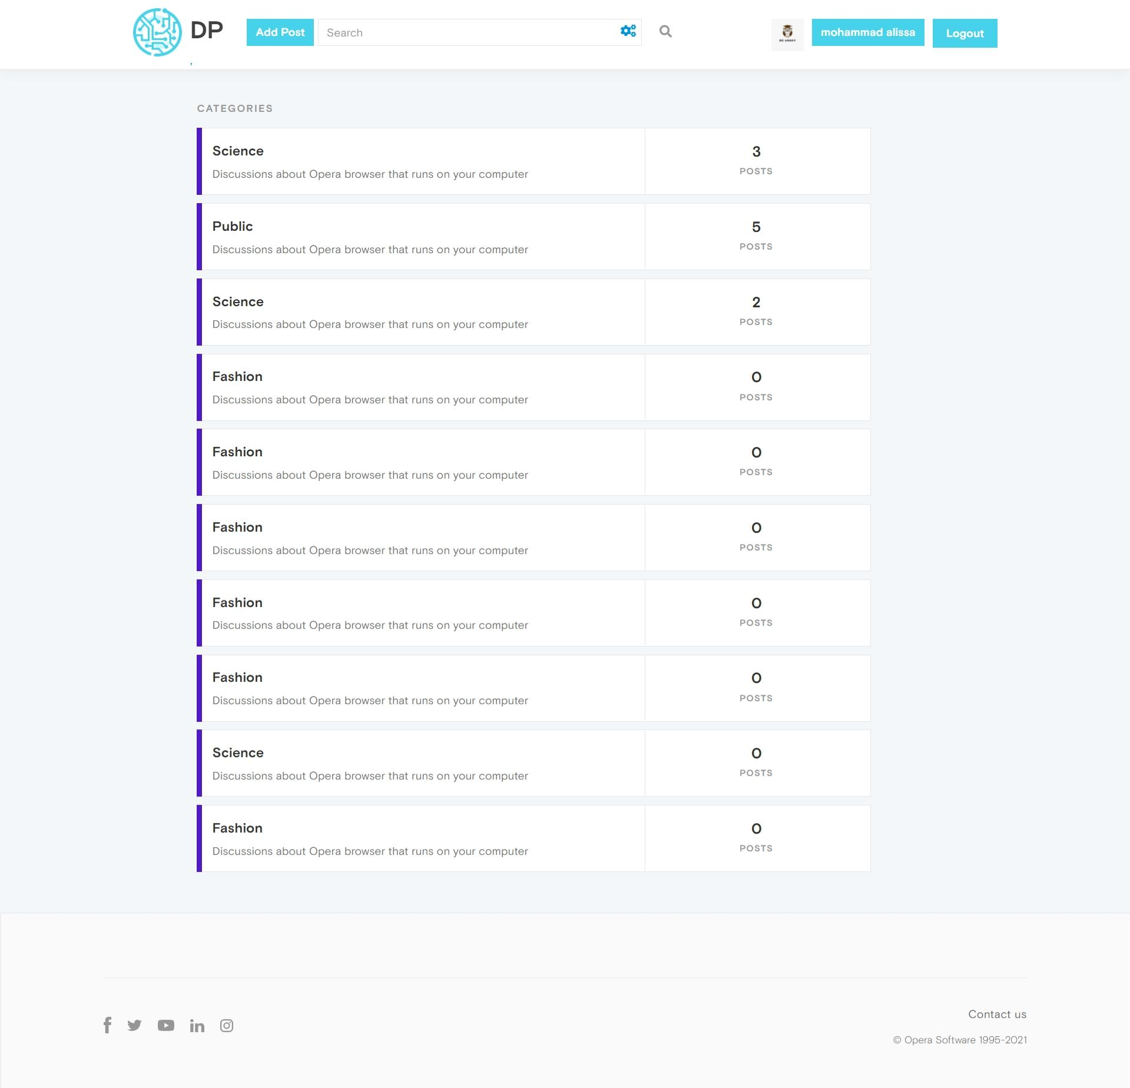
First Page

Slide 4
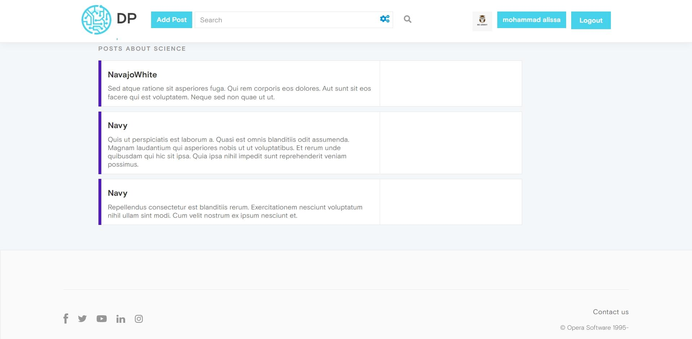
Second Page

Slide 5
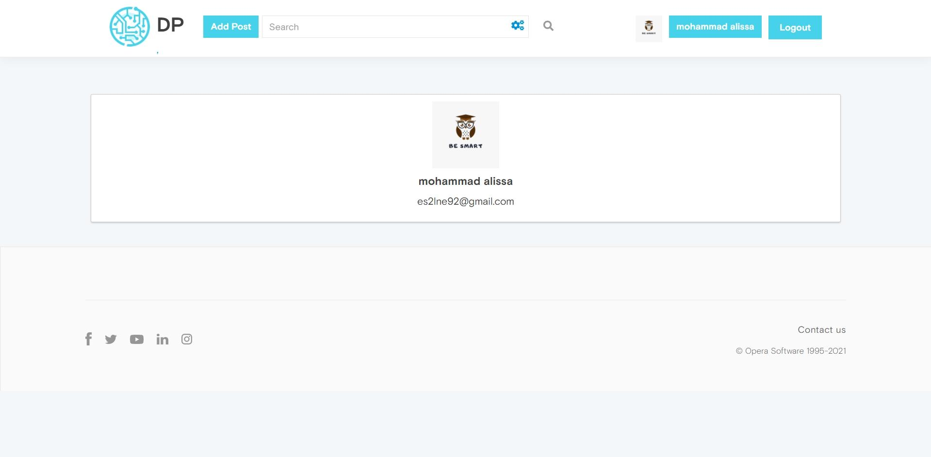
Third Page

Slide 6
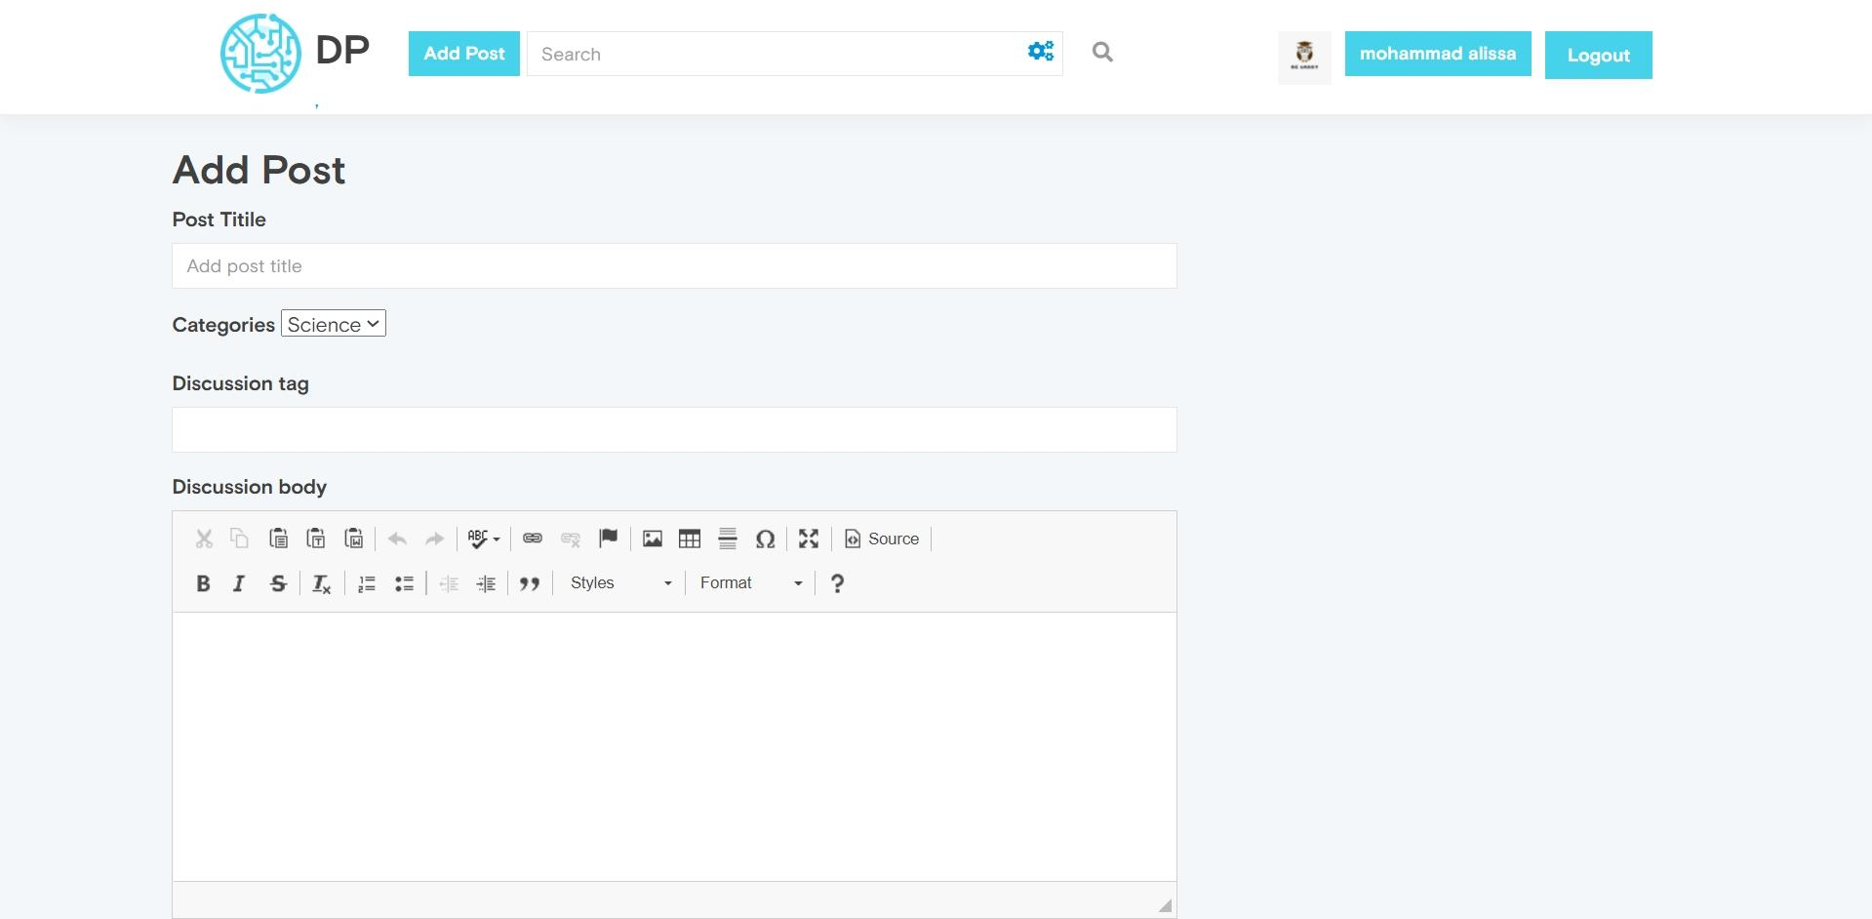
First Page

Slide 7
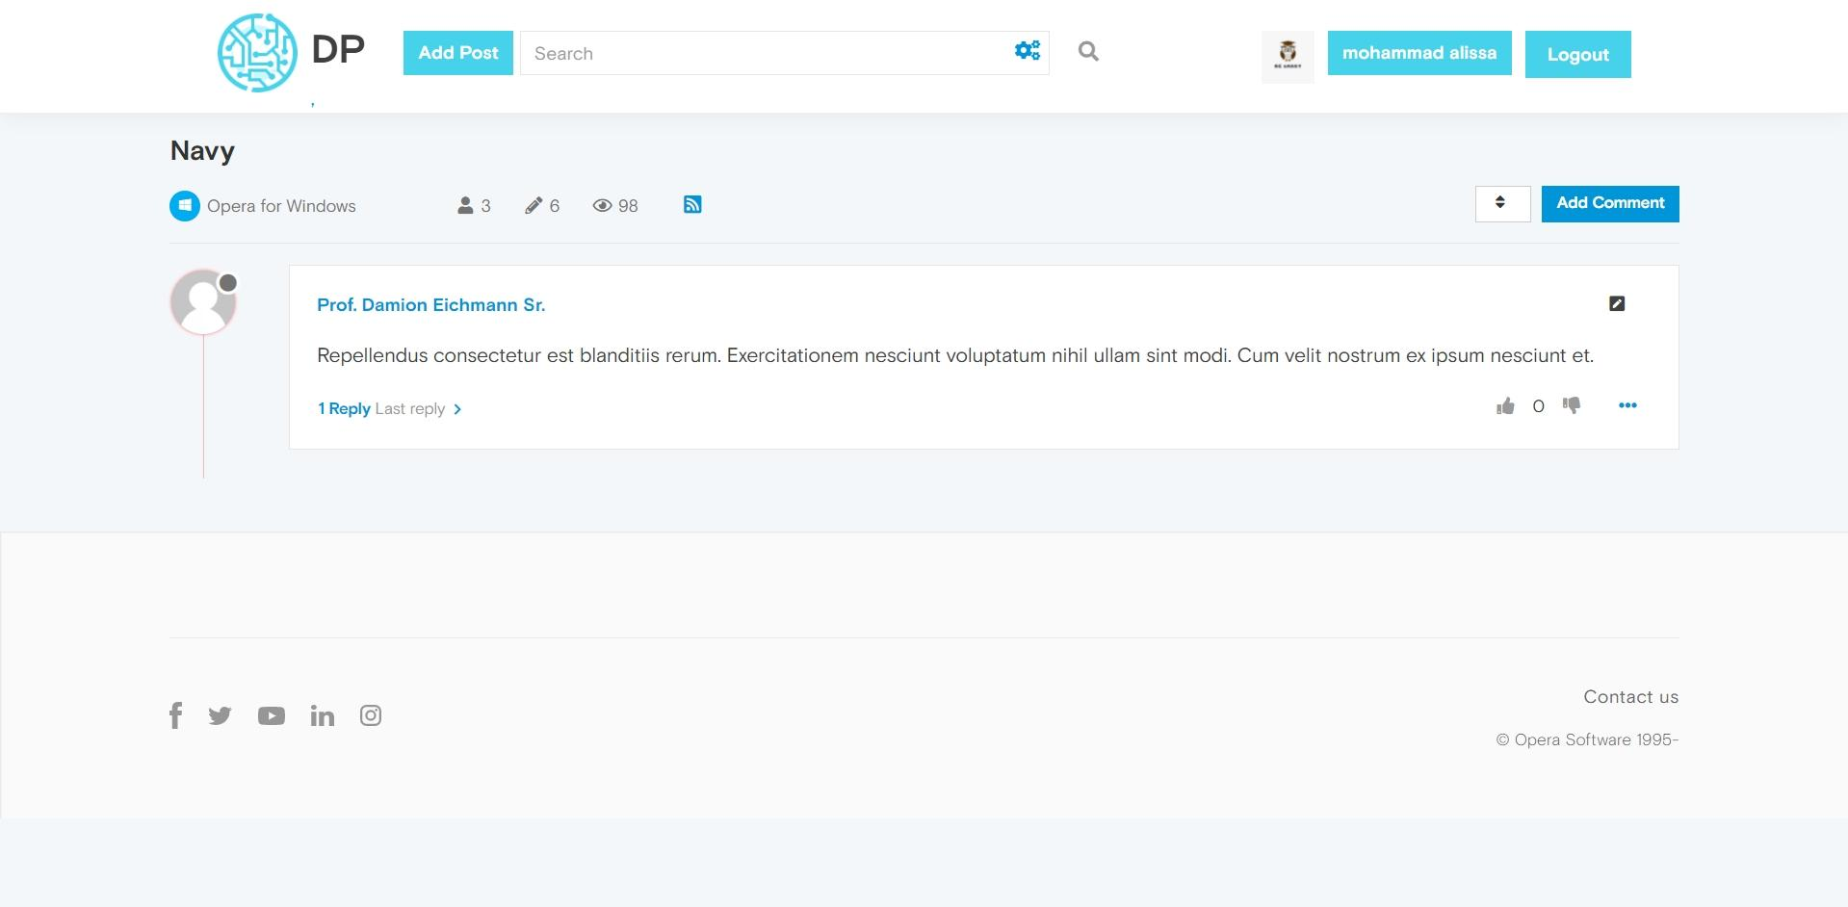
Second Page

Slide 8
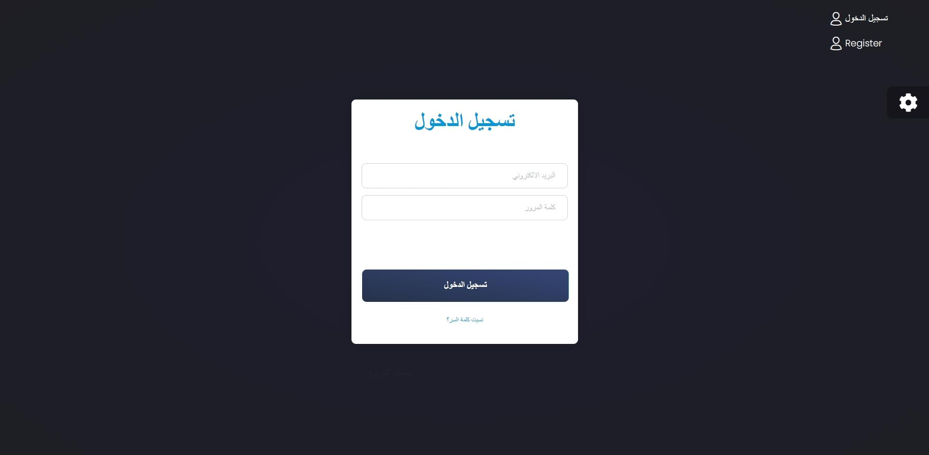
Third Page

Slide 9
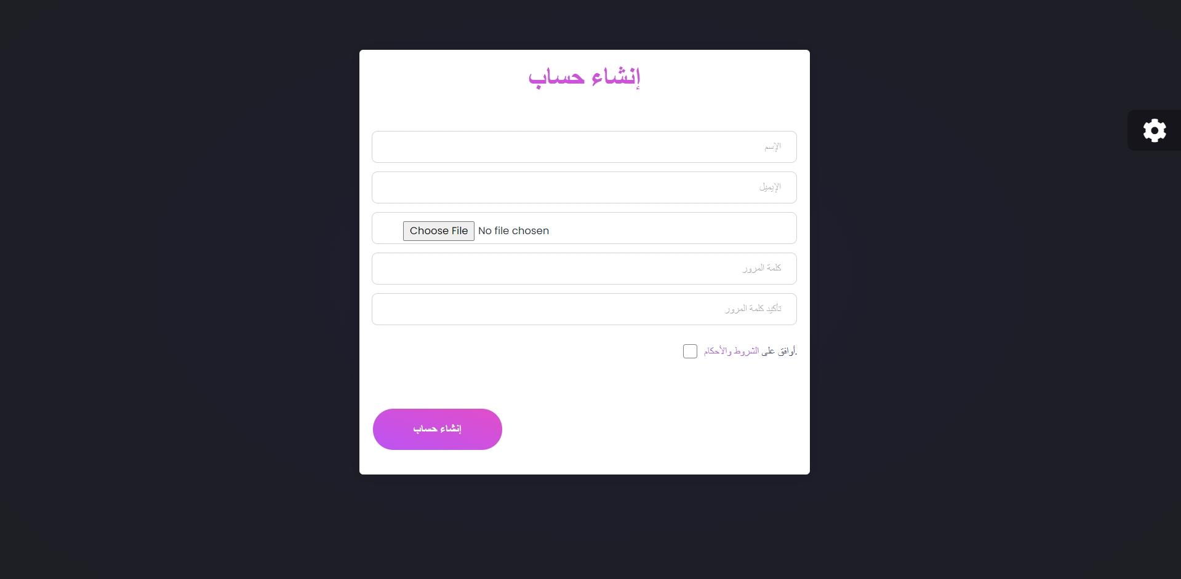
Third Page

Slide 10
Thank You

