Slide 1
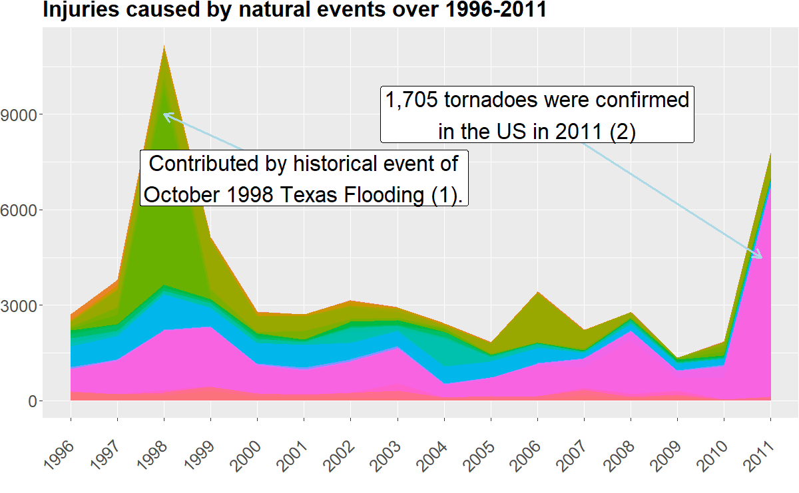
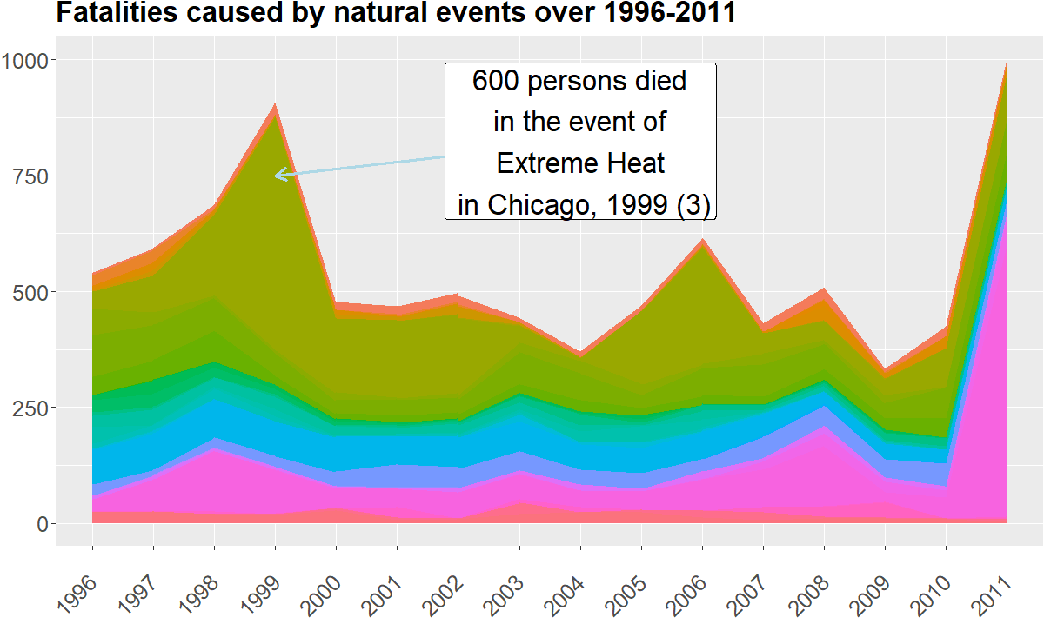
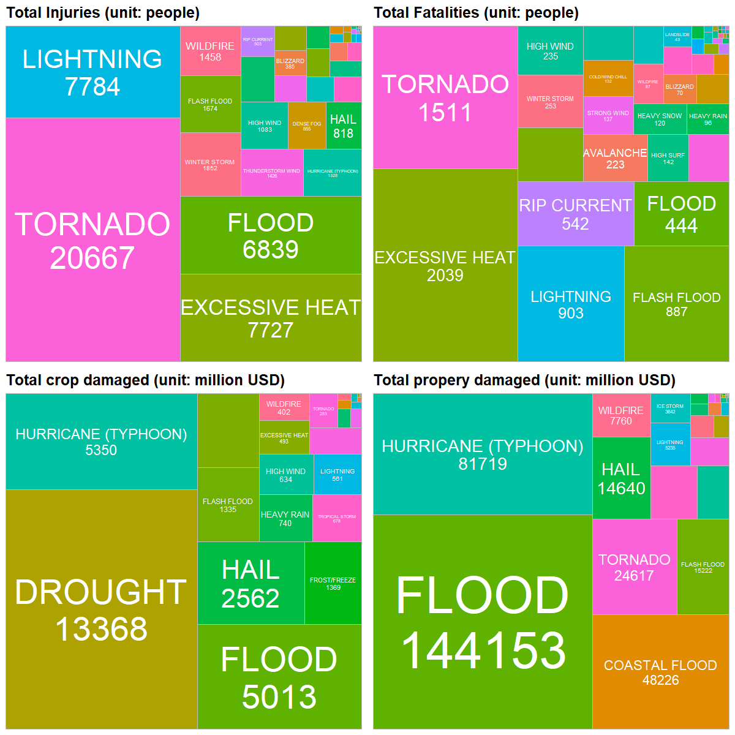
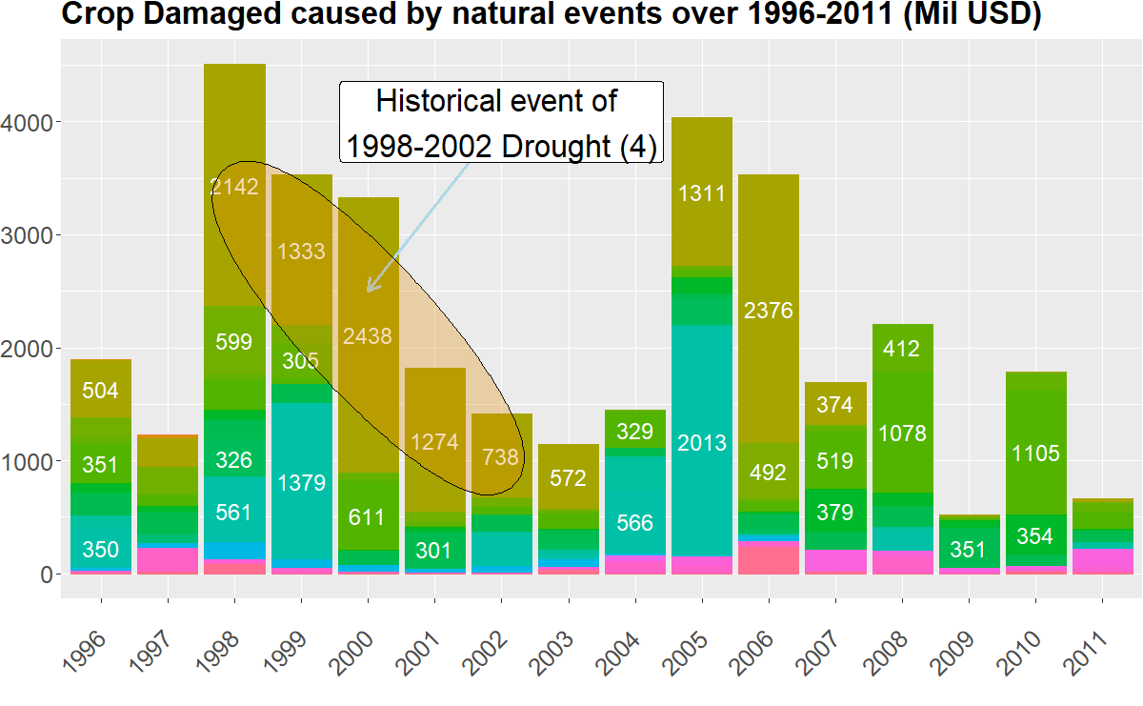
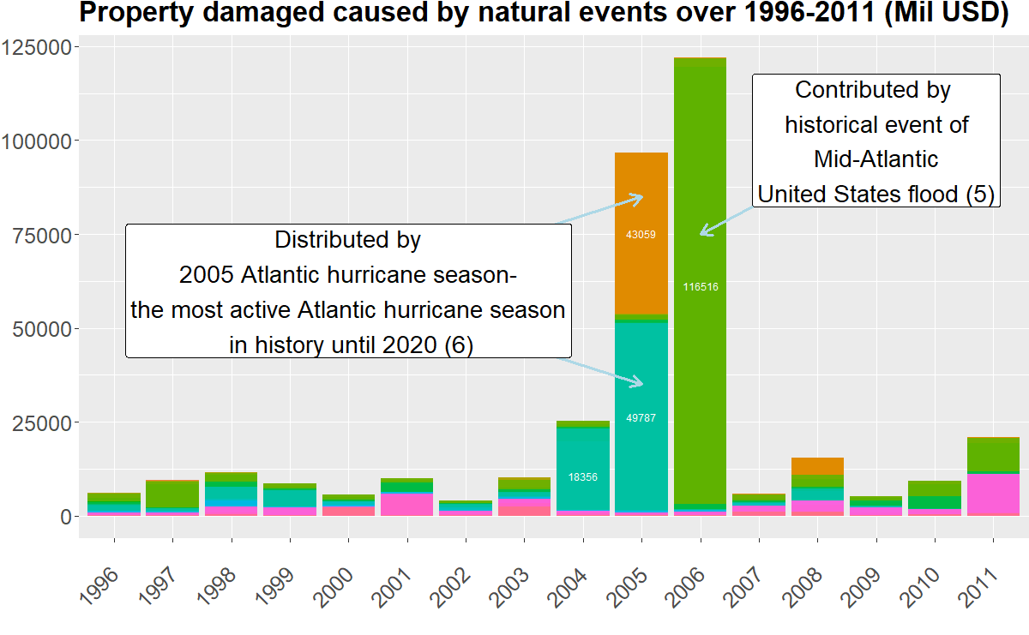
Storms and other disaster events data analysis
The data from U.S. National Oceanic and Atmospheric Administration’s (NOAA) Storm Database collected between 1996 and 2011 shows that in terms of population health, tornado, excessive heat, and lightning caused the most damage, while drought, flood and hurricanes had tremendous economic consequences.
The code is available at https://github.com/haithanhhoang/AMOD-5250H.git for recreation.
(1) Wikipedia contributors. (2023a, January 21). October 1998 Central Texas floods. Wikipedia. https://en.wikipedia.org/wiki/October_1998_Central_Texas_floods
(2) Wikipedia contributors. (2023, February 17). 2011 Super Outbreak. Wikipedia. https://en.wikipedia.org/wiki/2011_Super_Outbreak
(3) National Weather Service. (n.d.). Extreme Heat Episode in Chicago July 29-31, 1999. https://www.weather.gov/lot/1999Jul29
(4) CPPP | 1998–2002 Drought. (n.d.). https://www.cisa.sc.edu/atlas/events-2002.html
(5) Wikipedia contributors. (2023a, January 10). 2006 Mid-Atlantic United States flood. Wikipedia. https://en.wikipedia.org/wiki/2006_Mid-Atlantic_United_States_flood
(6) https://en.wikipedia.org/wiki/2005_Atlantic_hurricane_season
Pietrelli, A. (2016, August 31). Storms and other severe weather events data analysis. http://rstudio-pubs-static.s3.amazonaws.com/206348_99b74a6c8a1644cbb977298f0dee42bf.html

