Slide 1
Assignment 3
Jeonghee Jo
Copyright (C) Data Science Laboratory, Seoul National University. This material is for educational uses only. Some contents are based on the material provided by other paper/book authors and may be copyrighted by them. Written by Jeonghee Jo, Sang-gil Lee, JongYun Song, and Nohil Park, October 2019

Slide 2
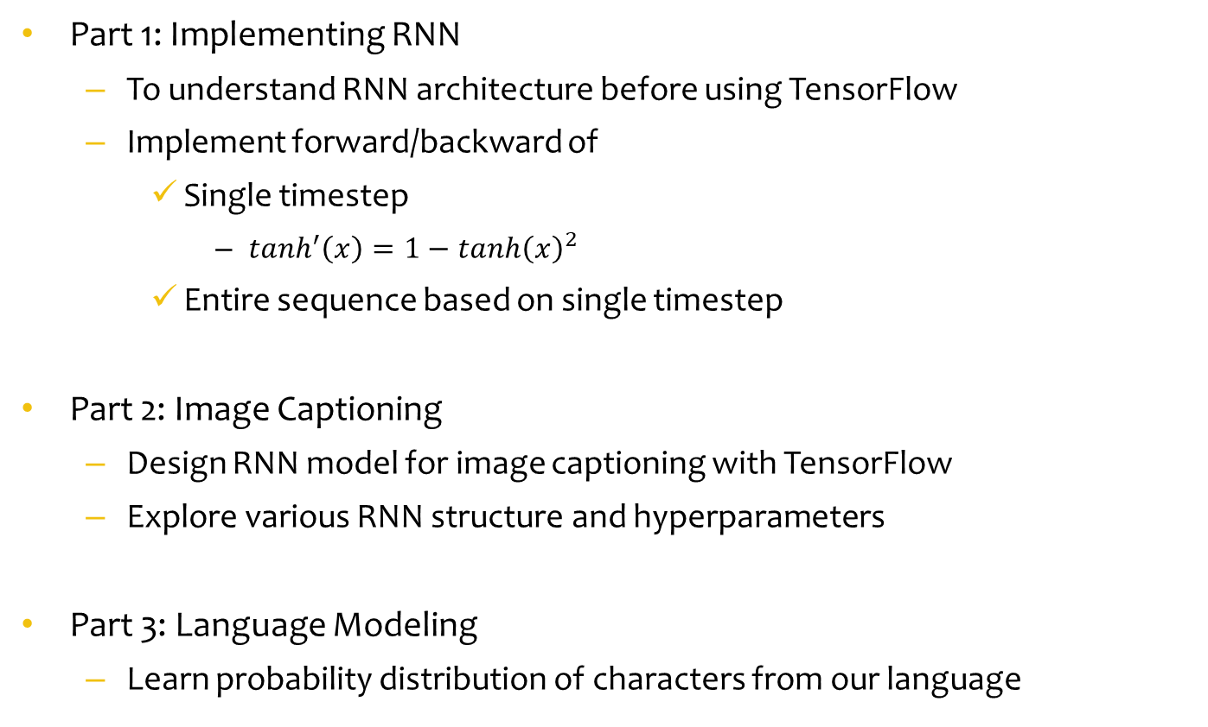
Assignment Objectives
Part 1: Implementing RNN
To understand RNN architecture before using TensorFlow
Implement forward/backward of
Single timestep
$\tanh^{′}\left(x\right)=1−{tanh\left(x\right)}^{2}$
Entire sequence based on single timestep
Part 2: Image Captioning
Design RNN model for image captioning with TensorFlow
Explore various RNN structure and hyperparameters
Part 3: Language Modeling
Learn probability distribution of characters from our language

Slide 3
Assignment Objectives
Part 4: Neural Machine Translation
Implement an attention
Train and evaluate your model
Part 5: Transformer
Explore hyperparameters and pick the best

Slide 4
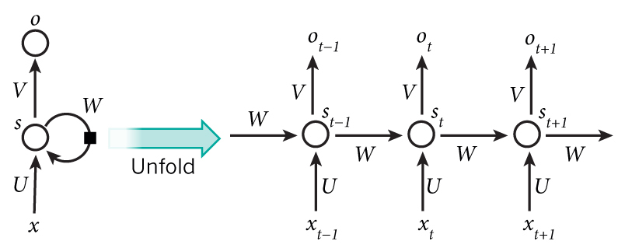

Recurrent Neural Networks
RNN (Recurrent Neural Networks)
RNN perform the same task for every element of a sequence
Output depending on the previous computations, “memory”
$s_{t}=f\left(Ux_{t}+{Ws}_{t−1}\right)$, $o_{t}=softmax\left(Vs_{t}\right)$
$f$is nonlinearity function such as tanh
The same parameters (U,V,W)

Slide 5
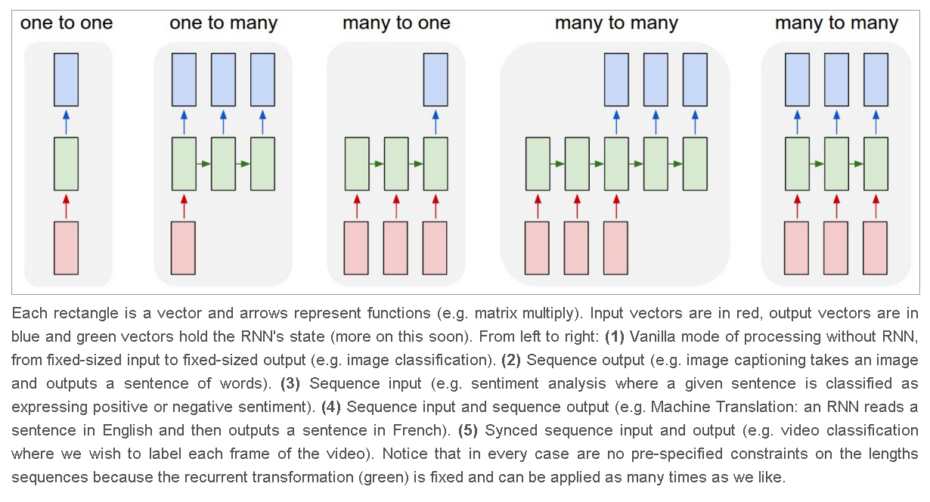
Recurrent Neural Networks

Slide 6
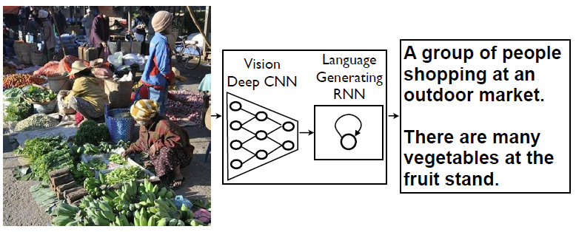
Part 2: Image Captioning
Generating natural sentences describing an image
Connecting computer vision and natural language processing
A vision CNN followed by a language generating RNN

Slide 7
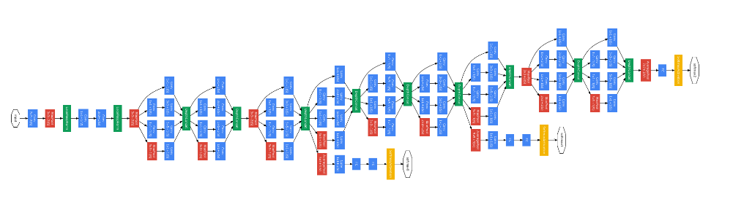
Part 2: Image Captioning
Implement image captioning with TensorFlow RNN modules
Input: extracted image feature from the VGG-16 network
4096 → 512
Output: predicted captions
Data: run the ./coco/get_coco_data.sh
Model: save your model in model_path
Evaluation: BLEU score for validation and independent TA’s test dataset
Test dataset is not provided
주의사항
테스트는 저장된 모델을 로드해서 평가하므로 반드시 저장 및 로드 상태 확인
Extracted feature
(4096)
PCA dimension
reduced
(512)

Slide 8
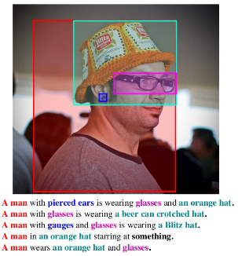

Microsoft COCO dataset
Microsoft coco dataset
Five independent human generated captions per image
Dataset
# train captions : 400,135
# validation captions: 10,000
주의사항
Full train 소요시간이 상당하므로 train 데이터의 일부 sample로 시험, 최종 제출시에 full train
512 extracted image feature 사용할것
maxlen, n_words, input_dimension 변경하지 말것

Slide 9
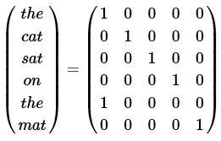
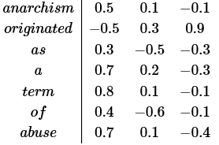
Preprocessing of language model
Preprocessing of training data of language model
Tokenize
Remove infrequent words
Limit vocabulary size to the most common words
<UNKNOWN>
Prepend special start and end token
<START> and <END> tokens
Word to index
Word to numeric vectors (Word2Vec)
<one-hot>
<embedding>
http://www.wildml.com/

Slide 10
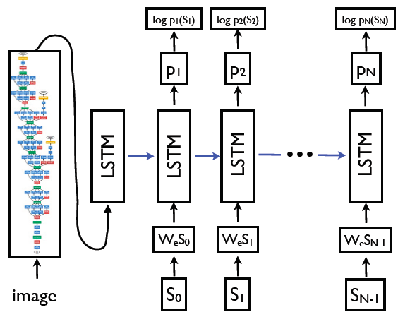
Example of image captioning
Vinyals, Oriol, et al. "Show and tell: A neural image caption generator." Proceedings of the IEEE conference on computer vision and pattern recognition. 2015.

Slide 11
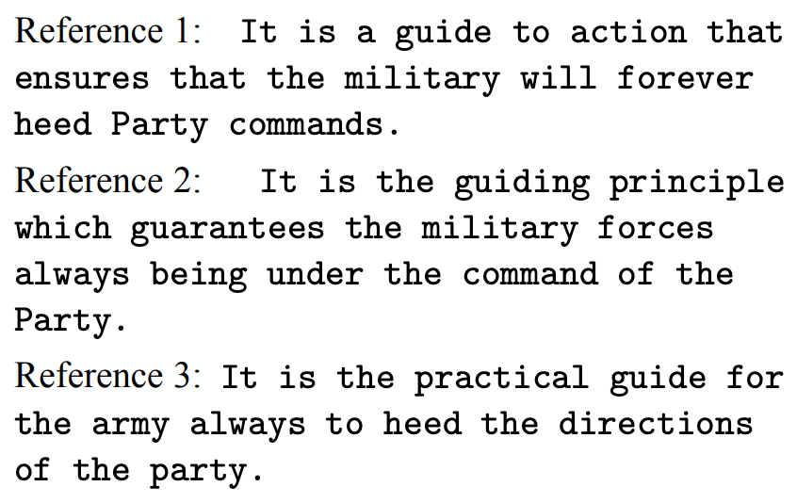
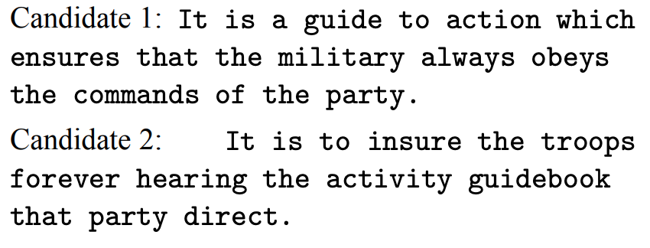

BLEU SCORE
How similar is the predicted sentence to the reference sentence?
$Bilingual Evaluation Understudy (BLEU)$
Machine translation에서 표준적으로 쓰이는 지표
Human evaluation과 비례적인 결과를 보임
정답 대한 reference set이 주어졌을 때, 번역 결과 (candidate)가 얼마나 유사하게 추론하였는가?

Slide 12
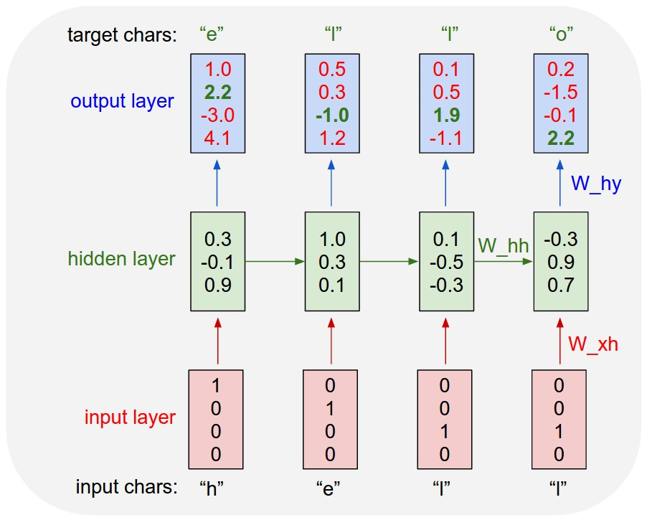
Character-level Language Modeling

Slide 13
Tinyshakespeare dataset
First Citizen:
Before we proceed any further, hear me speak.
All:
Speak, speak.
First Citizen:
You are all resolved rather to die than to famish?
All:
Resolved. resolved.
First Citizen:
First, you know Caius Marcius is chief enemy to the people.
All:
We know't, we know't.
First Citizen:
Let us kill him, and we'll have corn at our own price.
Is't a verdict?
All:
No more talking on't; let it be done: away, away!
Second Citizen:
One word, good citizens.
First Citizen:
We are accounted poor citizens, the patricians good.
What authority surfeits on would relieve us: if they
would yield us but the superfluity, while it were
wholesome, we might guess they relieved us humanely;
but they think we are too dear: the leanness that
afflicts us, the object of our misery, is as an
inventory to particularise their abundance; our
sufferance is a gain to them Let us revenge this with
our pikes, ere we become rakes: for the gods know I
speak this in hunger for bread, not in thirst for revenge.
Second Citizen:
Would you proceed especially against Caius Marcius?
All:
Against him first: he's a very dog to the commonalty.
Second Citizen:
Consider you what services he has done for his country?

Slide 14
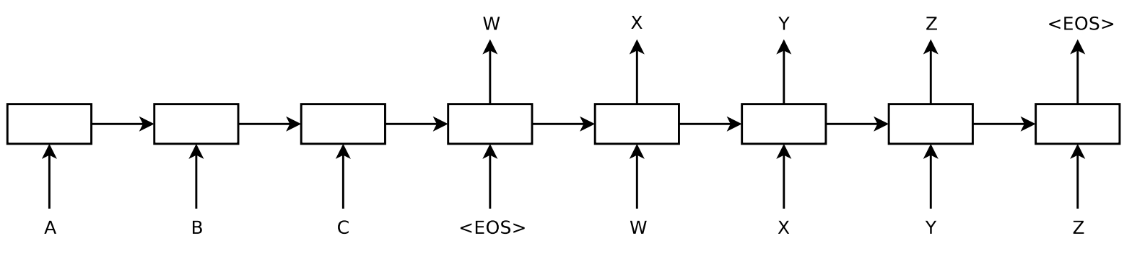
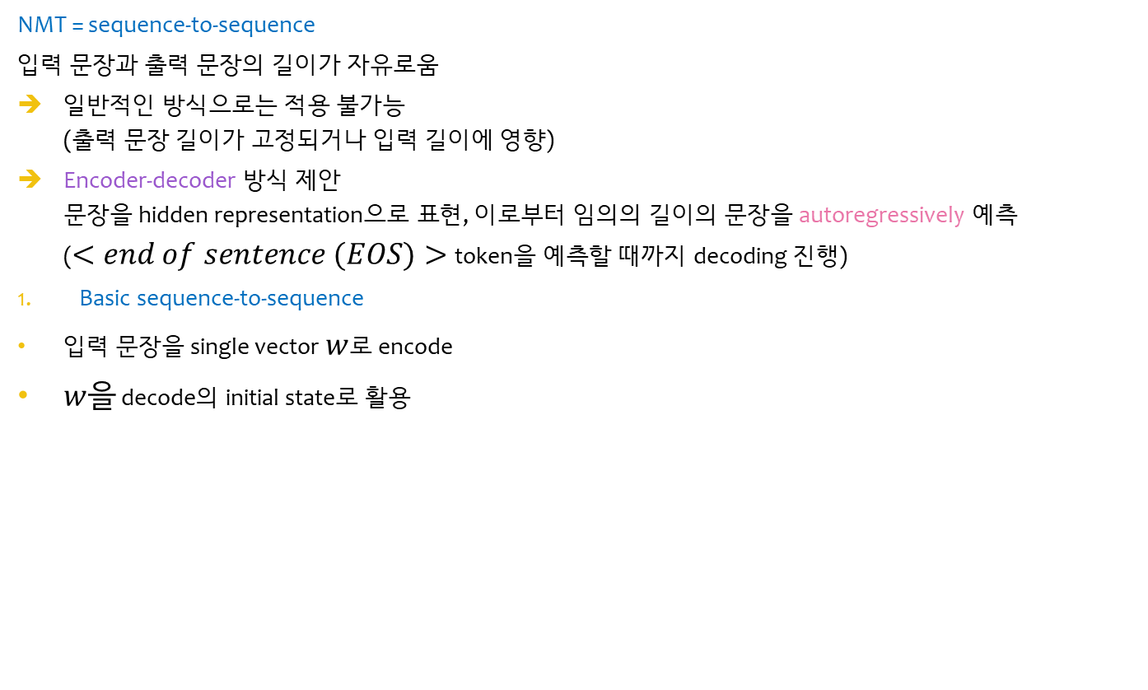
Neural machine Translation
NMT = sequence-to-sequence
입력 문장과 출력 문장의 길이가 자유로움
일반적인 방식으로는 적용 불가능 (출력 문장 길이가 고정되거나 입력 길이에 영향)
Encoder-decoder 방식 제안 문장을 hidden representation으로 표현, 이로부터 임의의 길이의 문장을 autoregressively 예측 ($<end of sentence (EOS)>$token을 예측할 때까지 decoding 진행)
Basic sequence-to-sequence
입력 문장을 single vector $w$로 encode
$w을$ decode의 initial state로 활용
Hidden representation
Encoder
Decoder
Sutskever, Ilya, Oriol Vinyals, and Quoc V. Le. "Sequence to sequence learning with neural networks." Advances in neural information processing systems. 2014.

Slide 15
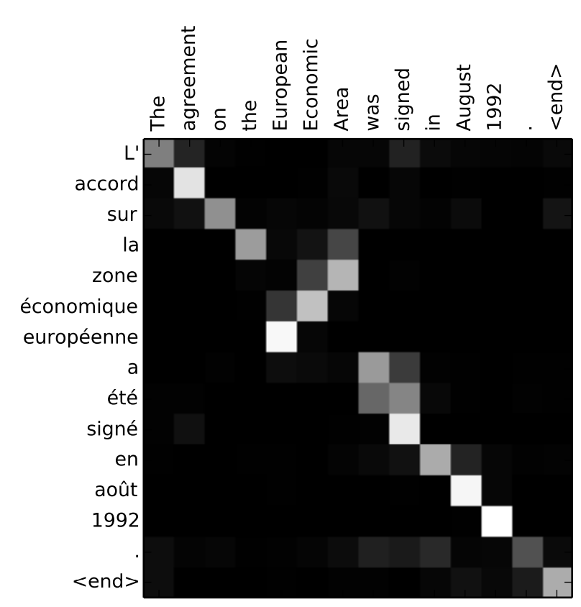
Neural machine Translation
Attention-based RNN/CNN model
Encoder는 문장 길이(T)만큼의 hidden representation을 생성
Decoder는 매 decoding step마다 T개의 encoding 결과에 [0, 1]의 가중치로 attend (sum to 1)
Attention 기법의 장점
Single vector가 모든 정보를 담을 필요가 없음
긴 문장의 번역 성능 향상 (Bahdanau et al., 2015)
Decoding step 별 attention weight plotting 가능
Interpretable latent alignment 정보를 얻을 수 있음
Latent alignment 예시 (영어-프랑스어)
Bahdanau, Dzmitry, Kyunghyun Cho, and Yoshua Bengio. "Neural machine translation by jointly learning to align and translate." arXiv preprint arXiv:1409.0473 (2014).

Slide 16
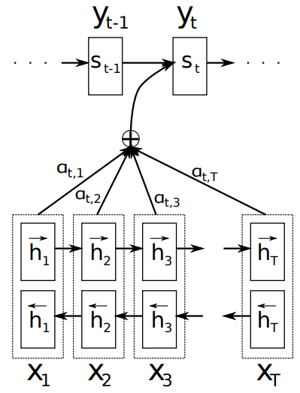

Attention Mechanism
$Neural Machine Translation by Jointly Learning to Align and Translate$ (Bahdanau et al., 2014)
수식 표현
입력 문장 {$x_{1},x_{2},…,x_{T}$}와 encoding된 hidden representation {$h_{1},h_{2},…,h_{T}$}
$s_{t}는$ time step $t에$서의 RNN hidden state이다
$s_{t}=f(s_{t−1},y_{t−1},c_{t})$
Decoding time step $t에$서 decoder는 token $y_{t}의$ 확률 분포를 예측
$$p\left(y_{t} | y_{1},y_{2}, …,y_{t−1},x\right)=g(y_{t−1},s_{t},c_{t})$$
Context vector $c_{t}는$ {$h_{1},h_{2},…,h_{T}$}의 weighted sum (attention weight)으로 얻는다
$$c_{t}=\sum_{k=1}^{T}{α_{tk}}∙h_{k}$$

Slide 17
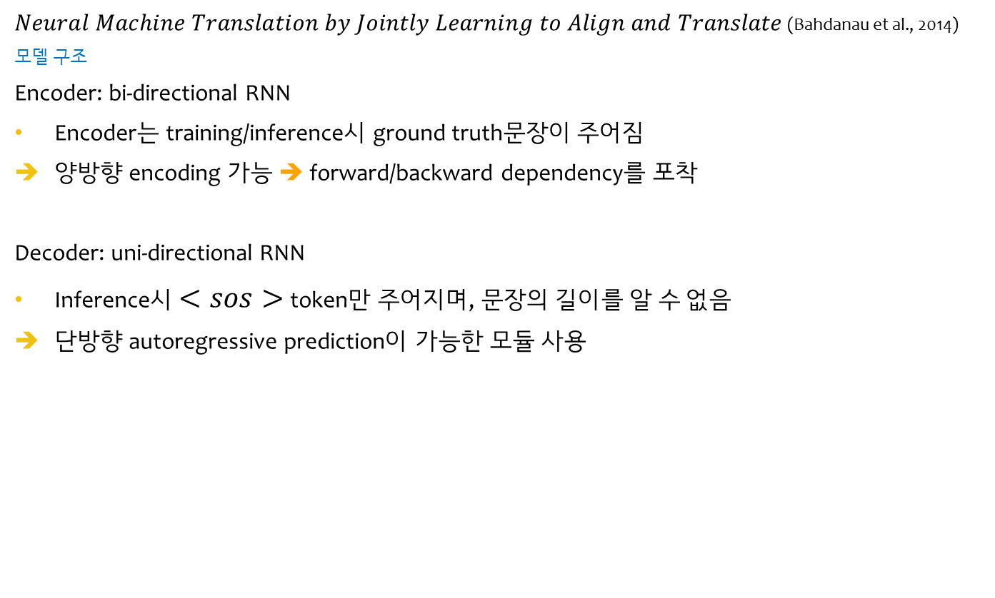
Attention Mechanism
$Neural Machine Translation by Jointly Learning to Align and Translate$ (Bahdanau et al., 2014)
모델 구조
Encoder: bi-directional RNN
Encoder는 training/inference시 ground truth문장이 주어짐
양방향 encoding 가능 ➔ forward/backward dependency를 포착
Decoder: uni-directional RNN
Inference시 $<sos>$token만 주어지며, 문장의 길이를 알 수 없음
단방향 autoregressive prediction이 가능한 모듈 사용

Slide 18
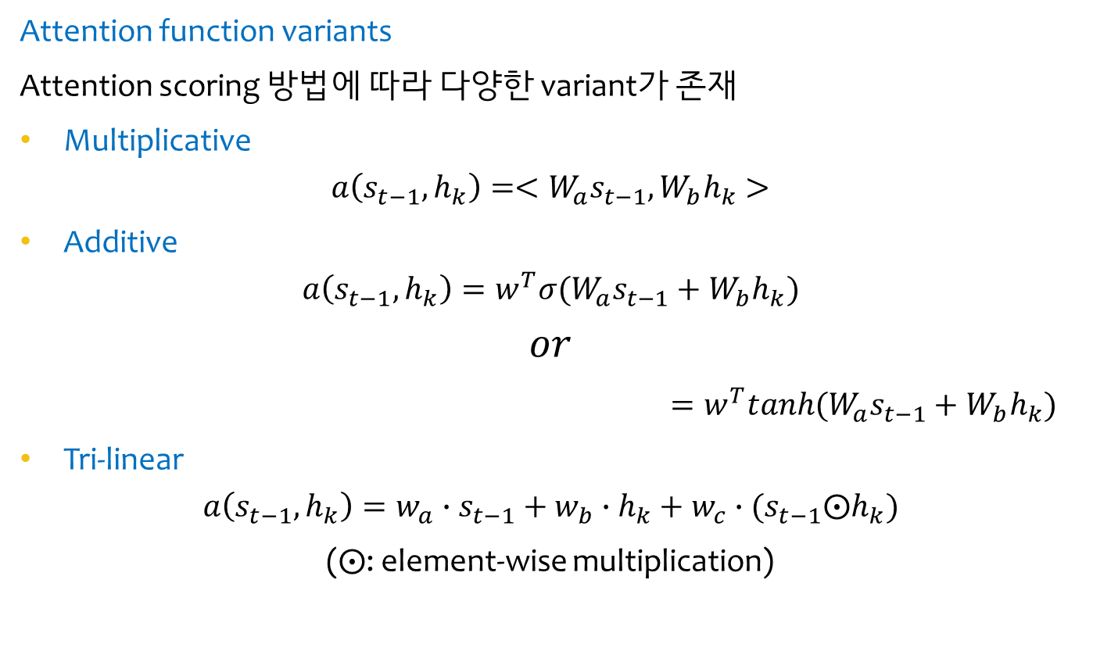
Attention Mechanism
Attention function variants
Attention scoring 방법에 따라 다양한 variant가 존재
Multiplicative $a\left(s_{t−1},h_{k}\right)={<W_{a}s}_{t−1},{W_{b}h}_{k}>$
Additive
$$a\left(s_{t−1},h_{k}\right)=w^{T}σ(W_{a}s_{t−1}+W_{b}h_{k})$$
$$or$$
$=w^{T}tanh(W_{a}s_{t−1}+W_{b}h_{k})$
Tri-linear
$$a\left(s_{t−1},h_{k}\right)=w_{a}∙s_{t−1}+w_{b}∙h_{k}+w_{c}∙(s_{t−1}⨀h_{k})$$
($⨀$: element-wise multiplication)

Slide 19
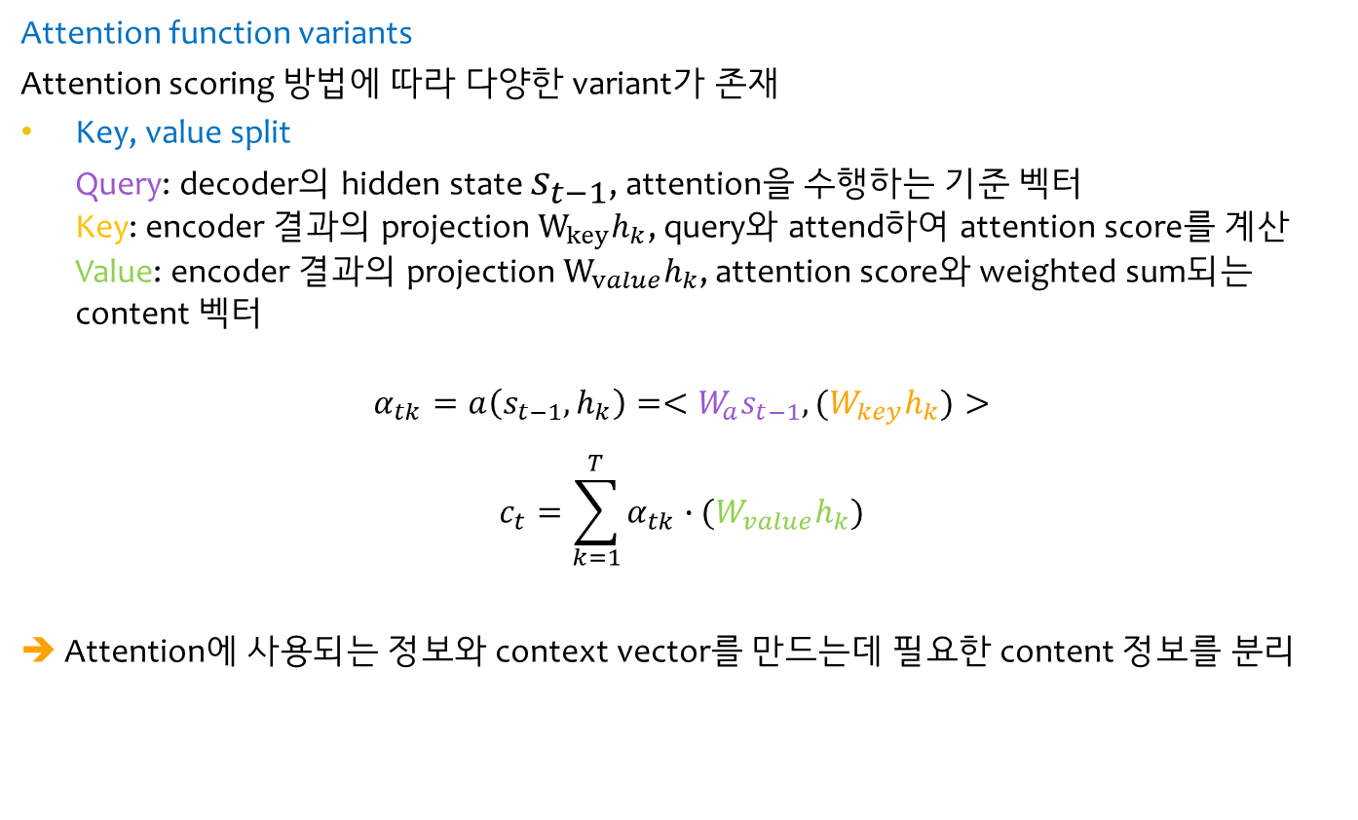
Attention Mechanism
Attention function variants
Attention scoring 방법에 따라 다양한 variant가 존재
Key, value split Query: decoder의 hidden state $s_{t−1}$, attention을 수행하는 기준 벡터 Key: encoder 결과의 projection $W_{key}h_{k}$, query와 attend하여 attention score를 계산 Value: encoder 결과의 projection $W_{value}h_{k}$, attention score와 weighted sum되는 content 벡터
$$α_{tk}=a\left(s_{t−1},h_{k}\right)={<W_{a}s}_{t−1},{(W_{key}h}_{k})> \\ c_{t}=\sum_{k=1}^{T}{α_{tk}}∙({W_{value}h}_{k})$$ ➔ Attention에 사용되는 정보와 context vector를 만드는데 필요한 content 정보를 분리

Slide 20
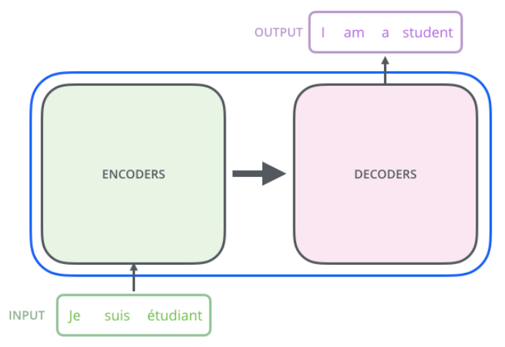
Transformer
In black box view
Encoder & decoder Input과 output 길이가 가변적이므로, 입력 문장을 처리하는 encoder와 출력 문장의 token을 하나씩 출력하는 decoder로 나눔
Autoregressive decoder Encoder에서 처리한 입력 문장과 이전 time step까지 예측한 출력 문장 token들을 입력 받아 현재 time step의 출력 문장 token을 예측 (“end-of-sentence” token을 예측할 때 까지 계속 진행)
https://nlpinkorean.github.io/illustrated-transformer/

Slide 21
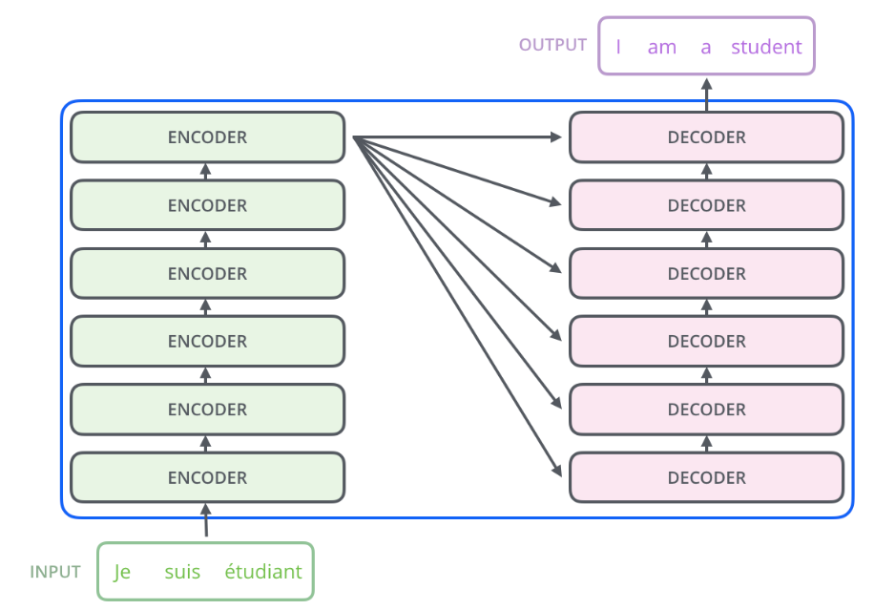
Transformer
In black box view
Multi-layer architecture Encoder와 decoder는 여러 층을 쌓은 구조
Multi-step attention Decoder의 각 층은 encoder 마지막 층이 출력한 hidden vectors에 attend, 출력에 필요한 벡터를 추론
https://nlpinkorean.github.io/illustrated-transformer/

Slide 22
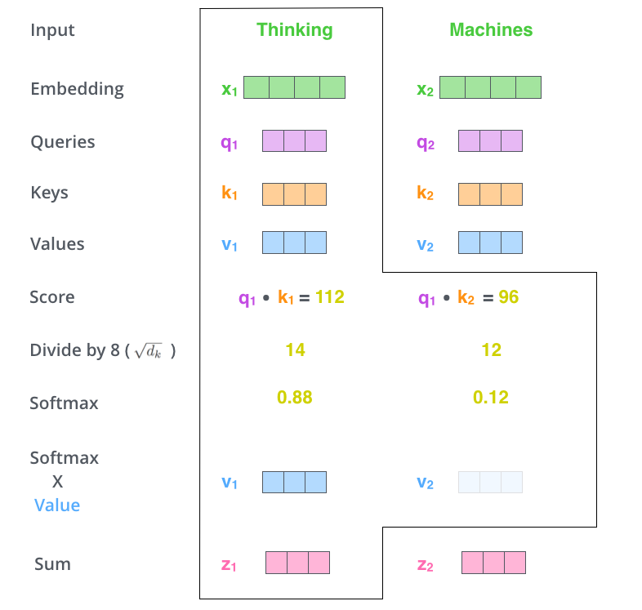
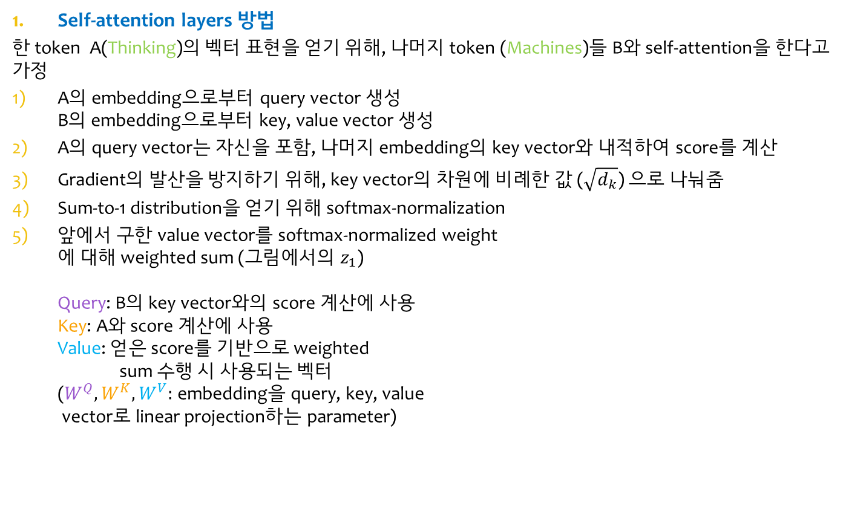
Transformer
Self-attention layers 방법
한 token A(Thinking)의 벡터 표현을 얻기 위해, 나머지 token (Machines)들 B와 self-attention을 한다고 가정
A의 embedding으로부터 query vector 생성 B의 embedding으로부터 key, value vector 생성
A의 query vector는 자신을 포함, 나머지 embedding의 key vector와 내적하여 score를 계산
Gradient의 발산을 방지하기 위해, key vector의 차원에 비례한 값 ($\sqrt{d_{k}}$) 으로 나눠줌
Sum-to-1 distribution을 얻기 위해 softmax-normalization
앞에서 구한 value vector를 softmax-normalized weight 에 대해 weighted sum (그림에서의 $z_{1}$) Query: B의 key vector와의 score 계산에 사용 Key: A와 score 계산에 사용 Value: 얻은 score를 기반으로 weighted sum 수행 시 사용되는 벡터 ($W^{Q},W^{K},W^{V}:$ embedding을 query, key, value vector로 linear projection하는 parameter)
https://nlpinkorean.github.io/illustrated-transformer/

Slide 23
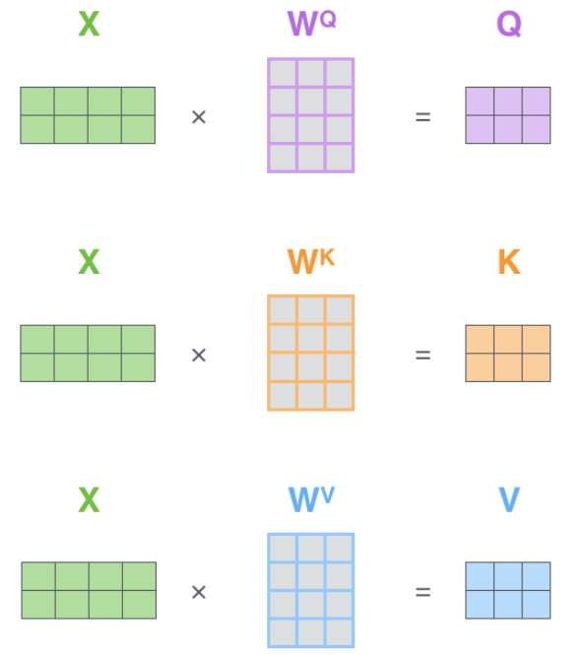

Transformer
Self-attention layers 방법
모든 embedding의 self-attention을 matrix operation으로 동시에 진행할 수 있음
Embedding을 stack하여 얻은 $X$ matrix를 통해 query, key, value vector stack (=matrix)를 일괄적으로 구함
https://nlpinkorean.github.io/illustrated-transformer/

Slide 24
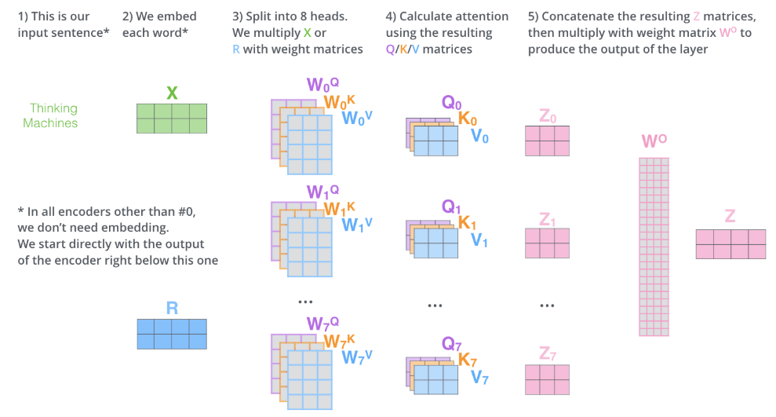

Transformer
Multi-head attention
방법
Self-attention을 $H$개의 $W^{Q},W^{K},W^{V}$를 이용해 $H$개의 양상으로 진행할 수 있음
https://nlpinkorean.github.io/illustrated-transformer/

Slide 25
[NOTICE] Assignment 3
I. What to do
Part1: rnn_layer.py
Part2: captioning.py, notebook (train, prediction, description of your implmentation)
DO NOT change maxlen (17), n_words (1004), input_dimension(512)
DO NOT change coco_utils.py
Explore structure, functions, rnn types, other hyperparameters (changeable)
Part 3: char_rnn.py, notebook (train, sampling, description of your implmentation)
DO NOT change utils.py
Explore structure, functions, rnn types, other hyperparameters (changeable)
Part 4: notebook
DO NOT change nmt_utils.py
Implement class Attention() (any type attention you want)
Part 5: transformer_modules.py
Explore the model performance using at least 12 different hyperparameters set (changeable)
Report the results
DO NOT change anything except the hyperparameters or path.
Submit only one checkpoint file for each part!
Use max_to_keep parameter in Saver()

Slide 26
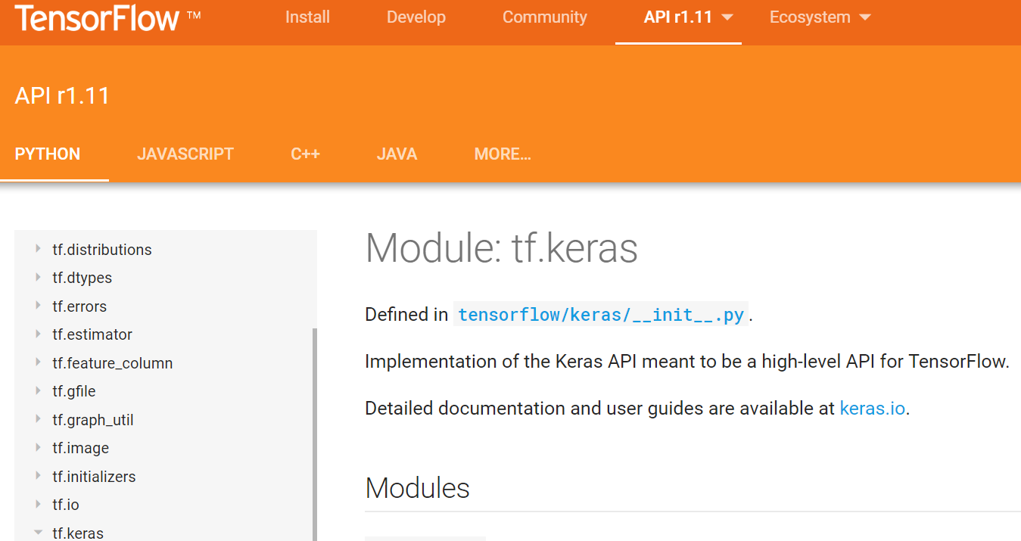
[NOTICE] Assignment 3
(PART 1, 2, 3 ONLY)
DO NOT USE tf.keras API

Slide 27
[NOTICE] Assignment 3
II. Grade
Part1 (20 point), Part2 (20 point), Part3 (20 point), Part4 (20 point), Part5 (20 point)
Save file log
Part2 & Part 3 & Part 4
Print out at least 10 continual losses in training process. The losses have to go down with the training progresses.
Describe your model in detail (Part 2-3 only; not part 4)
Part 2
We will load and evaluate your model using test data
BLEU score > 0.3 on validation set will be okay (mostly)
Part 3
Training & sampling: pass/fail grading (binary)
If sampled sentences are odd too much (“abababa…”, “I is if is …”), then fail.
Part 5
Report at least 12 BLEU score results from each different hyperparameters set. (See transformer_modules.py)

Slide 28
How to install assignment files
Assignment files
Models_captioning/ & models_char_rnn/ & nmt_checkpoints/ & transformer_checkpoint/ (checkpoint directories)
coco/ get_coco_data.sh
iwslt_download.sh
coco_utils.py
utils.py
rnn_layers.py
captioning.py
char_rnn.py
nmt_utils.py
multi-bleu.perl
transformer_modules.py
transformer_utils.py
Assignment3_Part1_Implementing_RNN.ipynb
Assignment3_Part2_ImageCaptioning.ipynb
Assignment3_Part3_CharRNN.ipynb
Assignment3_Part4_NMT.ipynb
Assignment3_Part5_Transformer.ipynb
the last page (result of Assignment3_5) of Assignment3.pptx (this file)
CollectSubmission.sh
Install assignment files
tar -zxvf assignment3.tar.gz
sudo chmod 755 CollectSubmission.sh
./coco/get_coco_data.sh
./iwslt_download.sh
jupyter notebook
Open the notebooks on your browser and get started
Be careful! There are lots of files to submit in this assignment.

Slide 29
Important Notes
PLEASE read the notes on the notebooks carefully
Google first before mailing TAs
Some details are missing, ambiguous, or even wrong on purpose
Submitting your work
DO NOT clear the final outputs
After you are done all five parts
$ ./CollectSubmission.sh team_#
Upload the team_#.tar.gz on ETL
Ex: team_1.tar.gz
TA email: deeplearning.snu@gmail.com

Slide 30
(Submission) Assignment 3-5 BLEU SCORE REPORT
Report your results on at least 12 different hyperparameter settings (on the test set)
You can use tables, plots, or just text (any format you want).
USE THE 1 PAGE ONLY (NOT MORE THAN 1 PAGE)
REPORT HERE (DELETE THIS BOX)

