Slide 1

EMPLOYEE ATTRITION
Why do I leave?

Slide 2
SUMMARY
01
02
03
04
INTRODUCTION
WHY DO PEOPLE LEAVE?
Identify the Problem
Top Three Factors Lead to Attrition
INTERESTING FINDINGS
RECOMMENDATION
Provide Solutions and Recommendation
Exploratory Data Analysis

Slide 3
Attrition
RESOURCES
SKILLS
Attrition can negatively affect a company's bottom line by increasing recruitment and training costs
Losing experienced employees can also result in a loss of institutional knowledge, skills, and expertise.
CULTURE
REPUTATION
When employees leave, it can create a sense of disconnection and disrupt the social fabric of the workplace.
High attrition rates can also damage a company's reputation,This can make it more difficult to attract top talent in the future.

Slide 4

HOW DO WE KEEP PEOPLE AROUND?
We are going to examine what causes people leave

Slide 5
1.DATA PRE-PROCESSING
Before we jump into the analysis, we need to do some data pre-processing:
What we did first is converted categorical variable into factor level (1,2,3,4)
Some of the categorical variable are not suitable for factorized level, because they do not mean equal distance between one another, but here we are process it for more cohesive data manipulation and will take that into consideration when picking our features.
Then we standardized 36 columns of data into one scale for easier analysis
Afterwards, our data only contains numeric variables

Slide 6
PROCESSING STREAMLINE
Preparing Data
Hypothesis Tests
Predict Outcome
Preprocessing data before our analysis
Determine significant factors
Use trained model to predict outcome of new attrition
Split Data
Fit The Model
Testing between people who stayed and people who left
Select the model and tune the hyperparameters

Slide 7
2. THEN, WE SPLIT THE DATA INTO TWO
People who stayed
People who left
1. Looking at people who stayed and comparing each feature/factors with people who left
2.Conducting hypothesis Tests see if each feature/factor is significantly different

Slide 8
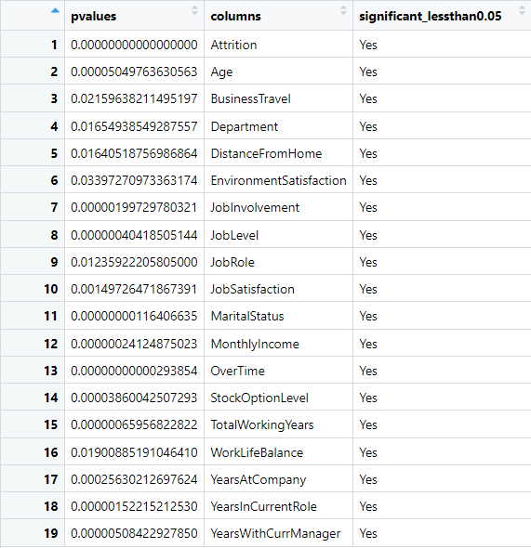
3. RUNNING HYPOTHESIS TESTS ON ALL FEATURES/COLUMNS
Assuming the difference between the mean of each feature between people who left and people who stayed is zero, see if they are significantly different than one another, if they are with P value less than 0.05 (significant level)， that could mean this partifuclar feature is a driving factor of what causes people leave.
The lesser the P value the more the evident suggests, that MEAN of that feature is significantly different from people who stayed and people who left in our data

Slide 9
TOP THREE FACTORS
OVERTIME
Marital Status
Monthly Income
p value:
0.00000000000293854
p value: 0.00000000116406635
p value:
0.00000024124875023

Slide 10
PROCESSING STREAMLINE
Preparing Data
Hypothesis Tests
Predict Outcome
Preprocessing data before our analysis
Determine significant factors
Use trained model to predict outcome of new attrition
Split Data
Fit The Model
Testing between people who stayed and people who left
Select the model and tune the hyperparameters

Slide 11
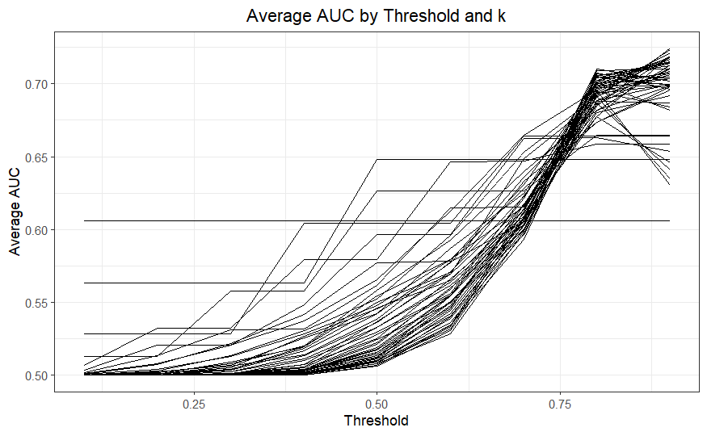
MODEL SELECTION: KNN
After iteration of 45000 in total, we ran a split test of 70% and 30% with hyperparameters :
Sampletimes: 100 times
K from 1 to 50
Threshold: 0.1 to 0.9
Optimizing for AUC (Area Under the Curve) value.
We can clearly see that on average when k is equal to 0.9, we have the near highest average AUC

Slide 12
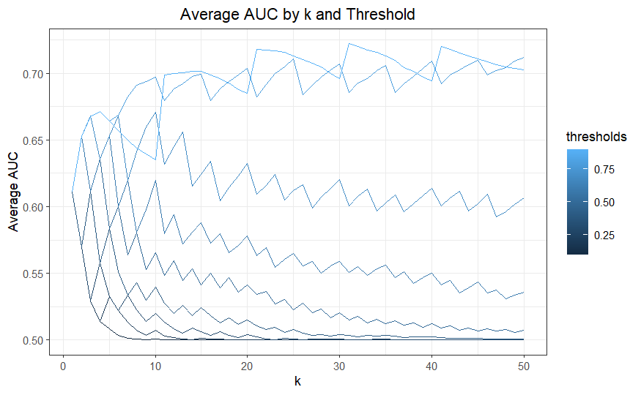
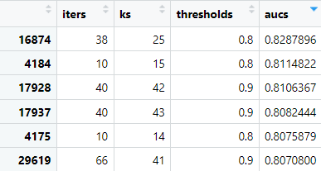
MODEL SELECTION: KNN
After running a split test of 70%, 30% test for 45000 iterations, AUC seems to peak at when k is equals to 25, and threshold equals to 0.8.
According to the chart on the left, threshold is best to set around 0.8-0.9 with K around 30

Slide 13
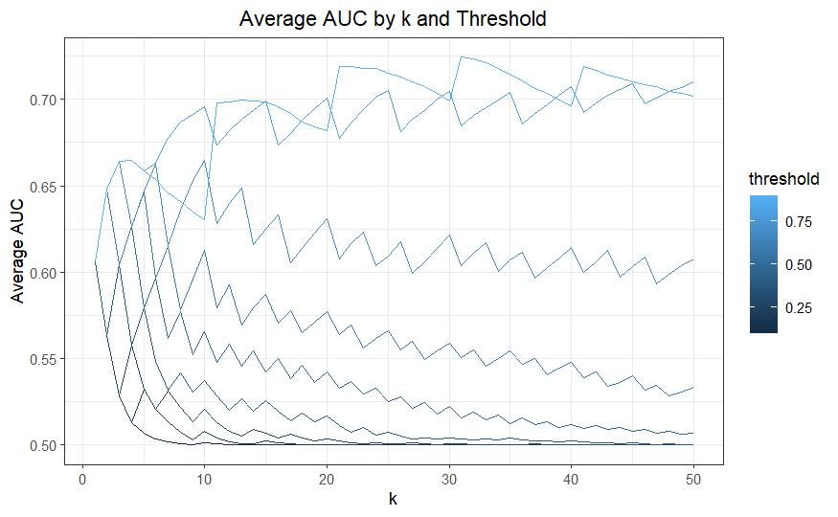
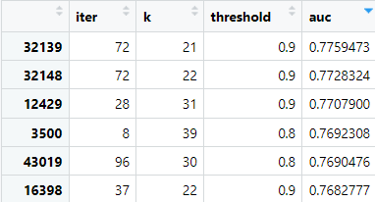
MODEL SELECTION: KNN.CV
This chart shows the result more directly, when threshold is above 0.75, we have the best AUC results, when K is from 20-50.
In fact the maximum AUC number was generated with k equals to 21, threshold equals to 0.9, on the 32139 iteration of the experiment.

Slide 14
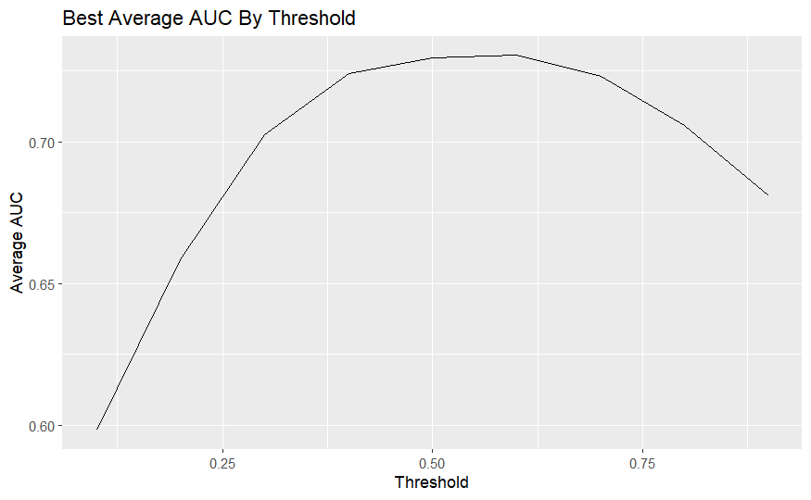
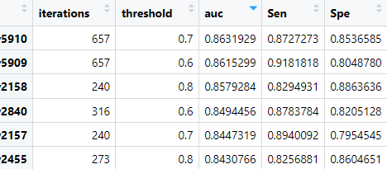
MODEL SELECTION: Naive Bayes
After 9000 iterations of Naive Bayes
We test the hyperparameter threshold from 0.1 to 0.9
The results are on the left, with auc value peaking at threshold 0.7 with sensitivity at 0.87 and specificity at 0.85
On average the best performing threshold is 0.6.

Slide 15
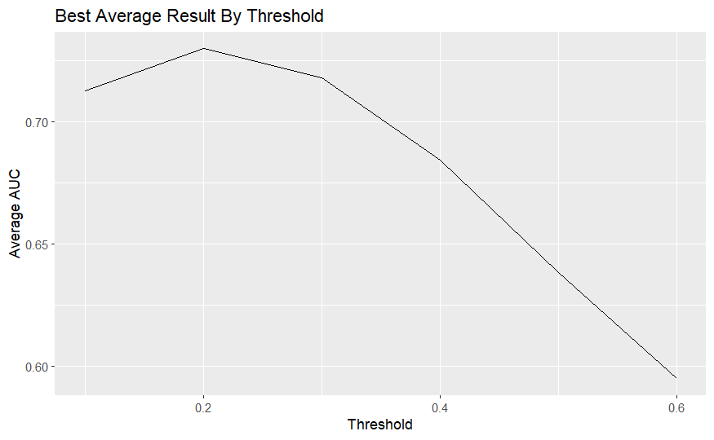
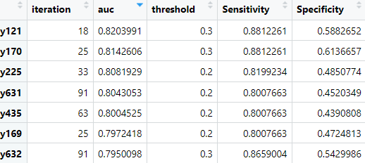
MODEL SELECTION: Linear Regression
After testing hyperparameter threshold, the best auc value comes at 0.82, and threshold comes at 0.3
Overall average auc value drops as threshold increase, therefore we are selecting threshold at 0.3

Slide 16
PEAK PERFORMANCE
 | ~AUC | ~SENSITIVITY | ~SPECIFICITY
KNN | 0.83 | 0.83 | (1)
KNN.CV | 0.776 | 0.66 | 0.77
NAIVE BAYES | 0.863 | 0.872 | 0.853
LINEAR REGRESSION | 0.82 | 0.88 | 0.59

Slide 17
BEST RESULTS (ON AVERAGE)
 | ~AUC (Mean) | Threshold | K
KNN | 0.7166 | 0.9 | 21
KNN.CV | 0.7245 | 0.9 | 41
NAIVE BAYES | 0.730 | 0.6 | NA
LINEAR REGRESSION | 0.720 | 0.2 | NA

Slide 18
Ensembling Models Together
KNN.CV
Majority
Vote
Naive
Bayes

Slide 19
PROCESSING STREAMLINE
Preparing Data
Hypothesis Tests
Predict Outcome
Preprocessing data before our analysis
Determine significant factors
Use trained model to predict outcome of new attrition
Split Data
Fit The Model
Testing between people who stayed and people who left
Select the model and tune the hyperparameters

Slide 20
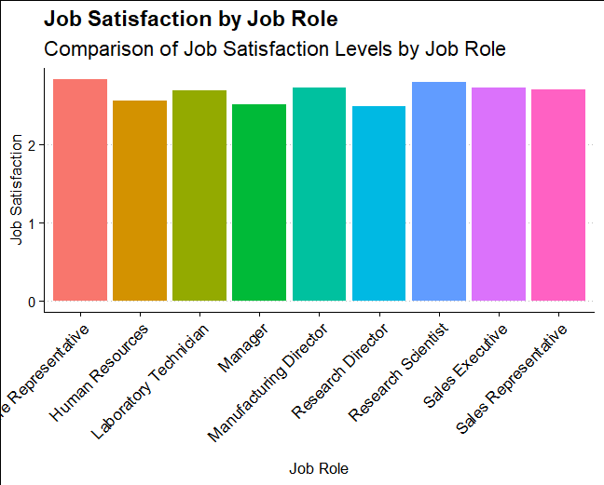
INTERESTING FINDINGS
Looks like the more satisfied jobs are Sales Rep and Research Scientists

Slide 21
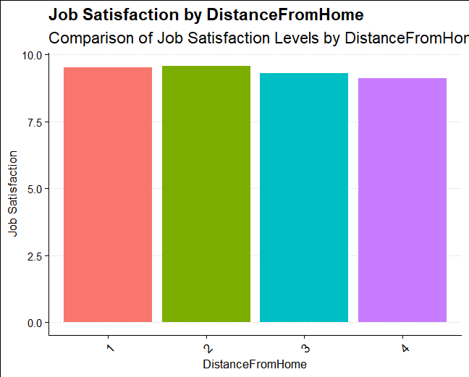
INTERESTING FINDINGS
On average, the least amount of distance from home has the highest level of Job satisfaction

Slide 22
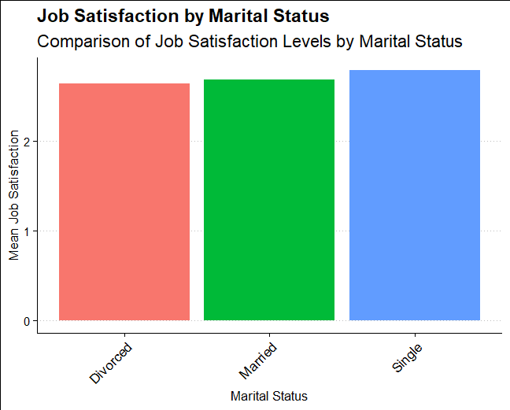
INTERESTING FINDINGS
Single workers are likely to be more satisfied with their jobs,however more likely to leave, we will discuss in the next slides

Slide 23
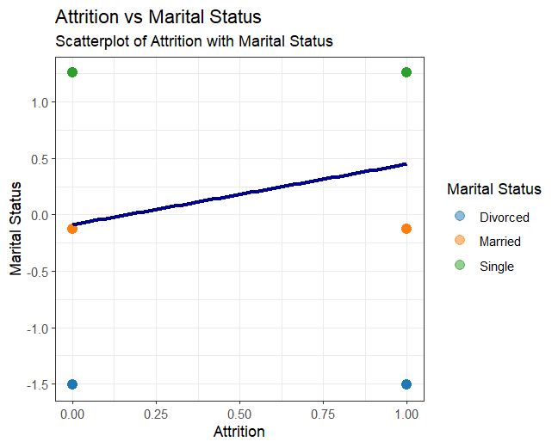
1: Attrition
0: Not Attrition
Married workers are less likely to leave.
You can enter a subtitle here i you need it

Slide 24
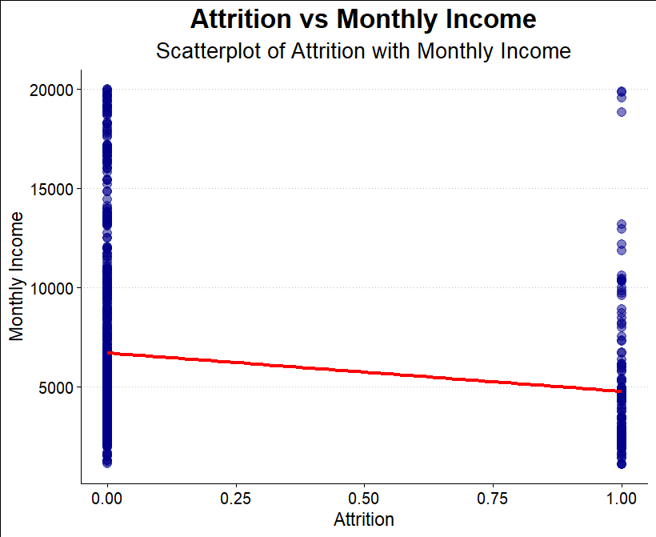
LINEAR RELATIONSHIP:
MONTHLY INCOME
Exploring Linear Relationship:
1: Attrition
0: Not Attrition
We can see that lower monthly income leads to higher possibility of attrition

Slide 25
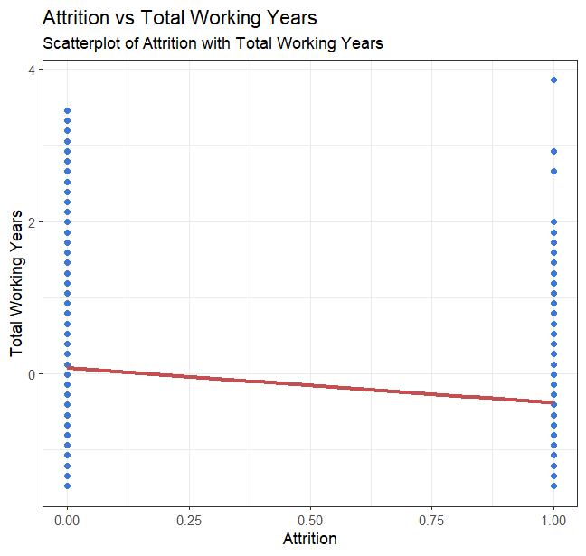
The longer you work in the company less likely to leave to another company
You can enter a subtitle here i you need it

Slide 26
CONCLUSION & RECOMMENDATION
1. Increase Monthly Income
2. Hire More Married Workers
3. OverTime
Increase Monthly Income might be a good way to keep people around
Married workers are less likely to leave
More Overtime seems to leads to more Attrition
4. Longevity Plan
5. Promotion
6.Foster Communication and Relationships
Maybe the longer people work in the company the better incentives they have
Increasing Job Level shows decrease in change of Attrition
Data shows increase in Job Involvement leads to less Attrition

Slide 27
THANKS!
Do you have any questions? haiti.liu@mail.smu.edu
Video Presentation
https://www.youtube.com/watch?v=NKKbte2gRtc

