Slide 1
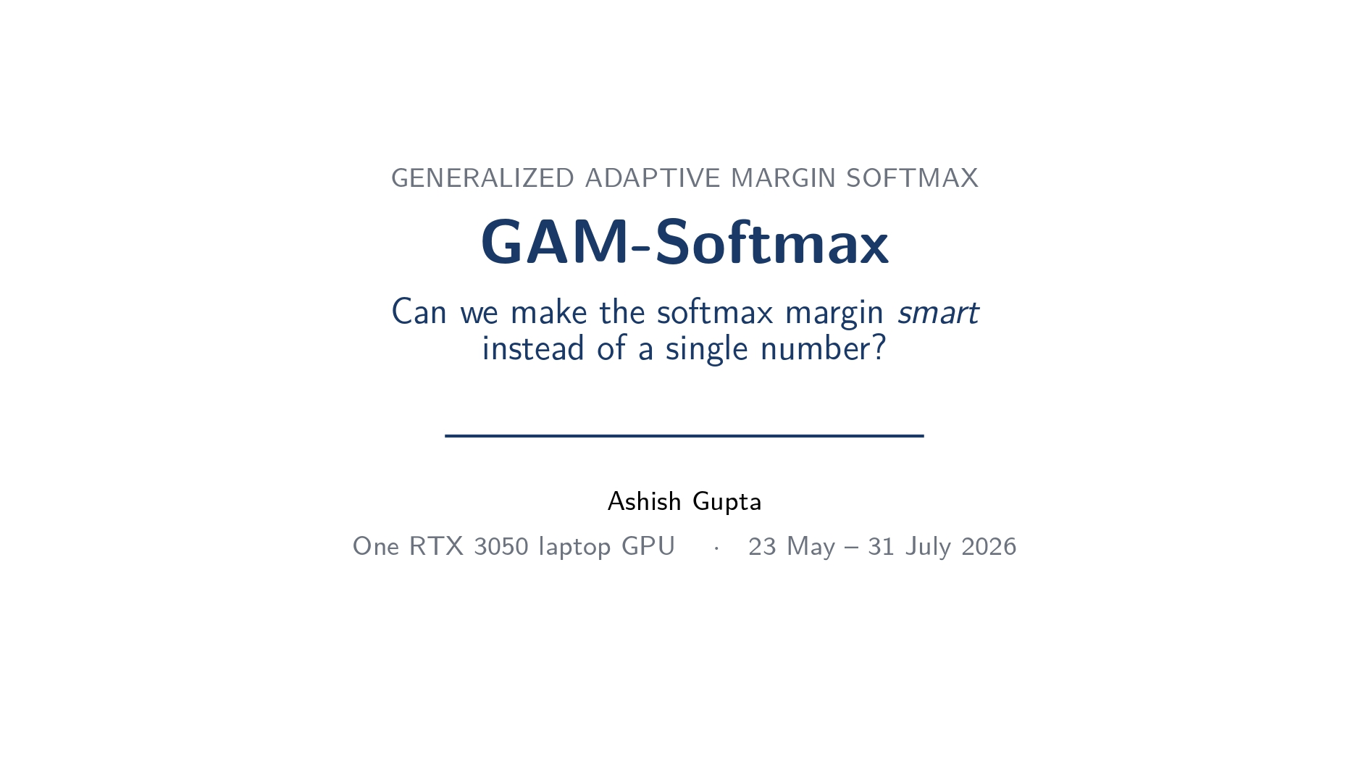

Slide 2
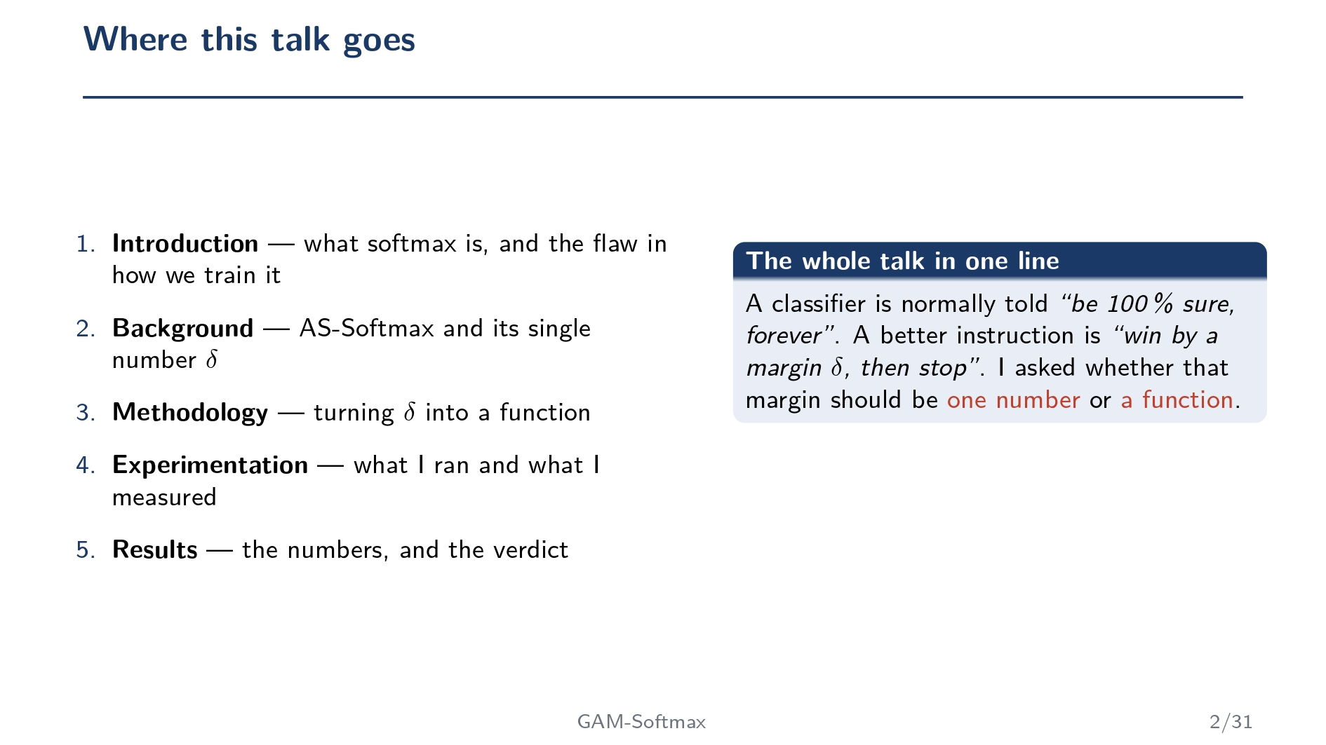

Slide 3
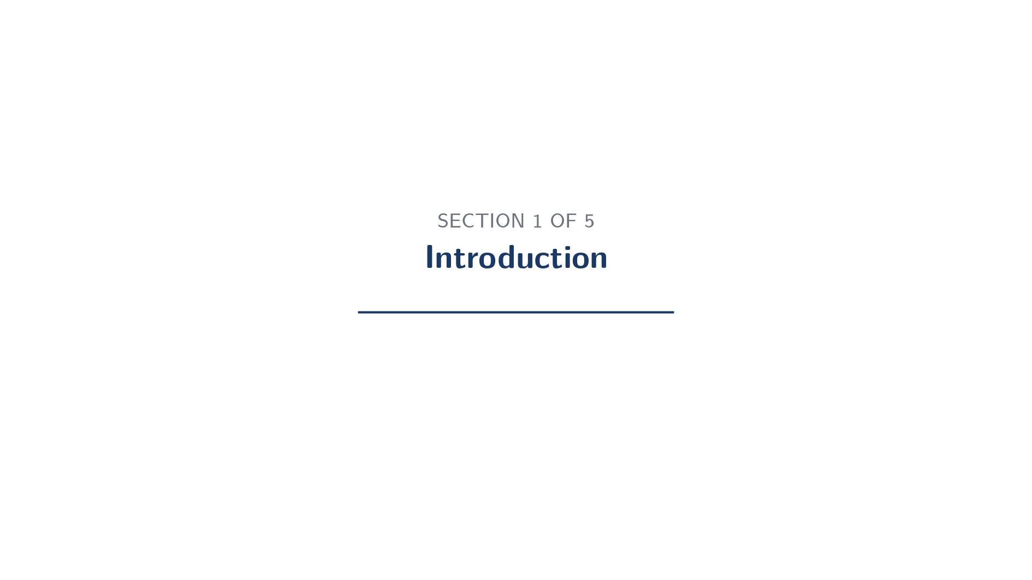

Slide 4
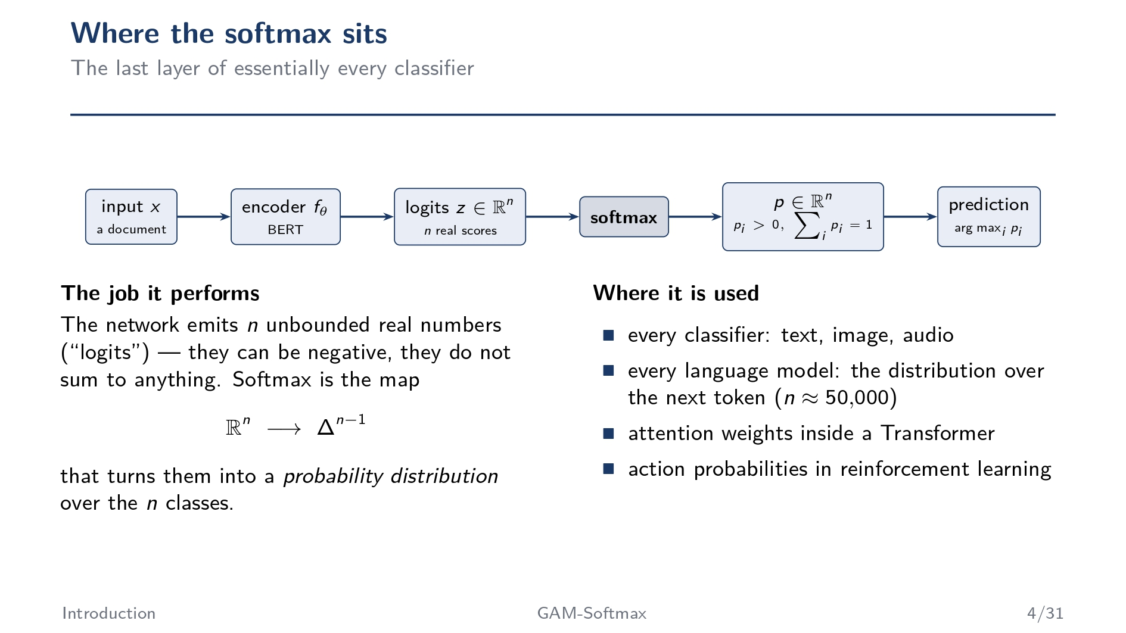

Slide 5
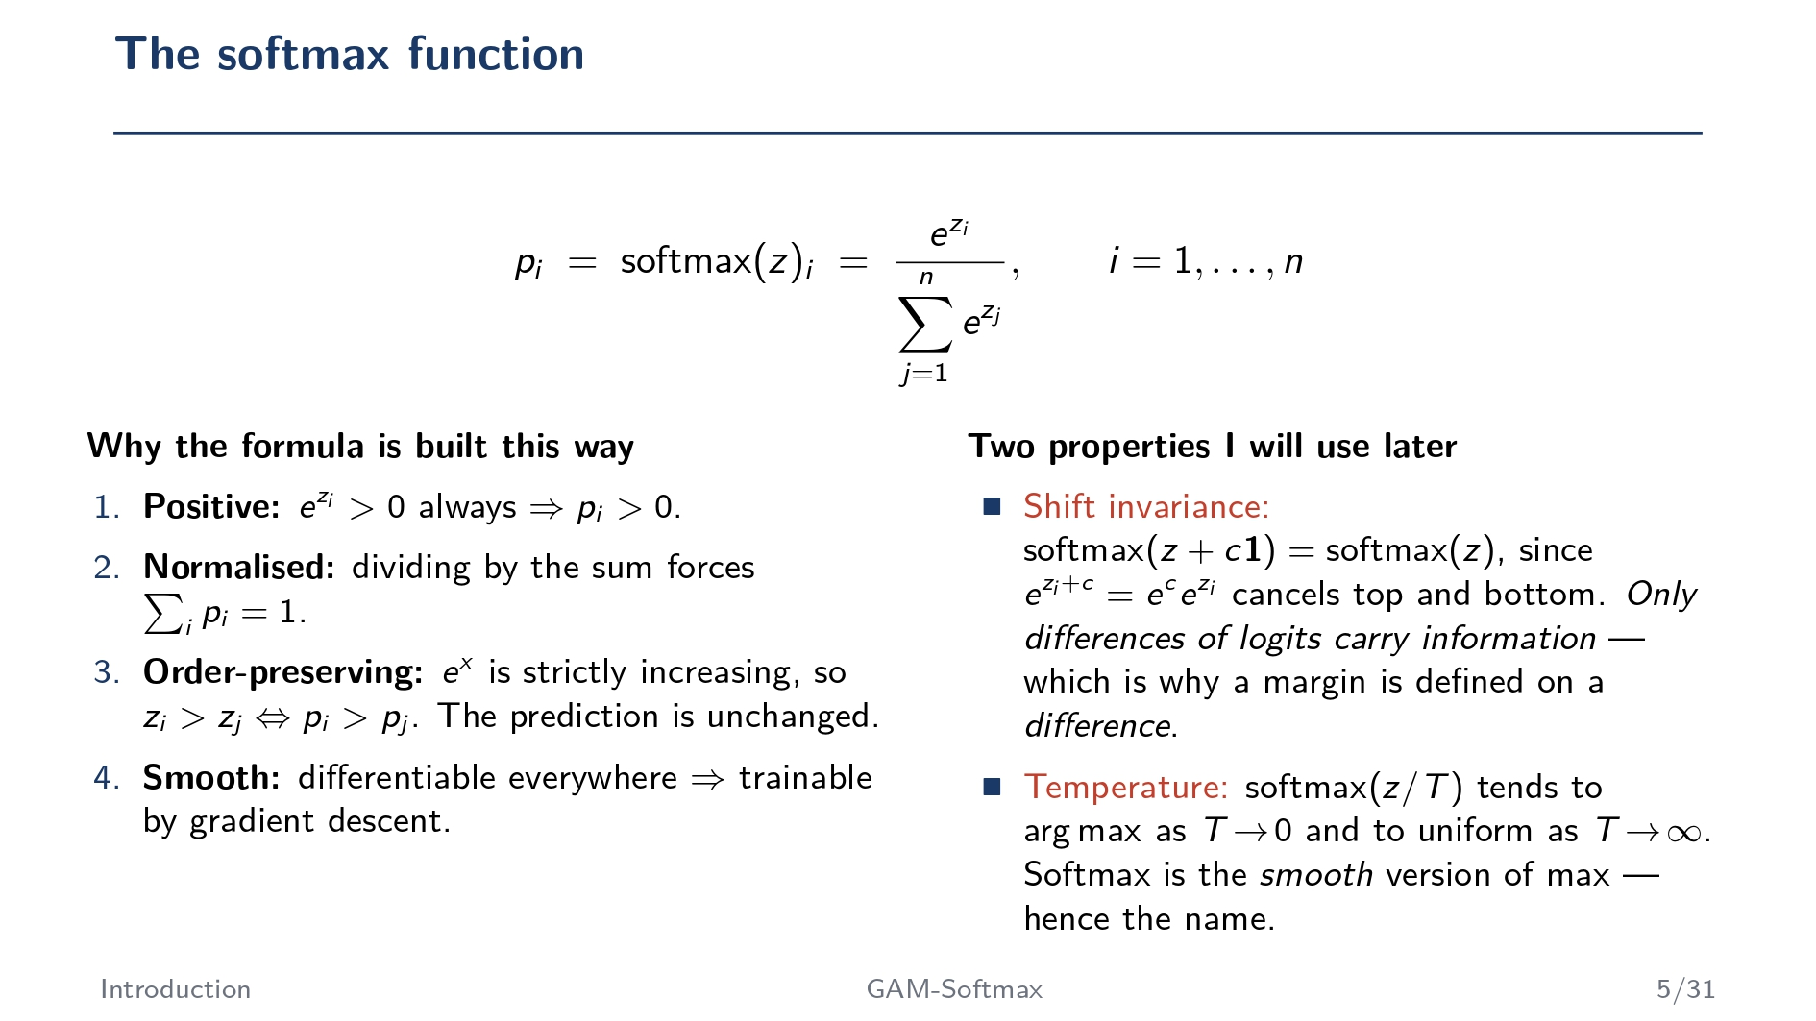

Slide 6
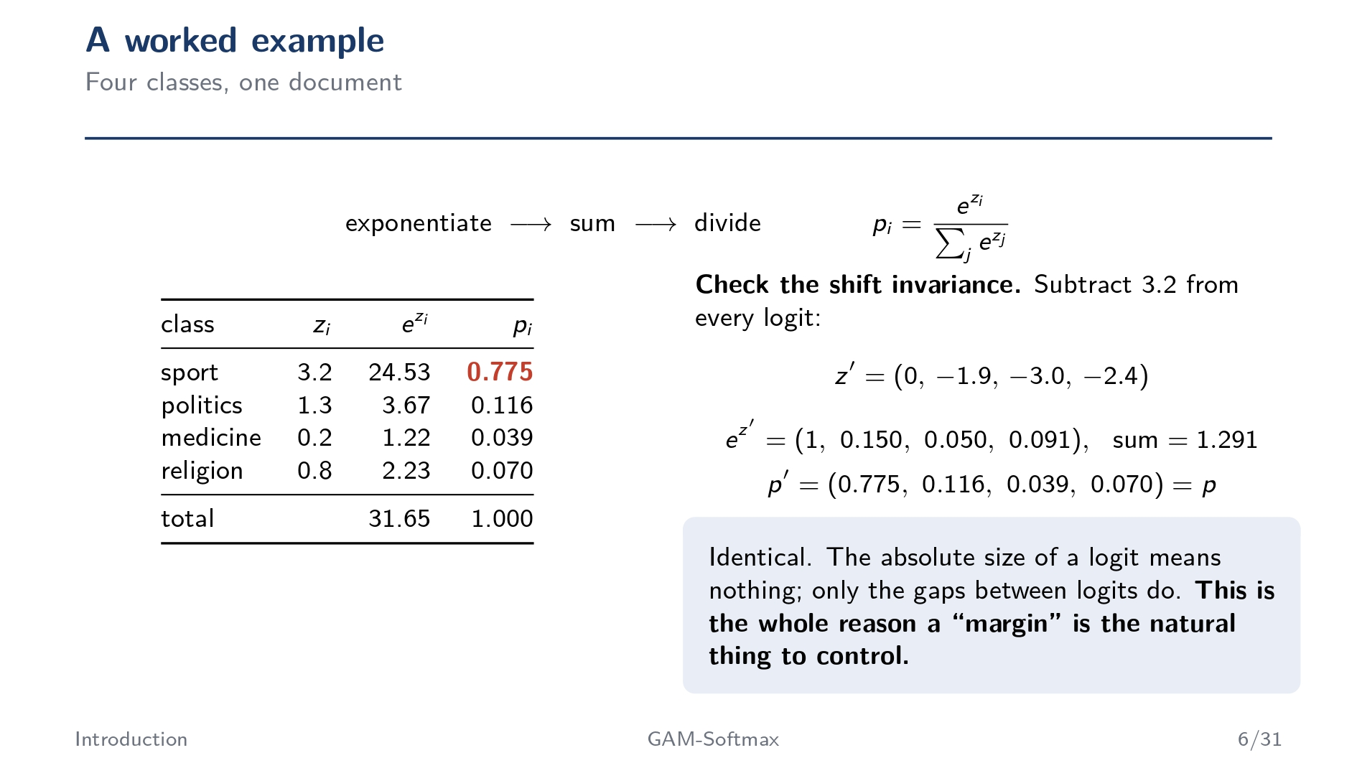

Slide 7
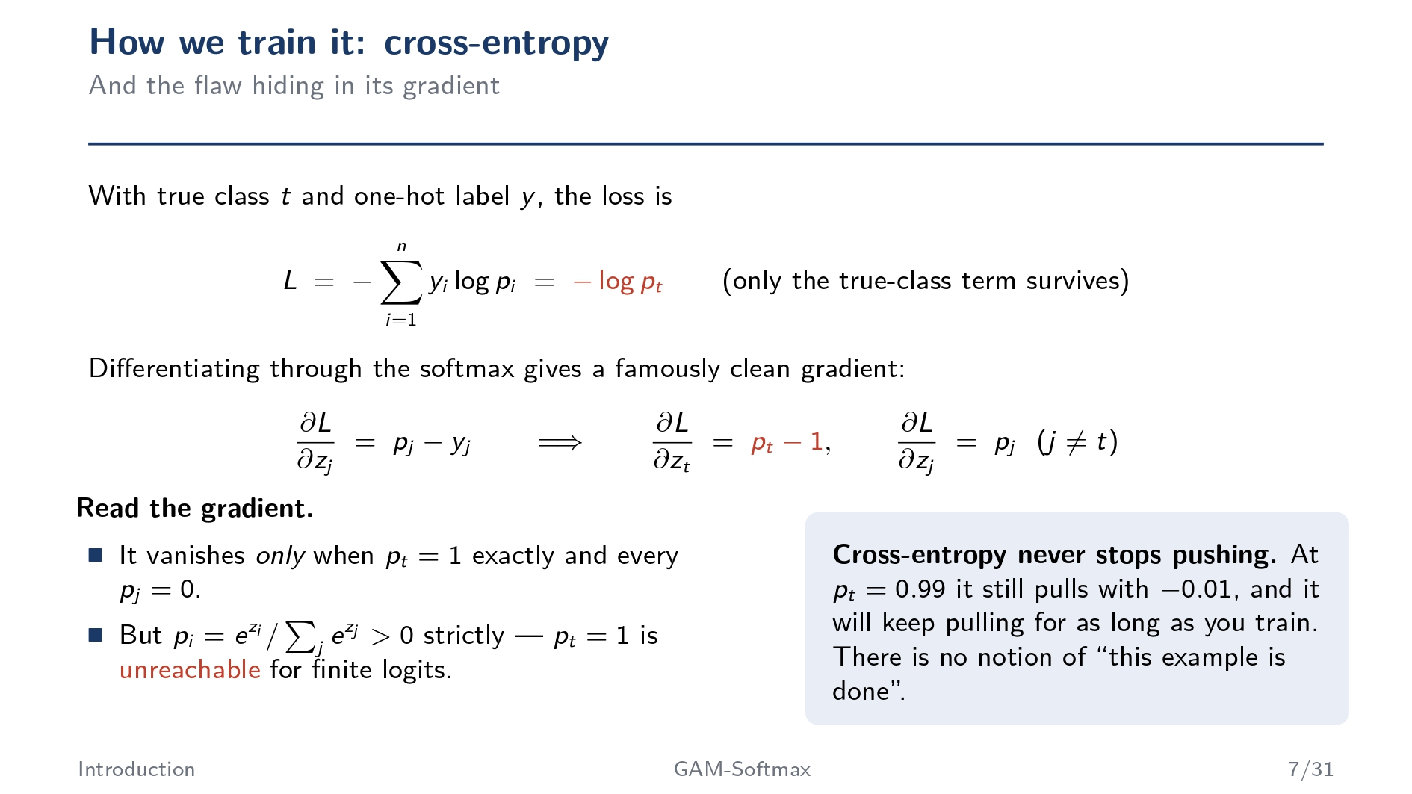
Cross-Entropy measures how far the model's prediction is from the correct answer. During training, it tries to increase the probability of the correct class and decrease the probabilities of all the incorrect classes.

Slide 8
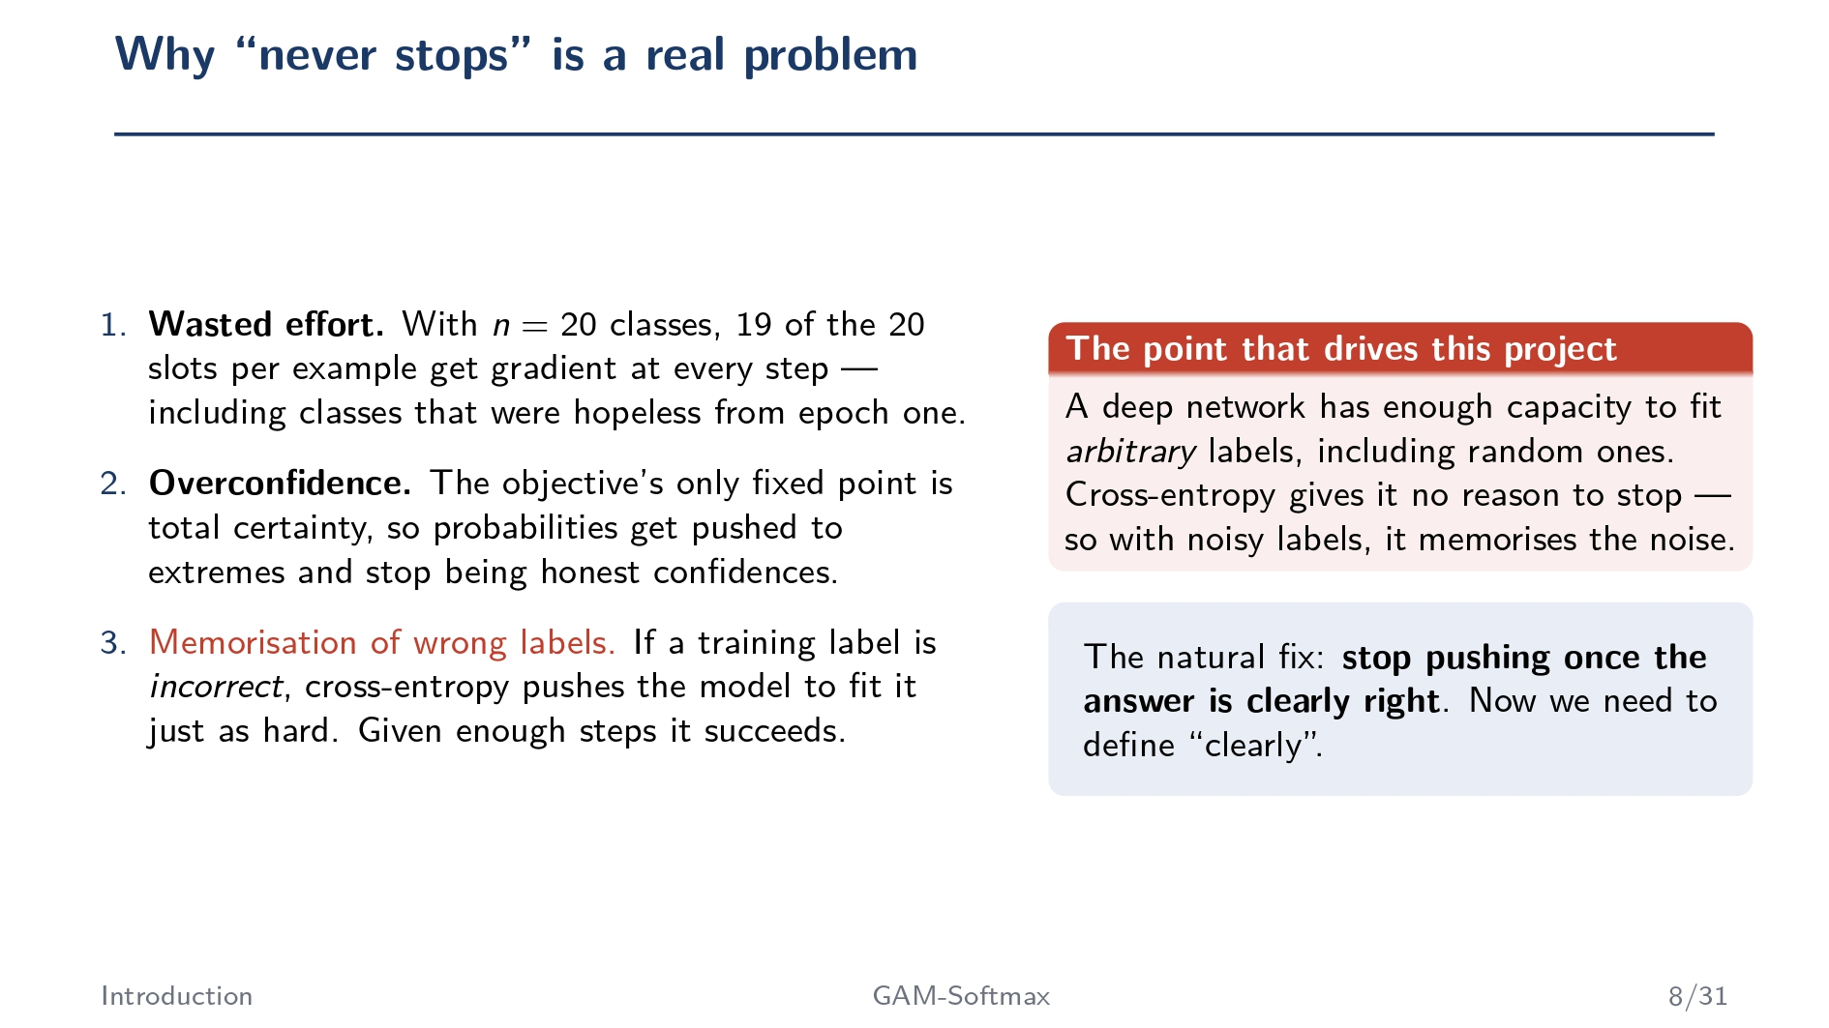

Slide 9


Slide 10
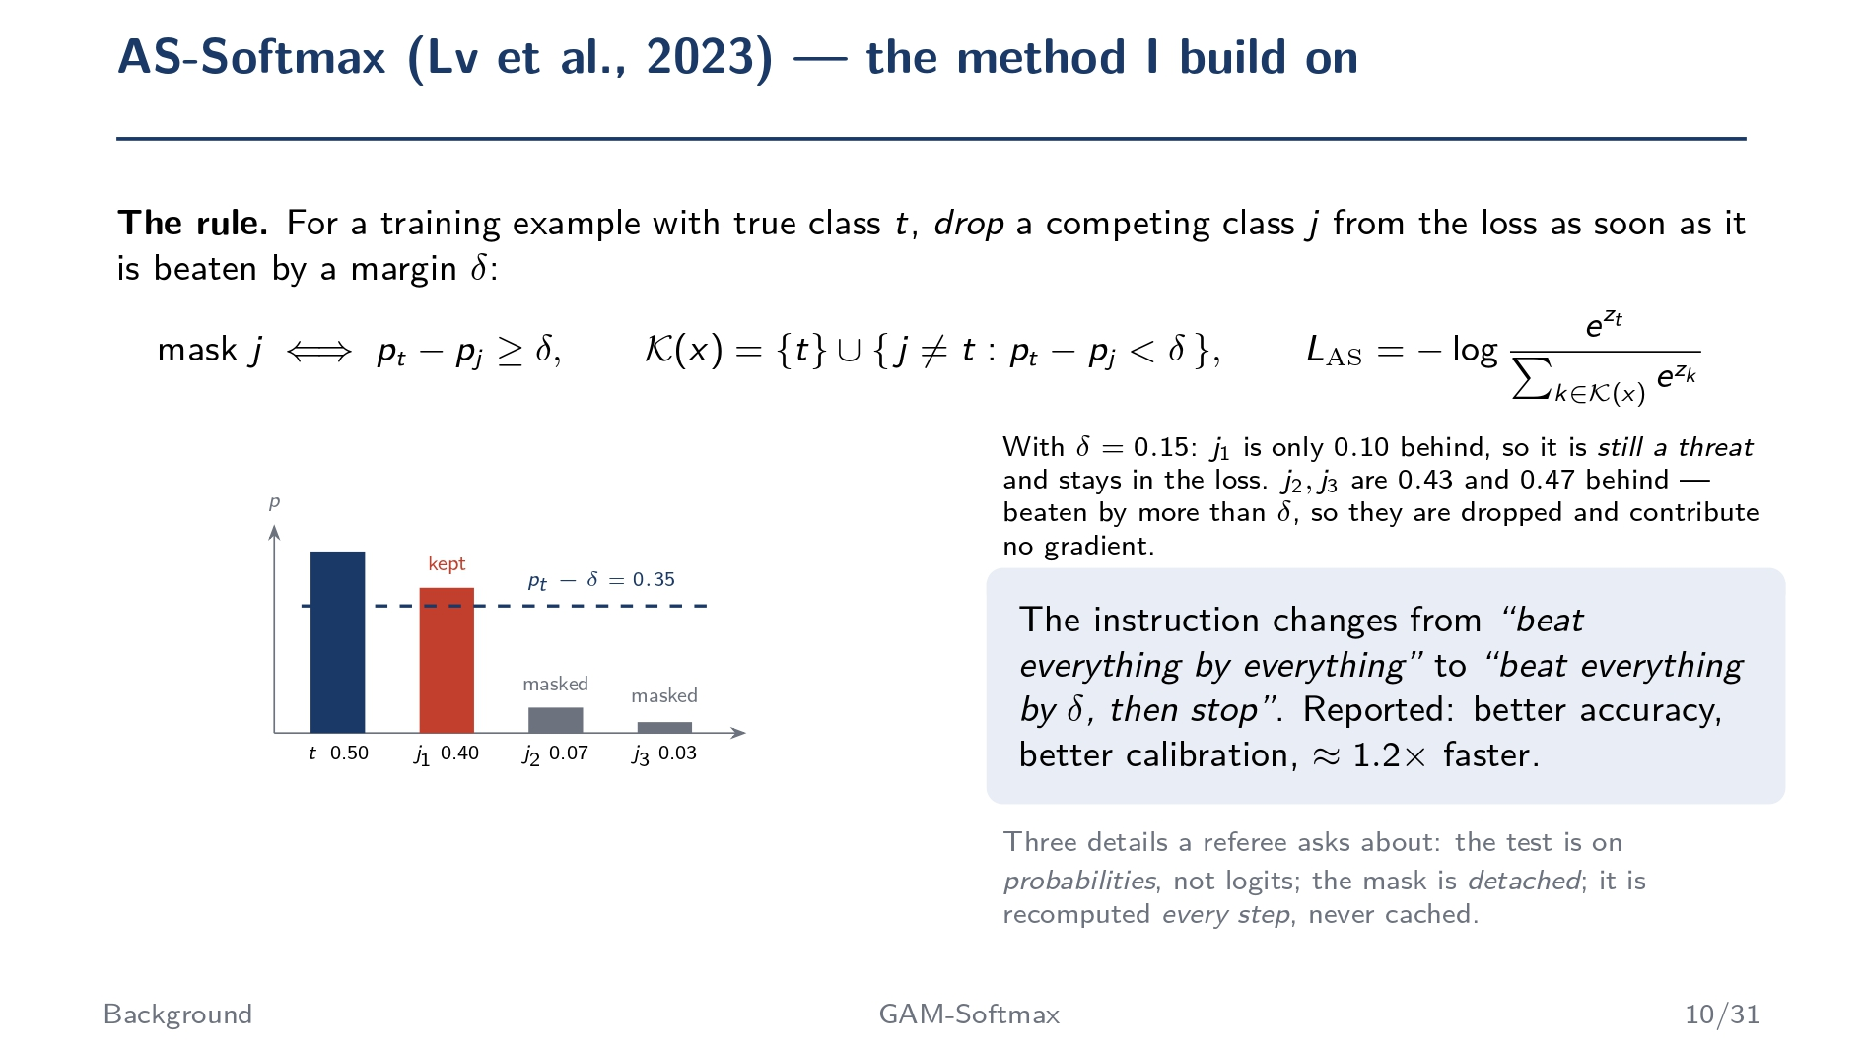

Slide 11
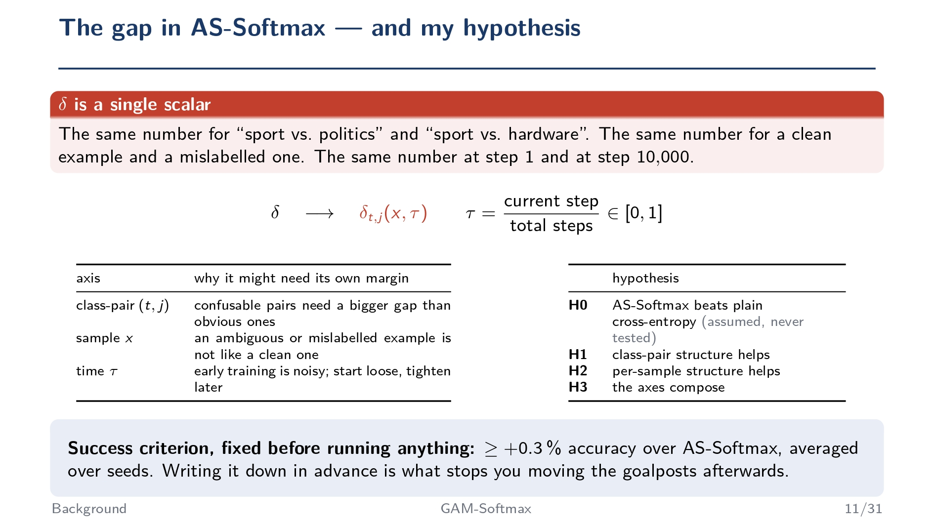

Slide 12
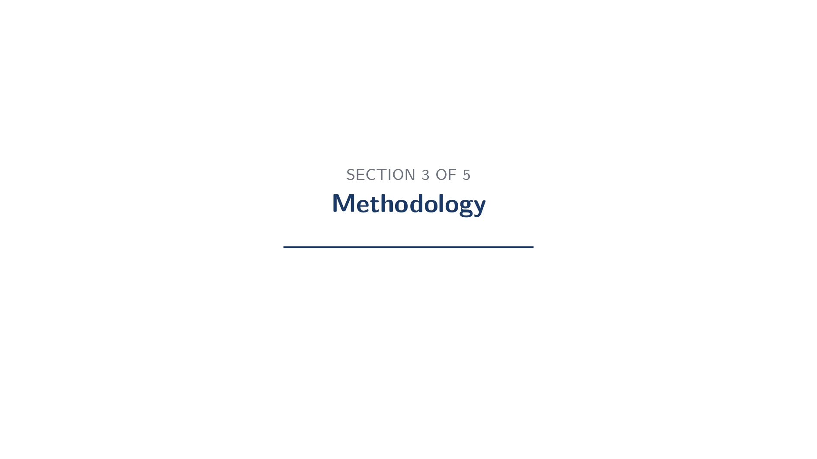

Slide 13
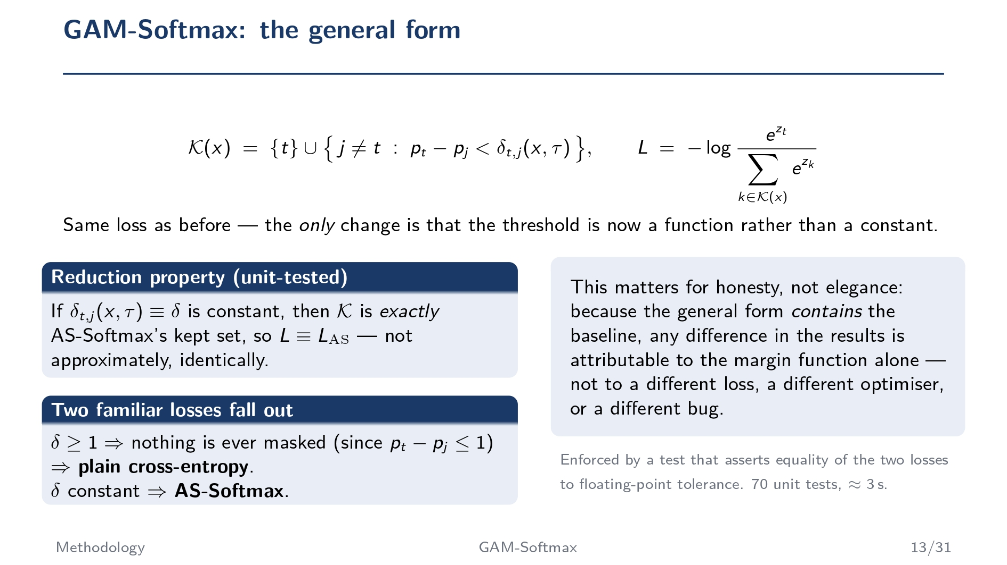

Slide 14
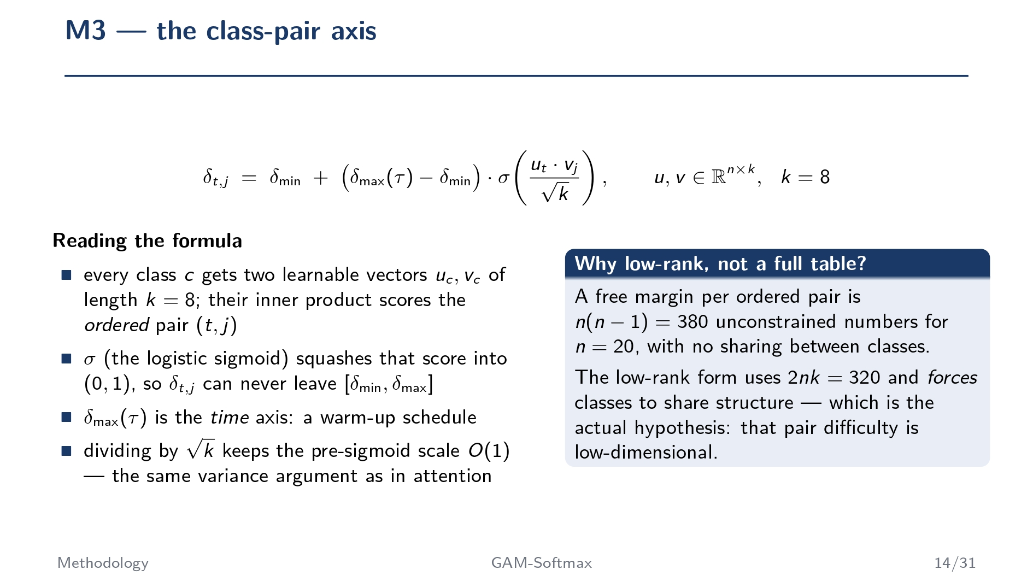
Instead of giving every pair of classes the same margin, let the model learn a different margin for each pair of classes.
Instead of using one fixed margin for every pair of classes, the model learns different margins automatically based on how confusing each pair of classes is. To do this efficiently, it represents every class with two learnable vectors rather than storing a separate margin for every class pair. This keeps the model compact while allowing it to adapt to different classification difficulties.

Slide 15
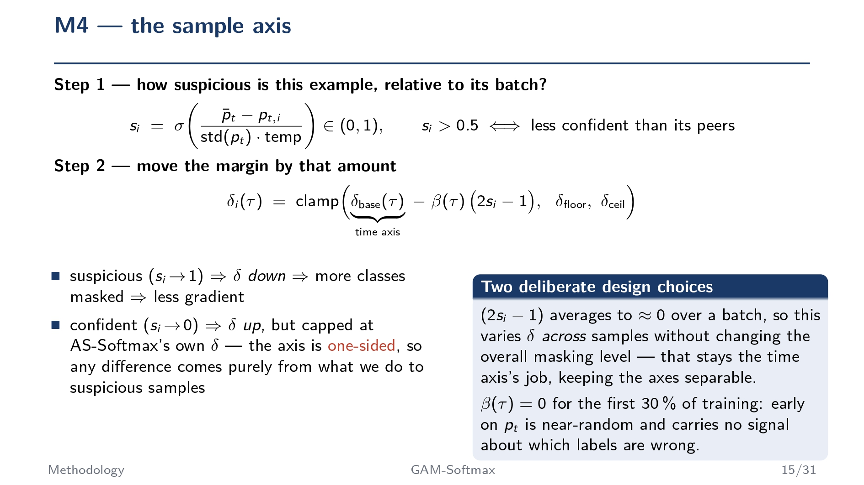
Not every training sample should be treated equally. Easy and reliable samples should be treated differently from difficult or suspicious ones.
(2si−1) averages to approximately zero over a batch. The formula is designed so that increasing the margin for some samples is balanced by decreasing it for others. On average, the overall amount of masking stays about the same.

Slide 16
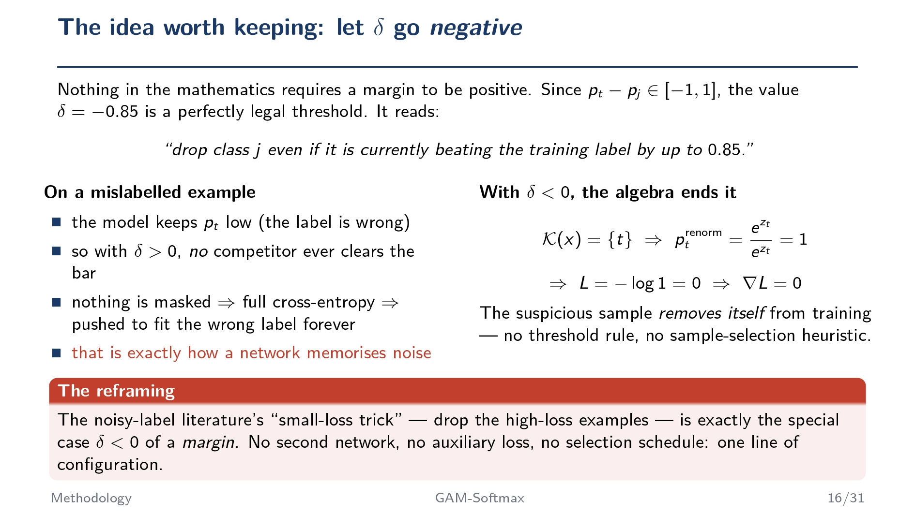

Slide 17
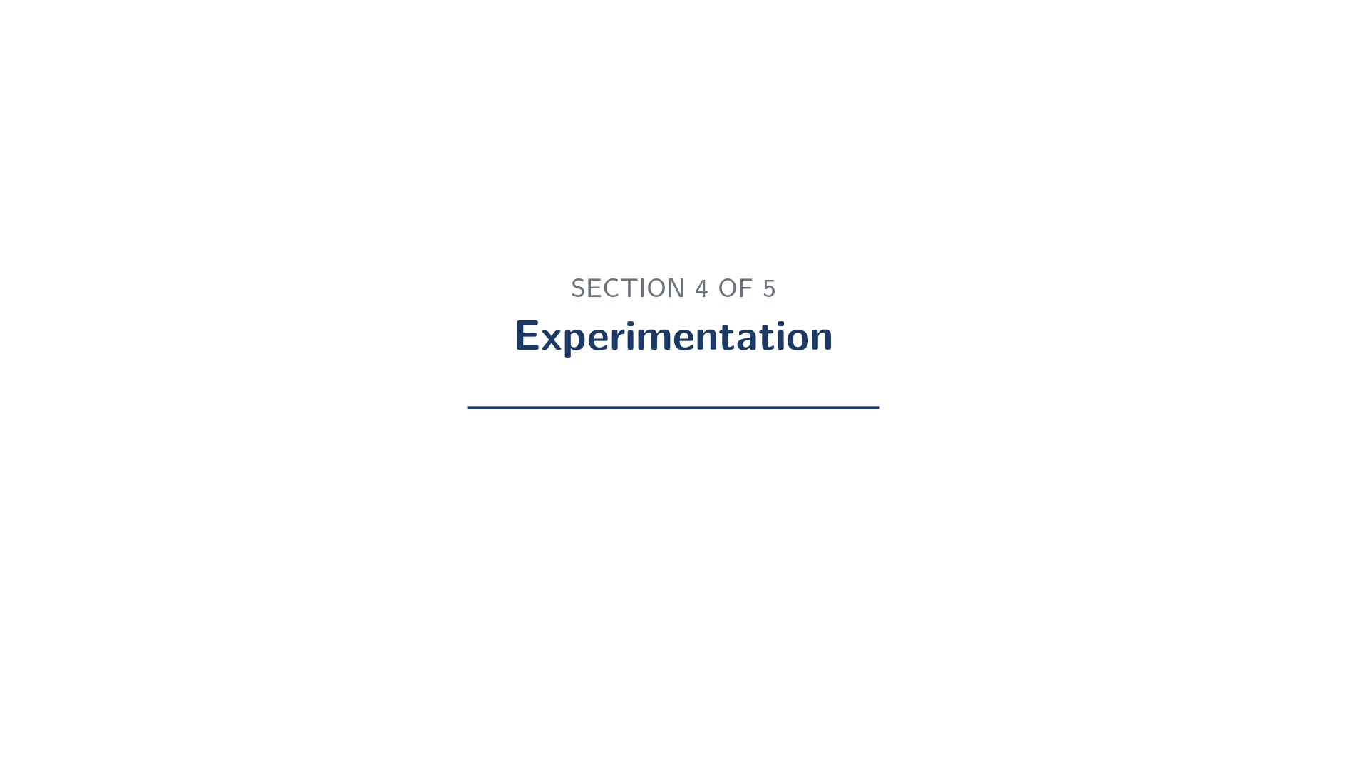

Slide 18
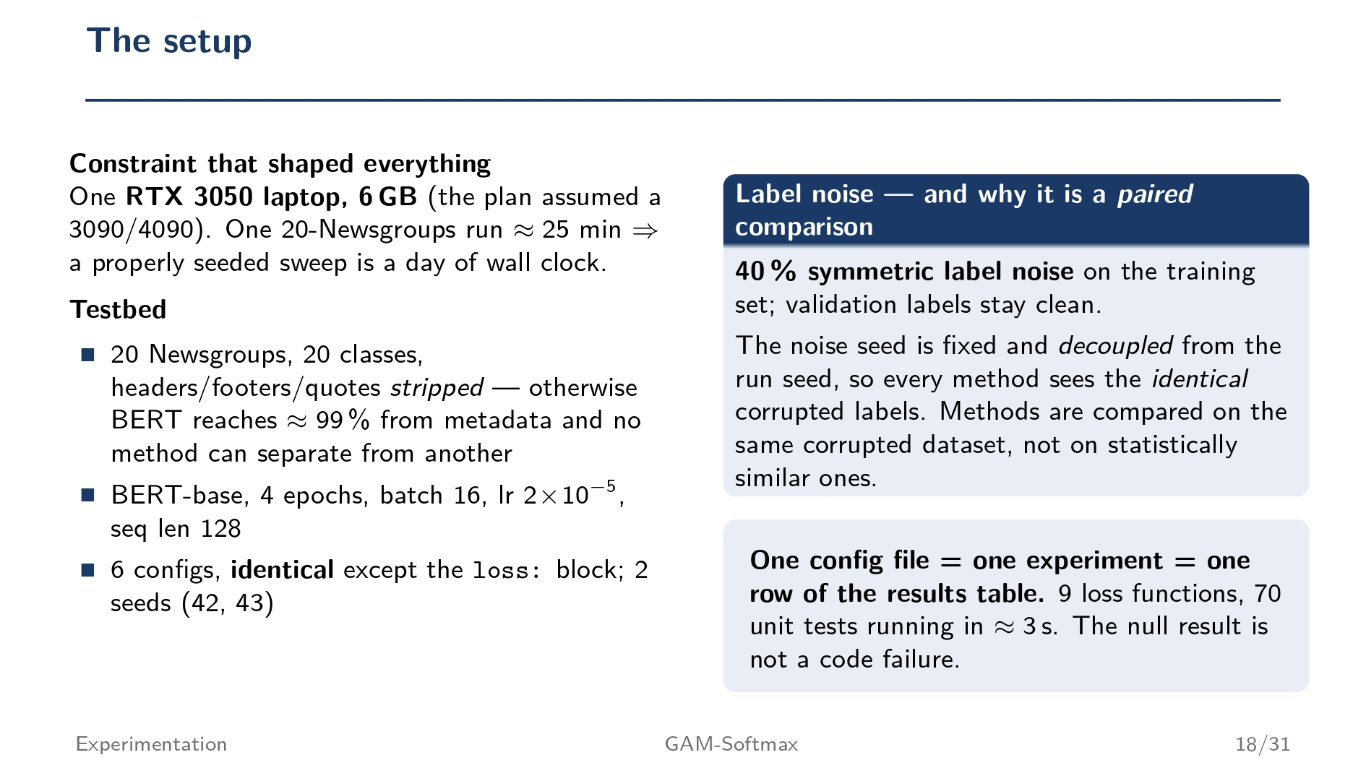

Slide 19
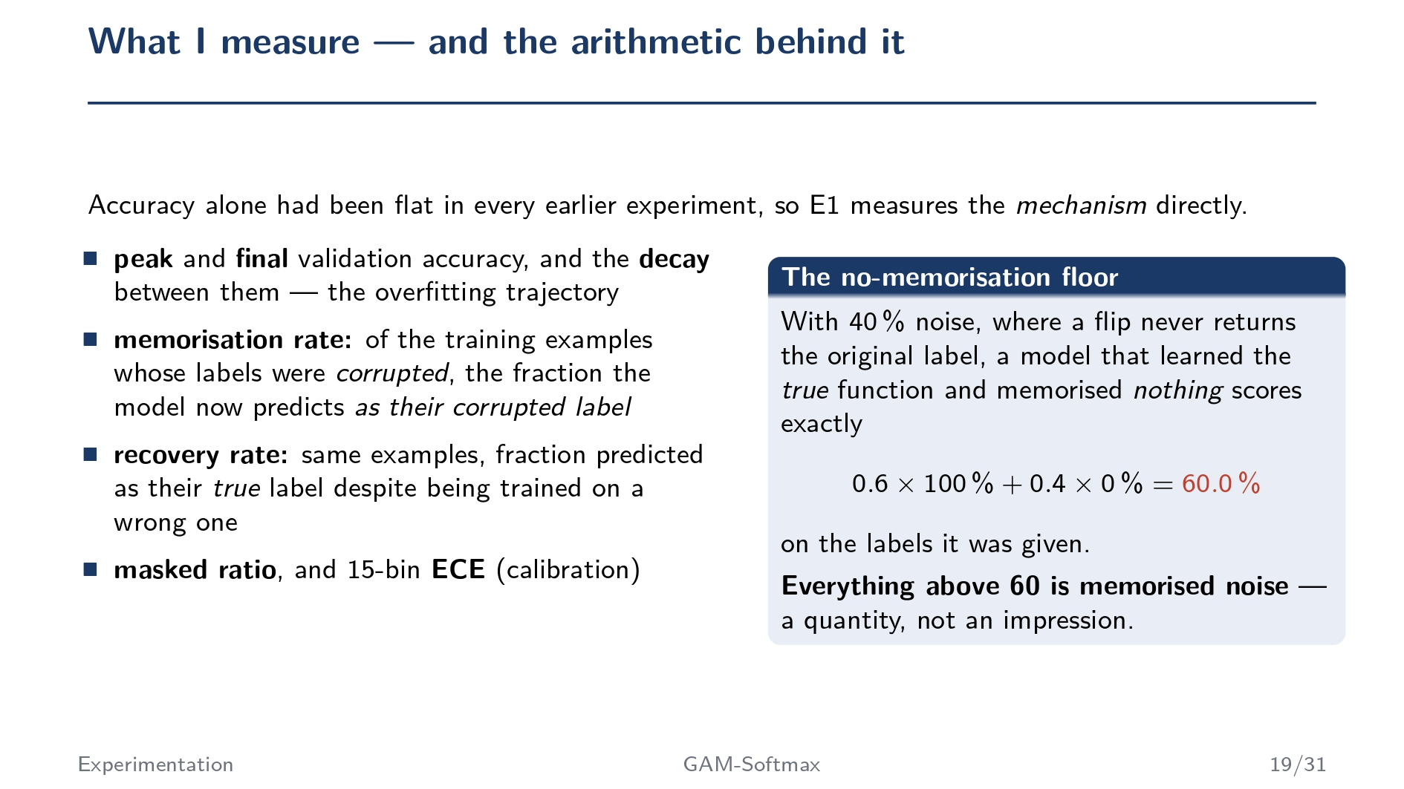

Slide 20
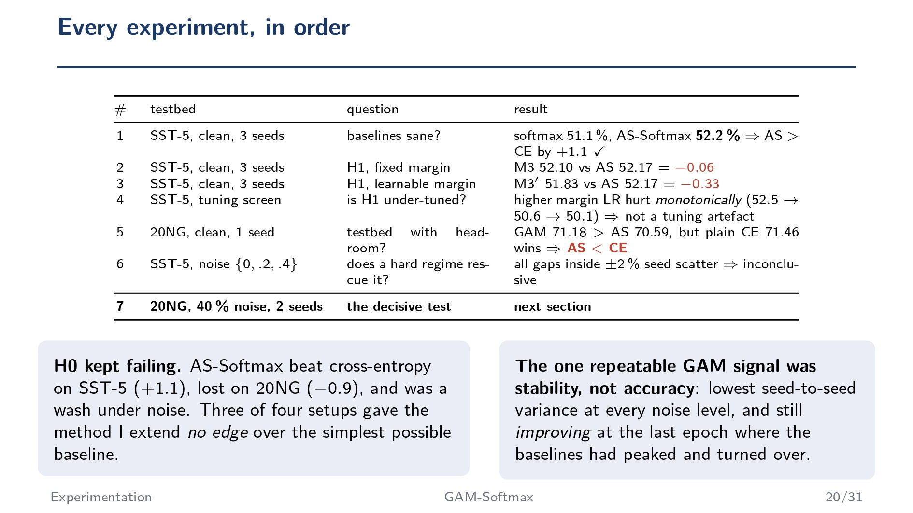

Slide 21
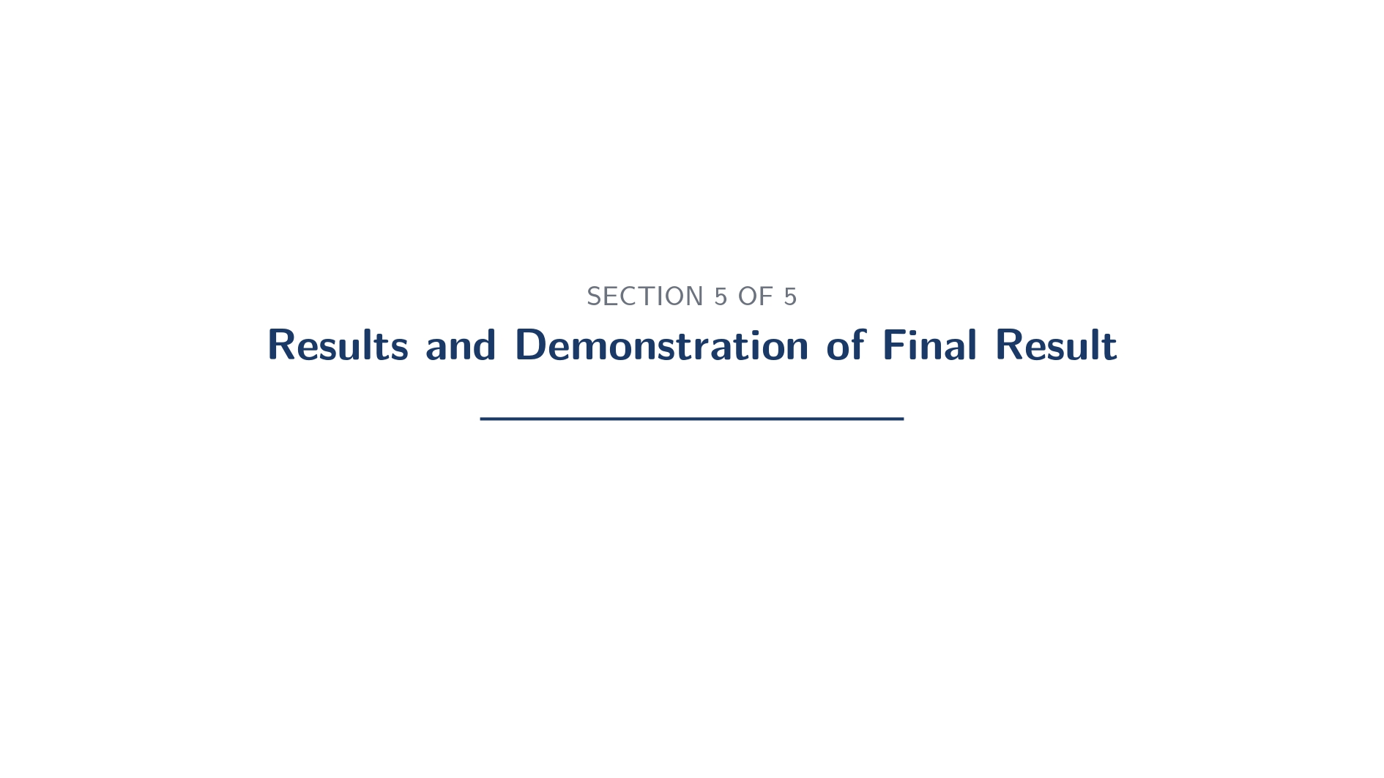

Slide 22
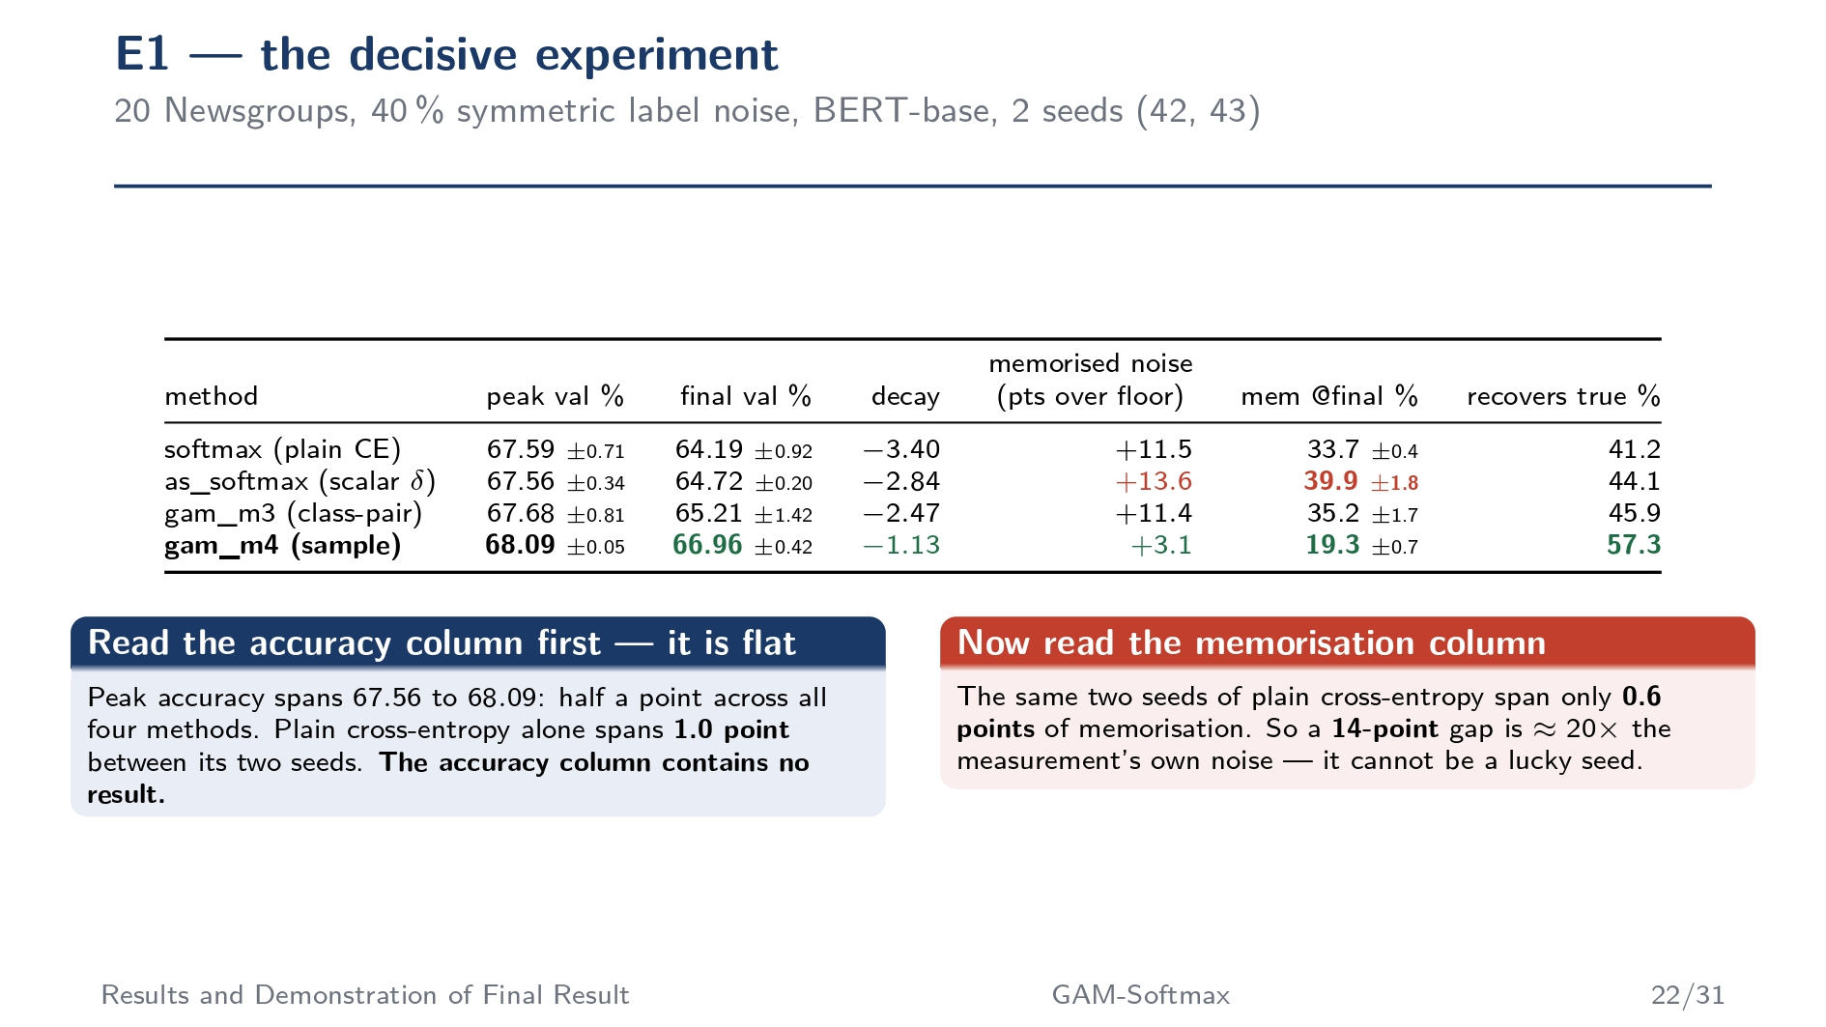

Slide 23
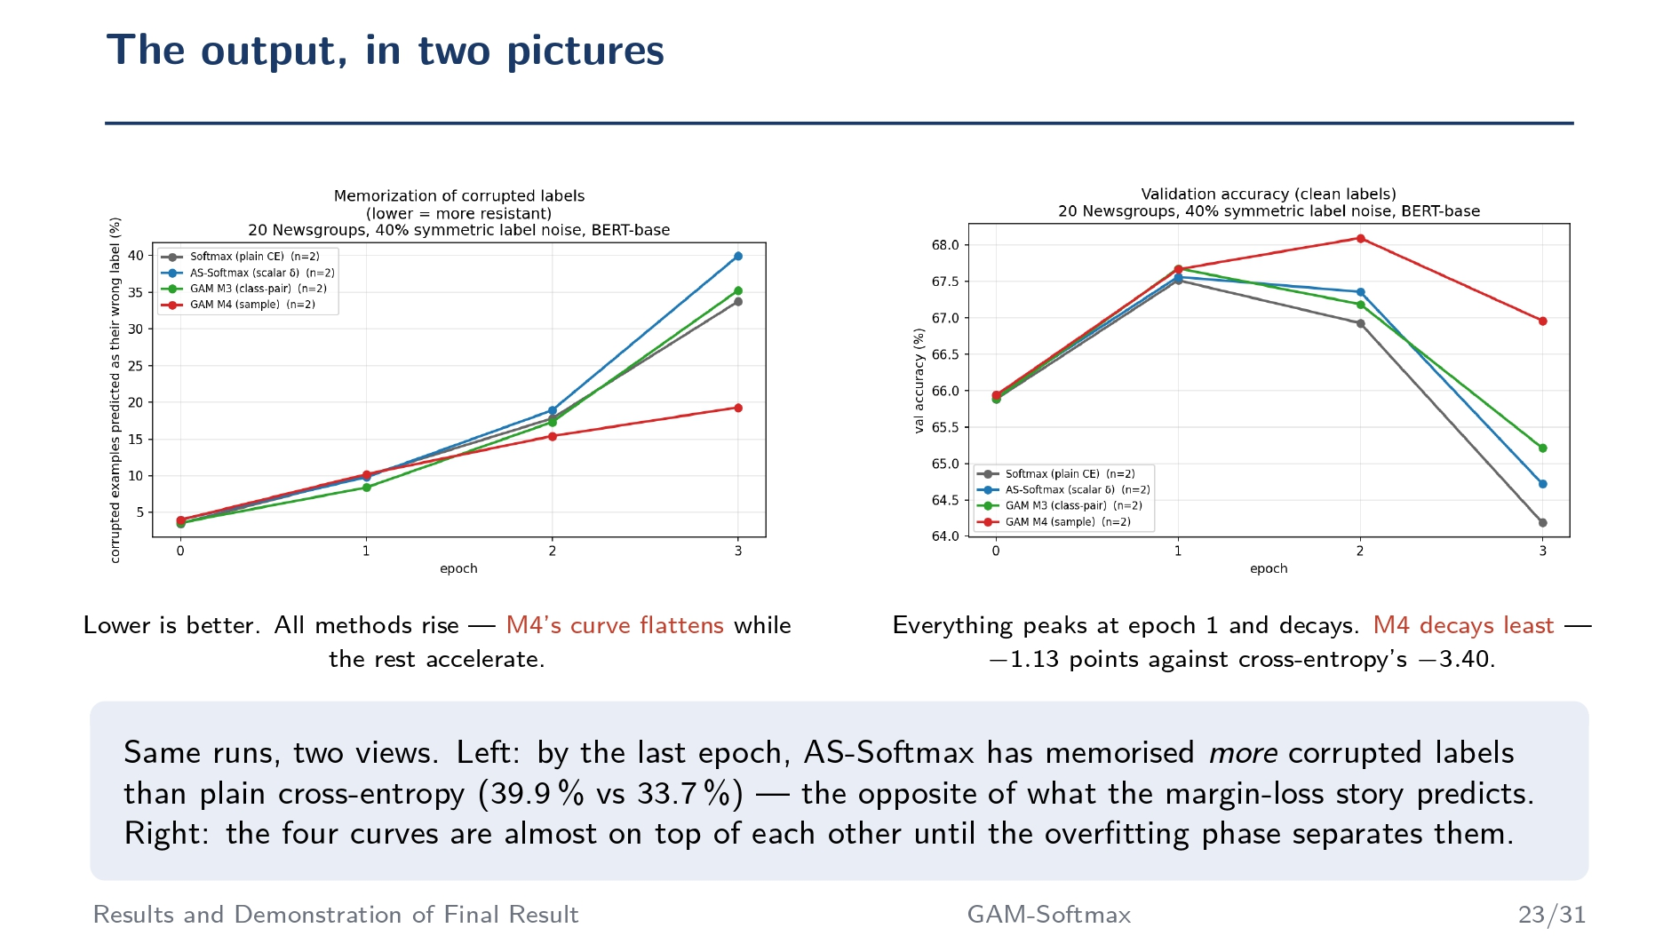

Slide 24
