Slide 1
Use Case Diagram

Slide 2
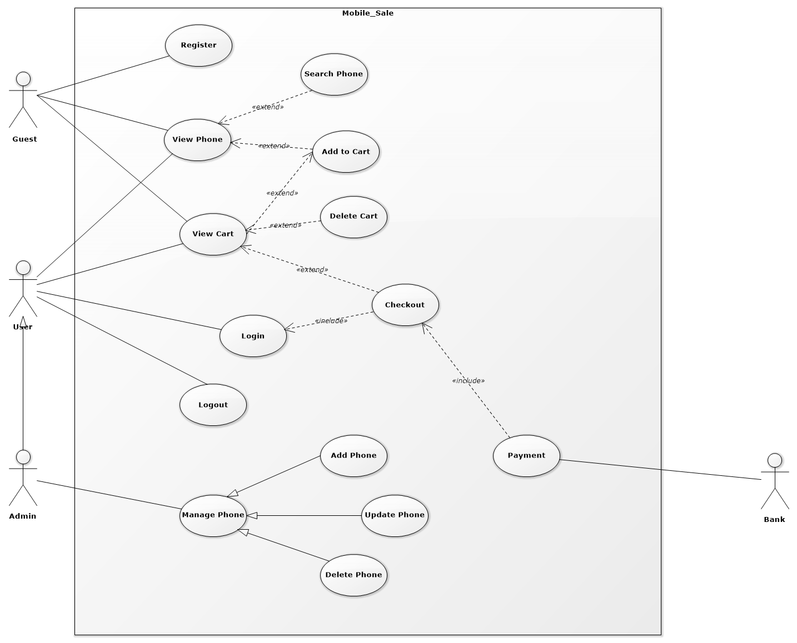
Use Case Diagram

Slide 3
Sequence Diagram

Slide 4
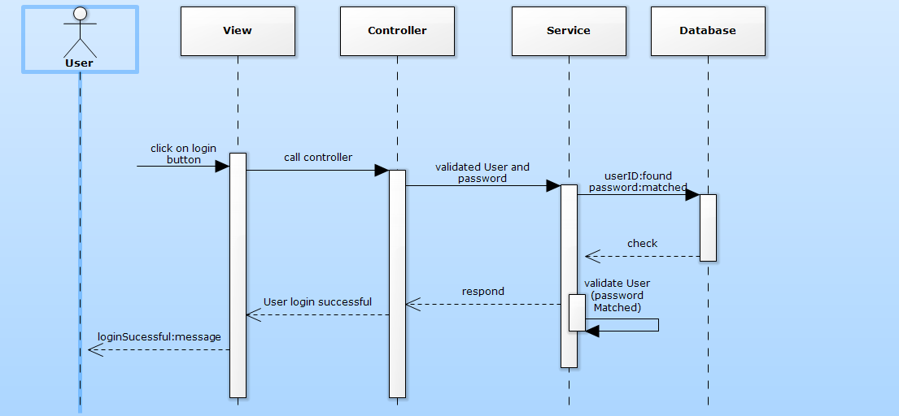
Login Function

Slide 5
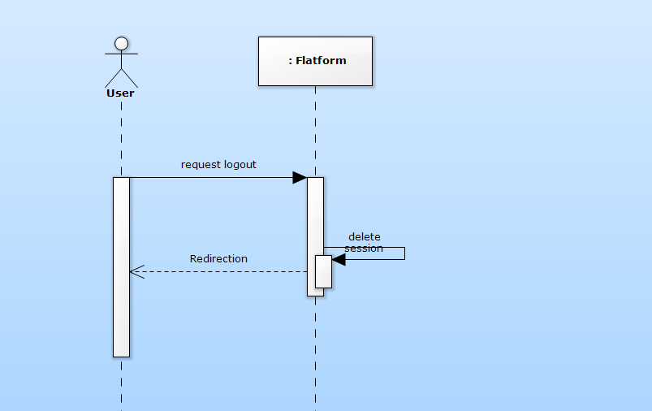
Logout Function

Slide 6
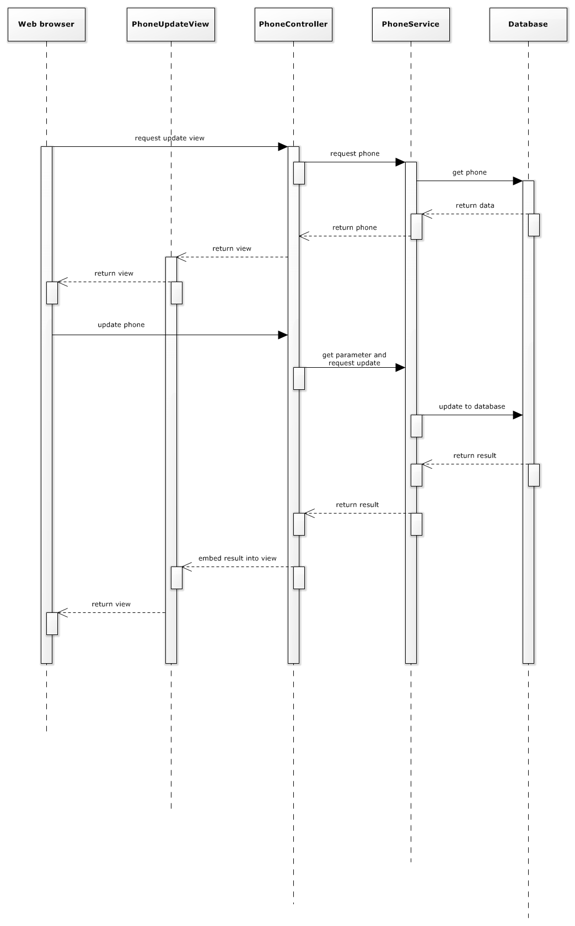
UpdatePhone Function

