Slide 1
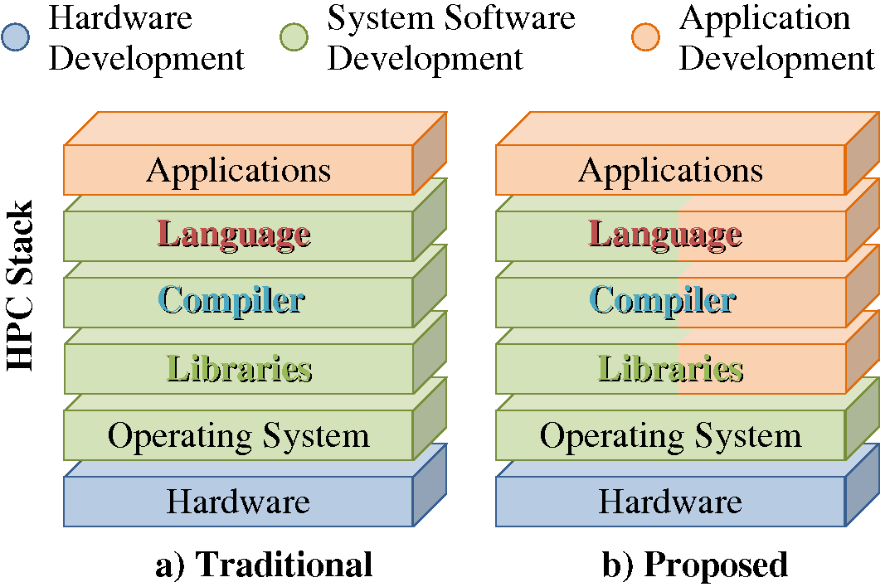
Different levels of users can reach into the HPC stack to solve there own problems directly for future architectures
Multiple levels of Users:
Programming model researchers: explore design space
Experienced application developers: build custom models targeting current and future machines
Application scientists can use compiler passes and runtimes systems developed by more experienced developers
Quick turn around of new ideas!
Classic
Future
The programming model framework vastly increases the flexibility in how the HPC stack can be used for application development.
HPC applications: scientific computing
Provide developers at different levels with the tools to solve there own problems
Building blocks: parallelism, locality, power efficiency, resilience

