Slide 1
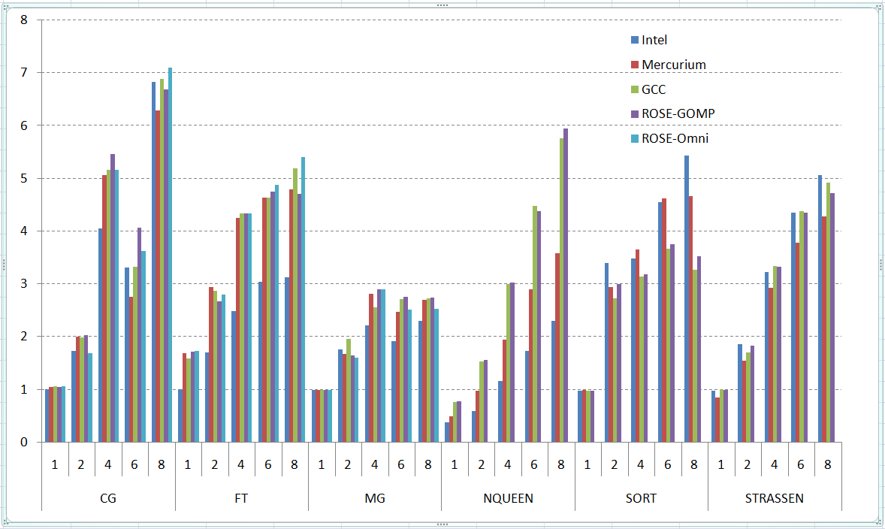
“ROSE framework: Developing Software for Exascale” – Daniel Quinlan et. al, LLNL
ASCR- Computer Science Highlight
Objectives
Impact
Communicate software characterization for exascale software/architecture co-design groups, by enabling instrumentation and generation of skeleton applications
Offer exascale research platform for compilers source-to-source transformations, and auto-tuning research of programming models, runtime systems, and applications
Automate multi-core use of MPI applications
Exascale Co-Design Transformations
Static and Dynamic Analysis of exascale code
Design of full exascale architectural model simulators
Optimization of MPI code for multicore
Auto-tuning of applications, programming models, and runtime systems
Accomplishments 2011
Automated parallelization for multi-core processors
More program analysis added to ROSE to support evaluation of applications for exascale architectures
Fortran support added to ROSE and demonstrated on large scale DOE Fortran 90 apps (LANL POP) as part of collaboration with Rice University
ROSE OpenMP compiler now supporting Fortran 90
Demonstrated superior performance for auto tuning of OpenMP runtime system (4.14x speedup)
Large number of publications
speedup
Notes:
Figure Explanation:
Platform: Dell Precision T5400, 3.16GHz quad-core Xeon X5460 dual processor, 8GB
Benchmarks: NAS parallel benchmark suite v 2.3, Barcelona OpenMP task suite v 1.0
Compilers: ROSE, Omni 1.6, GCC 4.4.1, Mercurium 1.3.3 compiler with Nanos 4.1.4 runtime. Intel compiler 11.1.059
1

