Slide 1
Status of ROSE Project Work
Dan Quinlan
Chunhua Liao, Peter Pirkelbauer
Combustion Exascale CoDesign Center All Hands
March 1, 2012

Slide 2
Overview of ROSE Status
Compiler Optimization for Many-Core NUMA architectures
Runtime system to support many-core (target 1K cores)
Focus on Stencils
Compiler Resiliency Analysis and Transformations
Transformations to detection of transient faults
Transformations for corrections of faults
Analysis to define where to add SW fault detection
Compiler UQ transformations
Automated generation of skeleton applications
Autotuning
Compiler Work
Connection to Clang
Rewrite system (connection to Stratego)
OpenCL support via Clang
C11 and C++11 work in progress
Better support for C++ template declarations
New Data-Flow framework in place

Slide 3
Overview of ROSE Status
Compiler Optimization for Many-Core NUMA architectures
Runtime system to support many-core (target 1K cores)
Focus on Stencils
Compiler Resiliency Analysis and Transformations
Transformations to detection of transient faults
Transformations for corrections of faults
Analysis to define where to add SW fault detection
Compiler UQ transformations
Automated generation of skeleton applications
Autotuning
Compiler Work
Connection to Clang
Rewrite system (connection to Stratego)
OpenCL support via Clang
C11 and C++11 work in progress
Better support for C++ template declarations
New Data-Flow framework in place

Slide 4
Single core data layout will be crucial to memory performance
Independent of distributed memory data partitioning
Beyond scope of Control Parallelism (OpenMP, Pthreads, etc.)
How we layout data effects performance of how it is used
New Languages and Programming Models have the opportunity to encapsulate the data layout; but data layout can be addressed directly
General purpose languages provide the mechanisms to tightly bind the the implementation to the data layout (providing low level control over issues required to get good performance)
Applications are commonly expressed at a low level which binds the implementation and the data layout (and are encouraged to do so to get good performance)
Compilers can’t unravel code enough to make the automated global optimizations to data layout that are required

Slide 5
Exascale architectures will include intensive memory usage and less memory coordination
A million processors (not relevant for this many-core runtime system)
A thousand cores per processor
1 Tera-FLOP per processor
0.1 bytes per FLOP
Memory bandwidth 4TB/sec to 1TB/sec
We assume NUMA
Assume no cross-chip cache coherency
Or it will be expensive (performance and power)
So assume we don’t want to use it…
Can DOE applications operate with these constraints?

Slide 6
We distribution each array into many pieces for many cores…
Assume a 1-to-1 mapping of pieces of the array to cores
Could be many to one to support latency hiding…
Zero false sharing → no cache coherency requirements
Core 0
array section
Core 1
array section
Single Array
Abstraction
Core 2
array section
Core 3
array section
Mapping of logical array positions to
physical array positions distributed over cores

Slide 7
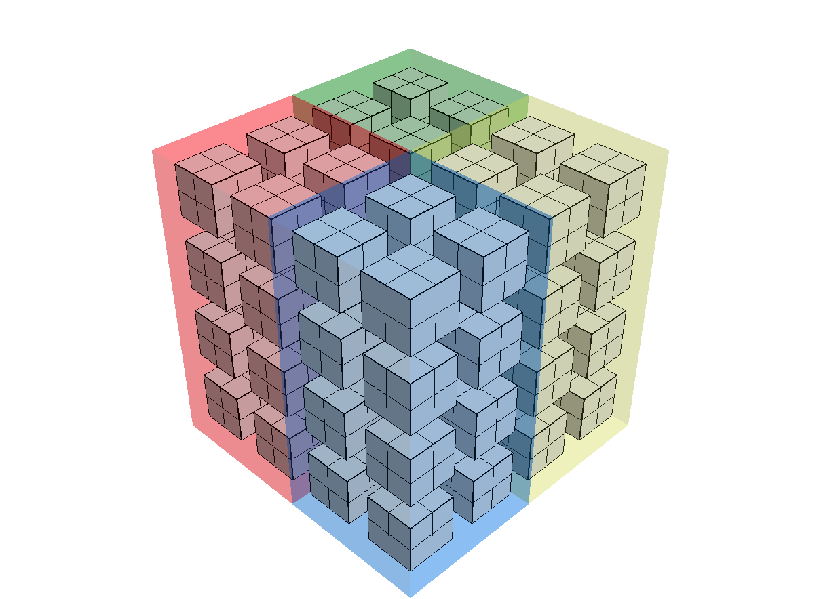
Many scientific data operations are applied to block-structured geometries
Supports Multi-dimensional array data
Cores can be configured into logical hypercube topologies
Currently multi-dimensional periodic arrays of cores (core arrays)
Operations on data on cores can be tiled for better cache performance
Constructor takes multidimensional array size and target multi-dimensional core array size
Supports table based and algorithm based distributions
Multi-dimensional Data
Simple 3D Core Array
(core arrays on 1K cores could be 10^3)

Slide 8
A high level interface for block-structured operations enhances performance and debugging across cores
This is a high level interface that permits debugging
Indexing provides abstraction for the complexity of data that is distributed over many cores
template <typename T>
void
relax2D_highlevel( MulticoreArray<T> & array, MulticoreArray<T> & old_array )
{
// This is a working example of a 3D stencil demonstrating a high level interface
// suitable only as debugging support.
#pragma omp parallel for
for (int k = 1; k < array.get_arraySize(2)-1; k++)
{
#pragma omp for
for (int j = 1; j < array.get_arraySize(1)-1; j++)
{
for (int i = 1; i < array.get_arraySize(0)-1; i++)
{
array(i,j,k) = ( old_array(i-1,j,k) + old_array(i+1,j,k) + old_array(i,j-1,k) +
old_array(i,j+1,k) + old_array(i,j,k+1) + old_array(i,j,k-1) ) / 6.0;
}
}
}
}
Indexing hides distribution
of data over many cores

Slide 9
Low level code for stencil on data distributed over many cores (to be compiler generated high performance code)
template <typename T>
void
relax2D( MulticoreArray<T> & array, MulticoreArray<T> & old_array )
{
// This is a working example of the relaxation associated with the a stencil on the array abstraction
// mapped to the separate multi-dimensional memorys allocated per core and onto a multi-dimenional
// array of cores (core array).
int numberOfCores = array.get_numberOfCores();
// Macro to support linearization of multi-dimensional 2D array index
computation
#define local_index2D(i,j) (((j)*sizeX)+(i))
// Use OpenMP to support the threading...
#pragma omp parallel for
for (int core = 0; core < numberOfCores; core++)
{
// This lifts out loop invariant portions of the code.
T* arraySection = array.get_arraySectionPointers()[core];
T* old_arraySection = old_array.get_arraySectionPointers()[core];
// Lift out loop invariant local array size values.
int sizeX = array.get_coreArray()[core]->coreArrayNeighborhoodSizes_2D[1][1][0];
int sizeY = array.get_coreArray()[core]->coreArrayNeighborhoodSizes_2D[1][1][1];
for (int j = 1; j < sizeY-1; j++)
{
for (int i = 1; i < sizeX-1; i++)
{
// This is the dominant computation for each array section per core. The compiler will use the
// user's code to derive the code that will be put here.
arraySection[local_index2D(i,j)] =
(old_arraySection[local_index2D(i-1,j)] + old_arraySection[local_index2D(i+1,j)] +
old_arraySection[local_index2D(i,j-1)] + old_arraySection[local_index2D(i,j+1)]) / 4.0;
}
}
// We could alternatively generate the call for relaxation for the internal boundaries in the same loop.
array.get_coreArray()[core]->relax_on_boundary(core,array,old_array);
}
// undefine the local 2D index support macro
#undef local_index2D
}
OpenMP used to provide control parallelism
Loop over all cores (linearized array)
Stencil (or any other local code)
generated from user applications

Slide 10
Overview of ROSE Status
Compiler Optimization for Many-Core NUMA architectures
Runtime system to support many-core (target 1K cores)
Focus on Stencils
Compiler Resiliency Analysis and Transformations
Transformations to detection of transient faults
Transformations for corrections of faults
Analysis to define where to add SW fault detection
Compiler UQ transformations
Automated generation of skeleton applications
Autotuning
Compiler Work
Connection to Clang
Rewrite system (connection to Stratego)
OpenCL support via Clang
C11 and C++11 work in progress
Better support for C++ template declarations
New Data-Flow framework in place

Slide 11
Source-to-source Compiler Resiliency Transformations for Processor Soft Errors
Original Source Code
Generated Source Code
void relax ()
{
#pragma resiliency elemental
for (int i = 1; i < arraySize-1; i++)
array[i] = (array[i-1] + array[i+1]) / 2.0;
}
void relax_tmr_elemental ()
{
for (int i = 1; i < arraySize-1; i++)
{
register float var1a = array[i];
register float var2a = array[i-1];
register float var3a = array[i+1];
register float var1b = array[i];
register float var2b = array[i-1];
register float var3b = array[i+1];
register float var1c = array[i];
register float var2c = array[i-1];
register float var3c = array[i+1];
var1a = (var2a + var3a) / 2.0;
var1b = (var2b + var3b) / 2.0;
var1c = (var2c + var3c) / 2.0;
if (var1a != var1b || var1a != var1c)
{
// Handle arbitration by recomputing value.
printf ("Detected an error...\n");
}
}
}
Transformation
Work done
3 times
Triple Modular Redundancy as a compiler transformation
Leverages ROSE source-to-source compiler
Targets soft errors in processor hardware
Could be supported directly via pragmas in the code for semi-automated solution
Compliments memory resiliency checking (previous slide)
Optimizations for memory reuse
Control over where separate computations could be done:
Same cores
Separate cores, processors, sockets, nodes … planets ☺
Threaded solutions …
ROSE Compiler Work in now being released…
Test for
same
results

Slide 12
Example: Jacobi solver
#pragma resiliency
for (int i = 1; i < arraySize-1; i++)
a[i] = (a[i-1] + a[i+1]) / 2.0;
for (int i = 1; i < (arraySize - 1); i++) {
int ii, correctCnt = 0;
float aI[3] = {a[i], a[i], a[i]};
#pragma omp parallel for
for(ii = 0; ii < 3; ii += 1) {
float aII[3] = {aI[ii], aI[ii], aI[ii]};
// Original statement: aI[ii] =
aII[0] = ((a[i - 1] + a[i + 1]) / 2.0);
aII[1] = ((a[i - 1] + a[i + 1]) / 2.0);
aII[2] = ((a[i - 1] + a[i + 1]) / 2.0);
aI[ii] = aII[0];
if (!(aII[2] == aII[1] && aII[1] == aII[0]))
aI[ii] = (aII[0] + (aII[1] + aII[2])) / 3.00000F;
}
#pragma omp parallel for reduction (+:correctCnt)
for(ii = (0); ii < 2; ii += 1)
correctCnt += array_inter[ii] == array_inter[ii + 1];
if (!(correctCnt == 2)) {
printf("Result is not consistent across executions...
assert(false);
}
}
FTTransform

Slide 13
Introduction
Basics: Handle transient faults by introducing redundant computations as part of compiler transformation.
y = f(x)
y₀ = f(x)
…
y_{N-1} = f(x)
Y = UNIFY(y₀,…,y_{N-1})
If( !(y₀ == y₁ && … && y_{N-2} == y_{N-1} ) ) {
FAULT HANDLER
}

Slide 14
Thread-level (Inter) vs. Inst.-level (Intra)
Thread-level [0, N_{T}]
y₀ = …
y₁ = …
…
y _{NI} = …
y₀ = …
y₁ = …
…
y _{NI} = …
ForAll(threads i in [0,N_{T}])
y_{i,0} = …
…
y_{i,NI} = …
Y_{i} = UNIFY(y_{i,1},…, y_{i,NI})
If( !(y₀ == y₁ && … && y_{N-2} == y_{N-1} ) )
FAULT HANDLER (INTRA)
correct = 0
ForAll(i in [1,N_{T}])
correct += (Y_{i-1} == Y_{i})
If( correct != N_{T}-1)
FAULT HANDLER (INTER)
Instruction-
level
Instruction-
level
y₀ = …
y₁ = …
…
y _{NI} = …
y₀ = …
y₁ = …
…
y _{NI} = …
Instruction-
level
Instruction-
level

Slide 15
Fault-handling policies (1)
Policy for inter (if N_{T} > 0) and intra (if N_{I}> 0)
Policies
Final wish
Second-chance
Die-on-error, OnDemand-TMR, Voting(*)
Configuration can be complexified by combining multiple policies in series.

Slide 16
Voting
If error occurs, vote on result
Voting mechanism depends on type, decision tree specified at initialization.
Default:
Integer, Char, Float/Double,…: Mean-voting [O(n)]
Pointer, Ref., Class, Struct,…: MJRTY algorithm [O(n)]
y₀ = f(x)
…
y_{N-1} = f(x)
Y = UNIFY(y₀,…,y_{N-1})
If( !(y₀ == y₁ && … && y_{N-1} == Y) ) {
y = (y₀ + y₁ + … + y_{N-1}) / N
}

Slide 17
FT Analysis
FTTransform adds a user or program specified number of redundant computations by…
#pragma resiliency-visitor
User-specified visitor
Often “too much” redundancy is added.
FTAnalysis deduces the necessary amount to a minimal failure probability, and exports a
FTAnalysis-visitor

Slide 18
Future Resiliency work
Evaluating the methodology under two extremes
Ranges are unknown.
Ranges are known by dynamic analysis.

Slide 19
Overview of ROSE Status
Compiler Optimization for Many-Core NUMA architectures
Runtime system to support many-core (target 1K cores)
Focus on Stencils
Compiler Resiliency Analysis and Transformations
Transformations to detection of transient faults
Transformations for corrections of faults
Analysis to define where to add SW fault detection
Compiler UQ transformations
Automated generation of skeleton applications
Autotuning
Compiler Work
Connection to Clang
Rewrite system (connection to Stratego)
OpenCL support via Clang
C11 and C++11 work in progress
Better support for C++ template declarations
New Data-Flow framework in place

Slide 20
UQ Support
First, we are not experts on invasive UQ…
So it is our understanding that…
Invasive UQ is a possible path for future UQ use
It has a lot of advantages and disadvantages
We though that a essential stumbling block was that it was difficult to automate and optimize
What I think we learned is that the automation is the smaller of the problems and that more fundamental UQ research is required
Automated UQ research does not currently have good solutions for program control flow, which is fundamental to any automated approach…

Slide 21
UQ Support (Source-to-source)
Automated Translation to imbed use of Sandia’s UQTK Library
#include <iostream>
#include "PCSet.h”
using namespace std;
int main() {
//Initialization of PC-based UQTK...
int pcDimension = 3;
int pcOrder = 1;
class PCSet pc(pcOrder,pcDimension,"HG");
class UQTKArray1D< double > tmpReg0 = UQTKArray1D< double > ::UQTKArray1D(pc. GetNumberPCTerms ());
const double defaultVal = 1.0e0;
//Kernel
const int N = 10;
const double ALPHA = 1.2;
class UQTKArray1D< double > __x[10UL];
double x[10UL];
class UQTKArray1D< double > __y[10UL];
double y[10UL];
class UQTKArray1D< double > __z[10UL];
double z[10UL];
for (int i = 0; i < N; i++) {
__x[i] = UQTKArray1D< double > ::UQTKArray1D(pc. GetNumberPCTerms (),defaultVal);
x[i] = defaultVal;
__y[i] = UQTKArray1D< double > ::UQTKArray1D(pc. GetNumberPCTerms (),defaultVal);
y[i] = defaultVal;
__z[i] = UQTKArray1D< double > ::UQTKArray1D(pc. GetNumberPCTerms (),defaultVal);
z[i] = defaultVal;
}
for (int i = 0; i < N; i++) {
pc. Add (pc. MultiplyScalar (__x[i],ALPHA,tmpReg0),__y[i],__z[i]);
z[i] = ((ALPHA * x[i]) + y[i]);
}
return 0;
}
#include <iostream>
#include "PCSet.h"
using namespace std;
#pragma UQ_PROCESS variables(x,y,z)
int main() {
const double defaultVal = 1.0e0;
//Kernel
const int N = 10;
const double ALPHA = 1.2;
double x[N], y[N], z[N];
for(int i = 0; i < N; i++) {
x[i] = defaultVal;
y[i] = defaultVal;
z[i] = defaultVal;
}
for(int i = 0; i < N; i++)
z[i] = ALPHA * x[i] + y[i];
return(0);
}
Note: UQ transformation is interleaved with the original code, this would not be the final version of the code, but it convenient for debugging.

Slide 22
Overview of ROSE Status
Compiler Optimization for Many-Core NUMA architectures
Runtime system to support many-core (target 1K cores)
Focus on Stencils
Compiler Resiliency Analysis and Transformations
Transformations to detection of transient faults
Transformations for corrections of faults
Analysis to define where to add SW fault detection
Compiler UQ transformations
Automated generation of skeleton applications
Autotuning
Compiler Work
Connection to Clang
Rewrite system (connection to Stratego)
OpenCL support via Clang
C11 and C++11 work in progress
Better support for C++ template declarations
New Data-Flow framework in place

Slide 23
What is a Skeleton and why you want one
A skeleton is a reduced size version of an application that focuses on one or more aspects of the behavior of the full original application. Examples include:
MPI usage, message passing patterns;
memory traversal;
I/O demands
This is important for Exascale:
Provides inputs to simulators for evaluation of expected Exascale architectures and features (e.g. SST/macro)
Provides smaller applications for independent study
A skeleton program will not get the same answer as the original application
There is prior work in this area…
I think we are the only ones with a distributed tool for this…

Slide 24
CoDesign Tool Flow Automatic Generation of Skeletons for Rapid Analysis
This is about these arrows

Slide 25
We can generate many skeletons from an App
Many skeletons could be generated from a single application
The process can work on full applications or smaller compact applications
Many Skeleton Apps
each with maybe
many files
Skeleton A
Aspect A
Single App
with many files
Aspect B
Skeleton B
Aspect X
Skeleton X

Slide 26
Example of Automated Skeleton Code Generation: Before/After
Before
After
do {
if (rank < size - 1)
MPI_Send( xlocal[maxn/size], maxn, MPI_DOUBLE,
rank + 1, 0, MPI_COMM_WORLD );
if (rank > 0)
MPI_Recv( xlocal[0], maxn, MPI_DOUBLE, rank - 1, 0,
MPI_COMM_WORLD, &status );
if (rank > 0)
MPI_Send( xlocal[1], maxn, MPI_DOUBLE, rank - 1, 1,
MPI_COMM_WORLD );
if (rank < size - 1)
MPI_Recv( xlocal[maxn/size+1], maxn, MPI_DOUBLE,
rank + 1, 1, MPI_COMM_WORLD, &status );
itcnt ++;
diffnorm = 0.0;
for (i=i_first; i<=i_last; i++)
for (j=1; j<maxn-1; j++) {
xnew[i][j] = (xlocal[i][j+1] + xlocal[i][j-1] +
xlocal[i+1][j] + xlocal[i-1][j]) / 4.0;
diffnorm += (xnew[i][j] - xlocal[i][j]) *
(xnew[i][j] - xlocal[i][j]);
}
for (i=i_first; i<=i_last; i++)
for (j=1; j<maxn-1; j++)
xlocal[i][j] = xnew[i][j];
MPI_Allreduce( &diffnorm, &gdiffnorm, 1, MPI_DOUBLE,
MPI_SUM, MPI_COMM_WORLD );
gdiffnorm = sqrt( gdiffnorm );
if (rank == 0) printf( "At iteration %d, diff is %e\n”,
itcnt, gdiffnorm );
} while (gdiffnorm > 1.0e-2 && itcnt < 100);
do {
if (rank < size - 1)
MPI_Send( xlocal[maxn / size], maxn, MPI_DOUBLE,
rank + 1, 0, MPI_COMM_WORLD )
if (rank > 0)
MPI_Recv( xlocal[0], maxn, MPI_DOUBLE, rank - 1, 0,
MPI_COMM_WORLD, &status );
if (rank > 0)
MPI_Send( xlocal[1], maxn, MPI_DOUBLE, rank - 1, 1,
MPI_COMM_WORLD );
if (rank < size - 1)
MPI_Recv( xlocal[maxn/size+1], maxn, MPI_DOUBLE,
rank + 1, 1, MPI_COMM_WORLD, &status );
itcnt ++;
MPI_Allreduce( &diffnorm, &gdiffnorm, 1, MPI_DOUBLE,
MPI_SUM, MPI_COMM_WORLD );
} while (gdiffnorm > 1.0e-2 && itcnt < 100);

Slide 27
Static Analysis Drives Skeleton Generation
First prototype:
Generate skeleton representing message passing via static analysis (using the use-def analysis in ROSE)
Basic concept, where MPI is the target aspect:
Identify message passing (MPI) operations.
Preserve MPI operations and code that they depend on, removing superfluous code.
Aim to remove large blocks of computational code, replacing it with surrogate code that is simpler to produce skeleton of app that contains essential message passing structure without the actual work.
Our research approach has been to explore four different forms of analysis to drive the skeleton generation:
Use-def analysis (to generate a form of program slice), works on the AST directly, not directly using the inter-procedural control flow graph (CFG)
Program slicing using ROSE’s System Dependence graph (SDG) which captures the def-use analysis and more on the inter-procedural control flow graph in ROSE
A new Data-Flow Framework in ROSE; another form of analysis using the interprocedural control flow graph in ROSE
Connections to Formal methods

Slide 28

Static Analysis: Program Slicing
int returnMe (int me) { return me; } int main (int argc, char ** argv) { int a = 1; int b; returnMe(a); b = returnMe(a); #pragma SliceTarget return b; }
System (Inter-procedural) Dependence Analysis
A sequence of directed edges define a slice
Can be used for Model extraction
Notes:
Examples of issues:
Personnel issues (personnel leaving, inability to hire, etc.)
Inability to meet schedule
Impact of the project has changed or may change
Etc.

Slide 29
Data Flow as an alternative approach to Drive Skeleton Generation
Future work will explore the use of a new Data Flow Framework in ROSE to support analysis required to generate skeletons
May be an easier way (for users) to specify aspects
It is related to slicing in that it uses the same inter-procedural control flow graph internally
Each form of analysis (Use-def, SDG, and Data-Flow) are an orthogonal direction of work which share the common infrastructure we have built for skeleton generation.
The analysis and infrastructure in implemented using ROSE

Slide 30
A Generic API for Skeletonization
Generalized skeletonization target APIs
Original work focused on skeletonizing relative to the MPI API.
Current code extended to allow skeletons against any API (e.g., Visualization and Data Analysis, I/O and Storage, use of domain-specific abstractions, etc.)
Important for building skeletons to probe different aspects of program behavior – IO, message passing, threading, app-specific libraries

Slide 31
Annotation guided skeletonization
Annotation guided skeletonization
Previous work focused on purely dependency-based slicing. This led to problems:
Removal of computational code could cause loops to cease to converge (iterate forever).
Branching patterns no longer meaningful with computational code gone.
Annotations let the user guide skeletonization to add semantics the skeleton that is impossible/difficult to statically infer.
Loop iteration counts ; branching probabilities ; variable initialization values.

Slide 32
Use of an Annotation Before/After
Before
After
int main() {
int x = 0;
int i;
// execute exactly 10 times
#pragma skel loopIterate 10
for (i = 0; x < 100 ; i++) {
if (x % 2)
x += 5;
}
return x;
}
int main() {
int x = 0;
int i;
// execute exactly 10 times
#pragma skel loopIterate 10
int k = 0;
for (i = 0; k < 10; k++) {{
if ((x % 2) != 0)
x += 5;
}
rose_label__1:
i++;
}
return x;
}

Slide 33
Overview of ROSE Status
Compiler Optimization for Many-Core NUMA architectures
Runtime system to support many-core (target 1K cores)
Focus on Stencils
Compiler Resiliency Analysis and Transformations
Transformations to detection of transient faults
Transformations for corrections of faults
Analysis to define where to add SW fault detection
Compiler UQ transformations
Automated generation of skeleton applications
Autotuning
Compiler Work
Connection to Clang
Rewrite system (connection to Stratego)
OpenCL support via Clang
C11 and C++11 work in progress
Better support for C++ template declarations
New Data-Flow framework in place

Slide 34
Initial results: simulating Jacobi-omp
Thrifty toolchain:
ROSE OpenMP compiler + GOMP 4.4.1 + Pthreads
+ SESCUtils (GCC 3.4.4 targeting MIPS) + SESC simulator
Simulated architecture:
MIPS 32-bit ISA, 5GHz, out-of-order, Issue width:3 , Fetch width:6
Inst L1 16KB, Data L1 16KB, L2 1024KB, Memory Infinite.
Benchmark: Jacobi OpenMP, 500 x 500 double precision array, 50 iterations

Slide 35
Performance/watt
Power consumption up to 16 processors
Power = Dynamic power + clock power + Leakage power (Not modeled yet)
Best performance/watt: 14 threads

Slide 36
Overview of ROSE Status
Compiler Optimization for Many-Core NUMA architectures
Runtime system to support many-core (target 1K cores)
Focus on Stencils
Compiler Resiliency Analysis and Transformations
Transformations to detection of transient faults
Transformations for corrections of faults
Analysis to define where to add SW fault detection
Compiler UQ transformations
Automated generation of skeleton applications
Autotuning
Compiler Work
Tighter integration with Clang, etc.
More Analysis

Slide 37
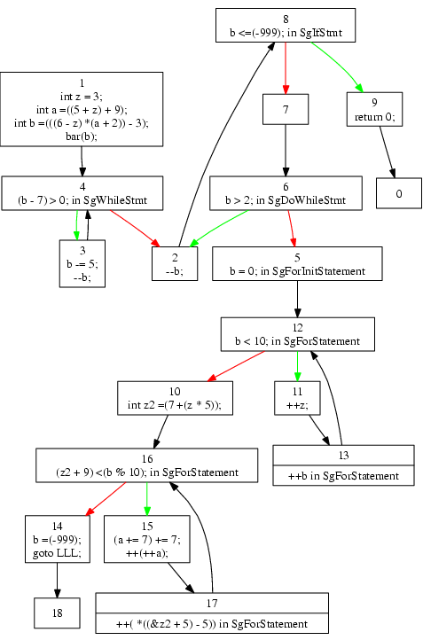
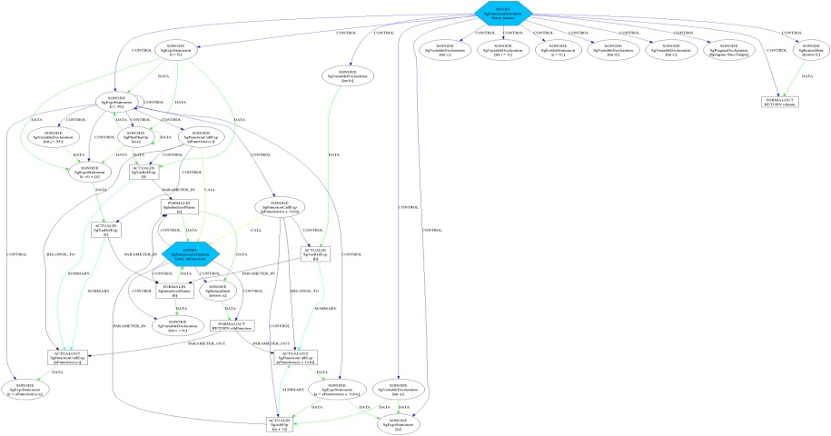
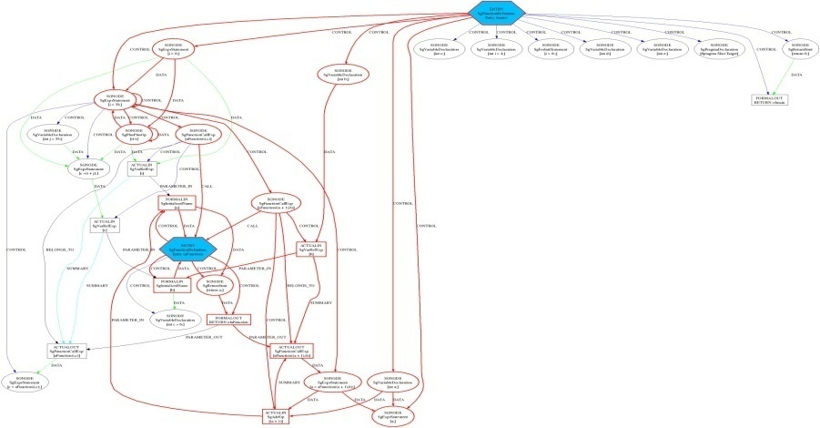
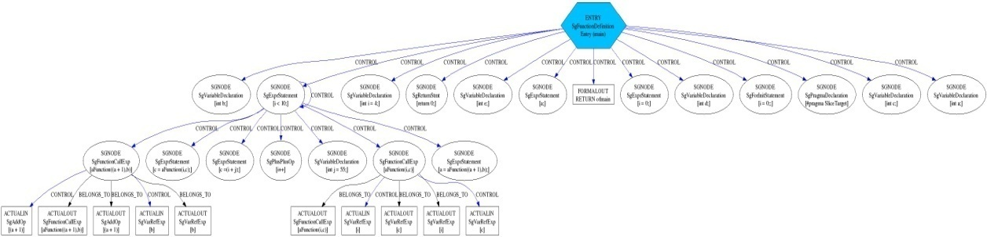
ROSE source-to-source transformation infrastructure
Source Code
or Binary Executable
ROSE-based tool
Transformed
Source Code
ROSE
Frontend
Unparser
ROSE
IR
System-dependency
Analyses Transformation Optimizations
Sliced-system-
dependency
Control-Flow
Control flow
ROSE
Control dependency

Slide 38
ROSE Progress
Connection to Clang
Rewrite System being added (connection to Stratego)
OpenCL generation in place but adding ability to read OpenCL (both reading and writing for CUDA is in place)
Data-Flow Framework in place
LLVM generation provides more than source-to-source
EU Program Analysis project “Static Analysis Tool Integration Engine” (SATIrE) recently added to ROSE distribution

Slide 39
ROSE Compiler Design
General Purpose Languages used within DOE
Front-End
C & C++
Fortran (F77-F2003)
CUDA
OpenMP 3.0
UPC 1.1
Python
AST Builder API
Mid-End
IR Extension API
(ROSETTA)
High Level Analysis
& Optimization
Framework
High Level IRs (AST)
Low Level IR
(LLVM)
Low Level Analysis & Optimization
Back-End
Unparser
LLVM Backend
Code Generation
Existing LLVM Analysis & Optimization
Vendor
Compilers
Vendor Compiler Infrastructures
Exascale
Architecture

