Slide 1
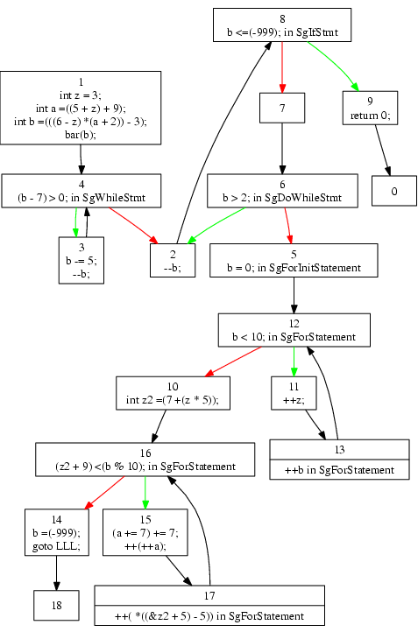
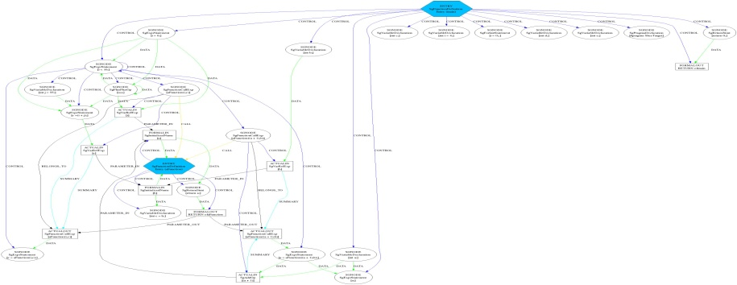
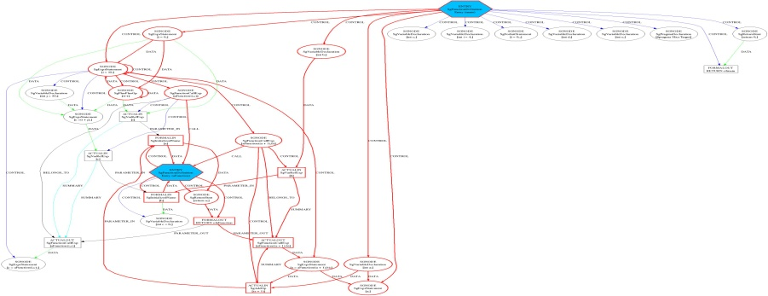
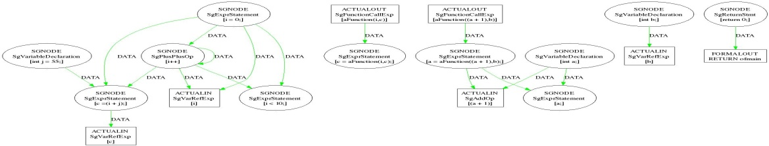
ROSE: Understanding Software for Exascale Co-Design
ROSE communicates subtle software design to architecture design groups
Software characterization for exascale software/architecture co-design
ROSE measures amount of parallelism in DOE applications
Classifies types of memory usage to inform hardware designers
Many other custom requests from exascale design teams for co-design
Instrumentation of applications to assess potential hardware exascale features
ROSE will generate skeleton apps to drive exascale hardware simulators
ROSE Compiler Analysis and Exascale Co-Design Transformations
main()
{
int a,b,c,d,e;
int i=4;
for (i=0;i<10;i++)
{
int j=55;
c=i+j;
c=aFunction(i,c);
a=aFunction(a+1,b);
}
#pragma SliceTarget
a;
return 0;
}
Control-Flow
System-dependency
Modified
(Instrumented)
Source Code
main()
{
int a,b,c,d,e;
int i=4;
for (i=0;i<10;i++)
{
int j=55;
c=i+j;
c=aFunction(i,c);
a=aFunction(a+1,b);
}
a;
return 0;
}
Sliced-system-dependency
Original
Source Code
Dynamic and
Static
Analysis
Exascale
Design Data
for
Architecture Team
Data-dependency

