Slide 1
ROSE Slides August 2010
Dan Quinlan
Center for Applied Scientific Computing
Lawrence Livermore National Laboratory
Lawrence Livermore National Laboratory, P. O. Box 808, Livermore, CA 94551
Operated by Lawrence Livermore National Security, LLC, or the U.S. Department of Energy,
National Nuclear Security Administration under Contract DE-AC52-07NA27344

Slide 2
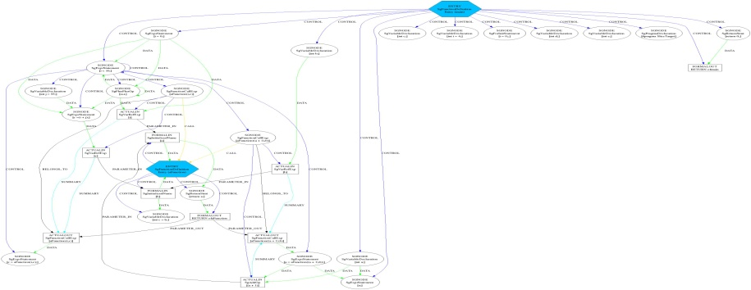
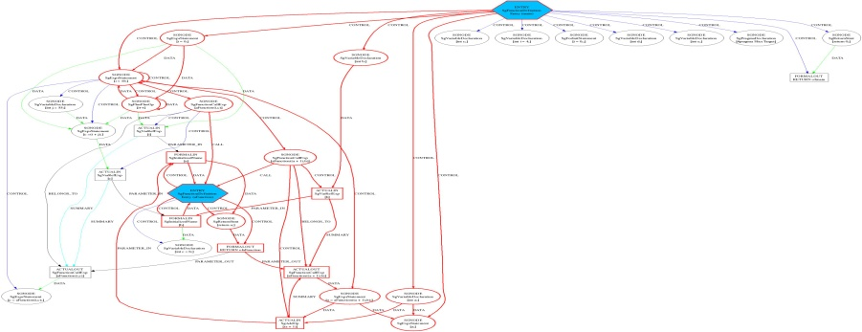
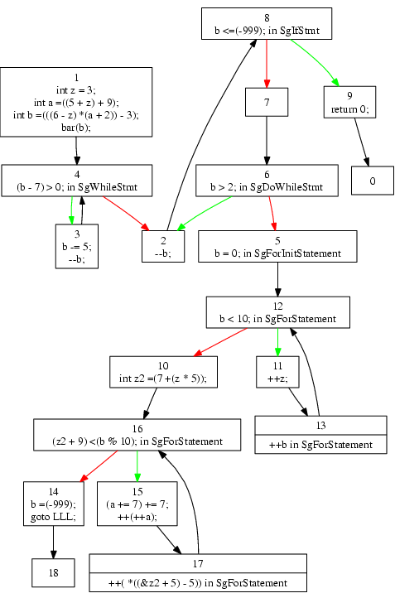
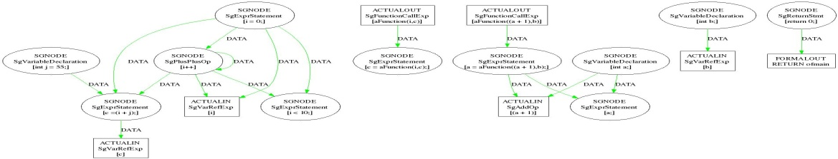
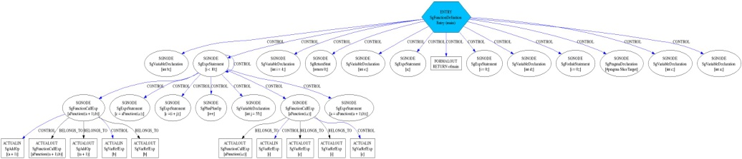
ROSE supports custom software analysis tools
Software analysis exposes behavioral properties of large scale software systems
ROSE is an open compiler infrastructure for custom domain-specific analysis
Source code: C, C++, Fortran 2003, OpenMP, UPC
Binary executables (Windows and Linux) (x86, Power-PC, ARM)
Program analysis uses/generates different graphs
Graphs for real software have millions of nodes
Graphs are for use in automated analysis (not users)
Optimization, Autotuning, Characterization for Exascale
System-dependency
Sliced-system-dependency
int aFunction(int a, int b)
{
int c=b;
return a;
}
main()
{
int a,b,c,d,e;
int i=4;
for (i=0;i<10;i++)
{
int j=55;
c=i+j;
c=aFunction(i,c);
a=aFunction(a+1,b);
}
#pragma SliceTarget
a;
return 0;
}
Source Code
or
Binary
Executable
Data-dependency
Control-Flow
Control-dependency
Notes:
ROSE is an infrastructure for building custom analysis and optimization tools. It has numerous built-in forms of analysis and transformation support for both source code and binaries. ROSE is the basis for how we build specialized tools for Cyber-Security.

Slide 3

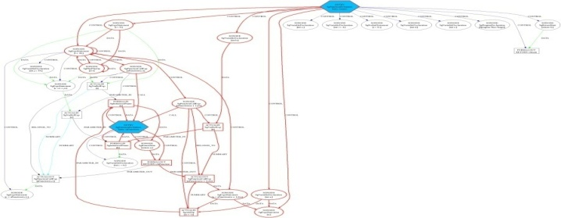

ROSE source-to-source transformation infrastructure
Source Code
or Binary Executable
ROSE-based tool
Transformed
Source Code
ROSE
Frontend
Unparser
ROSE
IR
System-dependency
Analyses/ Transformation/ Optimizations
Sliced-system-
dependency
Control-Flow
Control flow
ROSE
Control dependency

Slide 4
ROSE IR has many features required for tools
ROSE IR = AST + symbol tables + CFG + ...
Full type analysis (critical for C++, Fortran 90/95/2003)
Preserves details in source code
Token stream, including whitespace, woven into AST
Source comments and source position info.
C preprocessor control structure
All C++ template and instantiations
Rich AST interface for:
traversal, query, creation, copy, symbol lookup
Generic analyses, transformations, optimizations
Full support
Resolving complex types and overloaded functions
Abstraction recognition and semantic analysis
Documentation: web site, manuals, tutorial, examples, etc.

Slide 5
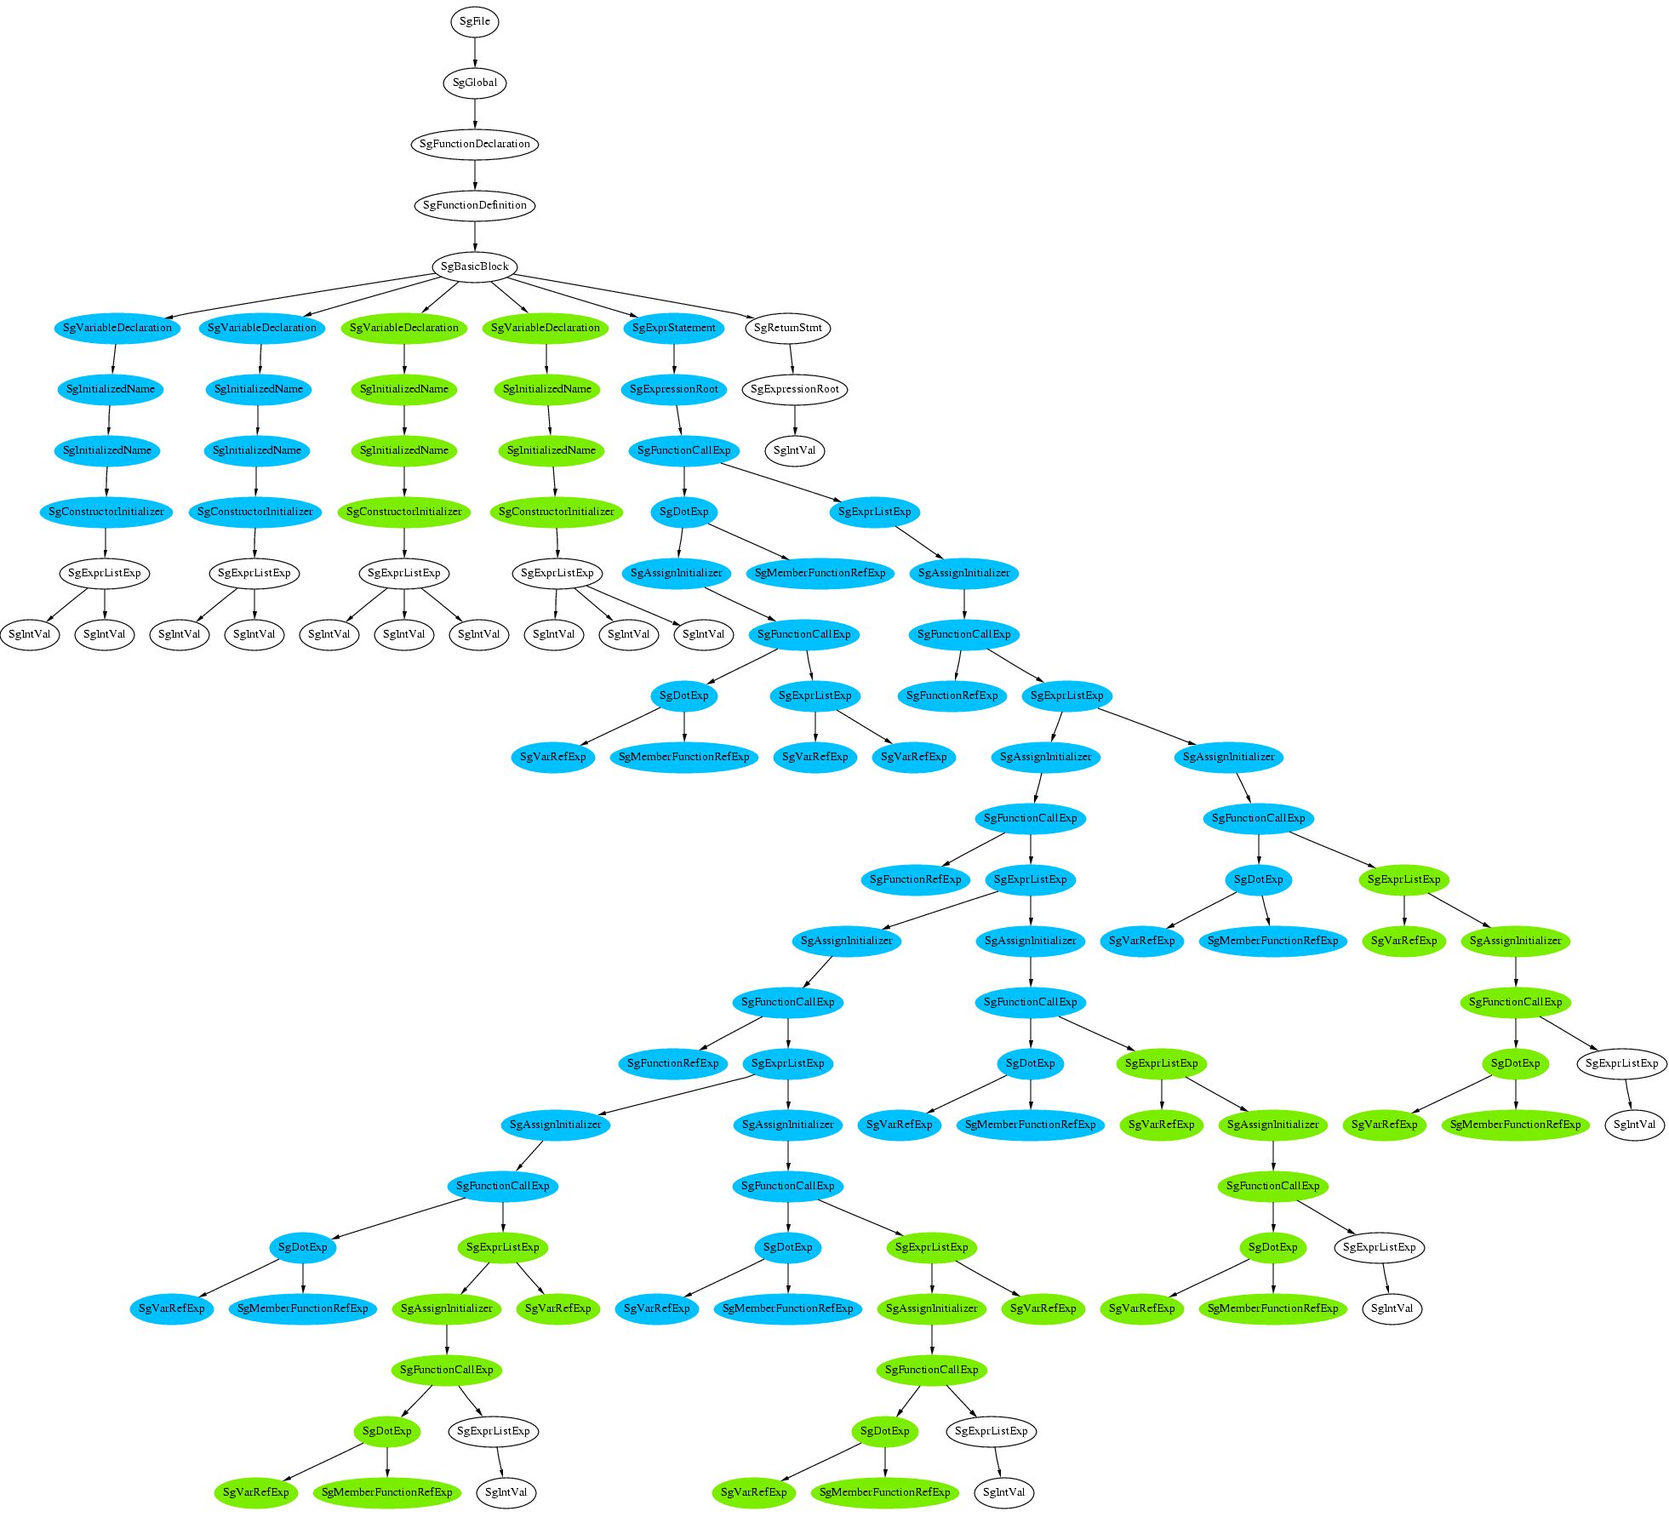
Source Code → Abstract Syntax Tree (AST)
ROSE tools operate on the AST
Full Type evaluation
Template instantiation
Custom Analysis
Custom Transformation
Abstract Syntax Tree
Source Code

Slide 6
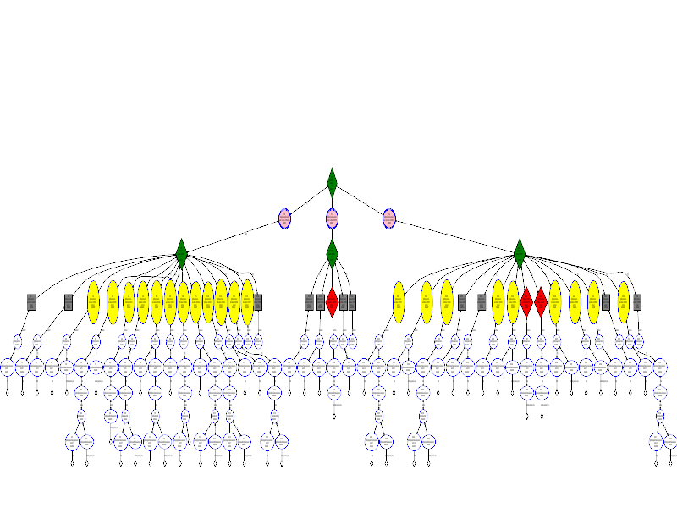
Executable → Binary AST → Assembly
Instructions level IR
Instruction operands as expression trees
Full analysis using ROSE Tools
Transformations
Code Generation
Generated
Assembly Code
8048334: push ebp 8048335: mov ebp,esp 8048337: sub esp,0x10 804833a: mov DWORD PTR [ebp-12],0x2 8048341: fld DWORD PTR [0x8048488 <dbl_8048488>] 8048347: fstp QWORD PTR [ebp-8] 804834a: mov eax,DWORD PTR [ebp-12] 804834d: push eax 804834e: fild DWORD PTR [esp] 8048351: lea esp,[esp+4] 8048355: fld QWORD PTR [ebp-8] 8048358: faddp , 804835a: fstp QWORD PTR [ebp-8] 804835d: leave 804835e: ret 804835f: push ebp 8048360: mov ebp,esp 8048362: call 8048334 <f2> 8048367: pop ebp 8048368: ret 8048369: lea ecx,[esp+4] 804836d: and esp,0xfffffff0 8048370: push DWORD PTR [ecx-4] 8048373: push ebp 8048374: mov ebp,esp 8048376: push ecx 8048377: sub esp,0x4 804837a: call 804835f <f1> 804837f: call 8048334 <f2> 8048384: mov eax,0x0 8048389: add esp,0x4 804838c: pop ecx 804838d: pop ebp 804838e: lea esp,[ecx-4] 8048391: ret
typedef struct mystruct { int x; } mystruct_t; void f2() { mystruct_t my; my.x=2; double y=3; y = my.x + y; } void f1() { f2(); } int main() { f1(); f2(); return 0; }

Slide 7

ROSE provides multiple graphs of software to support different forms of software analysis
Graph Type
AST
Control Flow
System
Dependence
Used to detect
Software Characterization and Localized Structural
Flaws
Optimization and
Buffer Overflow
Vulnerability
Mixing trusted data with
untrusted user input

Slide 8
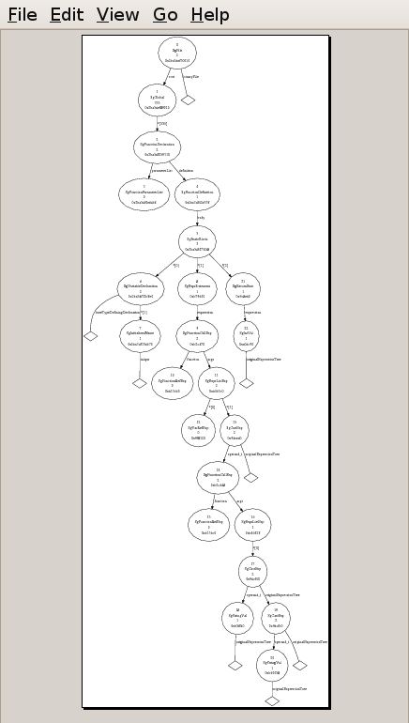
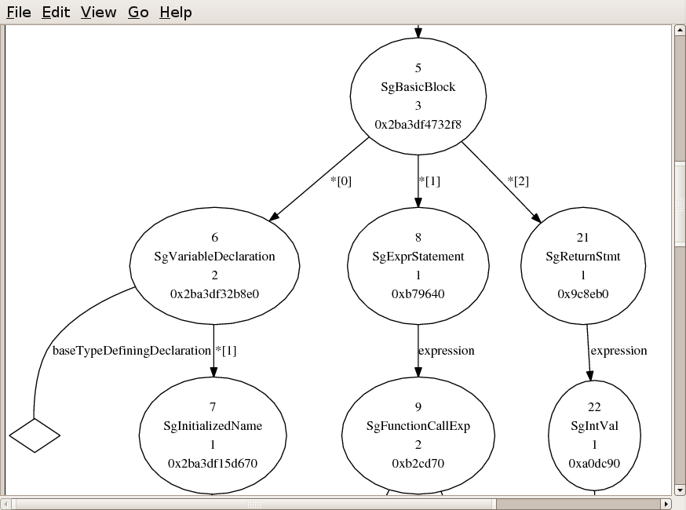
ROSE AST – An Internal Representation for Source and Binaries and a common set of tools for analysis and transformation

Slide 9
We have developed numerous collaborations through the ROSE compiler toolset
DOE Laboratories:
LLNL (A Div, B Div, Cyber-Security)
ANL, LANL, LBL, ORNL, PNNL
DOE Research Programs:
PERI (SLAC, Fortran/C/C++ Optimization, UT, ANL, ISI, LBL)
Collaborations:
DOD (Air Force)
NIST(SAMATE)
CERT (CMU)
GrammaTech
IBM (Program Verification Group)
Absint (developers of PAG)
London Imperial College
Texas A&M
Rice University
Vienna University of Technology
University of Tennessee
Cornell University
Indiana University
University of California at Berkeley
University of Bergen
University of Maryland
Friedrich-Alexander-University Erlangen-Nuremberg
University of Texas at Austin
UCSD
UC Davis
ROSE is winner of 2009 R&D100 award
ROSE used for graduate courses at seven different universities (compiler construction to cyber security)
ROSE being used to build products at five different companies (BSD license)
ROSE released at http://www.roseCompiler.org
Top Download on SciDAC web site…
Notes:
The ROSE projects has a wide number of collaborators specific to optimization and specialized compiler-based analysis tools.

