Slide 1
ROSE Compiler Project Computational Exascale Workshop December 2010
Dan Quinlan
Chunhua Liao, Justin Too, Robb Matzke, Peter Pirkelbauer
Center for Applied Scientific Computing
Lawrence Livermore National Laboratory
Lawrence Livermore National Laboratory, P. O. Box 808, Livermore, CA 94551
Operated by Lawrence Livermore National Security, LLC, or the U.S. Department of Energy,
National Nuclear Security Administration under Contract DE-AC52-07NA27344

Slide 2
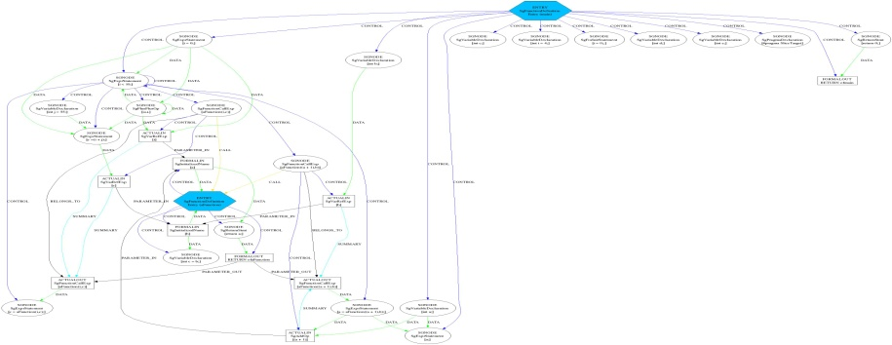
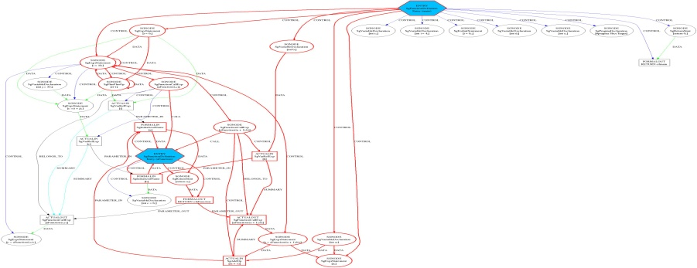
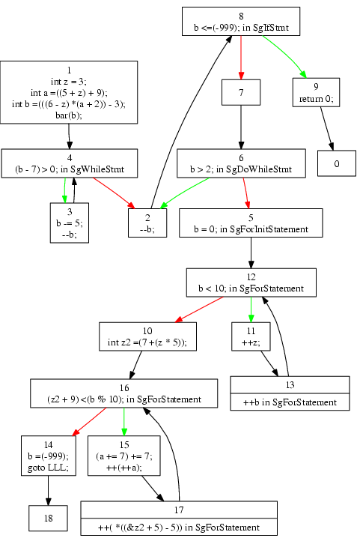
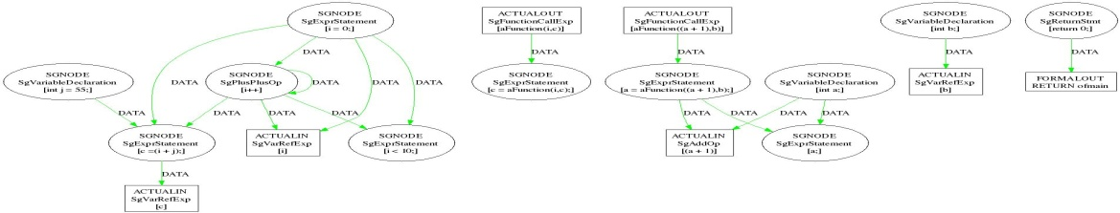
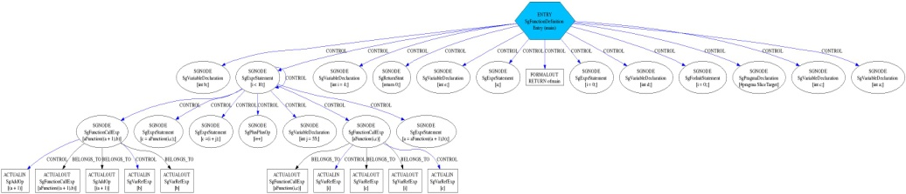
ROSE supports custom software analysis tools
Software analysis exposes behavioral properties of large scale software systems
ROSE is an open compiler infrastructure for custom domain-specific analysis
Source code: C, C++, Fortran 2003, OpenMP, UPC, PHP
Binary executables (Windows and Linux) (x86, Power-PC, ARM)
Program analysis uses/generates different graphs
Graphs for real software have millions of nodes
Graphs are for use in automated analysis (not users)
System-dependency
Sliced-system-dependency
int aFunction(int a, int b)
{
int c=b;
return a;
}
main()
{
int a,b,c,d,e;
int i=4;
for (i=0;i<10;i++)
{
int j=55;
c=i+j;
c=aFunction(i,c);
a=aFunction(a+1,b);
}
#pragma SliceTarget
a;
return 0;
}
Source Code
or
Binary
Executable
Data-dependency
Control-Flow
Control-dependency
Notes:
ROSE is an infrastructure for building custom analysis and optimization tools. It has numerous built-in forms of analysis and transformation support for both source code and binaries. ROSE is the basis for how we build specialized tools for Cyber-Security.

Slide 3

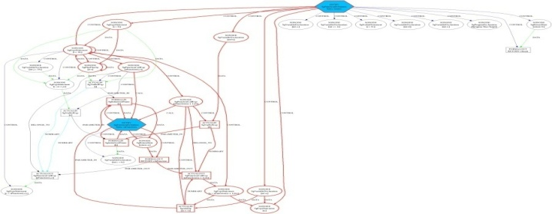

ROSE is a software analysis and source-to-source transformation infrastructure for building tools
Source Code
or Binary Executable
ROSE-based tool
Transformed
Source Code
ROSE
Frontend
Unparser
ROSE
IR
System-dependency
Analyses/ Transformation/ Optimizations
Sliced-system-
dependency
Control-Flow
Control flow
ROSE
Control dependency

Slide 4
GOAL: Position ROSE as a Strategic Part of DOE Research
Supports the languages used within DOE (Fortran/C/C++)
The only compiler project within DOE for DOE apps
ROSE targets all of the real-world applications across all of DOE
Used by many national labs:
ANL, LANL, LBL, ORNL, PNL, SNL, and LLNL
Used worldwide for external research projects
Supports many other research projects within DOE
Open source (top download on SciDAC web site)
BSD licensed
Fully automated testing and release process

Slide 5
Programming Model Research
OpenMP 3.0 compiler implemented using ROSE
Autoparallelization using OpenMP
UPC source-to-source support within ROSE
Custom analysis and transformation
MPI (code motion optimizations)
Basis of DARPA PACE project at Rice
Co-Array Fortran PGAS programming model (Rice)
C++ optimization of array language abstractions
E.g. Intel’s Threaded Building Blocks
Platform for imbedded domain specific language research
Language extension/restrictions
Exascale specific uses:
Analysis and transformation for active power control
Introduction of custom instructions (Co-Design)
Data layout transformations (Keasler, McGraw)

Slide 6
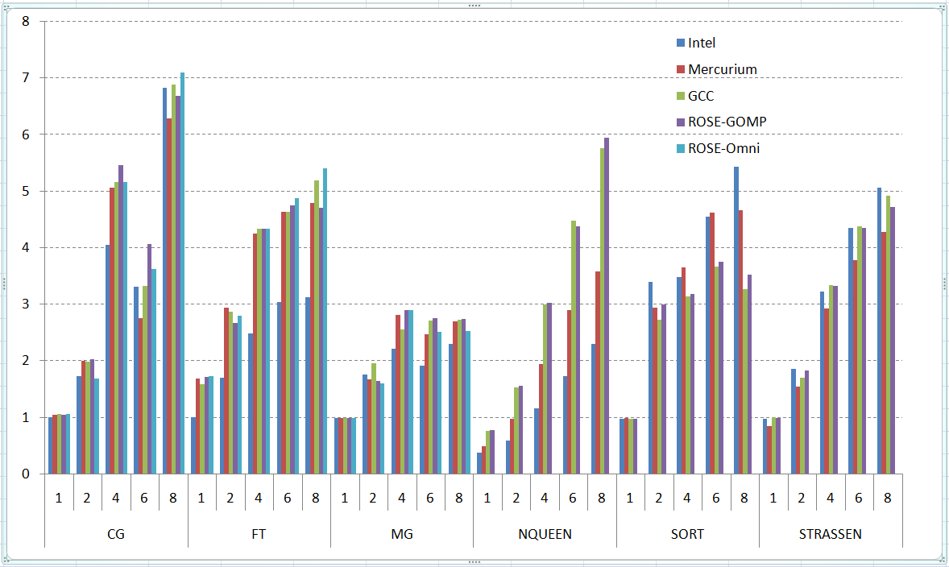
ROSE: Open Source OpenMP 3.0 compiler
OpenMP compiler built using ROSE compiler infrastructure
Research platform for multi-core and parallel programming model research
Unique open source platform for OpenMP research
Demonstrated competitive performance with commercial OpenMP compilers (as shown below on OpenMP benchmarks: ROSE-GOMP and ROSE-Omni)
speedup
Platform: Dell Precision T5400, 3.16GHz quad-core Xeon X5460 dual processor, 8GB
Benchmarks: NAS parallel benchmark suite v 2.3, Barcelona OpenMP task suite v 1.0
Compilers: ROSE, Omni 1.6, GCC 4.4.1, Mercurium 1.3.3 compiler with Nanos 4.1.4 runtime. Intel compiler 11.1.059

Slide 7
ROSE: Automating Multi-core use for MPI applications
MPI applications have to use multi-core nodes in current and future architectures
Hybrid MPI and Multi-core programming models square the complexity of using either one separately
ROSE’s new Autopar tool automatically inserts multicore optimizations into existing MPI applications, automatically detects existing parallelism.
Ongoing work on large scale LLNL applications
Demonstrated performance improvements on application kernels (8x speedup)
Uniquely applicable to loops, standard C++ abstractions, and user-defined types
Platform: Dell Precision T5400, 3.16GHz quad-core Xeon X5460 dual processor, 8GB
Compiler: ROSE OpenMP translator + Omni 1.6 Runtime + GCC 4.1.2

Slide 8
ROSE: Autotuning Performance Optimization Research
ROSE has rich support for custom autotuning (plus autotuning documentation)
Specific focus on whole application autotuning (ongoing research with PERI)
Applicable to wide range of Multi-core architectures
Demonstrated superior performance using autotuning (4.14x speedup)
A platform for autotuning research on programming models (results below show the autotuning of parameters to the OpenMP run-time system to control the depth of nested parallelism)
Platform: Xeon X5570 2.93GHz , 2x4=8 cores with HyperThreading (8x2=16 threads), 12GB
Compiler: ROSE-OpenMP + libgomp of GCC 4.4.4 (modified)
Search space: threads [1,16,2], queue length multiplier: 1, 2, 4, .., 64
Best sequential (n=14): 131.7 s
Best performance: 8 threads, 2*16 = 32 queue len, 31.8 s ( 4.14x)

Slide 9
ROSE: Understanding Software for Exascale Co-Design
ROSE communicates subtle software design to architecture design groups
Software characterization for exascale software/architecture co-design
ROSE measures amount of parallelism in DOE applications
Classifies types of memory usage to inform hardware designers
Many other custom requests from exascale design teams for co-design
Instrumentation of applications to assess potential hardware exascale features
ROSE will generate skeleton apps to drive exascale hardware simulators
ROSE Compiler Analysis and Exascale Co-Design Transformations
main()
{
int a,b,c,d,e;
int i=4;
for (i=0;i<10;i++)
{
int j=55;
c=i+j;
c=aFunction(i,c);
a=aFunction(a+1,b);
}
#pragma SliceTarget
a;
return 0;
}
Control-Flow
System-dependency
Modified
(Instrumented)
Source Code
main()
{
int a,b,c,d,e;
int i=4;
for (i=0;i<10;i++)
{
int j=55;
c=i+j;
c=aFunction(i,c);
a=aFunction(a+1,b);
}
a;
return 0;
}
Sliced-system-dependency
Original
Source Code
Dynamic and
Static
Analysis
Exascale
Design Data
for
Architecture Team
Data-dependency

Slide 10
We have developed numerous collaborations through the ROSE compiler toolset
DOE Laboratories:
LLNL (A Div, B Div, Cyber-Security)
ANL, LANL, LBL, ORNL, PNNL
DOE Research Programs:
PERI (SLAC, Fortran/C/C++ Optimization, UT, ANL, ISI, LBL)
Collaborations:
DOD (Air Force)
NIST(SAMATE)
CERT (CMU)
GrammaTech
IBM (Program Verification Group)
Absint (developers of PAG)
London Imperial College
Texas A&M
Rice University
Vienna University of Technology
University of Tennessee
Cornell University
Indiana University
University of California at Berkeley
University of Bergen
University of Maryland
Friedrich-Alexander-University Erlangen-Nuremberg
University of Texas at Austin
UCSD
UC Davis
ROSE is winner of 2009 R&D100 award
ROSE used for graduate courses at seven different universities (compiler construction to cyber security)
ROSE being used to build products at five different companies (BSD license)
ROSE released at http://www.roseCompiler.org
Top Download on SciDAC web site…
Notes:
The ROSE projects has a wide number of collaborators specific to optimization and specialized compiler-based analysis tools.

Slide 11
Economics of compilers…
Vendor compiler teams serve their masters
Compiler groups are subsidized (~75% from hardware)
Hardware groups rule, but are often ignored…
Marketing Department (competitive vendors)
Make the new chips look good
Direct competition against other vendors
There are few non-vendor associated compiler teams
The market for compilers is not really HPC…
A one off machine is not worth changing the compiler to support…
So the compiler you will get is the substantially the same vendor compiler that exists today (vendor compilers change slowly)
Free compilers are the norm for a lot of HPC work…(GNU)

