Slide 1
Manycore Optimizations: A Compiler and Language Independent ManyCore Runtime System
ROSE Team
Center for Applied Scientific Computing
Lawrence Livermore National Laboratory
Lawrence Livermore National Laboratory, P. O. Box 808, Livermore, CA 94551
Operated by Lawrence Livermore National Security, LLC, or the U.S. Department of Energy,
National Nuclear Security Administration under Contract DE-AC52-07NA27344

Slide 2
Single core data layout will be crucial to memory performance
Independent of distributed memory data partitioning
Beyond scope of Control Parallelism (OpenMP, Pthreads, etc.)
How we layout data effects performance of how it is used
New Languages and Programming Models have the opportunity to encapsulate the data layout; but data layout can be addressed directly
General purpose languages provide the mechanisms to tightly bind the the implementation to the data layout (providing low level control over issues required to get good performance)
Applications are commonly expressed at a low level which binds the implementation and the data layout (and are encouraged to do so to get good performance)
Compilers can’t unravel code enough to make the automated global optimizations to data layout that are required

Slide 3
Runtime systems can assist data layout optimizations
Assume user will permit use of array abstraction
40 years of history in array languages
currently used in F90
target for many-core BoxLib FAB abstraction
Motivating goal is to support exascale architectures

Slide 4
Exascale architectures will include intensive memory usage and less memory coordination
A million processors (not relevant for this many-core runtime system)
A thousand cores per processor
1 Tera-FLOP per processor
0.1 bytes per FLOP
Memory bandwidth 4TB/sec to 1TB/sec
We assume NUMA
Assume no cross-chip cache coherency
Or it will be expensive (performance and power)
So assume we don’t want to use it…
Can DOE applications operate with these constraints?

Slide 5
We distribution each array into many pieces for many cores…
Assume a 1-to-1 mapping of pieces of the array to cores
Could be many to one to support latency hiding…
Zero false sharing → no cache coherency requirements
Core 0
array section
Core 1
array section
Single Array
Abstraction
Core 2
array section
Core 3
array section
Mapping of logical array positions to
physical array positions distributed over cores

Slide 6
There are important constraints, just to make this more clear…
Only handle stencil operations
No reductions…
No indirect addressing…
Assume machine has low level support for synchronization
Regular structure grid operations…
Support for irregular computation would be handled via either Pat’s Lizt (Stanford) abstraction or Keshav’s Galois runtime system (University of Texas)

Slide 7
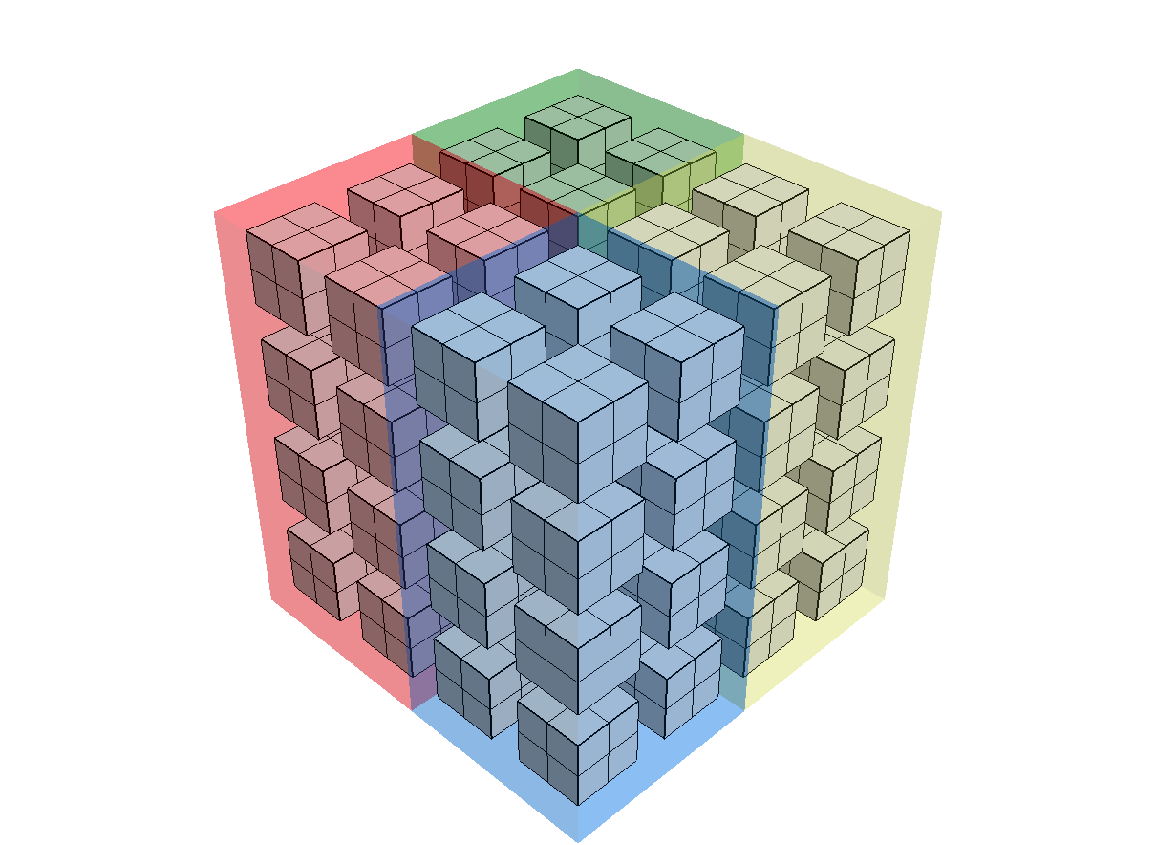
Many scientific data operations are applied to block-structured geometries
Supports Multi-dimensional array data
Cores can be configured into logical hypercube topologies
Currently multi-dimensional periodic arrays of cores (core arrays)
Operations on data on cores can be tiled for better cache performance
Constructor takes multidimensional array size and target multi-dimensional core array size
Supports table based and algorithm based distributions
Multi-dimensional Data
Simple 3D Core Array
(core arrays on 1K cores could be 10^3)

Slide 8
A high level interface for block-structured operations enhances performance and debugging across cores
This is a high level interface that permits debugging
Indexing provides abstraction for the complexity of data that is distributed over many cores
template <typename T>
void
relax2D_highlevel( MulticoreArray<T> & array, MulticoreArray<T> & old_array )
{
// This is a working example of a 3D stencil demonstrating a high level interface
// suitable only as debugging support.
#pragma omp parallel for
for (int k = 1; k < array.get_arraySize(2)-1; k++)
{
#pragma omp for
for (int j = 1; j < array.get_arraySize(1)-1; j++)
{
for (int i = 1; i < array.get_arraySize(0)-1; i++)
{
array(i,j,k) = ( old_array(i-1,j,k) + old_array(i+1,j,k) + old_array(i,j-1,k) +
old_array(i,j+1,k) + old_array(i,j,k+1) + old_array(i,j,k-1) ) / 6.0;
}
}
}
}
Indexing hides distribution
of data over many cores

Slide 9
Mid level interface as target for compiler generated or maybe also user code (unclear if this is a good user target)
Midlevel interface…simple… but not as high performance as the low level interface (next slide)…
template <typename T>
void
relax2D_highlevel( MulticoreArray<T> & array, MulticoreArray<T> & old_array )
{
// This is a working example of the relaxation associated with the a stencil on the array abstraction
// mapped to the separate multi-dimensional memories allocated per core and onto a multi-dimensional
// array of cores (core array).
int numberOfCores_X = array.get_coreArraySize(0);
int numberOfCores_Y = array.get_coreArraySize(1);
// Use OpenMP to support the threading...
#pragma omp parallel for
for (int core_X = 0; core_X < numberOfCores_X; core_X++)
{
#pragma omp for
for (int core_Y = 0; core_Y < numberOfCores_Y; core_Y++)
{
// This lifts out loop invariant portions of the code.
Core<T> & coreMemory = array.getCore(core_X,core_Y,0);
// Lift out loop invariant local array size values.
int sizeX = coreMemory.coreArrayNeighborhoodSizes_2D[1][1][0];
int sizeY = coreMemory.coreArrayNeighborhoodSizes_2D[1][1][1];
int base_X = (coreMemory.bounaryCore_2D[0][0] == true) ? 1 : 0;
int bound_X = (coreMemory.bounaryCore_2D[0][1] == true) ? sizeX - 2: sizeX - 1;
int base_Y = (coreMemory.bounaryCore_2D[1][0] == true) ? 1 : 0;
int bound_Y = (coreMemory.bounaryCore_2D[1][1] == true) ? sizeY - 2: sizeY - 1;
for (int j = base_Y; j <= bound_Y; j++)
{
for (int i = base_X; i <= bound_X; i++)
{
// Compiler generated code based on user application
array.getCore(core_X,core_Y,0)(i,j,0) =
( old_array.getCore(core_X,core_Y,0)(i-1,j,0) +
old_array.getCore(core_X,core_Y,0)(i+1,j,0) +
old_array.getCore(core_X,core_Y,0)(i,j-1,0) +
old_array.getCore(core_X,core_Y,0)(i,j+1,0) ) / 4.0;
}
}
}
}
}
Use OpenMP for control parallelism
Construct core data structure reference
Accesses to core indexing
data shown using core
data structure reference
core index reference
array element index reference on referenced core
Indexing could alternatively
use loop invariant references
(shown not using such references
to demonstrate explicit core indexing)
Note: array element index references outside of current
indexed core generate array references to adjacent core

Slide 10
Low level code for stencil on data distributed over many cores (to be compiler generated high performance code)
template <typename T>
void
relax2D( MulticoreArray<T> & array, MulticoreArray<T> & old_array )
{
// This is a working example of the relaxation associated with the a stencil on the array abstraction
// mapped to the separate multi-dimensional memorys allocated per core and onto a multi-dimenional
// array of cores (core array).
int numberOfCores = array.get_numberOfCores();
// Macro to support linearization of multi-dimensional 2D array index
computation
#define local_index2D(i,j) (((j)*sizeX)+(i))
// Use OpenMP to support the threading...
#pragma omp parallel for
for (int core = 0; core < numberOfCores; core++)
{
// This lifts out loop invariant portions of the code.
T* arraySection = array.get_arraySectionPointers()[core];
T* old_arraySection = old_array.get_arraySectionPointers()[core];
// Lift out loop invariant local array size values.
int sizeX = array.get_coreArray()[core]->coreArrayNeighborhoodSizes_2D[1][1][0];
int sizeY = array.get_coreArray()[core]->coreArrayNeighborhoodSizes_2D[1][1][1];
for (int j = 1; j < sizeY-1; j++)
{
for (int i = 1; i < sizeX-1; i++)
{
// This is the dominant computation for each array section per core. The compiler will use the
// user's code to derive the code that will be put here.
arraySection[local_index2D(i,j)] =
(old_arraySection[local_index2D(i-1,j)] + old_arraySection[local_index2D(i+1,j)] +
old_arraySection[local_index2D(i,j-1)] + old_arraySection[local_index2D(i,j+1)]) / 4.0;
}
}
// We could alternatively generate the call for relaxation for the internal boundaries in the same loop.
array.get_coreArray()[core]->relax_on_boundary(core,array,old_array);
}
// undefine the local 2D index support macro
#undef local_index2D
}
OpenMP used to provide control parallelism
Loop over all cores (linearized array)
Stencil (or any other local code)
generated from user applications

Slide 11
Call to low level compiler generated code to support internal boundary relaxation on the edges of each core
Relaxation (stencil) operator is applied on the boundary of each memory allocated to each core
Relies on share memory support on processor
Relaxation code for internal core boundaries is complex
Lots of cases for faces, edges, and corners
More complex for higher dimensional data
Current work supports 1D and 2D relaxation on internal core boundaries
template <typename T>
void
relax2D_on_boundary( MulticoreArray<T> & array, MulticoreArray<T> & old_array )
{
// This function supports the relaxation operator on the internal boundaries
// of the different arrays allocated on a per core basis. We take advantage
// of shared memory to support the stencil operations.
int numberOfCores = array.get_numberOfCores();
#pragma omp parallel for
for (int core = 0; core < numberOfCores; core++)
{
// Relaxation on edges of specific core (too large to show on slide)…
array.get_coreArray()[core]->relax_on_boundary(core,array,old_array);
}
}

Slide 12
Indexing for boundaries of core (stencil on core edges)
Example shows generated code for stencil on core edges
No ghost boundaries are required…but could be used (not implemented yet)
Array element “[Y-1][X]” is a reference to an element on a different cores memory
The use of this approach avoids ghost boundaries
But there are a lot of cases for each side of a multidimensional array
1D: 2 vertices
2D: 4 edges and 4 vertices
3D: 6 faces, 12 edges, and 8 vertices
4D: more of each…
2D example code fragment of upper edge relaxation on specific core
// Upper edge
// ***** | ****** | *****
// ----------------------
// ***** | *XXXX* | *****
// ***** | ****** | *****
// ***** | ****** | *****
// ----------------------
// ***** | ****** | *****
for (int i = 1; i < coreArrayNeighborhoodSizes_2D[1][1][0]-1; i++)
{
arraySection[index2D(i,0)] =
( /* array[Y-1][X] */ old_arraySectionPointers[coreArrayNeighborhoodLinearized_2D[0][1]][index2D(i,coreArrayNeighborhoodSizes_2D[0][1][1]-1)] +
/* array[Y+1][X] */ old_arraySection[index2D(i,1)] +
/* array[Y][X-1] */ old_arraySection[index2D(i-1,0)] +
/* array[Y][X+1] */ old_arraySection[index2D(i+1,0)]) / 4.0;
}
Array data reference on upper (adjacent) core
Array data reference on current core

Slide 13
We use libnuma to allocate the separate memory for each core closest to that core for best possible performance
NUMA based allocation of array subsection for each core (using memory closest to each core).
template <typename T>
void
MulticoreArray<T>::allocateMemorySectionsPerCore()
{
// This is the memory allocation support for each core to allocate memory that is as close as possible to it
// within the NUMA processor architecture (requires libnuma for best portable allocation of closest memory
// to each core).
#pragma omp parallel for
for (int core = 0; core < numberOfCores; core++)
{
int size = memorySectionSize(core);
#if HAVE_NUMA_H
// Allocate memory using libnuma to get local memory for the associated core.
arraySectionPointers[core] = (float*) numa_alloc_local((size_t)(size*sizeof(T)));
// Interestingly, libnuma will return a NULL pointer if ask to allocate zero bytes
// (but we want the semantics to be consistant with C++ allocation).
if (size == 0 && arraySectionPointers[core] == NULL)
{
arraySectionPointers[core] = new float[size];
assert(arraySectionPointers[core] != NULL);
}
#else
arraySectionPointers[core] = new float[size];
#endif
assert(arraySectionPointers[core] != NULL);
// Initialize the memory section pointer stored in the Core<T>.
assert(coreArray[core] != NULL);
coreArray[core]->arraySectionPointer = arraySectionPointers[core];
assert(coreArray[core]->arraySectionPointer != NULL);
}
OpenMP used to provide control parallelism
Libnuma specific code
Non-Libnuma specific code
Update Core<T> in
array of cores

Slide 14
Fortran example for 2D stencil operation using halos
Example shows halo exchange so all halo memory is sync’d and individual cores can begin computation on their tile
Halos required by runtime and the use of halos actually simplifies code for users
Otherwise, Array element “[Y-1][X]” is a reference to an element on a different cores memory
I don’t think is a problem, looks like coarrays, but when is memory transferred?
/* synchronize and transfer memory between cores and GPUs */
/* memory for cores and GPU buffers allocated previously */
exchange_halo(Array); /* user code */
/* I’m assuming this is “compiler generated” code */
for (int i = 1; i < coreArrayNeighborhoodSizes_2D[1][1][0]-1; i++)
{
/* call OpenCL runtime to run kernel on each GPU */
/* GPU memory (and arguments) set up previously by compiler */
clEnqueueNDRangeKernel(…,kernel, 2/*numDims*/, global_work_offset, global_work_size, local_work_size, …);
}
}
/* skeleton for GPU kernel */
__kernel relax_2D( __global float * Array, __global float * oldArray, __local float * tile)
{
/* fill “cache” with oldArray plus halo */
copy_to_local(tile, oldArray);
/* array offsets are macros based on tile/local cache size */
Array[CENTER] = (tile[LEFT] + tile[RIGHT] + tile[DOWN] + time[UP]) / 4.0f;
}

