Slide 1

Ch 2. Design of a Simple Compiler
Build a simple compiler for a very small language: AC (Adding Calculator).
  Computation and printing of numerical values for integer and FP variables
Although AC is simple, it serves the purpose of studying the phases and data structures of a compiler.
This chapter covers basic techniques that will be discussed in more details in Ch 3 through Ch 9
Department of Computer Science and Engineering

Slide 2
Informal AC definition
  Types
    Support only two types: integer and float
    Integer: a sequence of decimal numerals.
    Float: allows 5 fractional digits after the decimal point.
  Keywords
    Keywords vs. Reserved words
    All languages have some keywords such as if, while, …
    In AC, there are three reserved words: f (declare for float), i (declare for integer), p (print the value of a variable).
  Variables
    AC offers 23 variable names, from a to z, excluding the three reserved words: i, f, and p.
    Variables must be declared before using them
Department of Computer Science and Engineering

Slide 3

Informal AC definition (cont.)
  Type Conversion
    Implicit type conversion is also called type coercion
      e.g.
      int I; float f; double d;
      f = I; f = I*1.25+3; d = d+f;
      Quiz:
      unsigned ux;
      (ux > -1) is TRUE or FALSE?
    Explicit type conversion is often called type casting
    AC allows type coercion from integer to float, but not the other direction.
Department of Computer Science and Engineering

Slide 4
Structure of the AC Compiler
AC program
char stream
Token
stream
DC
code
Lexical
analyzer
Syntax
directed
translator
(scanner)
(parser + semantic routines)
AC-to-DC Compiler or
AC-to-DC Converter
Department of Computer Science and Engineering

Slide 5
Formal AC definition
  Must define the syntax and the semantics
  Use a CFG (Context Free Grammar) to describe its syntax
  Use RE (Regular Expression) to define its token specification
Department of Computer Science and Engineering

Slide 6
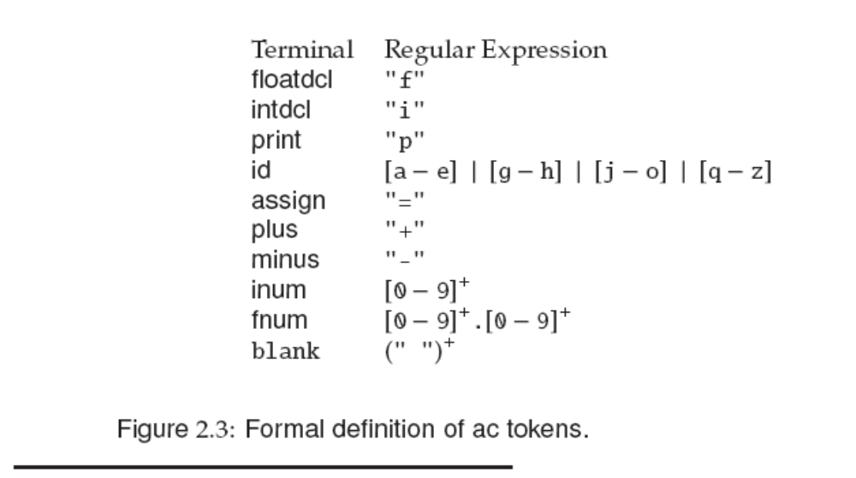
An AC Scanner
There are 10 tokens in AC, our scanner will be defined as a function that returns token (with attributes).
Department of Computer Science and Engineering

Slide 7
Handling Reserved Word
Reserved word vs. Key word
Reserved words are also valid identifiers. Other than defining them as special tokens, we can also treat them like identifiers. For each recognized identifier, we may
  Check a table of reserved words to recognized them.
  Alternatively, we can insert reserved words into the symbol table at initialization, and mark these entries as “reserved word”.
Token buffer to save the actual text (i.e. token attributes).
Department of Computer Science and Engineering

Slide 8
Syntax Definition
CFG (Context Free Grammar) is a set of rewriting rules. It is also called Backus-Naur Form (BNF) grammar.
The rewriting rule is called a production.
Example:
A → B C D … Z
where A is the left-hand side (LHS) of the production. B C D … Z is the right-hand side (RHS). This means any occurrence of A can be replaced by the RHS.
Department of Computer Science and Engineering

Slide 9
Production Example
<program> → begin <stmt_list> end
LHS is the name of the syntactic construct; the RHS shows a possible form of the syntactic construct.
LHS are always nonterminals, RHS can have terminals and nonterminals.
“begin”, “end” lexical elements are called tokens, or terminal symbols
For example, <program> is a nonterminal. <stmt_list> is also a nonterminal.
Department of Computer Science and Engineering

Slide 10
CFG
A set of tokens
A set of non-terminals
A set of productions
A start symbol (one of the non-terminals)
A string is derived by repeatedly applying productions to a non-terminal symbol
The language defined by a CFG is the token strings that can be derived from the start symbol
Department of Computer Science and Engineering

Slide 11
Recursion and Empty String
Recursion enables repetitions
Example:
<stmt_list> → <stmt> <stmt_tail>
<stmt_tail> → <stmt> <stmt_tail>
The empty or null string is represented by λ or ε
Example:
<stmt_tail> → λ
The empty string is very useful in representing optional items.
Department of Computer Science and Engineering

Slide 12
Extended BNF
Some abbreviations are introduced:
  optional: [ ] 0 or 1
    <stmt> → if <exp> then <stmt>
    <stmt> → if <exp> then <stmt> else <stmt>
    can be written as
    <stmt> → if <exp> then <stmt> [ else <stmt> ]
    Another example:
    <program> → [ ID: ] begin <stmt_list> end
    Means a program can be optionally labeled.
Department of Computer Science and Engineering

Slide 13
Extended BNF (cont.)
  repetitions: { } 0 or more
    <stmt list> → <stmt> <tail>
    <tail> → λ
    <tail> → <stmt> <tail>
    can be written as
    <stmt list> → <stmt> { <stmt> }
  alternative: | or
    <stmt> → <assign>
    <stmt> → <if stmt>
    can be written as
    <stmt> → <assign> | <if stmt>
Department of Computer Science and Engineering

Slide 14
Extended BNF (cont.)
  Extended BNF has the same expressive power as the regular BNF.
  Extended BNF is more compact and readable
  Extended BNF can be transformed into standard BNF
Department of Computer Science and Engineering

Slide 15
Exercise
  Transform Extended BNF into standard BNF
  Example
  <A> → <stmt> {<stmt>}
  <A> → <stmt> <R>
  <R> → λ
  <R> → <stmt><R>
Department of Computer Science and Engineering

Slide 16
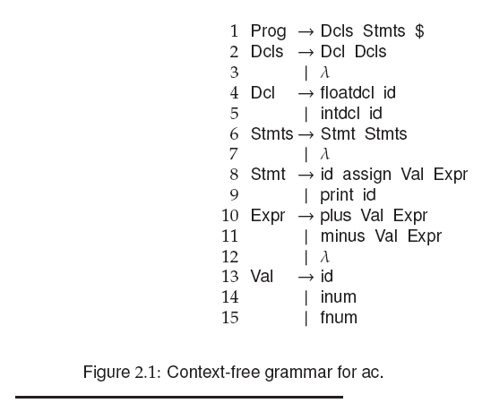
Syntax of AC
$ means end-of-file

Slide 17
Syntax of AC
f
i
id
=
p
+
-
I number
f number
All tokens in AC
blank

Slide 18
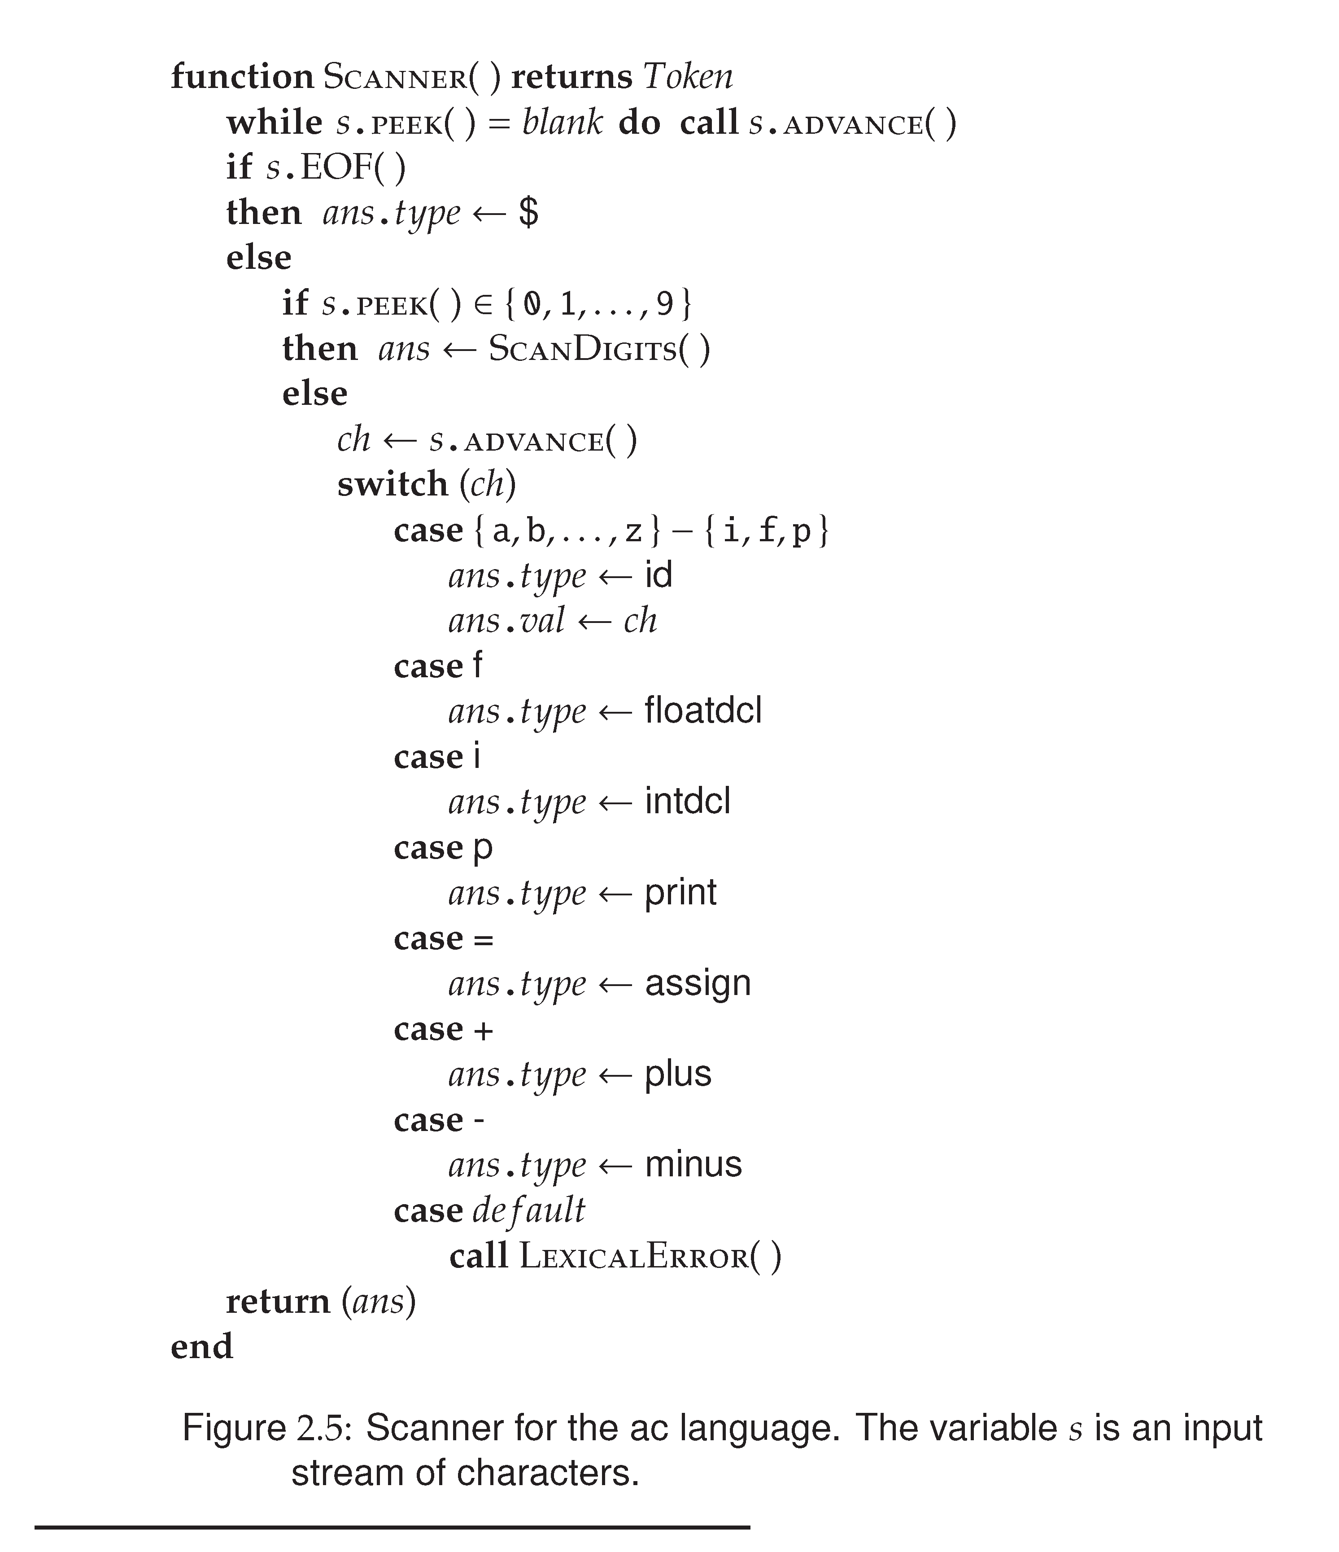

Slide 19
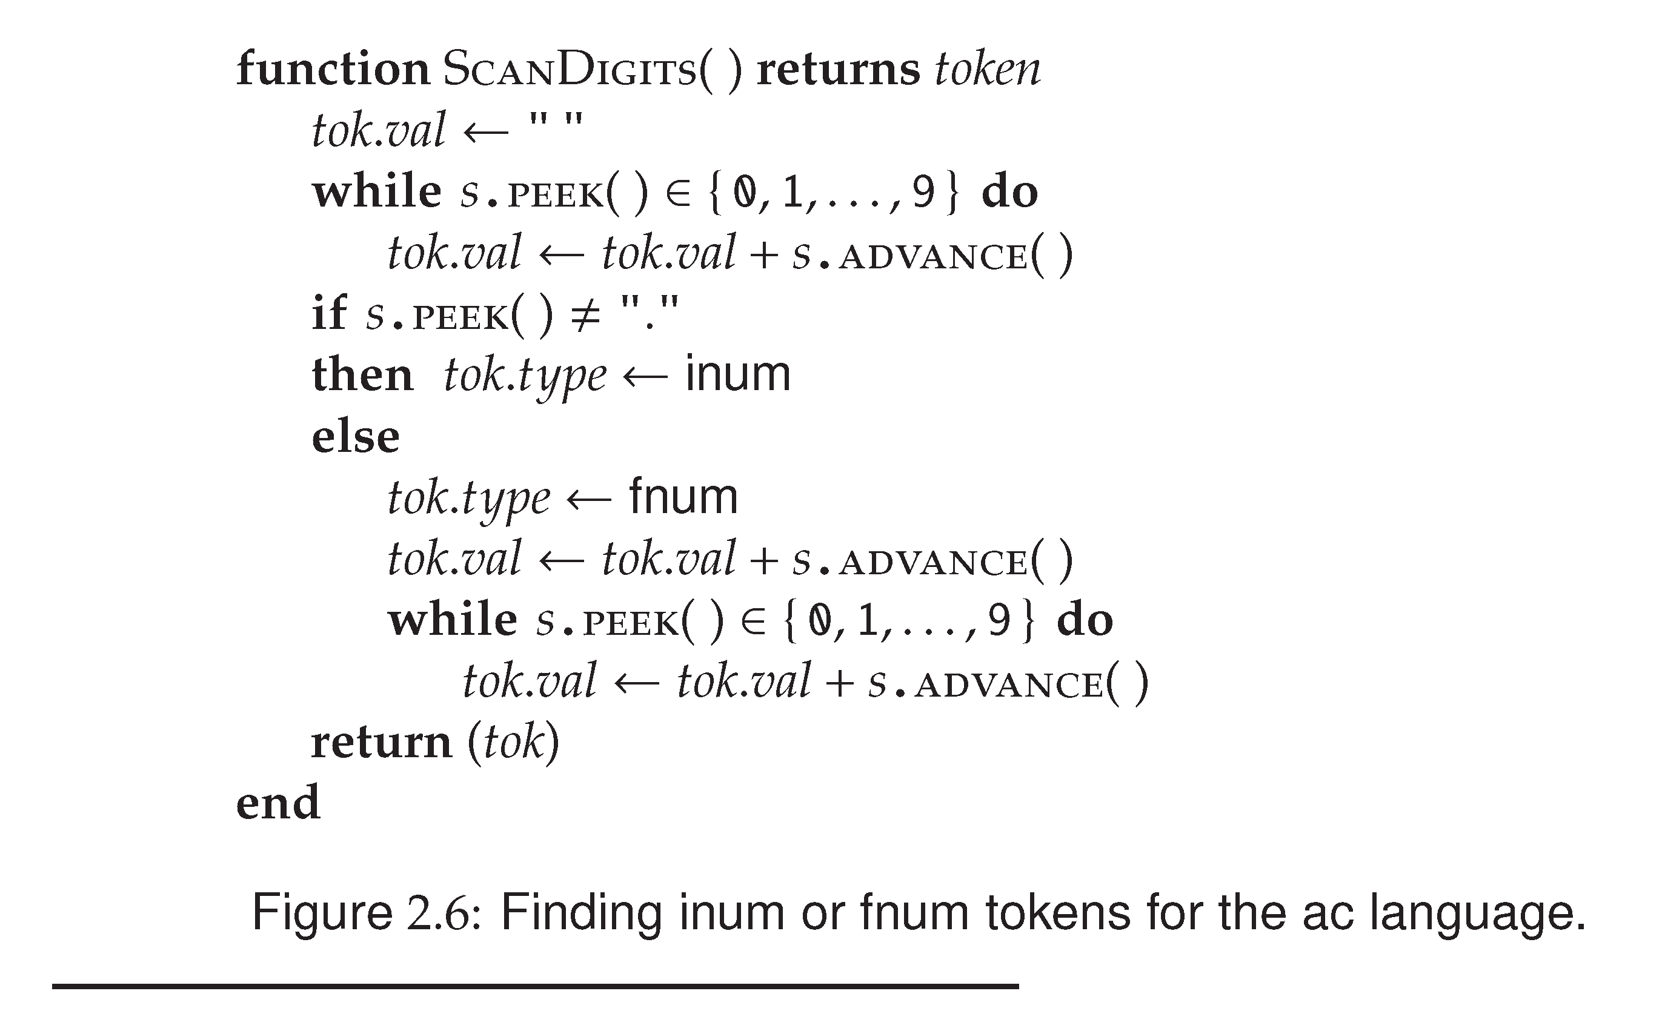
integer
float

Slide 20
How to derive an AC program
  Remember:
  The language defined by a CFG is the token strings that can be derived from the start symbol.
  Let us check if the following code fragment is a valid AC program?
  f b i a a = 5 b = a + 3.2 p b
  First, the scanner converts this program to
  floatdcl id intdcl id id assign inum id assign id plus fnum print id $
Department of Computer Science and Engineering

Slide 21
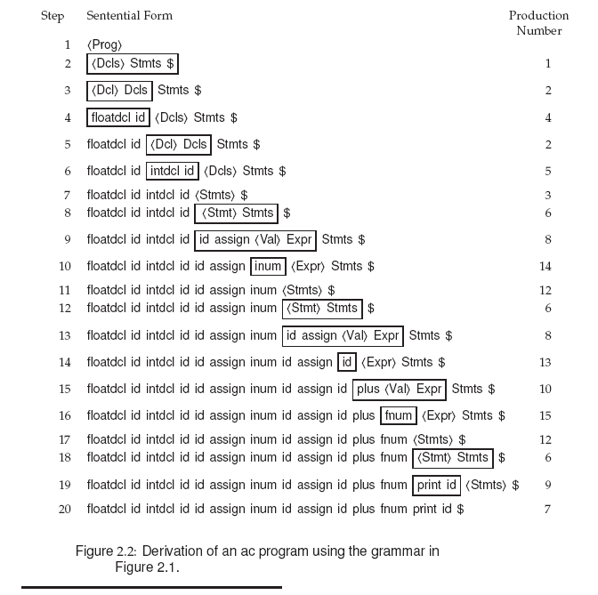

Slide 22
prog → dcls stmts $
dcls → dcl dcls
| λ
dcl → floatdcl id
| intdcl id
stmts → stmt stmts
| λ
stmt → id assign val expr
stmt → print id
…
  f b i a a = 5 b = a + 3.2 p b

Slide 23
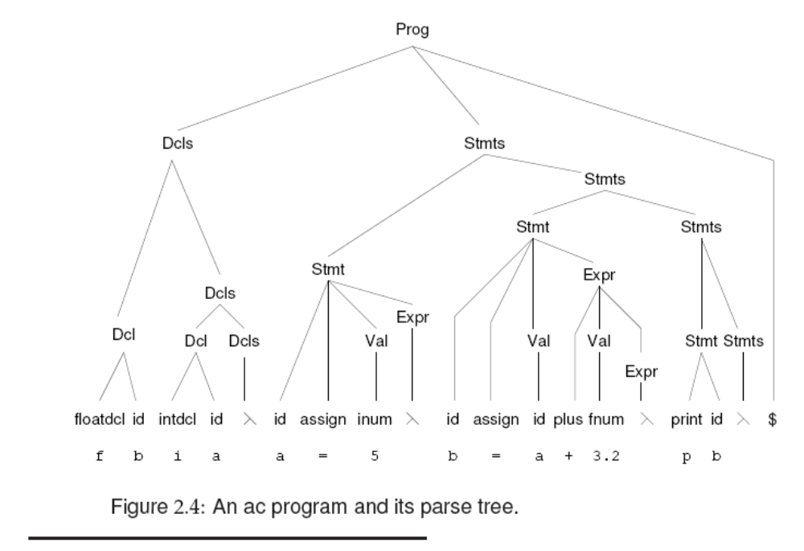

Slide 24
Quiz: Which of the following are in the language defined by the AC syntax
  f b i a a = 0 b = a + 3.2 p b
  b) p 15
  c) An empty file
  d) f b a = 1.0 i c c = 0 p a
  e) f b i a a = 0 b = - a - 3.2 p b
Department of Computer Science and Engineering

Slide 25
Quiz: Which of the following are in the language defined by the AC syntax
  f b i a a = 0 b = a + 3.2 p b
  b) p 15
  c) An empty file
  d) f b a = 1.0 i c c = 0 p a
  e) f b i a a = 0 b = - a - 3.2 p b
8. stmt → id assign val expr
9. stmt → print id
10. expr → plus val expr
| minus val expr
| λ
val → id
| inum
| fnum
Department of Computer Science and Engineering

Slide 26
Parse Tree
A Parse Tree shows how the start symbol derives a string.
Example: A→ XYZ
Example: expr → A + B - C
A
X
Y
Z
expr
expr
-
ID
ID
+
ID
Department of Computer Science and Engineering

Slide 27
Example
A subset of C grammar:
<function_decl> → <type> id ( <expr_list> ) { <block> }
<block> → <decl_list> <statement_list> | λ
A C program – a token string
int func() {}
A derivation:
Parsing: to come up with the parse tree and validate the token string is a correct C program.
function_decl
type
id
(
expr_list
)
int
?
Department of Computer Science and Engineering

Slide 28
Parse Tree
A Parse Tree has the following properties
  The root is labeled by the start symbol
  Each leaf is labeled by a token or by λ
  Each internal node is labeled by a non-terminal
  If A is the non-terminal labeling, and X,Y,Z are labels of the children of A from left to right, then A→ XYZ is a production
Parsing is the process of finding a parse tree for a given string of token.
If a grammar can have more than one parse tree for a given string, this grammar is ambiguous.
Department of Computer Science and Engineering

Slide 29
Ambiguous Grammar
Example CFG
  String → String + String
  String → String – String
  String → digit
The string 9-2+4 can have two parse trees
ST
ST
ST
ST
ST
ST
ST
ST
ST
ST
4
9
-
2
+
4
9
-
2
+
Department of Computer Science and Engineering

Slide 30
Association and Precedence
Left Association and Right Association
  An operator associates to the left if an operand has operators on both side, and the operand is taken by the operator to its left.
  Left associative operators:
    +, -, *, /
    e.g. A + B + C, A-B-C, A*B*C
  Right associative operators:
    Exponential and the assign operator
    e.g. A = B =C, (A?B:C?D:E)
Department of Computer Science and Engineering

Slide 31
Exercise
<expr> → <primary> { <add_op> <primary>}
+ and – are left associative operators, see how a string is derivated.
A {+ B} {+ C……
In the above example, B will be associated with the left operator
However, if the operator is right associative, how would the CFG be different? Consider the assignment operator, for example.
1/25/2006
Department of Computer Science and Engineering

Slide 32
Exercise (cont.)
<expr> → {<primary> <assign_op> } <primary>
➔ …. {A= } { B = } C
In the above example, B will be associated with the right operator.
Another way to define the production is
<expr> → <primary> <assign_op> <expr>
Use right recursion instead.
1/25/2006
Department of Computer Science and Engineering

Slide 33
Exercise (cont.)
CFG1. <expr> → <expr> OP <primary>
CFG2. <expr> → <primary> OP <expr>
In CFG1, OP is ?
Left Associative
In CFG2, OP is
Right Associative
Focus on what is repeating!!
(op primary) → left associative
(primary op) → right associative
3/03/2008
Department of Computer Science and Engineering

Slide 34
Precedence of Operators
* (multiply) and / (divide) have higher precedence than + and -. How is precedence of operators handled?
We can create two non-terminals for the two levels of precedence.
Example CFG
  Expr → expr + term | expr – term | term
  Term → term * factor | term / factor | factor
  Factor → digit | (expr)
But what if there are many levels
of precedences?
Operator Precedence parsing !!
table of operator priority + a stack …
Department of Computer Science and Engineering

Slide 35
Precedence of Operators in C
Operators | Associativity
() [] - > . | Left to Right
! ~ ++ -- + - * & (type) sizeof | Right to Left
* / % | Left to Right
+ - | Left to Right
<< >> | Left to Right
< <= > >= | Left to Right
== != | Left to Right
& | Left to Right
^ | Left to Right
| | Left to Right
&& | Left to Right
|| | Left to Right
?: | Right to Left
= += -= *= /= %= &= ^= |= <<= >>= | Right to Left
, | Left to Right
Department of Computer Science and Engineering

Slide 36
Parse Tree and Syntax Tree
list
+
list
digit
-
4
list
digit
digit
9
2
9
-
2
+
4
Syntax Tree
(also called AST)
Parse Tree
Department of Computer Science and Engineering

Slide 37
Parse Tree and Syntax Tree
stmt
while
while
(
expr
)
body
>
body
expr
term
term
A
0
Internal node: nonterminals
Internal node:
operators
A
>
0
Parse Tree
Syntax Tree
Department of Computer Science and Engineering

Slide 38
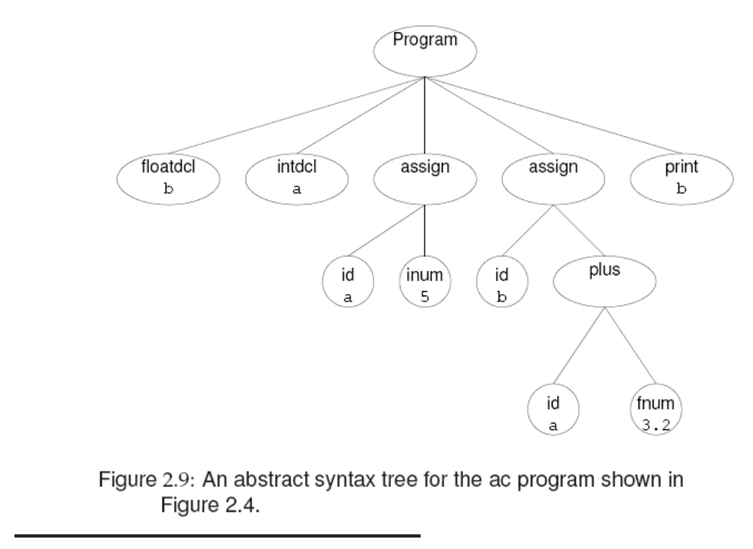

Slide 41
Parsing
Parsing is to determine if a token string can be generated by a CFG
Two common parsing methods: Top-down and bottom-up to come up with the parse tree.
Top-down starts at the root and proceeds towards leaves
Bottom-up starts at the leaves and proceeds towards the root
Department of Computer Science and Engineering

Slide 42
Parsing Example
Top-down
Bottom-up
String: abcxy
Productions:
S → AB
A → abc | w
B→ de | xy
S
S
A
B
A
B
abc
xy
abc
xy
1/25/2006
Department of Computer Science and Engineering

Slide 43
Top-down vs. Bottom-up
Top-down | Bottom-up
Easy to understand | Can handle a larger class of grammars
Efficient parsers can be built by hand | Efficient parsers can be built by tools
Some restrictions on grammars, may need to modify productions | Less restrictions on grammars
Also known as predictive parsing | More commonly used in production compilers
Department of Computer Science and Engineering

Slide 44
Recursive Descent Parsing
One of the simplest parsing method
Basic idea
  Each non-terminal has a parsing procedure
  For symbols on RHS, to match a non-terminal A, call the parsing procedure A, to match a terminal t, call match(t).
example
  Void system_goal (void)
  /* <system_goal> → <program> SCANEOF */
  {
  program();
  match (SCANEOF);
  }
Department of Computer Science and Engineering

Slide 45
Abstract Example
A → BCD
Function A
{
call B;
call C;
call D;
}
A → BxCyD
Function A
{
call B;
match(x);
call C;
match(y);
call D;
}
B,C,D are non-terminals
x,y are tokens
Department of Computer Science and Engineering

Slide 46
Abstract Example
A → BCD
| EF
Function A
{
if (lookahead == first(BCD))
{call B; call C; call D;}
elseif (lookahead == first (EF))
{call E; call F;}
}
Department of Computer Science and Engineering

Slide 47
Parsing Statement
Stmt → ID = Val Expr
| Print ID
Stmt() {
token t=next_token();
if (t == ID) { match(ID);
match(ASSIGN);
Val();
Expr();}
else if (t==Print) { match(Print); match(ID);} }
the next_token is used to determine what production to apply
Department of Computer Science and Engineering

Slide 48
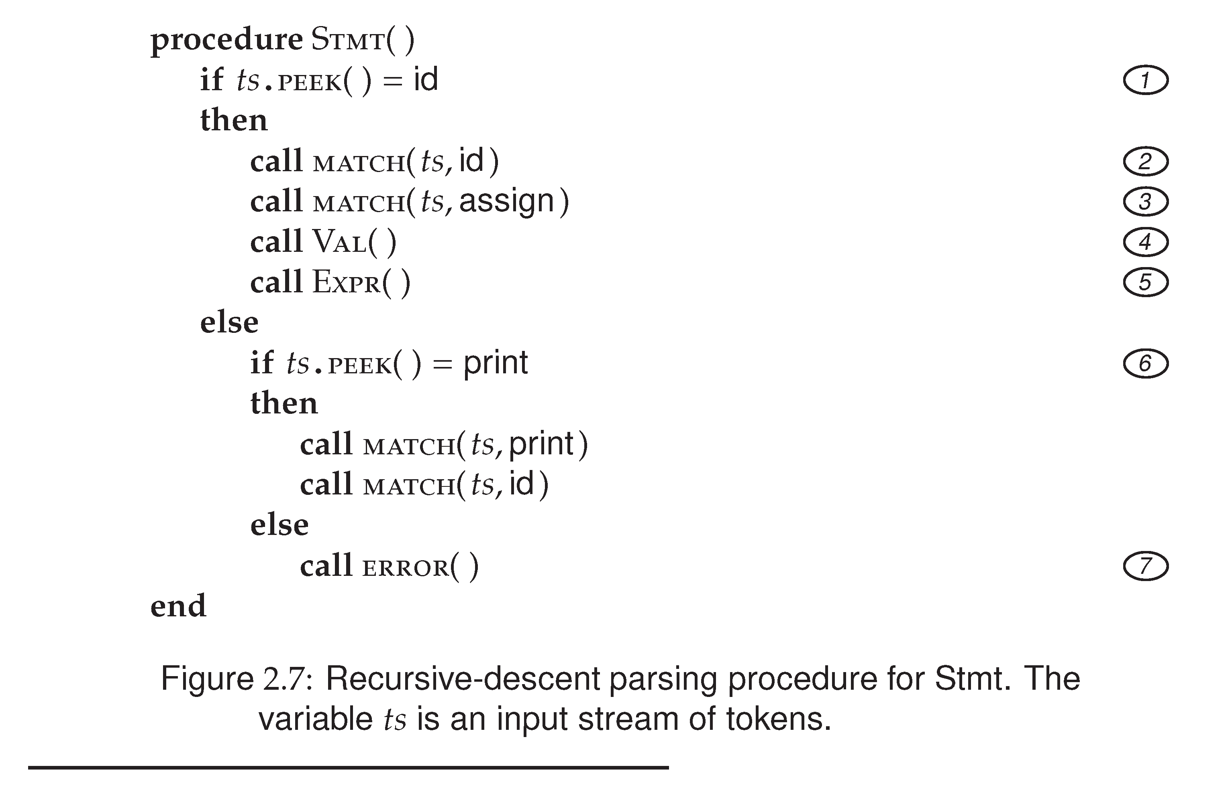

Slide 49
Constructing a Predictive Parser
Create a procedure for each non-terminal
It decides which production to use by look at the lookahead symbol. The lookahead token can uniquely determine which production to apply.
The procedure mimicking the right hand side: non-terminal will be a call, and a token match with the lookahead will cause the next token to be read.
Action routines can be copied into the parser.
Department of Computer Science and Engineering

Slide 50
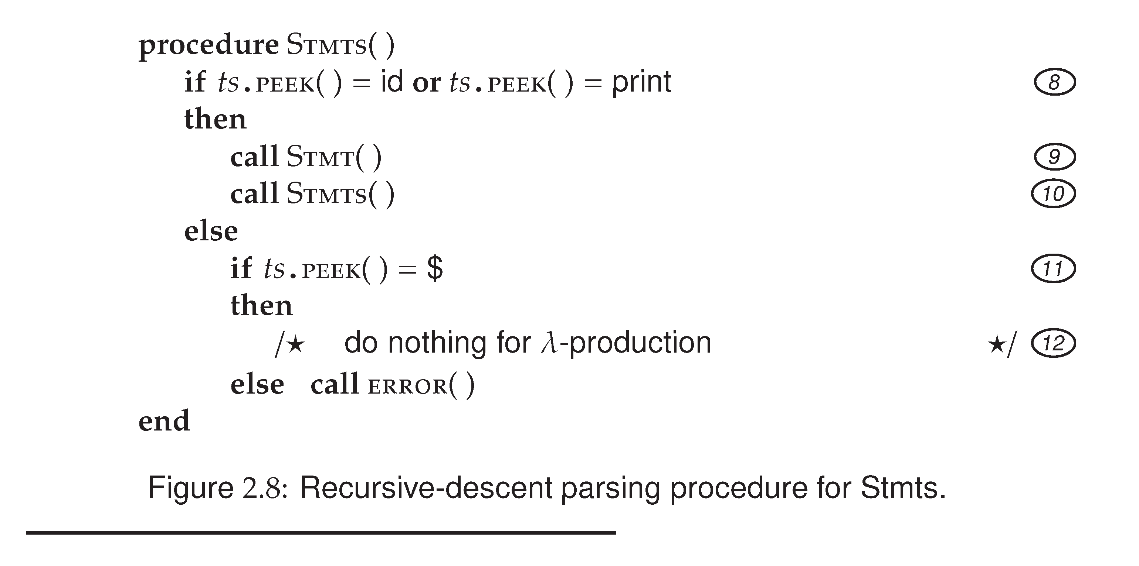
Stmts → Stmt Stmts
| λ

Slide 51
Predictive Parsing
In predictive parsing, the lookahead symbol can uniquely select the procedure for each non-terminal.
The FIRST(α) is defined to be the set of tokens that appear as the first symbols that can be generated from α.
example:
FIRST(Stmt) = {ID, print}
λ-production is used as default when no other productions can be used.

Slide 52
Predictive Parsing (cont.)
Not all CFG have the property of predictive parsing -- productions sharing the same LHS can be distinguished by the FIRST() set.
CFG with the above property is called LL(1) grammar.
LL(1) stands for “Left-to-Right, Left-most derivation”. (1) means only one lookahead token is required in predictive parsing.
The AC CFG is LL(1).

Slide 53
Left Recursion Removal
Left recursion creates troubles for recursive descent parsing
Example of left recursion
expr → expr + term
A → Aα | β{ β, βα, βαα, βααα, …..}
To eliminate left recursion, we can rewrite the productions.
A → β R
R → α R | λ { β, βα, βαα, βααα, …..}
Department of Computer Science and Engineering

Slide 54
Exercise
CFG
Expr → Expr + term
Expr → Expr – term
Expr → term
After rewriting:
Expr → term Rest
Rest → + term Rest
Rest → - term Rest
Rest → λ
What is α ?

What is β ?
α is + term and – term
β is term
Department of Computer Science and Engineering

Slide 55
Another Exercise
ID_List → ID_List , ID | ID
After rewriting
ID_List → ID Rest
Rest → , ID Rest | λ
What is α ?

What is β ?
α is , ID
β is ID
Department of Computer Science and Engineering

Slide 56
Quick Review
ΑC’s formal specification
Parsing
  What is parsing
  Two common methods of parsing
  Recursive descent parsing
  Predictive parsing
  Challenges to predicative parsing
  How to eliminate left recursions
RE and CFG
A process of finding a parse tree
Top-down & Bottom up
1st lookahead can uniquely select
a production (parsing procedure).
Left recursion &
Left factoring
A → Aα | β
A → βR
R → αR | λ
Department of Computer Science and Engineering

Slide 57
Left Recursion vs. Right Recursion
CFG for ID_list
ID_List → ID_list , ID | ID
or
ID_List → ID , ID_list | ID
Suppose the list we need to parse is
A, B, C, D, E
Department of Computer Science and Engineering

Slide 58
Top-down Parsing of ID_List
ID_List
ID
,
ID_List
A
ID
,
ID_List
B
ID
,
ID_List
C
CFG: ID_List → ID , ID_list | ID
Department of Computer Science and Engineering

Slide 59
Predictive Parsing of ID_List
ID_List
ID
Rest
A
,
B
Rest
,
C
Rest
CFG: ID_List → ID Rest
Rest → , ID Rest | λ
Department of Computer Science and Engineering

Slide 60
Bottom-up parsing of ID_List
ID_List
ID_List
ID_List
ID_List
ID
ID
ID
A
,
B
,
C
CFG: ID_List → ID_list , ID | ID
Department of Computer Science and Engineering

Slide 61
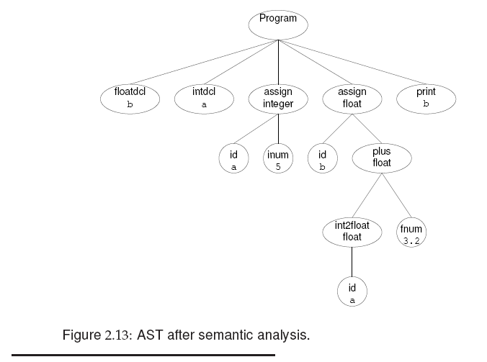

Slide 62
Building AST
AST is built during parsing
Example:
ParseStatement()
{
switch (source.peek().type) {
case: Token.identifier:
Token identifier = source.nextToken();
Token assign = source.peek();
if (source.peek().type() == Token.AssignmentOp) {
source.nextToken();
AST v=parseValue();
return AST.makeTree(assign, identifier, v, parseExpressionTail(v));

Slide 63
Semantic Analysis
Post-parsing processing to enforce aspects of a language’s definition that are not easily checked by syntax analysis.
  Symbol table
  Type checking
  Types are examined for consistency
  Type dependent behavior becomes explicit

Slide 64
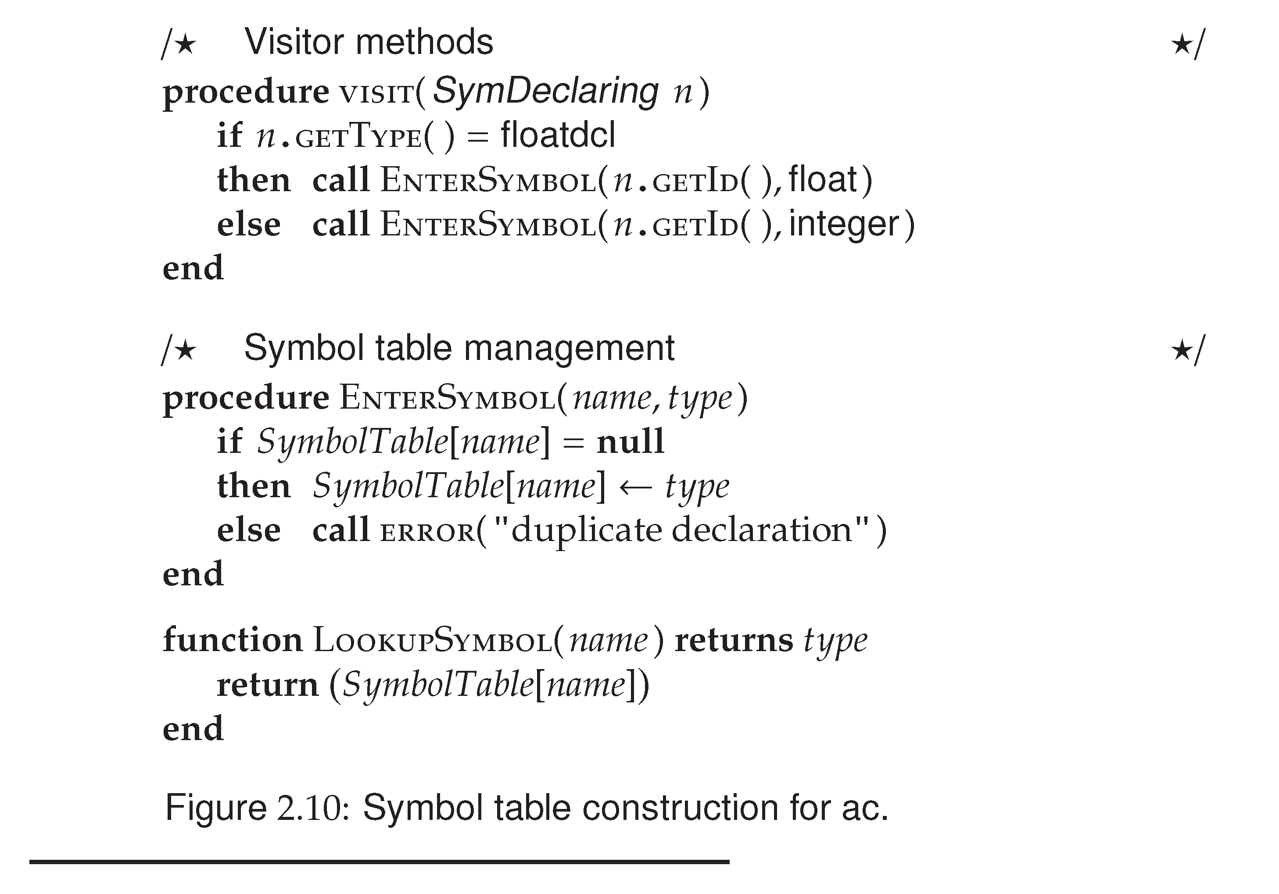

Slide 65
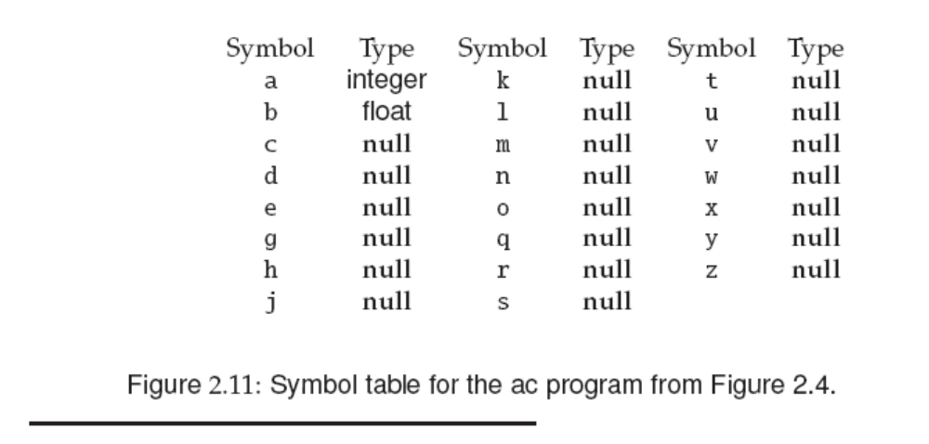

Slide 66
Type Checking in AC
All identifiers must be declared. After symbol table construction, executable statements can be checked for type consistency.
Automatic widening (e.g. from integer to float) is allowed in AC.
Narrowing is considered illegal in AC.
This process walks the AST bottom-up, from its leaves toward its root. At each node, the appropriate visitor method is applied.

Slide 67
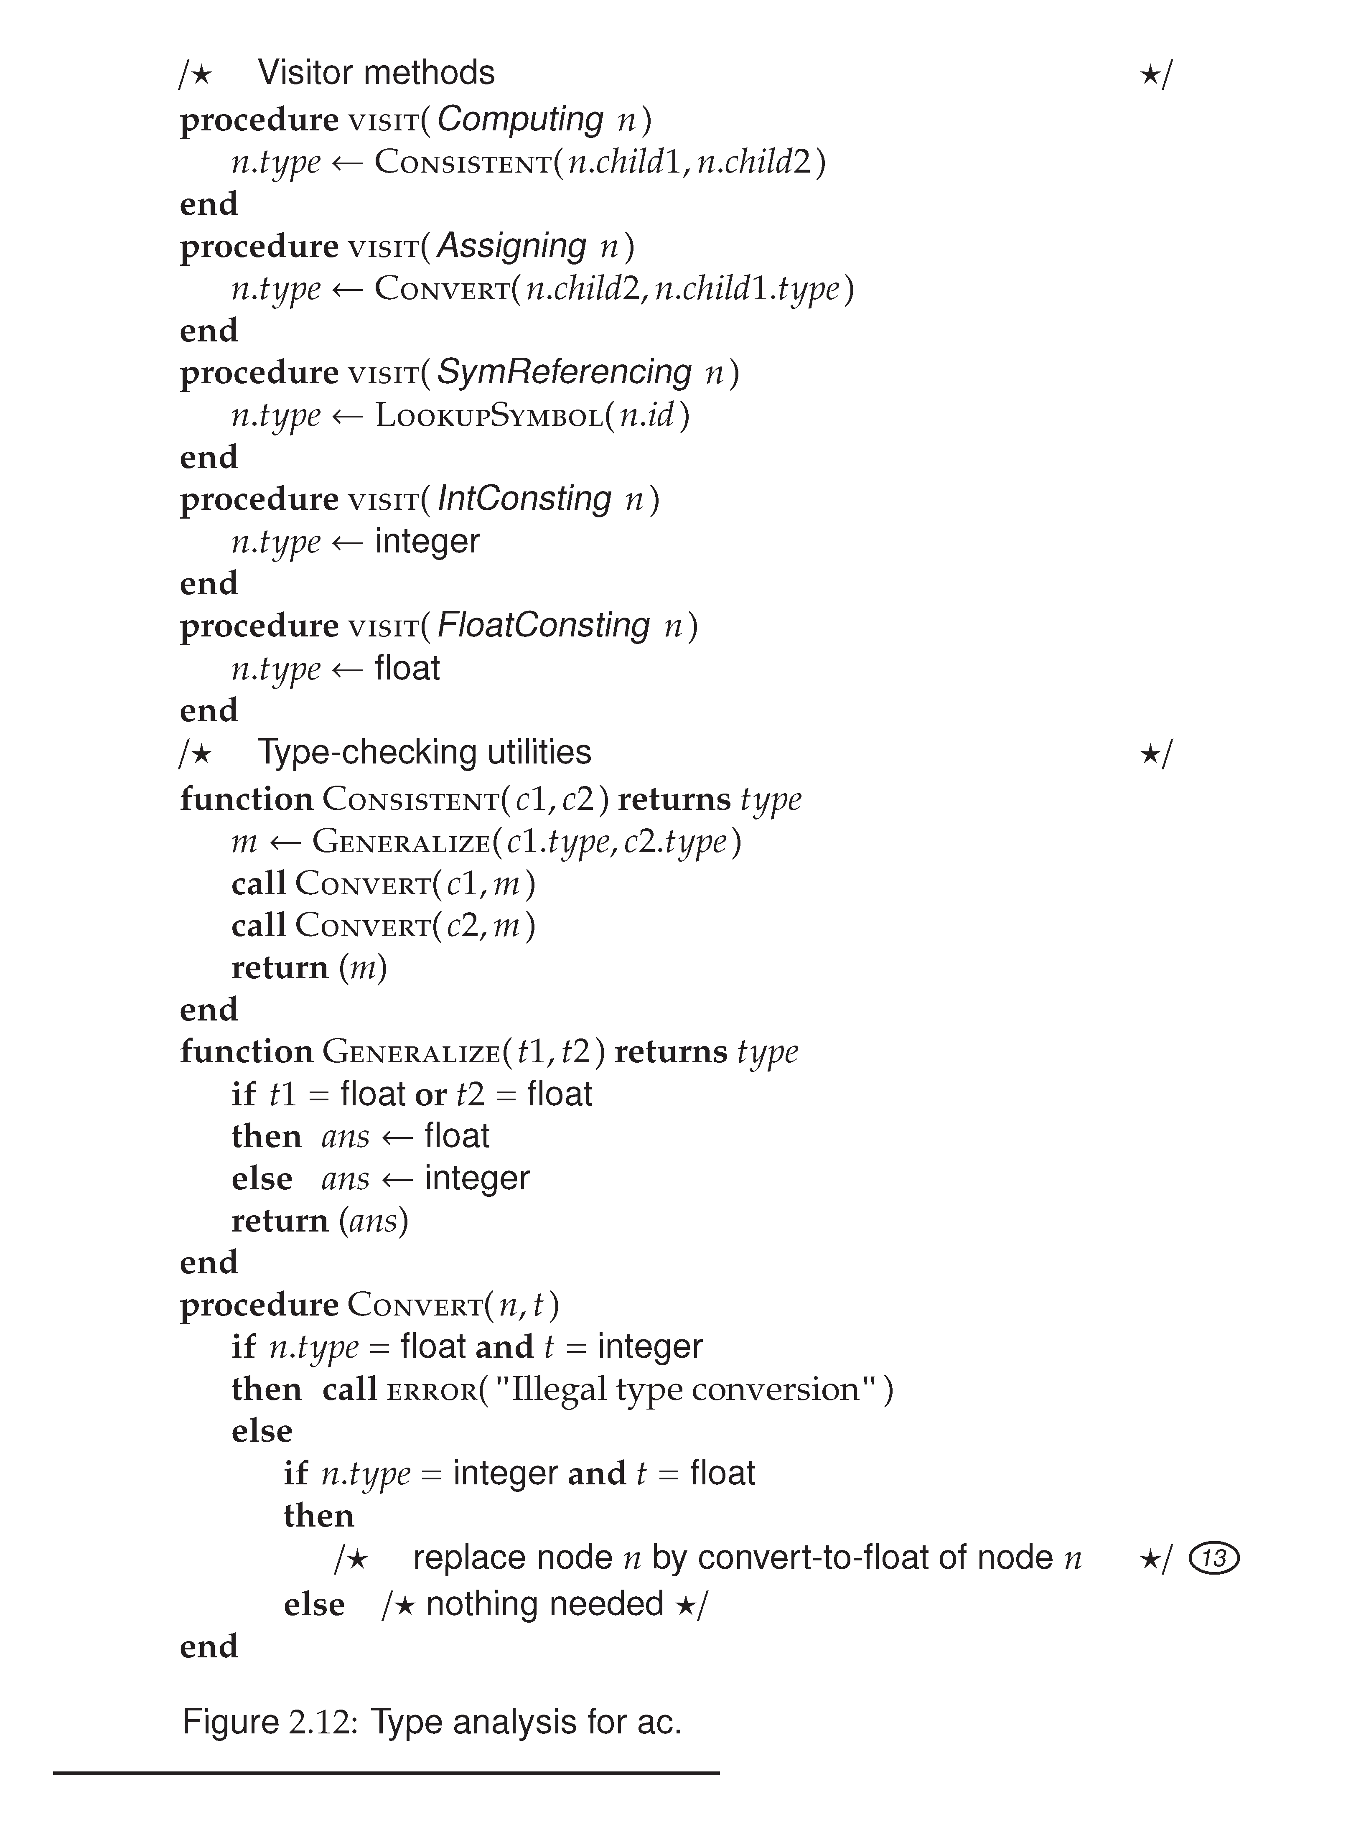

Slide 69
Translating AC
Target language: DC
Note that we do not worry about registers at this time.
  temporaries: To evaluate expressions, we need to hold temporary values.
    e.g. A+B+C
      ADD A,B,TEMP&1
      ADD TEMP&1,C,TEMP&2
  In real compilers, registers are typically used as temporaries.
  For our target code DC, we use the stack for temporaries.

Slide 70
About Assignment #1
Loading/Storing variables
  DC allows single character named registers for storing variables and for later retrieval.
  e.g.
  sc
  means pops the top of the stack and stores it in register c
  lc
  means push the value of register c
  onto the stack
  To simplify our first assignment, we limit the
  number of variables declared/used to be <= 23.

Slide 71
Some Questions
What are differences among Top-down, recursive descent, and predictive parsing?
Top-down parsing: build the parse tree top-down, left-to-right.
Recursive descent: one way to implement top-down parsing, may need to backtrack
Predictive parsing: recursive descent parsing when the CFG is LL(k), no backtracking.

Slide 72
Example
What parsing method is used by the AC compiler?
Top-down parsing
Recursive descent parsing
Predictive parsing
Bottom-up parsing
a,b,c

Slide 73
Left and Right Recursions
Why left recursion fails recursive descent parsing
ID_list → ID_list , ID | ID
ID_list()
{ ID_list(); match(“,”); match(ID); }
Why right recursion is OK
ID_list → ID R
R → , ID R | λ
Assuming the token string is A,B,C,D,E;

Slide 74
About AST building
CFG with left recursion
Expr → Expr + Term
maketree(“+”, Expr(), Term());
AC CFG with right recursion
Stmt → id assign Val Expr
Expr → + Val Expr
| - Val Expr
maketree(op, previous-subtree, Val);

Slide 75
Code Generation for AC
Code generation proceeds by traversing the AST, starting at its root and walking toward its leaves.
  Computing node: + and –
  code generator is called recursively to generate code for the left and right subtrees.
  Assigning node
    Evaluate the expression first, then the result is stored to a DC register. Also reset the precision to integer.
  SymReferencing node, Printing node, Converting node

Slide 76
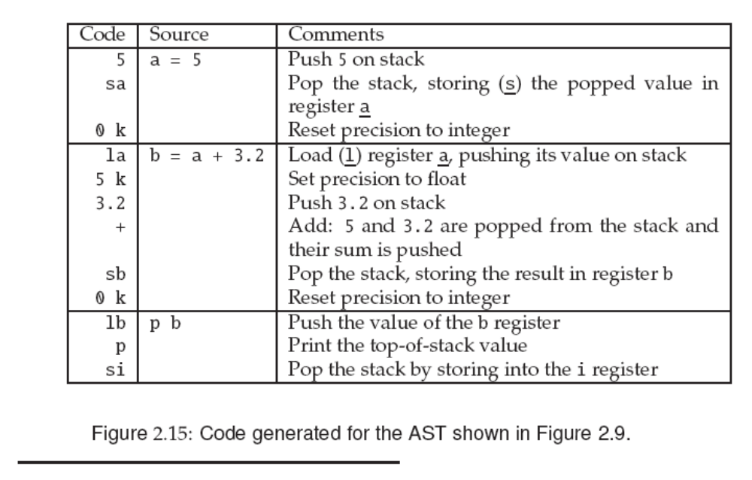

Slide 77
Syntax Directed Translation
Syntax-directed definition
  CFG + semantic rules
  Translation of a construct is specified by
    attributes associated with the grammar symbol
    semantic rules associated with each production
  Semantic rules can be actual code known as semantic routines (or action routines)
  Attributes can be type, name, memory location, structure, .. etc
  Most of the translation is done by semantic routines
e.g. Exp1→Exp2+Term (Exp2.type == numeric &&
Term.type==numeric).
attributes
Semantic rules

Slide 78
Single Pass vs. Multi-Pass Compilation
For our term project, semantic check and code generation can be accomplished together. The compilation process only goes through the code once. This is called single pass compilation.
Production compilers usually adopt multiple pass compilation. They usually generate AST (Abstract Syntax Tree) as IR, and conduct semantic check, code generation, and optimization in multiple passes. Each phase is implemented as a separate pass.

Slide 79
Semantic Routines
Action Symbols
  The bulk of a translation is done by semantic routine
  Action symbols can be added to a grammar to specify when semantic processing should take place
    Be placed anywhere in the RHS of a production
  translated into procedure call in the parsing procedures
    #add corresponds to a semantic routine named add()
  No impact on the languages recognized by a parser driven by a CFG

Slide 80
Semantic Records
In the code example, the semantic record for <expr> needs to specify information like type, what location is the expression saved (e.g. a temporary name), a constant value, … etc
Semantic record for a non-terminal (LHS) is created by a semantic routine after using the information of the symbols on RHS.
Example
<expr> → <primary> + <primary> #gen_infix
The gen-infix routine uses the information in the two semantic records for <primary> to generate a new record for <expr>.

Slide 81
Semantic Record (cont.)
When the semantic routine gen_infix is called, it must be given the semantic records of the two <primary> symbols.
Semantic records of non-terminals can be returned by the parsing routine (either as a result parameter or as a function return value)
Variant record
Information stored for various symbols are often different. So variant records (i.e. union in C) is often used to define one structure for all semantic records (especially true for using a parser generator)

Slide 82
Semantic Record for Expr
typedef struct operator {
enum op {PLUS, MINUS} operator;
} op_rec;
enum expr {IDexpr, LITexpr, TEMPexpr}
typedef struct expression {
enum expr kind;
union {
string name;
int value; }
} expr_rec;

Slide 83
Combined Variant Record
enum sem_type {op_type, expr_type}
typedef struct semantic_record {
enum sem_type tag;
union {
op_rec *op;
expr_rec *expr; } u;
} semantic_rec;

Slide 84
Combined Variant Record
Example:
union {
char *lexeme;
int intval;
float floatval;
decl *dcl;
id_list *idl;
par_list *pal;
ArrayInfo *arrinfo;
…}

Slide 85
Summary
A syntax-directed translator for simple language AC
Syntax definition – using CFG
Syntax-directed definition – CFG plus semantic routines (semantic attributes + semantic rules)
Predictive parsing – recursive descent parsing with unique FIRST() set
Left recursion elimination
Single pass translation: Action symbols and semantic records
Department of Computer Science and Engineering

