Slide 1
Ch 3. Scanning – Theory and Practice
How to specify and implement a scanner (i.e. lexical analyzer)
Using regular expressions (RE) to define tokens
Using a scanner generator: Lex
Practical considerations
Theory behind scanner generator: converting RE into DFA and transition table
Department of Computer Science and Engineering
Notes:
Processing of network packets, display of web pages, interpretation of digital video and audio media all require some form scanning

Slide 2
The Role of a Lexical Analyzer
pass token
and attribute value
read char
Lexical
analyzer
Parser
Source
program
put back
char
get next
Symbol Table
Read entire
Program (or module) into
memory
Application of scanning:
network packets, display of web pages,
Interpretation of digital video/audio, text search,
... etc.
2013/10/16
Department of Computer Science and Engineering

Slide 3
Lexical Analyzer
Functions
  Grouping input characters into tokens
  Stripping out comments and white spaces
  Correlating error messages with the source program
  Preprocessing (e.g. macro expansion, ..)
Issues (why separating lexical analysis from parsing)
  Simpler design
  Compiler efficiency
  Compiler portability
Department of Computer Science and Engineering

Slide 4

Typical Tokens in common PL
Symbols, operators
+, -, *, /, =, <, >, ->, …
Keywords or Reserved words
if, while, struct, float, int, …
Integer and Real (floating point) literals
123, 123.45
Char (string) literals
Identifiers
Comments
White space
Department of Computer Science and Engineering

Slide 5

Case Study
String Literals
  Quoted strings are most commonly used
  How about delimiter collision (e.g. want a quotation mark in the string)
  Can newline characters appear in string?
    C allows them if they have been escaped (\)
    Pascal forbids it
    Ada forbids unprintable characters in strings
  Are null strings (of length 0) allowed?
    Pascal forbids them
    Ada and C allow null strings
Department of Computer Science and Engineering

Slide 6
Case Study (cont.)
When blanks are not significant (as in Fortran and Algol68)
DO 5 I = 1.25
DO 5 I = 1, 25
DO5I is an ID
This is a DO loop
So 7 tokens will get generated
Department of Computer Science and Engineering

Slide 7
Case Study (cont.)
Should 1. And .10 be legal constant?
If yes, then how to tell
Is 1..10 a range ? or two constants 1. And .10?
Note that 1. And .10 are both allowed in Fortran and C, but not allowed in Pascal and Ada – because Pascal and Ada support ranges.
Department of Computer Science and Engineering

Slide 8
Why Formal Specification?
Precise definition of tokens is necessary to ensure lexical rules are properly enforced.
Allows flaws to be discovered before the design is completed.
Allows automatic scanner generation.
A trend towards nonprocedural programming.
Department of Computer Science and Engineering

Slide 9
Regular Expressions (RE)
Why RE?
  Suitable for specifying the structure of tokens in programming languages
Basic concept
  A RE defines a set of strings (called regular set)
  Vocabulary/Alphabet : a finite character set V
  Strings are built from V via catenation
  Three basic operations: concatenation, alternation ( | ) and closure (*).
  ∅ is a RE denoting the empty set
  λ is a RE denoting the set that contains only the empty string.
Department of Computer Science and Engineering

Slide 10
Example
The identifier in Pascal can be defined as
letter (letter | digit) *
More examples
  a | b denotes the set {a,b}
  (a|b) (a|b) denotes the set {aa, ab, ba, bb}
  a* denotes { λ, a, aa, aaa, …}
  (a|b)* denotes all strings of a’s and b’s
Department of Computer Science and Engineering

Slide 11
Regular Definition
We may give names to regular expressions and to define regular expressions using these names
letter = A | B | C …. | a | b | c …. | z
digit = 0 | 1 | 2 | … | 9
id = letter (letter | digit) *
digits = digit digit*
Department of Computer Science and Engineering

Slide 12
Regular Definition
Question: How is regular definition different from CFG?
Answer:
CFG allows recursion – a non-terminal can show up in the right hand side of itself.
Regular Definition does not allow recursion. It is like Macro definition.
Department of Computer Science and Engineering

Slide 13
Common notations and Metacharacter
* means repeat zero or more times
+ means repeat one or more times
? means repeat zero or one time
  P+ == PP*
  Not(A) == V – A /* A is a set of char
  Not(S) == V* - S /* S is a set of strings
  A^{K} == AA …A (k copies)
  P? == P | λ
Department of Computer Science and Engineering

Slide 14
Common notations (cont.)
[abc] means a | b | c
  [] form a character class which matches any char listed
  A negate class can be specified by an upper arrow e.g. [^ab] matches any char except a and b.
[a-z] denotes the RE a | b | c …. | z
() used for grouping, e.g. (a|b)
A dot (.) matches any character, except a new line
Department of Computer Science and Engineering

Slide 15
Common notations (cont.)
[abc] means a | b | c
  [] form a character class which matches any char listed
  A negate class can be specified by an upper arrow e.g. [^ab] matches any char except a and b.
[a-z] denotes the RE a | b | c …. | z
() used for grouping, e.g. (a|b)
A dot (.) matches any character, except a new line
How about precedence?
ab|c → ab or c
b I ac* → b or a or ac+
* > catenation > alternation
Department of Computer Science and Engineering

Slide 16
Special Characters
The following characters have special meaning when they are inside a char class.
  { start of macro name
  } end of macro name
  ] end of a char class
  - range of characters
  ^ negative char class
  \ take away special meaning of the next char
Other metacharacters, such as *,+,? are not special in a char class. For instance, [*?] matches * or ?.
Department of Computer Science and Engineering

Slide 17
Notation Examples
[a-z]
[z-a9-0] this is ok
[a\-z]
[a^b]
[^a-z]
[0-z] non-portable warning
({letter})*
ab*
Department of Computer Science and Engineering

Slide 18
Exercise
D=[0-9]
L=[A-Z]
D= (0 | 1 | 2 …| 9) L=(A |… | Z)
A Java or C++ single line comment that begins with // and ends with Eol
comment = // [^\n]*\n
A fixed decimal literal
decimal = D+ “•“ D+
b) An identifier, composed of L,D, and _ that begins with a letter, ends with a letter or digit
  ident = L (L | D)* (_+ (L | D)⁺)*
c) A comment delimited by ## that allows # in the body
  comments = ##([#]?[^#])* ##
// (.)*\n
How about
L (L|D|_)*(L|D)+
How about
C identifiers?
Department of Computer Science and Engineering

Slide 19
Exercise (cont.)
How about
(D+)?[\.](D+)?(e(+|-)?D+)?
Token While
while = “while”
White space
note: newline is often treated differently to track line number
WhiteSpace = [ \t]+
Define floating point constants. It can be any of the following forms
1.25e12 .25 .12e+10 12.5e-5 12e6
How about
(D+)?(\.D+)?(e(+|-)?D+)?
(D+ (\. D+)? (e (+|-)?D+)?) |
(D+)? (\. D+) (e (+|-)?D+)?
How about
125 ?
Department of Computer Science and Engineering

Slide 20
Exercise (cont.)
Token While
while = “while”
White space
note: newline is often treated differently to track line number
WhiteSpace = [ \t]+
Define floating point constants. It can be any of the following forms
1.25e12 .25 .12e+10 12.5e-5 12e6
(D+)(e(+|-)?D+) | (D+ (\. D+) (e (+|-)?D+)?) |
(D+)? (\. D+) (e (+|-)?D+)?
Department of Computer Science and Engineering

Slide 21
Non-regular set
RE can denote an unspecified number of repetitions of a given construct. Its best use is for describing identifiers, constants, … etc.
RE can not be used to describe balanced or nested structures, such as nested loops, nested if-then-else.
Example:
{ [^{i}]^{i} | i≥1} ➔ [[[ ]]], [[[[ ]]]], …
can we define it as
R = (“[“ R* “]”) ?
Department of Computer Science and Engineering

Slide 22
Finite Automata and Scanners
A Finite Automation (FA) can be used to recognize the tokens specified by a RE
Nondeterministic Finite Automation (NFA)
  A set of states
  A set of input symbols
  A transition function, move(), that maps state-symbol pairs to sets of states.
  A start state S0
  A set of states F as accepting (Final) states.
Department of Computer Science and Engineering

Slide 23
Example (RE=(a|b)*abb)
a
start
a
b
b
S0
S1
S2
S3
b
The set of states = {0,1,2,3}
Input symbol = {a,b}
Start state is S0, accepting state is S3
Department of Computer Science and Engineering

Slide 24
Transition Function
Transition function can be implemented as a transition table.
State | Input Symbol
 | a | b
0 | {0,1} | {0}
1 | -- | {2}
2 | -- | {3}
Department of Computer Science and Engineering

Slide 25
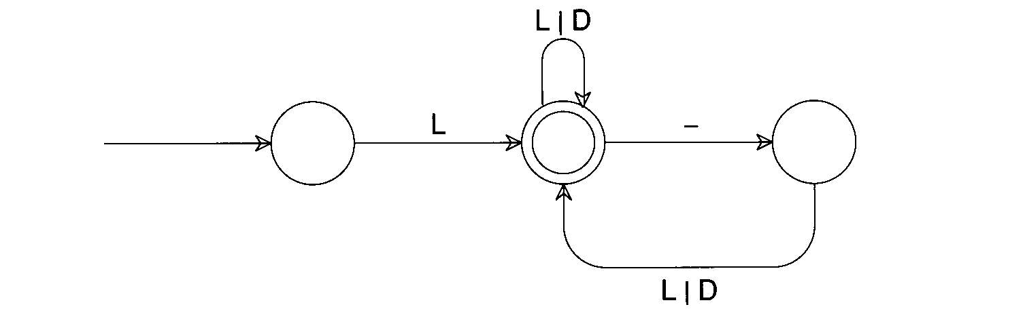
Example
ID = L(L|D)*(_(L|D)⁺)*
Department of Computer Science and Engineering

Slide 26
Non-deterministic Finite Automata (NFA)
  An NFA accepts an input string x iff there is a path in the transition graph from the start state to some accepting (final) states.
  The language defined by an NFA is the set of strings it accepts
Deterministic Finite Automata (DFA)
A DFA is a special case of NFA in which
  There is no λ-transition
  Always have unique successor states.
Department of Computer Science and Engineering

Slide 27
  How to simulate a DFA
  s := s0;
  c := nextchar;
  while ( c <> eof) do
  s := move(s, c);
  c := nextchar;
  end
  if (s in F) then return “yes”
Department of Computer Science and Engineering

Slide 28
Conversion of NFA to DFA
Why?
  DFA is difficult to construct directly from RE’s
  NFA is difficult to represent in a computer program and inefficient to compute
Conversion algorithm: subset construction
  The idea is that each DFA state corresponds to a set of NFA states.
  After reading input a1, a2, …, an, the DFA is in a state that represents the subset T of the states of the NFA that are reachable from the start state.
Department of Computer Science and Engineering

Slide 29
NFA to DFA conversion
a
start
a
b
b
0
1
2
3
b
(0,a) = {0,1}
(0,b) = {0}
({0,1}, a) = {0,1}
({0,1}, b) = {0,2}
({0,2}, a) = {0,1}
({0,2}, b) = {0,3}
New states
A = {0}
B = {0,1}
C = {0,2}
D = {0,3}
 | a | b
A | B | A
B | B | C
C | B | D
D | B | A
Department of Computer Science and Engineering

Slide 30
NFA to DFA conversion (cont.)
a
a
start
a
b
b
A
B
C
D
b
a
RE = =(a|b)*abb
abababb
aabbabb
abbbbaabb
b
 | a | b
A | B | A
B | B | C
C | B | D
D | B | A
Department of Computer Science and Engineering

Slide 31
NFA to DFA conversion (cont.)
a
a
1
2
λ
start
0
b
λ
b
3
4
How about λ-transition?
Due to λ-transitions, we must compute λ-closure(S) which
is the set of NFA states reachable from NFA state S on
λ-transition, and λ-closure(T) where T is a set of NFA states.
Example: λ-closure (0) = {0,1,3}
Department of Computer Science and Engineering

Slide 32
NFA to DFA conversion (cont.)
a
λ
1
2
λ
start
0
b
λ
b
3
4
λ-closure (0) = {0,1,2,3}
Department of Computer Science and Engineering

Slide 33
Subset Construction Algorithm
Dstates := λ-closure (s0)
While there is an unmarked state T in Dstates do
begin
mark T;
for each input symbol a do
begin
U := λ-closure ( move(T,a) );
if U is not in Dstates then
add U as an unmarked state to Dstates;
Dtran [T, a] := U;
end
end
Department of Computer Science and Engineering

Slide 34
Example
λ
a
2
a
a|b
start
4
5
1
a
3
b
Dstates := λ-closure(1) = {1,2}
U:= λ-closure (move( {1,2}, a)) = {3,4,5}
Add {3,4,5} to Dstates
U:= λ-closure (move( {1,2}, b)) = {}
λ-closure(move( {3,4,5}, a)) = {5}
λ-closure (move( {3,4,5}, b)) = {4,5}
λ-closure (move( {4,5}, a)) = {5}
λ-closure (move( {4,5}, b)) = {5}
 | a | b
A{1,2} | B | --
B{3,4,5} | D | C
C{4,5} | D | D
D{5} | -- | --
3/07/2008
Department of Computer Science and Engineering

Slide 35
DFA after conversion
 | a | b
A{1,2} | B | --
B{3,4,5} | D | C
C{4,5} | D | D
D{5} | -- | --
b
start
a
B
C
A
a
D
a|b
3/07/2008
Department of Computer Science and Engineering

Slide 36
Transition Table and Driver
The transition diagram can be naturally implemented by a transition table.
Table[ state ] [ c]
The driver looks as follows:
While (not eof) {
new_state = Table [current_state ] [c ]
c = nextchar();
current_state = new_state;
}
Department of Computer Science and Engineering

Slide 37
Practical Considerations
Reserved words
Compiler Directives and Listing Source Lines
Entry of Identifiers into the Symbol Table
Scanner Termination
Multi-character Lookahead
Lexical Error Recovery
3/07/2008
Department of Computer Science and Engineering

Slide 38
Reserved Words
When key words are not reserved words (such as in PL/1)
example 1:
IF THEN THEN THEN = ELSE ELSE ELSE = THEN;
Which THEN is an identifier?
Which THEN is the key word?
example 2:
Declare (arg1, arg2, arg3, …)
Is Declare a subroutine name or is it the key word?
3/07/2008
Department of Computer Science and Engineering

Slide 39
Reserved Words (cont.)
Assume begin and end are not reserved in Pascal.
example 3:
begin
begin;
end;
end;
begin;
end
How to parse this
code fragment?
For example 1 and 2,
ambiguity can be solved
by multiple characters look
ahead.
3/07/2008
Department of Computer Science and Engineering

Slide 40
Compiler Directives
Compiler options e.g. optimization, profiling, etc.
    handled by scanner or semantic routines
    Complex pragmas are treated like other statements.
Source inclusion
    e.g. #include in C
    handled by preprocessor or scanner
Conditional compilation
    e.g. #if, #endif in C
    useful for creating program versions
3/07/2008
Department of Computer Science and Engineering

Slide 41
Entry of ID into the Symbol Table
For simple language with only global variables, it is common to have the scanner enter an ID into the symbol table.
How about block-structured languages?
  { int a;
  …
  { int a; }
  }
Let the semantic routine to enter.
3/07/2008
Department of Computer Science and Engineering

Slide 42
Scanner Termination
Return Eof when the end of the input file is reached. (may need to define the Eof token)
What if a scanner is called after the end of file is reached?
  We may continue to return Eof. This is better than crash with a fatal error since it allows the parser to handle termination cleanly.
Department of Computer Science and Engineering

Slide 43
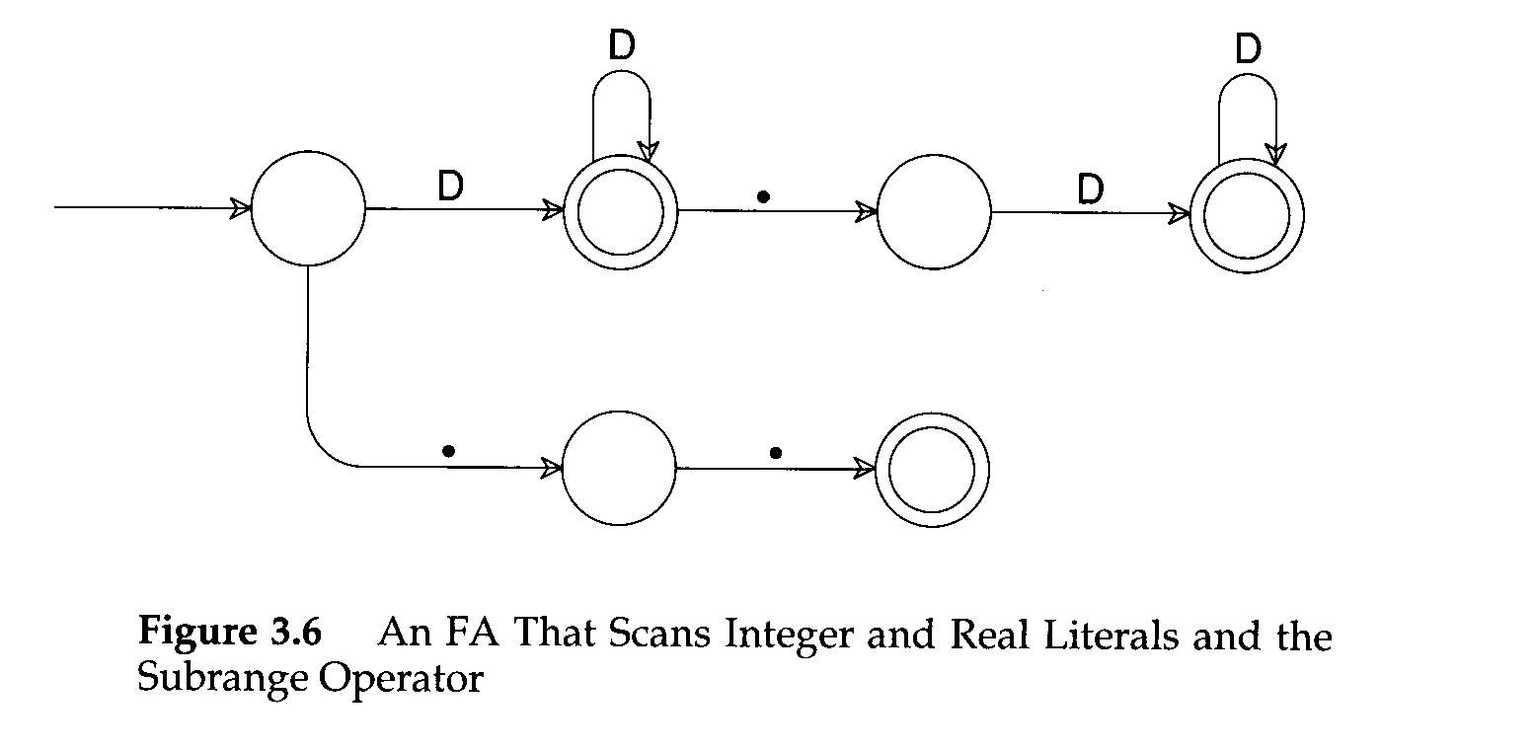
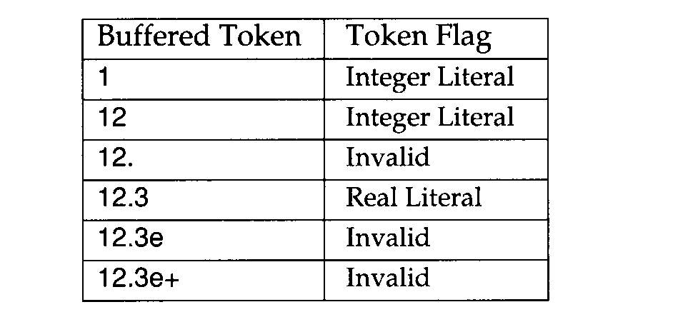
Multicharacter Lookahead
We can generalize FAs to look ahead beyond the next input char – this is important for implementing Fortran.
  remember the DO 10 I=1,100 case?
If we reach a situation in which we are not in final state backup is invoked until we reach a prefix of the scanned characters flagged as a valid token
Two examples for the following FA:
10..100 and 12.3e+q
Department of Computer Science and Engineering

Slide 44
Lexical Error and Recovery
Error detection
Error reporting
Error recovery
  Delete the current character and restart scanning at the next character
  Delete the first character read by the scanner and resume scanning at the character following it.
  How about runaway strings and comments?
Department of Computer Science and Engineering

Slide 45
LEX – A Language for Specifying
Lexical Analyzers
Lex is a lexical analyzer generator
  Implemented by Lesk and Schmidt of Bell Lab initially for Unix
  Not only a table generator, but also allows “actions” to associate with RE’s.
  Lex is widely used in the Unix community
  Lex is not efficient enough for production compilers, however, Flex (Fast Lex) is an improved version.
Department of Computer Science and Engineering

Slide 46
Lex Usage
Lex source lex.l
Lex
Lex.yy.c
Lex.yy.c
C/C++ compiler
a.out
Input stream
a.out
tokens
3/07/2008
Department of Computer Science and Engineering

Slide 47
Lex Specification
Declaration
  Variables, constants
  Regular definitions to define character class and auxiliary regular expressions
Translation rules
  Regular expression-1 {action 1}
Auxiliary procedures
  Routines needed by actions
  Symbol table routines
Department of Computer Science and Engineering

Slide 48
Example
%{
#define THEN 5
#define ID 100
%}
WS [ \t]+
letter [A-Za-z]
digit [0-9]
id {letter}( {letter} | {digit})*
%%
{WS} {}
{id} {yylval = insert_id(); return(ID);}
%%
Insert_id() {…}
Definition section
%%
Rules section
%%
Subroutine section
To pass attributes to the
parser, a global variable
yylval is often used.
Department of Computer Science and Engineering

Slide 49
Overlapped Regular Expressions
Lex allows RE’s to overlap. In the case of overlapped RE’s, two rules apply:
  Longest possible match, for example, how to get “<=“ token rather than “<“ and “=“.
  Order of rules. If two RE’s match the same string, the earlier rule is preferred.
  So if8 is an identifier while if is a reserved word. (assuming if is defined as a token by RE).
Department of Computer Science and Engineering

Slide 50
Lookahead Operator
In Lex/Flex, “/” is a special lookahead operator. It supports some PL constructs that need to look ahead beyond the end of a lexeme to determine a token. For example, a pattern “RE1 / RE2” matches RE1 only if it is followed by RE2.
Example: how to distinguish IF(I) = 3 from a regular IF statement, such as IF(I) A=B or IF(I) THEN …
IF / \( .*\) {letter} or
IF / {ws}”(“.*”)”{ws}{letter}
Department of Computer Science and Engineering

Slide 51
Special Variables/Procedures
yytext where token text is stores
yyleng length of the token text
yylineno the current line number
yylex() name of procedure for the lex generated scanner
yywrap A user supplied function. It returns 1 when no more input to process, otherwise, return 0
yyin, yyout input and output files
Department of Computer Science and Engineering

Slide 52
Additional Notes
[^a-z] negate the char class will also match a new line “\n”. This is true in Lex and Flex, but not necessary true in other implementation of RE.
ECHO copies yytext to output
If you use Lex, link with lex library –lf, if you use Flex, link with library –lfl.
EOF is not handled by RE, it is signaled by having yylex() to return integer 0.
Department of Computer Science and Engineering

Slide 53
Lexical Analyzer Generator
Lexical analyzer generator is to transform RE into a state transition table (i.e. Finite Automation)
Theory of such transformation
Some practical consideration
Department of Computer Science and Engineering

Slide 54
Map RE to NFA
Three basic operations
  All RE’s are built out of atomic regular expressions by using concatenation, alternation and closure.
Constructing A|B
FA for A
λ
A
λ
FA for B
λ
B
λ
Department of Computer Science and Engineering

Slide 55
Map RE to NFA
Constructing AB
λ
FA for A
λ
A
FA for B
B
Department of Computer Science and Engineering

Slide 56
Map RE to NFA
Constructing A*
λ
FA for A
λ
A
λ
λ
Department of Computer Science and Engineering

Slide 57
Example
Constructing NFA for regular expression
r = (a|b)*abb
Step 1: constructing a | b
a
A
λ
λ
λ
B
λ
b
Department of Computer Science and Engineering

Slide 58
Example
Constructing NFA for regular expression
r = (a|b)*abb
Step 2: constructing (a | b)*
ε
ε
a
A
ε
ε
B
ε
b
ε
Department of Computer Science and Engineering

Slide 59
Example
Constructing NFA for regular expression
r = (a|b)*abb
Step 3: catenate with abb
ε
a
a
b
b
ε
ε
ε
ε
b
ε
Department of Computer Science and Engineering

Slide 60
Optimizing Finite Automata
Minimizing the number of states
  For every DFA, there is a unique smallest equivalent DFA (that accept the same set of strings).
start
a
b
c
1
2
3
4
d
b
c
5
6
7
Department of Computer Science and Engineering

Slide 61
Optimizing Finite Automata
start
a
b
c
1
2
3
4
b
c
d
5
6
7
 | a | b | c | d
1 | 2 |  |  | 5
2 |  | 3
3 |  |  | 4
4
5 |  | 6
6 |  |  | 7
7
State 2 and state 5
State 3 and 6
State 4 and 7
Are equivalent!
Department of Computer Science and Engineering

Slide 62
We may begin by trying the most aggressive (or optimistic) merge by creating only two states: final state and non-final state. We then split the states.
Algorithm:
Repeat
Let S be any merged state {s1, s2, ..,sn}, and c be any input symbol.
Let t1, t2, … tn, be the successor state to {s1, .. sn} under c, if t1, .. tn do not all belong to the same merged state then split S into new states so that si and sj remain in the same merged state iff ti and tj are in the same merged state.
Until no more splits are possible.
Department of Computer Science and Engineering

Slide 63
Optimizing Finite Automata
Start with two states
Non-final = {1,2,3,5,6}
Final = {4,7}
 | a | b | c | d
1 | 2 |  |  | 5
2 |  | 3
3 |  |  | 4
4
5 |  | 6
6 |  |  | 7
7
Department of Computer Science and Engineering

Slide 64
Optimizing Finite Automata
Start with two states
Non-final = {1,2,3,5,6}
Final = {4,7}
 | a | b | c | d
1 | 2 |  |  | 5
2 |  | 3
3 |  |  | 4
4
5 |  | 6
6 |  |  | 7
7
Split non-final as
{1} {2,3,5,6}
Final = {4,7}
For input b, the successor state for 2, and 3 are not
in the same merged state, so we nee to split more
Department of Computer Science and Engineering

Slide 65
Optimizing Finite Automata
Non-final is
{1} {2,3,5,6}
Final = {4,7}
 | a | b | c | d
1 | 2 |  |  | 5
2 |  | 3
3 |  |  | 4
4
5 |  | 6
6 |  |  | 7
7
Non-final is
{1} {2,5} {3,6}
Final = {4,7}
No more split! Job done.
Department of Computer Science and Engineering

Slide 66
Optimizing Finite Automata
 | a | b | c | d
1 | 2 |  |  | 5
2 |  | 3
3 |  |  | 4
4
5 |  | 6
6 |  |  | 7
7
 | a | b | c | d
A | B |  |  | B
B |  | C
C |  |  | D
D
A = {1}
B = {2,5}
C = {3,6}
D = {4,7}
Department of Computer Science and Engineering

Slide 67

Optimizing Finite Automata
Table Compaction
  Two dimensional arrays provide fast access
  Table size may be a concern (10KB to 100KB)
  Table compression techniques
    Compressing by eliminating redundant rows
    Pair-compressed transition tables
Department of Computer Science and Engineering

Slide 68
A typical transition table has many identical columns and some identical rows.
 | a | b | c | … | 1 | 2 | … | =
1 | 1 | 1 | 1 |  | 2 | 2 |  | 5
2 | 1 | 1 | 1 |  | 2 | 2 |  | 5
3 | 2 | 2 | 2 |  | 3 | 3 |  | 4
4 | 3 | 3 | 3 |  | 4 | 4 |  | 4
5 | 2 | 2 | 2 |  | 3 | 3 |  | 4
6 | 3 | 3 | 3 |  | 4 | 4 |  | 4
7 | 4 | 4 | 4 |  | 3 | 3 |  | 6
8 | 4 | 4 | 4 |  | 3 | 3 |  | 6
Department of Computer Science and Engineering

Slide 69
We may create a much smaller transition table with indirect row and column maps. Table is now accessed as T[ rmap[s], cmap[c] ].
a b c …. 1 2 3 …. =
1 1 1….. 2 2 2 ….. 3
1 1
2 1
3 2
4 3
5 4
6 3
7 5
8 5
1 | 2 | 5
2 | 3 | 4
3 | 4 | 4
2 | 4 | 7
4 | 3 | 6
Department of Computer Science and Engineering

Slide 70
Sparse table techniques
0
2
a | 4
c | 6
1
2
3
4
3
1 | 1
( | 2
= | 5
5
Department of Computer Science and Engineering

Slide 71
Summary
Finite Automata, NFA, DFA
Converting NFA to DFA – subset construction
From RE to NFA – 3 basic operations
Time space tradeoffs
Optimizations: minimize the number of states and table compression
Department of Computer Science and Engineering

Slide 72
Summary
Learn how to specify and implement a lexical analyzer
Precise specification: RE
Map RE to transition diagram, and map transition diagrams to code
LEX – A pattern-directed language and a scanner generator
Department of Computer Science and Engineering

Slide 73
Homework / Assignment#2
Using Lex/Flex to write a scanner for a subset of language C
Define tokens in RE’s
Handle identifiers and interact with a symbol table
Department of Computer Science and Engineering

