Slide 1

Chapter 4
Formal Grammars and Parsing
Context-Free Grammars:
Concepts and Notation
Properties of CFG
Parsers and Recognizers
Grammar Analysis Algorithms
Department of Computer Science
1

Slide 2
Introduction
Why using CFG
  CFG gives a precise syntactic specification of a programming language.
  Automatic efficient parser generator
  Enabling automatic translator generator
  Language extension becomes easier
The role of the parser
  Taking tokens from scanner, parsing, reporting syntax errors
  Not just parsing, in a syntax-directed translator, the parser also conducts type checking, semantic analysis and IR generation.
Department of Computer Science

Slide 3
Example of CFG
A C– program is made out of functions, a function out of declarations and blocks, a block out of statements, a statement out of expressions, … etc
<program> → <global_decl_list>
<global_decl_list> → <global_decl_list><global_decl> | λ
<global_decl> → <decl_list> <function_decl>
<function_decl> → <type> id ( <param_list> ) { <block> }
<block> → <decl_list> <statement_list> | λ
<decl_list> → <decl_list> <decl> | <decl> | λ
<decl> → <type_decl> | <var_decl>
<type> → void | int | float
<statement_list> → ….
<statement> → { <block> }
Department of Computer Science

Slide 4
Example of Statements
Selection statements
if ( <expression> ) <statement>
if ( <expression> ) <statement> else <statement>
Iteration statements
while ( <expression> ) <statement>
for ( <expression>; <expression>; <expression>) <statement>
Other C statements
do <statement> while ( <expression> ) ;
switch ( <expression> ) <statement>
labeled statements, jump statement, … etc.
Department of Computer Science

Slide 5

A context-free grammar G = (Vt, Vn, S, P)
  Vt: A finite terminal vocabulary
    The token set produced by scanner
  Vn: A finite set of nonterminal vocabulary
    Intermediate symbols
  S: A start symbol, S ∈Vn that starts all derivations
      Also called goal symbol
  P: a finite set of productions (rewriting rules) of the form A→ X1X2 … Xm
    A∈Vn, Xi ∈ Vn∪Vt, 1≤i ≤m
    A →λ is a valid production
Department of Computer Science

Slide 6
Other notation
  Vocabulary V of G,
    V= Vn∪Vt
  L(G), the set of string s derivable from S
    Context-free language of grammar G
  Notational conventions
    a,b,c, … denote symbols in Vt
    A,B,C, … denote symbols in Vn
    (or some names enclosed in <>)
    U,V,W, … denote symbols in V
    α,β,γ,… denote strings in V*
    u,v,w, … denote strings in Vt*
Department of Computer Science

Slide 7
Exercise
Assume G is the grammar of the language C++. Which of the following notations is more appropriate for a C++ program
  α
  A
  W
  x
Answer: d
Department of Computer Science

Slide 8

Derivation
  One step derivation
    If A→γ, then αAβ⇒ αγβ
  One or more steps derivation ⇒⁺
  Zero or more steps derivation ⇒∗
If S ⇒∗β, then β is said to be sentential form of the CFG
  SF(G) is the set of sentential forms of grammar G
The language L(G) generated by G is the set of terminal strings w such that S ⇒+ w. The string w is called a sentence of G.
L(G) = {w ∈V_{t}*|S⇒⁺ w}
04/01/2014
Department of Computer Science

Slide 9
Exercise
What is a sentence of language L defined by the C++ grammar G?
Is the following string a sentence or a sentential form?
int parse(<parameter_list>) {}
a C++ program
A sentential form
Department of Computer Science

Slide 10
Exercise
Which of the following notations of derivation are incorrect?
  S ⇒* α
  a ⇒⁺ ABC
  S ⇒* x
  zZ ⇒⁺ BMW
Answer: b,d
Department of Computer Science

Slide 11
Left-most derivation
  denoted by ⇒_{lm} , ⇒+ _{lm} , ⇒∗ _{lm}
example of leftmost derivation of b(c+c)
E→Prefix(E)
E→c Tail
Prefix→b
Prefix→λ
Tail→+Ε
Tail→ λ
E⇒ _{lm} Prefix(E)
⇒ _{lm} b(E)
⇒ _{lm} b(c Tail)
⇒ _{lm} b(c+E)
⇒ _{lm} b(c+c Tail)
⇒ _{lm} b(c+c)
G₀
Top-down parsing is to come up with a leftmost derivation.
Department of Computer Science

Slide 12
Right-most derivation
  denoted by ⇒_{rm} , ⇒+ _{rm} , ⇒∗ _{rm}
example of rightmost derivation of b(c+c)
E→Prefix(E)
E→c Tail
Prefix→b
Prefix→λ
Tail→+Ε
Tail→ λ
E⇒ _{rm} Prefix(E)
⇒ _{rm} Prefix(c Tail)
⇒ _{rm} Prefix(c+E)
⇒ _{rm} Prefix(c+c Tail)
⇒ _{rm} Prefix(c+c)
⇒ _{rm} b(c+c)
G₀
Bottom-up parsing is to discover a rightmost derivation, it reverses the derivation.
Department of Computer Science

Slide 13
E→Prefix(E)
E→c Tail
Prefix→b
Prefix→λ
Tail→+Ε
Tail→ λ
E⇒ _{rm} Prefix(E)
⇒ _{rm} Prefix(c Tail)
⇒ _{rm} Prefix(c+E)
⇒ _{rm} Prefix(c+c Tail)
⇒ _{rm} Prefix(c+c)
⇒ _{rm} b(c+c)
G₀
E
Prefix
(
E
)
b
c
Tail
+
E
c
Tail
Department of Computer Science
λ

Slide 14
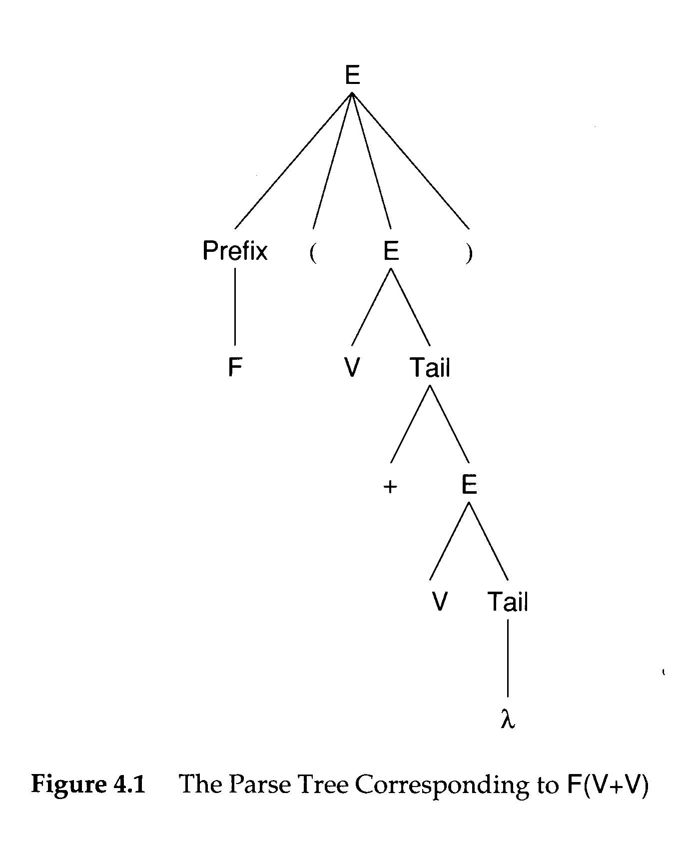
Parse Tree and Derivation
A Parse tree can be viewed as a graphical representation
for a derivation that ignore replacement order.
04/01/2014
Department of Computer Science

Slide 15
Phrase and Handle
A phrase of a sentential form is a sequence of symbols descended from a single nonterminal in the parse tree
  A simple or prime phrase is a phrase that contains no smaller phrase.
The handle of a sentential form is the left-most simple phrase
03/24/2008
Department of Computer Science

Slide 16
F ( E) is a sentential form.
F is a phrase
F is a also a handle
V Tail is a handle
+ E is a handle
A handle allows the parser to reduce it to a non-terminal
04/01/2014
Department of Computer Science

Slide 17
Example
abbabb
S
a sentence
aAbabB
A
B
a
a sentential
form
aAb
A
B
a
b
b
a handle
bB
a simple phrase
b
b
abb
a phrase of A
03/24/2008
Department of Computer Science

Slide 18
E→Prefix(E)
E→c Tail
Prefix→b
Prefix→λ
Tail→+Ε
Tail→ λ
E⇒ _{rm} Prefix(E)
⇒ _{rm} Prefix(c Tail)
⇒ _{rm} Prefix(c+E)
⇒ _{rm} Prefix(c+c Tail)
⇒ _{rm} Prefix(c+c)
⇒ _{rm} b(c+c)
G₀
E⇒ Prefix(E)
⇒ Prefix(c Tail)
⇒Prefix(c+E)
⇒ Prefix(c+c Tail )
⇒ Prefix(c+c)
⇒ b(c+c)
E ⇐ Prefix(E)
⇐ Prefix(c Tail)
⇐ Prefix(c+E)
⇐ Prefix(c+c Tail )
⇐ Prefix(c+c)
⇐ b(c+c)
Department of Computer Science

Slide 19
E
E→Prefix(E)
E→c Tail
Prefix→b
Prefix→λ
Tail→+Ε
Tail→ λ
E⇒ _{rm} Prefix(E)
⇒ _{rm} Prefix(c Tail)
⇒ _{rm} Prefix(c+E)
⇒ _{rm} Prefix(c+c Tail)
⇒ _{rm} Prefix(c+c)
⇒ _{rm} b(c+c)
G₀
Prefix
(
E
)
b
c
Tail
+
E
c
Tail
Department of Computer Science
λ

Slide 20
E
E→Prefix(E)
E→c Tail
Prefix→b
Prefix→λ
Tail→+Ε
Tail→ λ
E⇒ _{rm} Prefix(E)
⇒ _{rm} Prefix(c Tail)
⇒ _{rm} Prefix(c+E)
⇒ _{rm} Prefix(c+c Tail)
⇒ _{rm} Prefix(c+c)
⇒ _{rm} b(c+c)
G₀
Prefix
(
E
)
b
c
Tail
+
E
c
Tail
Department of Computer Science
λ

Slide 21
Properties of CFG
Useless nonterminals
  S → A | B
  A → a
  B → Bb
  C → c
Reduced Grammar
  A grammar is reduced after all useless non-terminals are removed
Ambiguity
<derives no terminal string>
<unreachable>
Department of Computer Science

Slide 22

Ambiguity
A grammar is ambiguous if it produces more than one parse tree for some sentences
example 1: A+B+C ( is it (A+B)+C or A+(B+C) )
  Improper production: expr → expr + expr | id
example 2: A+B*C ( is it (A+B)*C or A+(B*C) )
  Improper production: expr → expr + expr | expr * expr
example 3: if E1 then if E2 then S1 else S2 (which then does the else match with)
  Improper production:
    stmt → if expr then stmt
    | if expr then stmt else stmt
Department of Computer Science

Slide 23
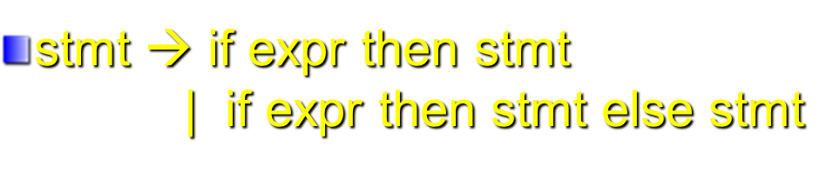
if E1 then if E2 then S1 else S2
Two parse trees of example 3
stmt
stmt
if
E1
then
stmt
if
E1
then
stmt
else
S2
if
E2
then
S1
else
S2
if
E2
then
S1
Department of Computer Science

Slide 24
Dangling Else Example
if ((k >=0) && (k < Table_SIZE))
if (table[k] >=0)
printf(“Entry %d is %d\n”, k, table[k]);
else printf(“Error: index %d out of range \n”), k);
In ANSI C, an else is always assumed to belong to the innermost if statement possible.
if ((k >=0) && (k < Table_SIZE)) {
if (table[k] >=0)
printf(“Entry %d is %d\n”, k, table[k]); }
else printf(“Error: index %d out of range \n”), k);
Department of Computer Science

Slide 25
Eliminating Ambiguity
Operator Associativity
  expr → expr + term | term
Operator Precedence
  expr → expr + term | term
  term → term * factor | factor
Dangling Else
  In YACC, shift is favored over reduction to enforce the dangling “else” to associate with the innermost if.
A+B+C
Department of Computer Science

Slide 26
Eliminating Ambiguity
Operator Associativity
  expr → expr + term | term
Operator Precedence
  expr → expr + term | term
  term → term * factor | factor
Dangling Else
  In YACC, shift is favored over reduction to enforce the dangling “else” to associate with the innermost if.
A+B+C
+
expr
C
Department of Computer Science

Slide 27
Eliminating Ambiguity
Operator Associativity
  expr → expr + term | term
Operator Precedence
  expr → expr + term | term
  term → term * factor | factor
Dangling Else
  In YACC, shift is favored over reduction to enforce the dangling “else” to associate with the innermost if.
A+B*C
+
expr
term
Department of Computer Science

Slide 28
Eliminating Ambiguity
Operator Associativity
  expr → expr + term | term
Operator Precedence
  expr → expr + term | term
  term → term * factor | factor
Dangling Else
  In YACC, shift is favored over reduction to enforce the dangling “else” to associate with the innermost if.
A+B*C
+
expr
*
term
factor
Department of Computer Science

Slide 29
Left Factoring
Consider the following grammar
A → αβ1 | αβ2
It is not easy to determine whether to expand
A to αβ1 or αβ2
A transformation called left factoring can be
applied. It becomes:
A → αA’
A’ → β1 | β2
03/24/2008
Department of Computer Science

Slide 30
Exercise
    stmt → if expr then stmt
    | if expr then stmt else stmt
    For the following grammar form:
    A → αβ1 | αβ2
    What is α? β1? β2?
: if expr then stmt
β1: λ
β2: else stmt
Department of Computer Science

Slide 31
Exercise
    stmt → if expr then stmt
    | if expr then stmt else stmt
    For the following grammar form:
    A → αβ1 | αβ2
    What is α? β1? β2?
: if expr then stmt
β1: λ
β2: else stmt
    stmt → if expr then stmt S’
    S’ → λ | else stmt
Department of Computer Science

Slide 32
Exercise
    stmt → if expr then stmt
    | if expr then stmt else stmt
    For the following grammar form:
    A → αβ1 | αβ2
    What is α? β1? β2?
: if expr then stmt
β1: λ
β2: else stmt
Just one example --
in this case, left factoring does not solve the problem
you may try the new grammar on the example stmt in slide 23
    stmt → if expr then stmt S’
    S’ → λ | else stmt
Department of Computer Science

Slide 33
Parsers and Recognizers
Recognizer
  An algorithm that does boolean-valued test
    “Is this input syntactically valid?”
Parser
  Answers more general questions
    Is this input valid?
    And, if it is, what is its structure (parse tree)?
Two general approaches to parsing
  Top-down and Bottom-up
Department of Computer Science

Slide 34
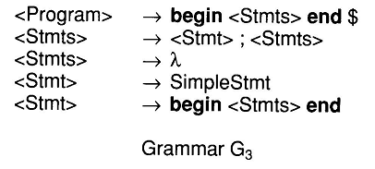
To parse
begin SimpleStmt; SimpleStmt; end $
Department of Computer Science

Slide 35
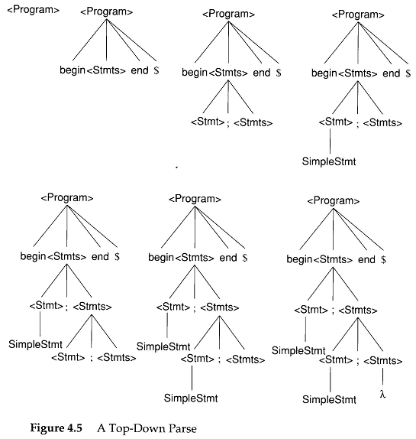
Department of Computer Science

Slide 36
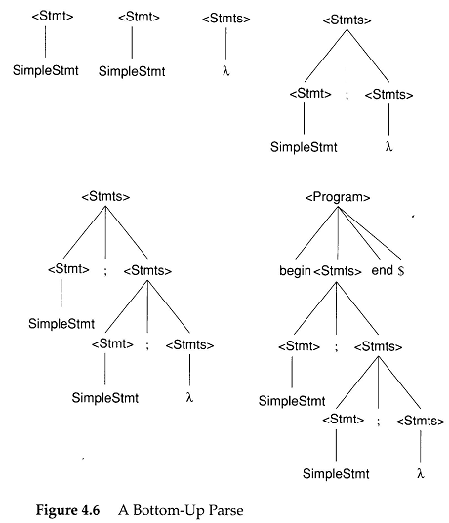
begin SimpleStmt; SimpleStmt; end $
Department of Computer Science

Slide 37
begin SimpleStmt; SimpleStmt; end $
Handle found!!
Reduce !!
begin
SimpleStmt
Department of Computer Science

Slide 38
begin SimpleStmt; SimpleStmt; end $
begin
<Stmt>
;
SimpleStmt
Department of Computer Science

Slide 39
begin SimpleStmt; SimpleStmt; end $
The next token is
end !!
What nonterminal
can be followed by
end?
<Stmts> !!
begin
<Stmt>
;
<Stmt>
;
Let’s take the λ production
Department of Computer Science

Slide 40
begin SimpleStmt; SimpleStmt; end $
Handle found!!
Reduce !!
begin
<Stmt>
;
<Stmt>
;
<Stmts>
Department of Computer Science

Slide 41
begin SimpleStmt; SimpleStmt; end $
Handle found!!
Reduce !!
begin
<Stmt>
;
<Stmts>
Department of Computer Science

Slide 42
begin SimpleStmt; SimpleStmt; end $
Handle found!!
Reduce !!
begin
<Stmts>
end
$
Department of Computer Science

Slide 43
begin SimpleStmt; SimpleStmt; end $
<Program>
Department of Computer Science

Slide 44
Naming of parsing techniques
The way to parse
token sequence
(e.g. from Left to R)
Number of
Lookahead
tokens
L: Leftmost
R: Righmost
Top-down
  LL(1)
Bottom-up
  LR(1)
Department of Computer Science

Slide 45
Grammar Analysis Algorithms
Goal of this section:
  Discuss a number of important analysis algorithms for Grammars
What non-terminals can derive λ?
  A ⇒ BCD ⇒ BC ⇒ B ⇒ λ
  An iterative marking algorithm
    Marking non-terminals that derive λ in one step, then marking non-terminals requires a parse tree of height 2, continue with increasing heights until no change.
Department of Computer Science

Slide 46
What non-terminals can derive λ?
count
Worklist:
B,D
count
Worklist:
C
A → BCD
B → BX
B → λ
C → EFG
C → BDD
D → E
D → λ
3
1
2
1
0
3
3
3
0
1
1
0
Department of Computer Science

Slide 47
What non-terminals can derive λ?
count
Worklist:
C
count
Worklist:
A
A → BCD
B → BX
B → λ
C → EFG
C → BDD
D → E
D → λ
1
0
1
1
3
3
0
0
1
1
Department of Computer Science

Slide 48
Follow(A)
  Follow(A) is the set of terminals that may follow A in some sentential form. It provides the lookaheads that might signal the recognition of a production with A as the left hand side
  Follow(A)={a∈Vt|S⇒* … Aa … } and more later
First(α)
  The set of all the terminal symbols that can begin a sentential form derivable from α
  If α is the right-hand side of a production, then First(α) contains terminal symbols that begin strings derivable from α
  First(α)={a∈Vt| α ⇒* aβ} ∪ {if α ⇒* λ then {λ} else ∅}
Department of Computer Science

Slide 49
begin SimpleStmt; SimpleStmt; end $
Handle found!!
Reduce !!
begin
<Stmts>
end
$
Department of Computer Science

Slide 50
FIRST(A)
  If A is a terminal, then FIRST(A) = {A}
  If A is a non-terminal, and A→ Y1Y2…Yk for some k >=1, then place a in FIRST(A) if for some i, a is in FIRST(Yi), and λ is in all of FIRST(Y1),… FIRST(Yi-1).
  If A→ λ is a production, then add λ to FIRST(A).
FOLLOW(A)
  Place $ in FOLLOW(S)
  If there is a production A → αBβ , then everything in FIRST(β) except λ, is in FOLLOW(B)
  If there is a production A → αB, or a production A → αBβ, where FIRST(β) contains λ, then everything in FOLLOW(A) is in FOLLOW(B).
Department of Computer Science

Slide 51
Exercise
S → AB
A → Aa | a
B → Bb | b
S → AB
A → Aa | a
B → CD
C → c | λ
D → d | λ
Department of Computer Science

Slide 52
Example 1
S → aSe
S → B
B → bBe
B → C
C → cCe
C → d
First (S) = { ? }
First (B) = { ? }
First (C) = { ? }
Follow (S) = {? }
Follow (B) = {? }
Follow (C) = {? }
Department of Computer Science

Slide 53
Example 1
S → aSe
S → B
B → bBe
B → C
C → cCe
C → d
First (S) = {a,b,c,d}
First (B) = {b,c,d}
First (C) = {c,d}
Follow (S) = {e, $}
Follow (B) = {e, $}
Follow (C) = {e, $}
Department of Computer Science

Slide 54
Example 2
First (S) = { ? }
First (A) = { ? }
First (B) = { ? }
S → ABc
A → a
A → λ
B → b
B → λ
Follow (S) = { ? }
Follow (A) = { ? }
Follow (B) = { ? }
Department of Computer Science

Slide 55
Example 2
First (S) = {a,b,c}
First (A) = {a, λ}
First (B) = {b, λ}
S → ABc
A → a
A → λ
B → b
B → λ
Follow (S) = {$}
Follow (A) = {b,c}
Follow (B) = {c}
Department of Computer Science

