Slide 1
Node.js self-study
haixiang.liu@emerson.com

Slide 2
Node.js overview
https://en.wikipedia.org/wiki/Node.js
https://en.wikipedia.org/wiki/Npm_(software)

Slide 3
Node.js installation
https://nodejs.org/en/download/package-manager/
https://www.digitalocean.com/community/tutorials/how-to-install-node-js-on-ubuntu-16-04

Slide 4
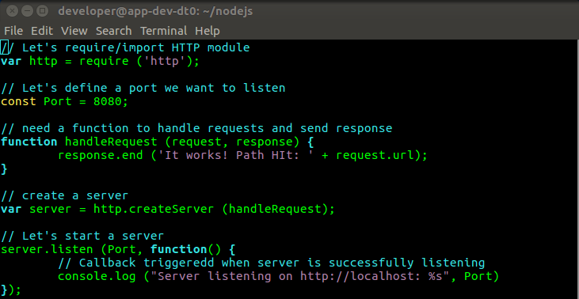
Node.js exercise
http server
http://blog.modulus.io/build-your-first-http-server-in-nodejs

Slide 5

Node.js exercise (cont.)
Running http javascript file
Open browser to access http server

Slide 6
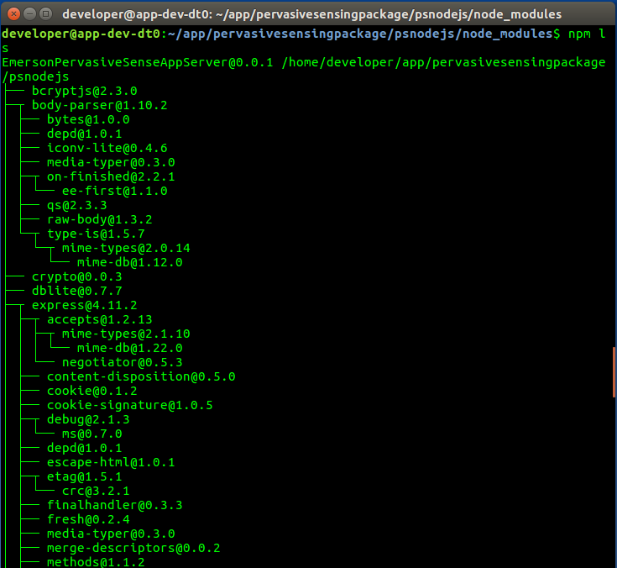
npm
npm is the default package manager for the JavaScript runtime environment Node.js.
http://www.cnblogs.com/chyingp/p/npm.html
Command to list the node modules installed in current directory
https://www.npmjs.com/package
To find installed npm package description

Slide 7
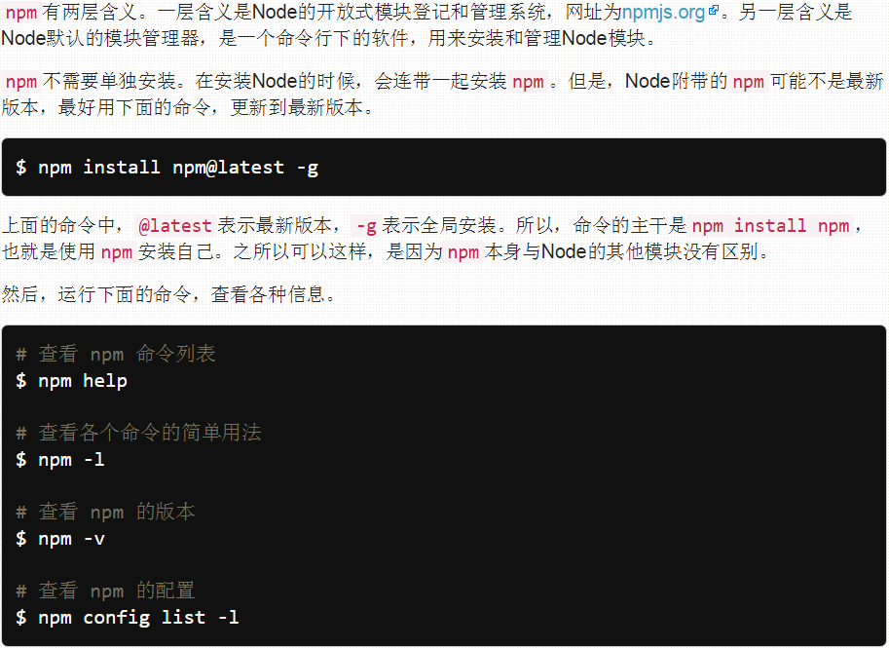
npm (cont.)
http://javascript.ruanyifeng.com/nodejs/npm.html

Slide 8
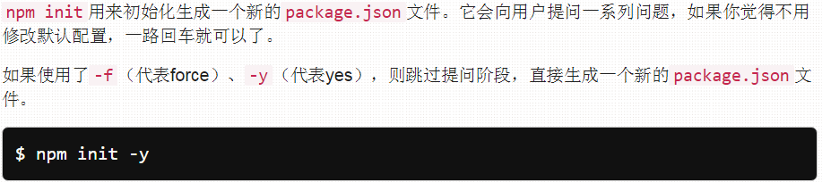
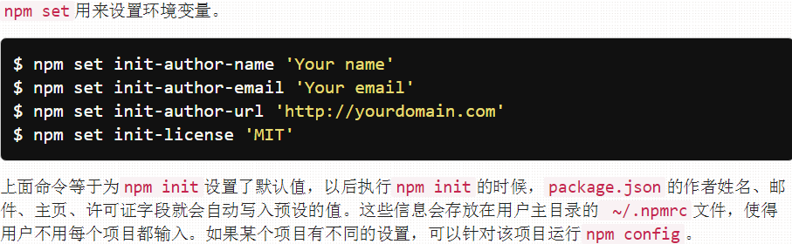
npm (cont.)
npm init
npm set

Slide 9
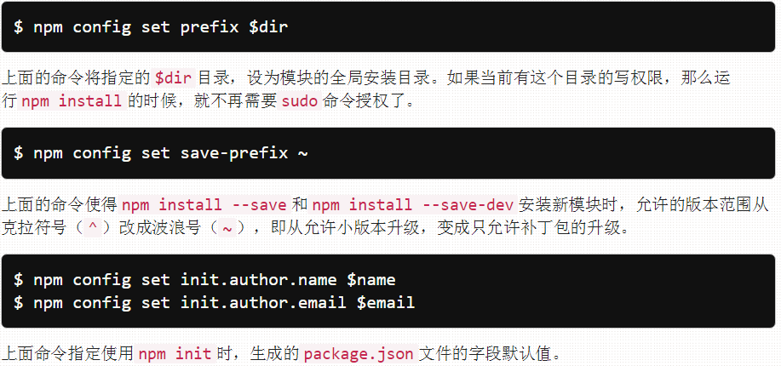
npm (cont.)
npm config

Slide 10
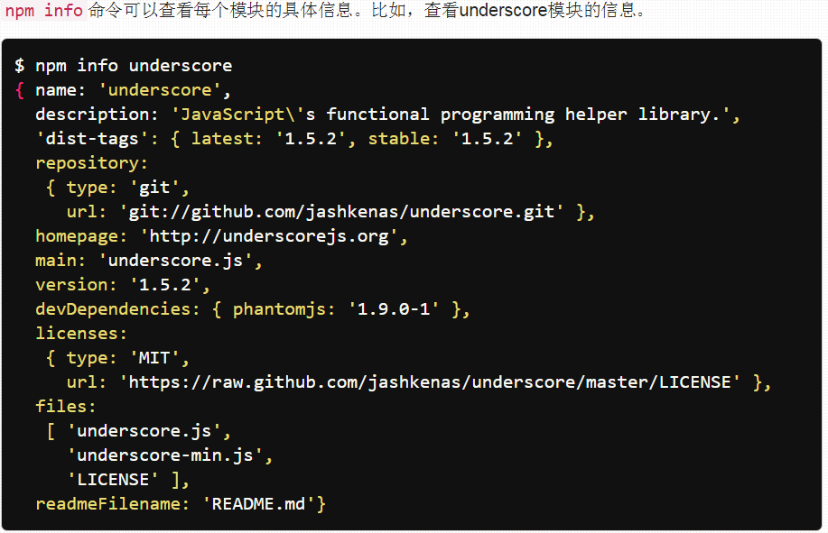
npm (cont.)
npm infor

Slide 11
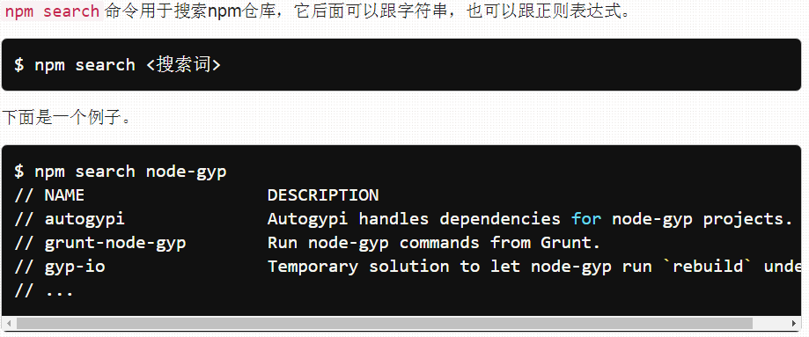
npm (cont.)
npm search

Slide 12
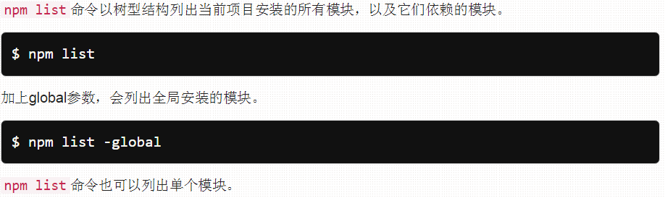
npm (cont.)
npm list

Slide 13
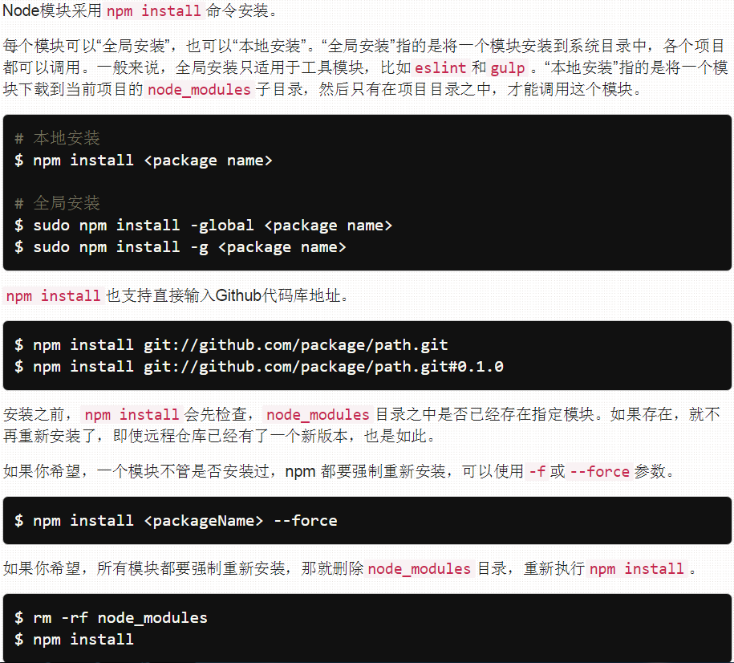
npm (cont.)
npm install

Slide 14
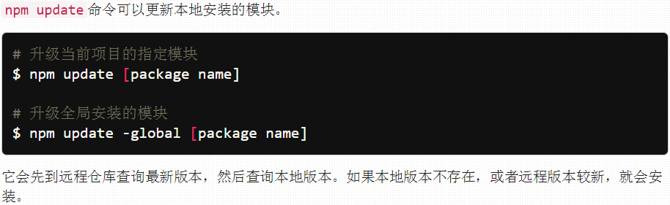
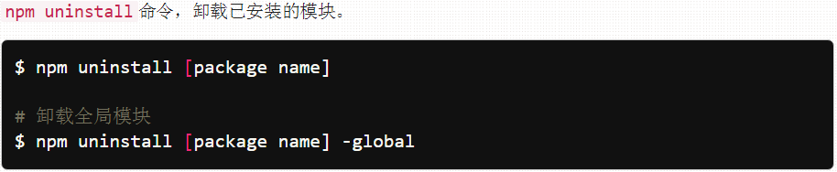
npm (cont.)
npm update, npm install

Slide 15
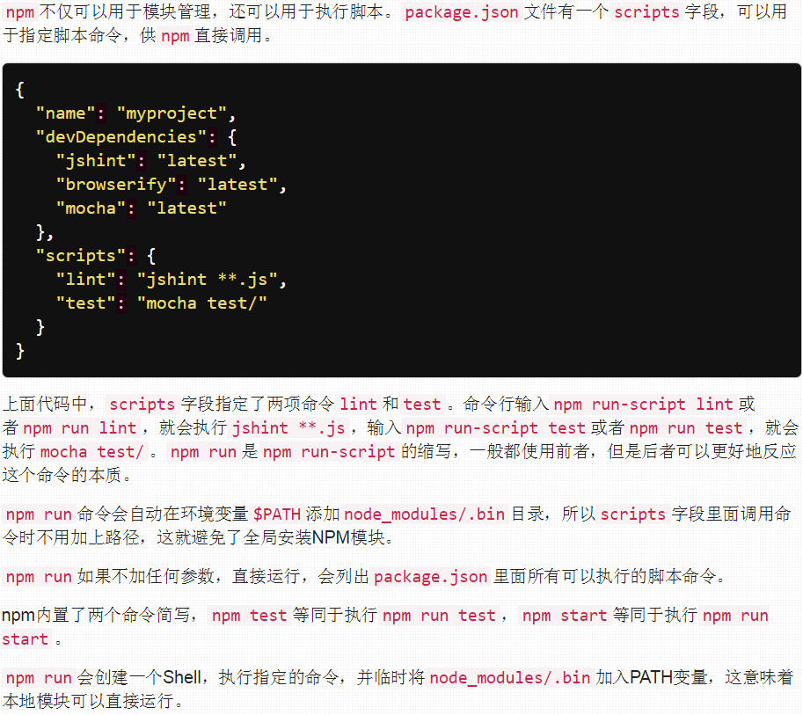
npm (cont.)
npm run

Slide 16
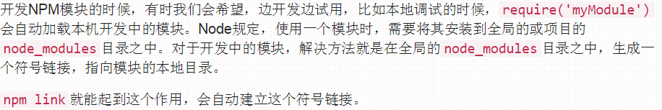
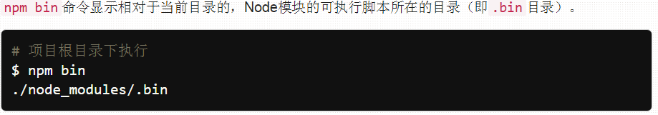
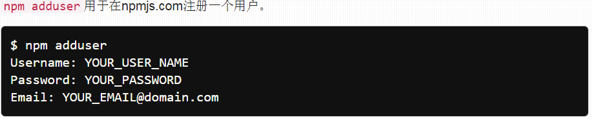
npm (cont.)
npm link
others

Slide 17
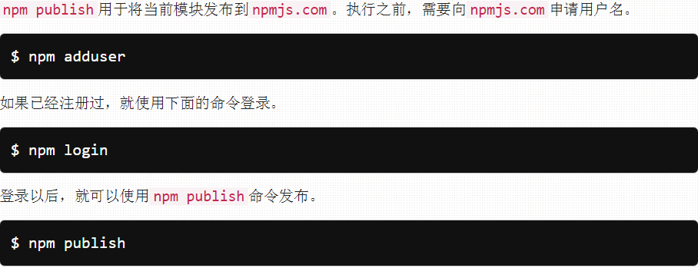
npm (cont.)
npm publish
Later
npm deprecate
npm owner
npm home，npm repo
npm outdated
npm prune
npm shrinkwrap

Slide 18
modules
https://nodejs.org/api/modules.html
Node.js has a simple module loading system. In Node.js, files and modules are in one-to-one correspondence (each file is treated as a separate module).

Slide 19
Node.js in action example: chat server
Data Flow
Http Server
(Node Server)
request
Web browser
response
Chat Server
(Node Server)
Web socket
Web browser
Bi-directional

Slide 20
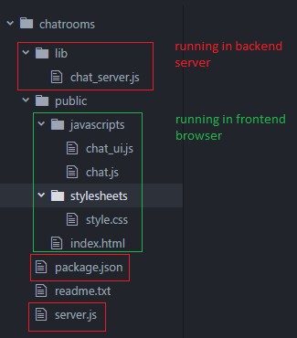
Node.js in action example: chat server (cont.)
File structure
chat_server.js
chat server js code
package.json
backend js dependency file
server.js
http server js code
Index.html
homepage of http server
chat_ui.js
chat.js
chat client js code
style.css
style sheet

Slide 21
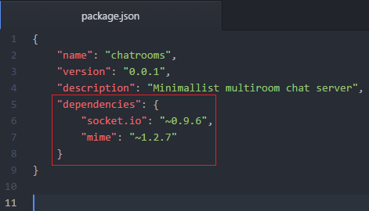
Node.js in action example: chat server (cont.)
package.json
An application dependency is a module that needs to be installed to provide functionality needed by application.
Application dependencies are specified using a package.json file.

Slide 22
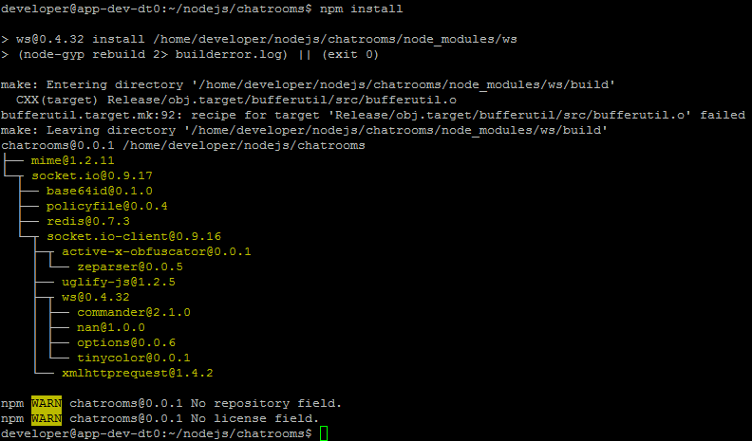
Node.js in action example: chat server (cont.)
Install dependencies
npm install

Slide 23

Node.js in action example: chat server (cont.)
Create a basic static file server (http server)
Create http server
Send index.html to web browser after connection

Slide 24
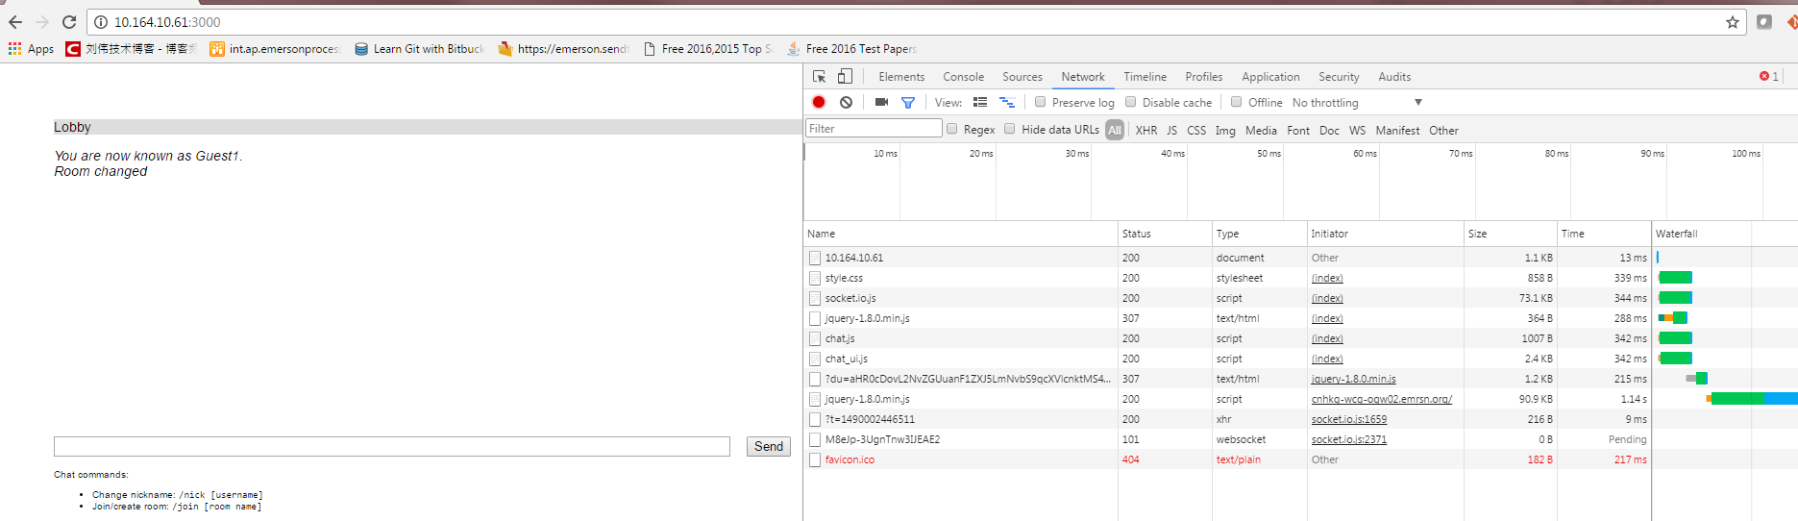
Node.js in action example: chat server (cont.)
Open browser to access the chat server
Download all the front-end related files to the browser

Slide 25
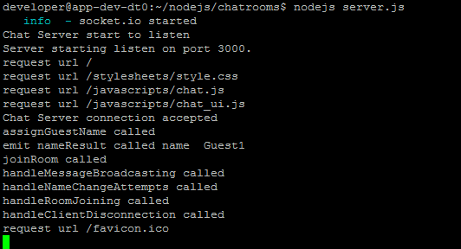
Node.js in action example: chat server (cont.)
Use console.log to debug backend
Use GUI to debug backend
http://stackoverflow.com/questions/1911015/how-do-i-debug-node-js-applications

Slide 26
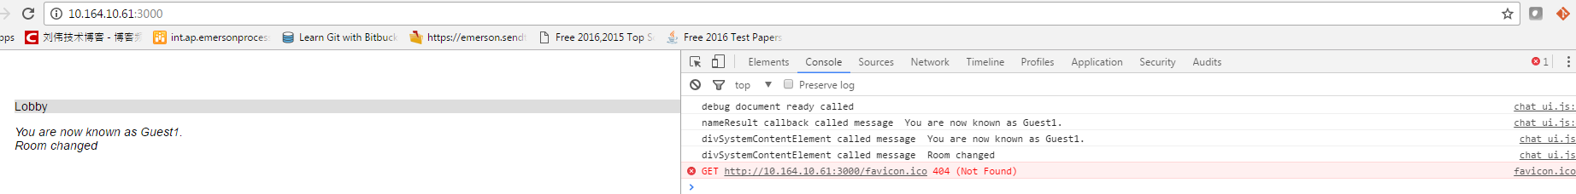
Node.js in action example: chat server (cont.)
Use chrome to debug frontend

Slide 27
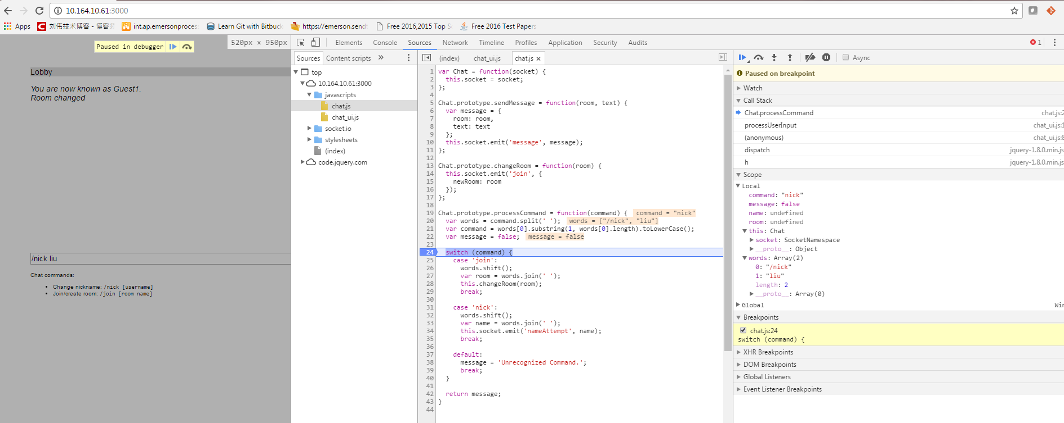
Node.js in action example: chat server (cont.)

Slide 28
Modules
If a module is a directory, the file in the module that will be evaluated is normally named index.js.
To specify an alternative to index.js, the package.json file must contains JSON data defining an object with a key named main that specifies the path, within the module directory to the main file.

Slide 29
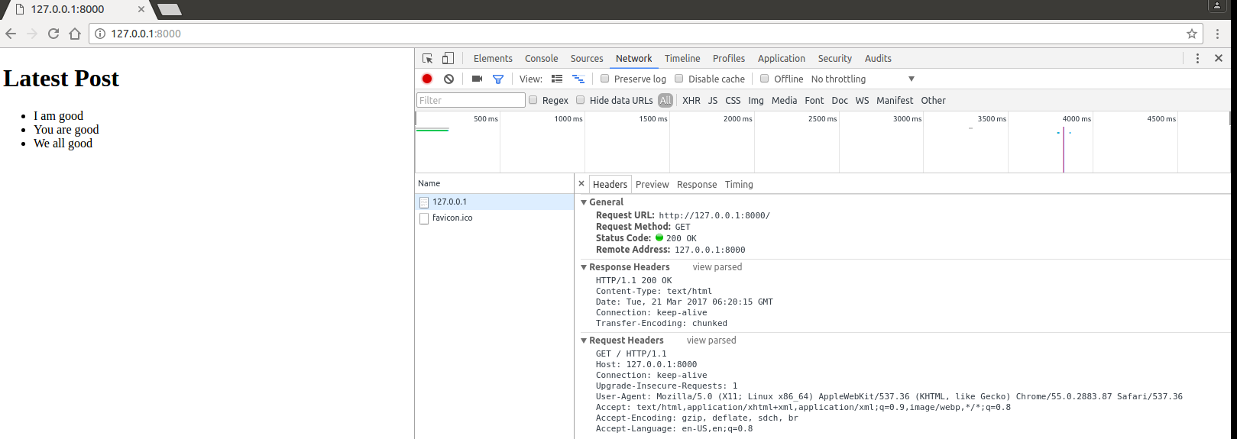
Asynchronous programming techniques
Callback

Slide 30
Asynchronous programming techniques (cont.)
Events listener
Essentially callbacks that are associated with a conceptual entity (an event)
Event emitters fire events and include the ability to handle those events when triggered.
Events are handled through the use of listeners. A listener is the association of an event with a callback that gets trigged each time the event occurs.

Slide 31
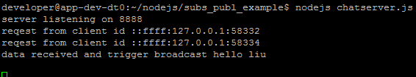
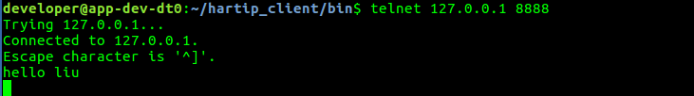
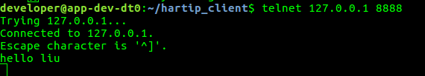
Asynchronous programming techniques (cont.)
Publish/subscriber example:

Slide 32
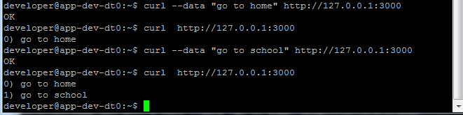
Building a RESTful web service
RESTful web services has gained popularity because they are simple to utilize and implement in comparison to SOAP
To create a web service, need to implement four HTTP verbs:
POST
GET
DELETE
PUT
To test, use curl as http client
curl --data “message” (POST)
curl (GET)

Slide 33
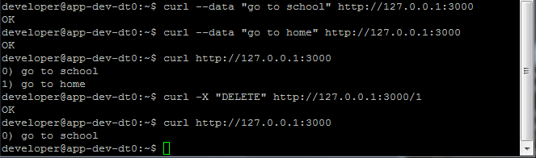
Building a RESTful web service (cont.)
DELETE

Slide 34
Express
Express is a minimal and flexible Node.js web application framework that provides a robust set of features for web and mobile applications.
http://expressjs.com/

Slide 35
express
Express is a minimal and flexible Node.js web application framework that provides a robust set of features for web and mobile applications.
http://expressjs.com/
npm install express –save

Slide 36
Reference
https://gist.github.com/wuhaixing/9755199
http://javascript.ruanyifeng.com/nodejs/npm.html
http://seniorzhai.github.io/2015/01/20/Express%E5%AD%A6%E4%B9%A0%E7%AC%94%E8%AE%B0-%E5%BF%AB%E9%80%9F%E5%BC%80%E5%A7%8B/

