Slide 1



V²FS: A Verifiable Virtual Filesystem for Multi-Chain Query Authentication
Haixin Wang¹, Cheng Xu¹, Xiaojie Chen², Ce Zhang¹,
Haibo Hu³, Shikun Tian², Ying Yan², Jianliang Xu¹
¹Hong Kong Baptist University, ²Ant Group, ³Hong Kong Polytechnic University

Slide 2
Background
Blockchain-based applications have led to significant need for on-chain data analysis

Slide 3
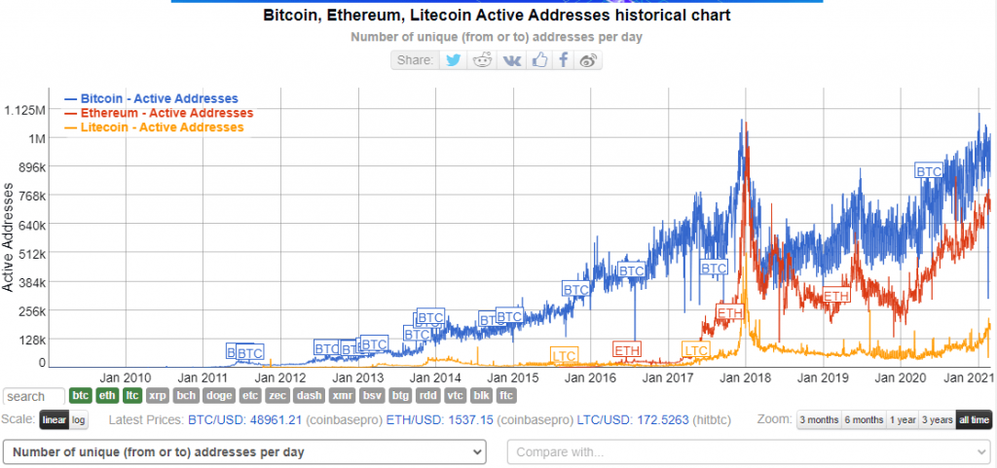
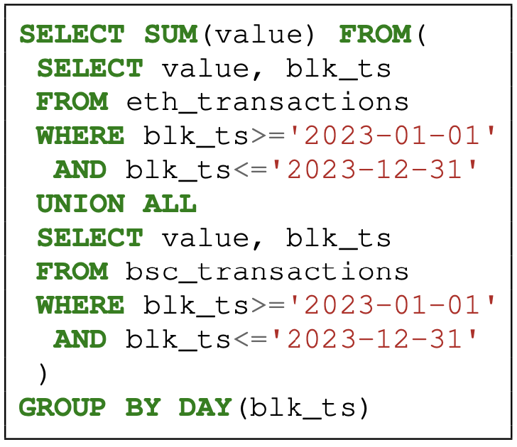
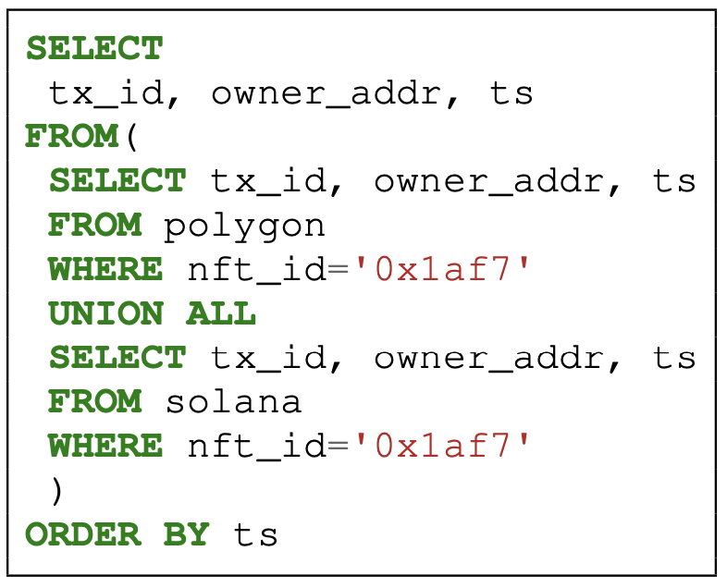
Background
Increasing demand to query multi-chain data
E.g., DeFi application uses blockchain data to
Evaluate risk
Optimize trading strategies
Monitor liquidity

Slide 4
Background
Requirements
Compatible with existing blockchains
Support various query types
Ensure query integrity

Slide 5

Existing Solutions
The Graph
A decentralized protocol for blockchain data indexing and querying
Rely on a set of indexers to index blockchain data

Slide 6


Existing Solutions
The Graph
A decentralized protocol for blockchain data indexing and querying
Rely on a set of indexers to index blockchain data
Integrity issue
A dispute mechanism to incentivize indexers behave honestly
Weak integrity guarantee
Client may not challenge indexer due to lack of knowledge
Long dispute period (e.g., up to 7 days)

Slide 7
Existing Solutions
Strong integrity guarantee: verifiable computation (VC)
Use authenticated data structure (ADS)
Support specific query type with efficiency
Use general VC schemes
Support general query types
Suffer from high computation overhead
Challenging to implement with various database engines

Slide 8
Our Solution
Our solution—verifiable virtual filesystem (V²FS)
Verifying computation → verifying data

Slide 9

Our Solution
Our solution—verifiable virtual filesystem (V²FS)
Verifying computation → verifying data
SELECT …
FROM …
WHERE …

Slide 10




Our Solution
Our solution—verifiable virtual filesystem (V²FS)
Verifying computation → verifying data
Move computation to a trusted zone (Client)
Client evaluates query locally using an off-the-shelf query engine
Fetch data on demand from a remote server
Verify the data integrity by cryptographic proof
SELECT …
FROM …
WHERE …
evaluate query
fetch data
verify data

Slide 11
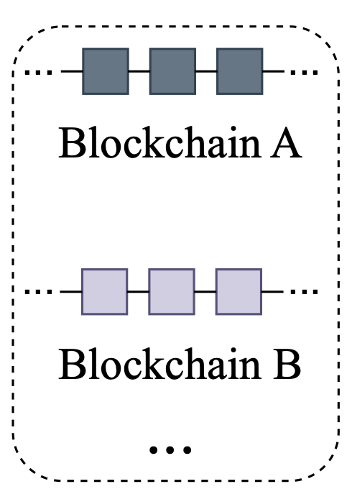
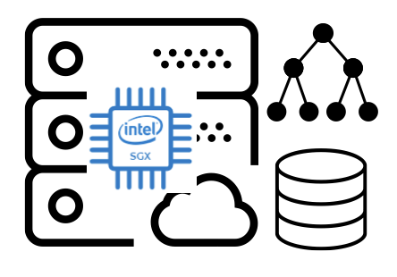
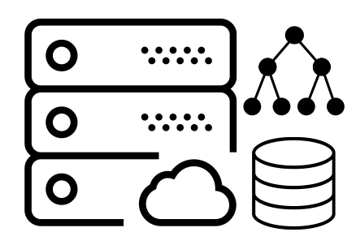
System Overview
System Model
consensus protocol
verifiable computation
trust hardware
trusted ADS root
Source Chains
V²FS CIs
ISPs

Slide 12

System Overview
System Model
Source Chains
V²FS CIs
ISPs
Query Client

Slide 13
System Overview
System Model
Block synchronization
hdr
Source Chains
V²FS CIs
ISPs
Query Client

Slide 14

System Overview
System Model
Database maintenance
$$C_{V^{2}FS}$$
Source Chains
V²FS CIs
ISPs
Query Client

Slide 15




System Overview
System Model
Query processing
$$C_{V^{2}FS}$$
$$R$$
$$data$$
$$π_{q}$$
Source Chains
V²FS CIs
ISPs
Query Client

Slide 16
System Design—Verifiable Virtual Filesystem (V²FS)
A middleware between the computing layer and storage layer
Enable the utilization of off-the-shelf database engines for verifiable queries
Computing Layer
V²FS
Storage Layer

Slide 17
System Design—Verifiable Virtual Filesystem (V²FS)
A middleware between the computing layer and storage layer
Enable the utilization of off-the-shelf database engines for verifiable queries
Computing Layer
Off-the-shelf DB Engine
V²FS
Extension of POSIX I/O interface for verifiability
Storage Layer
Underlying data & ADS

Slide 18
System Design—Verifiable Virtual Filesystem (V²FS)
A middleware between the computing layer and storage layer
Enable the utilization of off-the-shelf database engines for verifiable queries
Computing Layer
Off-the-shelf DB Engine
Essential POSIX operations for any filesystem to work
E.g., open, seek, read, write, close
Extended with integrity features
V²FS
Extension of POSIX I/O interface for verifiability
Storage Layer
Underlying data & ADS

Slide 19
System Design—V²FS
V²FS ADS:
Database is stored as files, which are organized in pages with a fixed page size (e.g., 4096 bytes)
A variant of MHT consists of two layers to authenticate page retrieval

Slide 20













System Design—V²FS
V²FS ADS:
Lower-layer: a complete binary Merkle tree built on pages in a single file
$$h_{6}$$
$$h_{0}=H(h_{9}||h_{10})$$
$$h_{7}$$
$$h_{8}$$
$$h_{9}=H(p_{0})$$
$$h_{9}$$
$$h_{10}$$
$$h_{11}$$
$$h_{12}$$
$$p_{0}$$
$$p_{1}$$
$$p_{2}$$
$$p_{3}$$

Slide 21







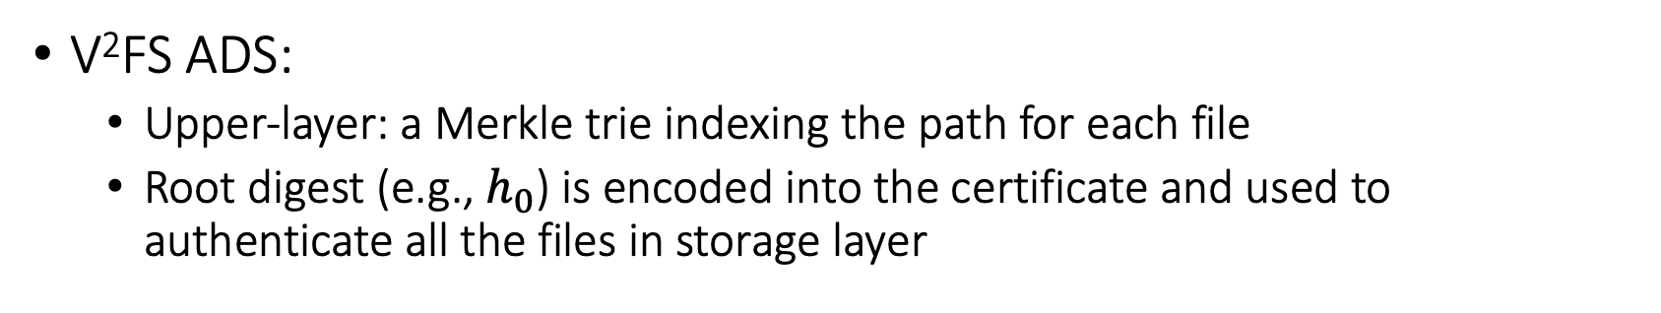











System Design—V²FS
V²FS ADS:
Upper-layer: a Merkle trie indexing the path for each file
Root digest (e.g., $h_{0}$) is encoded into the certificate and used to authenticate all the files in storage layer
$$h_{6}$$
/
$$h_{0}$$
$$h_{1}$$
$$h_{2}$$
$$h_{2}=H(var||H(h_{3}|\left|h_{4}\right))$$
var
etc
$$h_{7}$$
$$h_{8}$$
$$h_{3}$$
$$h_{4}$$
$$h_{5}$$
$$h_{9}$$
$$h_{10}$$
$$h_{11}$$
$$h_{12}$$
main.db
journal.log
sys.config
$$p_{0}$$
$$p_{1}$$
$$p_{2}$$
$$p_{3}$$
…
…

Slide 22

System Design—V²FS Maintenance
V²FS CI: updates storage layer & generates trusted new ADS root
Employs SGX for secure update
SGX consists of a DB engine and ADS engine
Storage layer is located outside of SGX
Computing Layer
SGX
DB Engine
V²FS
ADS Engine
Storage Layer
ADS

Slide 23
System Design—V²FS Maintenance
V²FS CI: updates storage layer & generates trusted new ADS root
Employs SGX for secure update
SGX consists of a DB engine and ADS engine
Storage layer is located outside of SGX
OCalls are invoked when SGX reads/writes pages from/to outside-SGX storage
Computing Layer
SGX
DB Engine
write
read
V²FS
ADS Engine
OCall
Storage Layer
ADS
Notes:
With layer indication

Slide 24
System Design—V²FS Maintenance
V²FS CI: updates storage layer & generates trusted new ADS root
Problem: Outside-SGX storage is distrusted
Solution: Verifiable computation
Verify all pages to be read
Verify the neighboring nodes related to pages to be written

Slide 25







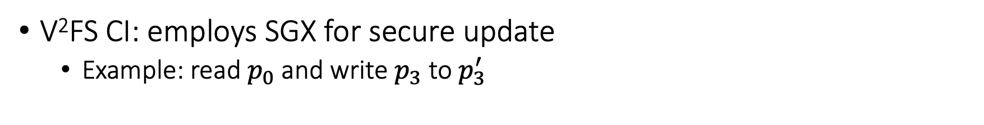

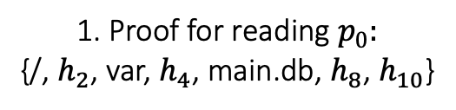









System Design—V²FS Maintenance
V²FS CI: employs SGX for secure update
Example: read $p_{0}$ and write $p_{3}$ to $p_{3}^{′}$
$$h_{0}$$
1. Proof for reading $p_{0}:$
{/, $h_{2}$, var, $h_{4}$, main.db, $h_{8}$, $h_{10}$}
$$h_{6}$$
/
$$h_{1}$$
$$h_{2}$$
var
etc
$$h_{7}$$
$$h_{8}$$
$$h_{3}$$
$$h_{4}$$
$$h_{5}$$
$$h_{9}$$
$$h_{10}$$
$$h_{11}$$
$$h_{12}$$
main.db
journal.log
sys.config
$$p_{0}$$
$$p_{1}$$
$$p_{2}$$
$$p_{3}$$
…
…

Slide 26



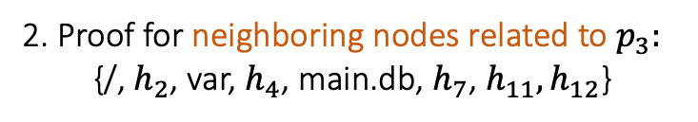




System Design—V²FS Maintenance
V²FS CI: employs SGX for secure update
Example: read $p_{0}$ and write $p_{3}$ to $p_{3}^{′}$
$$h_{6}$$
/
$$h_{0}$$
2. Proof for neighboring nodes related to $p_{3}:$
{/, $h_{2}$, var, $h_{4}$, main.db, $h_{7}$, $h_{11},h_{12}$}
$$h_{1}$$
$$h_{2}$$
var
etc
$$h_{7}$$
$$h_{8}$$
$$h_{3}$$
$$h_{4}$$
$$h_{5}$$
$$h_{9}$$
$$h_{10}$$
$$h_{11}$$
$$h_{12}$$
main.db
journal.log
sys.config
$$p_{0}$$
$$p_{1}$$
$$p_{2}$$
$$p_{3}$$
…
…

Slide 27




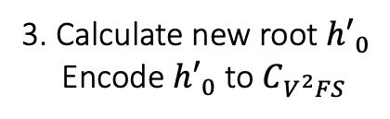





System Design—V²FS Maintenance
V²FS CI: employs SGX for secure update
Example: read $p_{0}$ and write $p_{3}$ to $p_{3}^{′}$
$${h′}_{6}$$
/
$${h′}_{0}$$
3. Calculate new root ${h′}_{0}$
Encode ${h′}_{0}$ to $C_{V^{2}FS}$
$${h′}_{1}$$
$$h_{2}$$
var
etc
$$h_{7}$$
$${h′}_{8}$$
$${h′}_{3}$$
$$h_{4}$$
$$h_{5}$$
$$h_{9}$$
$$h_{10}$$
$$h_{11}$$
$${h′}_{12}$$
main.db
journal.log
sys.config
$$p_{0}$$
$$p_{1}$$
$$p_{2}$$
$${p′}_{3}$$
…
…

Slide 28
System Design—V²FS Maintenance
ISP: same update but without SGX
Computing Layer
DB Engine
write
read
V²FS
ADS Engine
write
read
Storage Layer
ADS

Slide 29
System Design—Query Processing
Client evaluates the query locally and requests data pages on-demand
Query Client
Computing Layer
DB Engine
V²FS
Verification Engine
ISP
Storage Layer
ADS

Slide 30
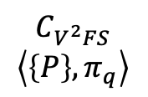
System Design—Query Processing
Client evaluates the query locally and requests data pages on-demand
ISP returns required data pages with Merkle proof
Client computes the query result && verifies data integrity using the Merkle proof
Query Client
Computing Layer
DB Engine
read
V²FS
Verification Engine
$$C_{V^{2}FS}$$
$$\left\langle \left\{P\right\},π_{q}\right\rangle$$
ISP
Storage Layer
ADS

Slide 31
Query Optimizations
Intra-query cache
Cache frequently visited pages within a single query
Inter-query cache
Cache frequently visited pages among queries
Bloom filter integrated validation
Utilize the page update information to validate pages in inter-query cache

Slide 32
Performance Evaluation
Implementation
Integrate V²FS with SQLite database
In Rust program language
Dataset
Data extracted from Ethereum and Bitcoin covering the period from May 12, 2023, to May 18, 2023
16 tables with over 70 million records
Query
Awesome BigQuery View Project
Available at https://github.com/blockchain-etl/awesome-bigquery-views

Slide 33
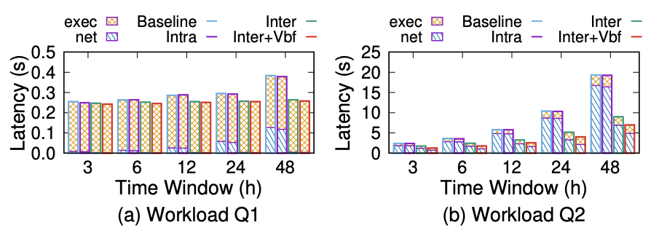
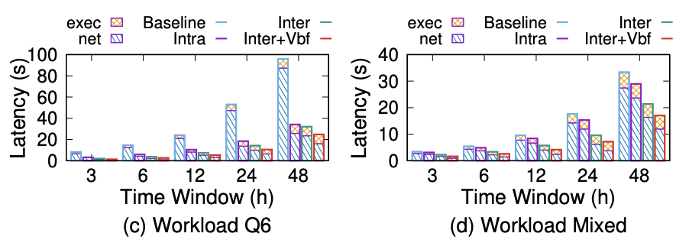
Performance Evaluation
Query Performance
Optimization improves the query performance by up to 6.1x
Network transmission time takes up 82.8% of query latency

Slide 34
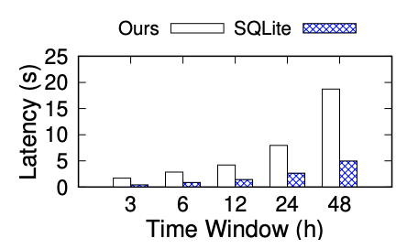
Performance Evaluation
Compare with SQLite
2.9x to 3.9x slower than SQLite
Acceptable for the additional integrity guarantee

Slide 35
Thank you

