Slide 1


Deploying LLMs on Structured Data Tasks: Lessons from the Trenches
Laurel Orr
Numbers Station

Slide 2

What’s a Numbers Station?
A Numbers Station - tangentially related to startup (at best)
Notes:
A quick intro about myself.
- Principal engineer and researcher at a startup out of the Hazy Research Labs at Stanford called NS
- First question that really matters for this talk is what is a Numbers Station. It’s a radio station believed to transmit private messages to intelligence officers in foreign countries
- It is, at best, tangentially related to the startup I work for which leads to asking [CLICK]

Slide 3
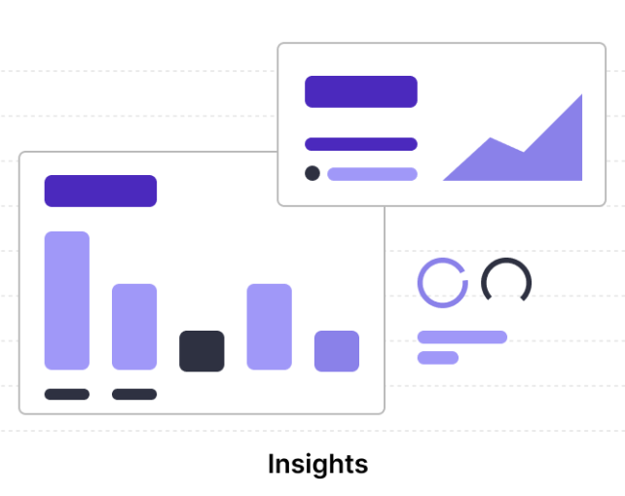

What is Numbers Station?
Numbers Station applies LLMs to structured data tasks
LLM
Prototyping is easy, production is hard
Notes:
What is Numbers Station
We are a LLM company using generative AI to help solve structured data tasks, which I’ll talk a lot more about later.
Over the past yearish I’ve spent much of my time battling with the challenges it takes to take that spark of demoable amazement from using an LLM for a task and turning it into a functioning deployed product.
In this talk I’m going to give some of the high level challenges and solutions to some of the tricky challenges I’ve faced when it comes to deploying LLMs on customer data because let me tell you, it is a lot harder than the twitter sphere would have you believe

Slide 4
What Are LLMs
And why are they changing how we build applications?

Slide 5








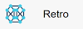



The “Eras” of LLMs
Sesame Street
Bigger is Better
Simon Says
Camelid
Sesame Street Character Era
Sesame Street Character Era
Sesame Street Character Era
Sesame Street Character Era
Text to Embedding Representation
Text to Text
Text to ”Task”
Open-source Text to ”Task”
2018
2020
2022
2023
Notes:
I want to give a quick recap of the history of LLMs and how we got here because although the LLM world exploded with ChatGPT, LLMs have been around for and deployed long before ChatGPT.
The first era circa 2018 is what I’m glibly calling the Sesame Street Character Era with models like Elmo, BERT, and Ernie. [Click]

Slide 6
The “Eras” of LLMs
Sesame Street
Sesame Street Character Era
Text to Embedding Representation
2018
Notes:
I want to give a quick recap of the history of LLMs and how we got here because although the LLM world exploded with ChatGPT, LLMs have been around for and deployed long before ChatGPT.
The first era circa 2018 is what I’m glibly calling the Sesame Street Character Era with models like Elmo, BERT, and Ernie. [Click]

Slide 7
The Rise of Self-Supervision
Self-supervised learning is training on data that does not require manual labels.
the
cat
jumped
out
of
the
_
Trained to predict next token from text
Notes:
- Around this time is when self-supervised learning turned on. Self-supervised learning is a paradigm where the models are trained over data that is inherently labeled.
- The most classic example of this is next work prediction where …
- Critically, this meant engineers did not need to manual label data. You could pull from a massive corpus of text data and pretraintrain over it without significant effort.
- The result was the BERT explosion and the ability to easily transfer a pretrained model to your task. The output representations from these models were also critical in things like search, retrieval, and even data wrangling tasks.

Slide 8
The “Eras” of LLMs
Sesame Street
Bigger is Better
Sesame Street Character Era
Sesame Street Character Era
Text to Embedding Representation
Text to Text
2018
2020

Slide 9
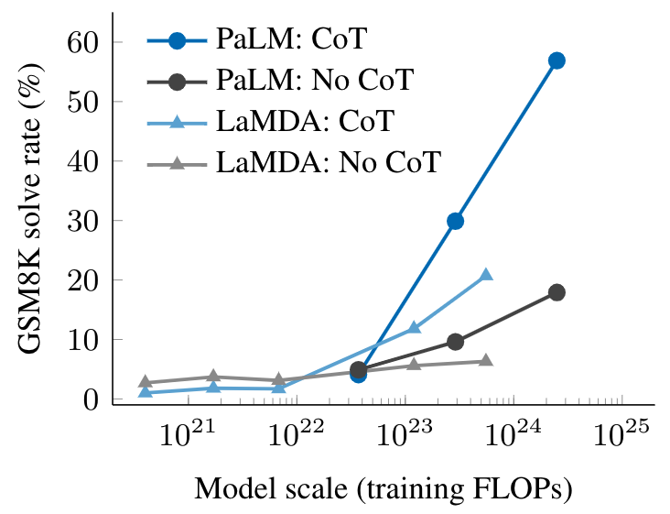
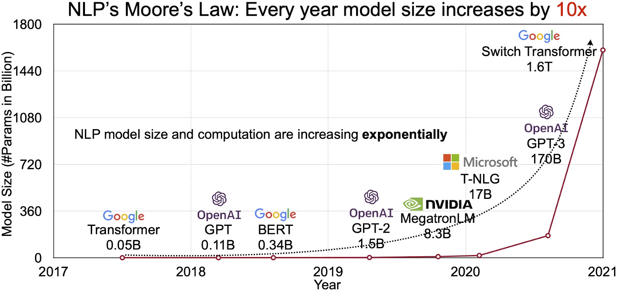
LLMs Get Bigger and Better
Hardware and algorithmic advances along with self-supervised learning resulted in explosion of larger models.
https://indiaai.gov.in/article/the-future-of-large-language-models-llms-strategy-opportunities-and-challenges
Notes:
- Then we get the Simon Says where the game is to scale up and go big. Advancements in hardware and architecture and training opened the door for even larger scale training.
- With ease of getting data we saw a massive increase in scale
- The result was the first GPT-3 model by OpenAI which, if you remember from the paper, had this incredibly ability to continue text provided by a user and write poems, code, and documents.

Slide 10
The “Eras” of LLMs
Sesame Street
Bigger is Better
Simon Says
Sesame Street Character Era
Sesame Street Character Era
Sesame Street Character Era
Text to Embedding Representation
Text to Text
Text to ”Task”
2018
2020
2022

Slide 11
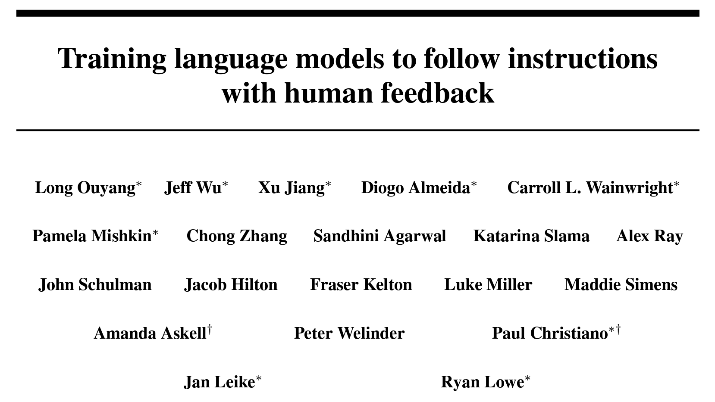
High Quality Instruction Data
Generalize to new tasks with no additional training! All you need is an instruction.
“Translate English to German: That is good.”
“Das ist gut.”
LLM
“Sum the two numbers: 4 + 5”
“9”
“Classify the sentence as positive or negative: the move was fantastic”
“Positive”
Notes:
- But we weren’t at the chat era quiet yet. What happened next is the Simon Says era where researchers realized that they key to making these models really follow user instructions and perform tasks was less about the scale and more about the quality of data.
- As I’m sure you saw in the news, companies started focusing on curated instruction rich datasets for training
– The result was this incredible in context learning phenomena where the same model could perform wildly different tasks just by changing the instruction and example shown to the model. They were becoming taskless. No training required!

Slide 12
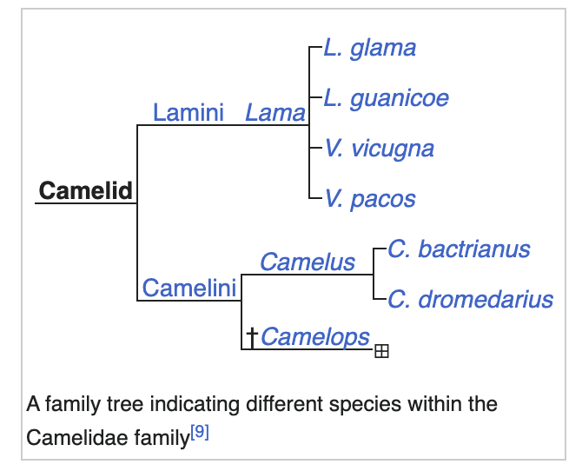
The “Eras” of LLMs
Sesame Street
Bigger is Better
Simon Says
Camelid
Sesame Street Character Era
Sesame Street Character Era
Sesame Street Character Era
Sesame Street Character Era
Text to Embedding Representation
Text to Text
Text to ”Task”
Open-source Text to ”Task”
2018
2020
2022
2023
Notes:
- This last era is the Camelid Era and is the one I’d say we’re currently in. This is the rise of Open Source models

Slide 13
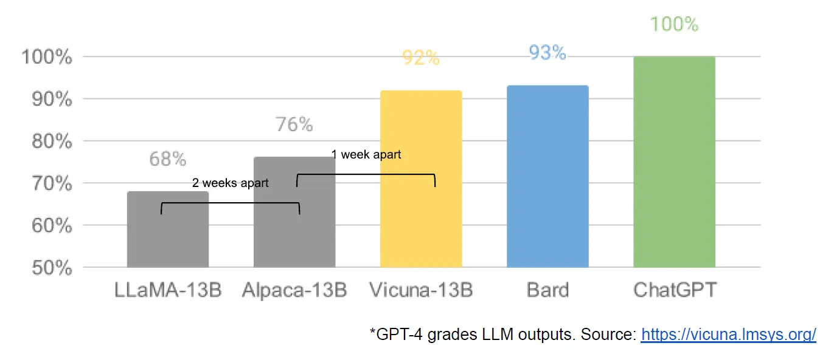
Open Source Is Catching Up
Better data (and more training) can result in smaller, cheaper models surpassing larger ones.
“We have no moat, and neither does OpenAI”
Infamous Google’s leaked memo “We have no moat, and neither does OpenAI”
Notes:
- The focus on data quality didn’t end with ChatGPT. The open source community picked up on the fact that with higher quality data (and more training), not only was quality better, but you didn’t need as large of a model.
- We saw the release of Llama and recently Llama2. Models a fraction of the size of OpenAI and competitive. Some of these models can run on your MacBook!
- For lack of a better word, the open source community started catching up

Slide 14
What Do LLMs Mean for Applications
No Task
Taskless
Simplify pipelines – single model for multiple tasks
No Labelled Data
Removes cold-start problem. No task specific training.
Encoded Knowledge
Captures vast amount of stored knowledge
Task 1
Task 2
…
LLM
Output 1
Output 2
…
Notes:
- What does this explosion of LLMs, small and large, mean for the DB community and building applications
- With LLMs, traditional ML pipelines become dramatically simpler because you only have one model. These models are taskless and do not need to be trained per task
- Further, this also means you don’t need expensive data labelling pipelines to curate data for training. All you need is prompts and a very small set of examples
- Lastly, these models contain a massive amount of general encoded knowledge – e.g how to write SQL queries. This alleviates the burden on engineers to manual inject this knowledge themselves.

Slide 15
LLMs for Data Wrangling
How can LLMs benefit structured data tasks?
Notes:
- I’ve just talked about the incredible rise of LLMs
- We now need to ask if LLMs can benefit classically hard structured data tasks

Slide 16

The Age Old Problem of Data Wrangling
Data wrangling is the task of transforming and preparing (typically) structured data for use downstream.
First | Last | State
Maya | Henry | CA
 | Doe | TT
First | Last | Area | State
Maya | Henry |  | CA
John | Doe | 346 | TT
First | Last | Area | State
Maya | Henry | 425 | CA
John | Doe | 346 | TX
Full | Area | State
John D | 346
J Henry | 303 | CO
Raw Documents
Extraction
Integration
Cleaning
Notes:
- To make sure we’re all on the same page, I’m classifying a structured data task as any wrangling task that transforms raw data into usable structured data downstream.
- This includes extraction, integration, and cleaning.

Slide 17
Challenges of Traditional Wrangling Pipelines (DL ones, too)
Task Specific Architecture
One model per task resulting in siloed pipelines.
Lots of Labelled Data
Need manually crafted labelled data per task.
Hard Coded Knowledge
Domain specific knowledge required and can be brittle with new domains.
First | Last | State
ID | Order | Cost
First | Last | State
ID | Order | Cost
Training Data
Training Data
Model
Model
Notes:
- How were traditional wrangling pipelines built
- for one, task specific architectures. You needed one model per dataset and per task. Pipelines were independent and siloed.
- Second, each model needed to be trained which required expensive labelled data
- Lastly, many pipelines still relies on some amount of engineer heuristics and encoded knowledge. For example, matching rules or labelling heuristics.

Slide 18


Should LLMs Be Able to Help?
With LLMs
Taskless
Simplify pipelines – single model for multiple tasks
No Labelled Data
Removes cold-start problem. No task specific training.
Encoded Knowledge
Captures vast amount of stored knowledge
Task Specific Architecture
One model per task resulting in siloed pipelines.
Lots of Labelled Data
Need manually crafted labelled data per task.
Hard Coded Knowledge
Domain specific knowledge required and can be brittle with new domains.
Notes:
- Recall all the benefits of LLMs
- LLMs have natural solutions to these challenge (what a coincidence that they align so well visually)
- It’s worth asking if we can use them

Slide 19






Can LLMs Wrangle Your Data?
LLMs are trained over unstructured data with wild success.
Movie Scripts
Books
20% of data
??
Code
Poems
Will LLMs even work over structured data?
Ads
Structured
Unstructured
https://www.sinequa.com/blog/structured-vs-unstructured-data-the-ultimate-guide
Notes:
- Be remember, LLMs are trained over unstructured data and, at the time of this work, were largely applied to unstructured tasks.
- Despite the fact that 20% of data is structured, we haven’t seen these models applied to LLMs.
- Is it even possible that LLMs can understand and work over structured data

Slide 20
Structured Data Meets LLMs
Yes
LLM
In-Context Example
Person A is First: Maya Last: Henry State: CA
Person B is Full: J Henry Area: 303 State: CO
Are person A and person B the same? No
Person A is First: John Last: Doe State: TX
Person B is Full: John D Area: 346 State: CO
Are person A and person B the same?
Input Example
First | Last | State
Maya | Henry | CA
John | Doe | TX
Full | Area | State
John D | 346 | TX
J Henry | 303 | CO
At VDLB this year!
Notes:
- We were some of the first to show that you could, in fact, use LLMs for data wrangling tasks
- At a high level, our method was to serialize rows as text inputs, craft a few in context examples of the task, and feed to the model.
– For matching, for example, we literally just asked the model if two rows are matching or now and it would output Yes or No.

Slide 21
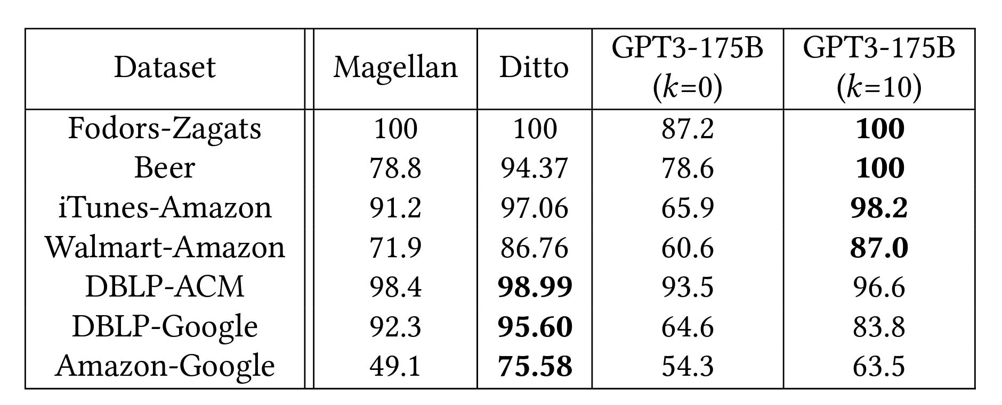
State of the Art Performance on Matching
BERT-based
No in-context demonstrations
With up to 10 in-context demonstrations
Notes:
- We showed that with LLMs, you can achieve state of the art quality across a variety of data wrangling tasks
- For matching, for example, we surpass even traditionally fine-tuned BERT models on 4 out of 7 tasks

Slide 22
Prototyping is Easy, Production is Hard
What makes deploying LLMs for structured data challenging? Can we solve it?
(I.e. My life the last 9 months)
Notes:
- I just showed these amazing results of using LLMs on structured data
- But prototyping and showing a POC is much easier that actually putting these models in production
- I’m now going to dive into what it takes to actually deploy LLMs over structured data and basically condense my life over the last 9 months into 15 minutes

Slide 23
Challenge 1: High Cost
End to end example – but now over real data.
Extracted 1M users
10 matching candidates per entity – 10M pairs
1M rows to clean
First | Last | State
Maya | Henry | CA
 | Doe | TT
First | Last | Area | State
Maya | Henry |  | CA
John | Doe | 346 | TT
First | Last | Area | State
Maya | Henry | 425 | CA
John | Doe | 346 | TX
Full | Area | State
John D | 346
J Henry | 303 | CO
Raw Documents
Assume each row 1k tokens, GPT-4 at ~0.03 / 1000 tokens = 400k dollar pipeline
Notes:
- Let me just first add the size of these structured dataset
- Academic benchmarks are on the order of 100s of rows. In the real world, if you were doing this over all of Wikipedia for example, you’re looking at XXX

Slide 24


Challenge 1: High Cost
Even at Numbers Station!
Don’t worry, fake model
Notes:
- As real proof that this stuff can get very pricey, this is a screen shot of a developer at Numbers Station a few months ago who was testing a cleaning task
- DON’T worry, he was using a fake model for testing
- But due to a large dataset size and some amount of retry logic, we spent an estimated 30K dollars in the span of an hour
- And you see that we also at this time let users go over budget – our product was in pre-alpha phrase if that is even a thing. Even better!

Slide 25
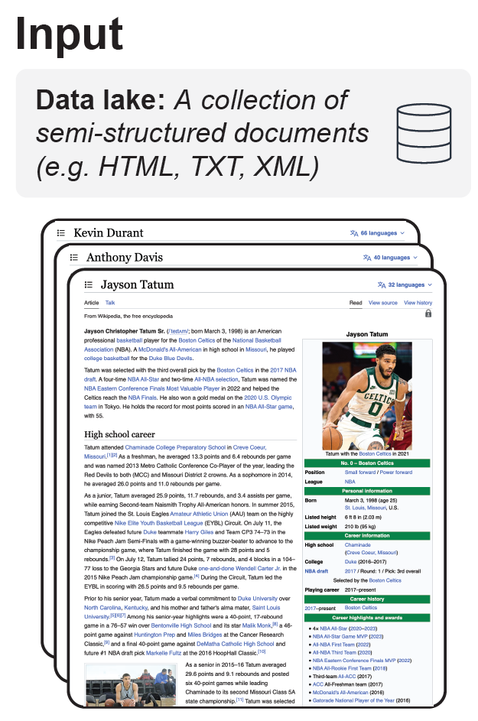
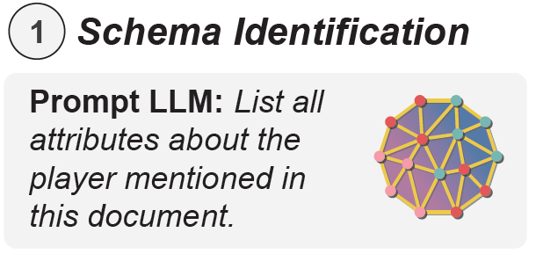
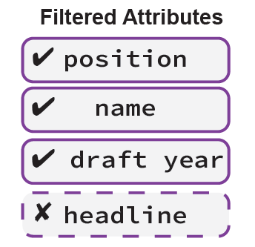
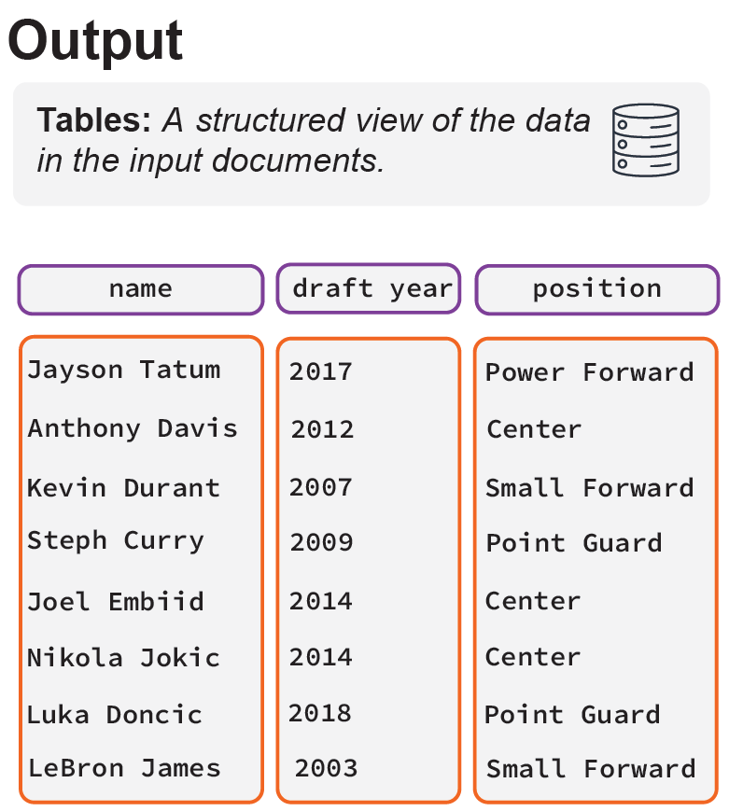
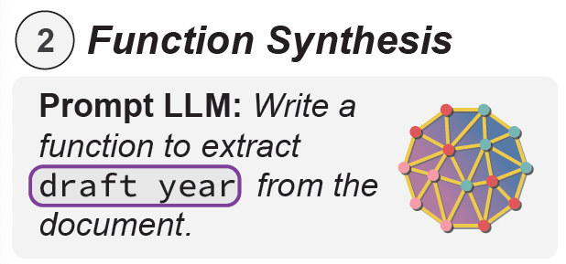
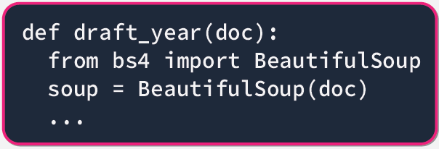
Solution 1: Generate Code to Perform Task
https://github.com/HazyResearch/evaporate/blob/main/technical-report.pdf
Notes:
- There are a few possible solutions to handle the high cost issue, but some super exciting work from collaborators at Stanford is to use a model to generate code that performs the task rather than having the model do the task itself

Slide 26
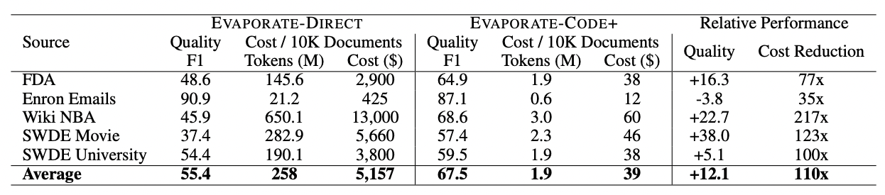
Solution 1: Code Saves Cost and Time
Notes:
[Evaluation results]

Slide 27

Another Application: Generate SQL for Analytics
Generate executable SQL for answering questions
SELECT State, COUNT(*)
FROM work_orders
GROUP BY State
State | Count
CA | 3450
TX | 6732
LLM
Generate SQL given question.
Schema: Address, State, WKO_ID, NEUT, Cost
Question: How many work orders does each state have?
Address | State | WKO_ID | NEUT | Cost
345 Main St | CA | 123 | 0.8 | 300
89 Yale Ave | TX | 346 | 0.6 | 125
Notes:
- We can use this generate code paradigm to also generate SQL queries which can be used for matching, cleaning, and general business analytics queries, too
- For example, …

Slide 28

Challenge 2: Lacking Personalization
General LLMs lack required enterprise knowledge
INCORRECT
CORRECT
SELECT MAX(NEUT)
FROM work_orders
WHERE State = ‘CA’
SELECT COUNT(*)/SUM(NEUT)
FROM work_orders
WHERE State = ‘CA’
LLM
“Satisfaction score is COUNT(*) / SUM(NEUT)”
Generate SQL given question.
Schema: Address, State, WKO_ID, NEUT, Cost
Question: What is the satisfaction score of California work orders?
Data Engineer
Address | State | WKO_ID | NEUT | Cost
345 Main St | CA | 123 | 0.8 | 300
89 Yale Ave | TX | 346 | 0.6 | 125
Notes:
- Even if you address the scale issue, an immediate next challenge is personalization
- Continuing with this data cleaning example, suppose you have an engineer asking for …
- And this is inspired by a customer query we saw at Numbers Station
- You go and ask this of ChatGPT, you get …
- This makes a lot of natural sense but is actually wrong
- A data engineer would know that XXX
- These models are jack of all trades and master of none. They don’t know or have seen this idiosyncratic business logic for this specific enterprise.

Slide 29


Solution 2: NSQL Backbone Model
Start with the best Open Source and customize to SQL.
Pretrain Over SQL Queries
-- Observe results of run SELECT COUNT(*) FROM experiment; SELECT name, MIN(v) FROM exp_A;
INSERT INTO revenue VALUES (342543, 32, 9813, ‘Main St.’, 2020/03/12, …);
WITH arg_group AS (SELECT name, (age / 10)::INT, state FROM employees), salary AS (SELECT…
Finetune Over Instruction-SQL Pairs | Pretrain Over SQL Queries
How many singers are older than 20 in NY? | SELECT name FROM singers WHERE age > 20 AND state = ‘NY’
Who is the highest paid artist? | SELECT name FROM singers WHERE salary = (SELECT MAX(salary) FROM singers)
Number of singers who has a concert was in 2010? | SELECT COUNT(*) FROM singers INNER JOIN concerts ON singers.id = concerts.singer_id WHERE…
Fully open model that can be owned by enterprise
HuggingFace Link: https://huggingface.co/NumbersStation
Notes:
- One solution to personalize models is to lean into the fact that we do have strong open source LLMS models that can be used and customized over relevant enterprise data
- Some recent work at Numbers Station wanted to pave the way for customized SQL generation models to be used for cleaning and analytics tasks.
- If you recall the “simon says” era, we took those insights into data curation for instruction tuned models and created a large set of instruction to SQL pairs and finetuned a text to SQL open source model over this data
- We recently released a suite of models over this data, even one of Llama2, that is now on HuggingFace.

Slide 30
Solution 2: Model Finetuning Customization
Customize over enterprise logs using LLMs to label data.
Address | State | WKO_ID | NEUT | Cost
345 Main St | CA | 123 | 0.8 | 300
89 Yale Ave | TX | 346 | 0.6 | 125
LLM-Generated Instructions from Query Logs | Pretrain Over SQL Queries
SELECT WKO_ID FROM work_orders WHERE month = ‘May’ | What are the orders occurring in CA?
SELECT MIN(cost) FROM work_orders | What is the cost of the cheapest order?
SELECT COUNT(*) FROM work_orders WHERE cost < 20 | List the total number of work orders less than 20.
Train LLM over Enterprise Logs
Enterprise Query Logs + NSQL Backbone
Matching execution accuracy of a model trained with gold labeled data
Notes:
- Now this model doesn’t fully solve the enterprise personalization yet. The model knows SQL but it doesn’t know a specific enterprise’s SQL and business logic
- The second step for this solution is to further customize the model over enterprise log data
- Specifically, we tap into the fact that LLMs (both open and closed source) are great text generators. It was what they were trained to do
- We can feed SQL queries from logs to get them labeled by an LLM to generate an instruction
- The enterprise specific instruction to SQL data is then used to finetune the SQL model for the enterprise
- We saw this model-labelled data approach result in a model that was within 1 F1 point of training over gold labeled data on the Spider text to SQL benchmark
- I want to highlight one aspect here which is that we actually finetune these models to use in-context examples – demonstrations. I’m going to dive into what this is important next.

Slide 31
Handling Updates without Retraining
Use in-context demonstrations to continually update model to new data and schema.
Generate SQL given question.
Schema: Address, State, EMP_ID, Type, HourlyRate
Question: How many plumbers service New York?
SQL: SELECT COUNT(*) FROM services WHERE state = ‘NY’ AND type = ‘Plumbing’
Question: What technicians in New York charge less than 100 / hr?
LLM-Generated Instructions from Query Logs | Pretrain Over SQL Queries
SELECT WKO_ID FROM work_orders WHERE month = ‘May’ | What are the orders occurring in CA?
SELECT MIN(cost) FROM work_orders | What is the cost of the cheapest order?
SELECT COUNT(*) FROM work_orders WHERE cost < 20 | List the total number of work orders less than 20.
In-Context Example from Log
New Database
SELECT COUNT(*) FROM services WHERE state = ‘NY’ AND type = ‘Plumbing’ | How many plumbers service New York?
Do not need to retrain at every update!
Notes:
- The in context demonstration bit is important because it’s a key mechanism through which you can continuously adapt and customize a model over time without retraining.
- Training can be expensive.
- These models are in-context learners (and you can train them to be so).
- This means as data and schema changes over time, you can allow the model to see updated examples in the prompt to maintain accuracy with its predictions

Slide 32
Challenge 3: Not Enough Context
Models have limited context length - an upper bound for how much information you can add to the prompt.
Generate SQL given question.
Schema:
CREATE TABLE work_order (id NUMBER, property_id NUMBER, cost FLOAT, invoice_amount FLOAT,i entered_date DATE, due_date DATE, complete_date DATE, cancel_date DATE, is_canceled BOOLEAN, is_completed BOOLEAN, is_open BOOLEAN, order_type TEXT, assigned_to TEXT )
CREATE TABLE property ( id NUMBER, property_name TEXT, area FLOAT, owner_id NUMBER, city TEXT, country TEXT )
…
Question: How many plumbers service New York?
SQL: SELECT COUNT(*) FROM services WHERE state = ‘NY’ AND type = ‘Plumbing’
…
Question: What technicians in New York charge less than 100 / hr?
3K+ tokens for schema
Enterprises have 100s of tables with 100s of columns
500 tokens per example
What a real prompt looks like
Quality suffers without enough context
Notes:
- The real challenge with this approach is that models have limited context length
- Llama supports 4k tokens, which feels like a lot, but you’re over the context length window with a small number of demonstrations
- And if your data has hundreds of columns (as happens in enterprise settings), you may not fit any examples or even fit the entire schema! Which will degrade performance.

Slide 33

Challenge 3: Not Enough Context
Models have limited context length - an upper bound for how much information you can add to the prompt.
Generate SQL given question.
Schema:
CREATE TABLE work_order (id NUMBER, property_id NUMBER, cost FLOAT, invoice_amount FLOAT,i entered_date DATE, due_date DATE, complete_date DATE, cancel_date DATE, is_canceled BOOLEAN, is_completed BOOLEAN, is_open BOOLEAN, order_type TEXT, assigned_to TEXT )
CREATE TABLE property ( id NUMBER, property_name TEXT, area FLOAT, owner_id NUMBER, city TEXT, country TEXT )
…
Question: How many plumbers service New York?
SQL: SELECT COUNT(*) FROM services WHERE state = ‘NY’ AND type = ‘Plumbing’
…
Question: What technicians in New York charge less than 100 / hr?
3K+ tokens for schema
Enterprises have 100s of tables with 100s of columns
500 tokens per example
What a real prompt looks like
Quality suffers without enough context
Notes:
- Just as proof it does happen in production

Slide 34
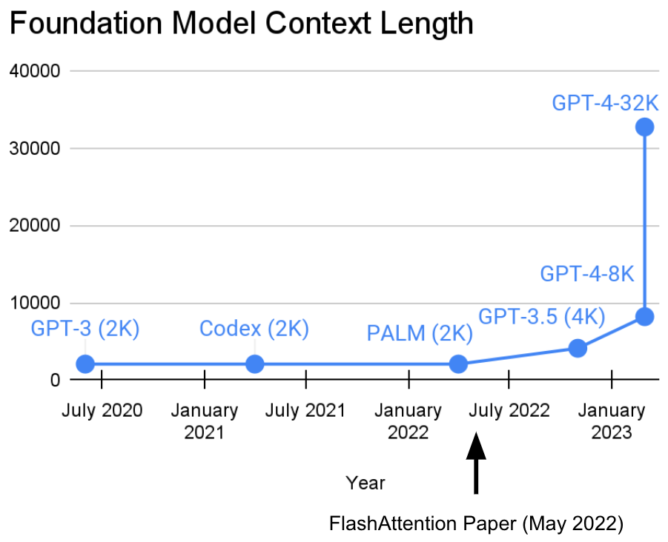
Solution 3: Long Context Models
Algorithmic advances in reducing memory allow for longer contexts
https://arxiv.org/abs/2205.14135, https://crfm.stanford.edu/2023/07/17/flash2.html
Notes:
- Luckily, we’ve seen a massive improvement in long context models. Models that can handle up to 100K tokens of input
- Even more impressive, these models can parameter match their smaller context counterparts meaning they remain at a small, manageable size
- Specifically, we’ve seen the recent work of Code-Llama 2 come out that uses embedding based memory to expand the context

Slide 35
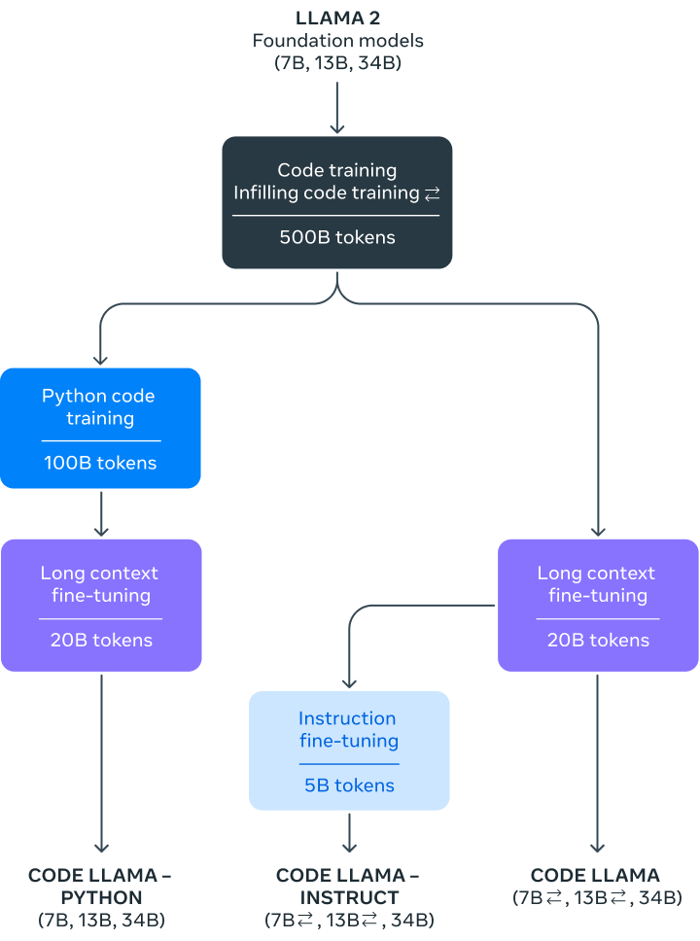
Solution 3: Long Context Models
Recently released Code Llama2 finetunes model to allow for context extrapolation up to 100k tokens
https://arxiv.org/pdf/2306.15595.pdf, https://ai.meta.com/research/publications/code-llama-open-foundation-models-for-code/

Slide 36
And The World is Only Getting Crazier
What goes around comes around
Notes:
- I just recapped three critical problems around cost to scale, personalization, and context length.
- Now I admit, this is not the complete problem space and everything is not solved
- But I want to end on some exciting future ideas that are only going to make the world a bit more crazy

Slide 37
The “Eras” of LLMs
Sesame Street
Bigger is Better
Simon Says
Camelid
Sesame Street Character Era
Sesame Street Character Era
Sesame Street Character Era
Sesame Street Character Era
From a systems perspective, embeddings were great. Precompute, index, …
Text to Embedding Representation
Text to Text
Text to ”Task”
Open-source Text to ”Task”
2020
2022
2023
2018
37
Notes:
- If you remember this Sesame Street character era I talked about earlier
- Well, what goes around comes around

Slide 38
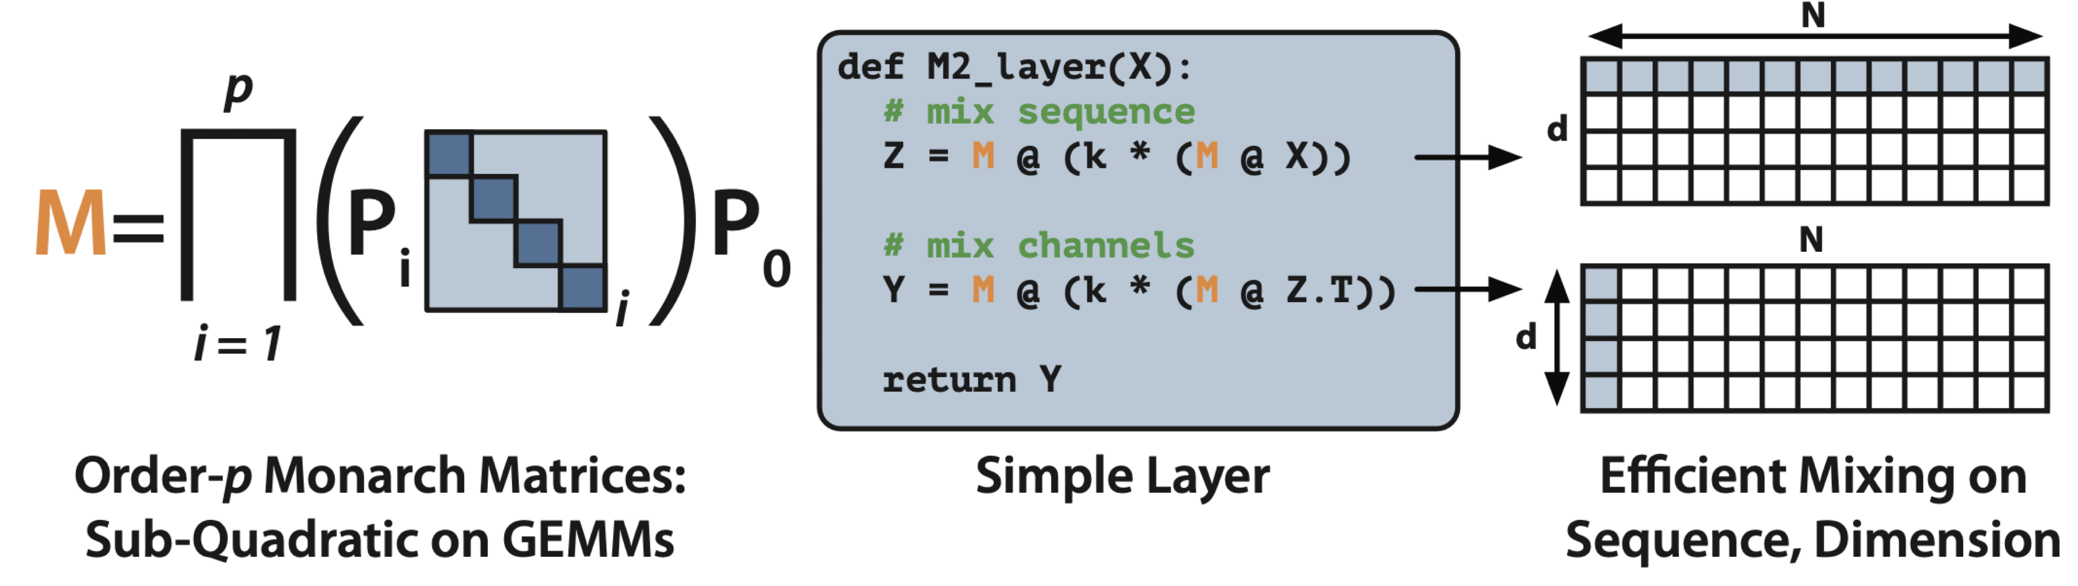
M2 - Long Context BERT
Uses block diagonal sparse matrices to have sub-quadratic in sequence and dimension lengths.
Able to train 2048 context BERT model on a single GPU with same throughput as standard 512 context – long context BERT
https://hazyresearch.stanford.edu/blog/2023-07-25-m2-bert
Notes:
- Some very recent work from Stanford is looking at how to extend the context length and efficiency of BERT models
- This method, called Monarch Matrices…
-

Slide 39

LLMs for Wrangling – Possible, Exciting, Not Easy
LLM
High Cost
Lacking Personalization
Limited Context
Prototyping is easy, production is hard
Contact: laurel.orr@numbersstation.ai
Blogs: https://www.numbersstation.ai/blog
Wrangling Paper: https://arxiv.org/abs/2205.09911
Notes:
- I want to end with a quick recap on the story of LLMs and Structured Data
- I’ve shown how, although LLMs are trained on a simple text task, they can be valuable tools for performing data wrangling tasks.
- Deploying them is hard and you need to manage challenges of scale, personalization, and context length
- But all I can say, is it is a very exciting time to be in this field, and I can’t emphasize enough the importance of high quality data for getting the best performance out of these models. It’s all in the data.
- On that note, thank you so much and please let me know what questions you have

