Slide 1


Proportionate Diversification of Top-k LLM Results using Database Queries (LLMDB Workshop, VLDB 2023)
Thinh On, Subhodeep Ghosh, Mengnan Du, Senjuti Basu Roy
Big Data Analytics Lab
https://centers.njit.edu/bdal/
CS, New Jersey Institute of Technology

Slide 2
Overview
Motivation
Problem Definition
Proposed Framework
Case Study
Open Problems
Summary and Ongoing Work
Notes:
2

Slide 3
What is Result Diversification?
Result diversification aims to return relevant results that cover a variety of perspectives
Returning top-k results is important and has been extensively studied^{[1,2,3]}
This work studies proportional diversification in top-k, which:
- groups results by shared attributes (e.g., genre and/or language for movies)
- retrieves proportion of each group satisfying user intent
- selects a number of items from each group based on their proportions
[1] R. Agrawal, S. Gollapudi, A. Halverson, S. Ieong, Diversifying search results, in: Proceedings of the second ACM international conference on web search and data mining, 2009, pp. 5–14.
[2] Y. Yue, C. Guestrin, Linear submodular bandits and their application to diversified retrieval, Advances in Neural Information Processing Systems 24 (2011).
[3] S. Gollapudi, A. Sharma, An axiomatic approach for result diversification, in: Proceedings of the 18th international conference on World wide web, 2009, pp. 381–390.
Notes:
3

Slide 4
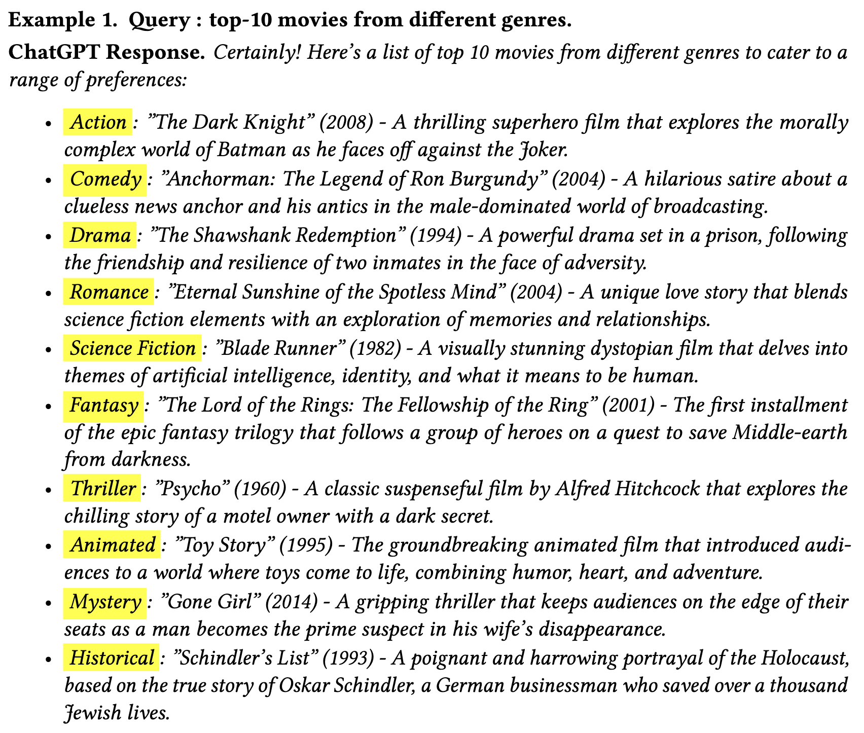
Motivation
The query results produced by LLMS alone are not representative enough of external world
In Example 1, LLM returns one movie per genre. In real-world datasets, the proportions of movies across genres are not uniformly distributed as what LLM returns in the example.
Goal. How to make top-k results from LLMs proportionally diverse by using external
data databases
[Generalization]. Use statistics from external data sources and improve LLM results
Notes:
4

Slide 5

Problem Definition – Proportionally Diversified Top-k
Single attribute. Given a user query $q$, integer $k$, user specified attribute $A$ with $ℓ$ domain size (on which the results are to be diversified), a proportionality constraint defined over a single attribute containing $ℓ$ different groups $G_{1},G_{2},..,G_{ℓ}$ requires that the representation of each group $G_{i}$ in top-k results is $a_{i}$, where $\sum_{i}^{ℓ}{a_{i}}=k$.
Multiple attributes. Generalizing this, if proportionality is defined over a set R of different attributes with a required representation on each group of each attribute, a proportional top-k result must simultaneously satisfy proportionate representation for all attributes in R.
Wei, D., Islam, M. M., Schieber, B., & Basu Roy, S. (2022, June). Rank aggregation with proportionate fairness. In Proceedings of the 2022 International Conference on Management of Data (pp. 262-275).
Notes:
5

Slide 6
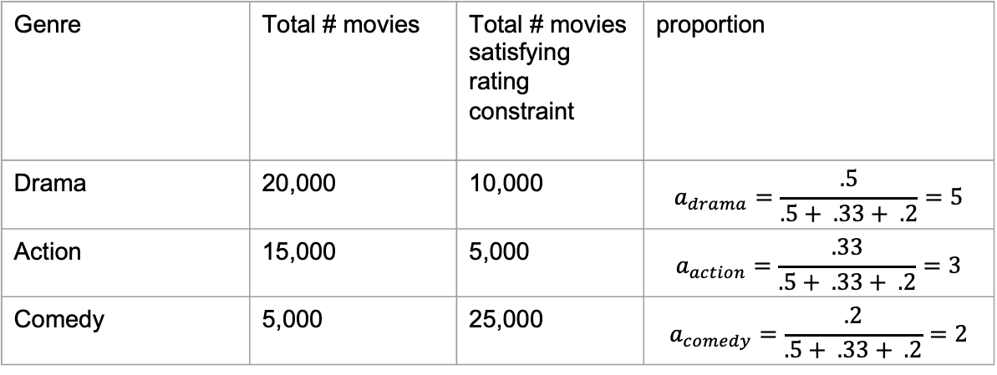
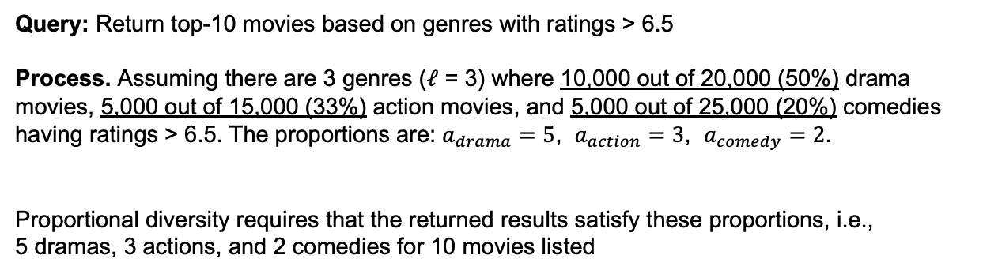
Example – Proportionally Diversified Top-k
Query: Return top-10 movies based on genres with ratings > 6.5
Process. Assuming there are 3 genres ($ℓ$ = 3) where 10,000 out of 20,000 (50%) drama movies, 5,000 out of 15,000 (33%) action movies, and 5,000 out of 25,000 (20%) comedies having ratings > 6.5. The proportions are: $a_{drama}=5$, $a_{action}=3$, $a_{comedy}=2$.
Proportional diversity requires that the returned results satisfy these proportions, i.e.,
5 dramas, 3 actions, and 2 comedies for 10 movies listed
Genre | Total # movies | Total # movies satisfying rating constraint | proportion
Drama | 20,000 | 10,000 | $$a_{drama}=\frac{.5}{.5+ .33+ .2}=5$$
Action | 15,000 | 5,000 | $$a_{action}=\frac{.33}{.5+ .33+ .2}=3$$
Comedy | 5,000 | 25,000 | $$a_{comedy}=\frac{.2}{.5+ .33+ .2}=2$$
Proportional diversification increases the likelihood of
seeing niche items in Top-k result set

Slide 7
Comparison with Related Work
ChatDB¹ leverages external data sources are to augment LLMs in multi-step reasoning
Makes use of chain-of-memory (CoM) approach for transforming user inputs into a series of intermediate memory operation steps that lead to final results
Proportional diversification is integrated to a similar framework as ChatDB with more complex reasoning for text-to-SQL^{2,3}: Convert natural language text to SQL statements that assist in calculating proportions for some user-specified attribute(s)
The new framework should include proportionality information when summarizing SQL results into a final prompt
Result diversity can be improved by representing groups in proportion to their prevalence in the database
C. Hu, J. Fu, C. Du, S. Luo, J. Zhao, H. Zhao. ChatDB: Augmenting LLMs with databases as their symbolic memory, 2023. arXiv:2306.03901.
G. Katsogiannis-Meimarakis, G. Koutrika, A survey on deep learning approaches for text-to-sql, The VLDB Journal (2023) 1–32
G. Katsogiannis-Meimarakis, G. Koutrika, A deep dive into deep learning approaches for text-to-sql systems, in: Proceedings of the 2021 International Conference on Management of Data, 2021, pp. 2846–2851
Notes:
7

Slide 8
User Input
(find 10 diverse movies based on genre)
Proposed Framework
Prompt
Text
To
SQL
Transform
SQL
to
Text
Transform
Summarize
LLMs
SQL response to find proportion of highly rated
(average rating greater than 6.5) movies per genre
(find
5 drama,
3 action,
2 comedy
movies)
Step 1
SELECT genre, COUNT(genre) From Movie group by genre;
+----------------+
| Count |
+----------------+
| drama 20,000 |
+----------------+
| action 15,000 |
+----------------+
| comedy 25,000 |
+----------------+
Step 2
SELECT Count (Movie_name)
From movie INNER JOIN Ratings
On movie.M_id=Rating.Movie_id where genre =‘Drama’
group by Rating.(Movie_id)
Having Avg(rating) > 6.5
+-------------+
| Count |
+-------------+
| 10,000 |
+-------------+
Step 3
SELECT Count (Movie_name)
From movie INNER JOIN Ratings
On movie.M_id=Rating.Movie_id where genre =‘Action’
group by Rating.(Movie_id)
Having Avg(rating) > 6.5
+-------------+
| Count |
+-------------+
| 5,000 |
+-------------+
Step 4
SELECT Count (Movie_name)
From movie INNER JOIN Ratings
On movie.M_id=Rating.Movie_id where genre =‘Comedy’
group by Rating.(Movie_id)
Having Avg(rating) > 6.5
+-------------+
| Count |
+-------------+
| 5,000 |
+-------------+
Query an
external SQL database
Calculate proportionate representation of movies per genre in 10 results
Output
Movie
Rating
User
M_id | Movie name | genre | Actor_id | Production company_id | Award id
1 | Citizen Kane | Drama | 853453 | 863453 | 123
2 | The Dark Knight | Action | 853454 | 863453 | 124
3 | Psycho | Thriller | 853455 | 863453 | 179
Movie_id | User_id | rating | date
1 | ABC | 4 | 01/01/2018
2 | ABC | 1 | 12/10/2021
3 | DEF | 2 | 1/10/2002
user_id | User_name | contact_name | email
1 | ABC | 131655 | of@gmail.com
2 | DEF | 131656 | tf@gmail.com
3 | GHI | 161657 | hf@gmail.com
Actor
Production Company
Award
Award Details
actor_id | name | Gender | Birth country
853453 | Orson Welles | M | US
853454 | Christian Bale | M | UK
853455 | Janet Leigh | F | US
Prod company_id | Name | Owner | Headquarter
863453 | RKO pictures | David Sarnoff | NYC
863454 | Warner Bros | Warner Bros. Pictures Group | CA
863455 | Paramount pictures | National Amusements | CA
Award id | Award name | Award category_id
123 | Academy Award | 3
124 | Golden Globe | 4
179 | Edgar Award | 1
Category_id | Category name
3 | Original screen play
4 | Best supporting actor
1 | Best motion picture
Database
SQL
Notes:
8

Slide 9
Implementation Details
A proof-of-concept case study is performed as follows.
Translate user intents to SQL statements
Calculate the proportional statistics from the database
Prompt LLM model with the proportionality information to produce diversified answers
MySQL and GPT-3.5-Turbo Model API are unified into a single Python interface
IMDb database is connected to MySQL and queried using Python via pymysql library
SQL statements and proportions are calculated
Proportion is summarized into a prompt and feed into the GPT Model API to produce final outputs
Notes:
9

Slide 10
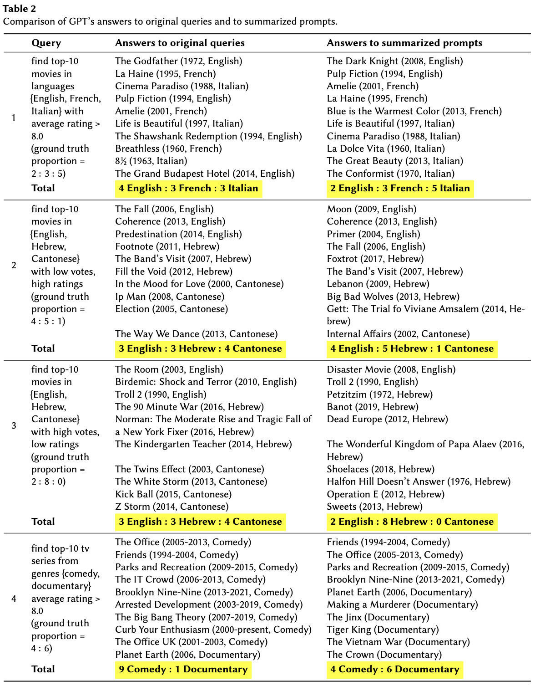
Case Study – Results
With summarized prompts, GPT can produce proportionally diverse answers
The ratios between groups of an attribute (e.g., language) are conforming with the proportions of those groups in the external data sources
Without these prompts, GPT tends to return answers skewed towards some attributes.
For example, GPT returns 9 comedy and 1 documentary to the 4th query
Notes:
10

Slide 11
Open Problems
Text-to-SQL: automating text-to-SQL is challenging: SQL statements must handle statistical analysis while maintaining overall semantics of user intents.
SQL-to-text: (1) map numerical values to textual quantifiers/aggregates (50% → half); (2) summary of SQL results needs to be concise, omitting unnecessary details; (3) preserve the context between user original query, the intermediate SQL queries and results, and the summarized text prompt
Finetuning LLMs to generate informative summaries that can explain the reasoning behind the SQL results

Slide 12
Summary and Ongoing Work
Initial directions on how to make query results coming from LLMs more representative to external data sources are presented
A framework is introduced to query external benchmark datasets, calculate proportions for relevant attributes, and summarize query results as text prompts
As a proof of concept, the proposed approach is implemented to improve diversity of query results according to genres
Ongoing work: investigating practical solutions to automate the proposed framework and evaluate its effectiveness on diverse query types and domains
Acknowledgement: The work of Senjuti Basu Roy and Thinh On are supported by the National Science Foundation (CAREER Award #1942913, IIS #2007935, IIS #1814595) and the Office of Naval Research (Grants No, N000141812838, N000142112966).

Slide 13
Thank you!

