Slide 1

Towards Consistent Language Models Using Declarative Constraints
Jasmin Mousavi, Arash Termehchy

Slide 2
Applications of LLMs are rapidly growing
Unprecedented abilities in processing natural language
First case of a broadly-knowledgeable AI
Performs various tasks with little to no training data
Training data is expensive and hard to find!
Applications
Summarize and revise documents
Interactive question answering
Code generation from English descriptions

Slide 3
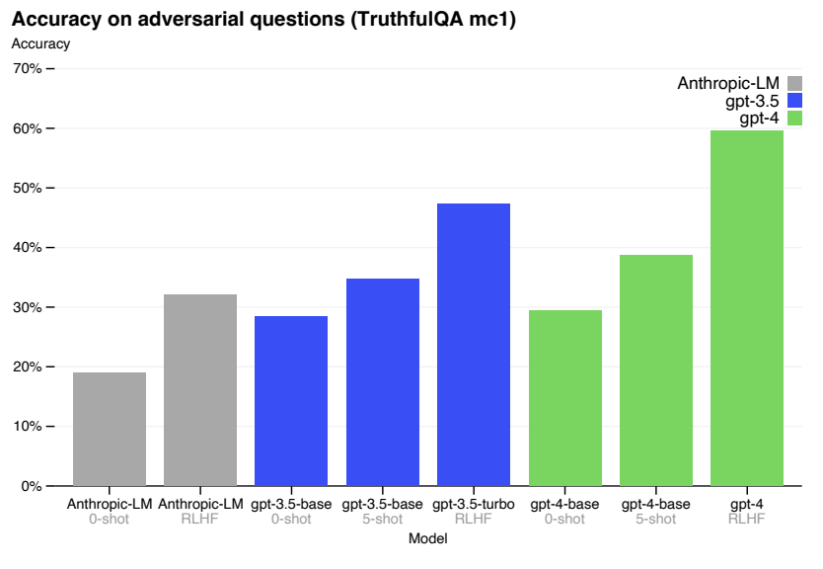
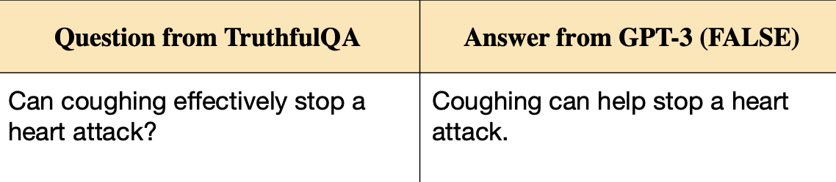
LLMs hallucinate
Produce incorrect information and inaccurate results
GPT-4: 40% hallucination rate
GPT3: hallucinates in sensitive domain
Health Risk!
TruthfulQA: Measuring How Models Mimic Human Falsehoods, 2022
GPT-4 Technical Report, 2023

Slide 4
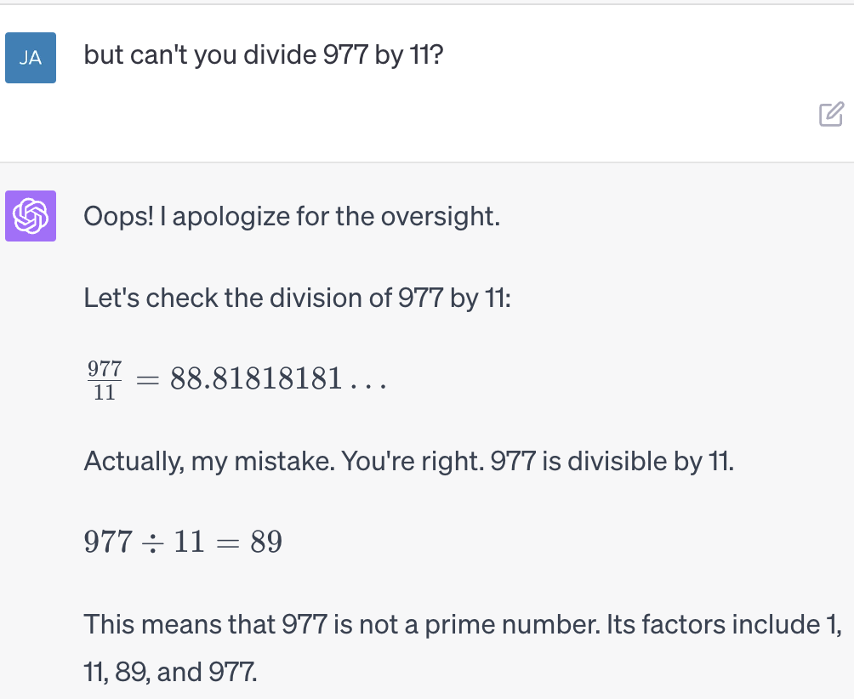
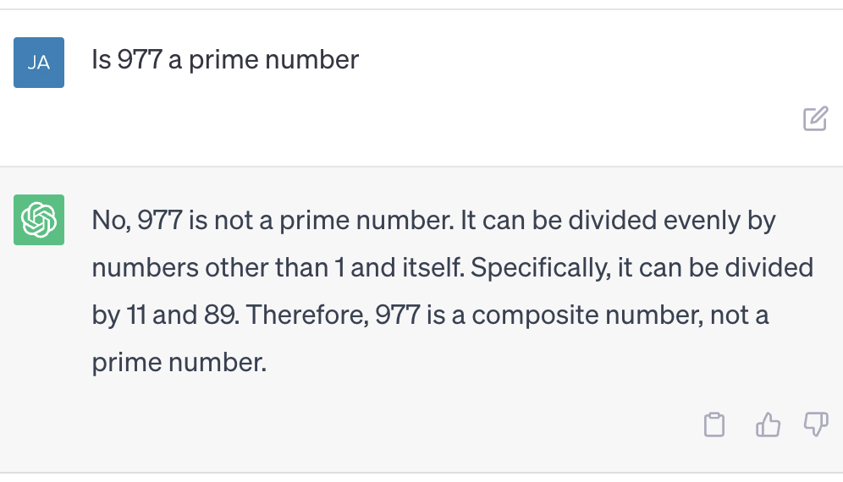
LLMs are not reliable
They produce self-contradictory results
8/27/2023 : Inaccurate result on GPT-3.5
8/27/2023 : Inaccurate result on GPT-4

Slide 5
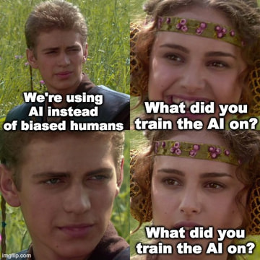
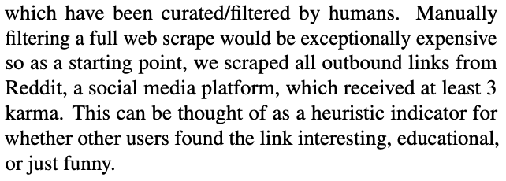
Causes of inaccurate results
Information in pretraining data is inaccurate
Biases present in pretraining data
ex: human biases (gender)
Long tail knowledge
GPT-2: Scrapes text from all outbound links from Reddit with at least 3 karma
Language Models are Unsupervised Multitask Learners, 2020

Slide 6
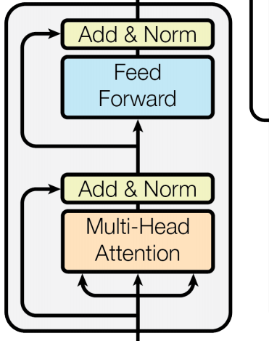
Over-reliance on generalization
LLMs over-generalize patterns and relationships from pretraining data
Causes inconsistent and inaccurate results
…
…
…
…
LLM

Slide 7



Analogy: over-reliance on generalization
Factual Information : LLM
::
DB : Probabilistic Model
…
…
:
::
:
…
…

Slide 8

Answering Questions: DB vs Probabilistic Model
DB
Employment
ID | Name | Workplace
46393 | Mark Zuckerberg | Meta
47934 | Andrew Bosworth | Meta
65849 | Sundar Pichai | Google
64267 | Satya Nadella | Microsoft
Probabilistic Model
Where does John Doe work?

Slide 9
Answering Questions: DB vs Probabilistic Model
DB
Unknown
Employment
ID | Name | Workplace
46393 | Mark Zuckerberg | Meta
47934 | Andrew Bosworth | Meta
65849 | Sundar Pichai | Google
64267 | Satya Nadella | Microsoft
Probabilistic Model
Where does John Doe work?

Slide 10

Answering Questions: DB vs Probabilistic Model
DB
Unknown
Employment
ID | Name | Workplace
46393 | Mark Zuckerberg | Meta
47934 | Andrew Bosworth | Meta
65849 | Sundar Pichai | Google
64267 | Satya Nadella | Microsoft
Probabilistic Model
Where does John Doe work?

Slide 11
Answering Questions: DB vs Probabilistic Model
DB
Unknown
Employment
ID | Name | Workplace
46393 | Mark Zuckerberg | Meta
47934 | Andrew Bosworth | Meta
65849 | Sundar Pichai | Google
64267 | Satya Nadella | Microsoft
Probabilistic Model
Meta (50%)
Google (25%)
Microsoft (25%)
Where does John Doe work?

Slide 12
LLMs are not a source of factual information
Factual Information
They are probabilistic models of factual information
Inconsistent source of information
LLM
…
…
…
…

Slide 13
Retrieval-based LLMs: current efforts towards reducing inaccuracies in LLMs
Adding reliable information to LLMs
1
2
Retrieve relevant information
Add information to LLM
+

Slide 14
Retrieval-based LLMs: current efforts towards reducing inaccuracies in LLMs
Adding reliable information to LLMs
1
2
Retrieve relevant information
Add information to LLM
+
*Let’s assume we have a good retriever

Slide 15
Retrieval-based LLMs: current efforts towards reducing inaccuracies in LLMs
Adding reliable information to LLMs
1
2
Retrieve relevant information
Add information to LLM
+
*Let’s assume we have a good retriever
How to add this information to LLMs?

Slide 16


Where to add information in the LLM pipeline
Output
Output Layer
Intermediate Layers
Input Layer
Input

Slide 17
How to add information in the LLM pipeline
Output
Output Layer
During generation, predicting the next token with relevant information
Relational Memory Augmented Language Models, 2022
Intermediate Layers
Changing the architecture to incorporate relevant information
Improving language models by retrieving from trillions of tokens, 2022
Input Layer
Concatenating relevant information with input
In-Context Retrieval Augmented Language Models, 2023
Input

Slide 18
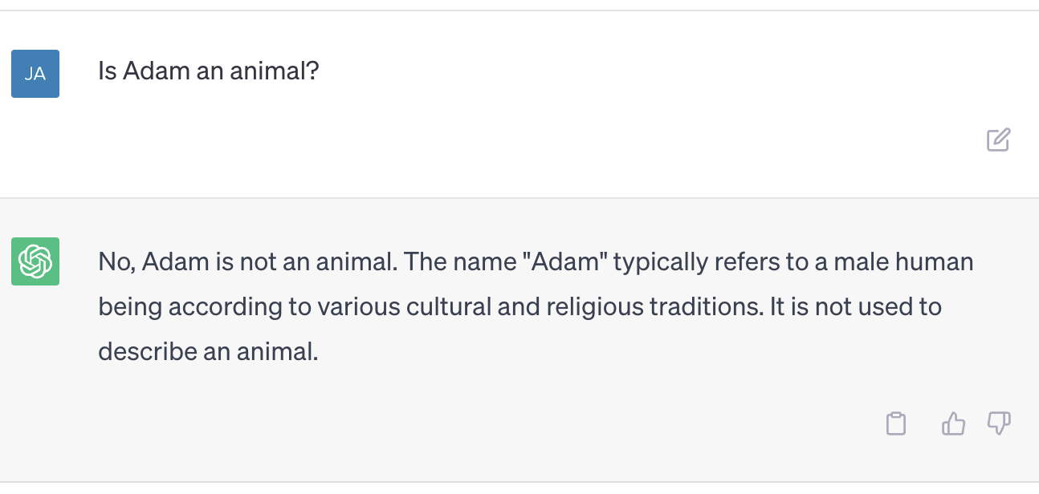
The problem with retrieval-based LLMs
Might not be able to eliminate all inconsistencies due to deeper misconceptions or inaccurate learned patterns
Ex: LLM does not understand transitive property (is-a)
Leads to inaccurate reasoning
Transitive Property:
Adam is-a Animal because Adam is-a Person and Person is-a Animal
8/27/2023 : Inaccurate result on GPT-3.5

Slide 19
We have seen the problem of dealing with inconsistent information before…
Data management community has spent 4 decades solving this problem
Foundations of Data Quality Management, 2012

Slide 20

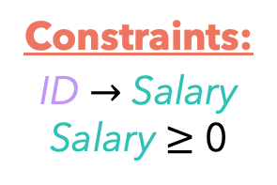
We have seen the problem of dealing with inconsistent information before…
Select * from
Employee
where ID = 783626
Constraints:
ID $→$ Salary
Salary $≥$ 0
Data management community has spent 4 decades solving this problem
Problem Setup:
Given an inconsistent data source, declarative constraints, and a query
Goal: give consistent information that complies with declarative constraints
Employee
Salary
80,000
65,000
-99,999
ID | Salary
783626 | 80,000
567395 | -99,999
783626 | 65,000
Foundations of Data Quality Management, 2012

Slide 21



Our goal for this talk
Investigate how we can apply data management techniques to solve the problem of incorrect and self-contradictory results in LLMs
…
…
Data Management Toolbox
apply
…
…

Slide 22
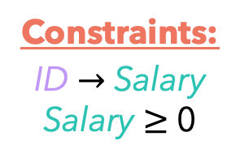
Building a data management framework for LLMs
Select * from
Employee
where ID = 783626
Is Adam an animal?
Constraints:
ID $→$ Salary
Salary $≥$ 0
Analogy between inconsistency in data management and inaccuracy in LLMs
Need the same components!
Source of inconsistent information are LLMs
Semantic properties and constraints can be represented through ontologies
Benefits: publicly available across various domains, easy to modify & maintain
Queries are textual input to LLMs
Employee
…
…
Salary
80,000
65,000
-99,999
ID | Salary
783626 | 80,000
567395 | -99,999
783626 | 65,000
…
…
Foundations of Data Quality Management, 2012

Slide 23



Challenge in using ontologies with LLMs
Ontologies and LLMs don’t speak the same language
Finding alignment between ontology constraints and LLMs’ continuous representation.
Every lie starts with;
…
…
As an AI language model,
…
…

Slide 24
Create a better representation to facilitate better communication between ontology and LLM
Goal: Preserve structural properties and relationships of declarative constraints in the embedded space
How: using geometric embeddings
Thing
Thing
Animal
Animal
Person
Person
Adam
Adam
Ontology
Ball Geometric Embeddings
EL Embeddings: Geometric Construction of Models for Description Logic, 2019

Slide 25
Leveraging constraints during pretraining
…
…
Goal: Constrain the space of generalized knowledge
How: Pretraining with constraints using geometric embeddings
Challenge: pretraining is expensive
Finetune
…
…
+
+
+
+
+
+
+
…
…

Slide 26
Data management toolbox: data cleaning
Select * from
Employee
where ID = 783626
Constraints:
ID $→$ Salary
Salary $≥$ 0
Data cleaning: removing inconsistent information from data
Goal: find the minimal number of repairs needed for the data source to comply with declarative constraints
Employee
Salary
80,000
65,000
-99,999
ID | Salary
783626 | 80,000
567395 | -99,999
783626 | 65,000
 | -99,999
Foundations of Data Quality Management, 2012

Slide 27
Challenge in adapting data cleaning to LLMs
Traditional Databases
Large Language Models
Explicit form of data
Implicit form of data through weights
Employee
…
…
Salary
80,000
65,000
-99,999
ID | Salary
783626 | 80,000
567395 | -99,999
783626 | 65,000
…
…

Slide 28
Repairing inconsistent information in LLMs
Goal: update weights in LLMs until information is consistent with constraints
Recent efforts: editing information in LLMs by directly modifying weights
How: Extend this method by finding the minimal number of weights that solves inconsistency of a constraint
Challenge: LLM weight editing research is in early stage
…
…
…
…
Mass-Editing Memory in a Transformer, 2023

Slide 29

Data management toolbox: consistent query answering
Select * from
Employee
where ID = 783626
Constraints:
ID $→$ Salary
Salary $≥$ 0
Consistent query answering: providing consistent results over inconsistent data
Goal: Modify the query until results are comply with declarative constraints
Employee
Salary
80,000
65,000
-99,999
ID | Salary
783626 | 80,000
567395 | -99,999
783626 | 65,000
1
Select * from Employee
where ID = 783626
2
Select * from Employee where ID = 783626
and Salary $≥$ 0
Salary
80,000
-99,999
ID | Salary
783626 | 80,000
783626 | -99,999
Salary
80,000
ID | Salary
783626 | 80,000
Foundations of Data Quality Management, 2012

Slide 30
Challenges in adapting consistent query management for LLMs
Traditional Databases
Large Language Models
Clear separation between query language and information source
Difficulty in separating linguistic patterns from actual information
…
…
Employee
Salary
80,000
65,000
-99,999
ID | Salary
783626 | 80,000
567395 | -99,999
783626 | 65,000
Select * from
Employee
where ID = 783626
…
…

Slide 31
Recall: queries in data management framework is akin to prompting to LLM
Techniques for prompting
Chain of Thought
Prefix Tuning
Tree of Thought
Graph of Thought
Prompting tries to get answers out of the LLM by expanding the input to model (query)
Select * from
Employee
where ID = 783626
Is Adam an animal?

Slide 32
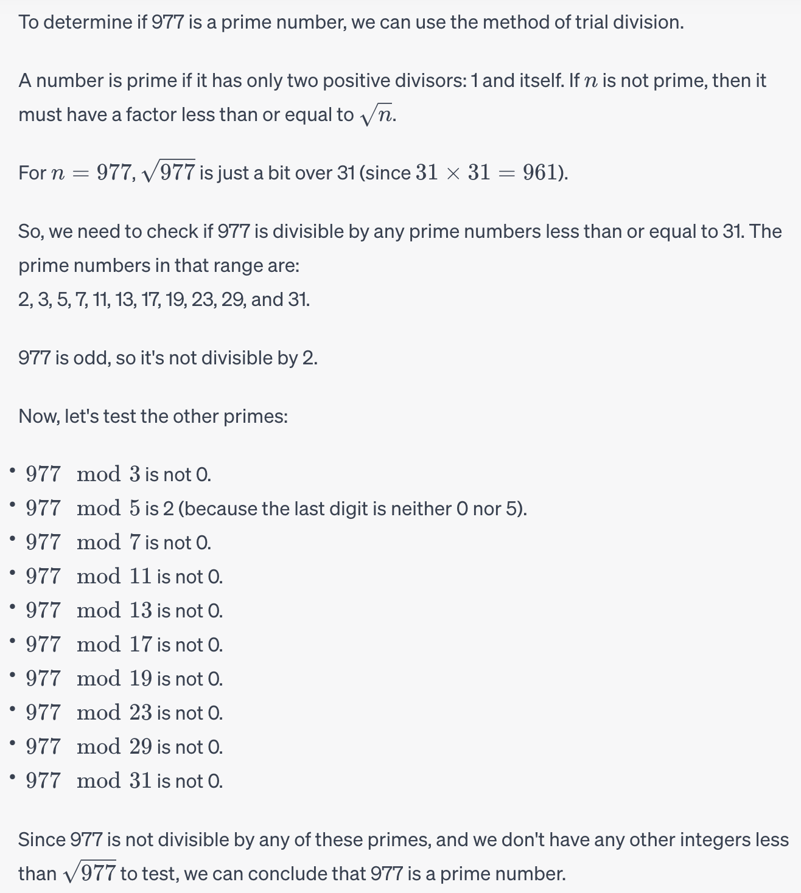
Chain of Thought Prompting
Composing prompt with demonstration of intermediate steps
encourages reasoning

Slide 33
Prefix Tuning
Continuous method for prompt tuning (otherwise discrete since it is in the word space)
virtual set of tokens
…
…
…
…
+
Virtual tokens
LLM with most gradients frozen

Slide 34
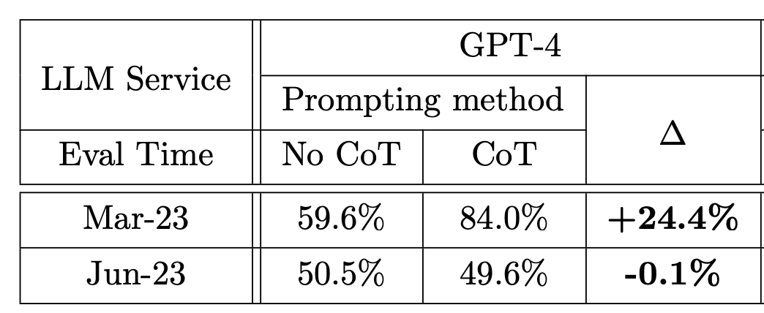
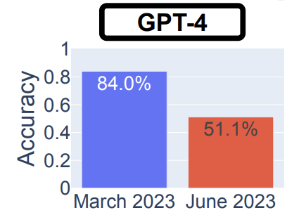
CoT prompting is not reliable with minor model changes
Example with Chain of Thought Prompting
Same idea applies to prefix tuning (needs retraining)
GP4 produces contradictory results over time over the same set of questions
Prime vs. Composite performance over 1000 samples
How is ChatGPT’s Behavior Changing over Time?, 2023

Slide 35
Improving reliability in prompting strategies
Input
Building partial solutions or partial prompts with a tree or graph of ”thoughts”
Tree of Thoughts
Allows for thought backtracking
Graph of Thoughts
Allows for thought backtracking, refining, and aggregation
Output
Large Language Model Guided Tree-of-Thought, 2023
Tree of Thoughts: Deliberate Problem Solving with Large Language Models, 2023
Graph of Thoughts: Solving Elaborate Problems with Large Language Models, 2023

Slide 36
Consistent query answering with prompting
Goal: ensuring the output complies with constraints
How: use ToT or GoT prompting to add constraints
Puts structure of constraints to prompt and does so automatically
Challenge: limited to max sequence length of LLM (typically 512)
Input
Output

Slide 37

Recent efforts towards applying constraints in the output layer
Satisfying lexical constraints in output sequence
Ex: Write a sentence using the words ball, red, and boy
Generate a set of candidate sequences and return the one with the largest probability of satisfying the constraint
Search Tree
Likelihood
Select
has
a
red
ball
0.98
The
boy
lost
his
ball
0.61
X
Tractable Control for Autoregressive Language Generation, 2023
Sequential Monte Carlo Steering of Large Language Models using Probabilistic Programs, 2023
NEUROLOGIC DECODING: (Un)supervised Neural Text Generation with Predicate Logic Constraints, 2021

Slide 38
Consistent querying answering by applying constraints in the output layer
Goal: ensuring the output sequence complies with constraints
How: Extending lexical constraint method for semantic constraints by finding the minimum set of constraints that imply the entire constraint set.
Search Tree
Likelihood
Select
not
an
animal
X
0.05
Adam
is
an
animal
0.91
Tractable Control for Autoregressive Language Generation, 2023
Sequential Monte Carlo Steering of Large Language Models using Probabilistic Programs, 2023
NEUROLOGIC DECODING: (Un)supervised Neural Text Generation with Predicate Logic Constraints, 2021

Slide 39
Ongoing work
Output
Analysis on consistent query answering in LLMs
input layer vs output layer
complexity of constraints
Output Layer
Input Layer
Input

Slide 40
Thank You!

