Slide 1
Discrepancy in Risky Decision Making of Insomniac Group and Correlated Neural Representations: A fNIRS Study
Presenter: Miao He, Wang Ruisi, Yuan Jingrui

Slide 2
Outline of Presentation
Introduction
Methods & Data Analysis
Results
Discussion & Conclusion

Slide 3
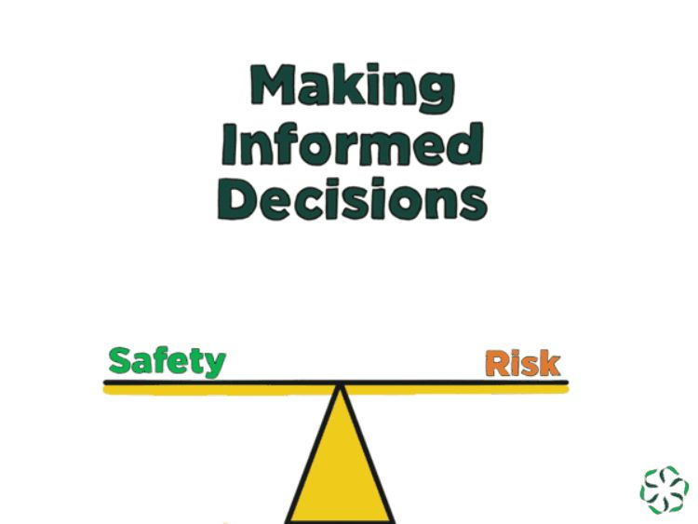

Introduction - Risky Decision Making and CGT
Risky decision-making involves uncertainty and potential negative outcomes.
Risky decision factors include potential benefits, risks, and their trade-offs.
CGT captures related factors specifically through:
- Bet choices with varying probabilities.
- Real-time decision-making under uncertainty.
- Assessment of impulsivity and response inhibition.
CGT uniquely measures cognitive and emotional facts of risk-taking.
Existing studies primarily focus on disorders types and impulsivity.
Lacks of evidence for specific decision making trends group.
Notes:
Risky decision-making navigate the uncertainty inherent in everyday choices that carry the potential for negative outcomes. This balance is struck by evaluating the potential benefits against the risks, a process that is deeply rooted in the neural circuitry of our brain.
The CGT captures these cognitive processes. It offers real-time decision-making under uncertainty is a critical aspect of the task that reflects the unpredictable situations.
CGT not only measures the behavioral outcomes of risk-taking, but also the cognitive and emotional facts that accompany these decisions
Previous results has investigated impulsivity and response inhibition and various disorders.
There remains a gap of knowledge regarding the unique effects of the CGT in populations with specific cognitive tendencies, such as those with insomnia.

Slide 4


Introduction – Insomnia and Cognitive Aspects
Insomnia characterized by dissatisfaction with sleep quality, duration, or continuity
Evaluation tools: PSQI, ISI, and ESS.
Insomnia Impaired Cognitive Functions:
- Working memory
- Attention
- Concentration
Insomniacs show attentional bias towards sleep-related stimuli
Abnormal neural patterns observed in insomnia patients during risky-decision tasks.
Notes:
Insomnia is quite common, affecting many adults and particularly college students. characterized by dissatisfaction with sleep quality, duration, or continuity. We assess it using tools like the PSQI, ISI, and ESS. Insomnia isn't just about poor sleep; it impacts our cognitive abilities, including memory, attention, and concentration—key factors in making decisions. Those with insomnia may also be more inclined towards riskier choices, which is significant for understanding decision-making behaviors.

Slide 5
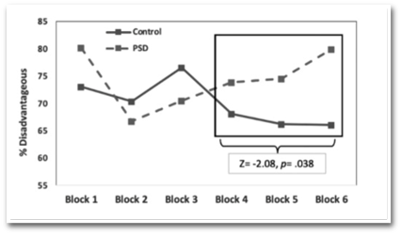
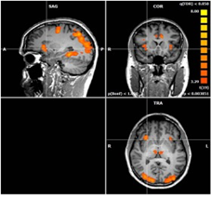
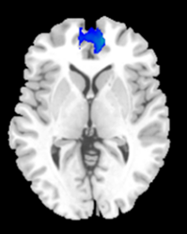
Introduction - Combining Insomnia and CGT Results
Sleep Impact on Decisions: Sleep quality directly affects risk-taking behaviors:
Sleep duration ↓ → Sleep Need ↑ → Risk-taking Tendencies ↑.
Frontal Lobe and PCC are key brain areas in CGT decisions.
Sleep-related studies also highlight differences in these brain areas between insomniacs and controls.
Use CGT as the bridge of gap between insomnia and decision-making differences.
Notes:
Sleep quality directly influences the willingness to take risks. Specifically, we see that as sleep duration decreases, there's a corresponding increase in sleep need, which in turn is linked to a greater tendency towards risk-taking behaviors.
When we look at the Cambridge Gambling Task, or CGT, it is found the activation in Frontal Lobe and the Posterior Cingulate Cortex, or PCC. These regions are not only active during the CGT but are also the focus of sleep-related studies, which have observed differences between individuals with insomnia and a control group.
The significance of these findings is that CGT could be used as a bridge between the realms of sleep and decision-making. It allows us to understand how insomnia can manifest as differences in brain activity during decision-making tasks

Slide 6
Hypothesis
Main Hypothesis: Insomnia people will have a greater tendency to make risky decisions
Hypothesis 1: Insomnia group will have overall worse performance in Cambridge Gambling Tasks
Hypothesis 2: Insomnia people will have slower reaction speed compared to control group.
Hypothesis 3: Insomnia people will have higher risk- taking trends compared to control group.
Neural Hypothesis (Omitted)

Slide 7
Outline of Presentation
Introduction
Methods & Data Analysis
Results
Discussion & Conclusion

Slide 8
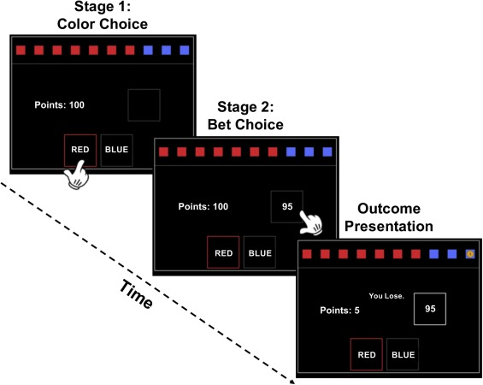

Methods
Quality
Latency
Efficiency
Duration
7 sub-scales
Medication
Disturbances
Dysfunction
Notes:
The Cambridge Gambling Task, or CGT, consists of three phases. In the first phase, participants choose between two colors—red and blue. The probability of reward aligns with the color distribution shown. Participants select their choice by clicking left or right.
Following the color decision, the bet decision phase begins. Bets range from small to large, presented in varying ratios and in random order. using the Down button to select their bet amount.
Finally, the outcome phase reveals whether the guess was correct. A correct guess earns the chosen bet amount, while an incorrect guess results in a loss of that amount.
Let’s see the demo…
We use PSQI as the scale measures the insomnia, overall score over 7 will be treated as insomnia group.

Slide 9
Data Analysis
**Quality of Decision Making (QDM):**
- Total number of rational choices made.-
**Deliberation Time (DT):**
- Mean reaction time for making a decision.-
**Risk Taking (RT):**
- Average bet amount placed.-
**Risk Adjustment (RA):**
- Average bet difference relative to the box ratio.
Notes:
Firstly, we look at the Quality of Decision Making, or QDM, which is reflected in the total count of rational choices our participants make throughout the task.
Next, we measure the Deliberation Time, or DT. This is the average time it takes for an individual to make a decision, offering insight into their cognitive processing speed.
We also examine Risk Taking, denoted as RT, which is the average bet amount our participants are willing to place. This variable is crucial in assessing their propensity for risk.
Lastly, we consider Risk Adjustment, or RA. This is the average difference in betting relative to the changing odds presented, indicating how participants adapt their betting behavior in response to varying probabilities.

Slide 10
Outline of Presentation
Introduction
Methods & Data Analysis
Results
Discussion & Conclusion

Slide 11
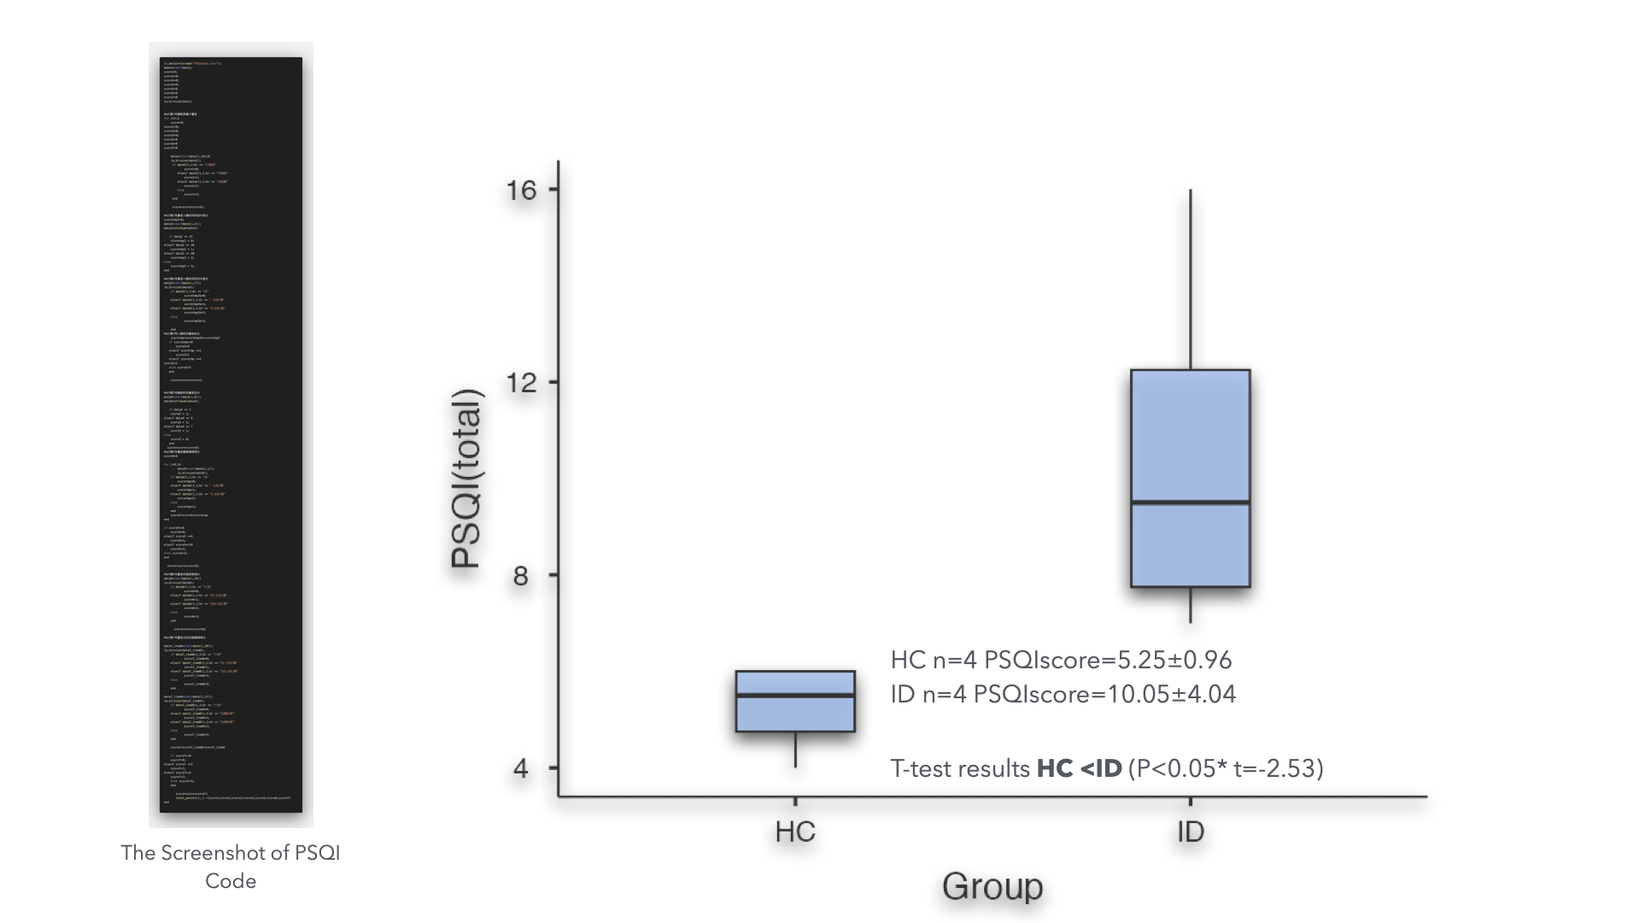
Outline of Presentation
Introduction
Methods & Data Analysis
Results
Discussion & Conclusion

Slide 12
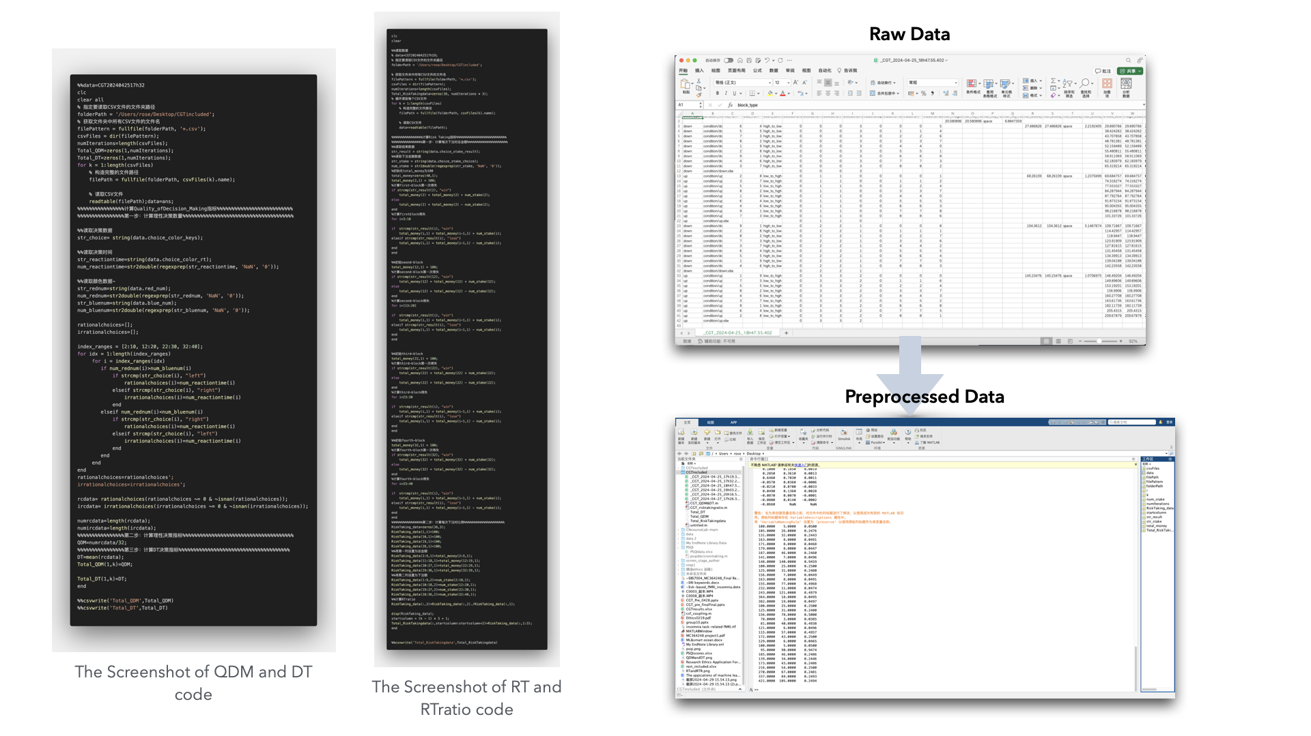
Outline of Presentation
Introduction
Methods & Data Analysis
Results
Discussion & Conclusion

Slide 13
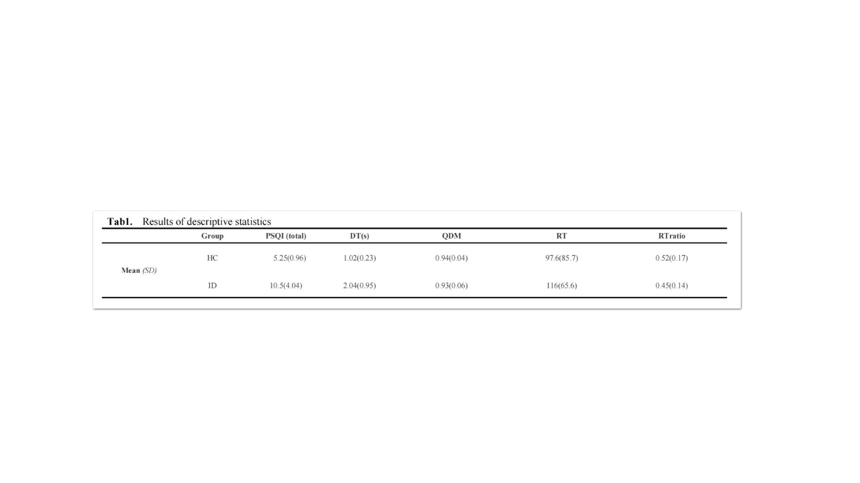
Outline of Presentation
Introduction
Methods & Data Analysis
Results
Discussion & Conclusion

Slide 14
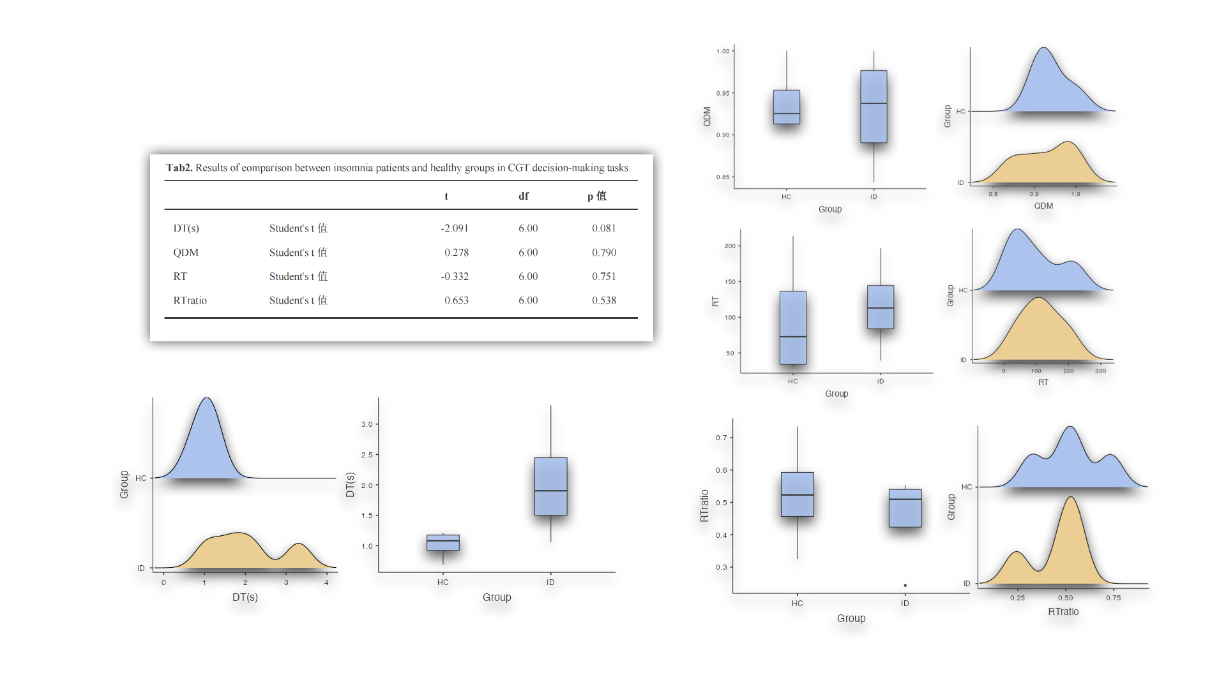
Outline of Presentation
Introduction
Methods & Data Analysis
Results
Discussion & Conclusion

Slide 15
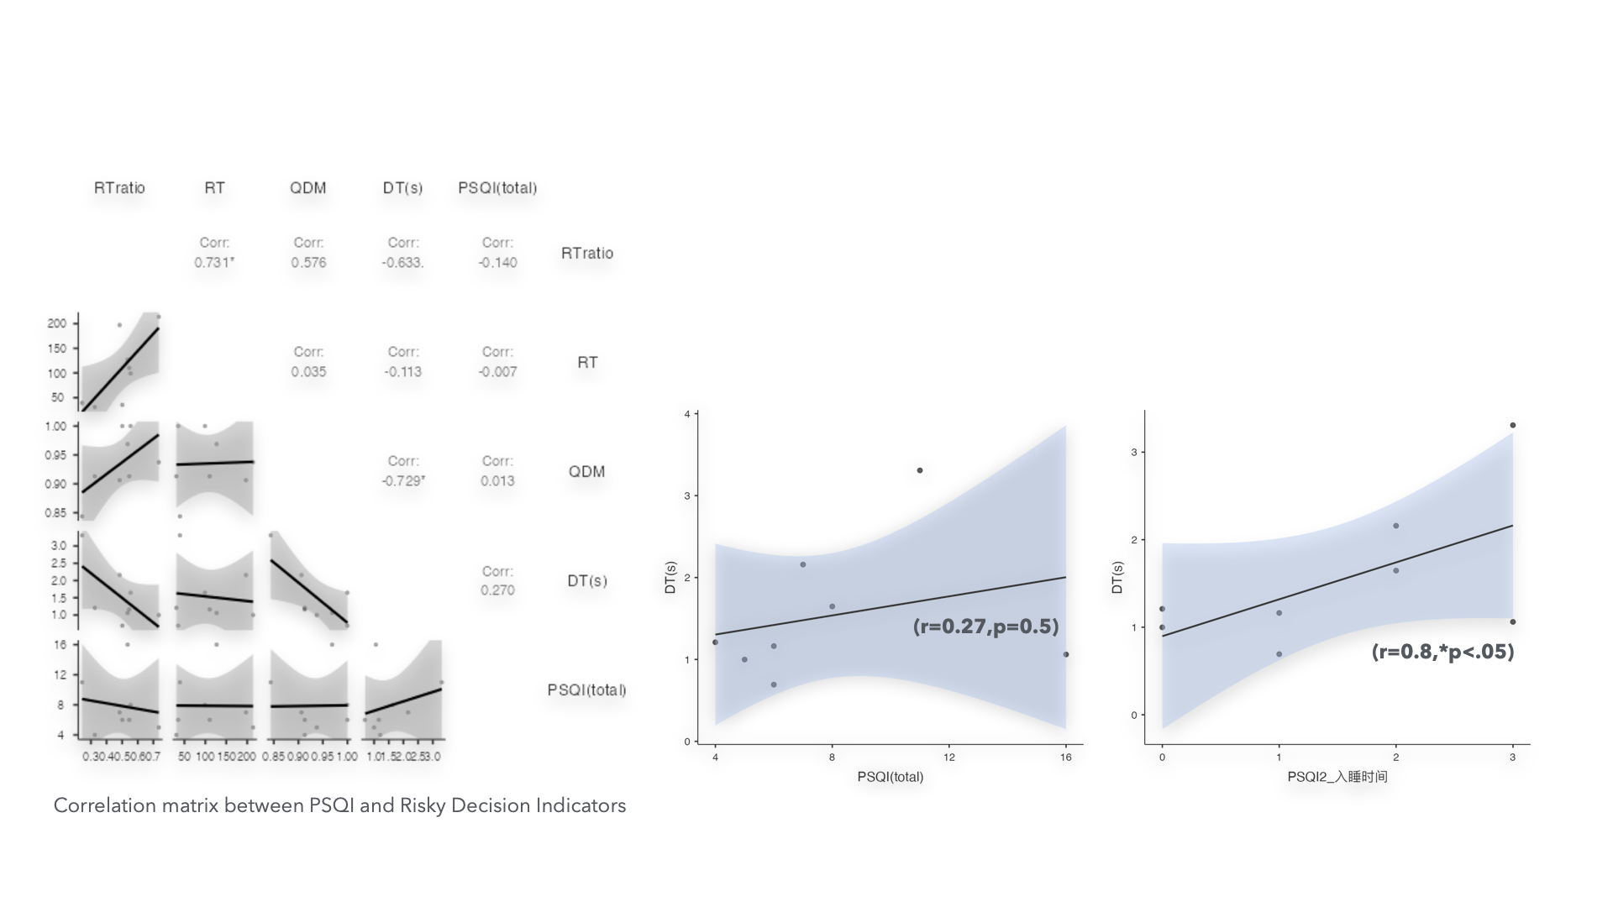
Outline of Presentation
Introduction
Methods & Data Analysis
Results
Discussion & Conclusion

Slide 16
Outline of Presentation
Introduction
Methods & Data Analysis
Results
Discussion & Conclusion

Slide 17
Conclusion
Based on Following Results:
For Quality of Decision Making (QDM):
Insomnia Group ≈ Control Group
For Deliberation Time (DT):
Insomnia Group > > Control Group
For Risk Taking (RT):
Insomnia Group > Control Group
For Risk Adjustment (RA):
Insomnia Group < Control Group
The overall performance is good. No Differences
Insomnia Group significantly react faster in risky decisions compared to Control group.
The Insomnia group’s overall bet amount put in bet is larger than Control group.
The Average bet difference ratio is lower in Insomnia group compared to Control group
It could be concluded that people facing insomnia question will have higher tendency in making risky decisions

Slide 18
Discussion
QDM no difference:
Expected, because Color’s prob is directly demonstrated.
Shorter DT:
- Reveals Reckless decision making in Insomnia: Fewer trade-offs.
- Following previous research: Insomnia decreased working memory.
- Make decision faster to prevent forgetting probability.
Higher RT and RA
- Align with previous neural findings: Activation in both risky decision making
and insomnia group.
- DLPFC : Behavioral Control and Cognitive Evaluation
- VMPFC: Representation of value and Reward Estimation.
- Insomnia group shows decreased activation in both two regions when taking the
cognitive and decision tasks.
- Reveals impairment of cognitive and decision-making functions
Notes:
The results of Quality Decision Making are not unexpected, because CGT does not involve the perception and learning of probability, and the probabilities of the two colors are directly revealed.
Shorter DT: This may reveal an element of reckless decision-making in insomniacs, that insomniacs make fewer trade-offs when faced with risky decisions. This result is also consistent with the activation results of overlapping brain regions in previous literature with the insomnia group’s decreased working memory function. Due to impaired working memory, subjects wanted to make decisions faster to prevent forgetting of previous probabilities.
DLPFC is for executive functions and is involved in cognitive evaluation and behavioral control in the decision-making process. In risk decision-making, processed risk-related information and helping individuals make trade-offs
The activity of vmPFC is related to the individual's processing and representation of value and reward.
Insomnia group shows decreased activation in both two regions when taking the cognitive and decision tasks.
Reveals impairment of cognitive and decision-making functions

Slide 19
Limitation
No enough participants, lacks of significance.
Hard to recruit control group participants.
Insomnia scales not separated in different dimensions.
Complex decision strategy not analyzed.
Notes:
For the limitations, First we're having a tough time getting enough people to take part in our studies. Next, we're finding it really hard to get people for our control group. We've also noticed that we're not looking closely enough at the different parts of insomnia. Insomnia can affect people in different ways. Finally, we're not digging deep enough into the different ways people make decisions. People have all kinds of strategies for dealing with risk, and if we don't look at all of them, it's like trying to solve a puzzle without all the pieces.

