Slide 1
CS4101 Introduction to Embedded Systems Lab 9: FreeRTOS
Prof. Chung-Ta King
Department of Computer Science
National Tsing Hua University, Taiwan

Slide 2
Lab 9
Basic 1: Induction Speed Monitor (30%)
In this lab, we want to design a system that can control a aircraft by hands.
Use two photoresistors to control aircraft’s speed:
Left photoresistor for deceleration.
Right photoresistor for acceleration.
Then add a seven-segment display to show the current speed. (from 0 to 9)
Implement all operations using original Arduino functions. There is no need to control the timing.
Hint: Analog pins can be used as digital pins, declared as pin 14~19.

Slide 3
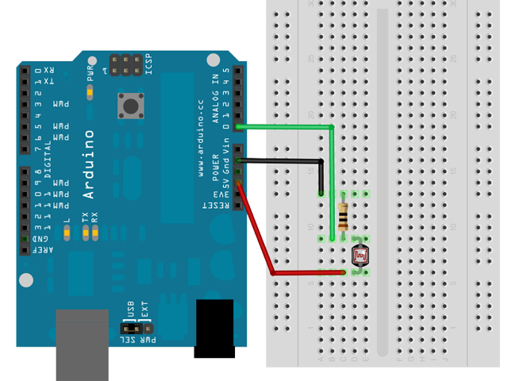
Photoresistor and Arduino
Resistor suggestion: 10k ohm

Slide 4
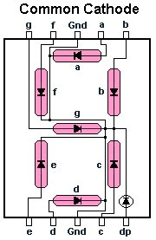
Seven-Segment Display
Essentially 7 LEDs
To display a particular number, turn on individual segments:
Digit | a | b | c | d | e | f | g
0 | on | on | on | on | on | on | off
1 | off | on | on | off | off | off | off
2 | on | on | off | on | on | off | on
3 | on | on | on | on | off | off | on
4 | off | on | on | off | off | on | on
5 | on | off | on | on | off | on | on
6 | on | off | on | on | on | on | on
7 | on | on | on | off | off | off | off
8 | on | on | on | on | on | on | on
9 | on | on | on | on | off | on | on
https://www.allaboutcircuits.com/projects/interface-a-seven-segment-display-to-an-arduino/

Slide 5
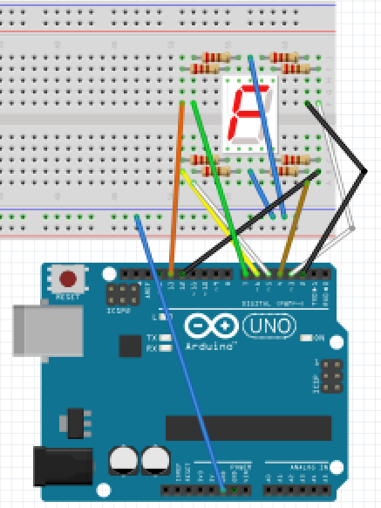
Seven-Segment Display Connection
Digital pin 2 to a Digital pin 3 to b Digital pin 4 to c Digital pin 5 to d Digital pin 6 to e Digital pin 7 to f Digital pin 13 to g Digital pin 12 to dp
Resistor suggestion : 220 ohm
Please use resistors

Slide 6
Sample Code for 7-Segment Display
int pins[8] = {2, 3, 4, 5, 6, 7, 13, 12};//pins to 7-seg.
boolean data[3][8] = {
// define the pins to light the 3 number: 0, 1, 2
{true, true, true, ...}, // 0
...
}
// to display the number 0, 1, or 2
for(int i = 0; i < 8; i++){ digitalWrite(pins[i],
data[number][i] == true ? HIGH : LOW); }

Slide 7
Lab 9
Basic 2: Induction Speed Monitor (30%)
Implement all operations in Basic 1 using FreeRTOS tasks:
Create ONE FreeRTOS task for EACH photoresistor.
Create one FreeRTOS task to set seven-segment display.
Set the priority of all three tasks to 1.
Now you have a situation in which data has to be passed between tasks. This may lead to race condition if you use a variable, SPEED, to track current speed. Why?
Hint: What if both photoresistor tasks try to update SPEED?
Implement this lab without causing race condition. Note that you do not need to use any synchronization primitives of FreeRTOS, which will be covered in later labs.
Hint: Do not allow 2 tasks to update 1 variable simultaneously.

Slide 8
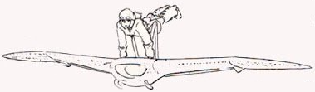
Lab 9
Basic 3: Induction Aircraft (40%)
Add an ultrasonic sensor to Basic 2 to detect if pilot is 15 cm away from the aircraft:
If so, set speed to zero and ignore photoresistor inputs.
Add a RGB LED to Basic 2 to show the speed status:
Speed < 4 - Green
Speed >=4 & Speed < 7 - Yellow
Speed >=7 - Red

Slide 9
Lab 9
Basic 3: Induction Aircraft (40%) (cont.)
You have to implement all operations using FreeRTOS tasks.
Now you have a situation in which tasks have sequence. Again, you do not need to use any synchronization primitives of FreeRTOS, which will be covered in later labs

Slide 10
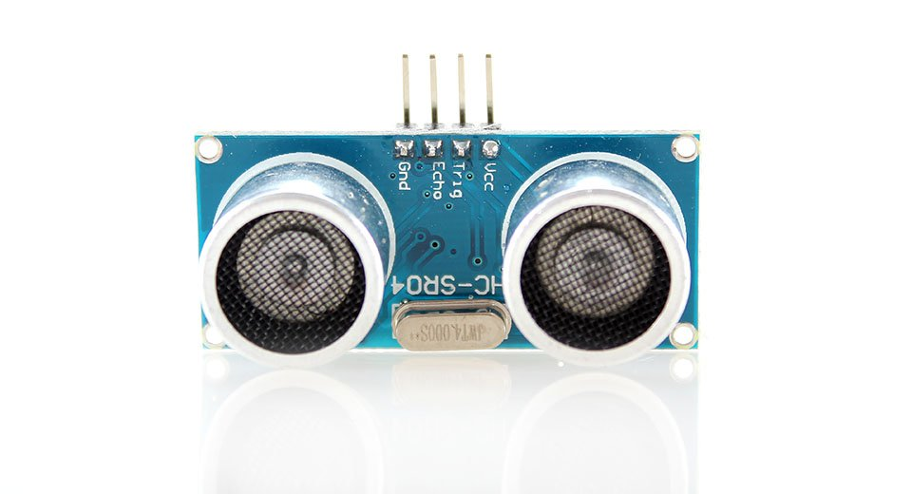
Ultrasonic Sensor
An ultrasonic sensor emits an ultrasound that travels through the air; if there is an object or obstacle on its path It will bounce back to the sensor
Considering the travel time and the speed of the sound, the distance can be calculated
Ex.: HC-SR04
Effectual angle: <15°
Ranging distance : 2cm – 500 cm
Resolution : 0.3 cm
40KHz ultrasonic signal
4 pins: Vcc, Trig, Echo, GND

Slide 11
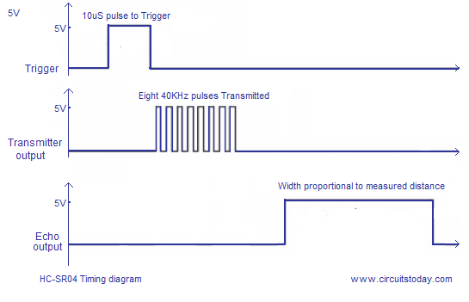
Distance Calculation
Set the Trig pin on at HIGH for > 10 µs to start
That will send out an 8-cycle sound wave that can be received in the Echo pin
Echo pin will be HIGH based on the time in microseconds that the sound wave traveled
Distance = HIGH Duration*(Sonic:340m/s)/2
HC-SR04 Timing Diagram
Trigger Pin
10 µs tripper pulse
Transmit Wave
8 x 40kHz sound wave
Echo Pin
Width proportional to measured distance

Slide 12
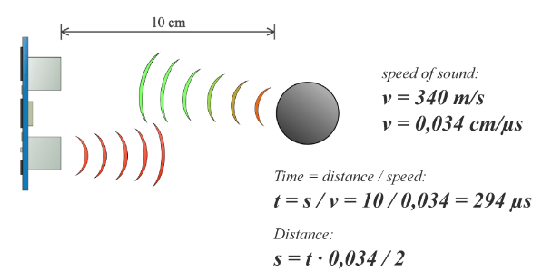
Distance Calculation: Example
So in order to get the distance in cm we need to multiply the received travel time value from the Echo pin by 0.034 cm/µs and divide it by 2

Slide 13
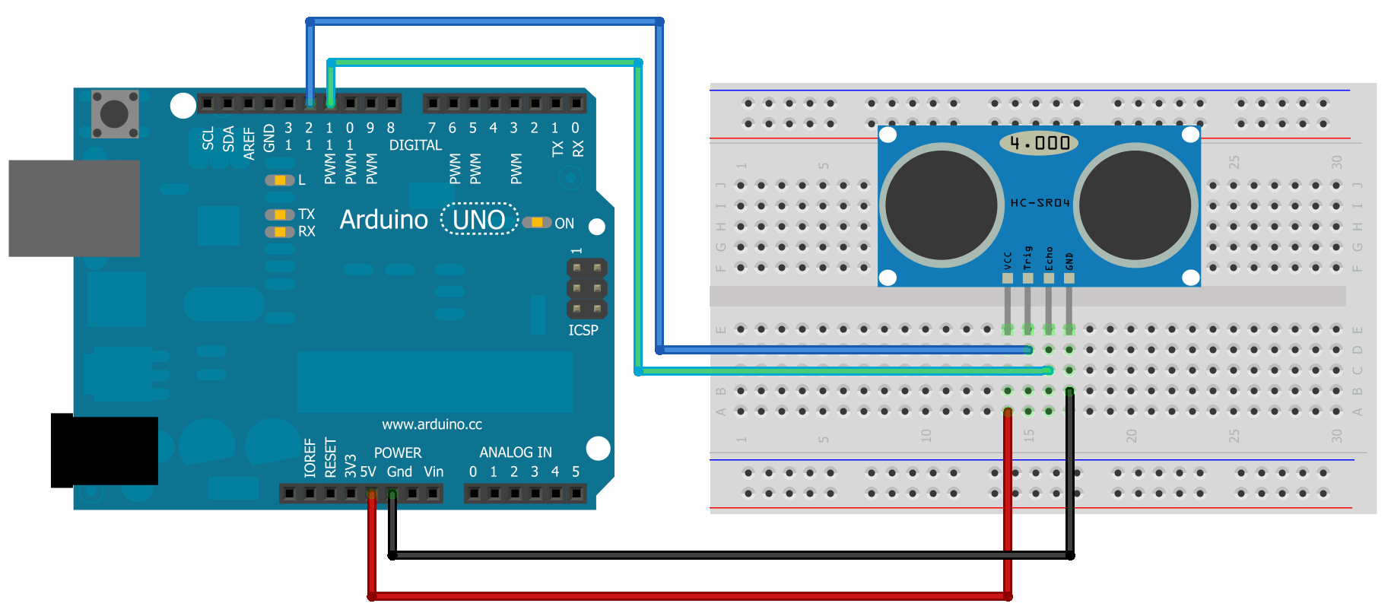
Ultrasonic Sensor and Arduino
HC-SR04 has 4 pins: Ground, Vcc, Trig, Echo
Vcc is connected to the 5 volt pin, trig and echo pins to any digital I/O pin on Arduino Uno

Slide 14
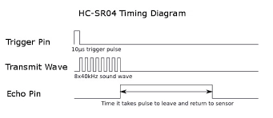
Ultrasonic Sensor and Arduino
pulseIn()reads a pulse (either HIGH or LOW) on a pin
Syntax : pulseIn(pin, value)
If value is HIGH, pulseIn() waits for the pin to go HIGH, starts timing, then waits for the pin to go LOW and stops timing
Returns the length of the pulse in microseconds or 0 if no complete pulse was received within the timeout
Echo Pin
Time it takes pulse to leave and return to sensors

Slide 15
Sample Code for Ultrasonic Sensor
const int trigPin = 12; const int echoPin = 11;
long duration; int distance;
void setup() {
pinMode(trigPin, OUTPUT);
pinMode(echoPin, INPUT);
}
void loop() {
digitalWrite(trigPin, LOW); // Clears the trigPin
delayMicroseconds(2);
/* Sets the trigPin on HIGH state for 10ms */
digitalWrite(trigPin, HIGH); delayMicroseconds(10);
digitalWrite(trigPin, LOW);
/* Reads Echo pin, returns sound travel time in ms */
duration = pulseIn(echoPin, HIGH);
/* Calculating the distance */
distance = duration*0.034/2;
}

