Slide 1
CS4101 Introduction to Embedded Systems Lab 10: Task Scheduling
Prof. Chung-Ta King
Department of Computer Science
National Tsing Hua University, Taiwan

Slide 2
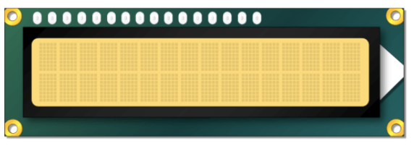

Lab 10
Basic 1: based on Basic 2 of Lab 9 (40%)
Connect 2 photoresistors and an LCD to your Arduino UNO.
Display and move cacti on LCD.
Initialize the positions of cacti randomly on the right half of LCD and let cacti move from right to left.
Control the moving speed of cacti by photoresistors:
Left photoresistor dark for deceleration
Right photoresistor dark for acceleration
Both photoresistors dark for stopping the movement

Slide 3
Lab 10
Basic 1: (cont.)
Implement all operations using FreeRTOS functions.
Create one task, “cactiTask”, to set the positions of cacti.
Use FreeRTOS functions such as vTaskDelay() or vTaskDelayUntil() to move the positions of cacti.
Create one task, “LCDTask”, to display cacti on LCD, according to the positions of cacti.
Create “leftTask” and “rightTask” to detect the light of the left and right photoresistors respectively.
When both photoresistors become dark, stop movement of cacti by suspending cactiTask. Otherwise, resume it.
There is no restriction on the priorities of the tasks.

Slide 4
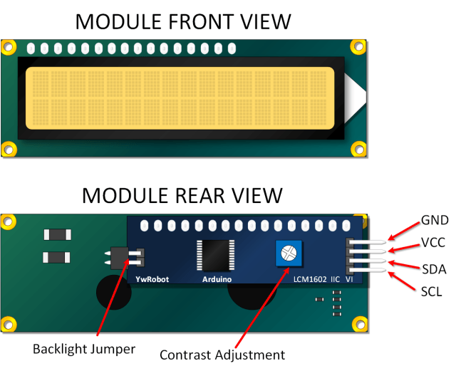
LCD Display
Liquid crystal displays (LCDs) are commonly used to display data in devices such as calculators and home appliances
They can support message scrolling, cursor displaying, and LED backlight
A typical LCD display is 16×2 LCD Module, which can display 32 ASCII characters in 2 lines (16 characters in 1 line)
LCM1602 I2C V1

Slide 5
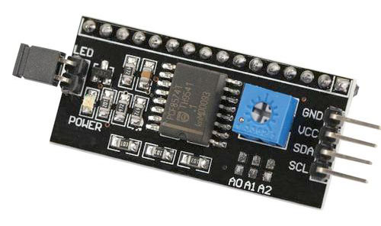
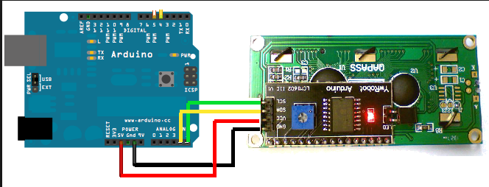
LCM1620 I2C LCD
GND (ground)
VCC (power supply 5V)
SDA (I2C data line)
SCL (I2C clock)
A4
A5
I2C (IIC, I²C): a synchronous serial computer bus

Slide 6
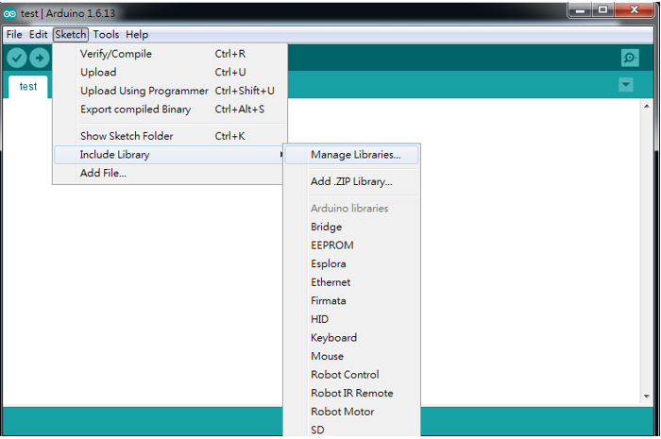
LCD Library
Go to “Sketch” → “Include Library” → “Manage Libraries…” to open Arduino IDE Library manager

Slide 7
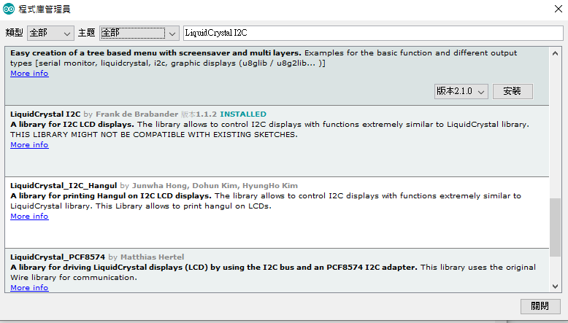
LCD Library
In Arduino IDE Library manager, type “LiquidCrystal I2C” and download LiquidCrystal I2C

Slide 8
Sample Code for LCD
#include <Wire.h>
#include <LiquidCrystal_I2C.h>
// Set pins on I2C chip for LCD connections:
LiquidCrystal_I2C lcd(0x27,16,2);
// Set I2C address and size
void setup() {
lcd.init(); // initialize LCD
lcd.backlight(); // open LCD backlight
lcd.setCursor(0, 0); // setting cursor
lcd.print("Hello, world!");
delay(1000); lcd.clear(); // clear all
lcd.setCursor(0, 1);
lcd.print("Type to display");
}
void loop() { }
Notes:
rs: the number of the Arduino pin that is connected to the RS pin on the LCD
rw: the number of the Arduino pin that is connected to the RW pin on the LCD (optional)
enable: the number of the Arduino pin that is connected to the enable pin on the LCD
d0, d1, d2, d3, d4, d5, d6, d7: the numbers of the Arduino pins that are connected to the corresponding data pins on the LCD. d0, d1, d2, and d3 are optional; if omitted, the LCD will be controlled using only the four data lines (d4, d5, d6, d7).

Slide 9
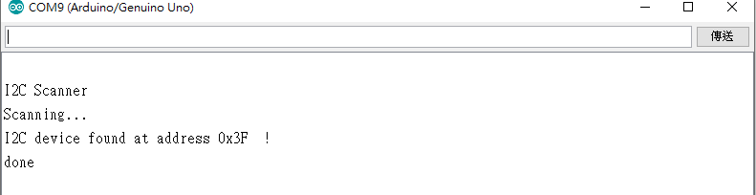
I2C Address
Need to set correct address for different I2C devices
You can try 0x27 or 0x3F
Or use i2c_scanner to find your address https://playground.arduino.cc/Main/I2cScanner/
LiquidCrystal_I2C lcd(0x27,16,2);

Slide 10
lcd.createChar() and lcd.write()
#include <Arduino_FreeRTOS.h> #include <Key.h> #include <Keypad.h> #include <LiquidCrystal_I2C.h> LiquidCrystal_I2C lcd(0x27,16,2); byte dinosaur[8] = {0x07, 0x05, 0x06, 0x07, 0x14, 0x17, 0x0E, 0x0A}; byte cactus[8] = {0x04, 0x05, 0x15, 0x15, 0x16, 0x0C, 0x04, 0x04}; void setup(){ Serial.begin(9600); lcd.init(); lcd.backlight(); lcd.createChar(0, dinosaur); lcd.createChar(1, cactus); } void loop(){ lcd.setCursor(0,0); lcd.write(0); lcd.setCursor(0,15); lcd.write(1); }

Slide 11

Lab 10
Basic 2: Dinosaur game (60%)
Add a keypad to Basic 1.
Create one task, “keypadTask”, to set the positions of a dinosaur on LCD.
Use button “2” for up and ”8” for down.
Initialize the dinosaur on position (0,0).
You should avoid the character from running out of the edge.
Display the dinosaur on LCD also by LCDTask.
press “2”
press “8”

Slide 12
Lab 10
Basic 2: (cont.)
The dinosaur dodging a cactus successfully can get 1 point.
If the dinosaur runs into a cactus, the game is over.
Display “Game Over” and the points you get for 2 secs.
Restart the game.
Demo video: https://drive.google.com/file/d/1F8987EsEKwAnM_a7A23HB_jS5LgD_q5g/view?usp=sharing
Game Over
Score: 5

Slide 13
Lab 10
Basic 2: (cont.)
Set the priorities of all the tasks equal.
Let the tasks change each other’s priority so that the game runs correctly.
Note:
Use memory carefully and set the size of task stack properly.
To save memory, you can use print(F(“hello”)) instead of print(“hello”) .

Slide 14
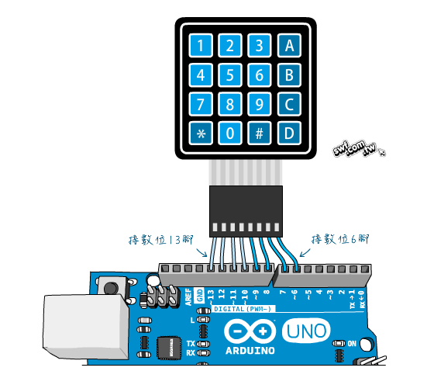
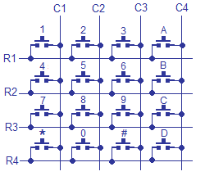
Hex Keypad
Use “column scanning” to identify the pressed key

Slide 15
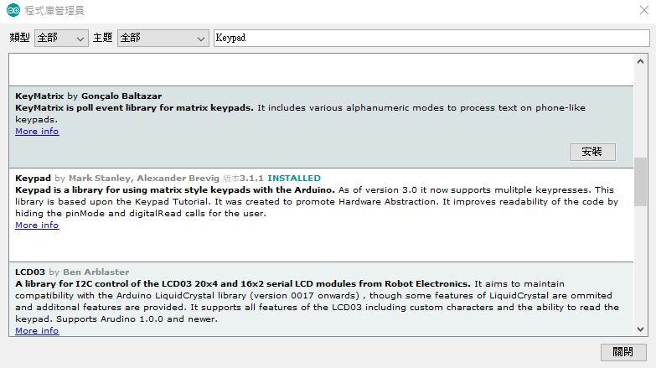
Hex Keypad Library
In Arduino IDE Library manager, type “Keypad” and download Keypad

Slide 16
Sample Code for Hex Keypad
#include <Keypad.h>
#define KEY_ROWS 4
#define KEY_COLS 4
char keymap[KEY_ROWS][KEY_COLS] = {
{'1', '2', '3', 'A'},
{'4', '5', '6', 'B'},
{'7', '8', '9', 'C'},
{'*', '0', '#', 'D'}
};
// Column pin 1~4
byte colPins[KEY_COLS] = {9, 8, 7, 6};
// Column pin 1~4
byte rowPins[KEY_ROWS] = {13, 12, 11, 10};

Slide 17
Sample Code for Hex Keypad
// initialize keypad
Keypad myKeypad = Keypad(makeKeymap(keymap), rowPins, colPins, KEY_ROWS, KEY_COLS);
void setup(){
Serial.begin(9600);
}
void loop(){
char key = myKeypad.getKey();
if (key)
Serial.println(key);
}

