Slide 1
CS4101 Introduction to Embedded Systems Lab 12: Task Synchronization
Prof. Chung-Ta King
Department of Computer Science
National Tsing Hua University, Taiwan

Slide 2
Lab 12
Basic 1: Cactus Strikes Again (60%)
Extend Basic 2 of Lab 11.
Use Joystick instead of Keypad.
Use Joystick to move the dinosaur and its button to lay eggs. You should set the moving speed of the dinosaur properly.
Create a char array buf[2][16] to store data to be displayed on the LCD (a frame buffer).
Protect buf[2][16] with a Mutex.
Create three tasks to control the game:
displayTask: displays the contents of buf[2][16] on LCD continuously.

Slide 3
Lab 12
Basic 1: (cont.)
Create three tasks to control the game: (cont.)
dinoTask: (1) reads inputs from Joystick, writes char to buf[2][16] to update the game state, and informs cactusTask to move also; (2) detects if 3 eggs are laid successfully, writes “Succeed!” to buf[2][16] for 1 sec, and restarts the game.
Informs cactusTask with a binary semaphore.
cactusTask: (1) informed by dinoTask to move cactus, writes to buf[2][16] to update the game state; (2) detects if cactus steps on one of the egg, writes “broken” character to buf[2][16] for 1 sec, followed by “Game over” for 1 sec, and restarts the game.
Note: include semphr.h after Arduino_FreeRTOS.h.

Slide 4
Lab 12
Basic 2: (40%)
Extend Basic 1 by adding a buzzer.
When the game ends:
If failed, ring the tone (tone(buzzer, 500)) for 1 second.
If succeeded, ring the tone (tone(buzzer, 1000)) for 1 second.
Detect the button event, button down, with an interrupt.
Update the game state, buf[2][16], from within the interrupt service routine.
You need to properly handle the interaction between the interrupt service routine and the dinoTask.

Slide 5
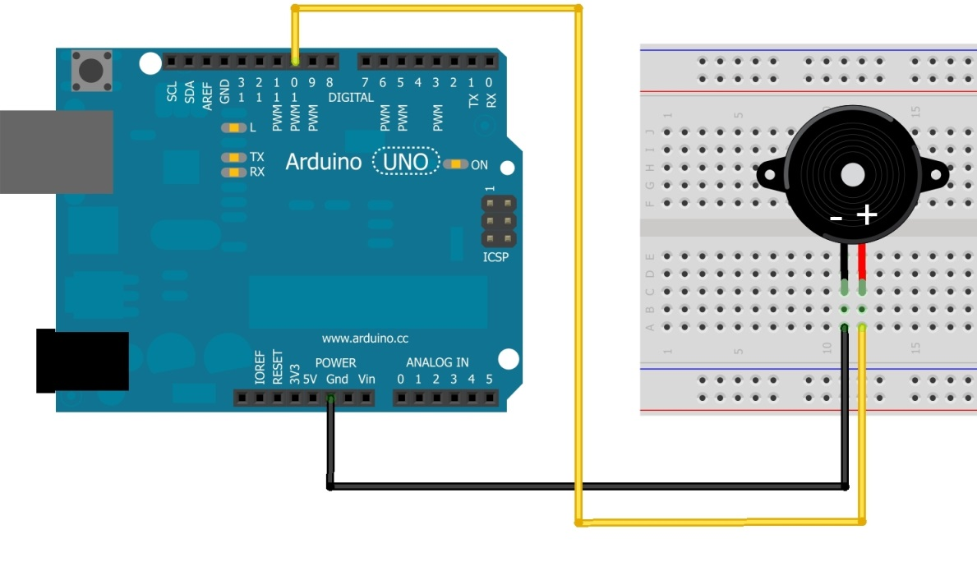
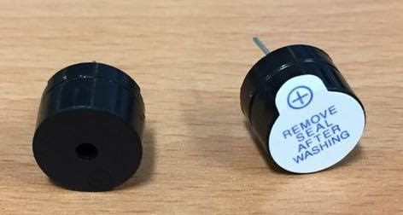
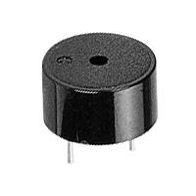
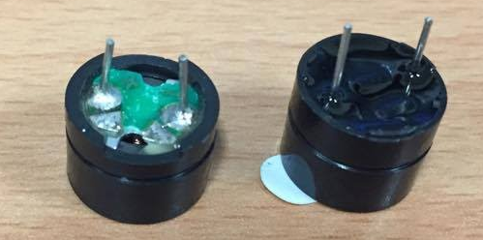
Buzzer
Piezoelectric buzzer:
Contains a metal disc that deforms under a current
By applying an alternating current at a high enough frequency, the disc will move fast to create a sound wave
You have two buzzers; use left one
Use pin 9 instead of 10
Side view
Bottom view

Slide 6
Playing a Tone
tone(pin, frequency) tone(pin, frequency, duration)
Generates a square wave of the specified frequency (and 50% duty cycle) on a pin
A duration can be specified, otherwise the wave continues until a call to noTone()
Only one tone can be generated at a time. If the tone is playing on the same pin, the call will set its frequency.
For Uno: min frequency 31 Hz; max frequency 65535 Hz

Slide 7
Sample Code for Buzzer
int buzzer = 9;
void setup() {
pinMode(buzzer, OUTPUT);
}
void loop() {
for(int i=0; i<10; i++) {
if(i%2 == 0) tone(buzzer,698);
else tone(buzzer, 523);
delay(500);
}
noTone(buzzer); // turn off the buzzer
delay(2000);
}

