Slide 1
Term Project
CS4101: Introduction to Embedded Systems
109/12/3

Slide 2
Specification
One person to a group.
Use Arduino Uno and/or MSP430.
Design term project on your own.

Slide 3
Score
Basic (40%)
Demo & Rank (50%)
Report (10%)
Bonus (20%)
You can get a maximum 120 points in the term project.
Plagiarism is not allowed.

Slide 4
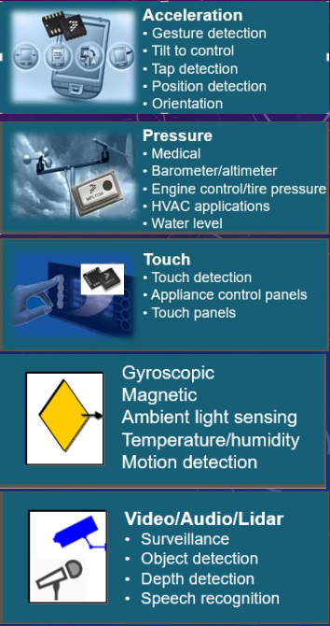
Basic (40%)
Timer 5 %
DAC 5 %
LCD/Actuator(Motor) 10%
Sensors 20%
Choose at least two of them
Need to be useful and related to your goal
*Each type of components could only be counted once!

Slide 5
Demo & Rank (50%)
Completeness will be an important part when demo. You will get penalty if the final work does not match your proposal well.
After everyone has demonstrated the project, TAs will rank the projects.
The rank will be then mapped to a grade from 6 to 10 as 50% of your total score.
Top 10 of the projects will get into the Final Demo Contest on 1/21.

Slide 6
Bonus (20%)
Use extra sensors (5%)
But the sensors must “be helpful and useful in your project, not just for decoration.”
Use FreeRTOS (5%)
Combine MSP430 with Arduino UNO properly (5~10%, depending on TAs)

Slide 7
Notes
Ready-made module kits (套件) are not allowed.
300 NTD maximum per person, with the invoices, to purchase extra components. (the invoices must include the tax ID “46804804”)

Slide 8
Final Demo Contest on 1/21 for Top 10 Projects
Award price:
First price : 3000 NTD (1 project)
Second price : 2000 NTD (1 project)
Third price : 1000 NTD (2 projects)
Honorable mention : 500 NTD (6 projects)

Slide 9
Proposal
Project title.
Introduction (motivation, functionality, etc.)
The components you are going to use.
You should upload the proposal to eLearning, revisable before 23:59 2020/12/22.
TAs may give you feedbacks if they have problems with your proposal.

Slide 10
Report
Report must include
The goal of your project.
What components you use in the term project, explain the detail of your implement in diagram, figure and sentences.
What difficulties did you encounter when implementing this project.
Program flow chart.
If you have any feedbacks, please also write it down.
You should upload the report and project code to eLearning before 23:59 2021/1/23.

Slide 11
Proposal & Report Format
Please name your proposal Proposal_{student-ID}.pdf and upload to eLearning.
Please package your final project code and report in a file named Final_{student-ID}.zip and name your codes/report as follows:
Final_report_{student-ID}.pdf
Final_project_{student-ID}.ino
• E.g. Proposal_106062501.pdf

Slide 12
Schedule
Sun | Mon | Tue | Wed | Thu | Fri | Sat
 |  | 12/15
 |  | 12/22 Proposal deadline
 |  | 12/29
 |  | 1/5
 |  | 1/12
 | 1/18 Demo | 1/19 Demo | 1/20 Demo | 1/21 Final Demo Contest |  | 1/23 Project code & Report deadline

Slide 13
Demo Time
Please fill in your preferred demo time at
https://docs.google.com/spreadsheets/d/1CSll5sRSKzAs-DzPxzgxrTAVnTzlgQM4v5lQ4OJ-zJE/edit?usp=sharing

