Slide 1
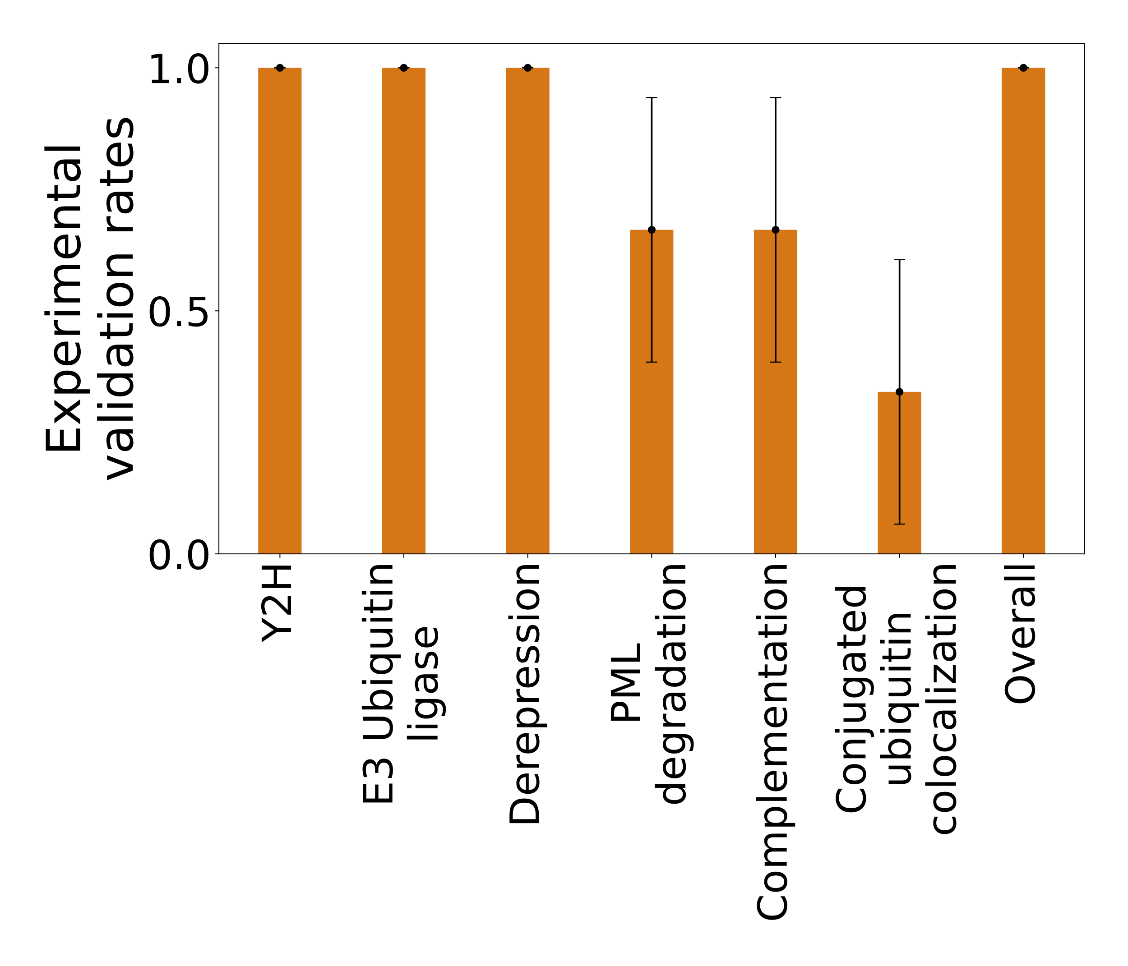
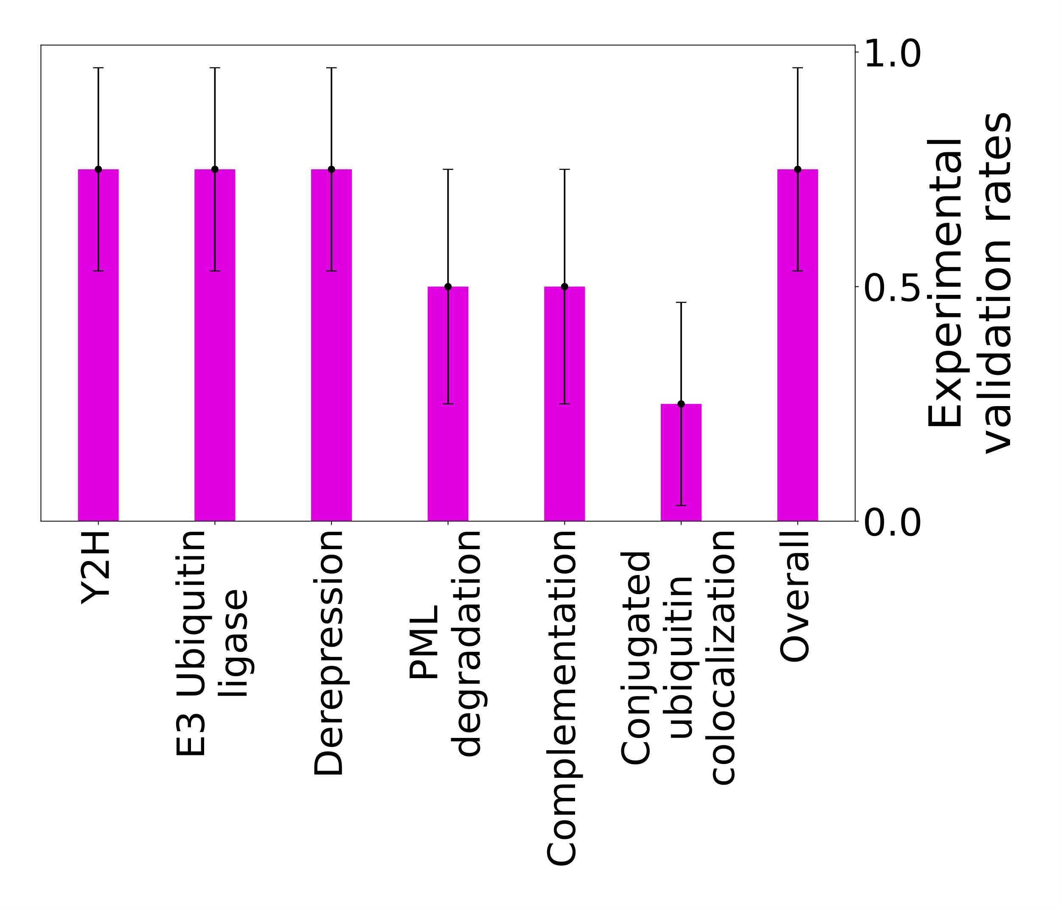
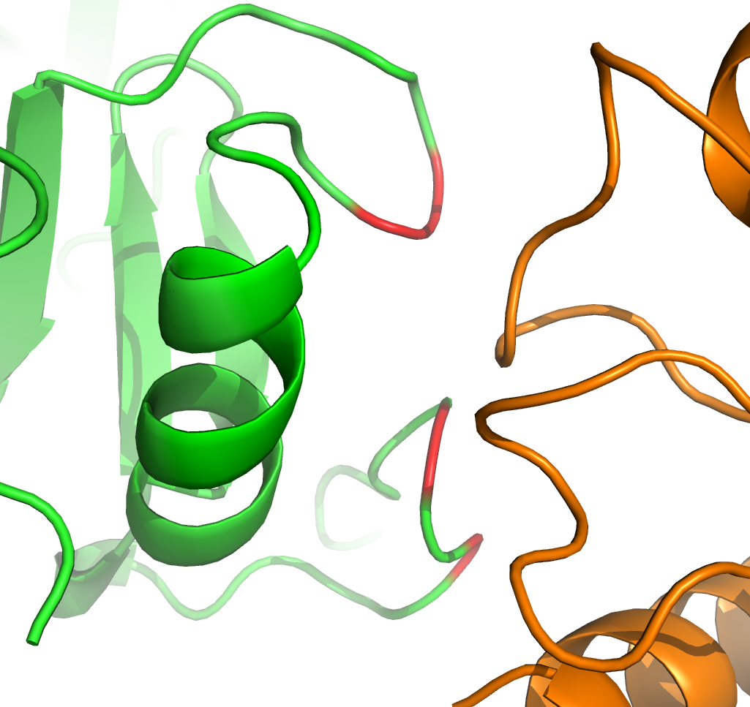
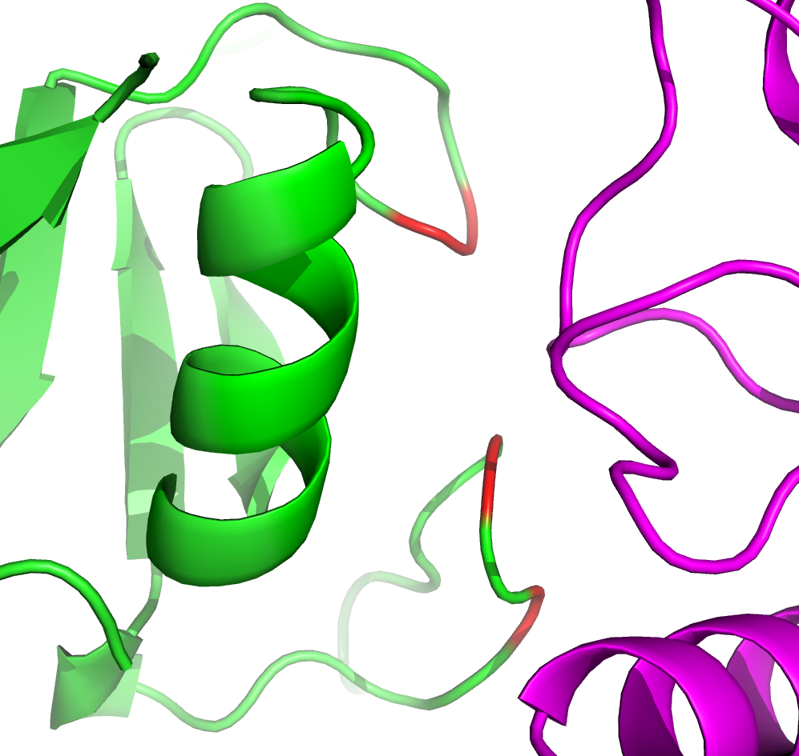
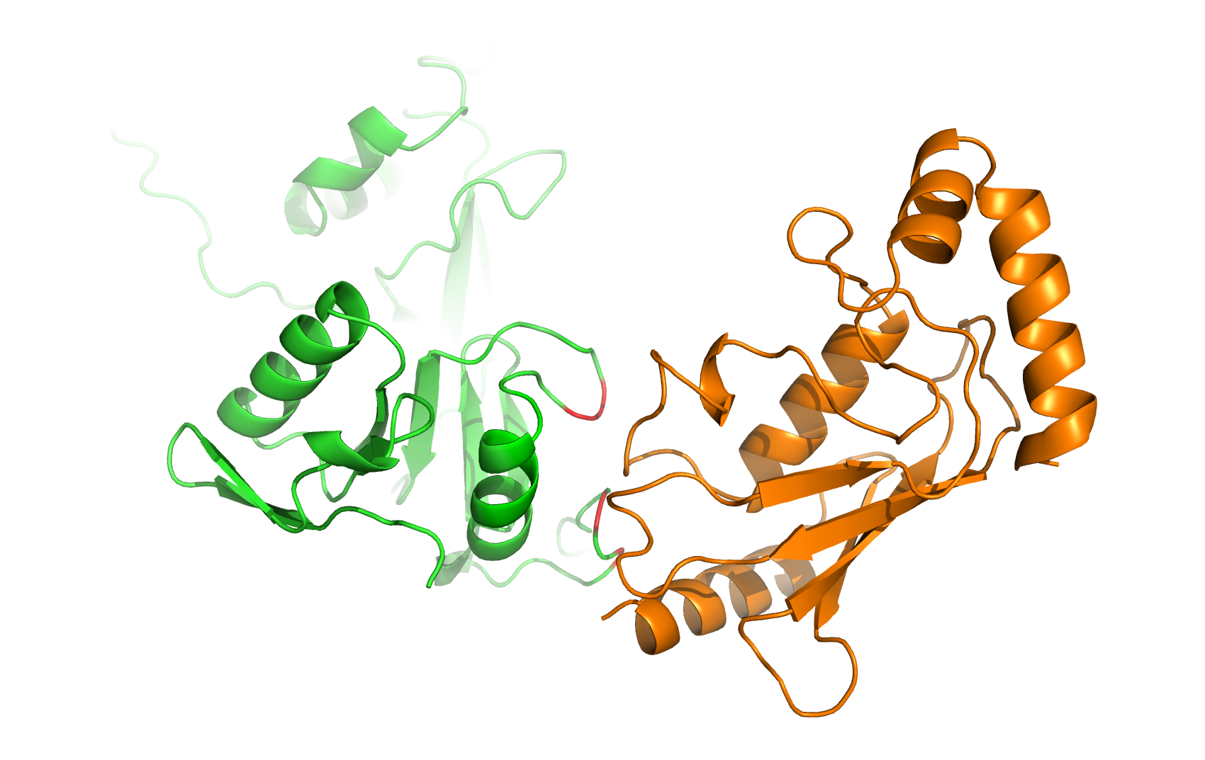
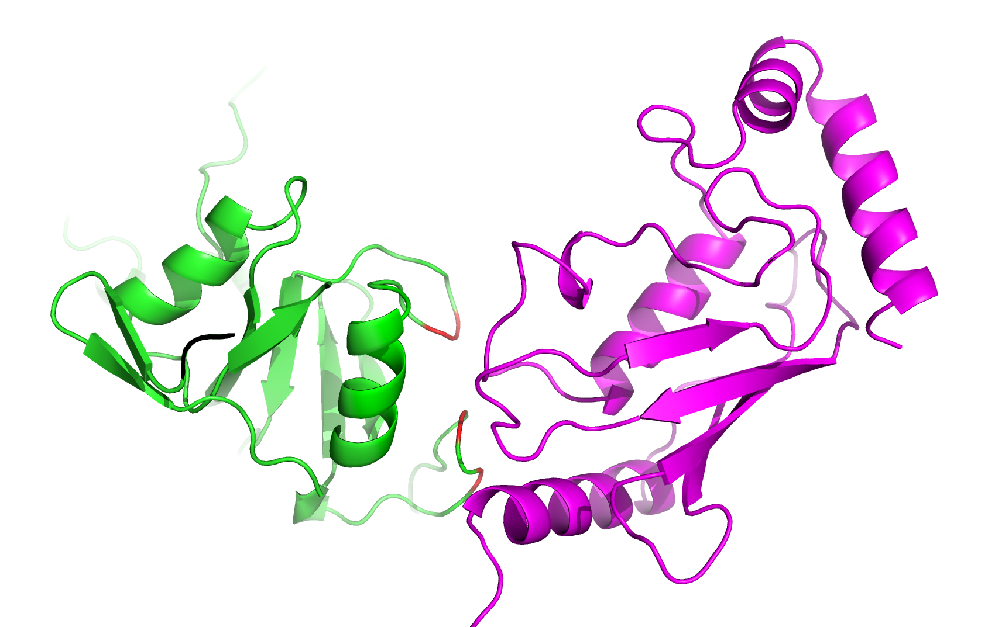
ICP0 (HHV11) – UB2D1 (HUMAN)
ICP0 (HHV11) – UB2E1 (HUMAN)
P154
P154
V118
V118
T120
T120
Predicted interface
Residues validated by Y2H
Predicted interface
Residues validated by Y2H

