Slide 1
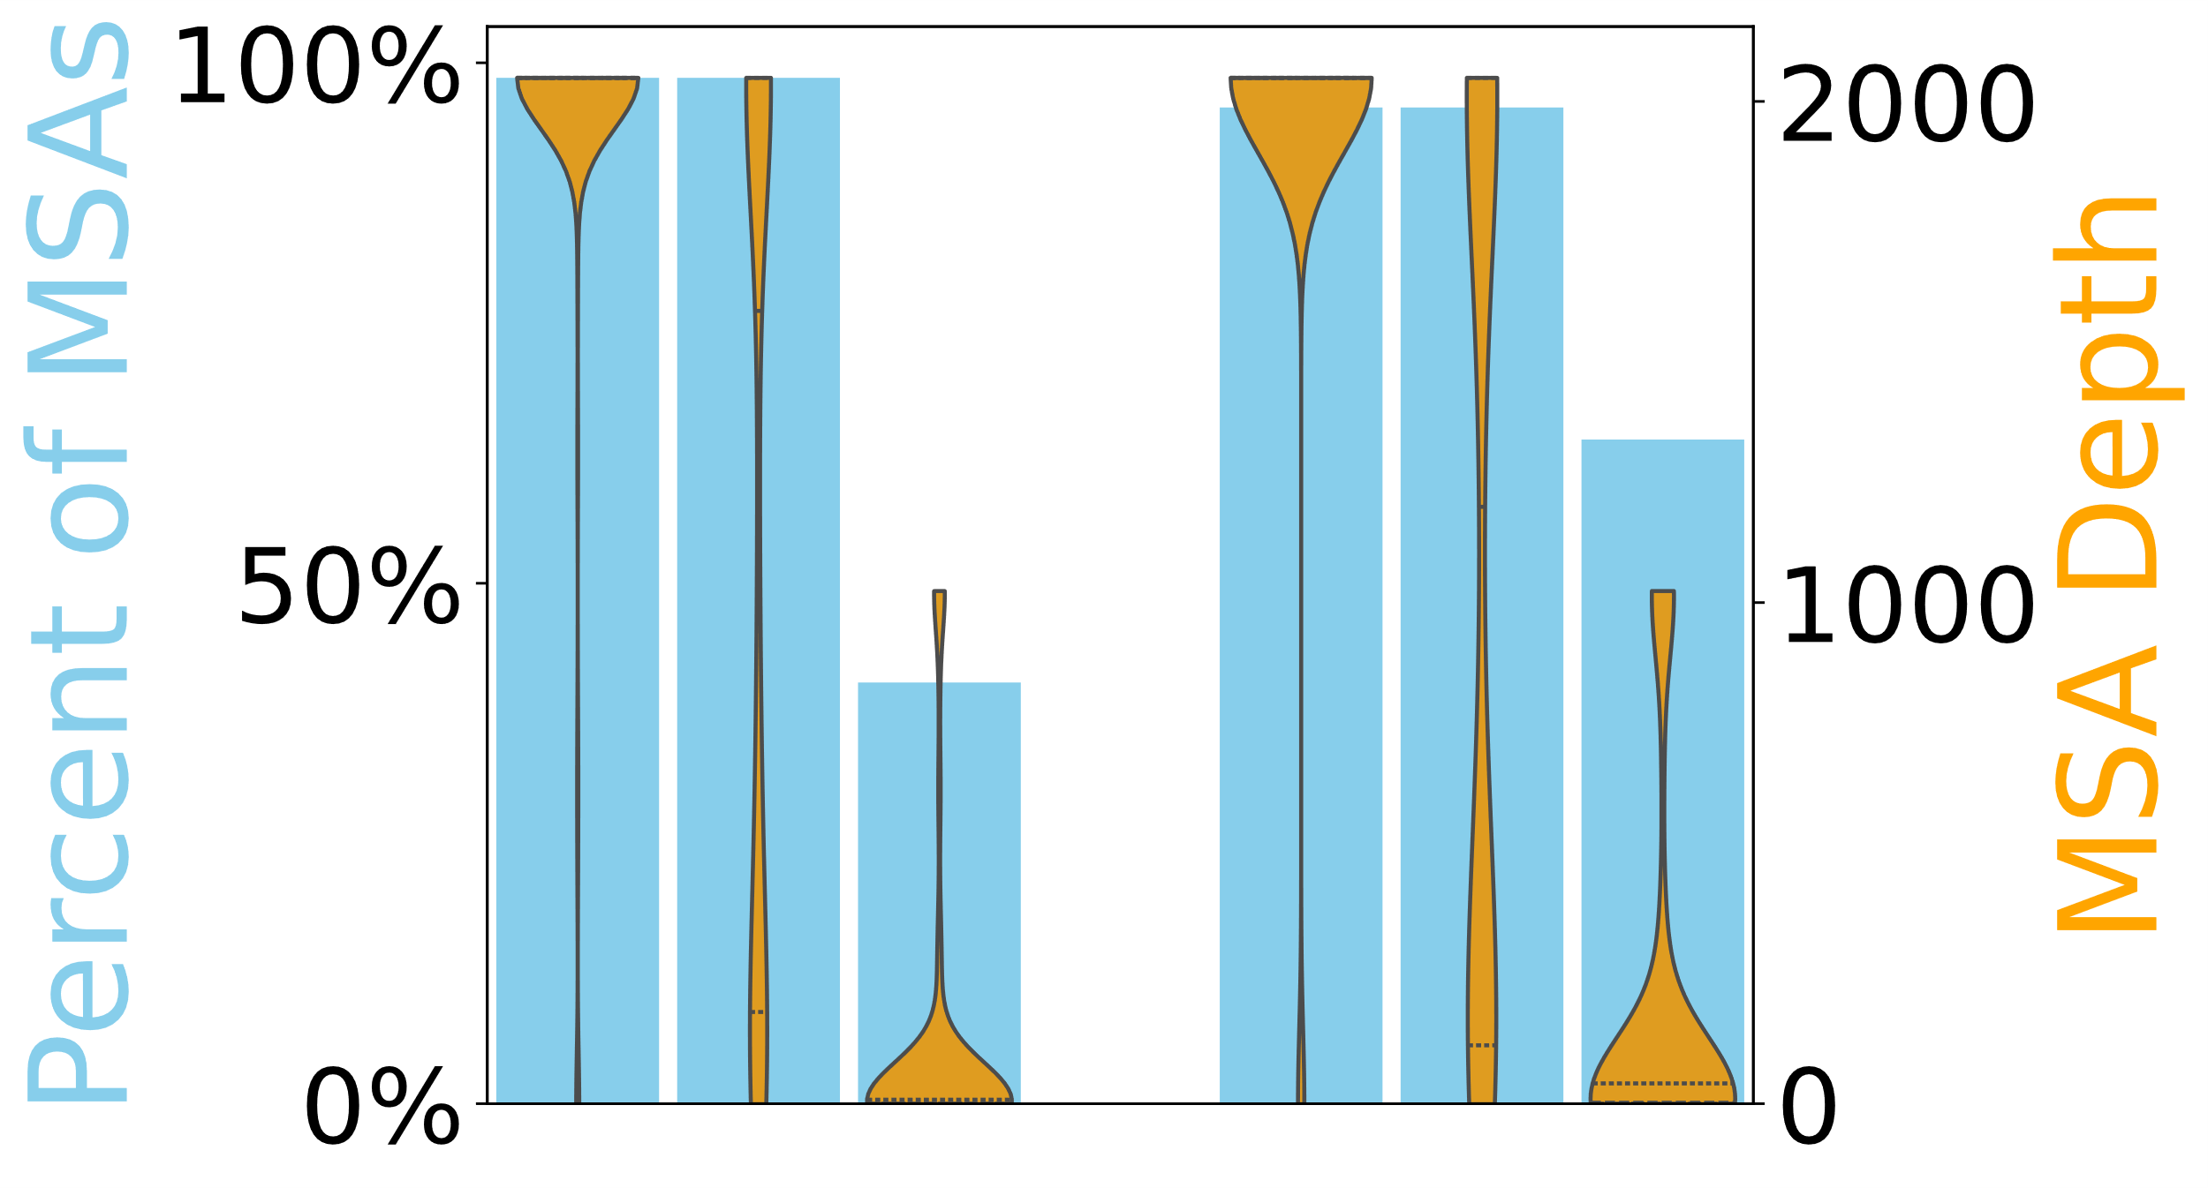
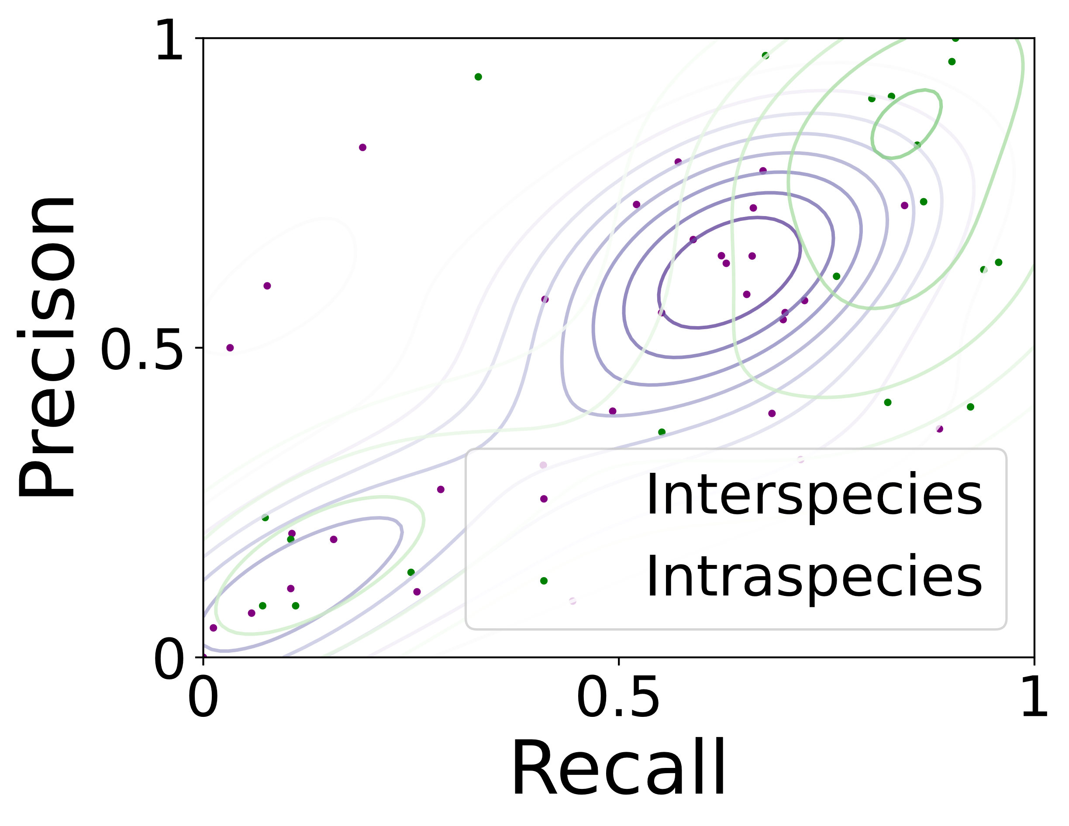
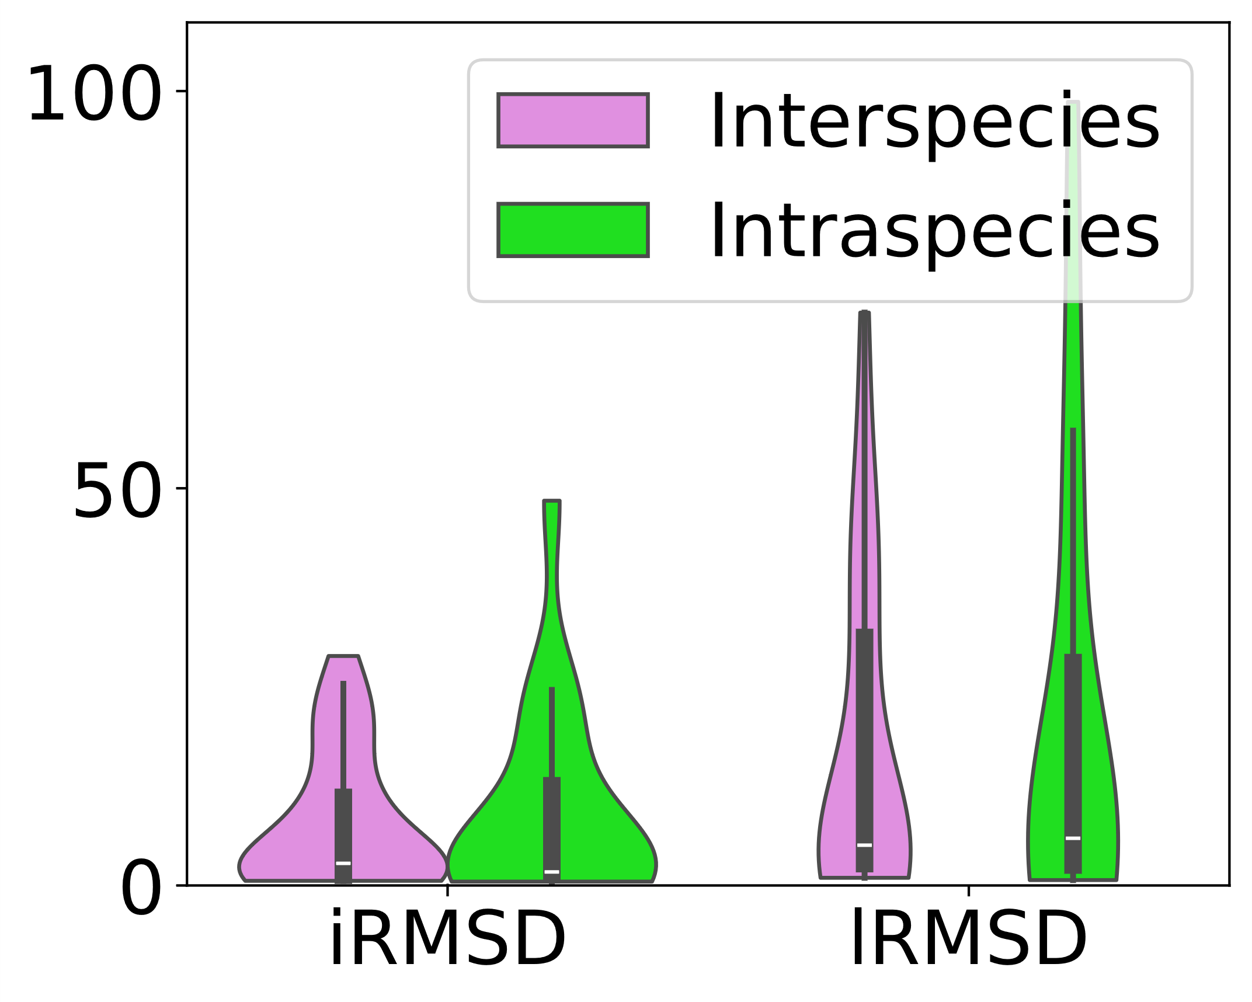
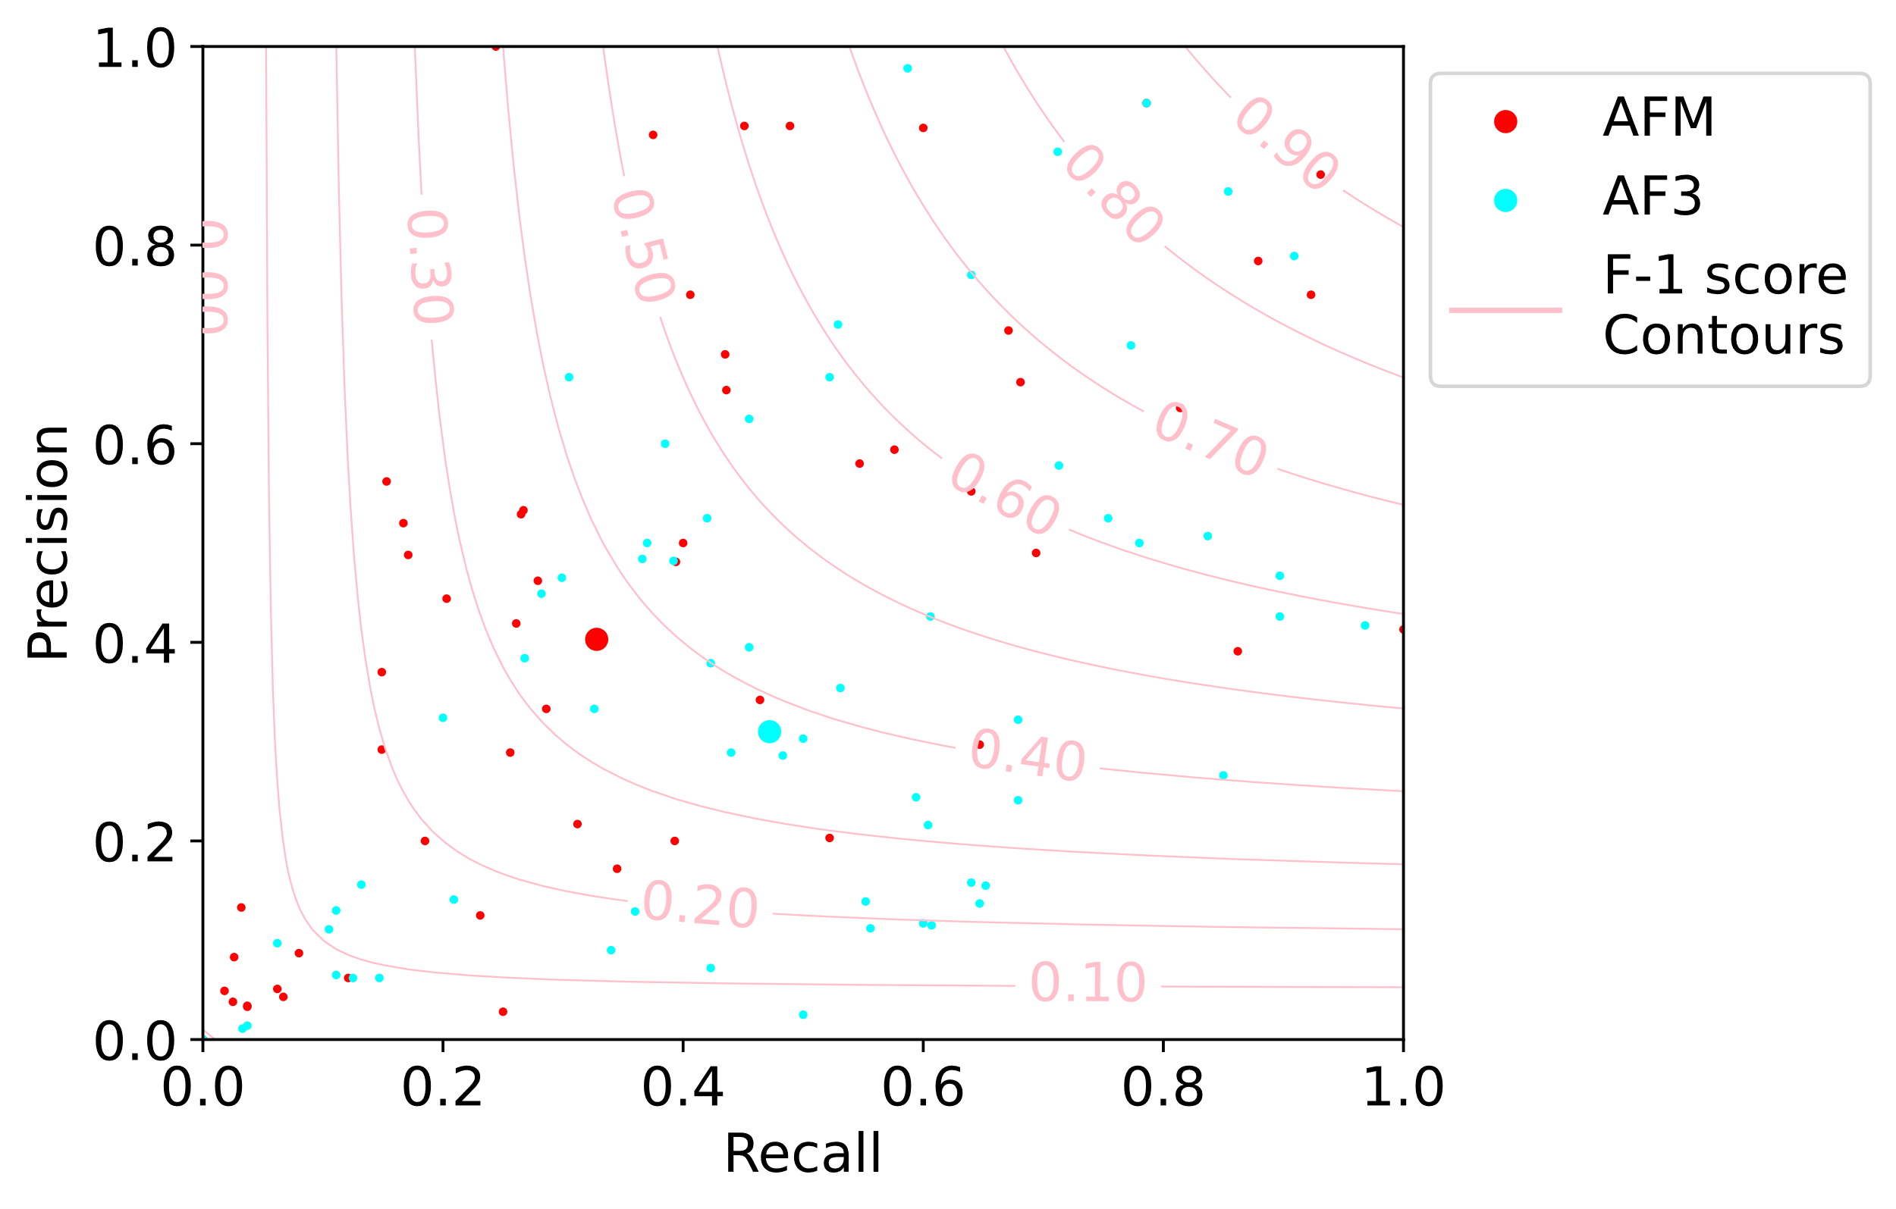
A
Human
Virus
Joint
Human
Joint
Bacteria
Viral-human
interactions
Bacteria-human
interactions
B
C
D

