Slide 1
Results Report

Slide 2
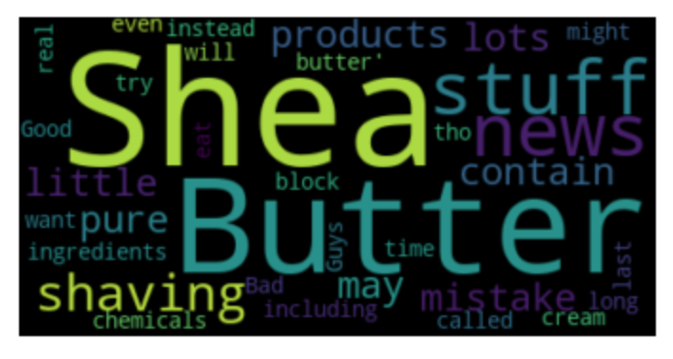
“review_text” Analysis Results
We can see the key words in the review_text.
We find that users give reviews on shea butter frequently and this item may be popular in some degree.

Slide 3

“review summary” Analysis Results
We can see the key words in the review_summary.
We find that most of the users would like to give positive or neutral reviews, which means people are content with most of the items.

Slide 4
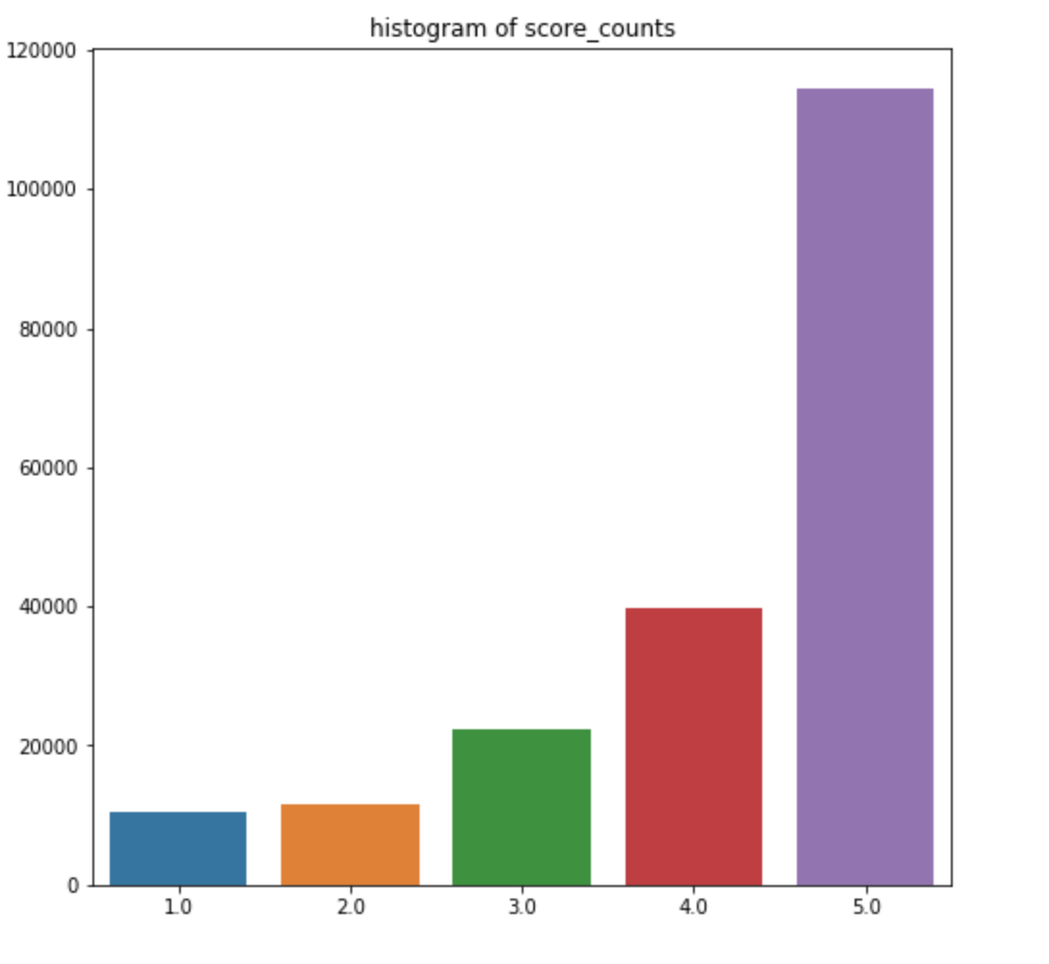
“score_counts” Distribution
From this histogram, We can see that most of the customers give scores higher than 4, But here are still a few of lower review scores from the customers.

Slide 5
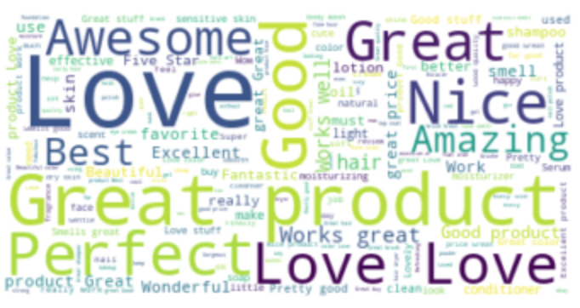
Key Words from the “review_summary” with “scores >= 4”
We can find there are many customers would like to use “love” , “ great”, “good product” …to express their satisfaction.

Slide 6
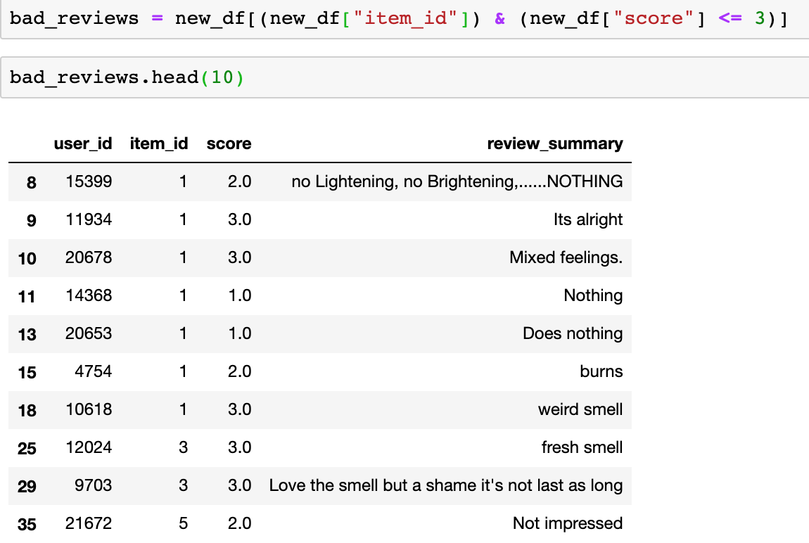
Find Out all the Items with Bad Scores
We can find all the items with scores lower than 4. So sellers may need to find problems and optimize these items.

Slide 7
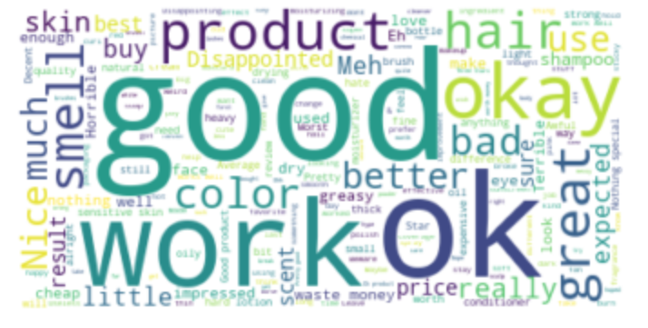
Key Words from the “review_summary” with “scores < 4”
We can get some
interesting insights:
The bad review_summary usually contains word “good”, we can see some people give bad reviews but they use some positive words like “good”, ”OK”, “great” . We can infer that even though some part of the item is not bad, customers are still not content with the overall experiences.

Slide 8


