Slide 1

Flume 架构实战

Slide 2
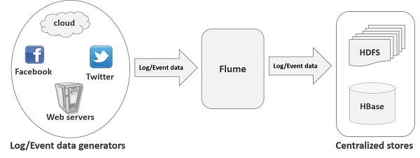
Flume是什么
Flume是Cloudera提供的一个高可用的，高可靠的，分布式的海量日志采集、聚合和传输的系统，Flume支持在日志系统中定制各类数据发送方，用于收集数据；同时，Flume提供对数据进行简单处理，并写到各种数据接受方（可定制）的能力。当前Flume有两个版本Flume 0.9X版本的统称Flume-og，Flume1.X版本的统称Flume-ng。由于Flume-ng经过重大重构，与Flume-og有很大不同，使用时请注意区分。

Slide 3
Flume特点
可靠性
数据不丢失
可扩展性
各组件数目可扩展
高性能
高吞吐量，可以满足海量日志的搜集
可管理
动态增加、删除组件
文档丰富、社区活跃
Hadoop生态应用及其广泛

Slide 4
Flume NG架构
Source
Flume组件，负责读取日志源，存储到Channel中
Sink
flume组件，负责从channel中获取数据到目的地
Source System
存储来自于系统日志和用户接口的数据
Channel
flume组件，负责存储Event数据
Source System
Eg . Web server、JMS、RDBMS、Streams
Source
Channel
Sink
Destination System
eg. HDFS、NoSQL、RDBMS
Raw Data
Event
eg local File system
RDBMS、Memory
Event
Raw Data
Event
Flume传输的数据，该数据由Source产生，存储到Channel中
Raw Data
数据通过flume的中Source组件读取进来的文本数据

Slide 5
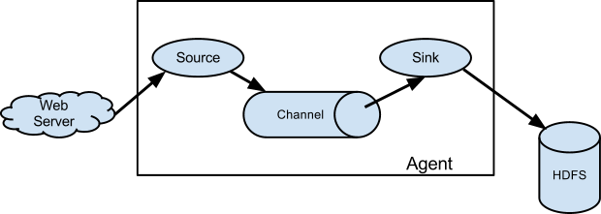
Flume NG 架构
flume的核心是把数据从数据源(source)收集过来，在将收集到的数据送到指定的目的地(sink)。为了保证输送的过程一定成功，在送到目的地(sink)之前，会先缓存数据(channel),待数据真正到达目的地(sink)后，flume在删除自己缓存的数据。

Slide 6
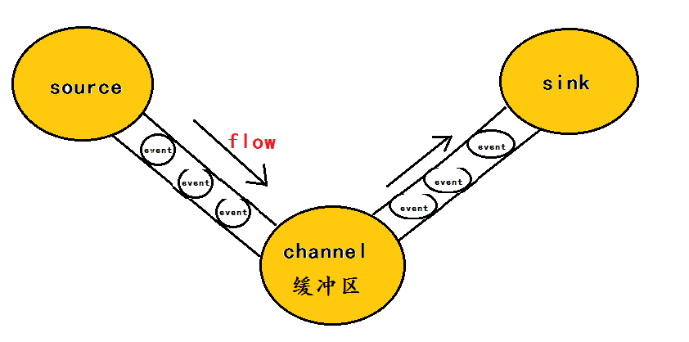

Flume NG 架构
在整个数据的传输的过程中，流动的是event，即事务保证是在event级别进行的。event将传输的数据进行封装，是flume传输数据的基本单位，如果是文本文件，通常是一行记录，event也是事务的基本单位。event从source，流向channel，再到sink，本身为一个字节数组，并可携带headers(头信息)信息。event代表着一个数据的最小完整单元，从外部数据源来，向外部的目的地去。
一个完整的event包括：event headers、event body (即文本文件中的单行记录)，如下所以：

Slide 7
Agent-Channel/Sink
Source
Event
…
Commit Event
Take Commit
Event
Event
Sink
Event
Channel

Slide 8
Flume核心概念
Cleint
Event
Agent
Source
Channel
Sinks
其他组件 Interceptor、Channel Selector、Sink Processor

Slide 9
Event
Flume事件的传输基本单元
Flume以事件的形式从事件源传输到最终目的地
一个完整的event包括：event headers、event body
Header容纳了key-value的无序集合，其中key在一个header中是唯一的
Body 一般指数据主体

Slide 10
Agent
Agent由Source、Channel、Sink组件以及其他组件构成
Agent利用这些组件负责将Event从一个节点传输到另外一个节点
Agent是Flume 流的基本组成部分
Flume提供了对Agent的配置、监控、生命周期管理等

Slide 11
Agent-Source
从数据发生器接收数据,并将接收的数据以Flume的event格式传递给一个或者多个通道channal,Flume提供多种数据接收的方式,比如Avro,Thrift
Agent
外部数据
Sink
Source
数据目的地
Channel

Slide 12
拦截器、选择器、SinkGroup
source
Event
日志
Event
source
拦截器
sinks
source
sinks
sinks
sinks
channel
sinks
Selector
sinks
sinks
sinks
sinks
拦截器：作用于Source，按照设定的顺序对event装饰或者过滤
通道选择器：允许Source基于预设的从所有的通道中选择一个或者多个
SinkGroup:多个Sink可以构成一个SinkGroup可以实现Sink的负载均衡/故障转移

Slide 13
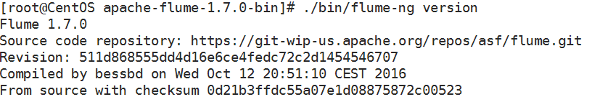
安装Flume
1.下载flume安装包解压到/usr目录
http://www.apache.org/dyn/closer.lua/flume/1.7.0/apache-flume-1.7.0-bin.tar.gz
2.安装JDK1.7配置JAVA_HOME环境变量
3.验证是否安装成功

Slide 14
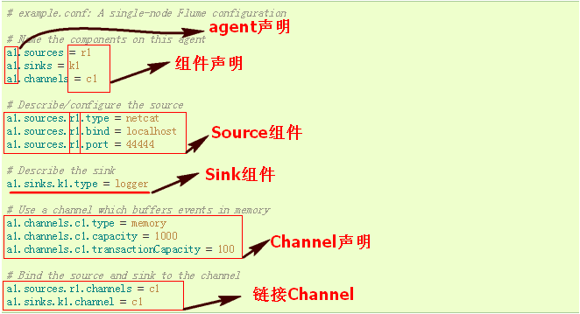
Flume 配置文件格式
NetCat
src
logger
Sink
Agent
Channel
yum install -y telnet
./bin/flume-ng agent --conf conf -f conf/flume-conf.properties -n agent -Dflume.root.logger=INFO,console

Slide 15
基本组件测试
Flume Sources
Avro Source
Exec Source
Spooling Directory Source（收集目录日志）
Kafka Source
Taildir Source（动态采集文本行）
Flume Sinks
HDFS Sink
Avro Sink
File Roll Sink（输出文件）
Kafka Sink（消息队列）
Flume Channels
Memory Channel
JDBC Channel Kafka Channel File Channel

Slide 16


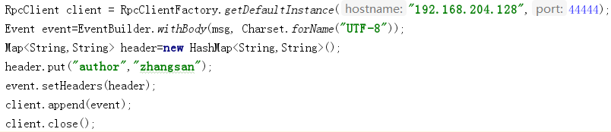
Avro Source+MemoryChannel+ File Roll Sink
# 命名组件
a1.sources = r1
a1.sinks = k1
a1.channels = c1
# 配置source
a1.sources.r1.type = avro
a1.sources.r1.bind = 192.168.204.128
a1.sources.r1.port = 44444
# 配置 sink
a1.sinks.k1.type = file_roll
a1.sinks.k1.sink.directory = /root/file_roll
a1.sinks.k1.sink.rollInterval = 0
# 配置 channel
a1.channels.c1.type = memory
a1.channels.c1.capacity = 1000
a1.channels.c1.transactionCapacity = 100
# 组建各个控件
a1.sources.r1.channels = c1
a1.sinks.k1.channel = c1
发送数据：
./bin/flume-ng avro-client -H 192.168.204.128 -p 44444 -F /root/access.log
./bin/flume-ng agent --conf conf -f conf/demo2.properties -n a1

Slide 17

Taildir Source+MemoryChannel+ File Roll Sink
# 命名组件
a1.sources = r1
a1.sinks = k1
a1.channels = c1
# 配置source
a1.sources.r1.type = TAILDIR
a1.sources.r1. filegroups = f1 f2
a1.sources.r1.filegroups.f1 = /root/tail_dir/.*\.java
a1.sources.r1.filegroups.f2 = /root/tail_dir/.*\.log
a1.sources.r1.fileHeader = true
a1.sources.r1.headers.f1.from = f1
a1.sources.r1.headers.f2.from = f2
# 配置 sink
a1.sinks.k1.type = file_roll
a1.sinks.k1.sink.directory = /root/file_roll
a1.sinks.k1.sink.rollInterval = 0
# 配置 channel
a1.channels.c1.type = memory
a1.channels.c1.capacity = 1000
a1.channels.c1.transactionCapacity = 100
# 组建各个控件
a1.sources.r1.channels = c1
a1.sinks.k1.channel = c1
./bin/flume-ng agent --conf conf -f conf/demo3.properties -n a1

Slide 18
案例-Source/Channel
NetCat
src
File_roll
Sink
# 声明 采集流 source channel sinks
agent.sources = s1 s2
agent.channels = c1
agent.sinks = sk1
# 定义source源
agent.sources.s1.type = netcat
agent.sources.s1.bind = 0.0.0.0
agent.sources.s1.port = 8888
agent.sources.s2.type = netcat
agent.sources.s2.bind = 0.0.0.0
agent.sources.s2.port = 9999
# 定义channel
agent.channels.c1.type = memory
agent.channels.c1.capacity = 100
Agent
NetCat
src
Channel
# 定义sinks
agent.sinks.sk1.type = file_roll
agent.sinks.sk1.sink.directory = /root/dir1
agent.sinks.sk1.sink.rollInterval=0
# 对接 source 和 sinsk
agent.sources.s1.channels = c1
agent.sources.s2.channels = c1
agent.sinks.sk1.channel = c1
附注:多个source对接一个channel,将收集到的数据输出到指定目录

Slide 19
案例-拦截器配置
Host Interceptor
Event添加host属性
Timestamp Interceptor
给EvnetHeader添加时间戳
Search and Replace Interceptor
匹配替换拦截器，修改event的body体
Regex Filtering Interceptor
配置满足正则表达是的event，配置的是消息体
Regex Extractor Interceptor
正则抽取evnet体的内容，将内容添加到header里
Static Interceptor
给Event添加固定头信息
UUID Interceptor
给消息添加UUID消息头
拦截器：作用于Source，按照设定的顺序对event装饰或者过滤

Slide 20
案例-拦截器配置
# 声明 采集流 source channel sinks
agent.sources = s1
agent.channels = c1
agent.sinks = sk1
# 定义source源
agent.sources.s1.type = netcat
agent.sources.s1.bind = 0.0.0.0
agent.sources.s1.port = 8888
#定义拦截器
agent.sources.s1.interceptors = i1 i2 i3
agent.sources.s1.interceptors.i1.type= timestamp
agent.sources.s1.interceptors.i2.type= host
agent.sources.s1.interceptors.i2.hostHeader=host
agent.sources.s1.interceptors.i3.type= static
agent.sources.s1.interceptors.i3.key=datacenter
agent.sources.s1.interceptors.i3.value=NEW_YORK
# 定义channel
agent.channels.c1.type = memory
agent.channels.c1.capacity = 100
agent.channels.c1.transactionCapacity = 100
# 定义sinks
agent.sinks.sk1.type = logger
# 对接 source 和 sinsk
agent.sources.s1.channels = c1
agent.sinks.sk1.channel = c1
File_roll
Sink
Agent
NetCat
src
Channel
拦截器
Event: {
headers:{timestamp=1500310172182, host=192.168.145.144, datacenter=NEW_YORK}
body: 63 68 69 6E 61 0D china.
}

Slide 21
案例-拦截器配置（正则）
# 定义channel
agent.channels.c1.type = memory
agent.channels.c1.capacity = 100
agent.channels.c1.transactionCapacity = 100
# 定义sinks
agent.sinks.sk1.type = logger
# 对接 source 和 sinsk
agent.sources.s1.channels = c1
agent.sinks.sk1.channel = c1
# 声明 采集流 source channel sinks
agent.sources = s1
agent.channels = c1
agent.sinks = sk1
# 定义source源
agent.sources.s1.type = netcat
agent.sources.s1.bind = 0.0.0.0
agent.sources.s1.port = 8888
agent.sources.s1.interceptors = i1
agent.sources.s1.interceptors.i1.type= regex_filter
agent.sources.s1.interceptors.i1.regex=^ERROR.*
File_roll
Sink
Agent
NetCat
src
只收集含有ERROR的日志数据
拦截器
Channel

Slide 22
案例-拦截器配置（正则）
# 定义channel
agent.channels.c1.type = memory
agent.channels.c1.capacity = 100
agent.channels.c1.transactionCapacity = 100
# 定义sinks
agent.sinks.sk1.type = logger
# 对接 source 和 sinsk
agent.sources.s1.channels = c1
agent.sinks.sk1.channel = c1
# 声明 采集流 source channel sinks
agent.sources = s1
agent.channels = c1
agent.sinks = sk1
# 定义source源
agent.sources.s1.type = netcat
agent.sources.s1.bind = 0.0.0.0
agent.sources.s1.port = 8888
agent.sources.s1.interceptors = i1
agent.sources.s1.interceptors.i1.type= regex_extractor
agent.sources.s1.interceptors.i1.regex=^([a-zA-Z0-9]*\\W?).*
agent.sources.s1.interceptors.i1.serializers = s1
agent.sources.s1.interceptors.i1.serializers.s1.name = type
File_roll
Sink
提取事件消息将提取内容添加到事件头
Agent
NetCat
src
Channel
拦截器

Slide 23
案例-Selector
拦截器
File_roll
Sink
Channel
NetCat
src
Channel
File_roll
Sink
Selector
Flume的Selector的形式有2种：
①Replication 形式 数据同步给多个Channel
②Multiplexing形式 数据分流

Slide 24
案例-Selector（Replication）
拦截器
# 声明 采集流 source channel sinks
agent.sources = s1
agent.channels = c1 c2
agent.sinks = sk1 sk2
# 定义source源
agent.sources.s1.type = netcat
agent.sources.s1.bind = 0.0.0.0
agent.sources.s1.port = 8888
# 定义channel
agent.channels.c1.type = memory
agent.channels.c1.capacity = 100
agent.channels.c1.transactionCapacity = 100
agent.channels.c2.type = file
File_roll
Sink
event
Channel
NetCat
src
event
Selector
File_roll
Sink
event
Channel

Slide 25
案例-Selector（Replication）
# 定义sinks
agent.sinks.sk1.type = file_roll
agent.sinks.sk1.sink.directory = /root/dir1
agent.sinks.sk1.sink.rollInterval=0
agent.sinks.sk2.type = file_roll
agent.sinks.sk2.sink.directory = /root/dir2
agent.sinks.sk2.sink.rollInterval=0
# 设置Channel Selector
agent.sources.s1.selector.type = replicating
# 对接 source 和 sinsk
agent.sources.s1.channels = c1 c2
agent.sinks.sk1.channel = c1
agent.sinks.sk2.channel = c2
拦截器
File_roll
Sink
event
Channel
NetCat
src
event
Selector
File_roll
Sink
event
Channel

Slide 26
案例-Selector（ Multiplexing ）
# 声明 采集流 source channel sinks
agent.sources = s1
agent.channels = c1 c2
agent.sinks = sk1 sk2
# 定义source源
agent.sources.s1.type = netcat
agent.sources.s1.bind = 0.0.0.0
agent.sources.s1.port = 8888
# 添加正则拦截器
agent.sources.s1.interceptors = i1
agent.sources.s1.interceptors.i1.type= regex_extractor
agent.sources.s1.interceptors.i1.regex=^(ERROR|INFO|WARN).*
agent.sources.s1.interceptors.i1.serializers = s1
agent.sources.s1.interceptors.i1.serializers.s1.name = level
拦截器
ERROR
File_roll
Sink
Channel
NetCat
src
event
Selector
File_roll
Sink
Channel
INFO|WARN

Slide 27
案例-Selector（ Multiplexing ）
# 定义channel
agent.channels.c1.type = memory
agent.channels.c1.capacity = 100
agent.channels.c1.transactionCapacity = 100
agent.channels.c2.type = file
# 定义sinks
agent.sinks.sk1.type = file_roll
agent.sinks.sk1.sink.directory = /root/dir1
agent.sinks.sk1.sink.rollInterval=0
agent.sinks.sk2.type = file_roll
agent.sinks.sk2.sink.directory = /root/dir2
agent.sinks.sk2.sink.rollInterval=0
拦截器
File_roll
Sink
ERROR
Channel
NetCat
src
event
Selector
File_roll
Sink
INFO|WARN
Channel
# 设置Channel Selector
agent.sources.s1.selector.type = multiplexing
agent.sources.s1.selector.header = level
agent.sources.s1.selector.mapping.ERROR = c1
agent.sources.s1.selector.mapping.INFO= c2
agent.sources.s1.selector.mapping.WARN = c2
agent.sources.s1.selector.default = c2
# 对接 source 和 sinsk
agent.sources.s1.channels = c1 c2
agent.sinks.sk1.channel = c1
agent.sinks.sk2.channel = c2

Slide 28
案例-SinkGroup
sinks
sinks
Channel
source
sinks
SinkGroup:多个Sink可以构成一个SinkGroup可以实现Sink的负载均衡/故障转移

Slide 29
案例-SinkGroup
# 声明 采集流 source channel sinks
agent.sources = s1
agent.channels = c1
agent.sinks = sk1 sk2
# 定义source源
agent.sources.s1.type = netcat
agent.sources.s1.bind = 0.0.0.0
agent.sources.s1.port = 8888
# 定义channel
agent.channels.c1.type = memory
agent.channels.c1.capacity = 100
agent.channels.c1.transactionCapacity = 100
# 对接 source 和 sinsk
agent.sources.s1.channels = c1
agent.sinks.sk1.channel = c1
agent.sinks.sk2.channel = c1
# 定义sinks
agent.sinks.sk1.type = file_roll
agent.sinks.sk1.sink.directory = /root/dir1
agent.sinks.sk1.sink.rollInterval=0
agent.sinks.sk2.type = file_roll
agent.sinks.sk2.sink.directory = /root/dir2
agent.sinks.sk2.sink.rollInterval=0
# 对sink 做分组
agent.sinkgroups = g1
agent.sinkgroups.g1.sinks = sk1 sk2
agent.sinkgroups.g1.processor.type = load_balance
agent.sinkgroups.g1.processor.backoff = true
agent.sinkgroups.g1.processor.selector = round_robin

Slide 30
Flume NG案例(一)
Tier 1(第一梯队)
Tier 2(第二梯队)
AVRO
src
AVRO
Sink
App
FlumeSDK
Agent
AVRO
Sink
AVRO
src
HDFS
Sink
Channel
Agent
AVRO
src
AVRO
Sink
Channel
App
FlumeSDK
Agent
HDFS
AVRO
Sink
Channel
AVRO
src
HDFS
Sink
App
FlumeSDK
Agent
AVRO
src
AVRO
Sink
Agent
Channel
AVRO
Sink
Channel

Slide 31
Flume NG案例(一)
# 声明 采集流 source channel sinks
agent.sources = s1
agent.channels = c1
agent.sinks = sk1
# 定义source源
agent.sources.s1.type = AVRO
agent.sources.s1.bind = 0.0.0.0
agent.sources.s1.port = 44144
#添加时间戳拦截器
agent.sources.s1.interceptors = i1
agent.sources.s1.interceptors.i1.type = timestamp
# 定义channel
agent.channels.c1.type = memory
agent.channels.c1.capacity = 100
# 定义sinks
agent.sinks.sk1.type = hdfs
agent.sinks.sk1.hdfs.path=hdfs://CentOS:9000/demo/%y%m%d%H%M
agent.sinks.sk1.hdfs.fileType=DataStream
agent.sinks.sk1.hdfs.rollInterval=0
agent.sinks.sk1.hdfs.round=true
agent.sinks.sk1.hdfs.roundUnit=minute
agent.sinks.sk1.hdfs.roundValue=10
# 对接 source 和 sinsk
agent.sinks.sk1.channel = c1
agent.sources.s1.channels = c1
Tier 1(第二梯队)
AVRO
src
HDFS
Sink
Agent
Channel

Slide 32
Flume NG 案例(一)
# 声明 采集流 source channel sinks
agent.sources = s1
agent.channels = c1
agent.sinks = sk1 sk2
# 定义Source源
agent.sources.s1.type = avro
agent.sources.s1.bind = 0.0.0.0
agent.sources.s1.port = 44144
# 定义channel
agent.channels.c1.type = memory
agent.channels.c1.capacity = 100
# 定义sinks
agent.sinks.sk1.type = avro
agent.sinks.sk1.hostname = 192.168.145.154
agent.sinks.sk1.port = 44144
agent.sinks.sk2.type = AVRO
agent.sinks.sk2.hostname= 192.168.145.155
agent.sinks.sk2.port=44144
# 定义多个Sink的负载均衡
agent.sinkgroups= g1
agent.sinkgroups.g1.sinks = sk1 sk2
agent.sinkgroups.g1.processor.type = load_balance
agent.sinkgroups.g1.processor.selector = round_robin
agent.sinkgroups.g1.processor.backoff = true
# 对接 source 和 sinsk
agent.sources.s1.channels = c1
agent.sinks.sk1.channel = c1
agent.sinks.sk2.channel = c1
Tier 1(第一梯队)
AVRO
src
AVRO
Sink
Agent
AVRO
Sink
Channel

Slide 33
Flume NG案例
<dependency> <groupId>org.apache.flume</groupId> <artifactId>flume-ng-sdk</artifactId> <version>1.7.0</version> </dependency>
Properties props = new Properties(); props.put("client.type", "default_failover"); props.put("hosts", "h1 h2"); props.put("hosts.h1", "192.168.145.153" + ":" + 44144); props.put("hosts.h2", "192.168.145.154" + ":" + 44144); RpcClient client = RpcClientFactory.getInstance(props); String message="10010 jiangzz true 18 2017-02-01"; Event event = EventBuilder.withBody(message.getBytes()); client.append(event); client.close();
App
FlumeSDK

Slide 34
Flume NG案例
App
FlumeSDK
<dependency> <groupId>org.apache.flume</groupId> <artifactId>flume-ng-sdk</artifactId> <version>1.7.0</version> </dependency>
<dependency> <groupId>org.apache.flume.flume-ng-clients</groupId> <artifactId>flume-ng-log4jappender</artifactId> <version>1.7.0</version> </dependency>
<dependency> <groupId>org.slf4j</groupId> <artifactId>slf4j-log4j12</artifactId> <version>1.7.5</version> </dependency>
import org.apache.commons.logging.Log; import org.apache.commons.logging.LogFactory;
Log logger = LogFactory.getLog(LogDemo.class);
logger.info("10010 wangxiaowu true 2017-01-01");
log4j.appender.flume = org.apache.flume.clients.log4jappender.Log4jAppender log4j.appender.flume.Hostname=192.168.145.153 log4j.appender.flume.Port=44144 log4j.appender.flume.UnsafeMode = true # configure a class's logger to output to the flume appender log4j.logger.com.baizhi.demo =debug,flume log4j.appender.flume.layout=org.apache.log4j.PatternLayout log4j.appender.flume.layout.ConversionPattern=%p %d{yyyy-MM-dd HH:mm:ss} %c [ %m ]%n
参考: http://flume.apache.org/FlumeUserGuide.html#log4j-appender

Slide 35
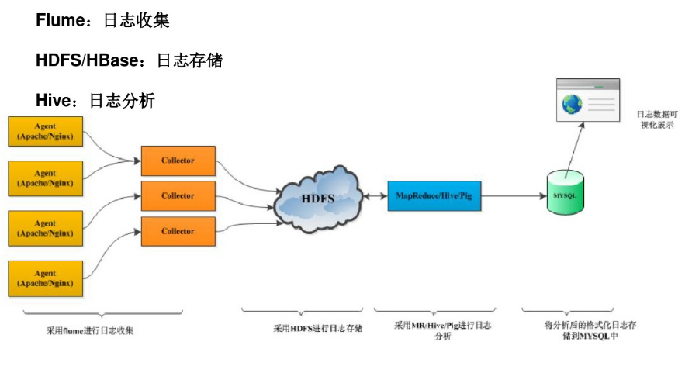
日志集群构建

Slide 36
技巧 定时切割 nginx的日志文件
#nginx日志切割脚本
#!/bin/bash
#设置日志文件存放目录
logs_path="/usr/local/nginx-1.11.1/logs/"
#设置pid文件
pid_path="/usr/local/nginx-1.11.1/logs/nginx.pid“
#重命名日志文件
mv ${logs_path}custom_access.log ${logs_path}access_$(date -d "yesterday" +"%Y-%m-%d%I:%M:%S").log
#向nginx主进程发信号重新打开日志
kill -USR1 `cat ${pid_path}`
*/1 * * * * /root/echo.sh
[root@CentOS ~]# crontab –e （添加定时脚本）
参考: http://www.nginx.cn/255.html
http://blog.csdn.net/smilefyx/article/details/22478107
http://www.linuxidc.com/Linux/2016-02/128323.html
Notes:
//判断文件大小是否大于10*1024 如果大于则 移动该文件
#!/bin/sh
filename=media.log
filesize=`ls -l $filename | awk '{ print $5 }'`
maxsize=$((1024*10))
if [ $filesize -gt $maxsize ]
then
echo "$filesize > $maxsize"
mv media.log media"`date +%Y-%m-%d_%H:%M:%S`".log
else
echo "$filesize < $maxsize"
fi
//定时的
#nginx日志切割脚本
#author: http://www.nginx.cn
#!/bin/bash
#设置日志文件存放目录
logs_path="/usr/local/nginx-1.11.1/logs/“
#设置pid文件
pid_path="/usr/local/nginx-1.11.1/logs/nginx.pid“
#重命名日志文件
mv ${logs_path}custom_access.log ${logs_path}access_$(date -d "yesterday" +"%Y-%m-%d %I:%M:%S").log
#向nginx主进程发信号重新打开日志
kill -USR1 `cat ${pid_path}`

