Slide 1
A Git Workflow Model
Slides produced from blog by Vincent Driessen http://nvie.com/git-model and secondary posting at
http://gist.github.com/287237
Notes:
The first few slides are cut-ups from a large diagram, which can be found in PDF at Vincent Driessen’s website, along with the rest of the material here. I have reformatted it here for classroom presentation.

Slide 2
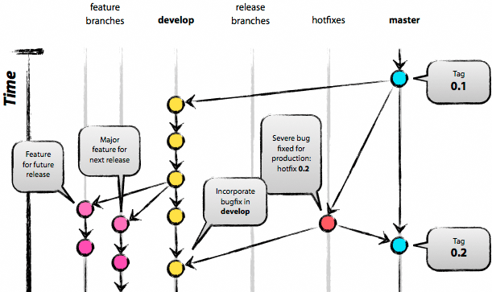
The big picture
Original blog by Vincent Driessen
http://nvie.com/git-model
Notes:
I first found this example on a web page of the Apache Portable Runtime Project. They had taken it from a blog by Vincent Driessen. This is a good example of how to use Git on a medium-sized development project, as well as a good version numbering scheme.
The images and text below are all reproduced from those web pages, with just a few modifications, reformatted for classroom use.
This project uses a “semantic version numbering” system.
Versions are denoted using a standard triplet of integers: MAJOR.MINOR.PATCH. The basic intent is that MAJOR versions are incompatible, large-scale upgrades of the API. MINOR versions retain source and binary compatibility with older minor versions, and changes in the PATCH level are perfectly compatible, forwards and backwards. Patch level changes could also be for correcting incorrect APIs. In this case, the previous patch release may be incompatible, but because of bugs. Minor versions may introduce new features, but do not alter any of the previous API. Major versions may introduce new features and change the old API in incompatible ways. For background see description of Semantic Versioning at http://semver.org/.
The different types of branches are:
master
production releases
develop
AKA integration branch
Release branches (release-*)
for finalizing a major/minor release, branched from develop
Hotfix branches (hotfix-*)
for applying patches, branched from master (or support-* for older releases)
Support branches (support-*)
for applying patches to old release versions, branched from master
Feature branches (feature-*)
for developing features or wild speculation, branched from develop

Slide 3
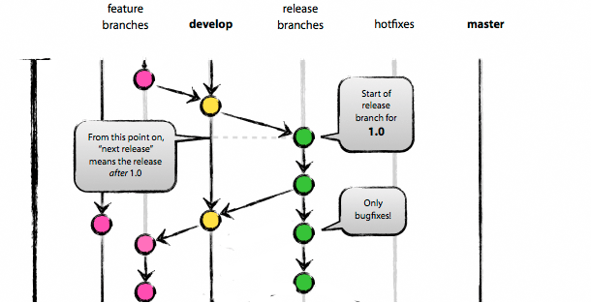
http://nvie.com/git-model

Slide 4
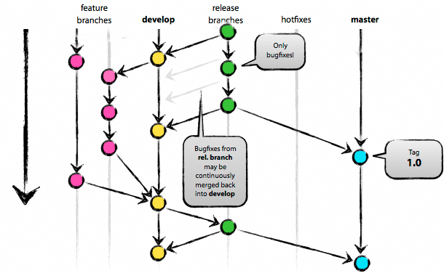
http://nvie.com/git-model

Slide 5
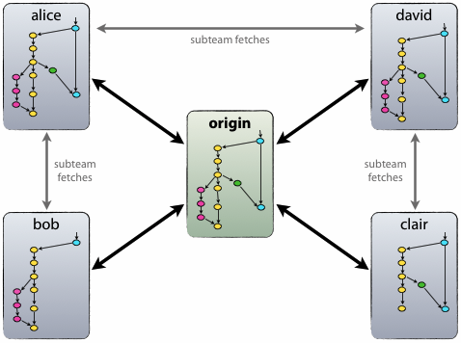
Repository relationships
http://nvie.com/git-model
Notes:
From here on I quote from the original blog.
The repository setup is that with a central “truth” repo. Note that this repo is only considered to be the central one (since Git is a DVCS, there is no such thing as a central repo at a technical level). We will refer to this repo as origin, since this name is familiar to all Git users.
Each developer pulls and pushes to origin. But besides the centralized push-pull relationships, each developer may also pull changes from other peers to form sub teams. For example, this might be useful to work together with two or more developers on a big new feature, before pushing the work in progress to origin prematurely. In the figure above, there are subteams of Alice and Bob, Alice and David, and Clair and David.
Technically, this means nothing more than that Alice has defined a Git remote, named bob, pointing to Bob’s repository, and vice versa.

Slide 6
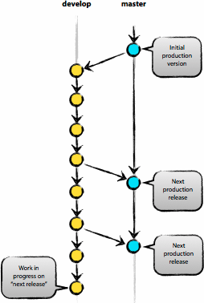
Main branches
master used for production releases
develop used for integration and regression testing
http://nvie.com/git-model
Notes:
The central repository holds two main branches with an infinite lifetime:
master
Develop
The master branch at origin should be familiar to every Git user.
Parallel to the master branch, another branch exists called develop.
We consider origin/master to be the main branch where the source code of HEAD always reflects a production-ready state.
We consider origin/develop to be the main branch where the source code of HEAD always reflects a state with the latest delivered development changes for the next release. Some would call this the “integration branch”. This is where any automatic nightly builds are built from.
When the source code in the develop branch reaches a stable point and is ready to be released, all of the changes should be merged back into master somehow and then tagged with a release number. How this is done in detail will be discussed further on.
Therefore, each time when changes are merged back into master, that is a new production release by definition.
We tend to be very strict at this, so that theoretically, we could use a Git hook script to automatically build and roll-out our software to our production servers every time there was a commit on master.
Next to the main branches master and develop, our development model uses a variety of supporting branches to aid parallel development between team members, ease tracking of features, prepare for production releases and to assist in quickly fixing live production problems. Unlike the main branches, these branches always have a limited life time, since they will be removed eventually.
The different types of branches we may use are:
Feature branches
Release branches
Hotfix branches
Each of these branches have a specific purpose and are bound to strict rules as to which branches may be their originating branch and which branches must be their merge targets. We will walk through them in a minute.
By no means are these branches “special” from a technical perspective. The branch types are categorized by how we use them. They are of course plain old Git branches.
May branch off from: develop
Must merge back into: develop
Branch naming convention: anything except master, develop, release-*, or hotfix-*
Feature branches (or sometimes called topic branches) are used to develop new features for the upcoming or a distant future release. When starting development of a feature, the target release in which this feature will be incorporated may well be unknown at that point. The essence of a feature branch is that it exists as long as the feature is in development, but will eventually be merged back into develop (to definitely add the new feature to the upcoming release) or discarded (in case of a disappointing experiment).
Feature branches typically exist in developer repos only, not in origin.

Slide 7
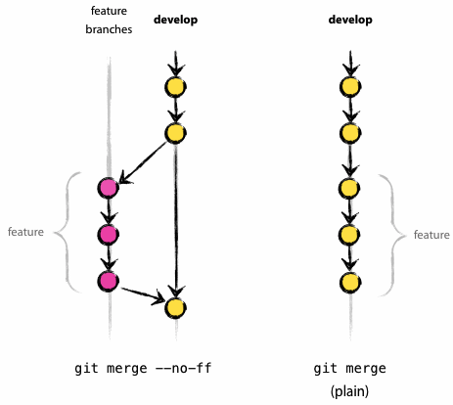
Feature branches
http://nvie.com/git-model
Notes:
Feature branches
Created for feature development that may require several or more commits to produce a working tree. May make occasional merges from develop to keep it up to date. If it will be separate for an extended period of time, create a feature-branch-readme.txt in the top level directory dictating the reason for the branch.
May branch off from: develop
Creating a feature branch
When starting work on a new feature, branch off from the develop branch.
$ git checkout -b myfeature develop
Switch to a new branch "myfeature"
Incorporating a finished feature on develop
Finished features must be merged into the develop branch to add them to the upcoming release:
$ git checkout develop
Switch to branch 'develop'
$ git merge --no-ff myfeature
Update ea1b82a..05e9557 (Summary of changes)
$ git branch -d myfeature
Delete branch myfeature (was 05e9557).
$ git push origin develop
The --no-ff flag causes the merge to always create a new commit object, even if the merge could be performed with a fast-forward. This avoids losing information about the historical existence of a feature branch and groups together all commits that together added the feature.
In the latter case, it is impossible to see from the Git history which of the commit objects together have implemented a feature—you would have to manually read all the log messages. Reverting a whole feature (i.e. a group of commits), is a true headache in the latter situation, whereas it is easily done if the --no-ff flag was used.
Yes, it will create a few more (empty) commit objects, but the gain is much bigger that that cost.
Unfortunately, I have not found a way to make --no-ff the default behaviour of git merge yet, but it really should be.

Slide 8
Release branches
Branched from develop when it almost reflects the desired new release
Bug fixes for the release are applied here
No new features may be added to this branch
New feature development can continue in parallel on the develop branch
Notes:
Release Branches
Release branches are created from the develop branch when the develop branch is at a stable point and release specific changes need to be made, such as bumping version numbers, etc. At that point, develop should be branched and the changes made before ultimately merging it into master and tagging the release. There should only be one active release branch at a time. Until the current release is wrapped up, merged into master and deleted, development of the next release should take place on develop. When develop reaches another state of stability for release, another release branch is be created.
May branch off from: develop
Must merge back into: develop and master
Branch naming convention: release-*
Release branches support preparation of a new production release. They allow for last-minute dotting of i’s and crossing t’s. Furthermore, they allow for minor bug fixes and preparing meta-data for a release (version number, build dates, etc.). By doing all of this work on a release branch, the develop branch is cleared to receive features for the next big release.
The key moment to branch off a new release branch from develop is when develop (almost) reflects the desired state of the new release. At least all features that are targeted for the release-to-be-built must be merged in to develop at this point in time. All features targeted at future releases may not—they must wait until after the release branch is branched off.
It is exactly at the start of a release branch that the upcoming release gets assigned a version number—not any earlier. Up until that moment, the develop branch reflected changes for the “next release”, but it is unclear whether that “next release” will eventually become 0.3 or 1.0, until the release branch is started. That decision is made on the start of the release branch and is carried out by the project’s rules on version number bumping.
Creating a release branch
$ git checkout -b release-1.2 develop
Switched to a new branch "release-1.2”
$ ./bump-version.sh 1.2
Files modified successfully, version bumped to 1.2.
$ git commit -a -m "Bumped version number to 1.2"
[release-1.2 74d9424] Bumped version number to 1.2
1 files changed, 1 insertions(+), 1 deletions(-)
After creating a new branch and switching to it, we bump the version number. Here, bump-version.sh is a fictional shell script that changes some files in the working copy to reflect the new version. (This can of course be a manual change—the point being that some files change.) Then, the bumped version number is committed.
This new branch may exist there for a while, until the release may be rolled out definitely. During that time, bug fixes may be applied in this branch (rather than on the develop branch). Adding large new features here is strictly prohibited. They must be merged into develop, and therefore, wait for the next big release.
Finishing a release branch
When the state of the release branch is ready to become a real release, some actions need to be carried out. First, the release branch is merged into master (since every commit on master is a new release by definition, remember). Next, that commit on master must be tagged for easy future reference to this historical version. Finally, the changes made on the release branch need to be merged back into develop, so that future releases also contain these bug fixes.
The first two steps in Git:
$ git checkout master
Switched to branch 'master'
$ git merge --no-ff release-1.2
Merge made by recursive. (Summary of changes)
$ git tag -a 1.2
The release is now done, and tagged for future reference.
(You might as well want to use the -s or -u <key> flags to sign your tag cryptographically.)
To keep the changes made in the release branch, we need to merge those back into develop, though. In Git:
$ git checkout develop
Switched to branch 'develop'
$ git merge --no-ff release-1.2
Merge made by recursive. (Summary of changes)
This step may well lead to a merge conflict (probably even, since we have changed the version number). If so, fix it and commit.
Now we are really done and the release branch may be removed, since we don’t need it anymore:
$ git branch -d release-1.2
Deleted branch release-1.2 (was ff452fe).

Slide 9
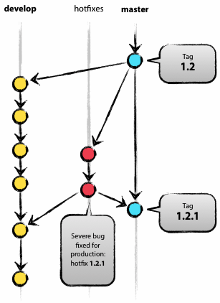
Hotfix Branches
Are like release branches, but for bug fixes
http://nvie.com/git-model
Notes:
Hotfix branches
Patches that need to be made to the most recent production release are applied to a hotfix branch off master. For older releases, hotfixes branch off a support-* branch (explained later.)
May branch off from: master
Must merge back into: develop and master
Branch naming convention: hotfix-*
Hotfix branches are very much like release branches in that they are also meant to prepare for a new production release, albeit unplanned. They arise from the necessity to act immediately upon an undesired state of a live production version. When a critical bug in a production version must be resolved immediately, a hotfix branch may be branched off from the corresponding tag on the master branch that marks the production version.
The essence is that work of team members (on the develop branch) can continue, while another person is preparing a quick production fix.
Creating the hotfix branch
Hotfix branches are created from the master branch. For example, say version 1.2 is the current production release running live and causing troubles due to a severe bug. But changes on develop are yet unstable. We may then branch off a hotfix branch and start fixing the problem:
$ git checkout -b hotfix-1.2.1 master
Switched to a new branch "hotfix-1.2.1"
$ ./bump-version.sh 1.2.1
Files modified successfully, version bumped to 1.2.1.
$ git commit -a -m "Bumped version number to 1.2.1”
[hotfix-1.2.1 41e61bb] Bumped version number to 1.2.1
1 files changed, 1 insertions(+), 1 deletions(-)
Don’t forget to bump the version number after branching off!
Then, fix the bug and commit the fix in one or more separate commits.
$ git commit -m "Fixed severe production problem”
[hotfix-1.2.1 abbe5d6] Fixed severe production problem
5 files changed, 32 insertions(+), 17 deletions(-)
Finishing a hotfix branch
When finished, the bugfix needs to be merged back into master, but also needs to be merged back into develop, in order to safeguard that the bugfix is included in the next release as well. This is completely similar to how release branches are finished.
First, update master and tag the release.
$ git checkout master
Switched to branch 'master'
$ git merge --no-ff hotfix-1.2.1
Merge made by recursive. (Summary of changes)
$ git tag -a 1.2.1
(You might as well want to use the -s or -u <key> flags to sign your tag cryptographically.
Next, include the bugfix in develop, too:
$ git checkout develop
Switched to branch 'develop'
$ git merge --no-ff hotfix-1.2.1
Merge made by recursive. (Summary of changes)
The one exception to the rule here is that, when a release branch currently exists, the hotfix changes need to be merged into that release branch, instead of develop.
Back-merging the bugfix into the release branch will eventually result in the bugfix being merged into develop too, when the release branch is finished. (If work in develop immediately requires this bugfix and cannot wait for the release branch to be finished, you may safely merge the bugfix into develop now already as well.)
Finally, remove the temporary branch:
$ git branch -d hotfix-1.2.1
Deleted branch hotfix-1.2.1 (was abbe5d6).

Slide 10
Support Branches
If master has moved on to a new and a hotfix must be applied to a older version ( e.g 1.x):
create a support-1.x branch (if none exists) based on the newest 1.x tag in master
create a branch (e.g. hotfix-1.1.1), based on support-1.x
fix the bug and merge hotfix-1.1.1 back into support-1.x
Do this for other older major releases as necessary
The support branch effectively becomes a master branch for a past version.
Notes:
This is a distinction added by http://gist.github.com/287237, for hotfixes to old releases.
If master has moved on a point release (1.0, 1.1, 2.0, etc) and a hotfix must be applied to a older version ( e.g 1.x):
create a support-1.x branch (if none exists) based on the newest 1.x tag in master
create a branch (e.g. hotfix-1.1.1), based on support-1.x
fix the bug and merge hotfix-1.1.1 back into support-1.x
Do this for other older major releases as necessary
The support branch effectively becomes a master branch for a past version.

