Slide 1


ECOLE SUPERRIEUR DE TECHNOLOGIE - BENI MELLAL
DEPARTEMENT Informatique et Techniques de Gestion
Filière : DUT en Sécurité informatique et réseaux
STAGE D’INITIATION
Sous le thème
Audit and security of a local network using
pfSense and Nmap
Prepared by :
Hajar Rachid
Supervised by :
Mr. Saad Jabri
To the jury :
Pr. M. OURRIBBANE
Pr. M. OUTANOUTE
Année Universitaire : 2025/2026

Slide 2
Introduction
Plan
The project context
Technical Environment & Implementation
Results and Analysis
Conclusion
1

Slide 3


Introduction
The project context
Technical Environment & Implementation
Results and Analysis
Conclusion
Introduction
The objective of this project is to set up a virtual laboratory for the audit and security of a local network, using pfSense as a firewall and Nmap as a scanning tool. It aims to reduce the attack surface of a server by applying filtering rules, while strengthening information system protection and demonstrating the importance of network security mechanisms in a professional environment.
2

Slide 4
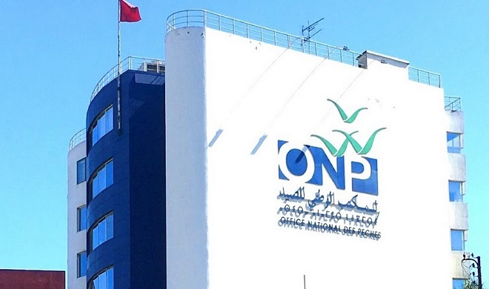
Introduction
The project context
Technical Environment & Implementation
Results and Analysis
Conclusion
Presnetation of the ONP
The ONP is a public institution created in 1969. It operates under the Ministry of Agriculture and Maritime Fisheries. Its main role is to develop coastal and artisanal fishing, organize and modernize fish marketing, and promote fish consumption in Morocco
3

Slide 5

Introduction
The project context
Technical Environment & Implementation
Results and Analysis
Conclusion
Context and Project Objectives
Context:
project was carried out in a virtual lab simulating a secure local network to test and analyze security mechanisms like firewalls and auditing tools.
Objectives:
Strengthen practical skills in network configuration and security management.
Learn how to protect systems using auditing and firewall rules.
4

Slide 6













Introduction
The project context
Technical Environment & Implementation
Results and Analysis
Conclusion
Tools Used :
5

Slide 7
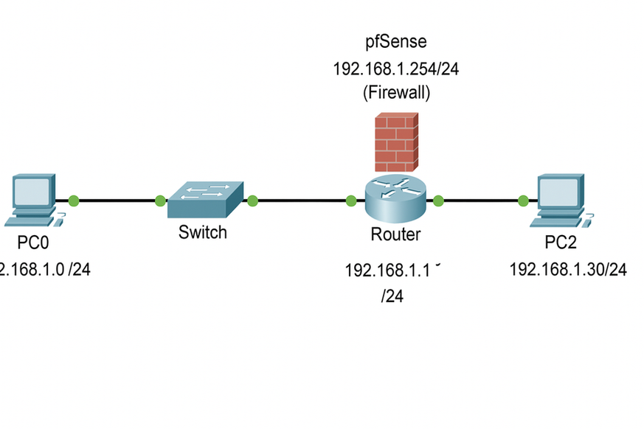
Introduction
The project context
Technical Environment & Implementation
Results and Analysis
Conclusion
Network Architecture
Virtual topology:
pfSense: acts as a firewall between the internal and external networks.
Ubuntu Server: target machine hosting services like SSH and Apache.
Kali Linux: auditing workstation used for scanning and testing security.
6

Slide 8

Introduction
The project context
Technical Environment & Implementation
Results and Analysis
Conclusion
Implementation Steps
Creation and configuration of virtual machines under VirtualBox (pfSense, Ubuntu, Kali Linux).
Network setup and service deployment (SSH, Apache).
Perform initial Nmap scan
Apply pfSense firewall rules
Perform final scan and compare.
7

Slide 9
Introduction
The project context
Technical Environment & Implementation
Results and Analysis
Conclusion
Results and Analysis
Before Firewal | After Firewall
Ports 22, 80 open | Only port 22 open
Interpretation:
The firewall reduced the attack surface.
Only essential services remained accessible
8

Slide 10

Introduction
The project context
Technical Environment & Implementation
Results and Analysis
Conclusion
Lessons Learned
Importance of firewalls in protecting systems.
Learned how to configure and test network security.
Gained hands-on experience with virtualization and auditing tools.
9

Slide 11

Introduction
The project context
Technical Environment & Implementation
Results and Analysis
Conclusion
Conclusion
This project allowed me to combine theoretical and practical knowledge. It demonstrated the importance of network security and strengthened my technical and analytical skills.
10

Slide 12

Thank you for your attention !
Hajar Rachid
EST Beni Mellal
Sécurité Informatiques et réseaux
2025/2026

