Slide 1
Application of Compiler Technology
Applications of Compiler Technology
1.Implementation of high-level programming languages:
A high level programming language defines a programming abstraction:
The programmer expresses an algorithm using the language, and the complier must translate that program to the target language.
Generally, higher level programming languages are easier to program as it is less efficient, the target program runs more slowly.
Programmers using a low level language have more control over a computation and can, produce more efficient code.
Unfortunately, lower level programs are harder to write as it is:
Less portable
Prone to errors
Hard to maintain

Slide 2
All programming languages user-defined aggregate data types, such as arrays and structures and high-level control flow, such as loops and procedure invocations.
Dataflow optimizations, has been developed to analyze the flow of data through the program and removes redundancies across these constructs.
Object orientation was first introduced in Simula in 1967, and has been incorporated in languages such as Smalltalk, C++, C#, and Java. The key ideas behind object orientation are
1. Data abstraction and
2. Inheritance of properties
Java language is type-safe that is, an object cannot be used as an object of an unrelated type. All array accesses are checked to ensure that they lie within the bounds of the array.
Java has no pointers and does not allow pointer arithmetic.
It has a built-in garbage-collection facility that automatically frees the memory of variables that are no longer in use.

Slide 3
2.Optimization for Computer Architectures
The rapid evolution of computer architectures has also led to an insatiable demand for new compiler technology.
Almost all high-performance systems take advantage of the same two basic techniques:
Parallelism
Memory hierarchies
Parallelism can be found at several levels: at the instruction level, where multiple operations are executed simultaneously and at the processor level, where different threads of the same application are run on different processors.
Memory hierarchies are a response to the basic limitation that we can build very fast storage or very large storage, but not storage that is both fast and large.

Slide 4
Parallelism
Programs are written as if like instructions ; the hardware dynamically checks for dependencies in the sequential instruction stream and issues them in parallel when possible.
In some cases, the machine includes a hardware scheduler that can change the instruction ordering to increase the parallelism in the program.
VLIW (Very Long Instruction Word) machines have instructions that can issue multiple operations in parallel.
The Intel IA64 is a well-known example of such an architecture.
Programmers can write multithreaded code for multiprocessors.
Parallelization techniques have been developed to translate automatically sequential scientific programs into multiprocessor code.

Slide 5
Memory Hierarchies
A memory hierarchy consists of several levels of storage with different speeds and sizes, with the level closest to the processor being the fastest but smallest.
The average memory-access time of a program is reduced if most of its accesses are satisfied by the faster levels of the hierarchy.
Both parallelism and the existence of a memory hierarchy improve the potential performance of a machine, but they must be harnessed effectively by the compiler to deliver real performance on an application.
Memory hierarchies are found in all machines.
A processor usually has a small number of registers consisting of hundreds of bytes, several levels of caches containing kilobytes to megabytes, physical memory containing megabytes to gigabytes, and finally secondary storage that contains gigabytes and beyond.
Unlike registers that have to be managed explicitly in software, caches and physical memories are hidden from the instruction set and are managed by hardware.

Slide 6
3.Design of New computer Architectures
The performance of a computer system is determined not by its raw speed but also by how well compilers can exploit its features.
Thus, in modern computer architecture development, compilers are developed in the processor design stage and compiled code, running on simulators is used to evaluate the proposed architectural features.

Slide 7
RISC (Reduced Instruction-Set Computer)
It is a type of microprocessor architecture that utilizes small, highly-optimized set of instructions.
Compiler optimizations often can reduce complex instructions to a small number of simpler operations by eliminating the redundancies across complex instruction.
Thus, it is desirable to build simple instruction sets; compilers can use them effectively and the hardware is much easier to optimize.
Most general-purpose processor architectures, PowerPC, SPARC, MIPS, Alpha, and PA-RISC, are based on the RISC concept.

Slide 8
Specialized Architectures
Over the last three decades, many architectural concepts have been proposed.
They include data flow machines, vector machines, VLIW (Very Long Instruction Word) machines, SIMD (Single Instruction, Multiple Data) arrays of processors, multiprocessors with shared memory, and multiprocessors with distributed memory.
The development of each of these architectural concepts was accompanied by the research and development of corresponding compiler technology.
Compiler technology is needed not only to support programming for architectures, but also to evaluate proposed architectural designs.

Slide 9
4. Program translation
• Compiler as a translation from a high-level language to the machine level same technology can be applied to translate between different kinds of language.
Binary Translation
• Complier technology can be used to translate the binary code for one machine to that of another allowing a machine to run programs originally complied for another instruction set.
• Binary translation technology has been used by various computer companies to increase the availability of software for their machine.
• Binary translator have been developed to convert 8086 code into alpha and sparc code.
• Binary translator can also used to provide backward compatibility.

Slide 10
Hardware Synthesis
• Not only in software written H.L.L. even hardware design are mostly described in high level language. Hardware description language like VHDL (very high-speed integrated circuit hardware description language)
• Hardware design are typically described at RTL (register transfer level), where variables represents register and expression represents combinational logic.
• Hardware synthesis tool translated RTL description automatically into gates, which are then mapped to transistors and to physical layout.
• Techniques to translate designs at higher level such as behavior or functional level also exist.

Slide 11
Database Query Interpreters
• Besides specifying software, hardware languages are useful in many other applications like SQL are used to search databases.
• DB queries consists of predicates containing relational and Boolean operators. They can be interpreted or compiled into commands to search a database for records satisfying that predicate.

Slide 12
Compiled Simulation
• Simulation is a general techniques used in many scientific and engineering disciplines to understand a phenomenon or to validate a design.
• Input to a simulator usually include the description of the design and specific input parameter for that particular simulation run.
• Simulation can be very expensive.
• Typically need to simulate many possible design alternatives on many different input sets and each experiment may take days to complete on a high-performance machine.
• Complied simulation can run orders of magnitude faster than an interpreter-based approach.

Slide 13
5.Software Productivity Tools
Programs are arguably the most complicated engineering arti-facts ever produced; they consist of many details, every one of which must be correct before the program will work completely.
As a result, errors are rampant in programs; errors may crash a system, produce wrong results, render a system vulnerable to security attacks, or even lead to catastrophic failures in critical systems.
Testing is the primary technique for locating errors in programs.
Types of software productivity tools
Type Checking
Bounds Checking
Memory Management Tools

Slide 14
TYPE CHECKING
Type checking is an effective and well-established technique to catch inconsistencies in programs.
It can be used to catch errors.
Program analysis can go beyond finding type errors by analyzing the flow of data through a program.
Bounds checking
It is easier to make mistakes when programming in a lower-level language than a higher-level one. For example, many security breaches in systems are caused by buffer over flows in programs written in C.
Because C does not have array-bounds checks, it is up to the user to ensure that the arrays are not accessed out of bounds.

Slide 15
Thus, while it is adequate to use simple techniques to optimize range checks, sophisticated analyses, such as tracking the values of pointers across procedures,are needed to get high-quality results in error detection tools.
Memory Management Tools:
Garbage collection is another excellent example of the trade of between effciency and a combination of ease of programming and software reliability.
Tools that help identify some of these problems statically have also been developed.

Slide 16
Application of Compiler Technology
INTRODUCTION
PROGRAMMING LANGUAGE BASICS:
The most important terminology and distinction that appear in the study of programming languages.
It is not our purpose cover all concepts or all the popular programming languages.
We assume that the reader is familiar with at least one of C, C++, C#, or Java, and may have encountered other languages as well.
The Static/Dynamic Distinction:
If a language uses a policy that allows the compiler to decide an issue, then we say that the language uses a static policy or that the issue can be decided at compile time.
On the other hand, a policy that only allows a decision to be made when we execute the program is said to be dynamic policy or to require a decision at run time.

Slide 17
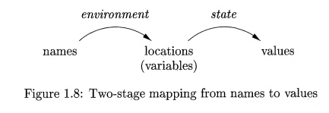
ENVIRONMENTS AND STATES :-
Another important distinction we must make when discussing programming languages is whether changes occurring as the program runs a affect the values of data elements or affect the interpretation of names for that data.
The association of names with locations in memory (the store) and then with values can be described by two mappings that change as the program runs
1. The environment is a mapping from names to locations in the store. Since variables refer to locations (\l-values” in the terminology of C), we could alternatively define an environment as a mapping from names to variables.
2. The state is a mapping from locations in store to their values. That is, the state maps l-values to their corresponding r-values, in the terminology of C.
Environments change according to the scope rules of a language

Slide 18
EXAMPLE: 1
Int I; /* global I*/
….
void f(….) {
int i; /* local I */
…..
i= 3; /* use of local I */
….
}
….
x= i + 1; /* use of global I */

Slide 19
The environment and state mappings in Fig. 1.8 are dynamic, but there are a few exceptions:
Static versus dynamic binding of names to locations. Most binding of names to locations is dynamic, and we discuss several approaches to this binding throughout the section. Some declarations, such as the global I in Fig. 1.9, can be given a location in the store once and for all, as the compiler generates object code.
2. Static versus dynamic binding of locations to values. The binding of locations to values (the second stage in Fig. 1.8), is generally dynamic as well, since we cannot tell the value in a location until we run the program. Declared constants are an exception. For instance, the C definition.

Slide 20
Static Scope and Block Structure :
Most languages, including C and its family, use static scope.
The scope rules for C are based on program structure.
the scope of a declaration is determined implicitly by where the declaration appears in the program.
Later languages, such as C++, Java, and C#, also provide explicit control over scopes through the use of keywords like public, private, and protected.
In this section we consider static-scope rules for a language with blocks,where a block is a grouping of declarations and statements.
C uses braces { and} to delimit a block; the alternative use of begin and end for the same purpose dates back to Algol.

Slide 21
EXAMPLE:
To a first approximation, the C static-scope policy.
1. A C-program consists of a sequence of top-level declarations of variables and functions.
2. Functions may have variable declarations within them, where variables include local variables and parameters. The scope of each such declaration is restricted to the function in which it appear.
3.The scope of a top-level declaration of a name x consists of the entire program that follows, with the exception of those statements that lie within a function that also has a declaration of x.

Slide 22
Explicit Access Control:
Classes and structures introduce a new scope for their members.If P is an object of a class with field(member)x, then the use of x in p:x refers to field x in the class defination.
In analogy with block structure, the scope of a member declaration x in a class C extends to any subclass C` , except if C` has a local declaration of the same name x.
Through the use of keywords like public, private, and protected, ob jectoriented languages such as C++ or Java provide explicit control over access to member names in a superclass.
These keywords support encapsulation by restricting access.
Thus, private names are purposely given a scope that includes only the method declarations and definitions associated with that class and any \friend” classes (the C++ term).
Protected names are accessible to subclasses.Public names are accessible from outside the class.

Slide 23
Dynamic Scope:
Technically, any scoping policy is dynamic if it is based on factor(s) that can be known only when the program executes.
The term dynamic scope, however, usually refers to the following policy: a use of a name x refers to the declaration of x in the most recently called, not-yet-terminated, procedure with such a declaration.
Dynamic scoping of this type appears only in special situations.
We shall consider two examples of dynamic policies: macro expansion in the C preprocessor and method resolution in object-oriented programming.

Slide 24
In the C program identifier a is a macro that stands for expression (x +1). But what is x? We cannot resolve x statically, that is, in terms of the program text.
#define a (x+1)
int x = 2;
void b() { int x = 1; printf(“%d\n”, a); }
void c() { printf(“%d\n”, a); }
void main() { b(); c(); }

Slide 25
Parameter Passing Mechanisms:
All programming languages have a notion of procedure,but they can differ in how these procedures get their arguments.
We shall consider how the actual parameters (the parameters used in the call of a procedure) are associated with the formal parameters (those used in the procedure definition).
Which mechanism is used determines how the calling-sequence code treats parameters. The great majority of languages use either “call-by-value” or “call-by-reference” or both.
We shall explain these terms, and another method known as “call-by-name” that is primarily of historical interest.

Slide 26
Call by value :
In call-by-value, the actual parameter is evaluated (if it is an expression) or copied (if it is a variable).
The value is placed in the location belonging to the corresponding formal parameter of the called procedure.
This method is used in C and Java, and is a common option in C++, as well as in most other languages Call-by-value has the ect that all computation involving the formal parameters done by the called procedure is local to that procedure, and the actual parameters themselves cannot be changed.

Slide 27
Parameter passing mechanism:
Call-By-Reference:
In call-by-reference, the address of the actual parameter is passed to the callee as the value of the corresponding formal parameter.
Uses of the formal parameter in the code of the callee are implemented by following this pointer to the location indicated by the caller.
Changes to the formal parameter thus appear as changes to the actual parameter.

Slide 28
Call-By-Name:
A mechanism call-by-name was used in the early programming language Algol 60. It requires that the callee execute as if the actual parameter were substituted literally for the formal parameter in the code of the callee, as if the formal parameter were a macro standing for the actual parameter (with renaming of local names in the called procedure, to keep them distinct).
When the actual parameter is an expression rather than a variable, some unintuitive behaviors occur, which is one reason this mechanism is not favored today.

Slide 29
Aliasing:
There is an interesting consequence of call-by-reference parameter passing or its simulation, as in Java, where references to objects are passed by value.
It is possible that two formal parameters can refer to the same location; such variables are said to be aliases of one another.
As a result, any two variables, which may appear to take their values from two distinct formal parameters, can become aliases of each other, as well.

Slide 30
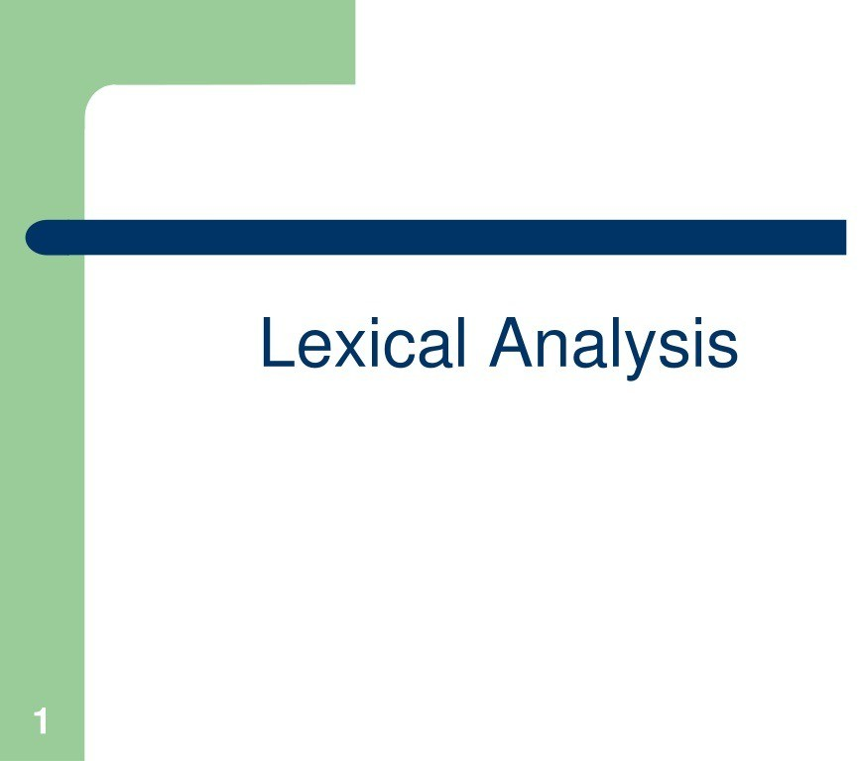

Slide 31
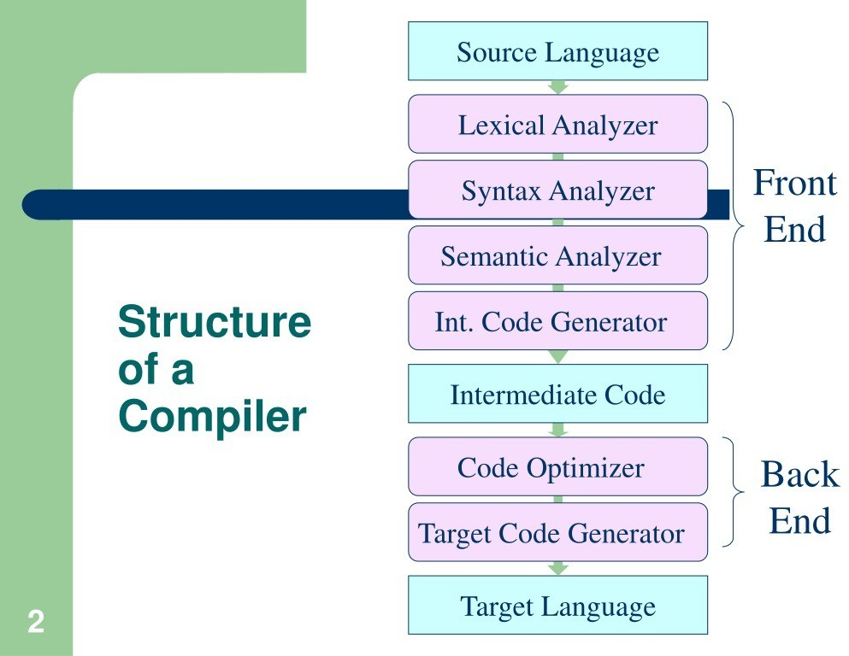

Slide 32
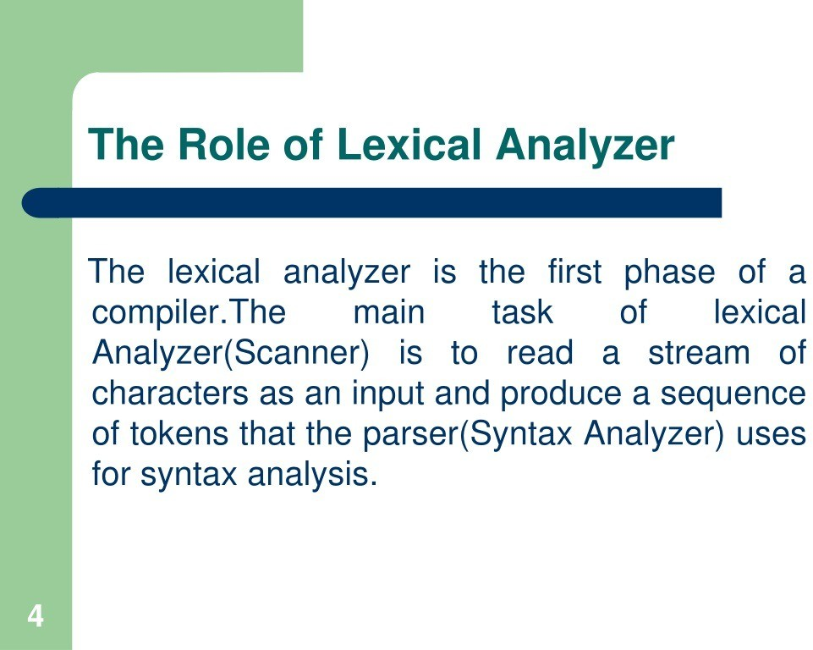

Slide 33
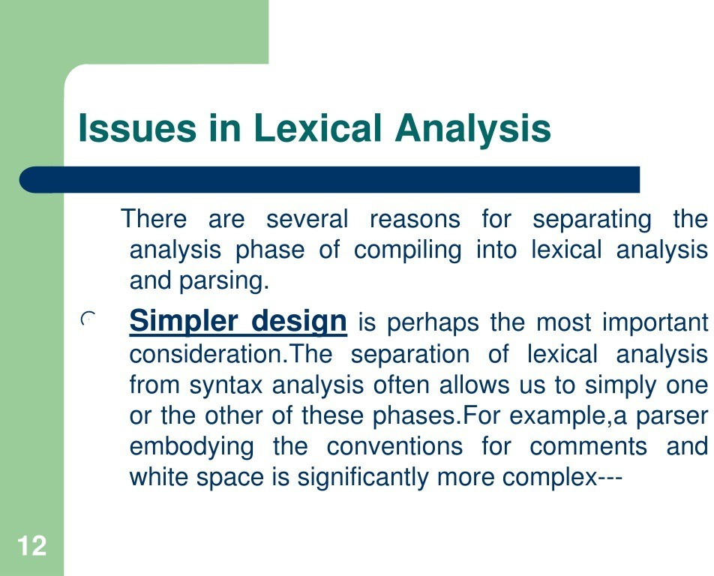

Slide 34
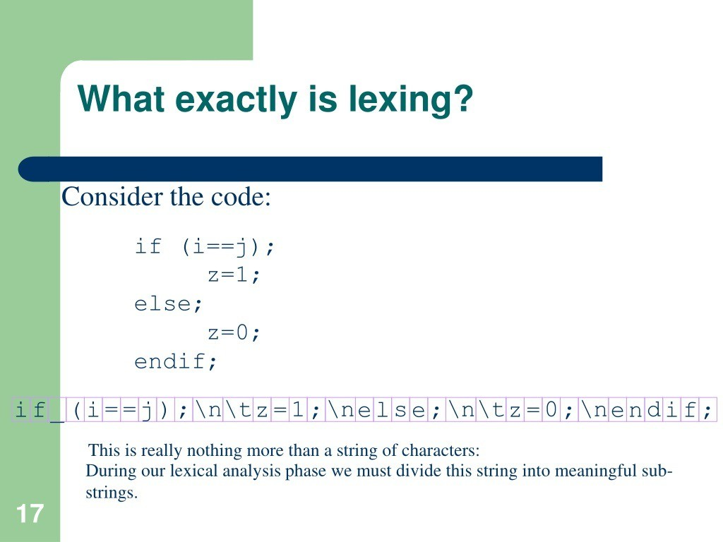

Slide 35
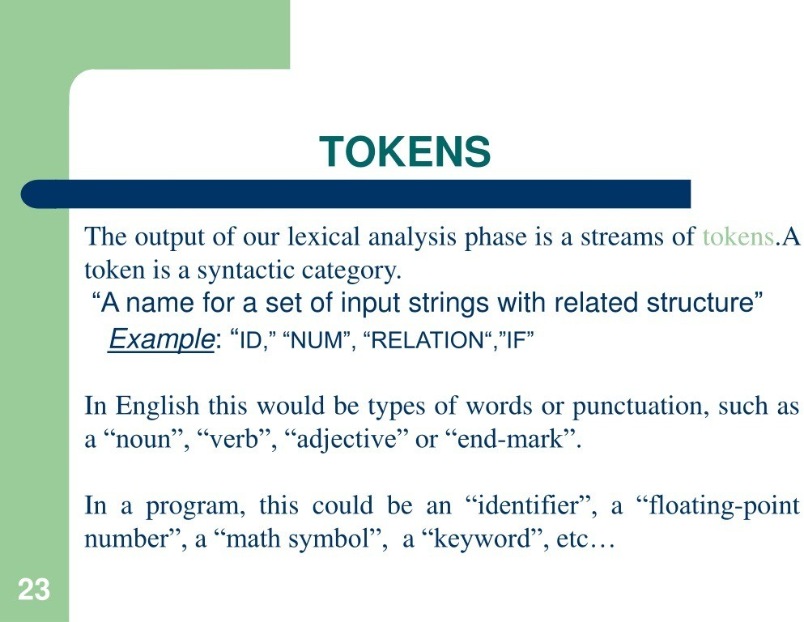

Slide 36
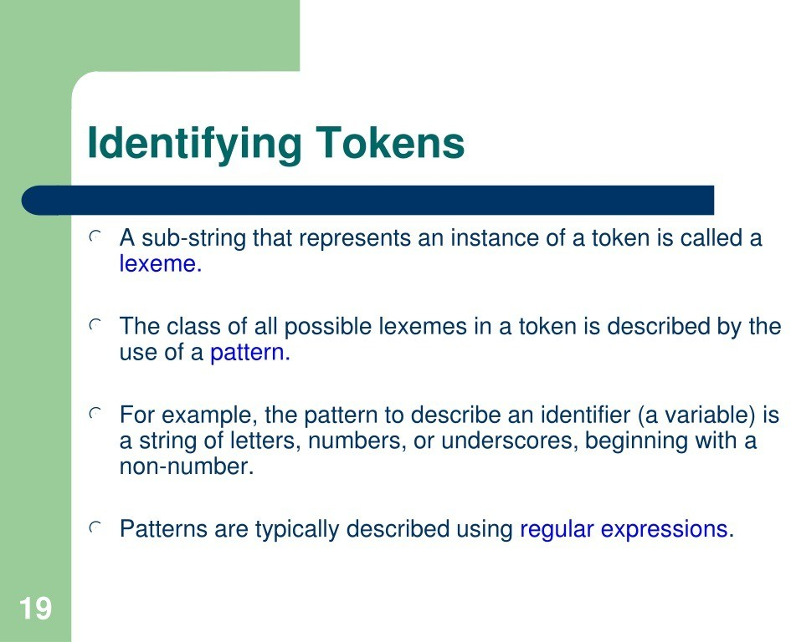

Slide 37
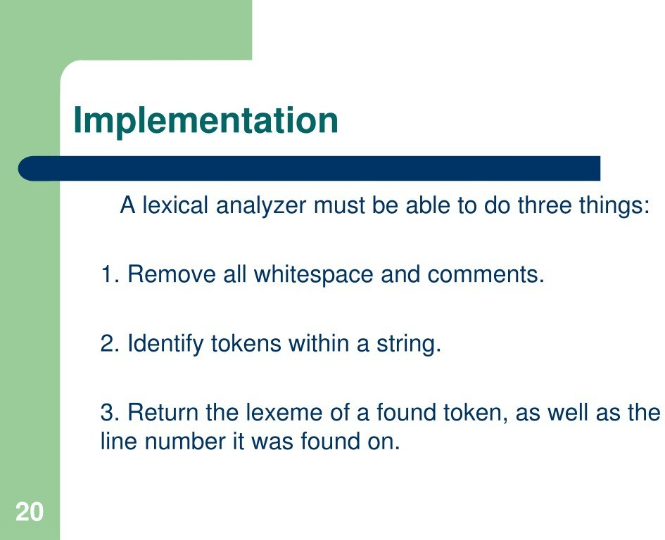

Slide 39
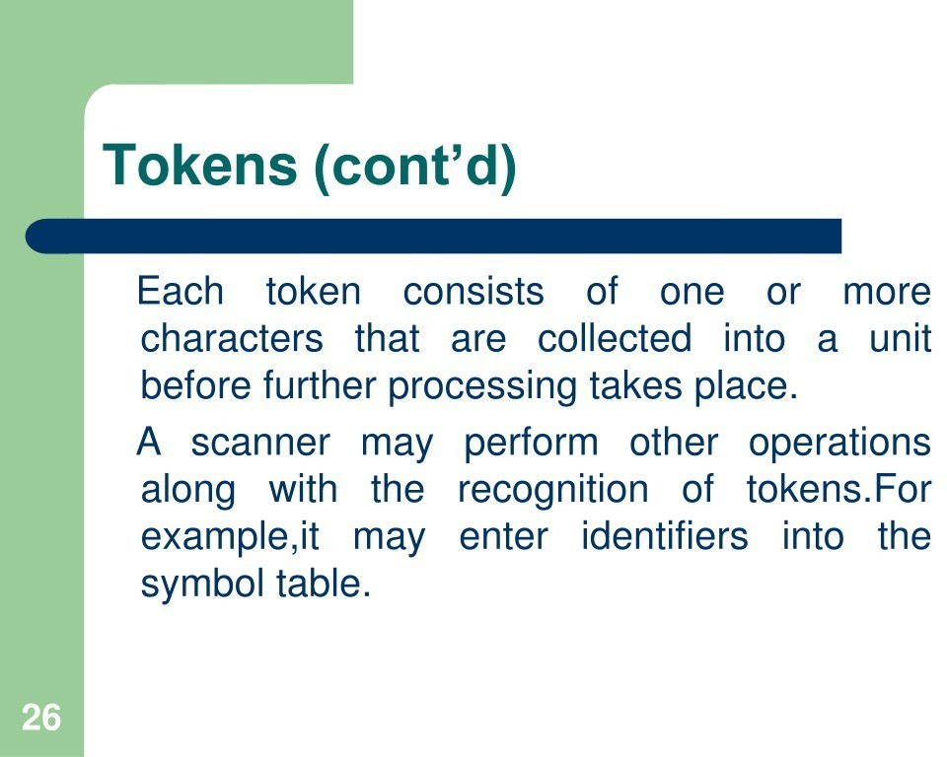

Slide 40
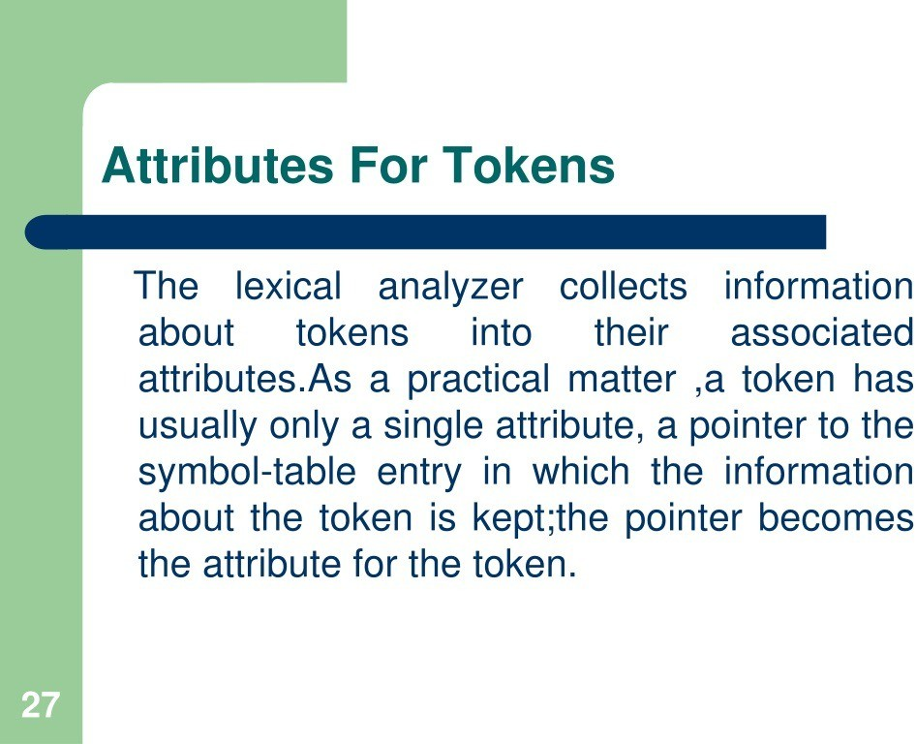

Slide 41
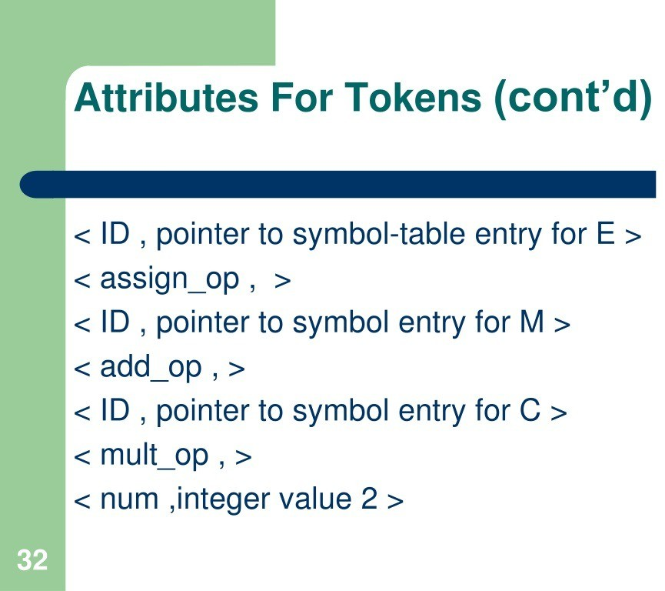

Slide 42
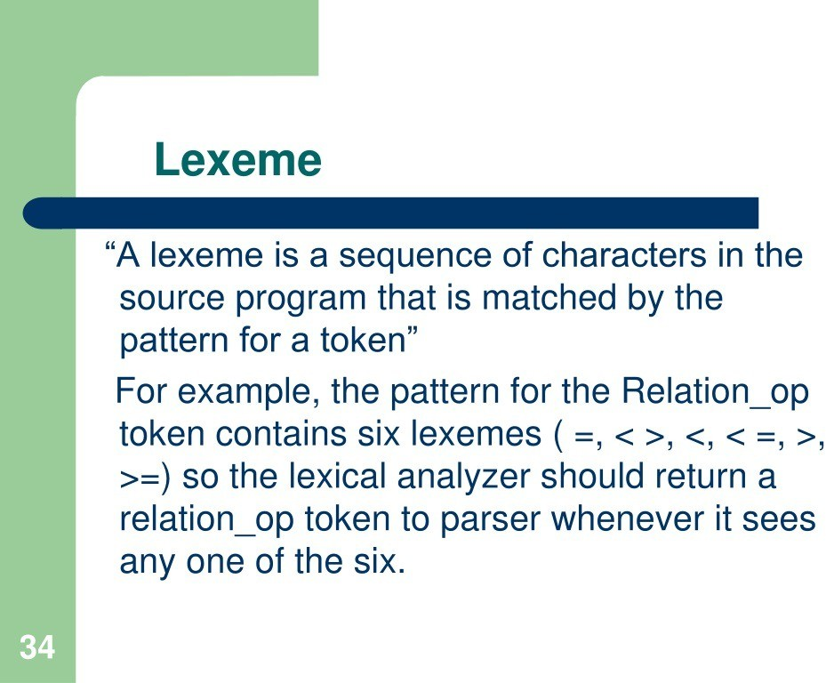

Slide 43
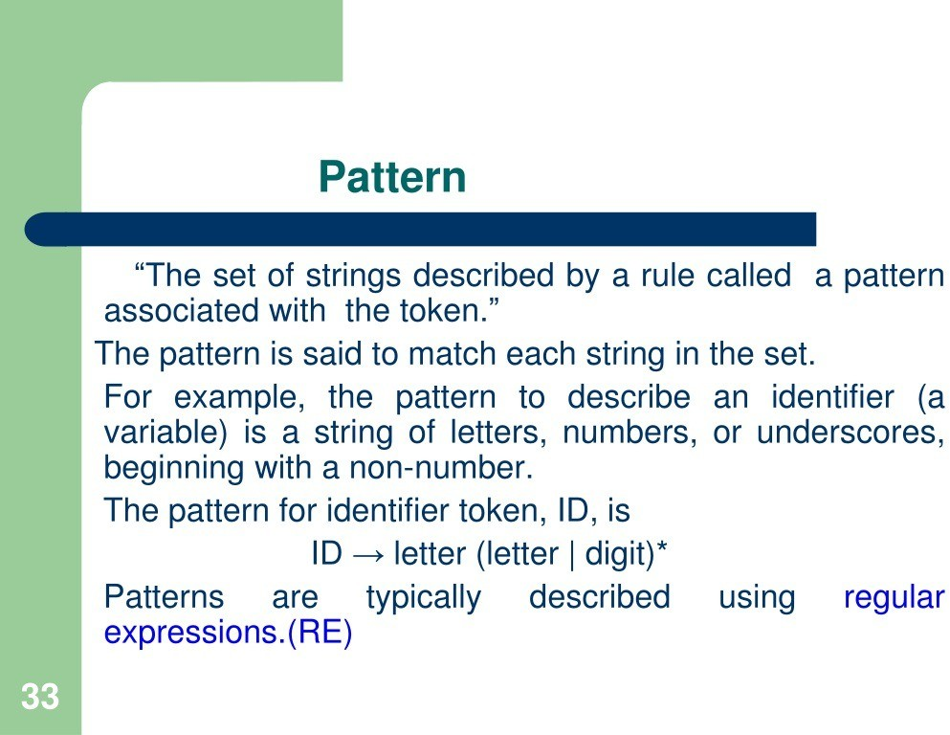

Slide 44
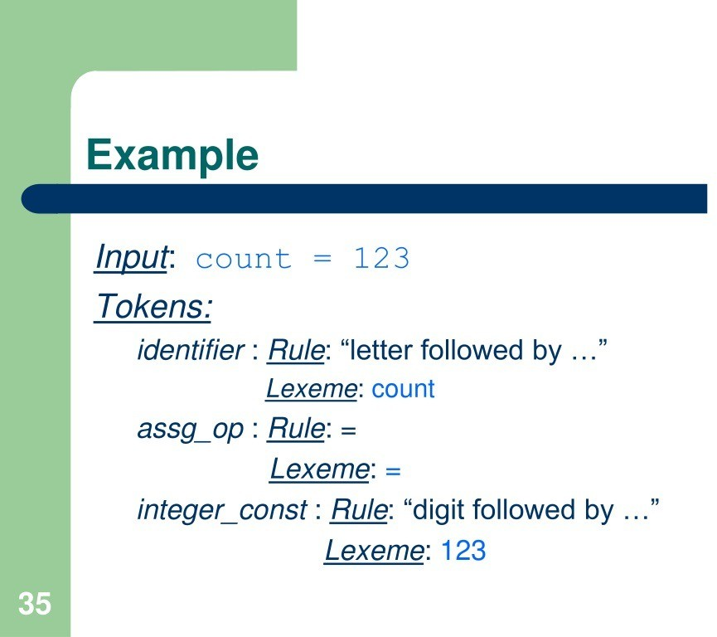

Slide 45
Contents:
Input Buffering
Types
Advantage
Disadvantage
Buffering Pairs
Sentinels
Conclusion

Slide 46
Input Buffering:
The lexical analyzer scans the input from left to right one character at a time.
The basic idea behind input buffering is to read a block of input from the source code into a buffer, and then process that buffer before reading the next block.
The size of the buffer can vary depending on the specific needs of the compiler and the characteristics of the source code being compiled.
For example, a compiler for a high-level programming language may use a larger buffer than a compiler for a low-level language, since high-level languages tend to have longer lines of code.

Slide 47
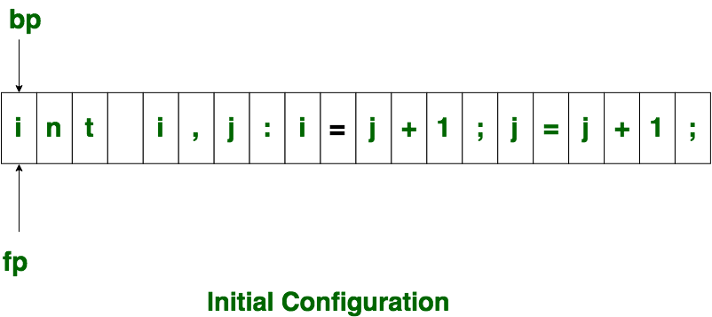
Input Buffering:
It uses two pointers begin ptr(bp) and forward ptr(fp) to keep track of the pointer of the input scanned.
The forward ptr moves ahead to search for end of lexeme.
In above example as soon as ptr (fp) encounters a blank space the lexeme “int” is identified.
The fp will be moved ahead at white space, when fp encounters white space, it ignore and moves ahead.
The input character is thus read from secondary storage, but reading in this way from secondary storage is costly. hence buffering technique is used.

Slide 48
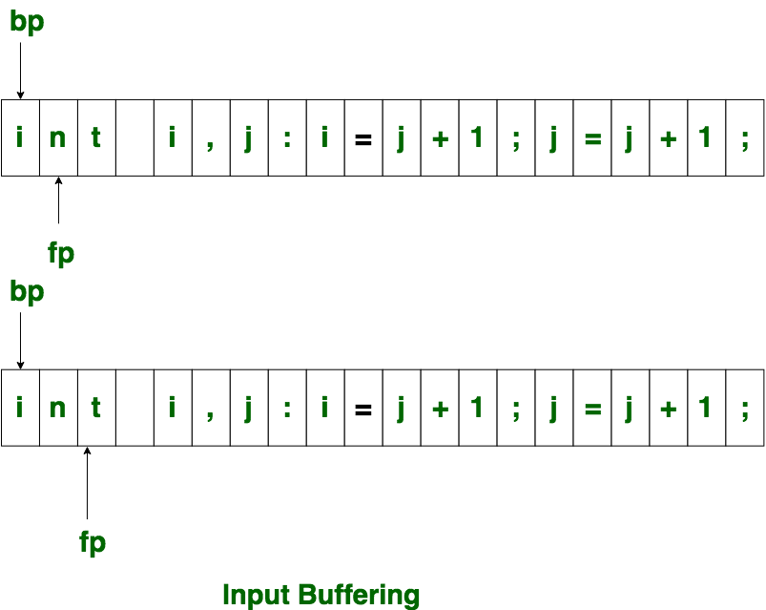
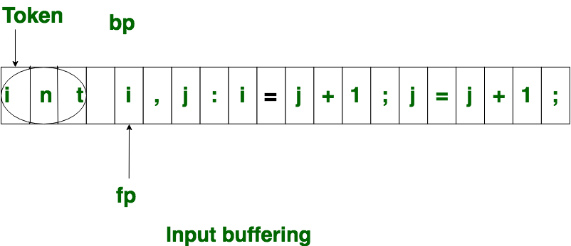
Input Buffering:

Slide 49
Types:
One Buffer Scheme: In this scheme, only one buffer is used to store the input string but the problem with this scheme is that if lexeme is very long then it crosses the buffer boundary,
To scan rest of the lexeme the buffer has to be refilled, that makes overwriting the first of lexeme.
Two Buffer Scheme: To overcome the problem of one buffer scheme, in this method two buffers are used to store the input string. the first buffer and second buffer are scanned alternately.
when end of current buffer is reached the other buffer is filled.
The only problem with this method is that if length of the lexeme is longer than length of the buffer then scanning input cannot be scanned completely.

Slide 50
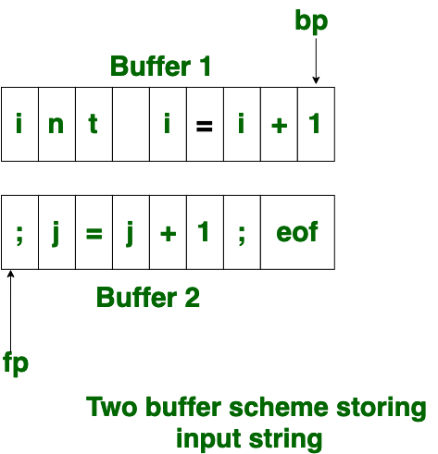
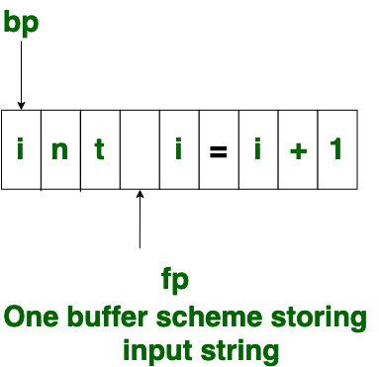
Types:

Slide 51
Advantages:
Reduced I/O operation
Improved performance
Minimized disk access
Flexible buffer management
Error recovery
Enhanced locality

Slide 52
Disadvantages:
Latency in error detection
Complexity in handling variable length tokens
Limited adaptability
Impact on responsiveness
Difficulty in parallelization
Increased memory usage

Slide 53
Buffer Pairs:
Specialized buffering techniques were developed to reduce the amount of overhead required to process an input character because of the large amount of time that is consumed in shifting characters.
“input buffer,” is responsible for reading characters from the source file or input stream.
This buffer is continuously filled with characters as they are read from the source, ensuring a steady supply of characters for lexeme recognition.
“output buffer” stores the characters grouped together as lexemes. This buffer allows the compiler to accumulate characters until a complete lexeme is recognized.
Once a lexeme is identified, it is passed on for tokenization and further processing.

Slide 54
Buffer pairs helps in:
Efficient Character Reading: The input buffer continuously reads characters from the source, minimizing the overhead of repeatedly fetching characters from the input source.
Lexeme Accumulation: The output buffer allows characters to be grouped together into lexemes efficiently, reducing the number of times lexeme recognition needs to occur.
Smoothing Input Variations: Buffer pairs can help smooth variations in input speed. They read characters at a consistent rate, allowing the compiler to operate more predictably.

Slide 55
Sentinels:
Sentinels play a vital role in managing buffer pairs effectively. A sentinel is a special character, often used at the end of the input buffer, to mark its boundaries.
Boundary Detection: Sentinels provide a clear demarcation between the end of the input buffer and the start of the output buffer.
This ensures that the compiler knows where to stop reading characters and where to begin forming lexemes.
Safety Against Buffer Overflow: Sentinels act as guards against buffer overflow. By signaling the end of the input buffer, they prevent
The input buffer from overflowing into the output buffer, which could lead to data corruption and unpredictable behavior.

Slide 56
Conclusion:
Input buffering in compiler design, understanding the role of buffer pairs and sentinels is crucial for building efficient and robust compilers.
These concepts are the backbone of input buffering, ensuring that source code is processed accurately and swiftly.
Buffer pairs, consisting of input and output buffers, streamline character reading and lexeme accumulation.
Sentinels act as guardians, marking the boundaries between these buffers and preventing data corruption.
Together, they lay the foundation for efficient input buffering, which, in turn, contributes to the accurate specification of tokens in compiler design.

Slide 57
SPECIFICATION OF TOKEN IN COMPILER DESIGN
In compiler design, there are three specifications of token-
String
Language
Regular Expressions

Slide 58
Strings
Strings are a finite set of symbols or characters. These symbols can be a digit or an alphabet.
There is also an empty string which is denoted by ε.

Slide 59
Operations on String
The operations that can be performed on a string are-
Prefix
Suffix
Substring
Subsequence
Concatenation

Slide 60
1. Prefix
The prefix of String S is any string that is extracted by removing zero or more characters from the end of string S.
For example, if the String is "NINJA", the prefix can be "NIN" which is obtained by removing "JA" from that String. A string is a prefix in itself.
Proper prefixes are special types of prefixes that are not equal to the String itself or equal to ε. We obtain it by removing at least one character from the end of the String.

Slide 61
2. Suffix
The suffix of string S is any string that is extracted by removing any number of characters from the beginning of string S.
For example, if the String is "NINJA", the suffix can be "JA," which is obtained by removing "NIN" from that String. A string is a suffix of itself.
Proper suffixes are special types of suffixes that are not equal to the String itself or equal to ε. It is obtained by removing at least one character from the beginning of the String.

Slide 62
3. Substring
A substring of a string S is any string obtained by removing any prefixes and suffixes of that String.
For example, if the String is "AYUSHI," then the substring can be "US," which is formed by removing the prefix "AY" and suffix "HI." Every String is a substring of itself.
Proper substrings are special types that are not equal to the String itself or equal to ε. It is obtained by removing at least one prefix or suffix from the String.

Slide 63
4. Subsequence
The subsequence of the String is a string obtained by eliminating zero or more symbols from the String. The symbols that are removed need not be consecutive.
For example, if the String is "NINJAMANIA," then a subsequence can be "NIJAANIA," which is produced by removing "N" and "M."
Proper subsequences are special subsequences that are not equal to the String itself or equal to ε. It is obtained by removing at least one symbol from the String.

Slide 64
5. Concatenation
Concatenation is defined as the addition of two strings. For example, if we have two strings S=" Cod" and T=" ing," then the concatenation ST would be "Coding."

Slide 65
2. Language
A language can be defined as a finite set of strings over some symbols or alphabets.
Operations on Language
Union
Concatenation
Kleene closure
Positive Closure

Slide 66
Union
Union is one of the most common operations we perform on a set. In terms of languages also, it will hold a similar meaning.
Suppose there are two languages, L and S. Then the union of these two languages will be
L ∪ S will be equal to { x | x belongs to either L or S }
For example If L = {a, b} and S = {c, d}Then L ∪ S = {a, b, c, d}

Slide 67
Concatenation
Concatenation links two languages by linking the strings from one language to all the strings of the other language.
If there are two languages, L and S, then the concatenation of L and S will be LS equal to { ls | where l belongs to L and s belongs to S }.
For example, there are two languages, L and S, such that { L`, L"} is the set of strings belonging to language L and { S,` S, "S`"} is the set of strings belonging to language S.
Then the concatenation of L and S will be LS will be {L'S`, L'S ", L``S`, L``S "}

Slide 68
Kleene closure
Kleene closure of a language L is denoted by L*provides a set of all the strings that can be obtained by concatenating L zero or more times.
If L = {a, b}
then L* = {ε, a, b, aa, bb, aaa, bbb, …}

Slide 69
Positive Closure
L+ denotes the Positive closure of a language L and provides a set of all the strings that can be obtained by concatenating L one or more times.
If L = {a, b}
then L+ = {a, b, aa, bb, aaa, bbb, …}

Slide 70
Regular Expression
Regular expressions are strings of characters that define a searching pattern with the help of which we can form a language, and each regular expression represents a language.
A regular expression r can denote a language L(r) which can be built recursively over the smaller regular expression by following some rules.

Slide 71
Writing Regular Expressions
Writing Regular Expressions
Following symbols are used very frequently to write regular expressions
The asterisk symbol ( * ): It is used in our regular expression to instruct the compiler that the symbol that preceded the * symbol can be repeated any number of times in the pattern. For example, if the expression is ab*c, then it gives the following string- ac, abc, abbc, abbbc, abbbbbc.. and so on.

Slide 72
The plus symbol ( + ): It is used in our regular expression to tell the compiler that the symbol that preceded + can be repeated one or more times in the pattern. For example, if the expression is ab+c, then it gives the following string- abc, abbc, abbbc, abbbbbc.. and so on.
Wildcard Character ( . ): The. A symbol, also known as the wildcard character, is a character in our regular expression that can be replaced by another character.

Slide 73
Character Class: It is a way of representing multiple characters. For example, [a – z] denotes the regular expression a | b | c | d | ….|z.
The following rules are used to define a regular expression r over some alphabet Σ and the languages denoted by these regular expressions.
The ε is a regular expression that denotes a language L(ε). The language L(ε) has a set of strings {ε} which means that this language has a single string which is the empty String.

Slide 74
If there is a symbol 'a' in Σ, then 'a' is a regular expression that denotes a language L(a). The language L(a) = {a}, i.e., the language has only one String of length, and the String holds 'a' in the first position.
Consider the two regular expressions r and s then:
r|s denotes the language L(r) ∪ L(s).
(r) (s) denotes the language L(r) ⋅ L(s).
(r)* denotes the language (L(r))*.
(r)+ denotes the language L(r)

Slide 75
Recognition of Tokens
Recognition of Tokens refers to the process of identifying and categorizing individual
units of a programming language, known as tokens, from the source code.
Tokens are the building blocks of a programming language and represent the smallest
units of meaning.
The recognition of tokens is a crucial step in the lexical analysis phase of a compiler.
Tokens obtained during lexical analysis are recognized by Finite Automata.
Finite Automata (FA): The primary task of an FA is to used to recognize patterns ( accept or reject an input based on whether the defined pattern occurs within
the input).

Slide 76
There are two notations for representing Finite Automata.
They are:
Transition Table
Transition Diagram
Transition Table :
is a data structure that represents the transitions between
different states in a finite automaton used for
recognizing tokens.
Example 1:
int a = 10; //No of Tokens 5
Tokens int (keyword), a(identifier), =(operator), 10(constant)
and ;(punctuation-semicolon)

Slide 77
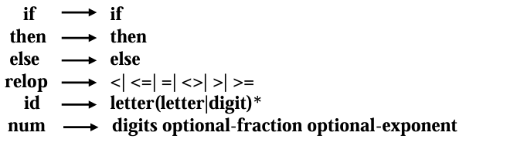
1.Grammar Rules:
The grammar fragment includes rules for constructing sentences in the language. The rules involve conditional statements (`if expr then stmt`), optional else clauses (`else stmt`), expressions (`term relop term`, `term expr`), identifiers (`id`), and numbers (`num term`).
2. Lexical Definitions:
The lexical definitions specify how keywords and lexemes (basic units of meaning) are formed in the language. For example, `if`, `then`, and `else` are keywords, and `relop`, `id`, and `num` are lexemes representing relational operators, identifiers, and numbers, respectively.
Example:
Where:
- `letter` represents a letter of the alphabet.
- `digits` represent a sequence of digits (0-9).
- `optional-fraction` represents an optional decimal fraction part of a number.
- `optional-exponent` represents an optional exponent part of a number.

Slide 78

3. Whitespace Handling:
Whitespace handling is crucial for token recognition. The text introduces the concept of a delimiter (`delim`), representing blanks, tabs, and newlines.
The regular definition `ws` specifies how whitespace is recognized, ensuring that it is ignored by the lexical analyzer.
The lexical analyzer will strip out white space. It will do so by comparing a string against the regular definition ws, below.

Slide 79
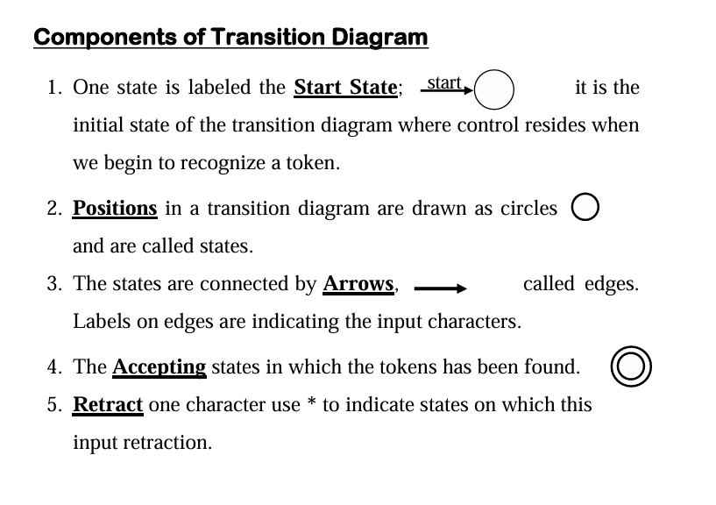
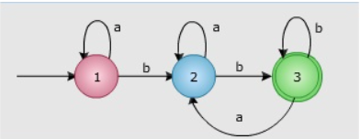
Transition Diagrams (TD)
The TD uses to keep track of information about characters that are seen as the forward pointer scans the input.
Example:

Slide 80
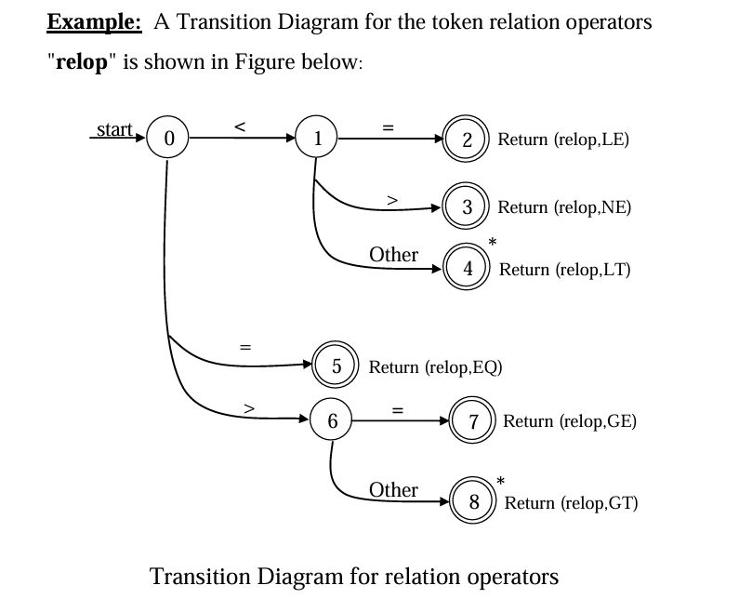
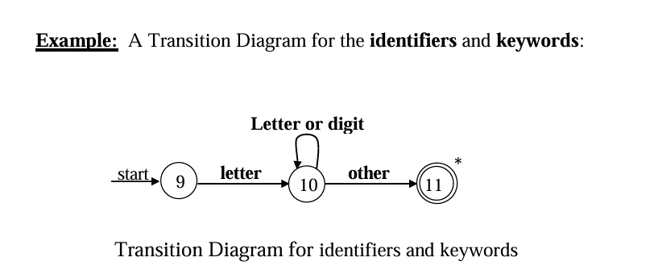

Slide 81
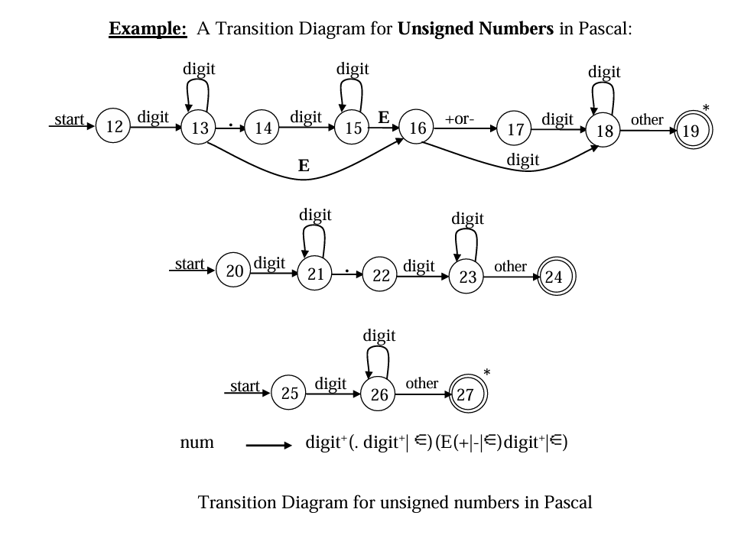

Slide 82
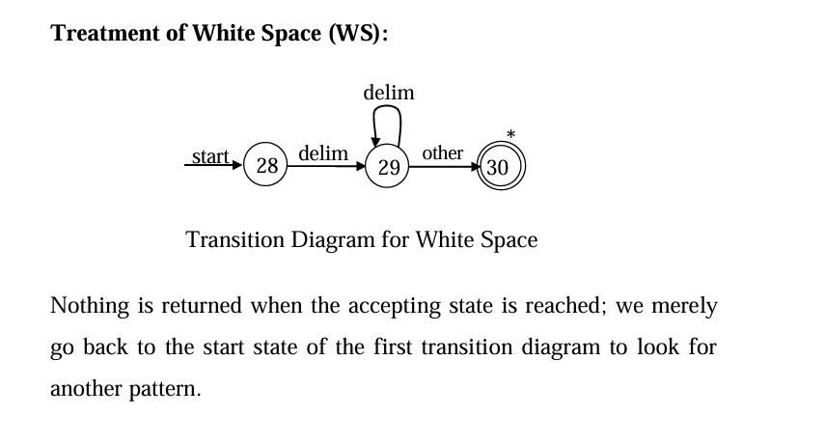

Slide 83
CONCLUSION :
Token recognition is a fundamental aspect of compiler design, playing a crucial role in the transformation of source code into executable form.
It requires careful consideration of language specifications, efficient algorithms, and error-handling strategies to ensure the successful compilation of programs.
The integration of token recognition with subsequent compiler phases is essential for a smooth and effective compilation process.

