Slide 1
UNIT- 1
Introduction: Meaning of Research, Objectives of Engineering Research, and Motivation in Engineering Research, Research Process, Types of Engineering Research, Finding and Solving a Worthwhile Problem.
Ethics in Engineering Research, Ethics in Engineering Research Practice, Types of Research Misconduct, Ethical Issues Related to Authorship. Copyright Infringements. Copyright Infringement is a Criminal Offence. Copyright Registration.
Books Referred:
Engineering Research Methodology by Dipankar Deb, Rajeeb Dey, Valentina E. Balas
Intellectual Property A Primer for Academia by Prof. Rupinder Tewari Ms. Mamta Bhardwaj.
Research Methodology by C R Kothari
Prepared By:
Ms. Vidya. R, Asst. Prof. Dept. of MBA, Dr.AIT

Slide 2
Research Definitions:
The word research is derived from the Middle French "recherche", which means "to go about seeking"
Research is "creative and systematic work undertaken to increase the stock of knowledge"
The systematic investigation into and study of materials and sources in order to establish facts and reach new conclusions.
According to Kothari (2004), defines that the research is an original contribution to the existing stock of knowledge making for its development. The systematic approach concerning generalizations and formulation of a theory is also research.

Slide 3
Research consists of:
Asking a question that nobody has asked before;
Doing the necessary work to find the answer; and
Communicating the knowledge you have acquired to a larger audience.

Slide 4
Objectives of Engineering Research
To acquire the ability to connect different areas.
Nourishment and Exercise for the Mind
Adding (maybe small and specific, yet original) contribution to that of existing body of knowledge.
To gain familiarity with a phenomenon or to achieve new insights into it
To solve a problem
A Way to Prove Lies and to Support Truths
To determine the frequency with which something occurs or with which it is associated with something else
To test a hypothesis of a causal relationship between variables
Means to Find, Gauge, and Seize Opportunities
Means to Understand Various Issues and Increase Public Awareness

Slide 5
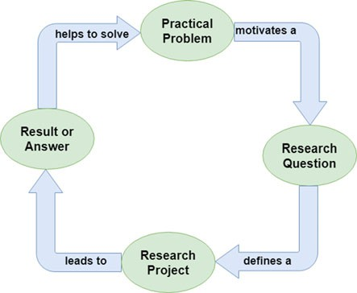
Research Flow Diagram

Slide 6
Motivation in Engineering Research
Intrinsic motivations like interest, challenge, learning, meaning, purpose, are linked to strong creative performance.
Extrinsic motivating factors like rewards for good work include money, fame, awards, praise, and status are very strong motivators, but may block creativity. For example: Research outcome may enable obtaining a patent which is a good way to become rich and famous.
Influences from others like competition, collaboration, commitment, and encouragement are also motivating factors in research. For example: my friends are all doing research and so should I, or, a person that I dislike is doing well and I want to do better.
Personal motivation in solving unsolved problems, intellectual joy, service to community, and respectability are all driving factors.
Wanting to do better than what has been achieved in the world.
Improve the state of the art in technology.
Contribute to the improvement of society.
Fulfillment of the historical legacy in the immediate sociocultural context.

Slide 7
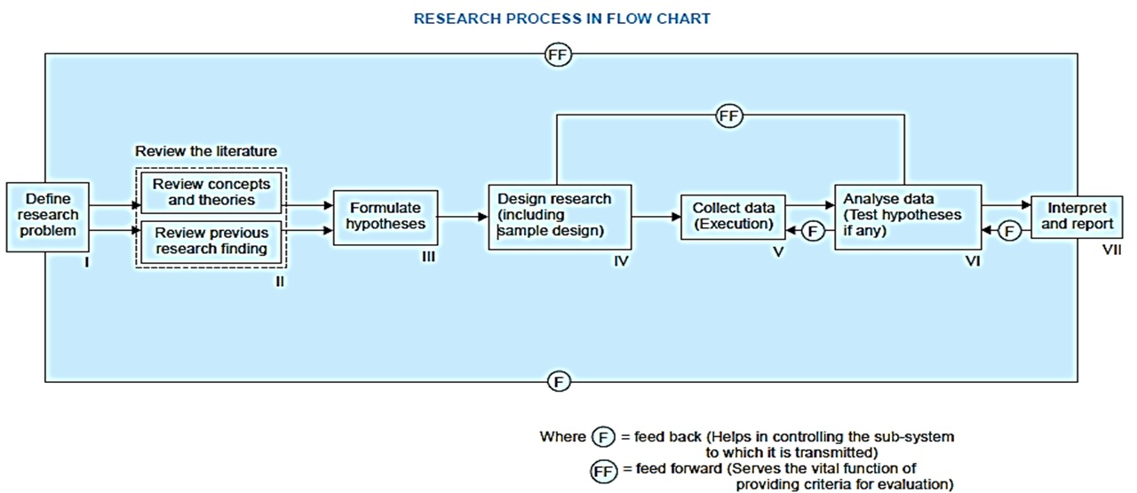
Research Process

Slide 8
Types of Engineering Research
Descriptive/ Ex post facto Research
Analytical Research
Fundamental/ Basic/ Pure Research
Applied Research
Quantitative Research
Qualitative Research

Slide 9
Descriptive research/ Ex post facto Research
Simplest form of research.
Descriptive research includes comparative and correlational methods, and fact-finding inquiries, to effectively describe the present state of art.
Restricted to the problems that are describable and not arguable and the problems in which valid standards can be developed for standards.
Existing theories can be easily put under test by empirical observations.
It is not directed by hypothesis.
Ex: implications of Blockchain technology, Implications of AI in Healthcare.

Slide 10
Analytical Research
The researcher has to use facts or information already available, and analyse these to make a critical evaluation of the material.
It involves the in-depth study and evaluation of available information in an attempt to explain complex phenomenon.
It primarily concerned with testing hypothesis and specifying and interpreting relationships, by analyzing the facts or information already available.
Ex: Analysis of Attrition Studies Within the Computer Sciences.

Slide 11
Fundamental/ Basic/ Pure Research
This research is mainly concerned with generalisations and with the formulation of a theory.
“Gathering knowledge for knowledge’s sake is termed ‘pure’ or ‘basic’ research.”
Research concerning some natural phenomenon or relating to pure mathematics are examples of fundamental research.
Similarly, research studies, concerning human behaviour carried on with a view to make generalisations about human behaviour, are also examples of fundamental research.
Thus basic research is aimed at seeking information which could have a broad base of applications in the medium to long term.

Slide 12
Applied Research
Based on the concept of the pure research.
Is problem oriented and helps in finding results or solutions for real life problems.
Provides evidence of usefulness to society.
Helps in testing empirical content of a theory.
Utilizes and helps in developing the techniques that can be used for basic research.
Provides data that can lead to the acceleration of the process of generalization.

Slide 13
Quantitative Research
Quantitative research is based on the measurement of quantity or amount. It is applicable to phenomena that can be expressed in terms of quantity.
It uses statistical observations of a sufficiently large number of representative cases to draw any conclusions
The goal of quantitative methods is to determine whether the predictive generalizations of a theory hold true.
Qualitative Research:
It is concerned with qualitative phenomenon, i.e., phenomena relating to or involving quality or kind.
This type of research aims at discovering the underlying motives and desires, using in depth interviews for the purpose

Slide 14
Finding and Solving a Worthwhile Problem
Research problems stated by the Supervisor
Research problems posed by others that are yet to be solved
Rethinking of a basic theory, or need to be formulated
Information gathered from research papers
Attributes Of Worthwhile Research Problem
Significant
Researchable
Original/ Replicable
Ethical
Suitable for researcher
Potential for new research

Slide 15
Mathematical problem-solving
George Polya an American mathematician suggested 4 step procedure:
Understand the problem, restate it as if its your own, visualize the problem by drawing figures, and determine if something more is needed.
Start somewhere and systematically explore possible strategies to solve the problem or a simpler version of it while looking for patterns.
Execute the plan to see if it works, and if it does not then start over with another approach. Having delved into the problem and returned to it multiple times, one might have a flash of insight or a new idea to solve the problem.
Looking back and reflecting helps in understanding and assimilating the strategy, and is a sort of investment into the future.

Slide 16
Ethics in Engineering Research
Ethics are branch of knowledge that deals with moral principles(distinguishing what is right or wrong)
Engineering ethics is the field of system of moral principles that apply to the practice of engineering. The field examines and sets the obligations by engineers to society, to their clients, and to the profession.
International norms for the ethical conduct of research have been there since the adoption of the Nuremberg Code in 1947
According to Dr. Caroline Whitbeck, Director of online Ethics Center for Engineering and Science at national Academy of engineering, the issues related to research credit dates back to the establishment of the British Royal Society (BRS) in the seventeenth century to refine the methods and practices of modern science.
This event altered the timing and credit issues on the release of research results since BRS gave priority to whoever first submitted findings for publication, rather than trying to find out who had first discovered.
This event altered the timing and credit issues on the release of research results since BRS gave priority to whoever first submitted findings for publication, rather than trying to find out who had first discovered.

Slide 17
Ethics in Engineering Research Practice
Honesty:
Honestly report data, results, methods and procedures, and publication status. Do not fabricate, falsify, or misrepresent data.
Integrity:
Keep your promises and agreements; act with sincerity; strive for consistency of thought and action.
Carefulness:
Avoid careless errors and negligence; carefully and critically examine your own work and the work of your peers. Keep good records of research activities.
Openness:
Share data, results, ideas, tools, resources. Be open to criticism and new ideas.
Respect for Intellectual Property:
Honour patents, copyrights, and other forms of intellectual property. Do not use unpublished data, methods, or results without permission. Give credit where credit is due. Never plagiarize.
Confidentiality:
Protect confidential communications, such as papers or grants submitted for publication, personnel records, trade or military secrets, and patient records.
Responsible Publication:
Publish in order to advance research and scholarship, not to advance just your own career. Avoid wasteful and duplicative publication.

Slide 18
Responsible Mentoring:
Help to educate, mentor, and advise students. Promote their welfare and allow them to make their own decisions.
Respect for Colleagues:
Respect your colleagues and treat them fairly.
Social Responsibility:
Strive to promote social good and prevent or mitigate social harms through research, public education, and advocacy.
Non-Discrimination:
Avoid discrimination against colleagues or students on the basis of sex, race, ethnicity, or other factors that are not related to their scientific competence and integrity.
Competence:
Maintain and improve your own professional competence and expertise through lifelong education and learning; take steps to promote competence in science as a whole.
Legality:
Know and obey relevant laws and institutional and governmental policies.
Animal Care:
Show proper respect and care for animals when using them in research. Do not conduct unnecessary or poorly designed animal experiments.
Human Subjects Protection:
When conducting research on human subjects, minimize harms and risks and maximize benefits; respect human dignity, privacy, and autonomy.

Slide 19
Types of Research Misconduct
Fabrication (Illegitimate creation of data)
Falsification (Inappropriate alteration of data)
Plagiarism (Taking other’s work and attribution)
Serious deviations from accepted con- duct could be construed as research misconduct. When there is both deception and damage.
Simultaneous submission of the same article to two different journals also violates publication policies.
Mistakes are found in an article or any published content

Slide 20
Authorship questionable on ethical grounds
Guest/ gift authorship
Career-boost authorship
Career-preservation authorship
Ghost authorship
Reciprocal authorship
Recognition only via acknowledgement
Double submission of research work

Slide 21
Ethical Issues Related to Authorship
Academic authorship involves communicating scholarly work, establishing priority for their discoveries, and building peer-reputation.
Credit for research contributions is attributed in three major ways in research publications:
By authorship (of the intended publication),
Citation (of previously published or formally presented work), and
Through a written acknowledgment (of some inputs to the present research).

Slide 22
Introduction to IPR
Intellectual property (IP) refers to creations of the mind, such as inventions; literary and artistic works; designs; and symbols, names and images used in commerce.
Intellectual Property rights provide certain exclusive rights to the inventors or creators of that property, in order to enable them to reap commercial benefits from their creative efforts or reputation. Some of the major are discussed below:
Copyright
Patent
Trademark
Industrial design
Geographical indication (GI)
Trade secrets

Slide 23
Copyright is a legal term used to describe the rights that creators have over their literary and artistic works. (specifically in the fields of literature and computer software) Works covered by copyright range from books, music, paintings, sculpture and films, to computer programs, databases, advertisements, maps and technical drawings. The general rule is that copyright lasts for 60 years. In the case of original literary, dramatic, musical and artistic works the 60-year period is counted from the year following the death of the author. Patent is an exclusive right granted for an invention. Generally speaking, a patent provides the patent owner with the right to decide how - or whether - the invention can be used by others. In exchange for this right, the patent owner makes technical information about the invention publicly available in the published patent document. A patent is granted for a term of 20 (twenty) years from the date of filling of the application. Trademark is a sign capable of distinguishing the goods or services of one enterprise from those of other enterprises. Trademarks date back to ancient times when artisans used to put their signature or "mark" on their products. There are several types of trademarks a business can choose from, including logos, names, taglines, and product brands. However, the use of any mark may be mistaken for an existing one is prohibited. All registered trade-marks are valid for a period of 10 years from the date of application.

Slide 24
Industrial design constitutes the ornamental or aesthetic aspect of an article. A design may consist of three-dimensional features, such as the shape or surface of an article, or of two-dimensional features, such as patterns, lines or color. Examples of industrial designs include the contour of a car hood, the graphical user interface on your phone or the shape of a stylish piece of furniture. The duration of the protection of industrial designs varies from country to country, but it amounts at least to 10 years. Geographical indication (GI) is a sign used on products that have a specific geographical origin and possess qualities or a reputation that are due to that origin. In order to function as a GI, a sign must identify a product as originating in a given place. The registration of a geographical indication shall be for a period of 10 years Examples of possible Indian Geographical Indications are Basmati Rice, Alphanso Mango, Nagpur Orange, Kolhapuri Chappal, Bikaneri Bhujia, Agra Petha, Paithani and Banaras Saree, Feni (Liquor from Goa), Lonavala Chikki, Tirunelveli Halwa, Mysore Rasam, etc. Trade secrets are IP rights on confidential information which may be sold or licensed. The unauthorized acquisition, use or disclosure of such secret information in a manner contrary to honest commercial practices by others is regarded as an unfair practice and a violation of the trade secret protection. Information considered a trade secret gives the company a competitive advantage over its competitors and is often a product of internal research and development. The trade secrets shall be protected without registration for an unlimited period unless the same information is discovered by others. Some examples include: The Google search algorithm, Kentucky Fried Chicken. The secret ingredients for KFC's original recipe were originally kept in Colonel Sanders' head. He eventually wrote the recipe down, and the original handwritten copy is in a safe in Kentucky. Only a few select employees know the recipe, and they are bound by a confidentiality agreement. Coca-Cola made a choice to brand the recipe a trade secret instead of patenting it, which would have led to the disclosure of the ingredients.

Slide 25
Copyright Infringements
Copyright infringement is the use or production of copyright-protected material without the permission of the copyright holder.
Types: Literature, dramatic work, sound recording, artistic work, musical work and cinematographs.
The Copyrights of the creator/author are legally protected under Section 14 of the Copyright Act, 1957.
A Copyright owner enjoys two types of rights i.e. Economic Rights (or Proprietary Rights) and Moral Rights (or Personal Rights).
As per the Copyrights Act, the following acts are regarded as an infringement of Copyrights:
Making copies for sale or hire or selling or letting them for hire without permission.
Permitting any place for the performance of owned work (in public) where such performance constitutes an infringement of Copyright.
Distributing infringing copies for trade or to such an extent to affect the interest of the owner of the Copyright prejudicially.
Public exhibition of infringing copies for trade purposes.
Importation of infringing copies.
Translating a work without the permission of the owner.

Slide 26
Copyright Infringement is a Criminal Offence
According to Section 63 of the Copyright Act, 1957, if any person knowingly infringes the Copyright, he qualifies for the criminal offence.
The punishment awarded for the infringement (of Copyright) is imprisonment for six months with the minimum fine of ₹ 50,000/-.
In case of a second and subsequent conviction, the minimum punishment is imprisonment for one year and a fine of ₹ 1,00,000.
There is a dedicated IP division to deal with Copyright cases. Also, there is a Copyright Board constituted by the Central Government in 1958 to adjudicate certain claims about Copyright.

Slide 27
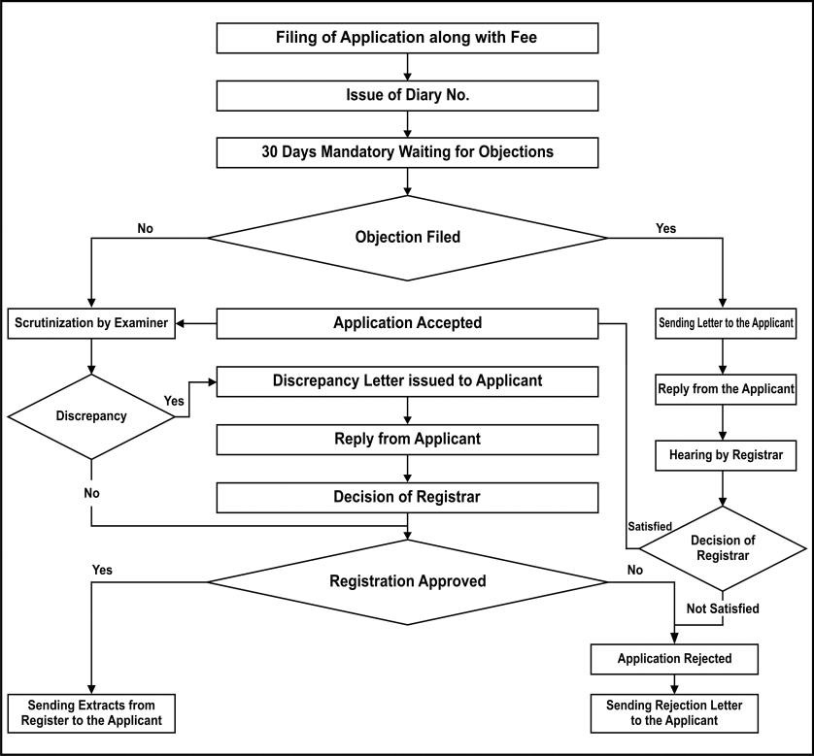
Copyright Registration Flowchart

Slide 28
FAQ’s
Define Research. Mention the objectives behind engineering research.
Elucidate the motivations of researchers in the field of engineering.
Describe the Research process with the a flowchart.
Explain the various types of research, stating examples in your respective area.
State the attributes of a worthwhile research problem
Discuss the types of research misconduct
Explain the situations where authorship is questionable on ethical grounds
What are copyright infringements? Enlist the following acts regarded as an infringement of Copyrights.
Explain the process for copyright registration with a flowchart.

Slide 29
THANK YOU

