Slide 1
UNIT-2
Literature Review and Technical Reading: New and Existing Knowledge, Analysis and Synthesis of Prior Art Bibliographic Databases, Web of Science, Google and Google Scholar, Effective Search: The Way Forward Introduction to Technical Reading Conceptualizing Research, Critical and Creative Reading, Taking Notes While Reading, Reading Mathematics and Algorithms, Reading a Datasheet.
Attributions and Citations: Giving Credit Wherever Due, Citations: Functions and Attributes, Impact of Title and Keywords on Citations, Knowledge Flow through Citation, Citing Datasets, Styles
for Citations, Acknowledgments and Attributions, What Should Be Acknowledged, Acknowledgments in, Books Dissertations, Dedication or Acknowledgments.
Book Referred:
Engineering Research Methodology by Dipankar Deb, Rajeeb Dey, Valentina E. Balas
Prepared By:
Ms. Vidya. R, Asst. Prof. Dept. of MBA, Dr.AIT

Slide 2
Literature Review
Literature can include several different types of publication:
Academic/scholarly journal articles (found either on the library’s databases or in the library’s collection of print journals)
Books
E-books
Conference proceedings
A literature review is an overview of the previously published works on a topic.
THE PROCESS:
Identify the major topics or subtopics or concepts relevant to the subject under consideration.
Place the citation of the relevant source (article/patent/website/data, etc.) in the correct category of the concept/topic/subtopic

Slide 3
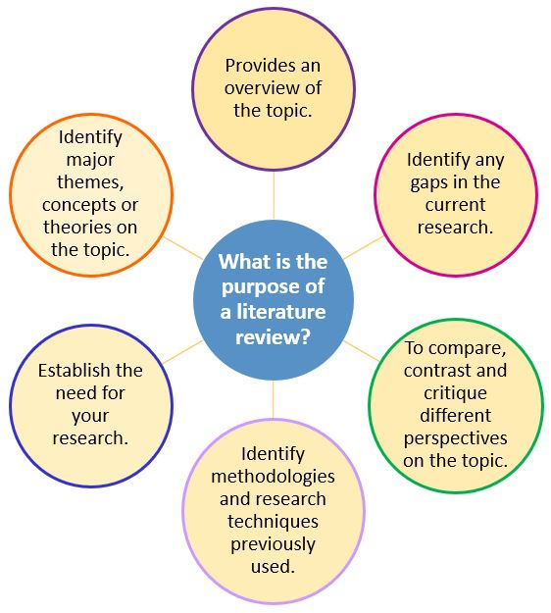
PURPOSE

Slide 4
New and Existing Knowledge
New knowledge in research can only be interpreted within the context of what is already known, and cannot exist without the foundation of existing knowledge.
Existing knowledge is needed to make the case that there is a problem and that it is important.
One can infer that the knowledge that is sought to be produced does not yet exist by describing what other knowledge already exists.
The review process must explain how a research item builds on another one and elucidate how and why certain technical development took place, so that it is easy for the reader to comprehend why the present talk is being undertaken.

Slide 5
Good literature survey
Do not draw hasty conclusions.
Look into the individual references to determine the underlying causes/assumptions/mechanisms in each of them so as to synthesize the available information in a much more meaningful way.
Summarize what is already known from the state of the art.
Detail the key concepts and the main factors or parameters and the underlying relationships.
Describe any complementary existing approaches.
Enumerate the inconsistencies or shortcomings in the published work.
Identify the reported results that are inconclusive or contradictory.
Provide a compulsive reason to do further work in the field.

Slide 6
Analysis and Synthesis of Prior Art Bibliographic Databases
After collecting the sources, the researcher breaks down each article and identify the useful content in it, and then synthesize the collection of articles.
A researcher should analyze the relevant information ascertained in the grid by undertaking the following steps:
Understanding the hypothesis.
Understanding the models and the experimental conditions used.
Making connections.
Comparing and contrasting the various information, and
Finding out the strong points and the loopholes.

Slide 7
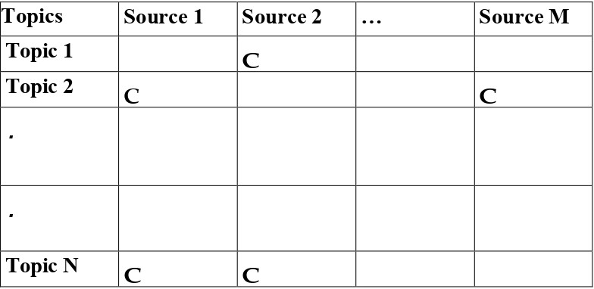
A literature survey grid of N topics and M sources is shown below to help crystallize the information in different categories.

Slide 8
Criteria that help researcher in evaluation of the information under study:
• Authority: What are the author’s credentials and affiliation? Who publishes the information?
• Accuracy: Based on what one already knows about the topic or from reading other sources, does the information seem credible? Does the author cite other sources in a reference list or bibliography, to support the information presented
• Scope:Is the source at an appropriate comprehension or research level
Other criteria: currency, objectivity, and purpose.

Slide 9
Bibliographic Databases
Refer to “abstracting and indexing services” useful for collecting citation-related information and possibly abstracts of research articles from scholarly literature and making them available through search.
Popular bibliographic databases:
Web of Science
Google and Google Scholar

Slide 10
Google and Google Scholar
Google Search is a search engine provided and operated by Google. Handling more than 3.5 billion searches per day, it has a 92% share of the global search engine market. It is the most-visited website in the world.
It can be helpful in finding freely available information, such as reports from governments, organizations, companies, and so on.
Limitations:
“Black box” of information. It searches everything on the Internet, with no quality control
Limited search functionality and refinement options.
Google Scholar:
Google Scholar is a freely accessible web search engine that indexes the full text or metadata of scholarly literature across an array of publishing formats and disciplines.
Google searches the entire Web, Google Scholar limits its searches to only academic journal articles produced by commercial publishers or scholarly societies.
Limitations:
Some of the results are not actually scholarly
Not comprehensive
Has limited search functionality and refinement options

Slide 11
There are search operators that can be used to help narrow down the results.
Some basic ones that one can use:
OR—Broadens search by capturing synonyms or variant spellings of a concept.
Brackets/Parentheses ( )—Gather OR’d synonyms of a concept together, while combining them with another concept.
Quotation marks “ ”—Narrow the search by finding words together as a phrase, instead of separately.
Site—limits the search to results from a specific domain or website.
Filetype—limits the search to results with a specific file extension one could look for pdf’s, PowerPoint presentations, Excel spreadsheets, and so on.

Slide 12
Effective Search: The Way Forward
A scholarly publication is one wherein the published outcome is authored by researchers in a specific field of skill.
Cites all source contents used and is generally peer reviewed for accuracy and validity before publication.
A researcher must consider what type of information is needed, and where it could be found. Not all information is available online. Some information is only available in print.
Searching is an iterative process:
Experiment with different keywords and operators
Evaluate and assess results, use filters
Modify the search as needed and
When relevant articles are found, look at their citations and references.
After the search is complete, the researcher needs to engage in critical and thorough reading, making observation of the salient points in those sources, and summarize the findings.
A detailed comparison and contrast of the findings is also required to be done.
The conclusion of the entire process of literature survey includes a summary of the relevant and important work done, and also the identification of the missing links and the challenges in the open problems in the area under study.
One must note that the literature survey is a continuous and cyclical process that may involve the researcher going back and forth till the end of the research project.
It is not as if literature survey ends and then research begins, for new literature keeps appearing, and as one’s understanding of the problem grows, one finds new connections and related/evolving problems which may need more search.

Slide 13
Technical Reading
Active researchers should update oneself with research outcomes in their field of interest.
Finding the right work to read can be difficult. The literature where knowledge is archived is very fragmented and there are bits and pieces all over the place.
While reading an engineering research paper, the goal is to understand the technical contributions that the authors are making.
Logical approach for identifying articles and reading them suitably for effective research.
Read the title and keywords .
Read the abstract to get an overview of the paper in minimum time(if it does not seem sufficiently important to the field of study, one should stop reading further).
If the abstract is of interest, one should skip most of the paper and go to the conclusions to find if the paper is relevant to the intended purpose. (read the figures, tables, and the captions therein, as it provides a broad idea as to what was done in the paper).
Read the Results and Discussion sections which is the heart of the paper.
Further, read sections like the Experimental Setup/Modeling, etc., only if one is really interested and wishes to understand exactly what was done to better understand the meaning of the data and its interpretation.
One should consider not only the knowledge that is written down but also the reputation of the people who made that knowledge.

Slide 14
Conceptualizing Research
Conceptualization is defining and specifying the key concepts in research to avoid misinterpretation.
To come up with a good research objective, one must already be aware of what is in the literature(edge of knowledge else)
If one is doing research at the Ph.D. level or higher then conceptualizing the research is the foremost task
To become that expert, one needs to be continually reading the literature so as to bring together the three parts: (i) significant problem, (ii) the knowledge that will address it, and (iii) a possible way to make that new knowledge.
If one is working on a research project that is of a smaller scope say a master’s thesis, then conceptualizing the research is difficult. In this case, the researcher may take the help of the supervisor who may already be an expert

Slide 15
Critical and Creative Reading
Reading a research paper is a critical process.
Critical reading is the analysis and interpretation of the text in order to test its accuracy and validity, judging perspectives and synthesizing various topics into a congruent whole. It’s a method which allows us to evaluate arguments and draw conclusions.
It involves asking questions like:
Have the authors attempted to solve the right problem?
Are there simpler solutions that have not been considered?
What are the limitations (both stated and ignored) of the solution and are there any missing links?
Are the assumptions that were made reasonable?
Is there a logical flow to the paper or is there a flaw in the reasoning?
Creative reading is based upon imagination, innovation and originality. It’s taking what you’ve read and evaluated through critical reading and using creative writing to build upon it, developing new ideas and problem-solving approaches.
In creative reading, the idea is to actively look for other applications, interesting generalizations, or extended work which the authors might have missed?
Are there reasonable modifications that may throw up important practical challenges?

Slide 16
Taking Notes While Reading
A researcher reads to write and writes well only if the reading skills are good. The bridge between reading and actually writing a paper is the act of taking notes during and shortly after the process of reading.
On completing a thorough reading, a good technical reading should end with a summary of the paper in a few sentences describing the contributions.
A thorough reading should bring out whether there are new ideas in the paper, or if existing ideas were implemented through experiments or in a new application, or if different existing ideas were brought together under a novel framework.

Slide 17
Reading Mathematics and Algorithms
An engineering researcher generally cannot avoid mathematical derivations or proofs as part of research work.
They are the heart of any technical paper.
By meticulous reading of the proofs or algorithms one can develop sound understanding about the problem.
Reading a Datasheet
A datasheet, data sheet, or spec sheet is a document that summarizes the performance and other characteristics of a product, machine, component, material, subsystem, or software in sufficient detail.
Researchers in the field of electronics need to read datasheets.
It enables a researcher (or a working professional) to design a circuit or debug any given circuit with that component.
The first page of the datasheet usually summarizes a part’s function and features, basic specifications, and usually provides a functional block diagram with the internal functions of the part.
A pin out provides the physical location of a part’s pins, with special mark for pin 1 so that the part can be correctly plugged into the circuit.
Some parts also provide graphs showing performance versus various criteria (supply voltage, temperature, etc.), and safe region for reliable operation which should be carefully read and noted by the researcher.
One should be also in the lookout for truth tables which describe what sort of inputs provide what types of outputs, and also timing diagrams which lay out how and at what speed data is sent and received from the part.
Datasheets usually end with accurate dimensions of the packages a part is available in. This is useful for printed circuit board (PCB) layout.

Slide 18
Attributions and Citations: Giving Credit Wherever Due
Every author should know that what should/should not be acknowledged.
Author should acknowledge quotation, ideas, facts, paraphrasing, funding organization, oral discussion or support, laboratory, and computer work.
Citations: Functions and Attributes
Citation is used as a reference source that has been used in a piece of work, while attribution is used to give credit to the creator of a work.
Citations (references) give credit to others for their work, while allowing the readers to trace the source publication if needed.
They are the currency that authors would wish to accumulate.
Materials that can be cited include journal papers, conference proceeding, books, theses, newspaper articles, websites, or other online resources and personal communication.
A researcher needs to cite each source twice: (i) in-text citation, in the text of the article exactly where the source is quoted or paraphrased, and (ii) a second time in the references, typically at the end of the chapter or a book or at the end of a research article.
Engineering researchers normally use LaTeX, a document preparation system to automatically format documents that comply with standard formatting needs and is very effective to track and update citations.

Slide 19
Failure to cite appropriately infringes on the rights of the researcher who did the original work. It may be considered as plagiarism.
Plagiarism is using another person’s ideas without giving credit or citation and is an intellectual theft.
There are three main functions of citation:
Verification function: to ascertain if the original source is justified or not
Acknowledgment function: To receive credit for their work through citations.
Documentation function: to document scientific concepts and historical progress of any particular technology over the years.
Certain cases when references do not fulfill the actual goal of citations and acknowledgments, and thus do not benefit the reader.
Spurious citations: When citation is not required or an appropriate one is not found, if the author nevertheless goes ahead with including one anyways
Biased citations: : When authors cite the work of their friends or colleagues despite there being no significant connection between the two works, or when they do not cite work of genuine significance because they do not wish to give credit in the form of citation to certain individuals.
Self-citations: Permitted only if it is relevant.
Coercive citations: An academic publishing practice in which an editor of a scientific or academic journal forces an author to add spurious citations to an article before the journal will agree to publish it.

Slide 20
Impact of Title and Keywords on Citations
The citation rate of any research paper depends on various factors including significance and availability of the journal, publication types, research area, and importance of the published research work.
Other factors like length of the title, type of the title, and selected keywords also impact the citation count.
Title is the most important attribute of any research paper.
It is the main indication of the research area or subject.
A good title is informative, represents a paper effectively to readers, and gains their attention.
The download count and citation of a research paper might be influenced by title.
There are three different aspects which provide a particular behavior to the title: (i) types of the title, (ii) length of the title, and (iii) presence of specific markers

Slide 21
Research findings about citations :
Title length positively affects the number of citations.
Highly amusing titles have fewer citations and pleasant titles have no significant relation with citations
Highly cited articles have more than twice as many words in the title compared with lower cited papers.
Articles with question-type titles are downloaded more but poorly cited compared to the descriptive or declarative titles
Longer titles are strongly associated with higher citation rates
Titles containing a question mark, colon, and reference to a specific geographical region are associated with lower citation rates
Keywords are important to ensure that readers are aware about research articles and their content

Slide 22
Knowledge Flow Through Citation
In engineering research, knowledge flow is primarily in the form of books, thesis, articles, patents, and reports.
Citing a source is important for transmission of knowledge from previous work to an innovation
Interdisciplinary nature of research encourages scholars to cooperate with each other to grab more advantages through collaboration, thereby improving quality of the research
Co-authored publications had more citations than single author paper and there was a positive co-relation between number of authors and the number of citations

Slide 23
Citing Datasets
Engineering research relies heavily on data to justify claims and provide experimental evidences so data citations must fetch proper credit to the creator of the dataset.
A researcher should obtain necessary permission for using data from a particular source.
Citations related to datasets should include enough information so that a reader could find the same dataset again in the future, even if the link provided no longer works.

Slide 24
Styles for Citations
Citation styles differ primarily in the order, and syntax of information about references, depending on difference in priorities attributed to concision, readability, dates, authors, and publications.
Most common styles for citation:
ASCE style (American Society of Civil Engineers)
(a) Reference list: This part is to be placed in the bibliography or references at the end of the article or report.
Ex: Template for books: Author Surname, Author Initial. (Year Published). Title. Publisher, City, Pages Used.
Template for journal publications: Author Surname, Author Initial. (Year Published). ‘Title’. Publication Title, Volume number(Issue number), Pages Used.
(b) In-text citation for journals or books: The following part is to be placed right after the reference to the source of the citation assignment.
Ex: (Author Surname/Website URL Year Published)
(2) IEEE style (Institute of Electrical and Electronics Engineers): It is standard for all IEEE journals and magazines, and is frequently used for papers and articles in the fields of electrical engineering and computer science. This style requires endnotes and that references be cited numerically in the text.
Ex: Chapter in an edited book
[1] A. Rezi and M. Allam, “Techniques in array processing by means of transformations,” in Control and Dynamic Systems, Vol. 69, Multidimensional Systems, C. T. Leondes, Ed. San Diego: Academic Press, 1995, pp. 133–180.
(3) ASME style (The Association of Mechanical Engineers)
Within the text, references should be cited in numerical order according to their order of appearance. The numbered reference citation within text should be enclosed in brackets.
Example: It was shown by Prusa [1] that the width of the plume decreases under these conditions.

Slide 25
Acknowledgments and Attributions
Acknowledgment section is a place to provide a brief appreciation of the contribution of someone or an organization or funding body to the present work.
Acknowledgment is a common practice to recognize persons or agencies for being responsible in some form or other for completion of a publishable research outcome.
In engineering research, acknowledgments are meant for participating technicians, students, funding agency, grant number, institution, or anyone who provide scientific inputs, shared unpublished results, provided equipment, or participated in discussions.
Acknowledgment displays a relationship among people, agencies, institutions, and research.
Classification of acknowledgment: moral, financial, editorial, institutional or technical, and conceptual support.

Slide 26
What Should Be Acknowledged?
Author should acknowledge quotation Direct(actual words) and Indirect(summarized phrases), ideas, facts, paraphrasing, funding organization, oral discussion or support, laboratory, and computer work.
Authors should acknowledge assistants, students, or technicians, who helped experimentally and theoretically during the research work.
Grant received from a funding agency to be acknowledged by providing full details of the funding program
Acknowledge use of the services and facilities of any center or organization with which they are not formally affiliated to
Acknowledge the results that have been presented elsewhere

Slide 27
Acknowledgments in Books & Dissertations
A page of acknowledgments is usually included at the beginning of a thesis/ dissertation immediately following the table of contents.
Detailed acknowledgments enable the researcher to thank all those who have contributed in completion of the research work.
One should express appreciation in a concise manner and avoid emotive language.
The following are often acknowledged in these types of acknowledgments:
Main supervisor, second supervisor, peers in the lab, other academic staff in the department, technical or support staff in the department, colleagues from other departments, other institutions, or organizations, former students, family, and friends.

Slide 28
Dedication or Acknowledgments
The dedication is the writer’s personal acknowledgment indicating his or her appreciation and respect for significant individuals in the writer’s life.
Dedication is personal thus, any individuals named are frequently unrelated to the topic of the dissertation. It need not be academic in any way.
Dedication is never used in a journal paper, an article in a conference proceedings, or a patent. It is used exclusively in larger documents like books, thesis, or dissertations.
A dedication is to whomever the author would like it to be dedicated to, whether it is the author’s mother, the best friend, the pet dog, or Almighty God.

Slide 29
FAQ’s
Explain the process and purpose of Literature Review.
Enlist the components of a good Literature survey.
Mention the Criteria that help researcher in evaluation of the information under study.
Write a note on Bibliographic Databases.
Briefly explain iterative process of Effective Search?
Elucidate the Logical approach for identifying articles and reading them for effective research?
Distinguish between Critical reading and Creative Reading.
What is a Datasheet? Explain the relevance of datasheet in engineering research?
What is citation? Explain the main functions of citation?
Mention the instances where references do not fulfill the actual goal of citation.
Write a note on popular styles for citing engineering research.
Distinguish between dedications and acknowledgements in a research work.

Slide 30
THANK YOU

