Slide 1


Dr. AMBEDKAR INSTITUTE OF TECHNOLOGY
Near Jnana Bharathi Campus, Bengaluru-560 056.
(An Autonomous Institution, Aided by Government of Karnataka)
Group 3: Tsunami
Course title:Research methodology & intellectual property rights
Under Guidance of : Dr Leela M H
Course Code: 21RMT506
Topic: Patents:
Patents
Notes:
Links:
https://pixabay.com/vectors/connection-internet-digital-network-4166469/

Slide 2
Group 3: Tsunami
Topic: Patents
Content:
Patent Application Forms
Grant Of Patents
Types Of Patent Applications
National Bodies Dealing With Patent Affairs
Patents
Notes:
Links:
https://pixabay.com/vectors/connection-internet-digital-network-4166469/

Slide 3
Patent Application Forms
Patents
Patent Forms for Filing Patent Application in India
Filing a patent application in the Indian Patent Office is the first step for securing a patent to your invention in India. To file a patent application, a set of forms has to be submitted to the patent office. The forms can be submitted either online
(Official website of Intellectual Property India (ipindia.gov.in)).
Let’s discuss different patent forms available at the Indian Patent Office and purpose of each form.
Notes:
Links:
https://www.pexels.com/photo/photo-of-people-looking-on-laptop-3182812/

Slide 4
Patent Application Forms
Application for Grant of Patent: Form -01
Form 1: Is an application form for a patent submitted by an applicant filing before the Indian Patent Office (IPO).
In particular, Form 1 contains details such as type of application, the applicant (s) name and details, category of the applicant (s), inventor(s) name and details, the title of the Invention, priority particulars of the application(s) filed in a convention country, particulars for filing patent cooperation treaty (pct) national phase application, particulars for filing a divisional application, particulars for filing Patent of Addition and etc.
Further, form 1 also contains a declaration by the Inventor(s) that the Inventor(s) is the true and first inventor for the innovation.
Patents
Notes:
Links:
https://www.pexels.com/photo/photo-of-people-looking-on-laptop-3182801/

Slide 5
Patent Application Forms
Patents
Provisional/Complete Specification: Form -02
Form 2 furnishes the patent specification or the description of the patent application filed before the Indian Patent Office (IPO).
In particular, the specification is either a provisional specification or a complete specification depending on the type of the patent filed by the applicant.
Preamble describing the provisional patent application in the first page of Form 2: “The following specification describes the invention”
Preamble describing the non provisional patent application in the first page of Form 2: “The following specification particularly describes the invention and the manner in which it is to be performed”
Notes:
Links:
https://www.pexels.com/photo/photo-of-people-looking-on-laptop-3182801/

Slide 6
Patent Application Forms
Statement and Undertaking Under Section 8: Form -03
Form 3 is a declaration submitted by the Inventor(s) to the Indian Patent Office (IPO) furnishing all the information/actions relating to patent applications filed in other countries for the present instant invention.
In particular, the Inventor(s) provides application number and other details in form 3 of the corresponding applications for patents filed outside India.
Moreover, Form 3 also contains an undertaking that the Inventor will inform the Indian patent Office in writing the details regarding corresponding applications for patents filed outside India within six months if he files any such application.
Patents
Notes:
Links:
https://www.pexels.com/photo/photo-of-people-looking-on-laptop-3182801/

Slide 7
Patent Application Forms
Patents
Request for Extension of Time: Form- 04
Form 4 furnishes a request for extension of time before the Controller for reasons such as an extension of time to pay renewal fees etc.
Declaration as to Inventorship: Form -05
Form 5 contains the name of the Inventor and a declaration by the inventor that the inventor(s) is the true and first inventor of the subject matter sought to be protected using the current patent application.
Claim or Request Regarding any Change in Applicant for Patent: Form 06
Form 6 furnishes a request to the controller regarding changes in applicant(s) for current patent application.
In particular, Form 6 is used for providing details such as, names of the applicant (s) to be added or removed, names of original applicants and reason for the change, among other details that are to be entered.
Further, Form 6 may also be used to add or remove an applicant from an Indian national phase application where a change in applicant has occurred after the international filing date.
Notes:
Links:
https://www.pexels.com/photo/photo-of-people-looking-on-laptop-3182801/

Slide 8
Patent Application Forms
Patents
Notice of Opposition: Form 07
Form 7 can be filed by any person interested having the opinion that his rights have been infringed and he wants to file an opposition to a patent filed by an Inventor can give notice of opposition to the Controller of Patents.
In particular, any person interested has to mention the grounds of opposition a particular patent.
Further, the notice of opposition is filed at any time after the grant of patent but before the expiry of a period of one year from the date of publication of the grant of a patent filed.
Representation for Opposition to Grant of Patent: Form 07A Form 7A is filed within six months from the date of publication of the application u/s 11A or before the grant of a patent by any person interested having the opinion that his rights have been infringed and he wants to file an opposition to a patent filed by an Inventor. Form 7A is filed for Pre grant opposition.
Notes:
Links:
https://www.pexels.com/photo/photo-of-people-looking-on-laptop-3182801/

Slide 9
Patent Application Forms
Claim or Request Regarding Mention of Inventor as Such in a Patent: Form -08
Form 8 is filed by the applicant to add or remove an inventor in the patent application under section 28 of the Indian Patent Act.
Request for Publication: Form -09
Form 9 is filed by the applicant for the publication of the patent specification of the filed patent application by the Indian Patent Office after 18 months from the priority date or date of filing whichever is the earliest.
Patent applications are published within 1 month after expiry of the statutory period of 18 months.
In case of a request for an early publication, the application is published within 1 month from the date of request.
Patents
Notes:
Links:
https://www.pexels.com/photo/photo-of-people-looking-on-laptop-3182801/

Slide 10
Patent Application Forms
Patents
Application for Amendment of Patent: Form -10
Form 10 is used by the person to whom the patent is granted for amending particulars in the Patent Application. The application for amendment is made along with substantiating evidence.
Application for Direction of The Controller: Form -11
Form 11 is submitted in order to request any directions under section 51(1) or 51(2) to the Controller’s office.
Request for Grant of Patent Under Section 261 and 522: Form -12
Form 12 is filed by an applicant to request for grant patent under section 26(1) & 52(2) grant of a patent to the true and first inventor, where it has been obtained by another in fraud of him.
Application for Amendment of The Application for Patent/Complete Specification: Form -13
Form 13 is submitted by the applicant who wants to amend the application for patent/ complete specification/any document related thereto submitted while filing the Patent Application.
Notes:
Links:
https://www.pexels.com/photo/photo-of-people-looking-on-laptop-3182801/

Slide 11
Patent Application Forms
Patents
Notice of Opposition to Amendment / Restoration / Surrender: Form -14
Form 14 is submitted by the applicant or any person interested to provide a notice of opposition to amendment/restoration/ surrender of patent/grant of compulsory license or revision of terms thereof or to the correction of clerical errors.
Application for Restoration of Patent: Form- 15
Form 15 is filed within 18 months from the date of lapse of a patent for the restoration of the patent when the patent has ceased to have an effect due to non- payment of renewal fees within the prescribed time.
The Application is accompanied with a statement highlighting the circumstances which led to failure to pay the prescribed fee.
Notes:
Links:
https://www.pexels.com/photo/photo-of-people-looking-on-laptop-3182801/

Slide 12
Patents
Patent Application Forms
Application for Restoration of Patent: Form- 15
Form 15 is filed within 18 months from the date of lapse of a patent for the restoration of the patent when the patent has ceased to have an effect due to non- payment of renewal fees within the prescribed time.
The Application is accompanied with a statement highlighting the circumstances which led to failure to pay the prescribed fee.
Application for Restoration of Title/Interest: Form -16
Form 16 is filed by a person/party who wants to register a title or interest in a patent or share in it or registration of any document purporting to affect proprietorship of the patent even if they are no the inventor.

Slide 13
Patents
Patent Application Forms
Application for Compulsory License: Form -17
Form 17 is filed before the controller of the patents by any person interested in applying for the grant of compulsory license of a Patent after the expiry of 3 years from the date of grant of patent.
In particular, the compulsory license is granted on the following three grounds:
1. The reasonable requirements of the public with respect to the patented invention have not been satisfied
2. The patented invention is not available to the public at a reasonably affordable price
3. The patented invention is not worked in the territory of India.

Slide 14
Patents
Patent Application Forms
Request/Express Request for Examination of Application for Patent: Form -18
Form 18 can be filed by applicant or any interested person within 48 months from the priority date or filing date whichever is at the earliest request for examination of the application for patent.
Request For Expedited Examination Of Application For Patent: Form -18A
Form 18 can be filed by applicant or any interested person requesting expedited examination of the patent application for a patent under rule 24C.
Application for Revocation of a Patent for Non-Working: Form -19
Form 19 is to be filed by the central government or any interested person who wish to revoke the patent before the expiry of the term for certain reasons of non-working.
Such application is made only after the expiry of 2 years from the date of grant of such patent.

Slide 15
Patents
Patent Application Forms
Application for Revision of Terms And Conditions of License: Form -20
Form 20 is filed by a licensee who is granted with a license by the controller and now wishes to Revise the terms of this License as he is unable to work with the previous terms of License.
Request for Termination of Compulsory License: Form -21
Form 21 is submitted by a patentee or any person interested who wishes to terminate a Compulsory license issued by the controller and is the original owner of the patent and wants the compulsory license Terminated for specific purposes.
Application Registration of Patent Agent: Form -22
Form 22 is submitted by a person who wishes to register themselves as Patent agents.
Application for The Registration of Name in The Register of Patent

Slide 16
Patents
Patent Application Forms
Agents: Form -23
Form 23 is submitted by a person whose name is removed from the Register of patent agents for reasons under Section 130 or rule 116 and who wishes to restore their name in the register after such issue has been solved.
Application for Review/setting Aside Controller Decision/Order: Form -24
Form 24 is to be filed by the applicant/ opponent/ party who is aggrieved by the Controller’s decision in order to review or set aside such order within 1 month from the date of communication of such decision.
Request for Permission for Making Patent Application Outside: Form -25
Form 25 enables an inventor, resident of India who wishes to file a patent directly outside India without filing in India to request permission from the patent office.

Slide 17
Patents
Patent Application Forms
Authorization of a Patent Agent in a Matter or Proceeding Under The Act: Form -26
Form 26 grants authorization to a Patent agent for representing the applicant in the Patent office in the matters or proceedings carried out under the Indian Patent Act.
Statement Regarding the Working of the Patented Invention on Commercial Scale in India: Form -27
Form 27 furnishes statement of working of the patent in India along with relevant information submitted by patentees and licensees in a Statement Regarding the Working of the Patented Invention in India.
To Be Submitted By Small Entity / Startup: Form -28
Form 28 is submitted by an applicant wishing to be declared as a small entity/startup along with the proof relating to the status of being a small entity/startup.

Slide 18
Patents
Patent Application Forms
Request For Withdrawal Of The Application For Patent: Form -29
Form 29 enables the applicant to withdraw the patent application or withdraw Request for examination before the issuance of the examination report. In particular, 90% examination fee shall be refunded.
To Be Used When No Other Form Is Prescribed: Form -30
Form 30 is used when no other form Is Prescribed.
Fees Schedule by IPO for filing the patent forms

Slide 19
Procedure for Grant of Patent
Persons entitled to apply for patents
(1) Subject to the arrangements contained in section 134, an application for a patent for an invention might be made by any of the accompanying persons, in other words,—
(a) By any individual professing to be the valid and first creator of the invention;
(b) By any individual being the assignee of the individual professing to be the valid and first innovator in regard of the privilege to make such an application;
(c) By the legitimate agent of any deceased individual who is preceding his demise and is qualified to make such an application.
(2) An application under sub-section (1) might be made by any of the persons alluded to in that either alone or mutually with some other individual.

Slide 20
Procedure for Grant of Patent
Filing of Application- Provisional/Complete: The Patent Application should be filed in form 1 accompanied by either provisional or complete specification in form 2 (If an applicant is not ready with the complete invention and need some more time for it then filing for the provisional application is recommended).
Publication of Application: The publication of the application is made after the expiry of 18 months from the priority date and no fees are required by the inventor. A prior- request for publication can be made (Rule 24A) under section 11A(2) in form 9 (optional step).
Request for Examination(REF): The request for examination to examine the patent application is made in form 18 (including fee) within 48 months from the filing date by the applicant.
Examination issue of First Examination Report(FER): The controller sends the patent application to the examiner who checks for patentability as per the patentability criteria and creates the first examination report (FER).
Any objection raised regarding the patentability requirements during examining the patent application has to have complied within 12 months.
Grant of Patent: Once the application meets all the requirements of patentability, the patent is granted to the inventor with the seal form patent office and is notified in the journal from time to time.

Slide 21
Procedure for Grant of Patent
Opposition: Section 25 of the Act deals with the opposition to grant of patents and are of two types: Pre Grant (before the patent is granted) and Post Grant (after 1 year of grant of the patent). The opposition can be filed by anyone interested in the field of the invention in form 7 with the prescribed fee within 12 months from the date of publication of the patent.
Grounds of Opposition to Patent
Obtained wrongly or fraudulently.
The invention has been already published and known.
Not involved in any of the inventive step.
Not completed within 12 months.
No clear and explicit description of the invention.
Not considered an invention based on the subject matters for the invention.

Slide 22
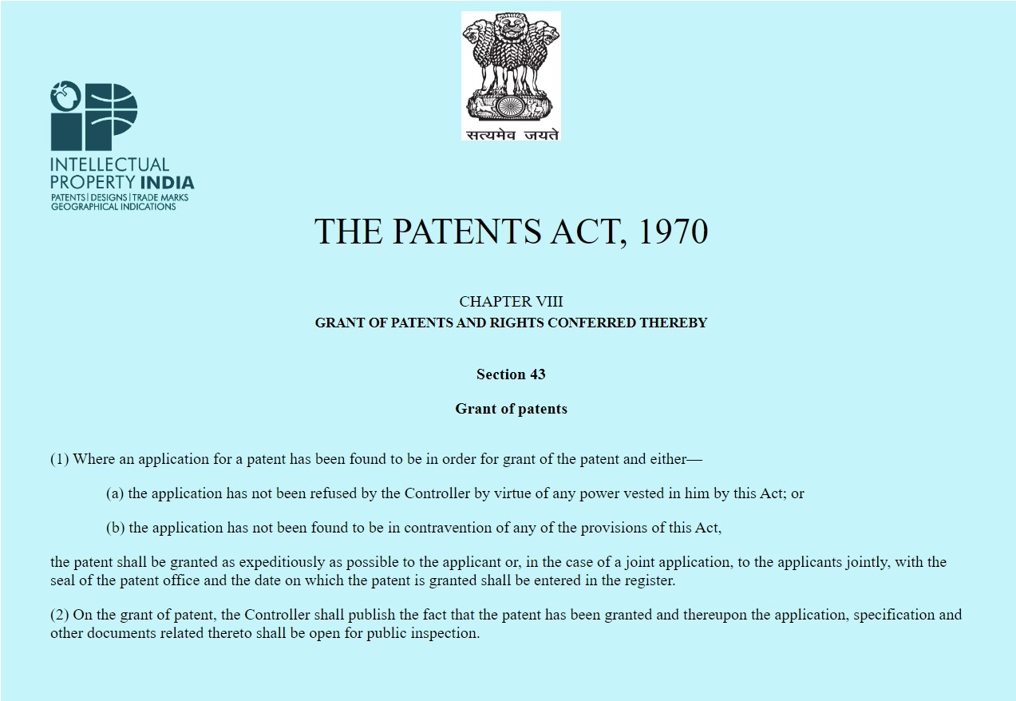

Slide 23
Conditions for Grant of Patents
The grant of a patent under the Patents Act, 1970 is not absolute. It is subject to certain conditions prescribed under Section 47 of the Act. Therefore, the grant of a patent is subject to the following conditions:
1. the patent granted for any machine, apparatus, article or any article made by using a process, can be imported or made by the government or on its behalf solely for its own use;
2. a patent granted for any process can be used by the Government or on its behalf for its own use;
3. a patent granted for any machine, apparatus, article or any article made by using a process or where a patent is granted for any process, can be made or used by any person, for research or experiment purpose which also includes conveying instructions to students;
4. where a patent is granted for any medicine or drug, the Government can import such drug or medicine solely for its own use or distribution in Government-supported dispensaries, hospitals, and other medical institutions and also those rendering public service.

Slide 24
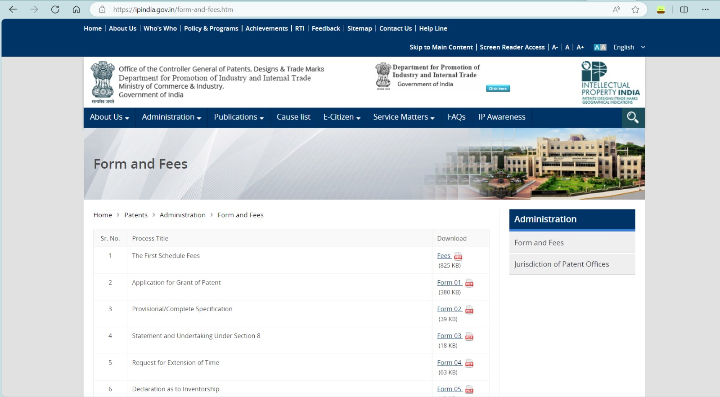

Slide 25
Patents
National Bodies Dealing With Patent Affair
The Office of the Controller General of Patents, Designs and Trade Marks (CGPDTM) generally known as the Indian Patent Office, is an agency under the Department for Promotion of Industry and Internal Trade which administers the Indian law of Patents, Designs and Trade Marks.
The CGPDTM reports to the Department for Promotion of Industry and Internal Trade (DPIIT) under the Ministry of Commerce and Industry and has five main administrative sections:
Patent Office
Designs Registry
Trademarks Registry
Geographical indications Registry
Rajiv Gandhi National Institute of Intellectual Property Management (NIIPM) and Patent Information System

Slide 26
Types Of Patent Applications:
Types of Patent application are:
Provisional Application
Ordinary or Non-Provisional Application
Convention Application
PCT International Application
PCT National Phase Application
Patent of Addition
Divisional Application
Patents
Notes:
Links:
https://pixabay.com/vectors/connection-internet-digital-network-4166469/

Slide 27
Provisional Application
Patents
A provisional application, also known as a temporary application, is filed when an invention is under experimentation and isn’t finalized. Moreover, it is a preliminary application which is filed before the patent office for claiming priority, as the Indian Patent Office follows the ‘First to File’ system (known popularly as the First-Come-First-Served-Basis). In technical terms, early filing of an invention will prevent the occurrence of any other related inventions from being designated as prior art to the inventor’s application.
An application for this purpose must include a brief explanation of the invention and must be drafted in a meticulous manner so as to ensure that the priority rights are secured for the invention.
Notes:
Links:
https://www.pexels.com/photo/photo-of-people-looking-on-laptop-3182812/

Slide 28
Ordinary or Non-Provisional Application
This type of application is filed if the applicant doesn’t have any priority to claim or if the application is not filed in pursuance of any preceding convention application. It must be supported by a complete specification, the likes of which must depict the invention in detail.
Complete specification can be filed through:
Direct Filing – wherein complete specification is initially filed with the Indian Patent Office without filing any corresponding provisional specification.
Subsequent Filing – wherein complete specification is filed subsequent to the filing of the corresponding provisional specification and claiming priority from the filed provisional specification.
Patents
Notes:
Links:
https://www.pexels.com/photo/photo-of-people-looking-on-laptop-3182801/

Slide 29
Convention Application
Patents
A convention application is filed for claiming a priority date based on the same or substantially similar application filed in any of the convention countries. To avail a status of convention, an applicant is required to file an application in the Indian Patent Office within a year from the date of the initial filing of a similar application in the convention country. To re-iterate in simpler terms, a convention application entitles the applicant to claim priority in all the convention countries.
Notes:
Links:
https://www.pexels.com/photo/photo-of-people-looking-on-laptop-3182801/

Slide 30
PCT International Application
As can be deciphered from its name, a PCT Application is an international application. Though the application does not provide for the grant of an international patent, it paves the way for a streamlined patent application process in many countries at one go. It is governed by the Patent Corporation Treaty and can be validated in up to 142 countries. Filing this application would protect an invention from being replicated in these designated countries.
Unlike other applications, it renders the application a time-frame of 30-31 months to enter into various countries from the international filing date or the priority date, thereby affording the applicant with additional time to access the viability of the invention.
Patents
Notes:
Links:
https://www.pexels.com/photo/photo-of-people-looking-on-laptop-3182801/

Slide 31
PCT National Phase Application
Patents
It is considered essential for an applicant to file a national phase application in each of the country wherein protection is sought for. The time-frame for filing the same is scheduled within 31 months from the priority date or the international filing date, whichever is earlier. The time-limit could be enhanced through National Laws by each member country.
With respect to the National Phase Application, the title, description, abstract and claims as filed in the International Application under PCT shall be considered as the Complete Specification. Apart from this, the regulations applicable for filing and processing an ordinary patent application is also applied here.
Notes:
Links:
https://www.pexels.com/photo/photo-of-people-looking-on-laptop-3182801/

Slide 32
Patent of Addition
Patents
This application must be filed if the applicant discovers that he has come across an invention which is a slight modification of the invention which has already been applied for or patented by the applicant. It can only be filed if the invention doesn’t involve a substantial inventive step.
A patent of addition is only granted after the grant of the parent patent, and hence no separate renewal fee should be remitted during the term of the main patent. Moreover, it shall be granted for a term equal to that of the patent for the main invention, and therefore expires along with the main patent. The date of filing here shall be the date on which the application for patent of addition has been filed.
Notes:
Links:
https://www.pexels.com/photo/photo-of-people-looking-on-laptop-3182801/

Slide 33
Divisional Application
When an application made by applicant claims more than one invention, the applicant on his own or to meet the official objection may divide the application and file two or more applications, as applicable for each of the inventions. This type of application, divided out of the parent one, is called a Divisional Application. The priority date for all the divisional applications will be same as that claimed by the Parent Application.
Patents
Notes:
Links:
https://www.pexels.com/photo/photo-of-people-looking-on-laptop-3182801/

Slide 34
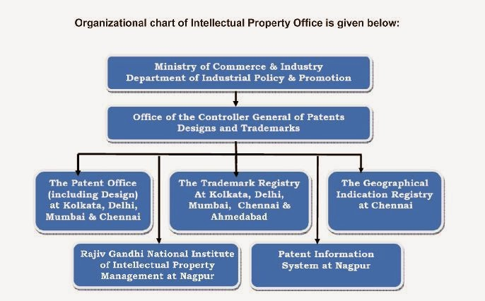
Patents
National Bodies Dealing With Patent Affair

Slide 35
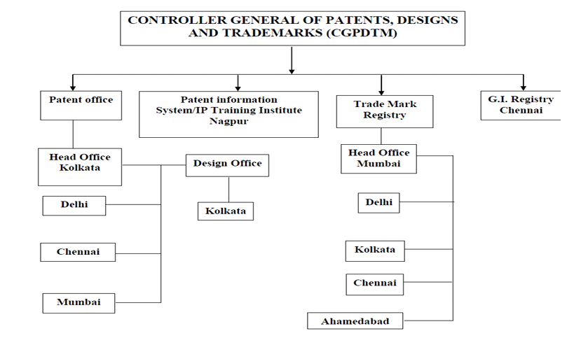
Patents
National Bodies Dealing With Patent Affair
The Structure of the Intellectual Property Offices of INDIA is

Slide 36


