Slide 1

MINI PROJECT PRESENTATION
Automated Car Parking System
Group Members :
Dileep Singh Bisht (1DA21EC046)
Divya U (1DA21EC049)
Namratha S D (1DA21EC091)
Prajwal K (1DA21EC105)
Under the guidance of
Dr. Girija S
Assistant Professor

Slide 2
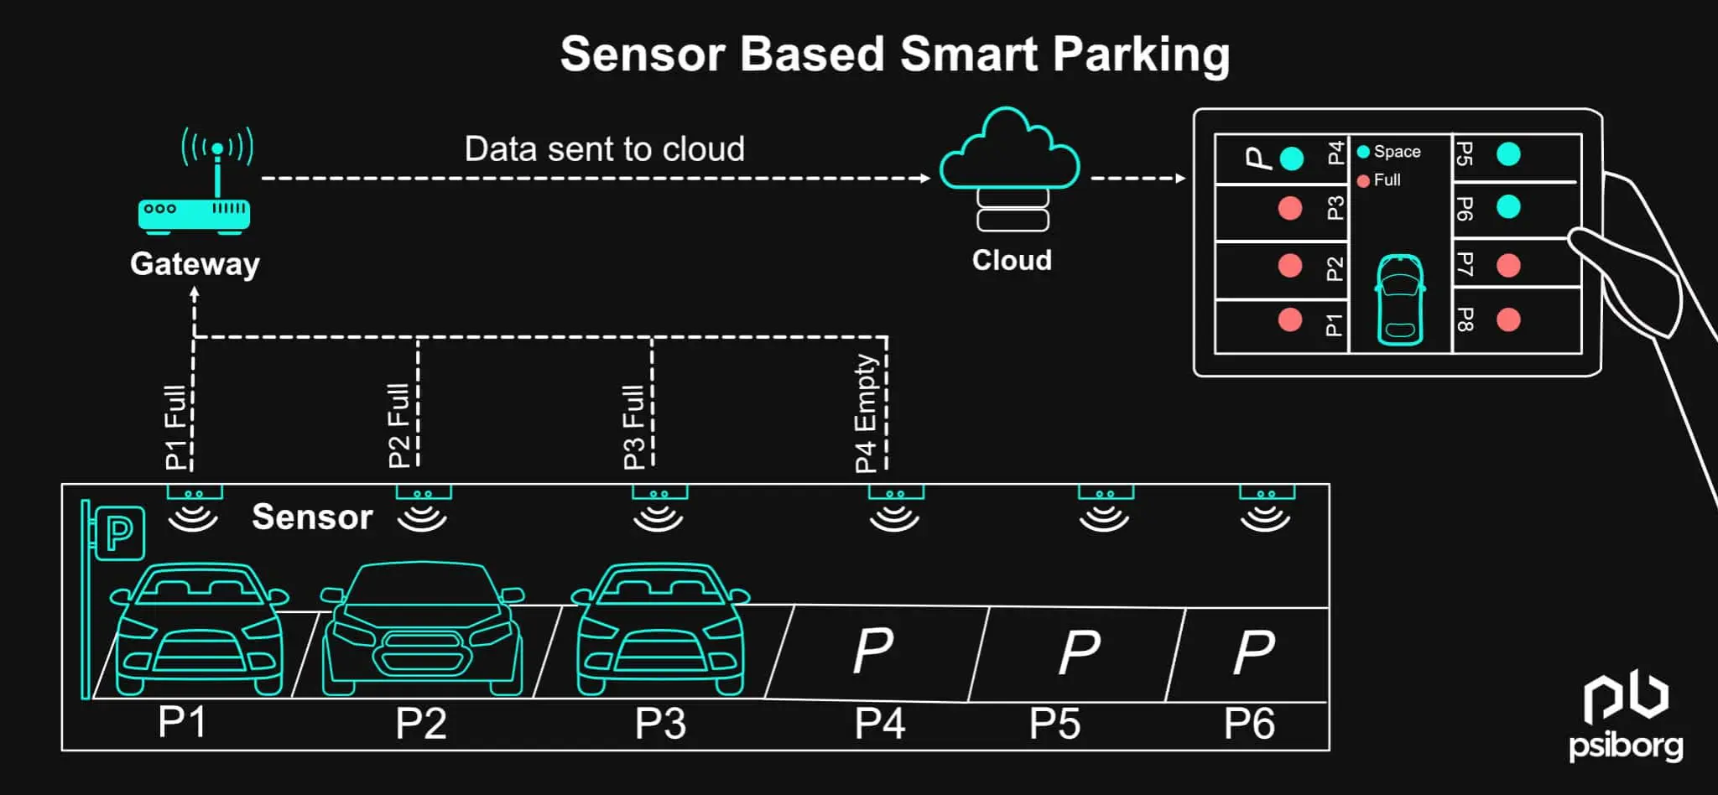
Introduction
Building an advanced parking system is essential in a developing country like India where population and automobiles are increasing rapidly.
Because of not properly maintained parking spaces, peoples are forced to park their vehicle on the roads which result in heavy congestion as well as road blockage.
Although, lot of time is wasted in searching for parking slot and while searching unintentionally it effects environment by the emission of harmful and dreadful gases from automobiles. Also, while searching parking slots, movement of traffic becomes slow.
Our automated parking provides the user-friendly environment to park a vehicle in a safe place.

Slide 3
Literature survey
“Detecting Efficient Parking Space Using Smart Parking” by Ajay Zajam :
The system consists of the integration of various frequency such as Ultra-High Frequency, Radio Frequency Identification and IEEE 802.15.4 Wireless Sensor Network. This system has customized algorithm, which collect the related to the occupancy state of the parking space and show the direction to the driver to the nearest car parking.
2. “Smart Parking System for Monitoring Cars and Wrong Parking” by Faris Alshehri:
In this paper ultrasonic sensor is used to help drivers to locate the vacant parking in a short period. The ultrasonic sensor is used as a detector to detect the car park availability. Smart Parking System contains few features such as vacant car park detection, improper parking detection, display available parking lot and directional indicators.
3. “Automatic parking lot mapping for available parking space detection” by Kairoek Choeychuen:
This paper presents a method to estimate map of parking lot for automatic system of available parking space detection. The parking space detection is important module for the parking guidance system (PGS) that can help drivers to find the parking space efficiently.

Slide 4
Problem statement
Existing manual parking systems often face issues such as inefficient space utilization, long wait times, and increased traffic congestion, causing frustration for drivers.
In public places where there are many visitors, a lot of time is wasted for searching parking slots. Also, a lot of manual labour is required to look after the existing parking arrangement.
Moreover, there is no way of knowing whether a vacant parking space is available or not.
The smart parking system solves these problems and this system is going to be implemented in several countries

Slide 5
Objectives
Enhance User Convenience: Provide a seamless and hassle-free parking experience for users.
Increase Safety: Minimize accidents and vehicle damage through precise and automated parking.
Improve Traffic Flow: Reduce congestion and wait times within parking facilities and surroundings.
Optimize Space :Utilization and energy efficiency: Efficiently manage and maximize the use of available parking space. Automated systems can be designed to operate with minimal energy.

Slide 6
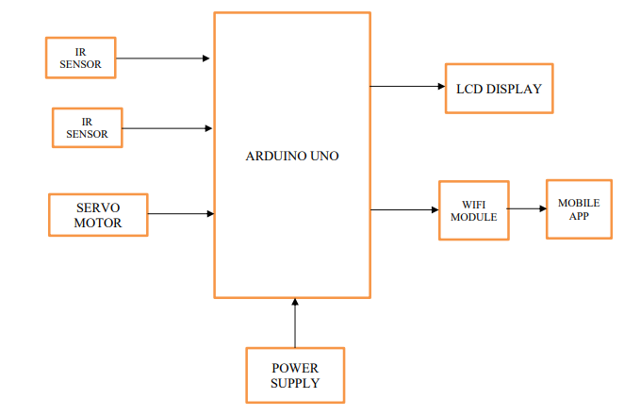
Block diagram and methodology
• Arduino Uno: Arduino Uno serves as a central unit in automated parking systems, coordinating various components.
• IR Sensor: Arduino Uno can interface with IR sensors to detect vehicle presence in parking spaces.
• LCD Display: Utilizing Arduino Uno, LCD displays provide users with visual feedback on parking space availability, guiding them to vacant spots.

Slide 7
• ESP8266 NodeMCU :WiFi module for connecting the parking lot to a cloud service so that we can be able to access the parking lot over the internet using a mobile phone application.
• Servo Motor: With Arduino Uno, servo motors can be precisely controlled to open and close parking barriers, allowing vehicles to enter and exit designated areas seamlessly.
• Power Supply: Provides the necessary power to components of the system.
The IR sensor at the entrance toll gate detects a coming car and will automatically open whenever there is a free slot in the parking lot but if the lot is full, then the gate will not open. A simple mobile app is designed to show the driver the occupied and empty slots in the parking lot where Esp8266 NodeMCU enables the communication between the sensors in the parking lot and any mobile device via a network cloud service.

Slide 8
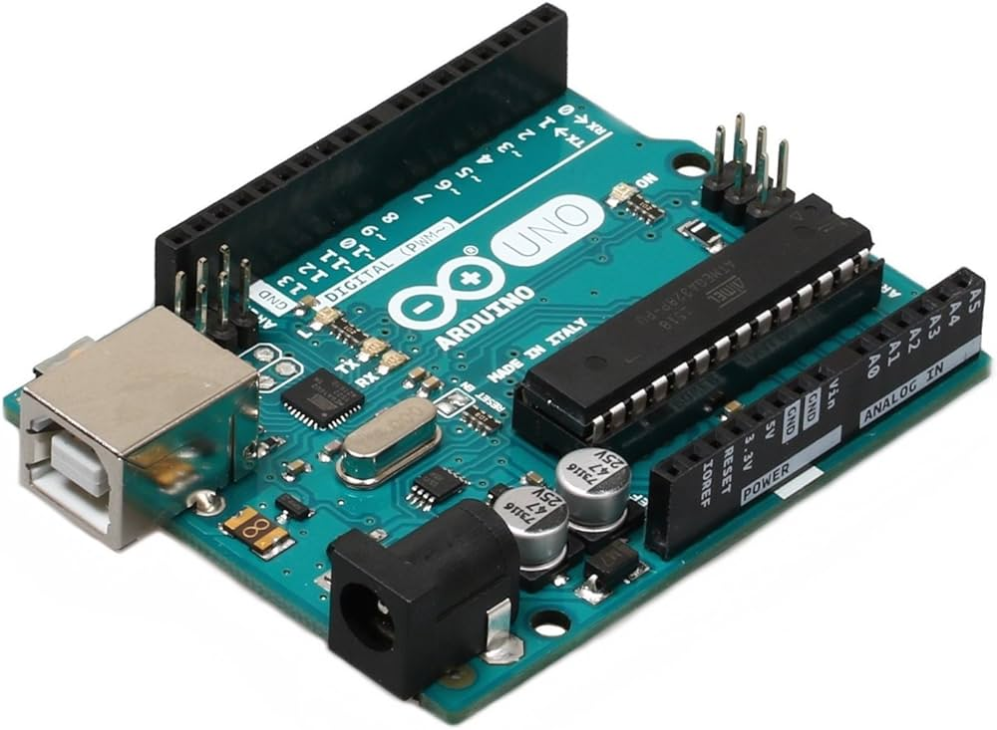
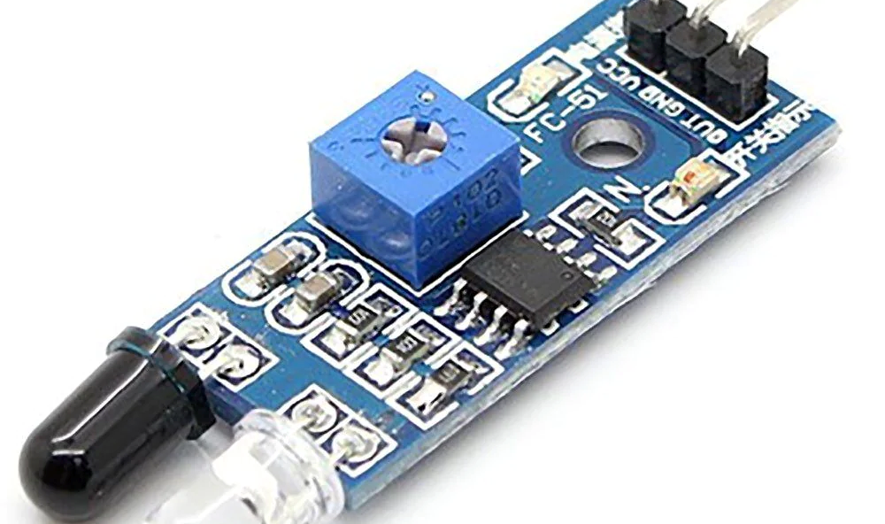
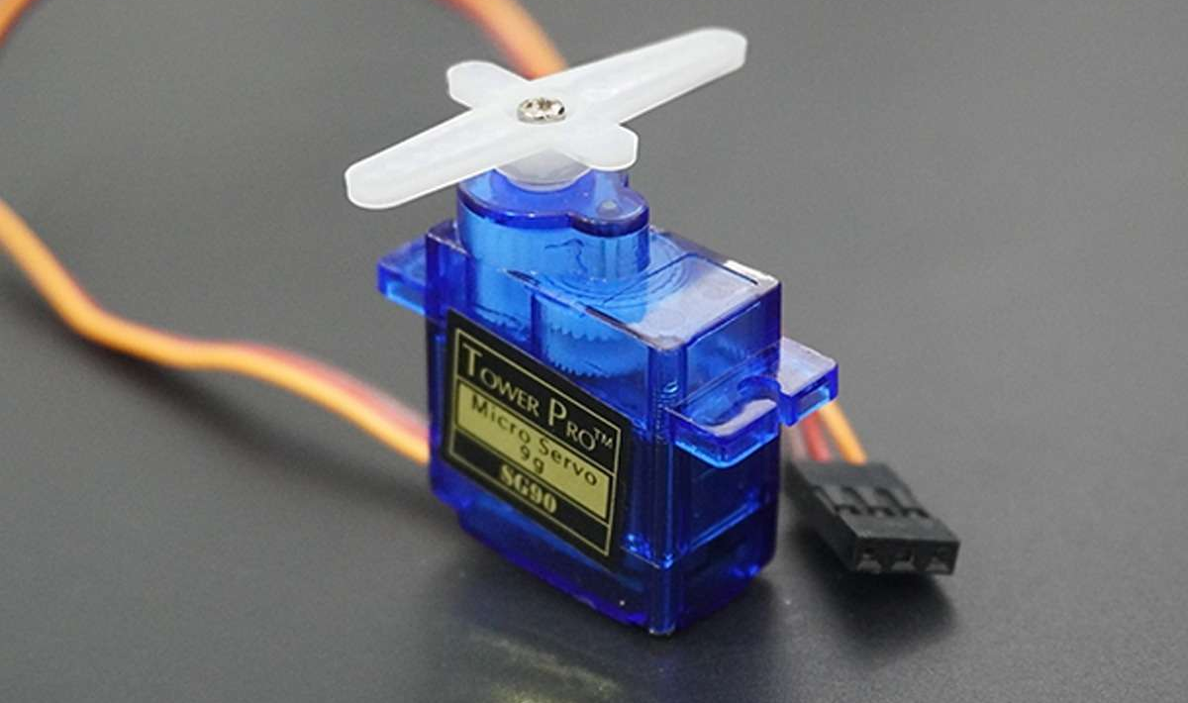
COMPONENT SPECIFICATION
AURDINO UNO
14 digital I/O pins, 6 analog pins
Programmable with the aurdino IDE(Integrated Development Environment) via a type B USB cable
Voltage – 7 and 20 volts
IR SENSOR
Detection Range : 2-10 cm
Response time:< 500ms
Operating temperature range : -30 to 950 degree celsius
SERVO MOTOR
Weight: 9g
Operating voltage: 4.8v-6v
Operating Temperature: -30 to +60 degree celsius

Slide 9
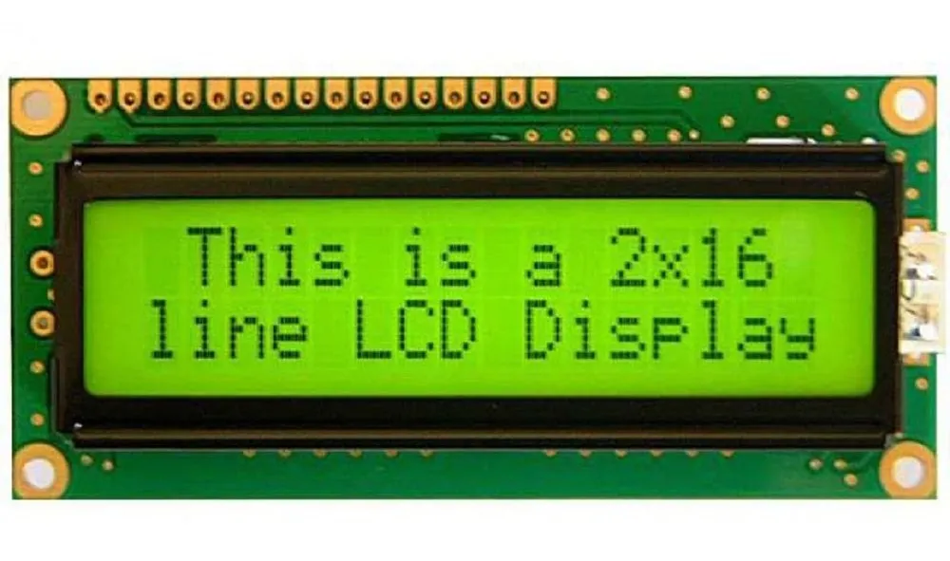
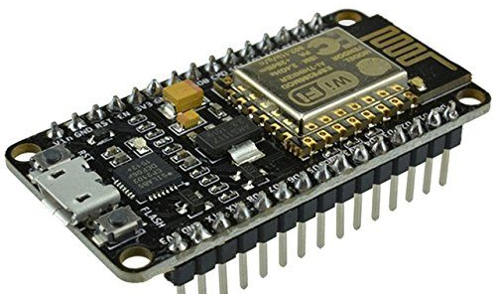
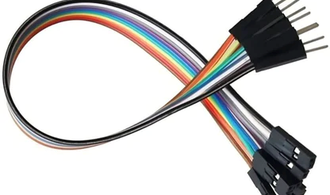
COMPONENT SPECIFICATION
LED DISPLAY
Character size: 2.95 mm wide x 4.35 mm high
Power Supply : 5v DC
Operating temperature range: 0 to +55°C
ESP8266
1. Operating Voltage: 3.3V
2. It has 17 GPIO pins
3. Frequency Range: 2.4 GHz - 2.5 GHz
JUMPER
1. Current. 4-20 mA.
2. Voltage. 12 V.
3. Weight. 30 gm.
4. Cable Length. 20 cm - 8 Inch.

Slide 10
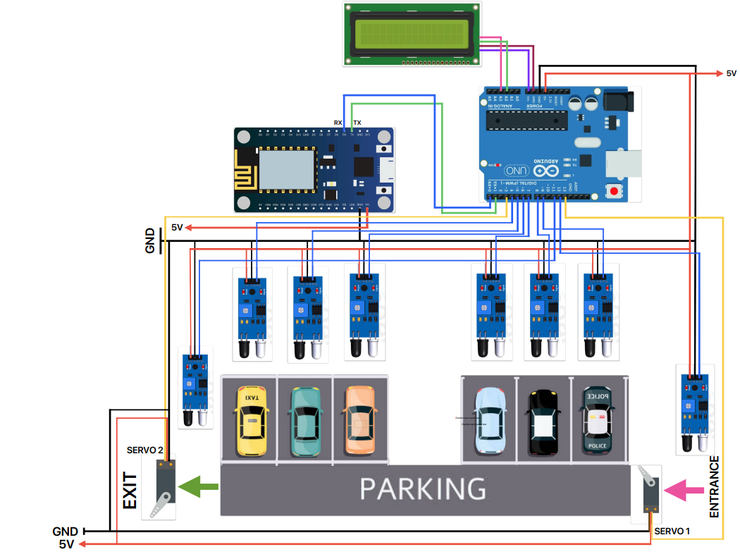
CIRCUIT DIAGRAM
The parking is divided into two lots with each parking having three parking slots. These slots have IR sensors attached to digital pins 4,5,6,7,8 and 9 of Aurdino.
Two other IR sensors are attached to Arduino digital pins 11 and 12,
two servo motors are attached to Arduino digital pins 3 and 13.
Communication between the Arduino board and ESP8266
is achieved through serial pins TR and RX of ESP8266
connected to Pins 0 and 2 of Arduino Uno
respectively.

Slide 11
REFERENCES
“Vision based automated parking System”, 10th International conference on Information Science,
Signal Processing and their Applications (ISSPA 2010).
Alan G Smith “Introduction to Arduino”. (2011).
H. Chaudhary, P. Bansal and B. Valarmathi, "Advanced CAR parking system using Arduino,"
2017 4th International Conference on Advanced Computing and Communication Systems (ICACCS),
Coimbatore, 2017.
Detecting efficient parking space using smart parking by Ajay Zajam , IISC , Bengaluru (2018).

