Slide 1

Group Activity:
Apache Storm
Group Members :
Hajaratali s Mogalalli(1DA22CS409)
Arun G Koravanavar(1DA21CS027)
Arya N D(1DA21CS028)
Bharatkumar N Medegar(1DA21CS033)
Arjun Pundir(1DA21CS026)
Ayushman Sharan(1DA21CS029)
Abhay Singh(1DA21CS004)
Akhil Kumar Tiwari(1DA21CS014)
Subject:
INTERNET OF THINGS (IOT) (21CST702)
Under the guidance of
prof . Lavanya Santhosh
Assistant Professor
Dr.AIT

Slide 2
Apache Storm
Index
Apache Storm – Home Apache Storm
Introduction Apache Storm
Core Concepts Apache Storm – Cluster Architecture
Apache Storm – Workflow
Storm - Distributed Msging System
Apache Storm - Working Example
Apache Storm – Trident
Apache Storm in Twitter

Slide 3
Apache Storm - Core Concepts:
Apache Storm reads raw stream of real-time data from one end and passes it through a sequence of small processing units and output the processed / useful information at the other end.
The following diagram depicts the core concept of Apache Storm.
Let us now have a closer look at the components of Apache Storm.
Components | Description
Tuple | Tuple is the main data structure in Storm. It is a list of ordered elements. By default, a Tuple supports all data types. Generally, it is modelled as a set of comma separated values and passed to a Storm cluster.
Stream | Stream is an unordered sequence of tuples

Slide 4
Apache Storm - Core Concepts:
Spouts | Source of stream. Generally, Storm accepts input data from raw data sources like Twitter Streaming API, Apache Kafka queue, Kestrel queue, etc. Otherwise you can write spouts to read data from data sources. “ISpout" is the core interface for implementing spouts. Some of the specific interfaces are IRichSpout, BaseRichSpout, KafkaSpout, etc.
Bolts | Bolts are logical processing units. Spouts pass data to bolts and bolts process and produce a new output stream. Bolts can perform the operations of filtering, aggregation, joining, interacting with data sources and databases. Bolt receives data and emits to one or more bolts. “I Bolt” is the core interface for implementing bolts. Some of the common interfaces are IRichBolt, IBasicBolt, etc.
Let’s take a real-time example of “Twitter Analysis” and see how it can be modelled in Apache Storm. The following diagram depicts the structure.

Slide 5
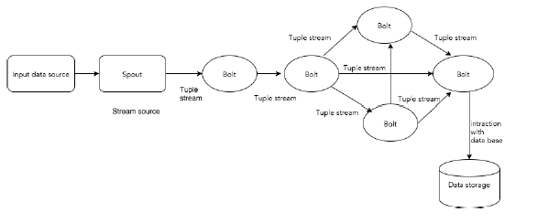
Apache Storm - Core Concepts
Make Effective Presentations
Using Awesome Backgrounds
Engage your Audience
Capture Audience Attention

Slide 6
Apache Storm - Core Concepts:
Let’s take a real-time example of “Twitter Analysis” and see how it can be modelled in Apache Storm. The following diagram depicts the structure.

Slide 7
Apache Storm
Index

Slide 8
Slide Title
Product A
Product B
Feature 1
Feature 2
Feature 3
Feature 1
Feature 2
Feature 3

Slide 9
Internet Of Things PowerPoint Template

Slide 11


