Slide 1

PROJECT PRESENTATION
Automated Car Parking System
Group Members :
Hajaratali s Mogalalli(1DA22CS409)
Arun G Koravanavar(1DA21CS027)
Arya N D(1DA21CS028)
Bharatkumar N Medegar(1DA21CS033)
Arjun Pundir(1DA21CS026)
Ayushman Sharan(1DA21CS029)
Abhay Singh(1DA21CS004)
Akhil Kumar Tiwari(1DA21CS014)
Subject:
INTERNET OF THINGS (IOT) (21CST702)
Under the guidance of
prof . Lavanya Santhosh
Assistant Professor
Dr.AIT

Slide 2
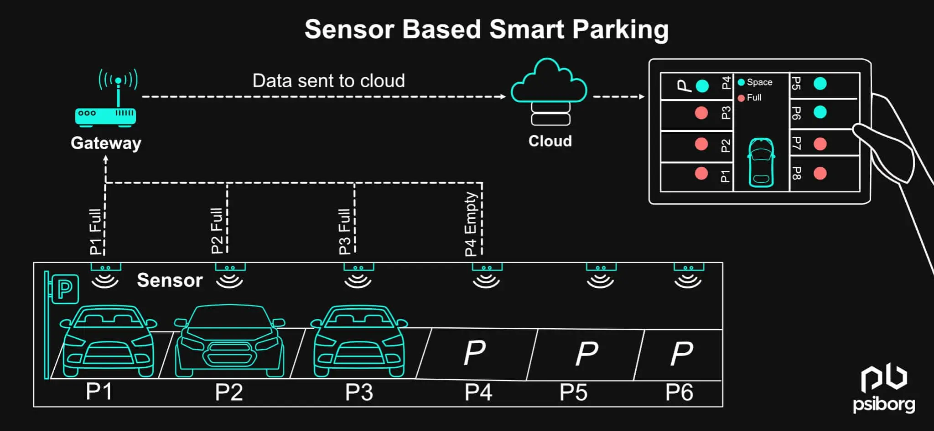
Introduction
Building an advanced parking system is essential in a developing country like India where population and automobiles are increasing rapidly.
Because of not properly maintained parking spaces, peoples are forced to park their vehicle on the roads which result in heavy congestion as well as road blockage.
Although, lot of time is wasted in searching for parking slot and while searching unintentionally it effects environment by the emission of harmful and dreadful gases from automobiles. Also, while searching parking slots, movement of traffic becomes slow.
Our automated parking provides the user-friendly environment to park a vehicle in a safe place.

Slide 3
IMPLEMENTATION:
Implementing an automated car parking system with an Arduino Uno, IR sensors, NodeMCU ESP8266, servo motors, LCD display, and a mobile application involves integrating these components to manage and control the parking process.
1.Defining System Requirements:
Parking Slots Management: We are using IR sensors to detect vehicle presence.
User Interface: Develop a mobile application (Blynk app) for user interaction.
Communication: NodeMCU ESP8266 for Wi-Fi connectivity to communicate with the mobile app.
Local Display: We are using an LCD display to show slot availability and status updates.
2. Components Needed:
Microcontrollers: Arduino Uno and NodeMCU ESP8266.
Sensors: IR sensors for detecting vehicle presence.
Actuators: Servo motors for gate control.
Communication Modules: NodeMCU ESP8266 for Wi-Fi.
Display Units: LCD display and the mobile app for displaying slot availability.
Power Supply: Adequate power supply for all components.
Software: Arduino IDE for programming, mobile app for user interaction.

Slide 4
3. Setup Hardware
Parking Slot Sensors: Install IR sensors in each parking slot to detect vehicle presence.
Entry/Exit Gates: Install servo motors to control the gates.
Central Controller: Connect sensors to the Arduino Uno and use NodeMCU ESP8266 for communication.
LCD Display: Connect an LCD display to the Arduino Uno to show real-time slot availability and other status updates.
4. Develop Software
Arduino Programming: Write code for the Arduino to read sensor data, control actuators, and update the LCD display.
NodeMCU Programming: Write code for ESP8266 to read sensor data and send the data to mobile app.
5. Testing and Calibration
Unit Testing: Individual components such as IR sensors, servo motors, LCD display, and communication modules are tested for accurate output.
Integration Testing: The entire system is tested to ensure all components work together seamlessly.

Slide 5
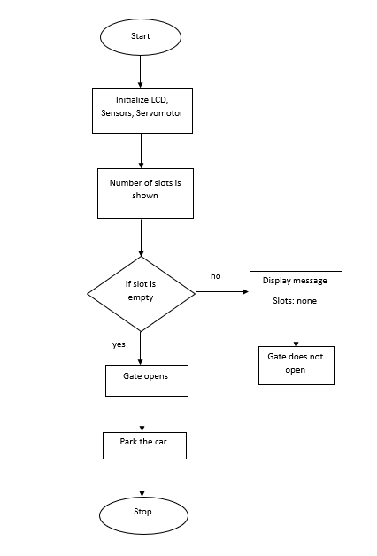
FLOWCHART:

Slide 6
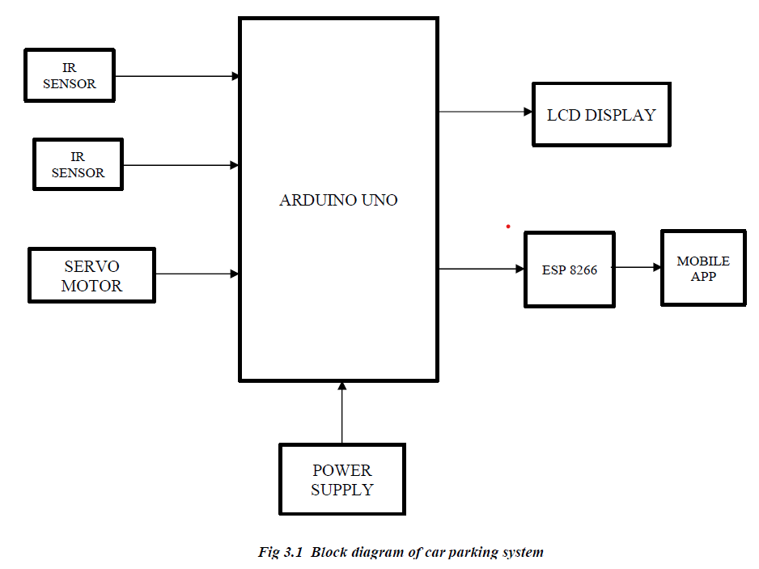
METHODOLOGY:
A simple mobile app is designed to show the driver the occupied and empty slots in the parking lot where Esp8266 NodeMCU enables the communication between the sensors in the parking lot and any mobile device via a network cloud service.
IR Sensor: Arduino Uno can interface with IR sensors to detect vehicle presence in parking spaces, ensuring effective space management and real-time occupancy monitoring.
LCD Display: Utilizing Arduino Uno, LCD displays provide users with visual feedback on parking space availability, guiding them to vacant spots and enhancing overall user in automated parking facility.

Slide 7
Servo Motor: With Arduino Uno, servo motors can be precisely controlled to open and close parking barriers, allowing vehicles to enter and exit designated areas seamlessly.
Arduino Uno: Arduino Uno serves as a central unit in automated parking systems, coordinating various components to optimize space usage and streamline operations.
ESP8266 NodeMCU :WiFi module for connecting the parking lot to a cloud service so that we can be able to access the parking lot over the internet using a mobile phone application
Power Supply: Provides the necessary power to components of the system.

Slide 8
SOFTWARE RERQUIREMENTS:
ARDUINO IDE
The Arduino Integrated Development Environment (IDE) is a software application used for programming Arduino boards.
It provides an easy-to-use interface for writing, compiling, and uploading code to the microcontroller.
The IDE supports the Arduino programming language, which is based on C/C++, and includes a built-in editor with features like syntax highlighting and automatic indentation.
It also offers a library manager for easily including various pre-written code libraries to extend functionality.
The Arduino IDE is compatible with Windows, macOS, and Linux, making it accessible for users on different operating systems.

Slide 9
ARDUINO CODE:
#include <Wire.h>
#include <LiquidCrystal_I2C.h>
#include <Servo.h>
LiquidCrystal_I2C lcd(0x27, 16, 2);
Servo gateServo;
Servo gateServo2;
const int irSensor1 = A0;
const int irSensor2 = A1;
const int irSensor3 = A2;
const int irSensor4 = A3;
const int irSensor5 = 5;
const int irSensor6 = 7;
const int servoPin = 10;
const int servoPin2 = 9;
bool isGateOpen = false;
bool isGate2Open = false;
void setup() {
lcd.init();
lcd.backlight();
gateServo.attach(servoPin);
gateServo2.attach(servoPin2);
pinMode(irSensor1, INPUT);
pinMode(irSensor2, INPUT);
pinMode(irSensor3, INPUT);
pinMode(irSensor4, INPUT);
pinMode(irSensor5, INPUT_PULLUP); pinMode(irSensor6, INPUT_PULLUP); Serial.begin(9600);
}
void loop() {
int slot1 = analogRead(irSensor1);
int slot2 = analogRead(irSensor2);
int slot3 = analogRead(irSensor3);
int slot4 = analogRead(irSensor4);
bool objectDetected1 = digitalRead(irSensor5);
bool objectDetected2 = digitalRead(irSensor6);
int threshold = 600;
String emptySlots = "";
if (slot1 > threshold) {
emptySlots += "1,"; }
if (slot2 > threshold) {
emptySlots += "2,"; }
if (slot3 > threshold) {
emptySlots += "3,"; }
if (slot4 > threshold) {
emptySlots += "4,";
}

Slide 10
if (emptySlots.length() > 0) {
emptySlots = emptySlots.substring(0, emptySlots.length() - 1);
} else {
emptySlots = "None";
}
lcd.clear();
lcd.setCursor(0, 0); lcd.print("Empty slots:"); lcd.setCursor(0, 1); lcd.print(emptySlots);
if (objectDetected1 && !isGateOpen) { Serial.println("Object detected by Sensor 5. Opening gate 1...");
openGate1();
isGateOpen = true;
} else if (!objectDetected1 && isGateOpen) { Serial.println("No object detected by Sensor 5. Closing gate 1...");
closeGate1(); isGateOpen = false;
if (objectDetected2 && !isGate2Open) { Serial.println("Object detected by Sensor 6. Opening gate 2...");
openGate2(); isGate2Open = true;
} else if (!objectDetected2 && isGate2Open) {
Serial.println("No object detected by Sensor 6. Closing gate 2...");
closeGate2();
isGate2Open = false;
}
}
void openGate1() {
gateServo.write(0);
}
void closeGate1() {
gateServo.write(-90);
}
void openGate2() {
gateServo2.write(0);
}
void closeGate2() {
gateServo2.write(90);
}

Slide 11
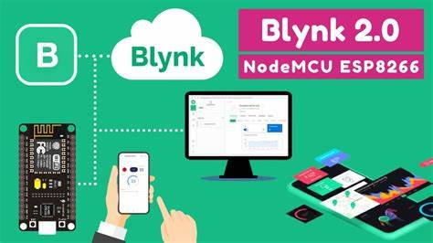
Blynk application:
Blynk is a tool that makes it easy for us to control and monitor electronic projects using a smartphone or computer.
Easy to Use: We can create custom control panels by dragging and dropping elements, so we don't need to be coding experts.
Works with Many Devices: It supports popular hardware like Raspberry Pi, and ESP8266, so we can use it with a wide range of projects.
Remote Control: Blynk connects our projects to the internet, so we can control them from anywhere in the world.
Custom Widgets: We can add buttons, sliders, graphs, and more to our control panel to interact with our project.

Slide 12
ESP8266 CODE:
#define BLYNK_PRINT Serial
#define BLYNK_TEMPLATE_ID "TMPL3v6koPubf“
#define BLYNK_TEMPLATE_NAME "parking system“
#define BLYNK_AUTH_TOKEN "f25CpIx0jxWaOovwpe8zjYsg7dTDkJfA“
#include <ESP8266WiFi.h>
#include <BlynkSimpleEsp8266.h>
char auth[] = "f25CpIx0jxWaOovwpe8zjYsg7dTDkJfA";
char ssid[] = "Khori";
char pass[] = "prajwal 1";
const int ir1 = D3;
const int ir2 = D4;
const int ir3 = D5;
const int ir4 = D6;I
nt status1 = 0;
int status2 = 0;
int status3 = 0;
int status4 = 0;
BlynkTimer timer;
void sendsend() {
status1 = digitalRead(ir1);
status2 = digitalRead(ir2);
status3 = digitalRead(ir3);
status4 = digitalRead(ir4);
Serial.print("IR1: "); Serial.print(status1);
Serial.print(" | IR2: "); Serial.print(status2);
Serial.print(" | IR3: "); Serial.print(status3);
Serial.print(" | IR4: "); Serial.println(status4);}
void myTimerEvent() {
Blynk.virtualWrite(V0, status1);
Blynk.virtualWrite(V1, status2);
Blynk.virtualWrite(V2, status3);
Blynk.virtualWrite(V3, status4);}
void setup() {
Serial.begin(9600);
pinMode(ir1, INPUT); pinMode(ir2, INPUT); pinMode(ir3, INPUT); pinMode(ir4, INPUT);
Blynk.begin(auth, ssid, pass);
timer.setInterval(1000L, myTimerEvent);
}
void loop() {
Blynk.run();
timer.run();
sendsend();
}
NODEMCU

Slide 13
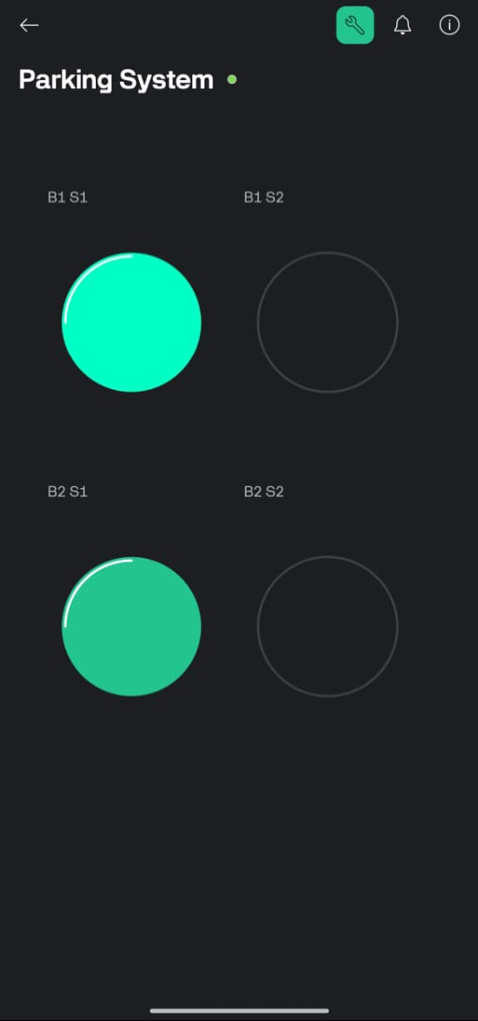
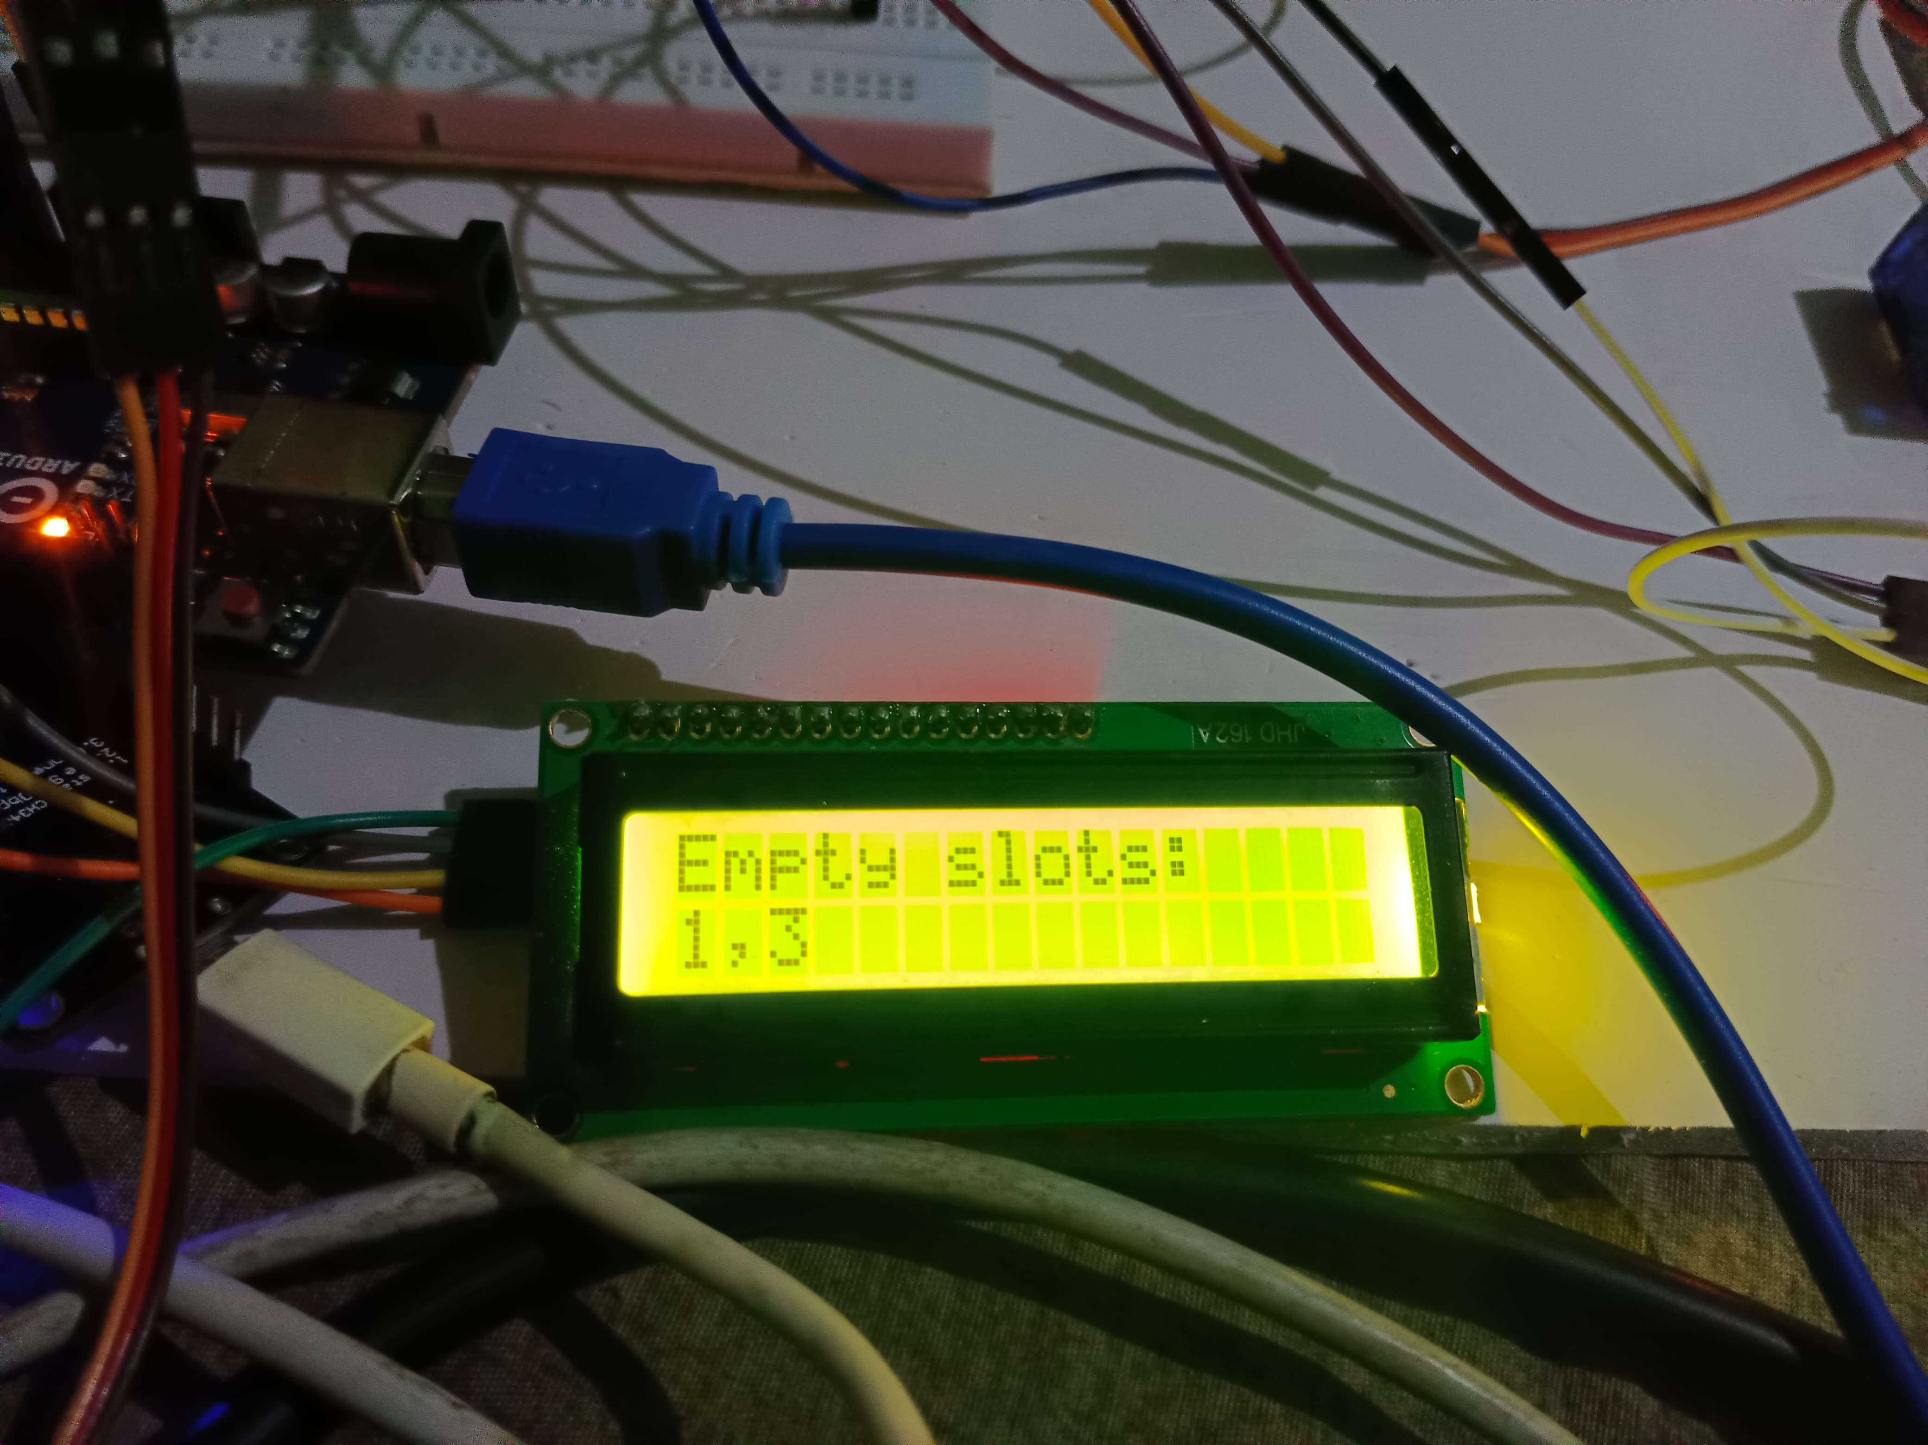
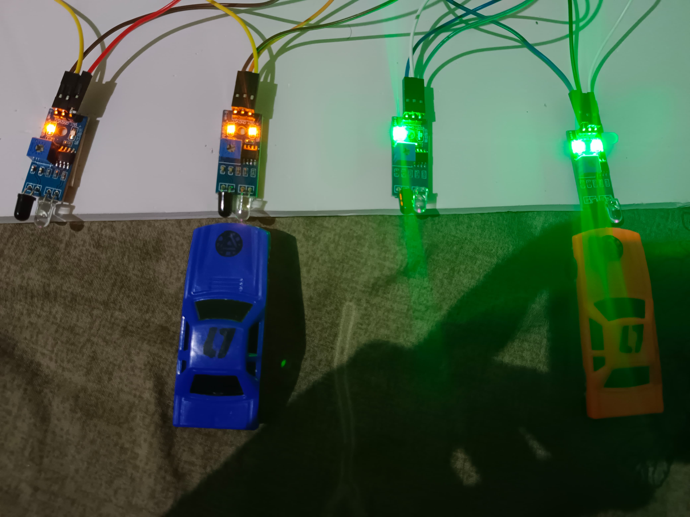
RESULT:

Slide 14
CONCLUSION:
Our project explores how these systems use advanced technology to make parking easier and save space.
They're especially useful in places like hospitals and busy areas because they streamline parking and cut down on costs. By automating parking, we've focused on making it simpler and safer for everyone.
These systems also help the environment by reducing emissions and saving energy.
Our project shows how automated parking improves traffic flow and safety by taking away the need for manual parking.
Looking ahead, we believe these systems will be vital in making cities better and meeting the growing need for improved parking solutions.
Embracing this technology sets the stage for smarter, more sustainable urban development and sets new standards for parking convenience and accessibility.

Slide 15
REFERENCES:
Automated Parking System with Fee Management Using Arduino A.Z. M. Tahmidul Kabir Department of Electrical and Electronic Engineering American International University-Bangladesh Dhaka-1229, Bangladesh.
Alan G Smith “Introduction to Arduino”. (2011)
Smart Parking System for Monitoring Cars and Wrong Parking Faris Alshehri, A. H. M. Almawgani, Ayed Alqahtani, Abdurahman Alqahtani Department of Electrical Engineering, College of Engineering,Najran University Najran, Saudi Arabia.
D.J. Bonde, R. Shende, K. Gaikwad, A. Kedari and A. Bhokre, "Automated car parking systemcommanded by android application", International Conference on Computer Communication and Informatics, (2014)

Slide 16
THANK YOU

