Slide 1

Group Activity:
Apache Storm
Group Members :
Hajaratali s Mogalalli(1DA22CS409)
Arun G Koravanavar(1DA21CS027)
Arya N D(1DA21CS028)
Bharatkumar N Medegar(1DA21CS033)
Arjun Pundir(1DA21CS026)
Ayushman Sharan(1DA21CS029)
Abhay Singh(1DA21CS004)
Akhil Kumar Tiwari(1DA21CS014)
Subject:
INTERNET OF THINGS (IOT) (21CST702)
Under the guidance of
prof . Lavanya Santhosh
Assistant Professor
Dr.AIT

Slide 2
Apache Storm
Index
Apache Storm – Home Apache Storm
Introduction Apache Storm
Core Concepts Apache Storm – Cluster Architecture
Apache Storm – Workflow
Storm - Distributed Msging System
Apache Storm - Working Example
Apache Storm – Trident
Apache Storm in Twitter

Slide 3
Apache Storm - Core Concepts:
Apache Storm reads raw stream of real-time data from one end and passes it through a sequence of small processing units and output the processed / useful information at the other end.
Let us now have a closer look at the components of Apache Storm.
Components | Description
Tuple | Tuple is the main data structure in Storm. It is a list of ordered elements. By default, a Tuple supports all data types. Generally, it is modelled as a set of comma separated values and passed to a Storm cluster.
Stream | Stream is an unordered sequence of tuples

Slide 4
Apache Storm - Core Concepts:
Spouts | Source of stream. Generally, Storm accepts input data from raw data sources like Twitter Streaming API, Apache Kafka queue, Kestrel queue, etc. Otherwise you can write spouts to read data from data sources. “ISpout" is the core interface for implementing spouts. Some of the specific interfaces are IRichSpout, BaseRichSpout, KafkaSpout, etc.
Bolts | Bolts are logical processing units. Spouts pass data to bolts and bolts process and produce a new output stream. Bolts can perform the operations of filtering, aggregation, joining, interacting with data sources and databases. Bolt receives data and emits to one or more bolts. “I Bolt” is the core interface for implementing bolts. Some of the common interfaces are IRichBolt, IBasicBolt, etc.

Slide 5
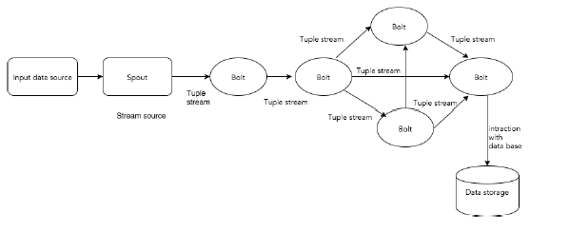
Apache Storm - Core Concepts:
The following diagram depicts the core concept of Apache Storm.
Make Effective Presentations
Using Awesome Backgrounds
Engage your Audience
Capture Audience Attention

Slide 6
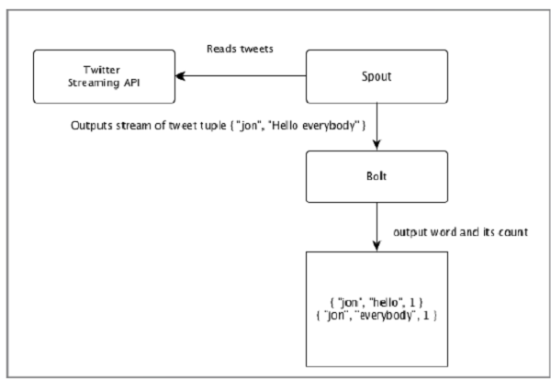
Apache Storm - Core Concepts:
Let’s take a real-time example of “Twitter Analysis” and see how it can be modelled in Apache Storm. The following diagram depicts the structure.

Slide 7
Apache Storm - Core Concepts:
The input for the “Twitter Analysis” comes from Twitter Streaming API. Spout will read the tweets of the users using Twitter Streaming API and output as a stream of tuples. A single tuple from the spout will have a twitter username and a single tweet as comma separated values. Then, this steam of tuples will be forwarded to the Bolt and the Bolt will split the tweet into individual word, calculate the word count, and persist the information to a configured data source. Now, we can easily get the result by querying the data source.

Slide 8
Apache Storm - Core Concepts:
Topology
Spouts and bolts are connected together and they form a topology. Real-time application logic is specified inside Storm topology. In simple words, a topology is a directed graph where vertices are computation and edges are stream of data.
A simple topology starts with spouts. Spout emits the data to one or more bolts. Bolt represents a node in the topology having the smallest processing logic and the output of a bolt can be emitted into another bolt as input.
Storm keeps the topology always running, until you kill the topology. Apache Storm’s main job is to run the topology and will run any number of topology at a given time.

Slide 9
Apache Storm - Core Concepts:
Tasks
Now you have a basic idea on spouts and bolts. They are the smallest logical unit of the topology and a topology is built using a single spout and an array of bolts.
They should be executed properly in a particular order for the topology to run successfully. The execution of each and every spout and bolt by Storm is called as “Tasks”.
In simple words, a task is either the execution of a spout or a bolt. At a given time, each spout and bolt can have multiple instances running in multiple separate threads.

Slide 10
Apache Storm - Core Concepts:
Workers
A topology runs in a distributed manner, on multiple worker nodes. Storm spreads the tasks evenly on all the worker nodes. The worker node’s role is to listen for jobs and start or stop the processes whenever a new job arrives.
Stream Grouping
Stream of data flows from spouts to bolts or from one bolt to another bolt. Stream grouping controls how the tuples are routed in the topology and helps us to understand the tuples flow in the topology. There are four in-built groupings as explained below.

Slide 11
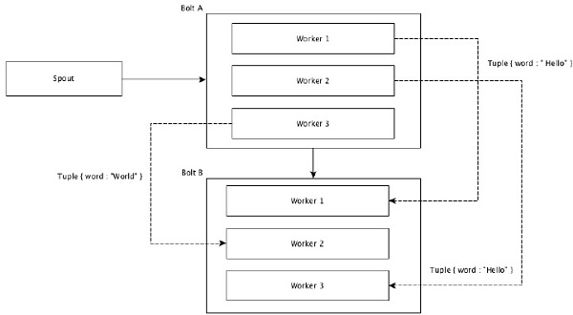
Apache Storm - Core Concepts:
Shuffle Grouping
In shuffle grouping, an equal number of tuples is distributed randomly across all of the workers executing the bolts. The following diagram depicts the structure.

Slide 12
Apache Storm - Core Concepts:
Field Grouping
The fields with same values in tuples are grouped together and the remaining tuples kept outside. Then, the tuples with the same field values are sent forward to the same worker executing the bolts. For example, if the stream is grouped by the field “word”, then the tuples with the same string, “Hello” will move to the same worker. The following diagram shows how Field Grouping works.

Slide 13
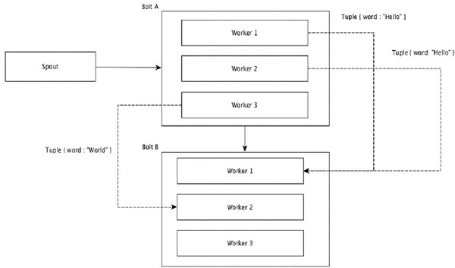
Apache Storm - Core Concepts:

Slide 14
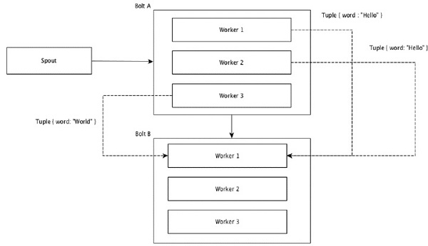
Apache Storm - Core Concepts:
Global Grouping
All the streams can be grouped and forward to one bolt. This grouping sends tuples generated by all instances of the source to a single target instance (specifically, pick the worker with lowest ID).

Slide 15
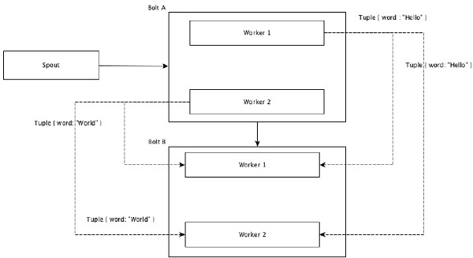
Apache Storm - Core Concepts:
All Grouping
All Grouping sends a single copy of each tuple to all instances of the receiving bolt. This kind of grouping is used to send signals to bolts. All grouping is useful for join operations.

