Slide 1
CRYPTOGRAPHY AND NETWORK SECURITY Chapter 2: Block Ciphers, Data Encryption Standard and Advanced Encryption Standard
Prof.POORNIMA R D
ASSISTANT PROFESSOR
DR AIT

Slide 2
TABLE OF CONTENTS
Simplified DES
Block Cipher Principles
DES
Differential and Linear Cryptanalysis
Modes of Operation
Evaluation Criteria for AES
AES Cipher Encryption and Decryption
Data Structure
Encryption Round
Triple DES
Blowfish

Slide 3
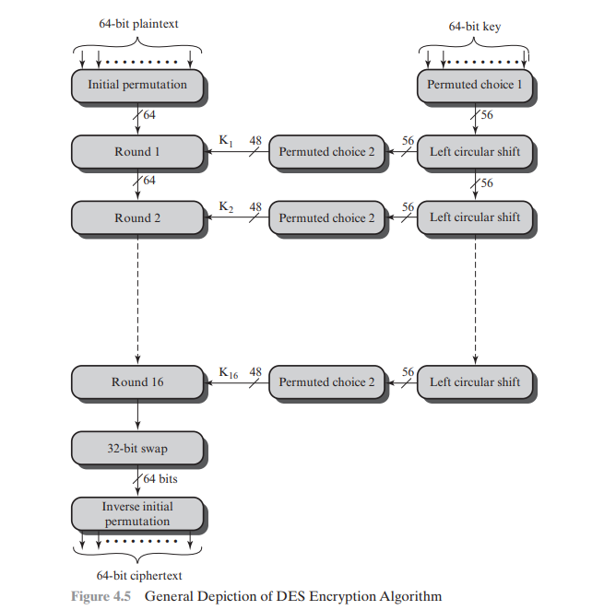
The Data Encryption Standard
As with any encryption scheme, there are two inputs to the encryption function: the plaintext to be encrypted and the key. In this case, the plaintext must be 64 bits in length and the key is 56 bits in length.8 Looking at the left-hand side of the figure, we can see that the processing of the plaintext proceeds in three phases. First, the 64-bit plaintext passes through an initial permutation (IP) that rearranges the bits to produce the permuted input.
This is followed by a phase consisting of sixteen rounds of the same function, which involves both permutation and substitution functions. The output of the last (sixteenth) round consists of 64 bits that are a function of the input plaintext and the key. The left and right halves of the output are swapped to produce the preoutput. Finally, the preoutput is passed through a permutation [IP-1 ] that is the inverse of the initial permutation function, to produce the 64-bit ciphertext. With the exception of the initial and final permutations, DES has the exact structure of a Feistel cipher

Slide 4
Simplified DES

Slide 5
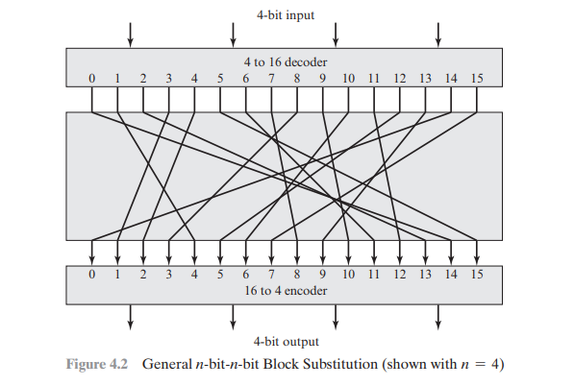
Block Cipher Principles

Slide 6
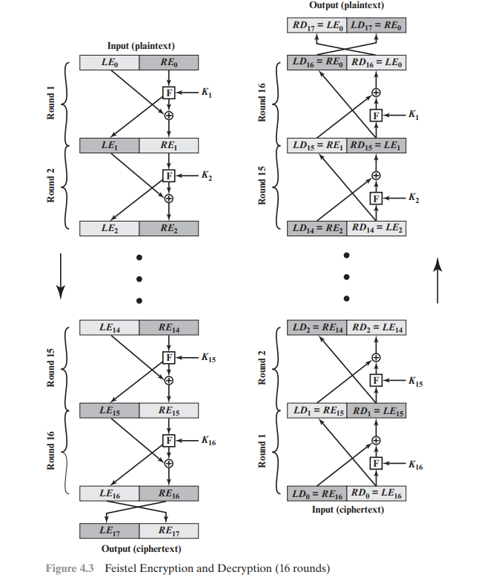
Block Cipher Principles

Slide 7
Modes of Operation
block ciphers encrypt fixed size blocks
eg. DES encrypts 64-bit blocks with 56-bit key
need some way to en/decrypt arbitrary amounts of data in practise
ANSI X3.106-1983 Modes of Use (now FIPS 81) defines 4 possible modes
subsequently 5 defined for AES & DES
have block and stream modes

Slide 8
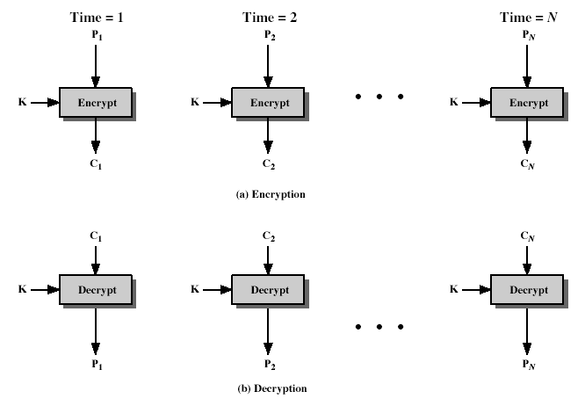
Electronic Codebook Book (ECB)
message is broken into independent blocks which are encrypted
each block is a value which is substituted, like a codebook, hence name
each block is encoded independently of the other blocks
C_{i} = DES_{K1}(P_{i})
uses: secure transmission of single values

Slide 9
Advantages And Limitations of ECB
message repetitions may show in ciphertext
if aligned with message block
particularly with data such graphics
or with messages that change very little, which become a code-book analysis problem
weakness is due to the encrypted message blocks being independent
main use is sending a few blocks of data

Slide 10
Advantages and Limitations of CTR
efficiency
can do parallel encryptions in h/w or s/w
can preprocess in advance of need
good for bursty high speed links
random access to encrypted data blocks
provable security (good as other modes)
but must ensure never reuse key/counter values, otherwise could break (cf OFB)

Slide 11
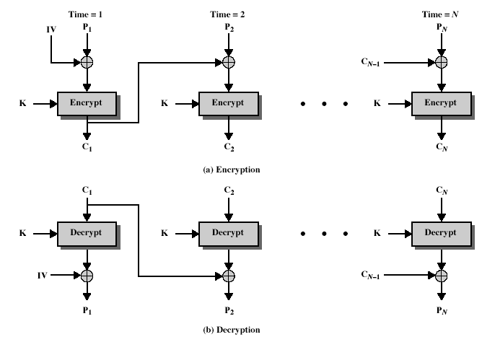
Cipher Block Chaining (CBC)
message is broken into blocks
linked together in encryption operation
each previous cipher blocks is chained with current plaintext block, hence name
use Initial Vector (IV) to start process
C_{i} = DES_{K1}(P_{i} XOR C_{i-1})
C₋₁ = IV
uses: bulk data encryption, authentication

Slide 12
Advantages and Limitations of CBC
a ciphertext block depends on all blocks before it
any change to a block affects all following ciphertext blocks
need Initialization Vector (IV)
which must be known to sender & receiver
if sent in clear, attacker can change bits of first block, and change IV to compensate
hence IV must either be a fixed value (as in EFTPOS)
or must be sent encrypted in ECB mode before rest of message

Slide 13
Cipher FeedBack (CFB)
message is treated as a stream of bits
added to the output of the block cipher
result is feed back for next stage (hence name)
standard allows any number of bit (1,8, 64 or 128 etc) to be feed back
denoted CFB-1, CFB-8, CFB-64, CFB-128 etc
most efficient to use all bits in block (64 or 128)
C_{i} = P_{i} XOR DES_{K1}(C_{i-1})
C₋₁ = IV
uses: stream data encryption, authentication

Slide 14
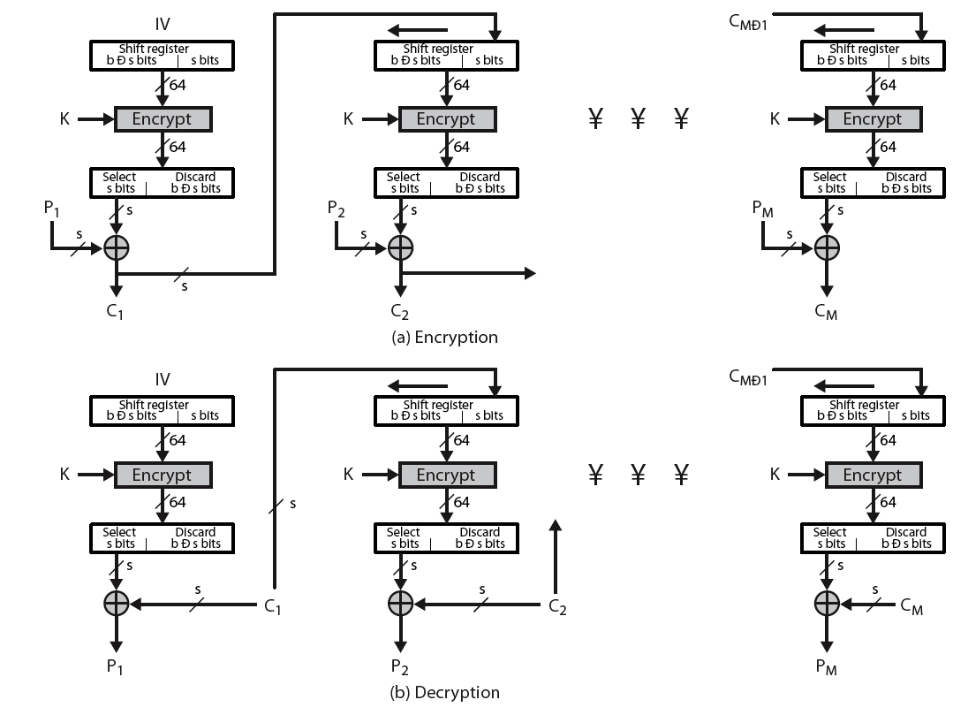
Cipher FeedBack (CFB)

Slide 15
Advantages and Limitations of CFB
appropriate when data arrives in bits/bytes
most common stream mode
limitation is need to stall while do block encryption after every n-bits
note that the block cipher is used in encryption mode at both ends
errors propogate for several blocks after the error

Slide 16
Output FeedBack (OFB)
message is treated as a stream of bits
output of cipher is added to message
output is then feed back (hence name)
feedback is independent of message
can be computed in advance
C_{i} = P_{i} XOR O_{i}
O_{i} = DES_{K1}(O_{i-1})
O₋₁ = IV
uses: stream encryption on noisy channels

Slide 17
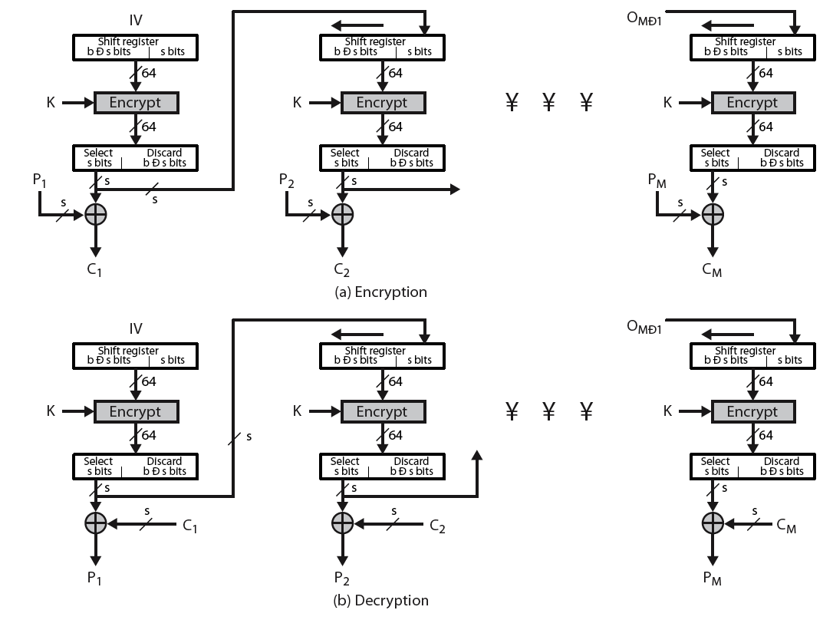
Output FeedBack (OFB)

Slide 18
Advantages and Limitations of OFB
bit errors do not propagate
more vulnerable to message stream modification
a variation of a Vernam cipher
hence must never reuse the same sequence (key+IV)
sender & receiver must remain in sync
originally specified with m-bit feedback
subsequent research has shown that only full block feedback (ie CFB-64 or CFB-128) should ever be used

Slide 19
Counter (CTR)
a “new” mode, though proposed early on
similar to OFB but encrypts counter value rather than any feedback value
must have a different key & counter value for every plaintext block (never reused)
C_{i} = P_{i} XOR O_{i}
O_{i} = DES_{K1}(i)
uses: high-speed network encryptions

Slide 20
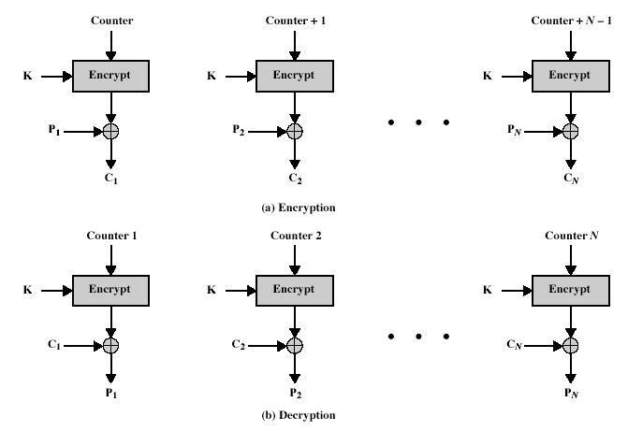
Counter (CTR)

Slide 21
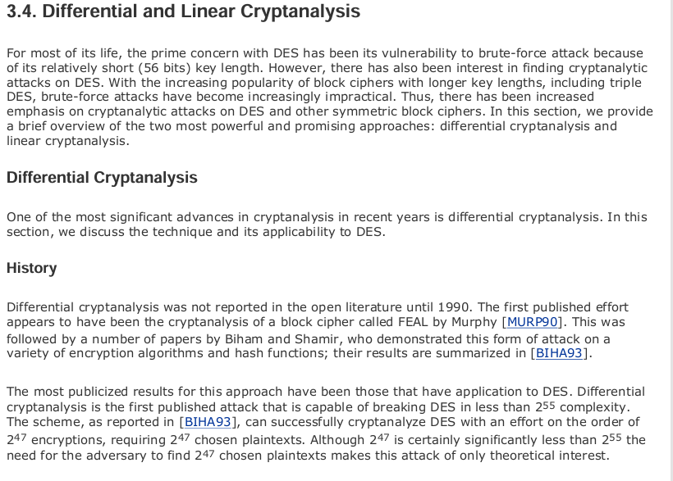
Differential and Linear Cryptanalysis

Slide 22
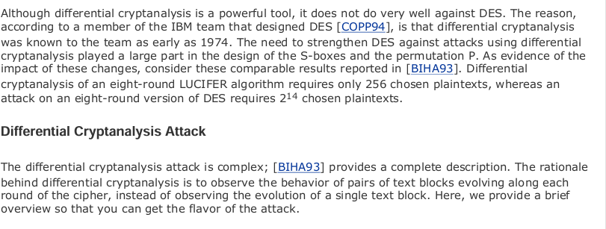

Slide 23
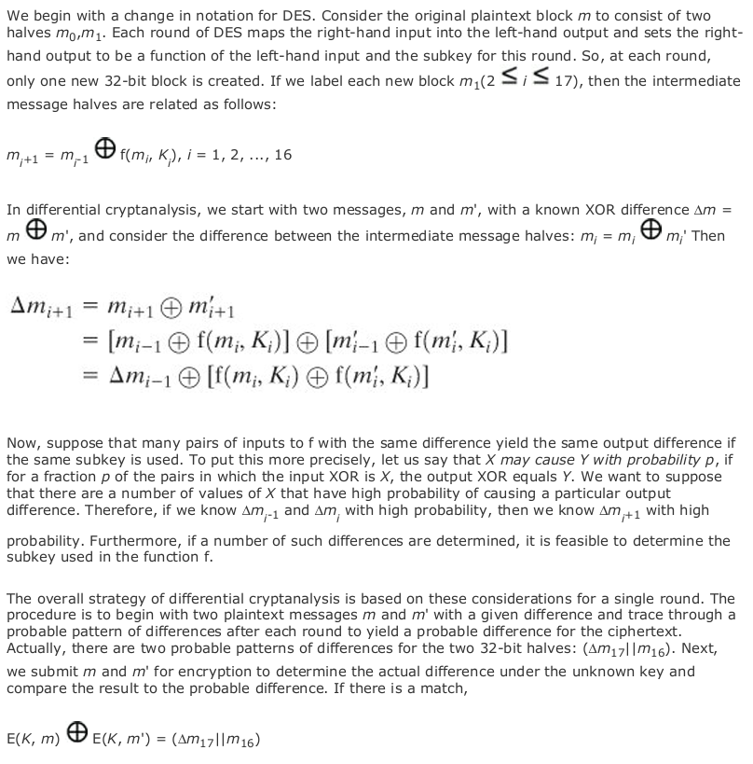

Slide 24
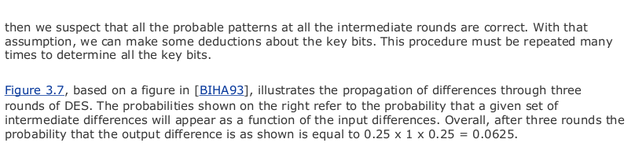

Slide 25
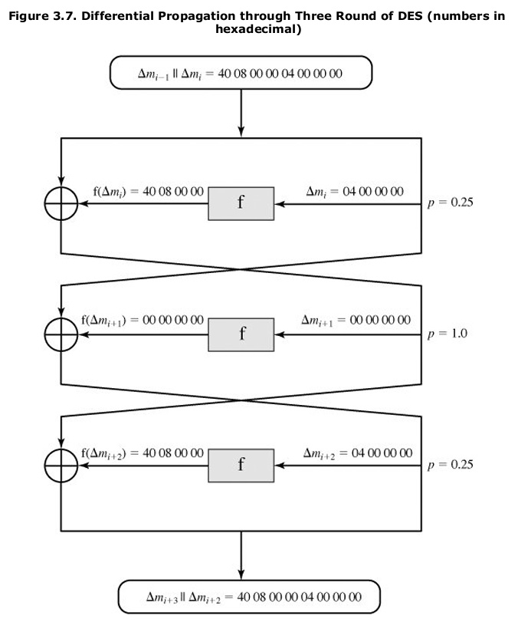

Slide 26
