Slide 1

Group Activity:
Apache Storm
Group Members :
Hajaratali s Mogalalli(1DA22CS409)
Arun G Koravanavar(1DA21CS027)
Arya N D(1DA21CS028)
Bharatkumar N Medegar(1DA21CS033)
Arjun Pundir(1DA21CS026)
Ayushman Sharan(1DA21CS029)
Abhay Singh(1DA21CS004)
Akhil Kumar Tiwari(1DA21CS014)
Subject:
INTERNET OF THINGS (IOT) (21CST702)
Under the guidance of
prof . Lavanya Santhosh
Assistant Professor
Dr.AIT

Slide 2
Apache Storm
Index
Apache Storm – Home Apache Storm
Introduction Apache Storm
Core Concepts Apache Storm – Cluster Architecture
Apache Storm – Workflow
Storm - Distributed Msging System
Apache Storm - Working Example
Apache Storm – Trident
Apache Storm in Twitter

Slide 3
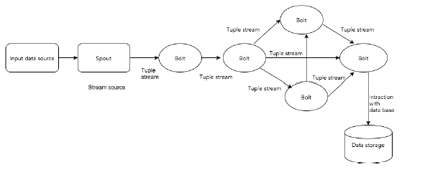
Apache Storm - Core Concepts:
Apache Storm reads raw stream of real-time data from one end and passes it through a sequence of small processing units and output the processed / useful information at the other end.
Let us now have a closer look at the components of Apache Storm.

Slide 4
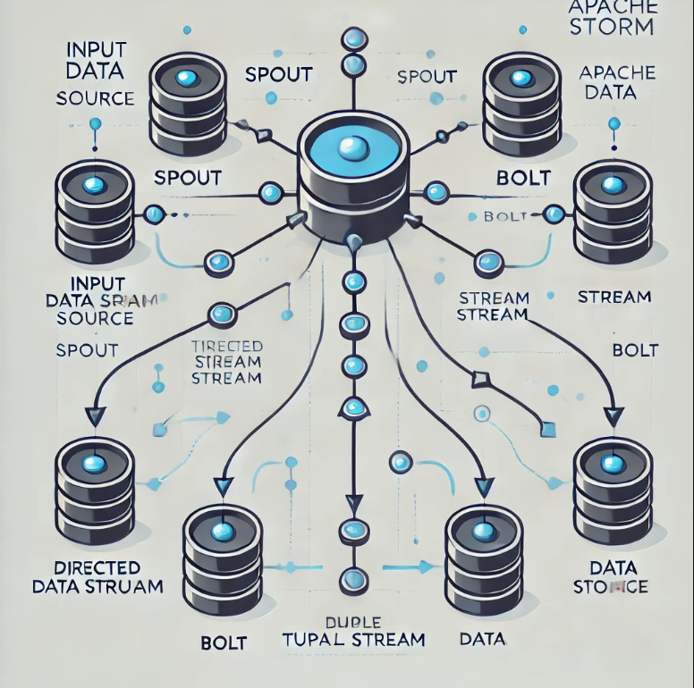
Apache Storm - Core Concepts:
The following diagram depicts the core concept of Apache Storm.

Slide 5
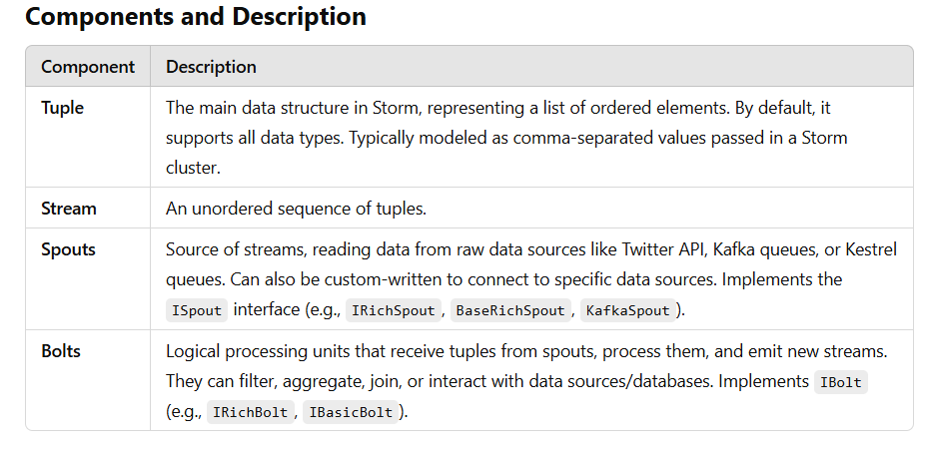
Apache Storm - Core Concepts:
The following diagram depicts the core concept of Apache Storm.

Slide 6
Apache Storm - Core Concepts:
The following diagram depicts the core concept of Apache Storm.
Example: Twitter Analysis
Input: Tweets are fetched from the Twitter Streaming API by a spout, which emits them as tuples, e.g., ["username", "tweet"].
Processing:
Bolt 1 splits the tweet into words.
Bolt 2 calculates the word count.
Data is persisted to a configured database.
Output:
Results can be queried from the database.

Slide 7
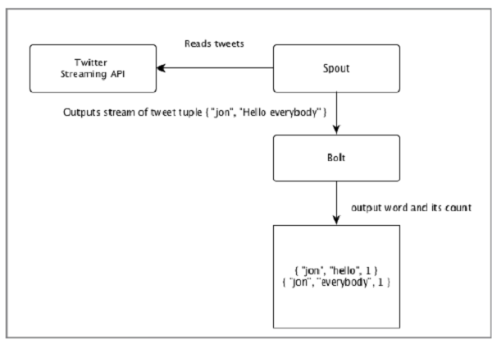
Apache Storm - Core Concepts:

Slide 8
Apache Storm - Core Concepts:
Topology
Spouts and bolts are connected to form a topology, which represents real-time application logic.
Topology:`
A directed graph, where:
Vertices: Computation units (spouts and bolts).
Edges: Stream of data.
Starts with spouts that emit data to bolts.
Storm keeps the topology running continuously until manually terminated.

Slide 9
Apache Storm - Core Concepts:
Tasks
Execution of spouts and bolts is referred to as a task.
Tasks run in parallel, with multiple instances of spouts and bolts executing in separate threads.
Workers
Topologies run on multiple worker nodes in a distributed manner.
Worker nodes listen for jobs and manage their execution.

Slide 11
Apache Storm - Core Concepts:
Spouts | Source of stream. Generally, Storm accepts input data from raw data sources like Twitter Streaming API, Apache Kafka queue, Kestrel queue, etc. Otherwise you can write spouts to read data from data sources. “ISpout" is the core interface for implementing spouts. Some of the specific interfaces are IRichSpout, BaseRichSpout, KafkaSpout, etc.
Bolts | Bolts are logical processing units. Spouts pass data to bolts and bolts process and produce a new output stream. Bolts can perform the operations of filtering, aggregation, joining, interacting with data sources and databases. Bolt receives data and emits to one or more bolts. “I Bolt” is the core interface for implementing bolts. Some of the common interfaces are IRichBolt, IBasicBolt, etc.
Let’s take a real-time example of “Twitter Analysis” and see how it can be modelled in Apache Storm. The following diagram depicts the structure.

Slide 12
Apache Storm - Core Concepts
Make Effective Presentations
Using Awesome Backgrounds
Engage your Audience
Capture Audience Attention

Slide 13
Apache Storm - Core Concepts:
Let’s take a real-time example of “Twitter Analysis” and see how it can be modelled in Apache Storm. The following diagram depicts the structure.

