Slide 1
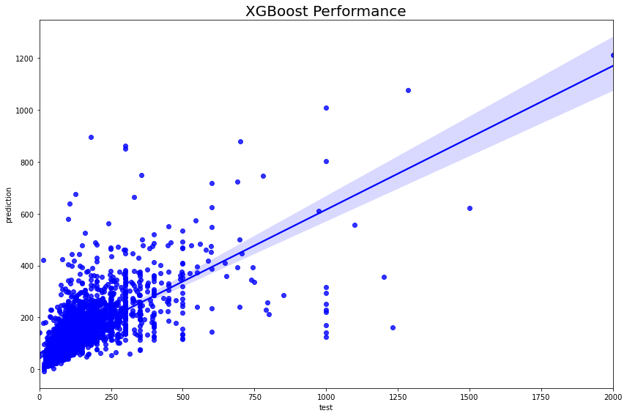
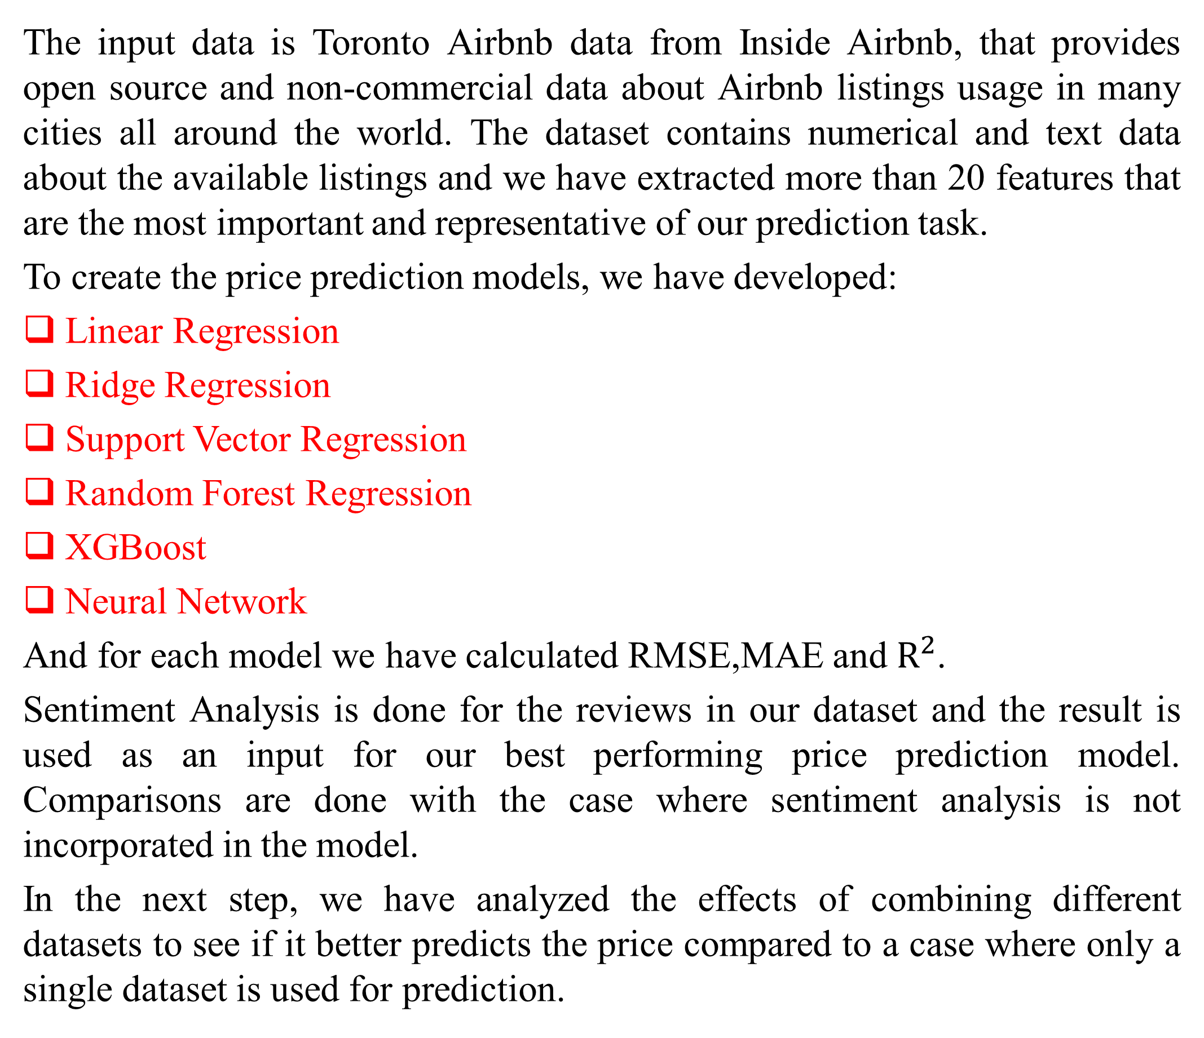
Airbnb Price Prediction and Sentiment Analysis
Amirhossein Hajigholam-Saryazdi, Fatemeh Zand
John Molson School of Business, HEC Montreal
Abstract
Results
A price prediction model for Airbnb benefits owners, customers, and Airbnb itself. It helps new owners entering market to have a reliable sense of the value of their property, customers can use it for their choice evaluations to find out which price is lower or higher than it is supposed to be, and Airbnb itself may utilize it to discover unreasonably cheap offers and check whether they are fake or not. In this project, we have built several price prediction models for the listings in Airbnb and we have also represented a comparison between different models based on their results. Moreover, we have also studied how sentiment of the reviews affect our price prediction models. In addition, we have investigated the effects of combining datasets of two or more different cities to see how good it is for price prediction of a completely new city in comparison with a model which is built on a single city. Our results show that including sentiment of the reviews in a prediction model reduces the error of the prediction. In addition, a model built on a single dataset performs better in price prediction of a completely new city compared to a model built on multiple datasets.
We run the aforesaid models on our dataset and the plot below shows the results for the prediction models. As can be seen, XGBoost outperforms all other models.
Objectives
Figure below shows the actual prices (x-axis) against our best predictions (y-axis) by XGBoost model on test set and the line represents the perfect prediction (x = y).
It is very important to use most relevant features from a dataset in order to be able to predict the price as accurate as possible. So in this project, we chose the features based on an explanatory data analysis and a feature correlation analysis.
The goal of this project is to run several price prediction models on the Toronto Airbnb dataset to see which model outperforms the others. Moreover, we have answered to the following two questions:
Does Sentiment Analysis of the reviews really help for a better price prediction?
Can further improvements be made in price prediction by building a generalizable model on datasets of two or more different cities instead of a single city?
Methods
Sentiment Analysis Effect
The input data is Toronto Airbnb data from Inside Airbnb, that provides open source and non-commercial data about Airbnb listings usage in many cities all around the world. The dataset contains numerical and text data about the available listings and we have extracted more than 20 features that are the most important and representative of our prediction task.
To create the price prediction models, we have developed:
Linear Regression
Ridge Regression
Support Vector Regression
Random Forest Regression
XGBoost
Neural Network
And for each model we have calculated RMSE,MAE and $R^{2}$.
Sentiment Analysis is done for the reviews in our dataset and the result is used as an input for our best performing price prediction model. Comparisons are done with the case where sentiment analysis is not incorporated in the model.
In the next step, we have analyzed the effects of combining different datasets to see if it better predicts the price compared to a case where only a single dataset is used for prediction.
We run our best performing model on two datasets, one of the with “review score rating as a feature” and the other one with “review sentiment” as a feature. The results show that using review sentiments improve the accuracy of the model.
 | RMSE | MAE
Model with sentiment analysis | 80 | 42.3
Model with review score rating | 78 | 41.89
Conclusions
The XGBoost model achieved the best fit and highest accuracy among all other models. Adding the sentiment of the reviews as a feature to our dataset improved the accuracy of the XGBoost model. Moreover, results showed that combining datasets from different cities does not necessarily improve the price prediction task.
AIM OF THIS PROJECT
Investigate ways to provide better price prediction models for Airbnb
Contact
Fatemeh.zand@hec.ca
amirhossein.hajigholam-saryazdi@hec.ca

