Slide 1

CS4305 · LECTURE 3 · AI TOOLS
Prolog: Programming in Logic
Tell the computer WHAT is true — let it work out the answers

Slide 2
Recap and Today's Plan
Today we will learn
Last lecture
1
Two ways of programming
Branches of AI
Expert systems use rules
Knowledge Representation is a core technique
2
Facts, rules and questions
3
How Prolog finds answers
4
Recursion and lists
5
A tiny expert system in Prolog
CS4305 Artificial Intelligence | Lecture 3
2

Slide 3


Two Ways to Program a Computer
Tell it HOW (Python, C++)
Tell it WHAT (Prolog)
You write every step, like giving a taxi driver turn-by-turn directions.
You describe the facts, like just telling the driver the address. The computer finds the way.
for p in people:
if p.parent == 'ahmed':
print(p.name)
parent(ahmed, bilal).
?- parent(ahmed, X).
Called imperative programming
Called declarative (logic) programming
CS4305 Artificial Intelligence | Lecture 3
3

Slide 4





What is Prolog?
Prolog = PROgramming in LOGic. A language where a program is a set of facts and rules, and running the program means asking questions.
Born in 1972
Made for AI
Built-in search
Still used
Created by Alain Colmerauer in France.
Reasoning, expert systems, understanding language.
Prolog searches for answers by itself — no loops needed.
SWI-Prolog is free; parts of IBM Watson used Prolog.
CS4305 Artificial Intelligence | Lecture 3
4

Slide 5



A Prolog Program Has Only 3 Things
FACTS
RULES
QUERIES
Things that are simply true
New knowledge made from facts
Questions we ask Prolog
parent(ahmed, bilal).
grandparent(X,Z) :-
parent(X,Y),
parent(Y,Z).
?- parent(ahmed, X).
X = bilal ;
X = ayesha.
CS4305 Artificial Intelligence | Lecture 3
5

Slide 6
Facts: Writing Down What Is True
Prolog
Prolog fact | Read it as
male(ahmed). | Ahmed is male
parent(ahmed, bilal). | Ahmed is a parent of Bilal
likes(sara, mangoes). | Sara likes mangoes
male(ahmed).
female(fatima).
parent(ahmed, bilal).
parent(fatima, bilal).
likes(sara, mangoes).
Three simple spelling rules
predicate(arguments) — the relation name comes first
small letters for names of things: ahmed, bilal, mangoes
full stop . at the end of every fact
CS4305 Artificial Intelligence | Lecture 3
6

Slide 7
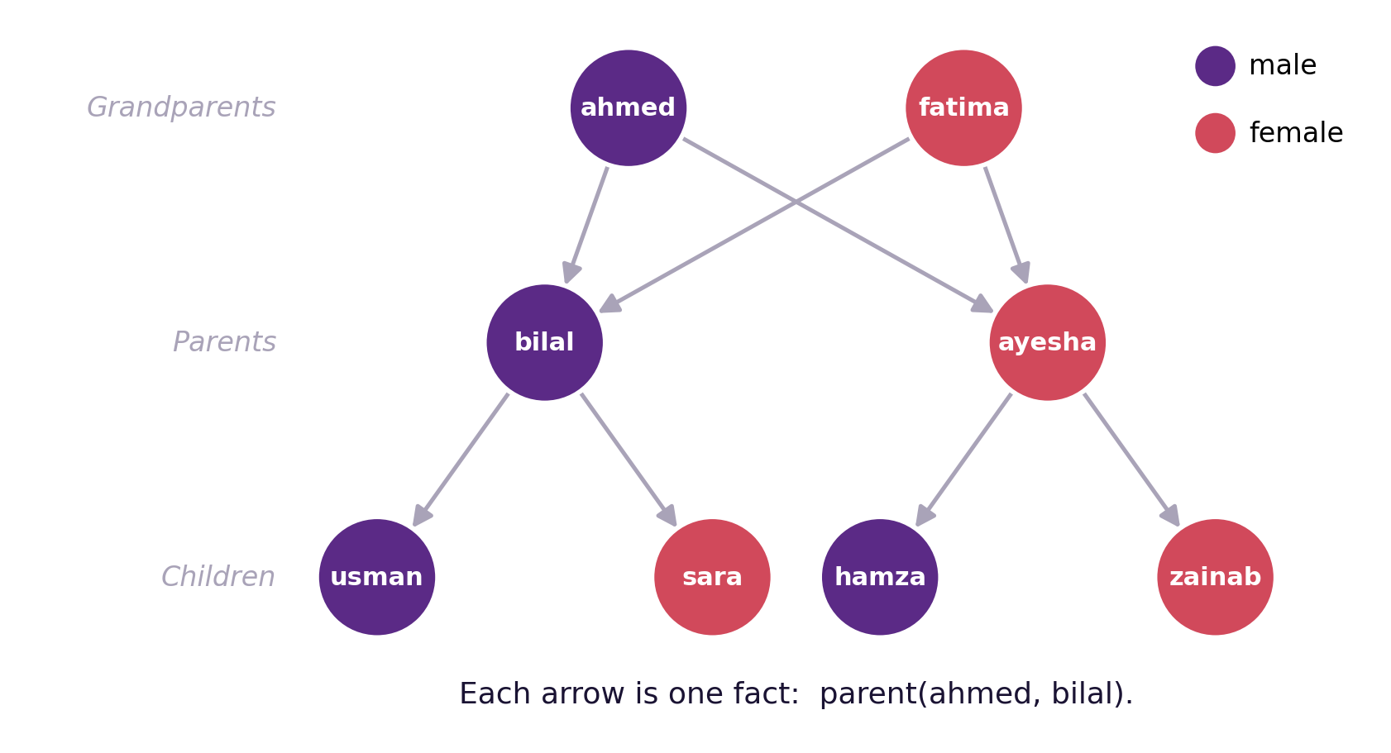
Our Example: A Family Tree
Each arrow is one parent fact. This is our knowledge base.
CS4305 Artificial Intelligence | Lecture 3
7

Slide 8

Asking Questions (Queries)
Yes / No questions
"Who...?" questions
?- parent(ahmed, bilal).
true.
?- parent(bilal, ahmed).
false.
?- parent(ahmed, X).
X = bilal ;
X = ayesha.
?- female(W).
W = fatima ; W = ayesha ; ...
Variables start with a CAPITAL letter (X, Who, Child). Prolog fills them in with every value that makes the question true. Typing ; asks for the next answer.
Closed-world rule: if Prolog cannot find it in the facts, the answer is false.
CS4305 Artificial Intelligence | Lecture 3
8

Slide 9

Rules: Making New Knowledge from Facts
grandparent(X, Z)
:-
parent(X, Y)
,
parent(Y, Z)
.
HEAD (conclusion)
IF
BODY (conditions)
AND
Read it as: X is a grandparent of Z IF X is a parent of Y AND Y is a parent of Z.
Symbol | :- | , | ; | \+
Means | IF | AND | OR | NOT
Example with OR: parent(X, Y) :- father(X, Y) ; mother(X, Y).
CS4305 Artificial Intelligence | Lecture 3
9

Slide 10

More Rules for Our Family
father(X, Y) :- parent(X, Y), male(X).
mother(X, Y) :- parent(X, Y), female(X).
sibling(X, Y) :- parent(P, X), parent(P, Y), X \= Y.
Rule | In simple English
father(X, Y) | X is the father of Y if X is a parent of Y and X is male
mother(X, Y) | X is the mother of Y if X is a parent of Y and X is female
sibling(X, Y) | X and Y are siblings if they share a parent P and are not the same person (\= means not equal)
Class activity: write a rule grandmother(X, Z). Which facts and rules will it use?
CS4305 Artificial Intelligence | Lecture 3
10

Slide 11

How Prolog Answers (1): Matching
Prolog compares the question with each fact. This matching is called UNIFICATION.
Question | Fact | Match? | Result
parent(ahmed, X) | parent(ahmed, bilal) | ✓ Yes | X = bilal
parent(ahmed, X) | parent(bilal, usman) | ✗ No | ahmed ≠ bilal
parent(P, usman) | parent(bilal, usman) | ✓ Yes | P = bilal
male(sara) | male(ahmed) | ✗ No | sara ≠ ahmed
Matching rules: the relation name and number of arguments must be the same; two names must be identical; a variable can match anything (and then keeps that value).
CS4305 Artificial Intelligence | Lecture 3
11

Slide 12
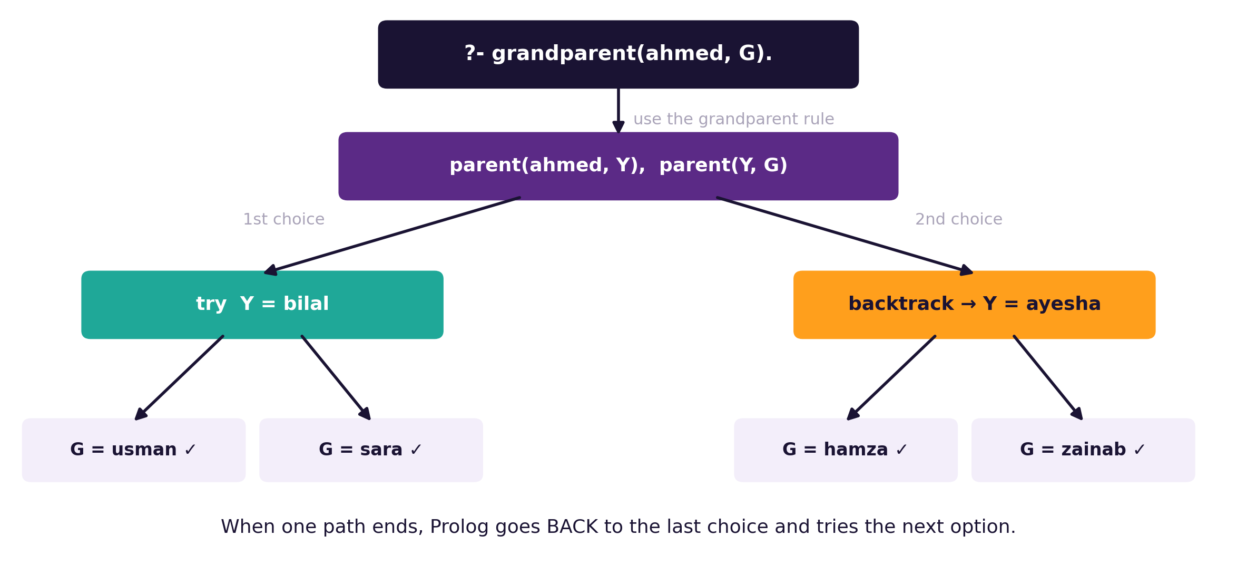
How Prolog Answers (2): Backtracking
?- grandparent(ahmed, G).
Backtracking = going back to the last choice and trying the next option. This is a built-in DEPTH-FIRST SEARCH (Lecture 6).
CS4305 Artificial Intelligence | Lecture 3
12

Slide 13
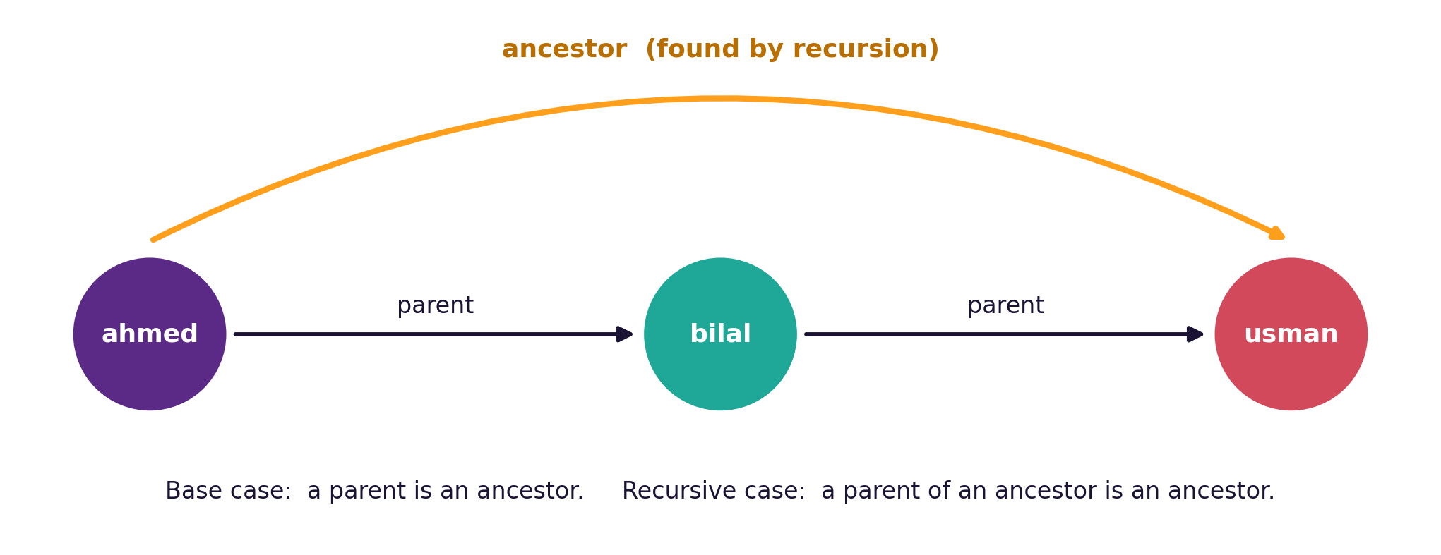
Recursion: A Rule That Uses Itself
ancestor(X, Y) :- parent(X, Y). % base case
ancestor(X, Y) :- parent(X, Z), ancestor(Z, Y). % recursive case
?- ancestor(A, zainab). → A = ayesha ; A = ahmed ; A = fatima
CS4305 Artificial Intelligence | Lecture 3
13

Slide 14
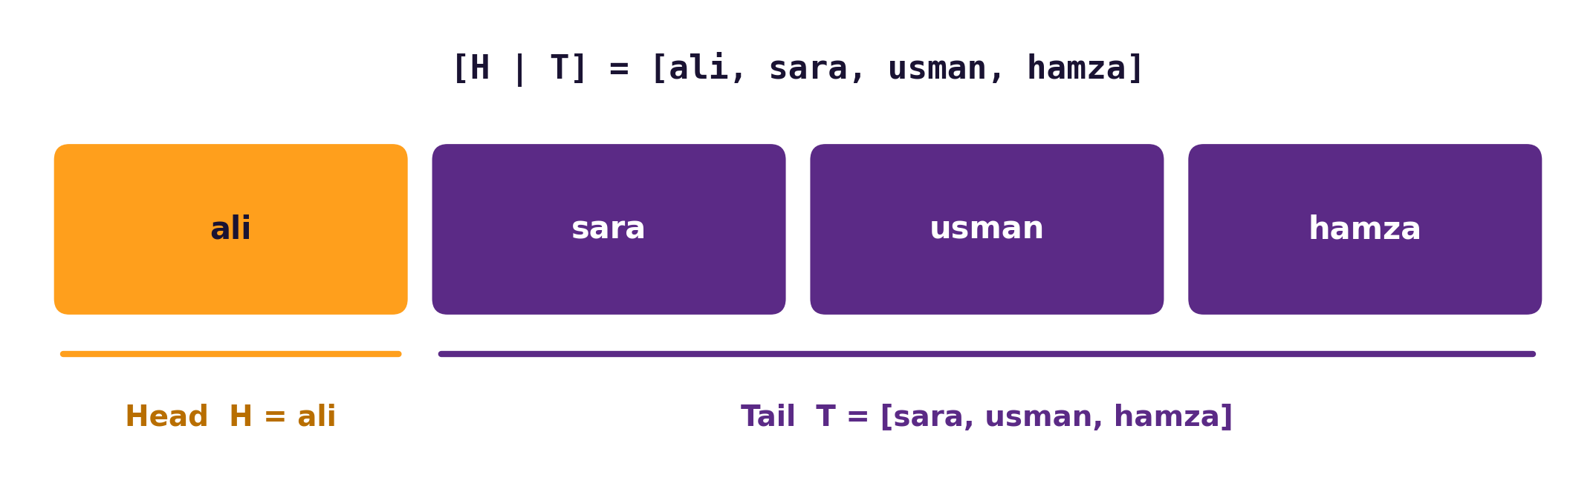


Lists in Prolog
Is X in the list?
my_member(X, [X|_]).
my_member(X, [_|T]) :- my_member(X, T).
?- my_member(sara, [ali, sara]).
true.
Base case
Recursive case
_ (underscore)
X is the Head → found it!
Otherwise, look for X in the Tail.
means "I don't care about this value".
CS4305 Artificial Intelligence | Lecture 3
14

Slide 15

Arithmetic: Use "is"
You write | Prolog gives | Why
X = 2 + 3 | X = 2+3 | = only matches shapes
X is 2 + 3 | X = 5 | is calculates
5 > 3 | true | comparison
?- X is 7 * 6 + 2.
X = 44.
factorial(0, 1).
factorial(N, F) :- N > 0, N1 is N - 1,
factorial(N1, F1),
F is N * F1.
?- factorial(5, F).
F = 120.
Common mistake: writing X = 2 + 3 and expecting 5.
CS4305 Artificial Intelligence | Lecture 3
15

Slide 16
Prolog as a Tiny Expert System
% observations (facts)
has(pingu, feathers). lays(pingu, eggs).
lives(pingu, water).
% expert rules
class(X, bird) :- has(X, feathers), lays(X, eggs).
animal(X, penguin) :- class(X, bird),
\+ can(X, fly), lives(X, water).
?- animal(pingu, T).
T = penguin.
Knowledge base
the facts and rules
Inference engine
Prolog's matching + backtracking
User interface
the ?- question prompt
CS4305 Artificial Intelligence | Lecture 3
16

Slide 17



Practical: Colab Lab 3
Open CS4305_Lab03_Prolog.ipynb in Google Colab
Install SWI-Prolog
Family tree
Backtracking
Runs inside Colab in about 30 seconds
Facts, rules and questions
See Prolog find all grandchildren
Recursion
Lists & arithmetic
Expert system
The ancestor rule
member, length, sum, factorial
Identify animals with rules
In the notebook: each part starts with a 📊 picture that explains the idea, then the 💻 code, then 📝 lab tasks at the end.
CS4305 Artificial Intelligence | Lecture 3
17

Slide 18
Summary
Prolog is declarative: you describe WHAT is true, not HOW to compute it.
Facts state simple truths; rules build new knowledge; queries ask questions.
:- means IF, , means AND. Variables start with a capital letter.
Unification matches a question with facts; backtracking finds all answers.
Recursion needs a base case and a recursive case; lists use [Head | Tail].
Prolog naturally works like an expert system: knowledge base + inference engine.
CS4305 Artificial Intelligence | Lecture 3
18

Slide 19
Review Questions
Differentiate between imperative and declarative programming with an example.
What are facts, rules and queries in Prolog? Give one example of each.
Write facts for a family of 3 generations and a rule for grandmother(X, Y).
What is unification? Show whether parent(P, sara) matches parent(bilal, sara).
Explain backtracking using ?- grandparent(ahmed, G).
Write a recursive Prolog rule to find the length of a list.
What is the difference between X = 2 + 3 and X is 2 + 3?
CS4305 Artificial Intelligence | Lecture 3
19

Slide 20

NEXT LECTURE
LISP and Expert System Shells
The list-processing language of AI, and ready-made expert systems

